Slide 1
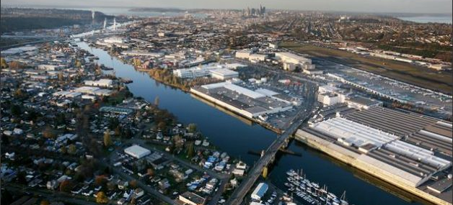
ENGAGING ENVIRONMENTAL DEMOCRACY
Tracing the Impacts of the Duwamish Cleanup HIA: Evaluation via Interpretative Phenomenological Analysis
A River Lost? (2007) Photo: Paul Joseph Brown, Seattle Post-Intelligencer
Jonathan Childers, MPH, MURP PhD program in the Built Environment, University of Washington, Seattle
Advisors:
William Daniell, MD, MPH – UW Department of Environmental and Occupational Health Robert Mugerauer, PhD – UW College of Built Environments
Notes:
Qualitative impact evaluation of HIA for Superfund Cleanup of Duwamish River in Seattle
Area around cleanup site – Duwamish Valley – industrial core of city for over 100 years – industry next to residential
With industrial use – pollution – one most polluted rivers in nation

Slide 2
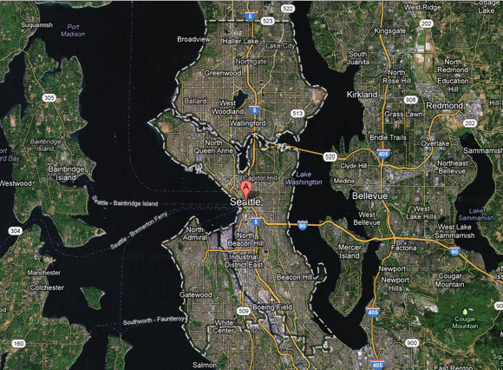
Seattle
In 2001, EPA listed a 5.5 mile stretch of the Lower Duwamish River as a Superfund site
Puget
Sound
Lake Washington
Elliott Bay
Duwamish
River
Google Maps (Oct 2012)
Notes:
2001 – EPA listed Lower Duwamish River at Superfund Cleanup site
2013 – Proposed Plan for Cleanup
Opportunity- investigate potential direct and effects of Cleanup not as well studied by EPA
Submit as formal comment on Proposed Cleanup Plan

Slide 3
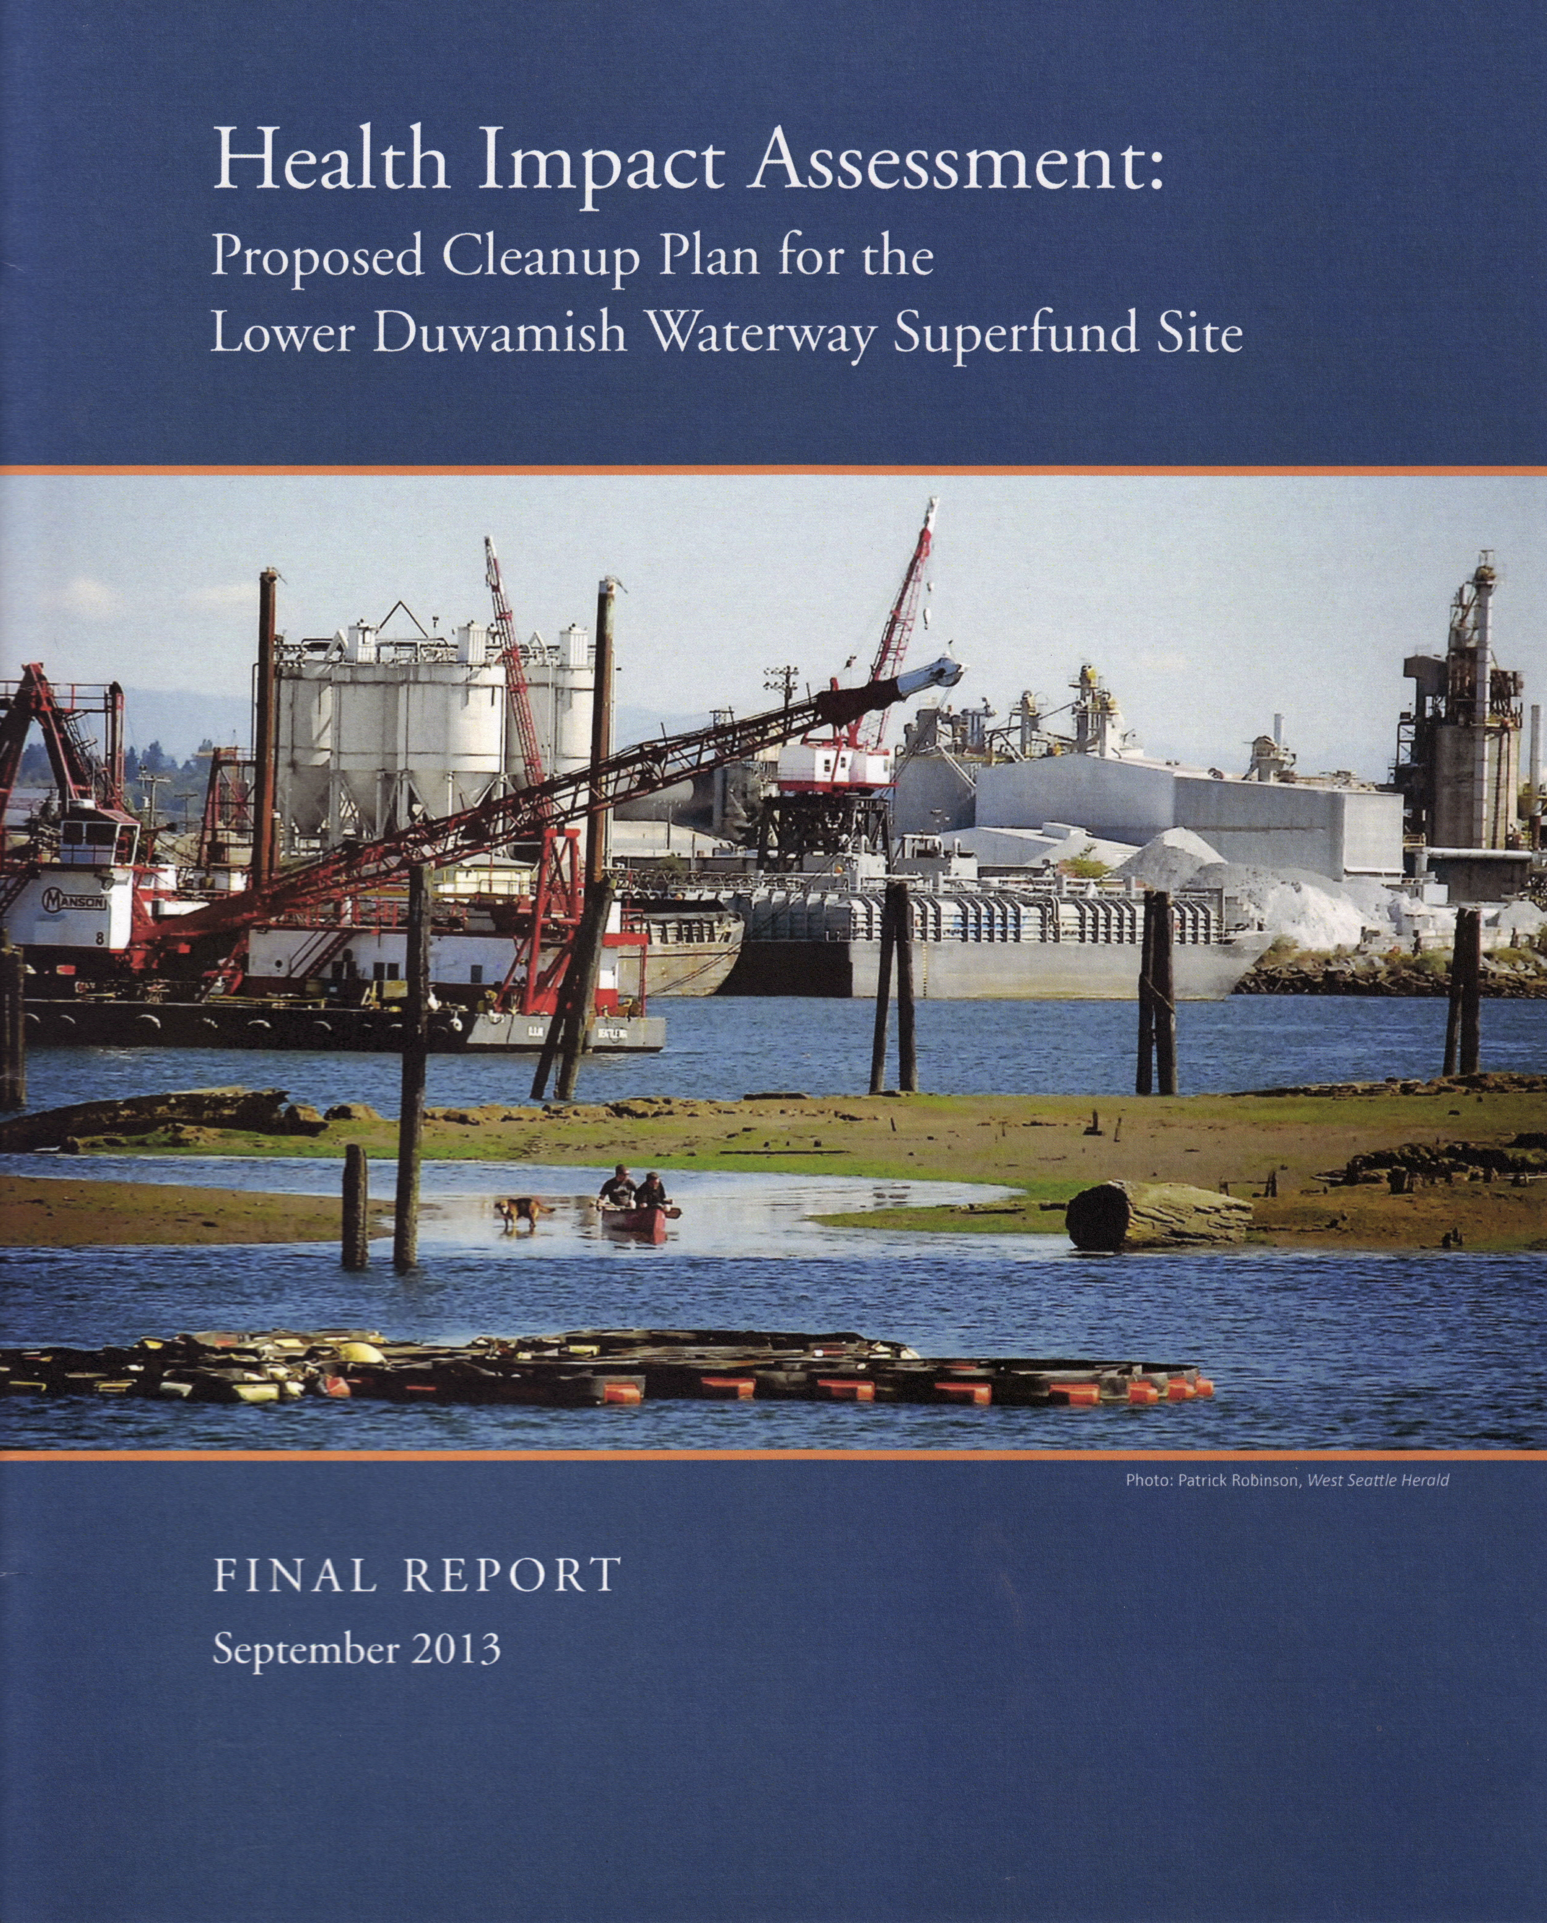



Bill Daniell UW Public Health Jonathan Childers Amber Lenhart
Linn Gould Just Health Action
BJ Cummings Duwamish River Cleanup Coalition/ Technical Advisory Group (DRCC/TAG)
Funders Health Impact Project – a collaboration of the Robert Wood Johnson Foundation and The Pew Charitable Trusts
UW Rohm and Haas Professorship in Public Health Sciences
Notes:
HIA conducted by UW – with DRCC - and JH
Funded by Health Impact Project (Pew Charitable Trusts and RWJF)
first HIA of a federal Superfund project

Slide 4
HIA Process & Pathways Diagram
Duwamish Superfund HIA: -Technical Report: Resources and Methods
Notes:
Detailed pathways of health effects as assessed in HIA

Slide 5
HIA
Shoreline contact
Food & economic security
Subsist. fishers
Ingest contaminated
seafood
Cultural & behavioral changes
Contaminated fish and sediments
Tribes
Self
determination
Well
being
EPA
CLEANUP
Resources
security
Local residents
Gentrification
Construction
impacts and
opportunities
(short term)
Revitalization
(long term)
New jobs
Workers in local industry
Job loss
Notes:
Conceptual model - overall structure of analysis
Listening sessions with Cleanup stakeholders – 4 vulnerable populations –tribes, non-tribal subsistence fishers, local residents, and local industry workers
Effects
-tribal and nontribal fishers: nutrition and other related effects due to cumulative effect of existing health burdens, and cultural effects
-community and industry: gentrification

Slide 6
HIA
Shoreline contact
Food & economic security
Subsist. fishers
Ingest contaminated
seafood
Liaison Committee
Cultural & behavioral changes
Contaminated fish and sediments
Tribes
Self
determination
Well
being
EPA
CLEANUP
Resources
security
Local residents
Gentrification
Construction
impacts and
opportunities
(short term)
Revitalization
(long term)
New jobs
Workers in local industry
Job loss
Notes:
Strong contacts for 2 vulnerable populations – formed advisory committees – also formed liaison committee with agencies and PRPs
Process evaluations throughout – great diversity of views on HIA process and potential outcomes – gaining local knowledge and situated perspectives critical
Opportunity to complement broad studies such as the nationwide study by the Group Health Center for Community Health and Evaluation… which provided a sense of common effects across many HIAs… by going “in-depth” to get a sense of the nuance and detail in 1 HIA

Slide 7
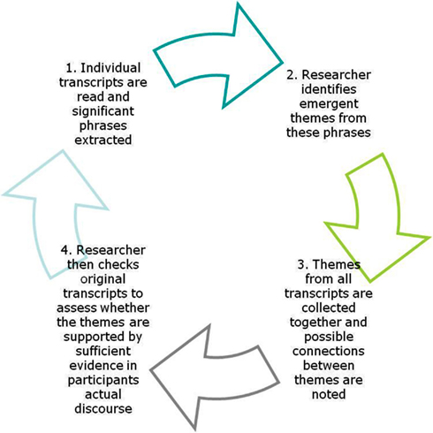
Evaluation: Theoretical Framework Interpretative Phenomenological Analysis
Notes:
General analytical framework for study – Interpretative Phenomenological Analysis:
- cyclical process of reviewing in depth input from participants to interpret how a given person, in a given context, makes sense of a given phenomenon
in-depth analysis of personal perspectives of decision makers and stakeholders regarding their experience of the Duwamish HIA in the context of the Cleanup

Slide 8
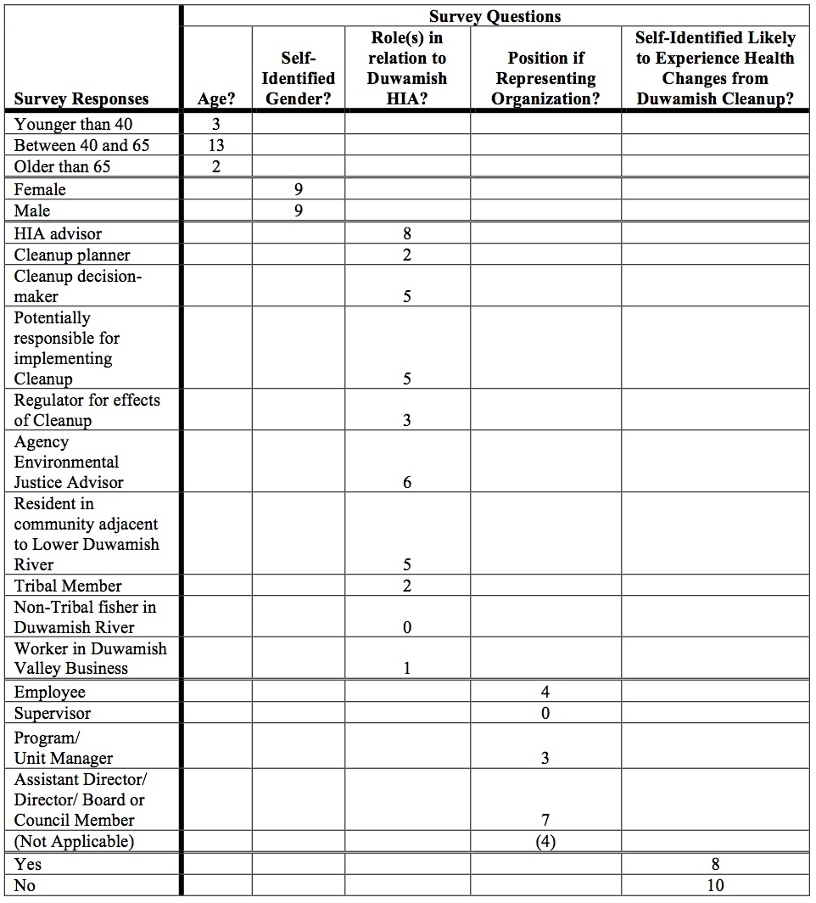

Evaluation: Recruitment
Notes:
To gain maximum diversity in input – “Snowball technique”
-Open invitation to participate sent to numerous members of LC, Residential TAC, and Tribal CAC
-Then additional interviews with interested individuals suggested by participants

Slide 9
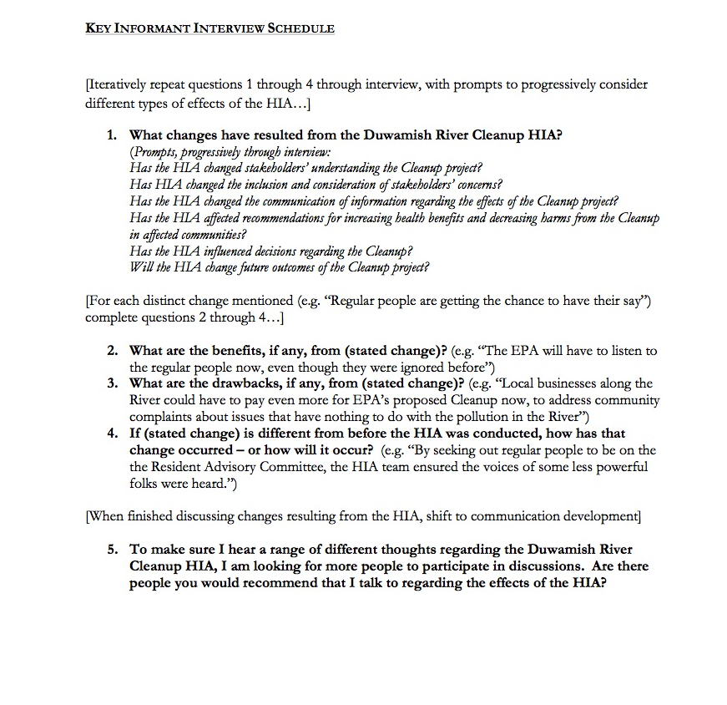
Evaluation Methods: Semi-Structured Interviews & Focus Groups
Notes:
For consistency – participants were asked to consider common set of questions
BUT – just starting point for semi-structured sessions – we asked questions and then followed direction of conversation

Slide 10
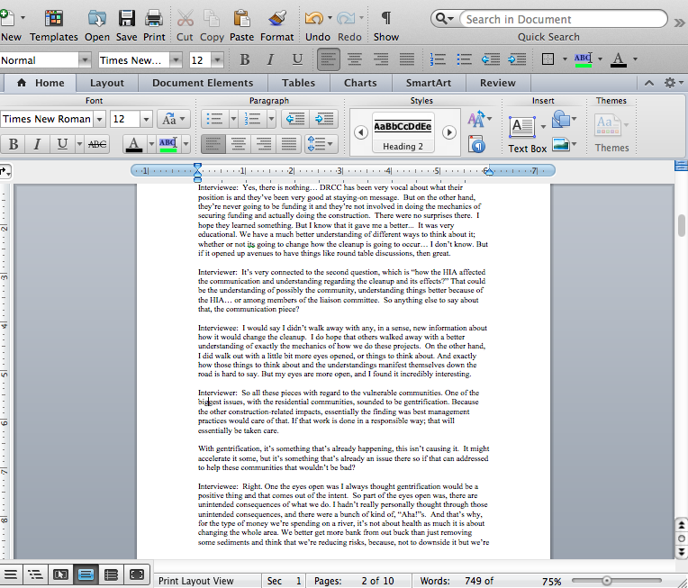
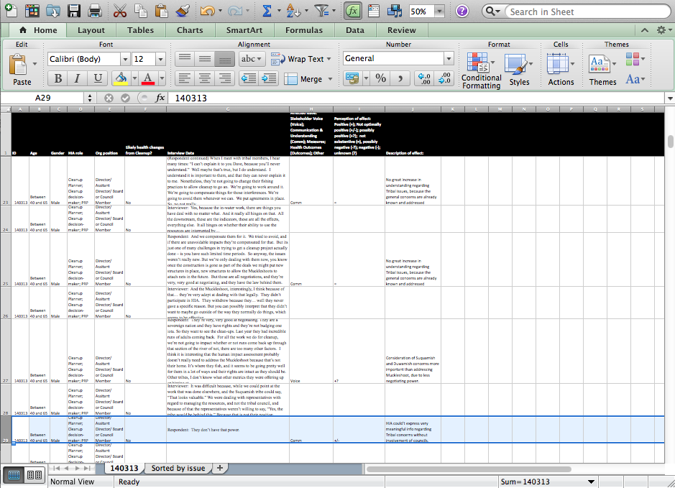
Evaluation Methods: “Qualitative Analysis Software”
Notes:
- Transcripts in Microsoft Word
- Transferred into Excel used for line-by-line data analysis and notation

Slide 11
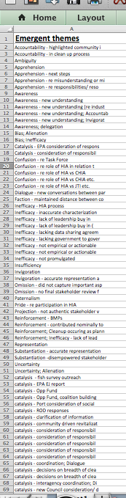
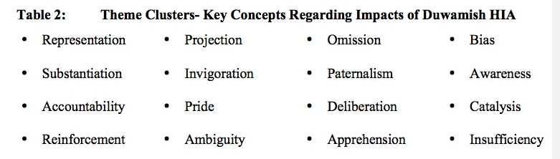
Evaluation Methods: Interpreted Emergent Themes
and Theme Clusters
Notes:
Interpretation of verbatim text - identified 65 emergent themes related to impacts of the Duwamish HIA
Comparing and contrasting across emergent themes – condensing according to key concepts - 16 theme clusters

Slide 12
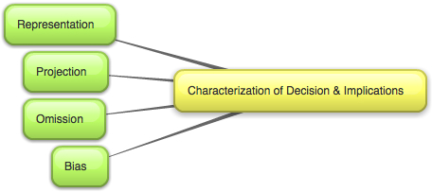
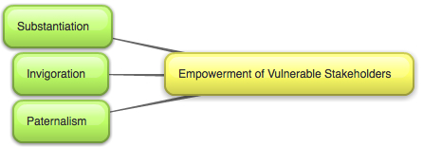
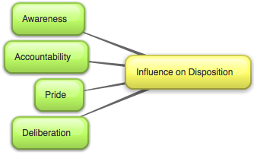
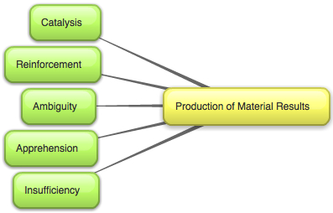
Theme Clusters grouped into Superordinate Themes
Notes:
Considering relationships among theme clusters – rolled up into 4 superordinate themes - over-arching concepts and meanings in the data
akin to primary domains of impact of the Duwamish HIA –
provided framework for better comparative understanding of “finer grain” HIA impacts represented by theme clusters
Each superordinate theme was represented in >50% of participant responses

Slide 13
Superordinate Theme: Characterization of Cleanup Decision and Implications
Notes:
Major goal and function of HIA - dissemination of accurate information framing EPA’s decision on the Duwamish Cleanup plan and related health implications

Slide 14
Characterization of Cleanup Decision and Implications: Representation
“Our concerns were noted. Our concerns are right here.” –Community representative
Notes:
The HIA was perceived by many respondents to have provided faithful representation of stakeholders’ ideas and concerns regarding the Cleanup and its implications
A variety of study respondents representing vulnerable communities and agencies indicated that the HIA had accurately discerned and represented perceptions and concerns regarding the Cleanup and its potential effects.

Slide 15
Characterization of Cleanup Decision and Implications: Bias
“…the HIA approach kind of ended up distancing some Tribal interests in favor of others… And similarly, kind of validating some community organizations, perhaps at the expense of others.” –Agency representative
Notes:
Bias favoring some stakeholder positions on the Cleanup over others
A few study participants stated that the HIA process and reporting, beyond distorting issues via projection or omission, had actually been fundamentally biased to favor certain interests over others.
In particular, the role of DRCC/TAG (a non-profit with advocacy interests related to the Cleanup) as a primary partner in the HIA team raised suspicions regarding the overall intent of the HIA project and the prospects for fair and meaningful outcomes from the process.

Slide 16
Superordinate Theme: Empowerment of Vulnerable Stakeholders
Notes:
Wide range of study participants commented on the role of the HIA in empowering the communities vulnerable to effects of the Cleanup.

Slide 17
Empowerment of Vulnerable Stakeholders: Substantiation
“A document like this… brings a lot of credibility to that kind of stakeholder process... helping the community be at least an equal partner in those conversations… in the eyes of officials like myself, decision makers.” –Cleanup decision maker
Notes:
Study participants from all sectors reported that the HIA had helped to substantiate the concerns of vulnerable stakeholders
Numerous respondents (including community, agency, and PRP representatives, as well as Cleanup decision makers) noted that HIA process and reports had validated, and increased the credibility of, vulnerable communities’ concerns regarding implications of the Duwamish Cleanup.

Slide 18
Empowerment of Vulnerable Stakeholders: Paternalism
“… there is part of it that is like- ‘Yeah, I wasn’t crazy.’ But there is also a part of it that is… ‘I am tired of people not listening to me. And I am tired of having things reinterpreted for me, that I have been saying all along!’ ” – PRP representative
Notes:
Conversely, it was noted that the HIA effort could also be seen as paternalistic, and that temporary institutional advocacy in the HIA would not be enough to address systemic disempowerment of affected communities.
In contrast to participants’ positive responses regarding vulnerable community empowerment via the HIA, one concerned agency respondent noted a valid, if sober, counterpoint. The needs for substantiation and invigoration in the affected vulnerable communities reveal systemic social and political problems that are not readily remedied by detached and impermanent institutional treatment in the HIA process and reports.

Slide 19
Superordinate Theme: Influence on Disposition
Notes:
HIA process - substantively influenced stakeholder and decision maker disposition toward the Cleanup decision

Slide 20
Influence on Disposition: Accountability
“Agencies would be fools not to acknowledge, if not the content of the HIA, at least the power behind the HIA… What I would like to hope is that this would demand increased engagement and accountability to these health concerns.” –Agency representative
Notes:
The increased awareness also conveyed greater accountability.
Beyond the prospect of simply raising awareness, many public sector participants also noted that the Duwamish HIA increased the accountability of agencies and decision makers. Those public servants now held new insights into community concerns regarding the Cleanup, as explicated in the HIA, and ignorance of issues was less defensible.

Slide 21
Influence on Disposition: Deliberation
“…that in itself is really good… I wasn’t coming in with my environmental hat… I was coming in, as everyone is coming in, in an open way to really truly consider what the proposals were.” –Agency representative
Notes:
HIA process also spurred uniquely open deliberation about Cleanup issues between various parties that would not typically engage in direct debate.
Several respondents indicated that the LC meetings for the HIA had accommodated uniquely open discussions about the Duwamish Cleanup among the committee members. Because the HIA was not prepared under regulatory requirements, and its recommendations were not to be automatically promulgated into regulation, the HIA meetings temporarily and subtly shifted accountability for LC members. In meetings regarding the HIA, they were able to speak freely in the interest of communities to whom they are legally responsible without concern for any regulatory implications of their ideas and statements. Accordingly, atypical discussions occurred between parties, sometimes with strongly opposed views, that broadened mutual understanding of perspectives and may have shifted dispositions regarding important Cleanup issues. However, any implications of stakeholders’ changed dispositions, beyond the walls of the HIA meeting rooms, remained unclear.

Slide 22
Superordinate Theme: Production of Material Results
Notes:
HIA - ultimate production of material results.
Participants discussed an assortment of responses and actions they believed to have resulted from the HIA. Participants also noted aspects of the HIA process or reports they perceived as inhibiting or complicating effectual response and action.

Slide 23
Production of Material Results: Catalysis
“…it is my guess that it would have been to difficult to get the Opportunity Fund in place, if it had not been for having the HIA.” –Cleanup decision maker
Notes:
Many study participants commented on variety of material results catalyzed by the HIA
City of Seattle - Duwamish Opportunity Fund and legislation creating new Interdepartmental Team to consider program responses beyond toxic Cleanup

Slide 24
Production of Material Results: Insufficiency
“There just wasn’t enough time to do what the Tribes wanted to do… everybody wanted more out of [the HIA] than what came out of it. That’s really just because of the time crunch and because there were no established methods to begin with.” –Tribal community representative
Notes:
Insufficiency of HIA as a tool for effecting change and improving health implications of the Duwamish Cleanup
- tight timelines, funding, and staffing - streamlined process that respondents considered to be well intentioned
But limited duration, engagement, and scope of the project was perceived as limiting its potential results.
E.g. for tribes

Slide 25


Focus of Comments:
Notes:
few comments on the impacts of the HIA - majority of commentary attended to environmental democracy
conveyed perception that democratic process and environmental justice is fundamental to wellbeing

Slide 26

Shhh… HIA is subversive!
Notes:
Non regulatory HIA – important (subversive) role - allowed Cleanup stakeholders from all perspectives to consider vulnerable community concerns regarding their wellbeing
HIA process provided a venue for open deliberation regarding issues that public officials could not acknowledge elsewhere (for fear of regulatory implications).

Slide 27
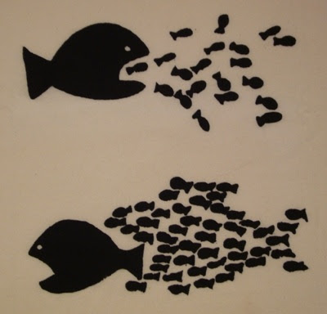
Tactics for Greater Impact?
Community Based Participatory Research
Collective Impact

Slide 28
