Slide 1
An Assessment of the Potential Costs and Benefits of Providing Free Public Transportation Passes to Students in Los Angeles County
Lauren Gase, MPH
Chief, Health and Policy Assessment
Division of Chronic Disease and Injury Prevention

Slide 2
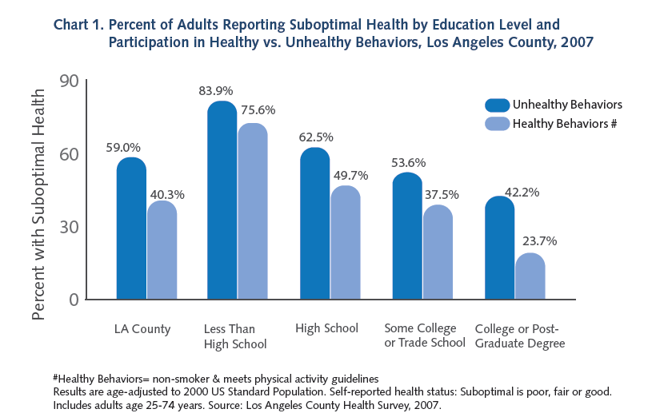
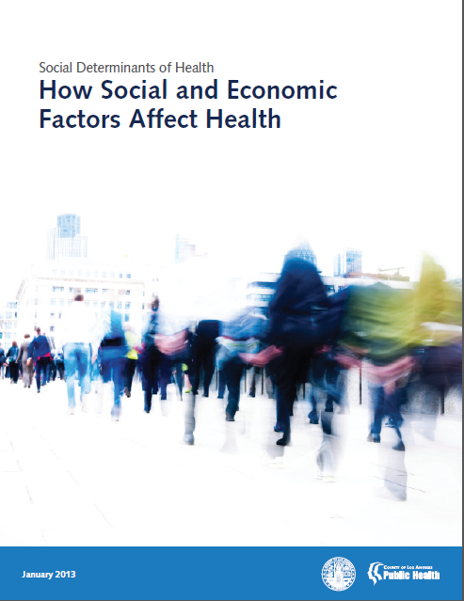
Background: Education as a Priority Area

Slide 3
Background: Timeline
September 2012: Engagement with the Los Angeles County School Attendance Task Force (SATF)
  Lead by Children’s Courts Presiding Judge, along with multidisciplinary stakeholders
December 2012: Submitted Health Impact Assessment Program Grant to the Health Impact Project, included proposal to conduct HIA on providing free transit passes to students
April 2013: on the recommendation of SATF, the Los Angeles County Education Coordinating Council (ECC) passed a resolution to work with transit stakeholders to provide free transit passes to students
June 2013: HIA formally launched
October 2013: Report released
April 2014: Addendum released

Slide 4
Research Questions and Scope
What are the potential costs of implementing a free transit pass program for students?
  Decreases in transit fare revenues
  Increases in transit ridership
What are the potential benefits of implementing a free transit pass program for students?
  Increase in school attendance
  Decrease in contact with the juvenile justice system
  Decrease in traffic volume and congestion
  Decrease in injuries
  Increase in available funds for schools
  Increase in disposable income for families
  Increase in freedom and mobility for youth

Slide 5
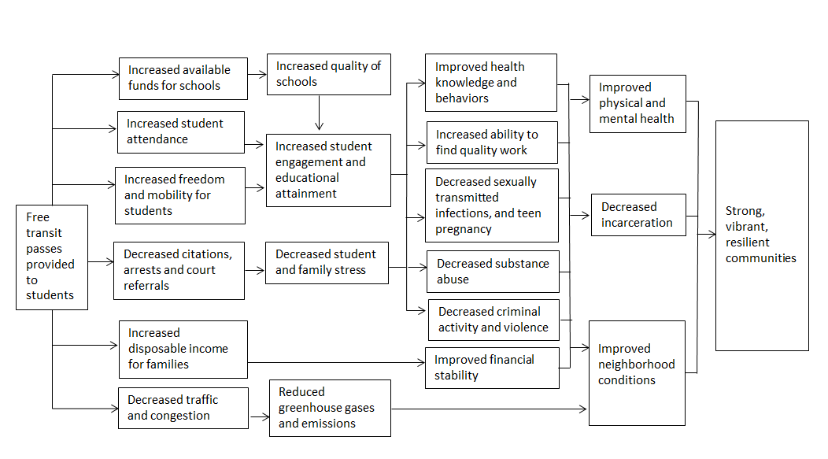
Pathway Diagram

Slide 6
Methods
Review of published literature
Analyses of existing datasets
  MTA Fiscal Year 2013 Revenue
  Southern California Association of Governments regional travel survey (2001 and 2010-2012)
  Fare evasion data from Los Angeles County Sheriff
  Los Angeles Unified School District absenteeism
  School district transportation budget data (state report)
  Consultation with experts
    Other jurisdictions that had implemented free/reduced student transit policies/programs
  Community input

Slide 7
Results: Costs Summary
Estimates from MTA suggest that students contributed over $20 million in fare revenues in 2013
  Total County revenue loss likely to be larger because this estimate (a) does not include losses to other LAC transit operators and (b) only includes students who take advantage of student pricing
Transit ridership could increase between 6% and 14% in the short-term (<2 years), representing an additional 63,200 to 158,000 riders daily, and by as much as 26% in the long-term (>10 years)

Slide 8
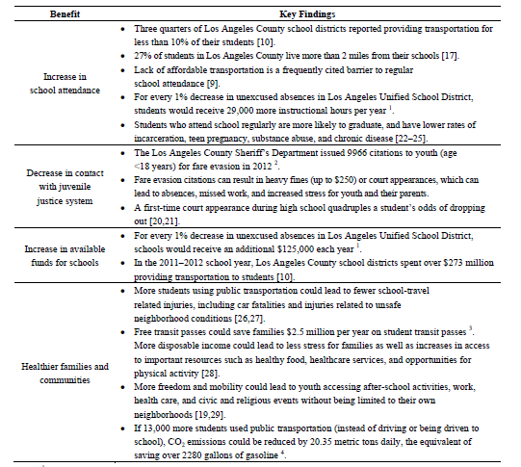
Results: Benefits Summary

Slide 9
Project Impacts
Synthesized data to help inform decision-making
  Decision makers (Los Angeles County Board of Supervisors Health Deputies, Mayor’s Office)
  Community-based organizations
  Health Department leadership
Identified gaps and sparked additional questions and dialogue
  Los Angeles County Metropolitan Transit Authority Board, Motion #55
  Letter from Judge Michael Nash to the Los Angeles County Metropolitan Transit Authority
  California Assembly Bill 891
Demonstrated DPH credibility and increased collaboration with SATF stakeholders
  Identifying Policy and Program Priorities for Reducing School Truancy
  Evaluation of the Los Angeles County Teen Court Program

Slide 10
Lessons Learned
The benefits and challenges associated with broad conceptualization of public issues
The need for more comprehensive, longitudinal data systems and dynamic simulation models to inform decision-making
The importance of having a comprehensive policy assessment strategy that considers health impacts as well as costs and feasibility
The need for additional efforts to delineate the interconnectivity between health and other agency priorities

Slide 11

References to Products
Transit Pass HIA Report, Issue Brief, and Addendum
  http://publichealth.lacounty.gov/pa/PA_Projects.htm
Transit Pass HIA Manuscript
  Gase LN, Kuo T, Teutsch S, Fielding JE. Estimating the Costs and Benefits of Providing Free Public Transit Passes to Students in Los Angeles County: Lessons Learned in Applying a Health Lens to Decision-Making. Int J Environ Res Public Health. 2014;11(11):11384-97.

Slide 12
Acknowledgments – Contributors and Members of the Health Impact Evaluation Center
OFFICE OF HEALTH ASSESSMENT AND EPIDEMIOLOGY
Margaret Shih, MD, PhD
Ricardo Basurto-Davila, PhD, MSc
Katherine Butler, MPH
OFFICE OF PLANNING, EVALUATION AND DEVELOPMENT
Virginia Huang Richman, PhD, MPH
DIVISION OF CHRONIC DISEASE AND INJURY PREVENTION
Tony Kuo, MD, MSHS
Eloisa Gonzalez, MD, MPH
Amelia DeFosset, MPH
Taylor Schooley, MPH

Slide 13
lgase@ph.lacounty.gov
213-427-4402
Lauren Gase, MPH

