Slide 1


National Evaluation of
Community Participation in HIA
National Health Impact Assessment Meeting
Washington, DC
June 17, 2015

Slide 2

Project Description
Two-year project funded by the W.K Kellogg and Kresge Foundations
Conducted by the Center for Community Health and Evaluation and Human Impact Partners
Methods:
  national survey of
  completed HIA projects
  interviews with experienced practitioners
  in-depth case studies of four current HIAs

Slide 3
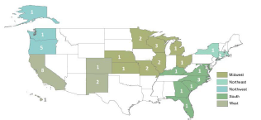
Selection Criteria
Selected 47 HIAs completed between January 2010 and September 2013
Diversified sample by sector, geography, and decision-making level
Notes:
Represents about one-third of the work in the field for this time
Generally representative of the diversity of the field for these criteria
All HIAs completed after stakeholder engagement guidelines were released

Slide 4
Survey Respondents
47 HIAs for the survey were identified through the Health Impact Project database
Project leads were contacted first, then asked to identify 1-3 community representatives to also take the survey
Note: Some respondents were identified by HIA leads as community members, but self-identified as HIA team members when they completed the survey

Slide 5
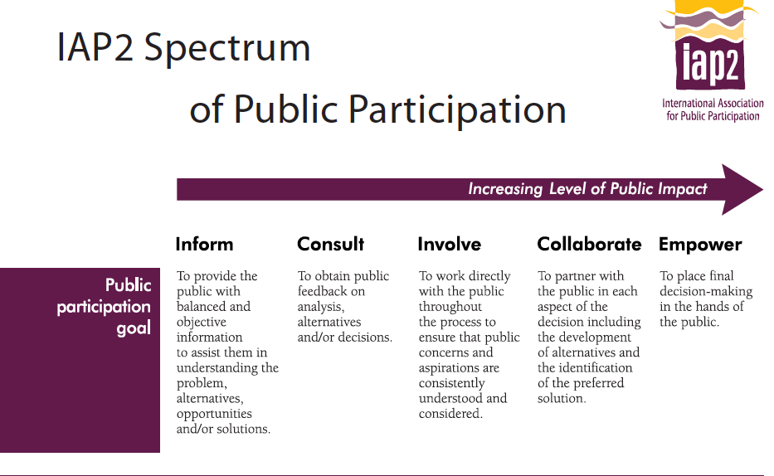

Slide 6
Category | Goal, Defined by IAP2 | HIA Interpretation
Inform | Provide public with information | Provide community with information about the HIA process
Consult | Obtain feedback from public on analysis, alternatives and/or decisions | Feedback obtained: yes, through a few opportunities with limited participation Feedback used: yes or no Community role: not defined
Involve | Work directly with public throughout process; ensure feedback is understood & considered | Feedback obtained: yes Feedback used: yes Community role: clear to all stakeholders & decision-makers
Collaborate | Partner with public in development of alternatives & identification of preferred solution | Feedback obtained: yes Feedback used: yes Community role: clear Decision-making authority: shared
Empower | Place final decision-making in the hands of the public | Feedback obtained: yes, in frequent & participatory manner Feedback used: yes Community role: clear Decision-making authority: Community has final authority on HIA decisions

Slide 7
Level of Community Participation in HIAs
Note: Of the 22 HIAs with both types of respondents, we found disagreement about the level of community participation in half (11/22).

Slide 8
Level of Participation by Organization Type
HIA team members who reported community participation in their HIA was at the level of Collaborate or Empower:

Slide 9

Facilitators of Community Participation
Familiarity with the
decision-making process (89%)
Established relationships
(89%)
Time (89%)
Facilitation expertise (75%)
Communications/outreach expertise (67%)
Community organizing expertise (64%)

Slide 10

Barriers to Community Participation
What challenges did incorporating community participation into the HIA lead to, if any?
Lack of time and resources
  HIA practitioners: 69%
  Community members: 35%
No negatives to community participation
  Community members: 39%
  HIA practitioners: 26%
Additional barriers for community members:
Lack of access to email or the internet (19%)
Challenges with transportation (12%)
Lack of compensation (12%)
“The desire for authentic community participation
led to conflicts between the lead HIA practitioner
and the agencies overseeing the process.”

Slide 11

Compensation to Community Participants
According to community
participant respondents
(N = 30):
70% reported they did not
receive any compensation
for their participation in the HIA
17% reported that their organization got funding
13% reported that they received money, a gift card, or some other form of compensation

Slide 12

Positive Impacts of Community Participation
Provided a unique perspective
that would have been missed (73%)
Decision-makers more receptive
to community participation
as a result of the HIA (49%)
HIA Team members:
Increased team member knowledge and/or skills (85%)
Established new ongoing partnerships (69%)
Community members:
Community member feedback incorporated in HIA (77%)
Learned how an HIA could affect a decision (65%)
“We are now called upon by decision makers to capture community engagement. Also, our community is now receiving much more attention from city agencies.”

Slide 13

Civic Agency
Because of the HIA, the community …
Took action to influence the
decision (85%)
Reported its individual voices were
heard (80%)
Acquired an increased awareness of the decision-making process (78%)
Had increased contact with decision makers (75%)
Acquired or strengthened skills that could help them influence future decisions (68%)
Got better at organizing to advocate for its interests (43%)

Slide 14
Impact of Community Participation on Success of HIA
83% of all respondents reported that community participation had a positive impact on the success of the HIA

Slide 15
Conclusions
Barriers of time and resources were expected
Most HIA practitioners are still not paying community members for participation, and community members indicate this is a barrier
Compelling benefits of community participation, including increased civic agency and success of HIA
Many HIAs are achieving admirable levels of participation, but there is still room for the HIA field to improve overall
Collaboration with community organizations may be one key to improvement
Notes:
Collaboration with community organizations helped in identification and outreach; established relationships and community organizing expertise were facilitators of participation; and community organizations were more likely to have high levels of community participation

Slide 16
Coming Soon…
Full report with additional findings
coming later this year!

Slide 17
Report Authors
Diana Charbonneau
charbonneau.d@ghc.org
Center for Community Health and Evaluation
Group Health Research Institute
www.cche.org
Kim Gilhuly
kim@humanimpact.org
Holly Avey
havey@humanimpact.org
Human Impact Partners
www.humanimpact.org
17

Slide 18
Thank you!!

Slide 19

Why Evaluate Community Participation in HIA?
Community participation aligns
with HIA values of democracy,
transparency, and elevating
the voices of those who are
impacted by decision-making
There is anecdotal evidence that community participation can affect the success of an HIA
Assess what skills, resources, and expertise are needed
Notes:
Limited evaluation of community participation in US-based HIA practice to date.

Slide 20

Identifying the Impacted Community
Most effective strategies
for HIA teams to identify who to engage to represent the impacted community
collaborating with local
organizations (86%)
collaborating with an interest group
affected by a policy (70%)
communicating with individuals (70%)

Slide 21

Effective Outreach Methods
Use of community organization(s)
(84%)
Networked/mutual contacts
(73%)
Public meetings (66%)
Community member respondent:
“HIA teams should come to us.”

Slide 22
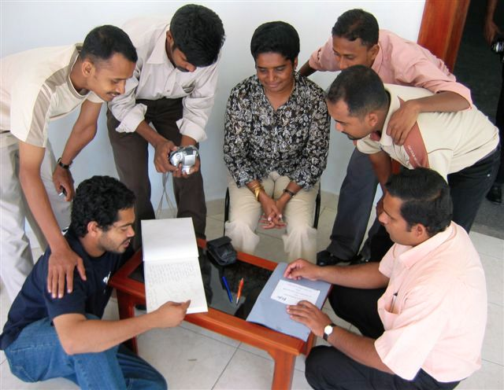
Effective Participation Methods
Both groups:
  Respond to a draft
  of the HIA (62%)
Community participant
respondents (N = 28):
  Interviews with
  key people (71%)
  Data collection (64%)
HIA team respondents (N = 59):
  Inclusion on a steering committee (64%)
  Public meetings (61%)

