Slide 1


Max Gakh, JD, MPH
University of Nevada, Las Vegas
School of Community Health Sciences

Slide 2
Our Team
UNLV: Courtney Coughenour, Sheila Clark, Max Gakh, Jennifer Pharr, Karen Callahan, Lisa Coker, Ashok Singh
Southern Nevada Health District: Deb Williams
Kenny Guinn Center for Policy Priorities: Victoria Carreon, Nancy Brune, Brian Davie
Children’s Advocacy Alliance: Denise Tanata-Ashby
Honoring Our Public Education: Caryne Shea

Slide 3
Context: FDK in Nevada
Nevada’s focus on K-12 education.
FDK in Nevada:
  Some have access to publicly funded FDK; some have access to HDK; some have access to tuition-based FDK.
  Mandatory enrollment in school at age 7.
  Funding for K = 60% of 1-12
  Priority of FDK for FRL and ELL students.
Opportunity to consider the connection between education and health and learn about HIA.
Notes:
Currently, some students in public school have access to publicly funded FDK; some have access to tuition-based FDK; and others have access to publicly funded half-day kindergarten (HDK).
The connection between education and health is well established by research: people with higher levels of education live healthier and longer lives. They tend to engage in healthier behaviors, have lower rates of illness, and higher life expectancies.

Slide 4
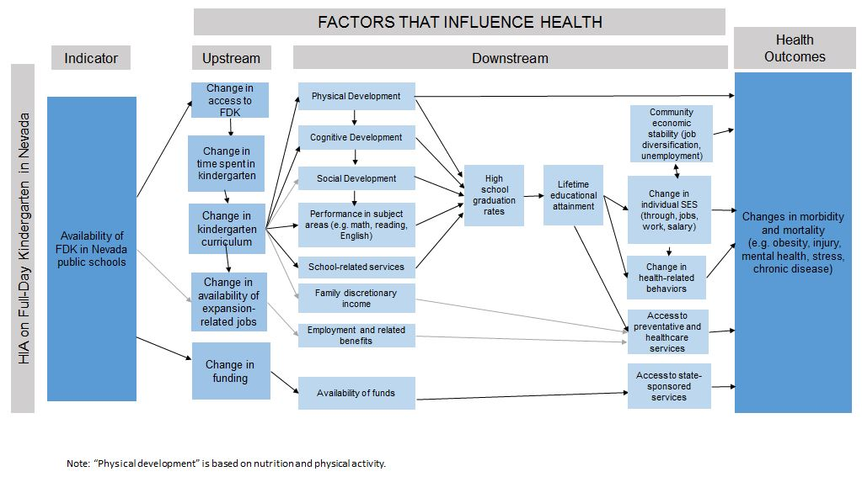
Factors that influence health
Notes:
Stakeholder input – Monthly SC meetings
SC – education policy, early childhood, advocacy, teacher
Kickoff event with Kansas Health Institute to help create this
Survey of stakeholders and community – rate importance of each

Slide 5
The Scope
Literature Review
Community Engagement
Survey
Focus group
Steering Committee & Internal Team
FDK & educational attainment
FDK & physical development
FDK & school-based services

Slide 6
Lesson Learned: Engaged Steering Committee
Reasoning | Advisory board with education and health expertise to meet regularly and guide HIA
Expectation | Provide feedback Connect with stakeholders
Reality | Engaged group of thoughtful stakeholders Interest in the subject area & HIA methodology
Lesson | Invaluable!

Slide 7
Lesson Learned: Value of Technical Assistance
Reasoning | Part of the project.
Expectation | Assistance with questions and HIA process.
Reality | Thorough and thoughtful feedback at every stage and on every piece of the HIA. Sharing of own lessons and examples. Invaluable (& positively received) training. Help with brainstorming & trouble-shooting.
Lesson | TA at every step of the HIA process is extremely helpful and educational, particularly for those new to HIA. Being part of an HIA team might be an alternative.

Slide 8
Lesson Learned: Community Interest
Reasoning | Steering Committee interest.
Expectation | Some community interest because of salience of issue.
Reality | Community members, stakeholders, and the public were curious about the HIA project and wanted to learn more. Personal stories about kindergarten. Preconceived notions about FDK.
Lesson | Genuine interest in objective, balanced analysis.
Notes:
Hunger for balanced, thorough, analysis

Slide 9
Lesson Learned: Secondary Effects
Reasoning | Build HIA capacity in Nevada
Expectation | Learn, with help, how to conduct an HIA First HIA in NV Build relationships
Reality | Relationships with/among SC members Interest in HIA from public health community Educational opportunities
Lesson | An HIA can generate local interest in the tool and provide critical information.
Notes:
Collateral consequences
Generated interest in HIA
Relationships
Class
Interest from SC partners

Slide 10
Lesson Learned: HIA at a University
Reasoning | Interest in learning about HIA and engaging with the community.
Expectation | Community-informed research
Reality | Access to students and experts Help with dissemination, communication & IT Competing commitments Access and balance Community perceptions University processes Interest from students, educators, & administrators
Lesson | A series of interests to balance.

Slide 11
Lessons Learned: Education HIAs
Reasoning | Critical social determinant of health Important issue in Nevada
Expectation | Chance to highlight education/health nexus. Need to rely on education experts.
Reality | Complexity of education policy Much decentralized data Much decentralized implementation Motivating issue – good place for health
Lesson | The education/health nexus can be surprising but is interesting & understandable. It can be challenging to keep the focus on health.
Notes:
Education
Complexity of education funding
Complexity of education policy
Complexity of education implementation
Galvanizing

Slide 12
Lesson Learned: Keeping Pace
Reasoning | Provide balanced, objective information
Expectation | Fast and unpredictable pace; short timeline
Reality | Difficulty anticipating how the landscape would change
Lesson | Importance of adaptability, flexibility, access, and knowledge. Not just one decision… “…plans are worthless, but planning is everything” -Dwight D. Eisenhower

Slide 13
Lesson Learned: Understanding the Baseline
Reasoning | Understand existing conditions to assess potential health effects.
Expectation | Access to data about the baseline
Reality | Challenge to determine number of students enrolled in each type of kindergarten. Variability and decentralization. Importance of connections to obtain data. The need for estimates.
Lesson | Accessing even the most basic baseline data can be a challenge.

Slide 14
Thank you!
Questions?
  Max Gakh, maxim.gakh@unlv.edu

