Slide 1

NORTH BIRMINGHAM COMMUNITY FRAMEWORK PLAN HEALTH IMPACT ASSESSMENT

Slide 2
Presentation Overview
What is an HIA?
HIA Steps
North Birmingham HIA Timeline
Community Profiles
Initial HIA Scoping Topics
Finalized Scoping Topics
Topic Assessment
Topic Recommendations

Slide 3
What is an HIA?
“A combination of procedures, methods and tools by which a policy, program or project may be judged in terms of its potential effects on the health of a population and the distribution of those effects within the population.”
(World Health Organizations, 1999)
Notes:
It informs decision makers on the positive and negative health effects of the policy, program, or project being implemented in order to reduce negative health effects and maximize positive ones.

Slide 4
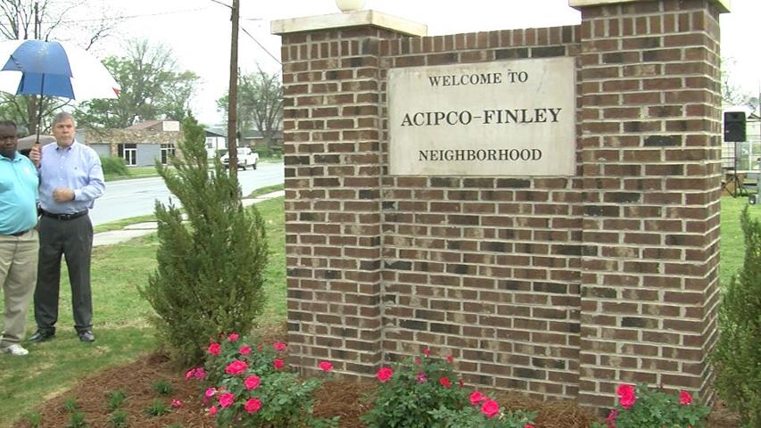
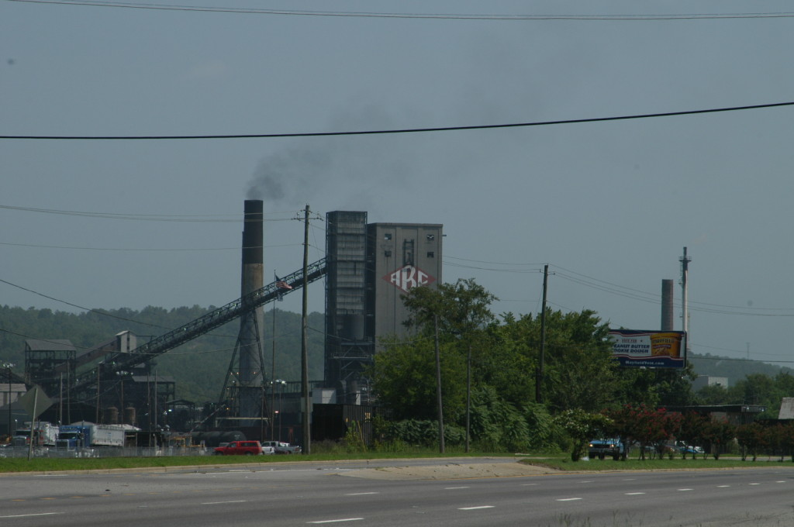

Purpose – Why Now?
To reinforce health issues affecting the North Birmingham neighborhoods
Bring other health issues to the surface that need to be addressed
To inform the community plan currently in development
Serve as a model for future HIAs conducted in Alabama
Notes:
(environmental hazards, air pollution);

Slide 5
Goals of HIA
The goals of the North Birmingham HIA are to:
Enhance the community planning process conducted by the Regional Planning Commission of Greater Birmingham to include health policies
Educate and empower stakeholders, including residents, community organizations, and involved governmental bodies on factors affecting community health and the health impact assessment process
Train graduate students on how to effectively conduct an HIA

Slide 6
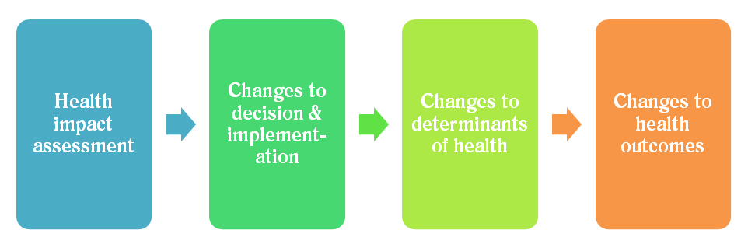
HIA Steps
1.) Screening
2.) Scoping
3.) Assessment
4.) Recommendations
5.) Reporting
6.) Evaluation
7.) Monitoring

Slide 7
Screening
Determines whether the HIA is likely to succeed and add value to the policy, program, or project.
How important to health is the decision?
Will the HIA provide new and important information or insight on previously unrecognized health issues?
Is it feasible in terms of available resources?
Notes:
The following questions were answered:
The project has a stakeholder who is concerned about the decision’s health effects.
The project has a decision-maker and/or stakeholder who is willing to interact with the students, including at least attending the first class to describe the project and the last class to hear the students present their findings.
The project team will have adequate access to existing data, methods, resources, and technical capacity to conduct analyses.
The HIA has the potential to add new information that would be useful to decision-makers.
The project is timely, so recommendations from the course HIA have the potential to be considered in the decision-making process.
The project is outside of the health sector but has potential health impacts.
If the project is local, the project site is accessible for the students to visit the area and understand the decisions being considered.
If the project is national in scope, the students are able to engage with individuals who represent the major stakeholders on the decision being considered.
The project can be completed during the academic term, with the exception of monitoring and evaluation.

Slide 8
Scoping
Creates objectives for the HIA, and an outline for the steps of the HIA process.
What health effects should the HIA address?
What concerns have stakeholders expressed about the pending decision?
Who will be affected by the policy, program, or project and how?
Notes:
The first step included a review of 14 topics that address both individual health outcomes and contextual health determinants. The HIA Team completed brief literature reviews on each of these areas and drafted causal pathways showing reasonable links from the North Birmingham Community Framework Plan and health.
The second step included a review by a health and policy professionals’ focus group, youth focus group and Neighborhood Members’ Focus Group. These groups all weighed in on their top priorities
The third step in scoping included both the steering committee’s and the North Birmingham Community Coalition’s votes and comments on the topics. A survey was distributed to these two groups, and results were reviewed on a conference call with the steering committee

Slide 9
Assessment
Describes the baseline health of people and groups affected by the policy, program, or project and predicts potential health effects.
What are the important causes of illness?
What conditions influence health and could be affected by the decision in question?
How are health risks distributed among vulnerable subgroups within the population?
Notes:
Assessment should include, at a minimum, a summary of existing (baseline) conditions and a assessment of health impacts.
Existing conditions should present a profile of relevant health status and health determinants among the affected communities. The existing conditions should also document known population health vulnerabilities including evidence of poor health status among affected communities.
Assessment of health impacts should be based on a synthesis of the best available evidence.
To support determinations of impact significance, the HIA should characterize health impacts using parameters such as (but not limited to) direction, severity, magnitude, likelihood, and distribution within the population.
Assessment of health impacts should explicitly acknowledge methodological assumptions as well as the strengths and limitations of all data and methods used.
The lack of formal, scientific, quantitative, or published evidence should not preclude reasoned evaluation of health impacts.

Slide 10
Recommendations
Provides strategies to promote positive health effects or to minimize adverse health effects of the proposed policy, program, or project.
What are practical, specific actions that can be taken in order to promote health and avoid or mitigate adverse consequences?
What are the potential risks, benefits, and costs of alternatives that may help policy makers make informed choices that support health?
Notes:
The recommendations step is where concise, evidence-based and action-oriented recommendations to mitigate determined negative impacts and to promote positive impacts are presented. Recommendations should be SMART (specific, measureable, assignable, realistic, and time-related) implementation of the recommendations

Slide 11
Reporting
Communicates the development of the HIA report, findings, and recommendations to stakeholders with a request for feedback.
What are the policy levers, regulatory avenues, and communications methods will ensure effective dissemination of the findings and facilitate adoption of the recommendations?
What are the best ways to engage, educate, and build consensus among stakeholders?
Notes:
The parties conducting the HIA should provide a publicly accessible final report that includes, at minimum, the HIA’s purpose, findings, and recommendations. The report should also document the process involved in arriving at findings and recommendations (e.g., assessment methodology and recommendation setting approach) or alternatively provide separate documentation of these processes.
To support effective, inclusive communication of the principal HIA findings and recommendations, a succinct summary should be created that communicates findings in a way that allows all stakeholders to understand, evaluate, and respond to the findings.
The full HIA report should document the screening and scoping processes and identify the sponsor of the HIA and the funding source, the team conducting the HIA, and all other participants in the HIA and their roles and contributions. Any potential conflicts of interest should be acknowledged.
The full HIA report should provide sufficient detail for each specific health issue analyzed to allow the audience to source data and replicate the analysis and recommendation process.
The HIA reporting process should offer stakeholders and decision-makers a meaningful opportunity to critically review evidence, methods, findings, conclusions, and recommendations. The HIA practitioners should address substantive criticisms.
The HIA report should be made available and readily accessible in a format that is accessible to all stakeholders, taking into consideration factors such as education, language, and digital access.

Slide 12
Evaluation
Evaluate the efficacy of the measures that are implemented and the HIA process as a whole.
Process evaluation: gauges the HIA’s quality according to established standards and the original policy, program, or project
Impact evaluation: assesses the HIA’s impact on decision-making and its success according to the objectives established during scoping
Outcome evaluation: assesses changes in health status and health determinants as the policy, program or project is implemented
Notes:
The HIA may be evaluated in terms of process. Process evaluation attempts to determine the effectiveness of how the HIA was designed and undertaken, including preparation, research, reporting, participation, and follow-up. Process evaluation may be conducted either after the completion of the HIA, or during the course of the HIA to facilitate adaptations that will improve HIA process.
The HIA may also be evaluated in terms of its impact. Impact evaluation seeks to understand the impact of the HIA itself on the decision and the decision-making process. Impact evaluation assesses the extent to which the HIA influenced various stakeholders and the extent to which the HIA recommendations were accepted and implemented.

Slide 13
Monitoring
Tracks how the adopted and implemented recommendations affect the identified health outcomes.
How will decision-makers be held accountable for reducing health impacts?
Where predictions made during the appraisal accurate?
Has the health, or health promoting behaviors, of the community improved?
Notes:
The monitoring plan should include goals for short- and long-term monitoring; indicators for monitoring; triggers or thresholds that may lead to review and adaptation in decision implementation; the identification of resources required to conduct, complete, and report the monitoring; and a mechanism to report monitoring outcomes to decision-makers and stakeholders.
When monitoring is conducted, methods and results from monitoring should be made available to the public, including the affected community, in a timely fashion.

Slide 14
HIA Timeline
Jan 2014
First class visit to Birmingham.
Mar 2014
Mid-semester assessment of group work
Focus groups with residents regional planning commission, local city offices, healthcare industry.
April 2014
Draft recommendations sent
Final presentation of draft recommendations
Assessment completed for scoping topics
Scoping topics were established.
Feb 2014
Overall schedule was created
Sent first data requests
Summer and Fall 2014
Stakeholders reviewed and commented on draft recommendations
Review comments and finalize document
Present final HIA to RPCGB
Fall 2013
Draft and finalize proposal approved by Birmingham City Council

Slide 15
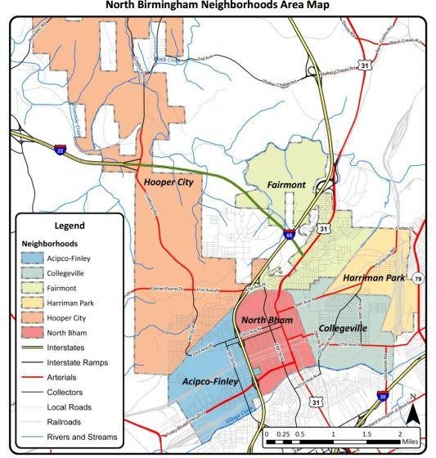
Six Neighborhoods
Acipco-Finley
Collegeville*
Fairmont*
Harriman Park*
Hooper City
North Birmingham
*Denotes EPA designated 35th Avenue Superfund Site
Notes:
3 of these intersect with the 35th Avenue Superfund Site: Collegeville, Fairmont, Harriman Park

Slide 16
Neighborhood Demographics

Slide 17
Jefferson County Health Data
Primary Health Indicators:
Overweight/Obese: 66%
Smokers: 21%
Prevalence of Heart Disease: 5.4%
Self Reported Poor Health: 16.9%
Social/Economic Indicators
Inadequate Social Support: 22.5%
Children eligible for Free/Reduced Lunch: 47.4%
Unemployment: 5.3%
Days exceeding standard air quality measures: 1.75%

Slide 18
What are HIA Health Determinants?
Health determinants that come together to affect the health of individuals and communities:
Social/economic determinants
Physical environment
Person’s individual characteristics and behaviors
It’s all a matter of place.
Source: World Health Organization, “Determinants of Health.” Healthy People 2020, “Social Determinants of Health.”
Social/Economic Examples
Availability of resources to meet daily needs
Quality of education
Public safety
Social support
Language/literacy
Physical/environmental examples
Green space
Built environment (sidewalks, buildings, etc)
Quality of housing
Exposure to toxic substances
Traffic hazards

Slide 19
Initial Scoping Topics
Access to Health Care
Pollution/Contamination/ Waste Piles (Air/Water/Soil)
Connectivity/Community Cohesion (Ownership, Gardens)
Quality/Secure Employment (Job training)
Transportation (Walkability/Connectivity)
Vacant Land/Properties/Clean Up/Buy Out Program
Water (Drainage, Sources/Contamination)
Access to Food
Freight (Noise, Air)
Violence/Crimes
Parks/Recs (Recreation)
Quality/Accessibility of Housing
Open Space/Greenspace (Passive Green Infrastructure)
Education
Notes:
Initial team research was done on these 14 indicators so students could see the link between each indicator and public health.
Each student did an introductory literature review on each topic area and its relationship to health

Slide 20
Initial Team Research on Topics
Access to Health care
Pollution/Contamination/ Waste Piles (Air/Water/Soil)
Connectivity/Community Cohesion (Ownership, Gardens)
Quality/Secure Employment (Job training)
Transportation (Walkability/Connectivity)
Vacant Land/Properties/Clean Up/Buy Out Program
Water (Drainage, Sources/Contamination)
Access to Food
Freight (Noise, Air)
Violence/Crimes
Parks/Recs (Recreation)
Quality/Accessibility of Housing
Open Space/Greenspace (Passive Green Infrastructure)
Education
Notes:
Focused in on variations of the 5 bolded topics above (with addtl info on some of the others)
Notes : initially included water and air but ultimately decided not to include these since the EPA is focusing on both of these issues and the student team did not have expertise in these areas.

Slide 21
Finalized Scoping Topics
Access to Quality Employment
Secure and quality employment provides income, benefits, and stability, which promote good health. (Robert Wood Johnson Foundation)
Access to Healthy Food
Food-secure areas are those having adequate availability of food supplies, secure access to sufficient food for all individuals, and the ability to provide a proper and balanced diet. (World Health Organization)
Access to Health Care “The timely use of personal health services to achieve the best health outcomes.” (U.S. DHHS)
Connectivity
Community cohesion/connectivity primarily references key destinations and the links between them, along with the social cohesion that they encourage
Freight
The impact of freight on health falls into three primary categories: roadway safety noise, and pollution.

Slide 22
Literature Review: Employment
1. Income, benefits, and stability promote good health and longer lifespans.
2. Unemployment is connected to:
higher levels of stress
chronic disease
Poverty
variety of unhealthy habits, including excessive smoking, drinking, and weight gain.
3. A well-paying job “makes it easier for workers to live in healthier neighborhoods, provide quality education for their children, secure child services, and buy more nutritious food” (RWJF 2013).

Slide 23
Assessment: Employment
1. North Birmingham residents cited jobs as one of their top concerns related to health.
2. Some of the North Birmingham neighborhoods have unemployment rates that are two to three times the national average.
3. North Birmingham is not included in the regional economic development strategy, does not have a workforce development program, does not provide adequate recreation/childcare opportunities, and needs better access to quality jobs.

Slide 24
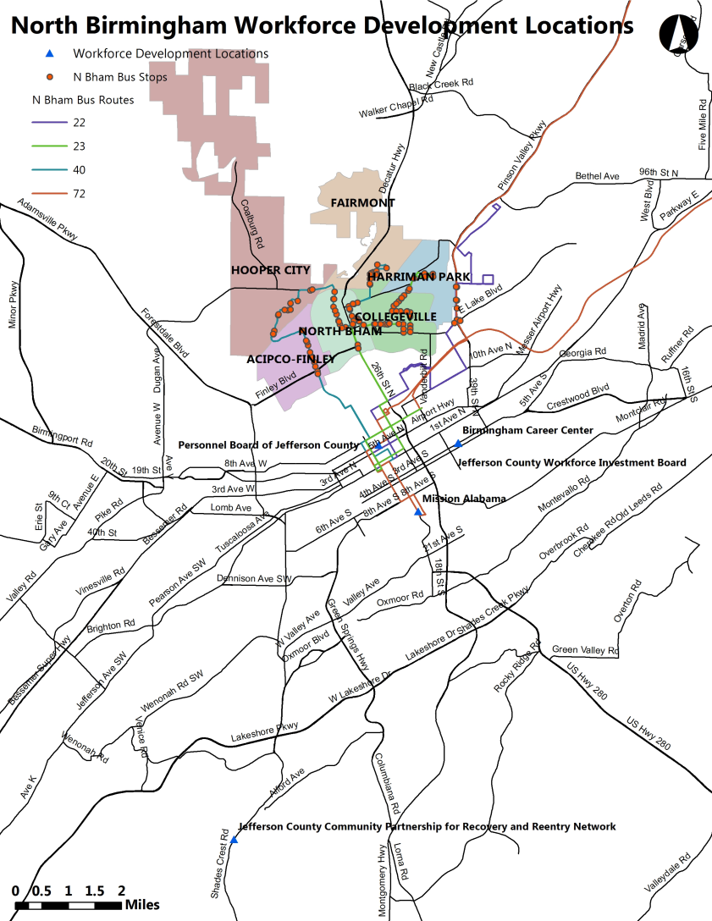
Assessment: Employment
Notes:
Better jobs have immediate effects on health insurance coverage for individuals, as quality jobs are more likely to offer health care and a steadier offering of work hours. This map shows that no workforce development centers are located in the Birmingham Community. Four such centers are located south of the community, two of which are along bus routes

Slide 25
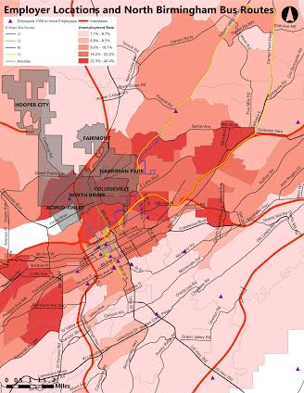
Assessment: Employment
Notes:
This map shows that only one employer with over 1000+ employees is located in the Community. The gradient shows the unemployment rates

Slide 26
Literature Review: Food Access
1. Food insecure neighborhoods have a disproportionate amount of food deserts, or areas where mainstream grocers are distant, and food imbalance or food swamps, or areas where both grocers are distant and unhealthy food is readily available, which are environmental conditions that contribute to a lower quality and length of life¹
2. Individuals living in food insecure areas suffer from higher rates of chronic health diseases such as obesity, type 2 diabetes, cardiovascular disease, and hypertension²
3. A 2010 study found that approximately 88,000 or one-third of Birmingham, Alabama residents were living in a food imbalance area, with 23,000 of those identified as children³
¹Examining the Impacts of Food Imbalance and Food Deserts in Birmingham, Alabama.
²Access to healthy food: challenges and opportunities.
³“Food deserts and food imbalance in urban areas: what can be done?”

Slide 27
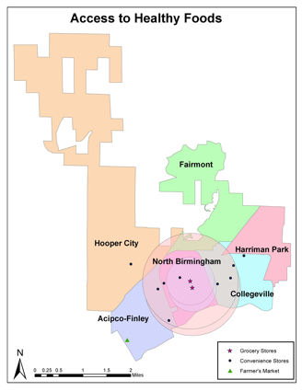
Assessment: Food Access
1. There are 2 grocery stores, 9 corner stores, and one farmers’ market in the N. Birmingham neighborhood
2. Because of the presence of grocery stores, the N. Birmingham neighborhood cannot be classified as a food desert, but the central issue is with access across the neighborhoods to these food suppliers
3. Since there are a number of corner stores throughout the neighborhoods, a program to improve the quality of their food supply could reach a larger number of residents
4. There are several organizations within the neighborhood addressing food access concerns who would make excellent partners for future projects
Notes:
This map locates the different food options in the area North Birmingham Community. The food sources include corner stores, two grocery stores, and one farmer’s market. The buffers represent a mile and half mile radius. A half-mile is the distance people are expected to walk to a given place. Very little of the area is in even a mile distance of a grocery store.

Slide 28
Literature Review: Access to Health Care
1. Quality access to healthcare affects physical, mental, and social health and as well as health outcomes and quality of life
2. To access healthcare one must enter into the healthcare system, be able to access a healthcare facility where needed services are provided, and have a healthcare provider that can be trusted
3. Lack of insurance is the main deterrent to healthcare access
4. Community access to healthcare is measured by the presence of resources that make healthcare possible such as insurance, a primary care provider, assessing how easily one can access healthcare, and the outcomes of receiving quality health care
1.Healthy People 2020: Access to Health Services.
2. National Center for Health Statistics. (2012). Health, United States, 2011: With Special Feature on Socioeconomic Status and Health

Slide 29
Assessment: Access to Health Care
1. Healthcare facilities in greater Birmingham are plentiful but general care clinics, special care clinics, urgent care, and hospitals are nonexistent in the North Birmingham community.
2. Of the two current healthcare amenities in the community, only the dentist office in North Birmingham is serviced by bus transit. Traveling to the dialysis clinic in Acipco-Finley likely requires an automobile.
3. The VA Hospital is the closest to North Birmingham and along a bus route, but from the available data it is unclear if there is a bus stop in close proximity. Bus travel from North Birmingham is estimated to be between 35 and 55 minutes one-way to this hospital.
4. Since North Birmingham and Collegeville are relatively well serviced by bus transit, a public health clinic would be most accessible if established in one of those neighborhoods.
5. Approximately 17% of North Birmingham residents do not have a vehicle, which further strains their access to healthcare.

Slide 30
Assessment: Access to Health Care
Notes:
This map reflects all of the health care facilities in the City of Birmingham and specifically in the North Birmingham Community, and the bus routes that serve the community. The map shows that there is a significant lack of health care facilities in the North Birmingham Community. In the community, a single dentist office is accessible to residents by bus, and one specialty (dialysis) clinic is accessible by car. Nearby, just south of the community, residents can access one hospital by bus. This route however requires the rider to walk several tenths of a mile to get to a hospital from the bus stop.

Slide 31
Literature Review: Connectivity
Street design impacts physical connectivity.
Safety is impacted by physical connectivity structures.
Social networks work as preventive factors against common chronic diseases.
Citations:
1.“Vacant Properties and Violence in Neighborhoods.” 2.. “Complexity in Built Environment, Health, and Destination Walking: A Neighborhood-Scale Analysis.”
3.“Built Environment and Health Behaviors Among African Americans: A Systematic Review.”

Slide 32
Assessment: Connectivity
1. There are valuable social connections in North Birmingham, mostly through the churches in the community.
2. Decentralizing residents of public housing can help with safety perception.
3. Vacant lots in the community are sources of safety concern.
4. The neighborhoods of North Birmingham are not well connected.
Notes:
. It’s not currently easy to utilize public transit when moving from neighborhood to neighborhood in the community or going to destinations outside of the community. Rethinking current public transit routes can improve connectivity between neighborhood, creating a North Birmingham Community that is more closely connected.

Slide 33
Assessment: Connectivity
Most Assets: North Birmingham
Fewest Assets: Harriman Park
Other Assets:
Senior Center (2)
Banks ( 3)
Dentist Offices (2)
 | Churches | Barber/ Beauty shop | Restaurants | Schools | Total
Number | 52 | 10 | 10 | 7 | 132
Notes:
Community cohesion will be influenced to different degrees across the community given its distribution of amenities and community institutions.

Slide 34
Literature Review: Freight
Freight - in the form of both trucks and trains affect health through 3 primary avenues:
1. Noise - Exposure to high noise levels can cause sleep disruption, which is a risk factor for heart disease, hypertension, fatigue, and depression
2. Pollution - Vehicle emissions such as particulate matter, elemental carbon, and nitrogen dioxide are associated with reduced lung function, cardiovascular disease, asthma, and chronic disease
3a. Safety (Truck) - Independent of fault, large truck crashes result in fatalities 1% of the time while car crashes are fatal only 0.5% of the time
3b. Safety (Rail) - 96% of rail related fatalities involve trespassing individuals
1. WHO Guidelines for Community Noise - Executive Report. 2. Occidental College and University of Southern California 3. American Trucking Association (ATA). (2013) Relative Contribution/Fault oin Car-Truck Crashes
4. Trade, Health and Environment Impact Project (THE Impact Project). (2012)
5. Federal Railroad Administration (FRA). (2014) Safety Fact Sheet. US Department of Transportation.

Slide 35
Assessment: Freight
1. Many North Birmingham communities are "trained in" or completely surrounded by rail lines
2. Development has grown around the train tracks putting residents at risk for train-related injuries
3. Semi-trucks/industrial trucks also pass through North Birmingham to get from I-20/59 to I-22/78
4. Our student focus groups identified intersections where they feel unsafe crossing

Slide 36
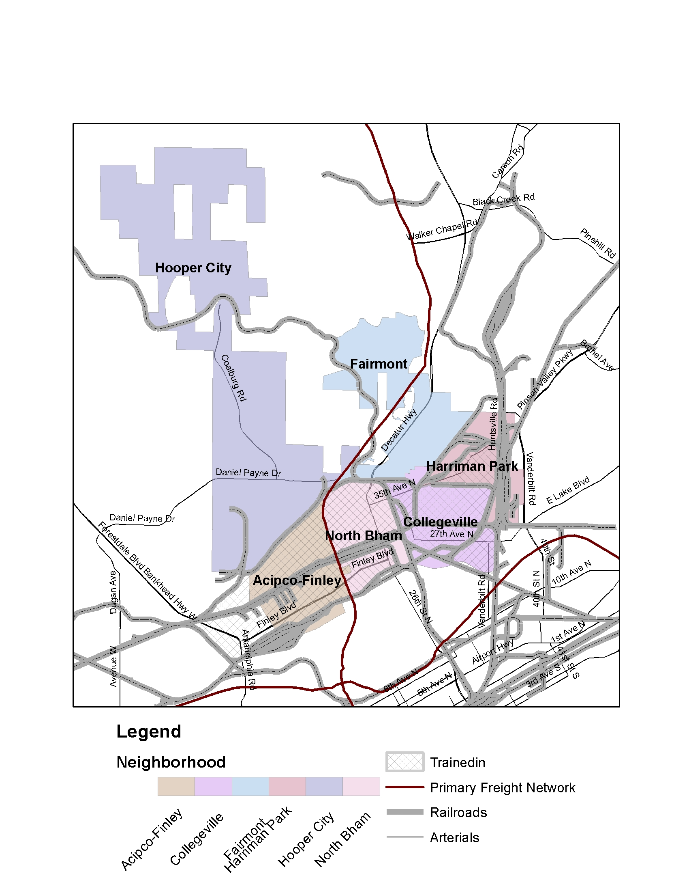
Assessment: Freight
Notes:
This map shows the North Birmingham neighborhoods with the freight networks - both rail (grey) and highway (red). Areas completely surrounded by railway lines are indicated as “trained-in” and shown with cross-hatching.

Slide 37
Final Recommendations
Access to Quality Employment
Access to Healthy Food
Access to Health Care
Connectivity
Freight

Slide 38
Recommendations: Employment
1. Incorporate a specific economic development and labor force strategy for the North Birmingham area into the regional Comprehensive Economic Development Strategy.
Primary Partners: Regional Planning Commission of Greater Birmingham
Term: Short and Long Term
2. Encourage the redevelopment of brownfield sites by creating agreements that release property owners from all future liability if they complete clean-up and educating property owners on brownfield clean-up practices.
Primary Partners: Regional Planning Commission of Greater Birmingham and City of Birmingham Office of Economic Development
Term: Short and Long Term
3. Expand existing enterprise zone to include North Birmingham communities.
Primary Partners: Regional Planning Commission of Greater
Birmingham and City of Birmingham Office of Economic Development
Term: Short and Long Term

Slide 39
Recommendations: Employment
4. Collaborate with workforce development agencies to target recruitment of North Birmingham residents for careers in civil service
Primary Partners: Personnel Board of Jefferson County and Jefferson County Workforce Investment Board, Workforce Development Council: Region 4, Mission Alabama, Alabama Department of Development Workforce Programs, local churches and schools
Term: Short and Long Term
5. Establish after-school enrichment and summer programs for school-age children (5-15)
Primary Partners: Birmingham Parks and Rec Department, YMCA, A.G. Gaston Boys & Girls Club, Schools and Churches
Term: Short and Long Term
6. Offer new daycare option for residents to replace program that was closed
Primary partners: Housing Authority of Birmingham and Alabama Department of Human Resources
Term: Short and Long Term

Slide 40
Recommendations: Food Access
1. Implement a Healthy Corner Store Initiative Primary Partners: UAB SSCRC, City of Birmingham, North Birmingham Planning Commission, Local Corner Stores, UAB JCPM, NBCC
Term: Long Term
2. Expand current fresh produce food truck program to reach all areas of North Birmingham
Primary Partners: Faith Based Organizations, Local Organizations, Wholesome Wave, Community Food Bank of Central Alabama- Mobile Pantry Program
Term: Short Term
3.Create a shuttle service programs that will run from key neighborhood destinations to Walmart, other full service grocery stores, and Farmers Markets
Primary Partners: Local Institutions, Faith Based Organizations, Walmart, Local Grocery Stores, Alabama Farmers Markets, NBCC
Term: Short Term

Slide 41
Recommendations: Food Access
4. Implement a healthy food educational component.
Primary Partners: REV Birmingham, Birmingham Public Schools, Health Action Partnership. Community Food Bank of Central Alabama- Weekender’s Backpack Program, Jones Valley Urban Teaching Farm, Alabama Cooperative Extension
Term: Short Term
5. Support a program for urban agriculture within the North Birmingham neighborhoods
Primary Partners: Alabama Cooperative Extension, Workforce Development, UAB, NBCC, Faith Based Organizations, REV Birmingham
Term: Long Term

Slide 42
Recommendations: Access to Health Care
1. Partner with churches for low infrastructure and easily accessible health care offerings
Primary partners: Faith Based Organizations, Jefferson County Health Department, Alabama
Health Department, City of Birmingham
Term: Short Term
2. Provide residents with a shuttle transportation to major health care destinations
Primary partners: Hospitals, Jefferson County Health Department, Faith Based Organizations
Term: Intermediate
3. Establish a local healthcare facility to serve the medical needs of the community
Primary partners: Jefferson County Health Department, Private Medical Group
Term: Long Term

Slide 43
Recommendations: Connectivity
1. Review the current transit routes and redirect routes to create an integrated transit system that provides greater connectivity to important locations inside and outside of North Birmingham
Primary Partners: City of Birmingham, Regional Planning Commission of Greater Birmingham (RPCGB), Birmingham-Jefferson County Transit Authority (BJCTA)
Term: Intermediate
2. Ensure affordable and healthy housing exists by introducing scattered-site housing in higher density areas of the community
Primary Partners: City of Birmingham, Housing Authority of the Birmingham District, Regional Planning Commission of Greater Birmingham (RPCGB), other affordable housing providers
Term: Long Term
3. Create a vacant property registry and a rental property registry to create safe neighborhoods
Primary partners: City of Birmingham, Housing Authority of the Birmingham District, Regional Planning Commission of Greater Birmingham (RPCGB), Project RISE, other affordable housing Providers
Term: Intermediate

Slide 44
Recommendations: Connectivity
4. Improve sidewalk infrastructure throughout the North Birmingham Community
Primary partners: Regional Planning Commission of Greater Birmingham (RPCGB), City of Birmingham
Term: Intermediate
5. Integrate traffic calming in key intersections and along roadways with high incidences of car, pedestrian and/or bicycle infrastructure in the North Birmingham Community. Primary partners: Regional Planning Commission of Greater Birmingham (RPCGB), City of Birmingham
Term: Intermediate

Slide 45
Recommendations: Freight
1. Minimize the time trains are stopped at residential street crossings
Primary Partners: Alabama Department of Transportation, RPCGB, Rail Industry, NBCC, Emergency Planning Committee
Term: Short Term
2. Eliminate at-grade rail crossings
Primary Partners: Alabama Department of Transportation, RPCGB, Rail Industry
Term: Intermediate

Slide 46
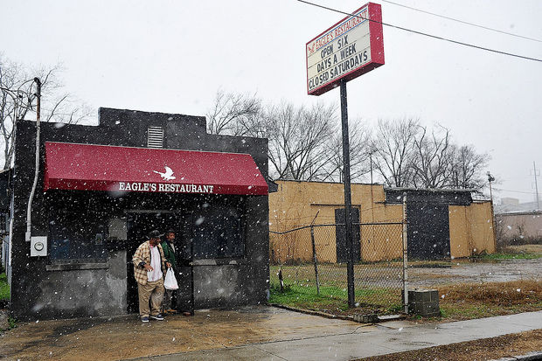
Questions?

Slide 47
Works Cited
1. WHO Guidelines for Community Noise - Executive Report. Edited by Berglund, Lindvall, and Schwela. 1999. Retreived: http://whqlibdoc.who.int/hq/1999/a68672.pdf 2. Occidental College and University of Southern California (USC). (2011) Global Trade Impacts: Addressing the Health, Social, and Environmental Consequences of Moving International Freight Through Our Communities. February 2011. Retreived: http://kresge.org/sites/default/files/Global%20Trade%20Executive%20Summary%203-21.pdf 3. American Trucking Association (ATA). (2013) Relative Contribution/Fault oin Car-Truck Crashes. www. trucking.org Retreived: http://www.truckline.com/ATA%20Docs/News%20and%20Information/Reports%20Trends%20and%20Statistics/02%2012%2013%20--%20FINAL%202013%20Car-Truck%20Fault%20Paper.pdf 4. American Trucking Association (ATA). (2013) Relative Contribution/Fault oin Car-Truck Crashes. www. trucking.org Retreived: 4.
5. Trade, Health and Environment Impact Project (THE Impact Project). (2012) Tracking Harm: Health and Environmental Impacts of Rail Yards. January 2012. Retrieved: http://hydra.usc.edu/scehsc/pdfs/Rail%20issue%20brief.%20January%202012.pdf 6. Federal Railroad Administration (FRA). (2014) Safety Fact Sheet. US Department of Transportation. February 2014. Retreived: https://www.fra.dot.gov/Elib/Details/L04936

Slide 48
Works Cited
7. Hubalek, Z. (1999). West Nile Fever--a Reemerging Mosquito-Borne Viral Disease in Europe. Emerging Infectious Diseases, 5(5), 643.
8. Environmental Protection Agency. 2012. Summaries of Water Pollution Reporting Categories. Accessed April 22, 2014. http://www.epa.gov/waters/ir/34PARENTATTAINSDESCRIPTIONS.pdf
9. Azuma, K., Ikeda, K., Kagi, N., Yanagi, U., Hasegawa, K., & Osawa, H. 2014. Effects of water-damaged homes after flooding: health status of the residents and the environmental risk factors. International Journal Of Environmental Health Research, 24(2), 158- 175.
10. Branas, Charles. “Vacant Properties and Violence in Neighborhoods.” ISRN Public Health. September 2013. http://www.ncbi.nlm.nih.gov/pmc/articles/PMC3693396/#!po=65.9091..Accessed 7 April 2014.
11. Carlson, Cynthia, Semra Aytur, Kevin Gardner, and Shannon Rogers. “Complexity in Built Environment, Health, and Destination Walking: A Neighborhood-Scale Analysis.” Journal of Urban Health: Bulletin of the New York Academy of Medicine, Vol. 89, No. 2. 2012 April.
12. Casagrande, Sarah Stark, MHS, Melicia C. Whitt-Glover, PhD, Kristie J. Lancaster, PhD, RD, Angela M. Odoms-Young, PhD, RD, Tiffany L. Gary, PhD. “Built Environment and Health Behaviors Among African Americans: A Systematic Review.” American Journal of Preventative Medicine. 2009 Feb; Vol. 36 (2), pp. 174-81.

Slide 49
Works Cited
13. Gallagher, Mari. (2010, August). Examining the Impacts of Food Imbalance and Food Deserts in Birmingham, Alabama. Retrieved January 29, 2014 from http://www.fooddesert.net/wp-content/themes/cleanr/images/Birm_Report_Cond.pdf
14. Access to healthy food: challenges and opportunties. (2012, June). Public Health Law Center. Retrieved January 30, 2014 from http://publichealthlawcenter.org/sites/default/files/resources/PHLC%20Access%20to%20Healthy%20Food%20-%20Challenges%20and%20Opportunities%202012.pdf
15. Alpolitics. (2010, August 11). “Food deserts and food imbalance in urban areas: what can be done?” Daily Kos. Retrieved January 29, 2014 from http://www.dailykos.com/story/2010/08/11/892276/-Food-Deserts-and-Food-Imbalance-in-Urban-Areas-What-Can-Be-Done 16. U.S. Department of Health and Human Services. (2013). Healthy People 2020: Access to Health Services. Retrieved April 19, 2014, from http://www.healthypeople.gov/2020/topicsobjectives2020/overview.aspx?topicid=1
17. National Center for Health Statistics. (2012). Health, United States, 2011: With Special Feature on Socioeconomic Status and Health. Retrieved April 19, 2014, from http://www.cdc.gov/nchs/data/hus/hus11.pdf

