Slide 1
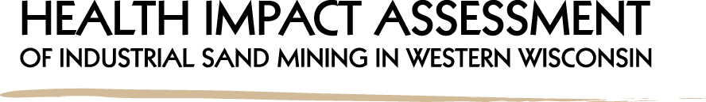

Date: 6/16/15
Presenter: Audrey boerner, HIA specialist
Institute for Wisconsin’s Health, Inc.

Slide 2
Acknowledgements
This project is supported by a grant from the Health Impact Project, a collaboration of the Robert Wood Johnson Foundation and The Pew Charitable Trusts.
Ongoing Technical Assistance and Project Support:
Marla Orenstein and Erica Westwood, Habitat Health Impact Consulting
Amber Lehnart, Health Impact Project (Pew Charitable Trusts)
The opinions expressed are those of the author(s) and do not necessarily reflect the views of the Health Impact Project, Robert Wood Johnson Foundation or The Pew Charitable Trusts.

Slide 3
Objectives
1. Industrial sand mining in Wisconsin overview
2. Our Health Impact Assessment approach
3. Challenges/opportunities
4. Q & A

Slide 4
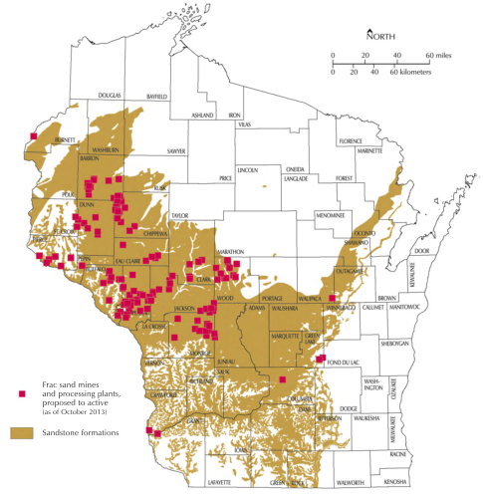
HIA of Industrial Sand in Wisconsin
63 mining sites
Mining for > 100 years
Sand mines and processing plants (Oct. 2013)
Sandstone formations
Image: WGNHS

Slide 5
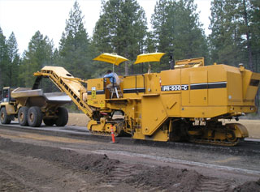
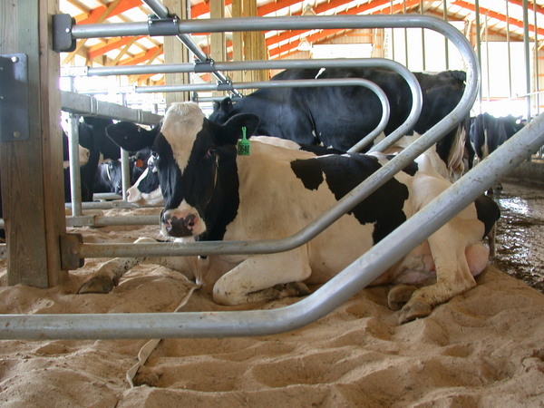
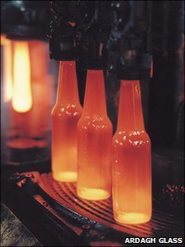
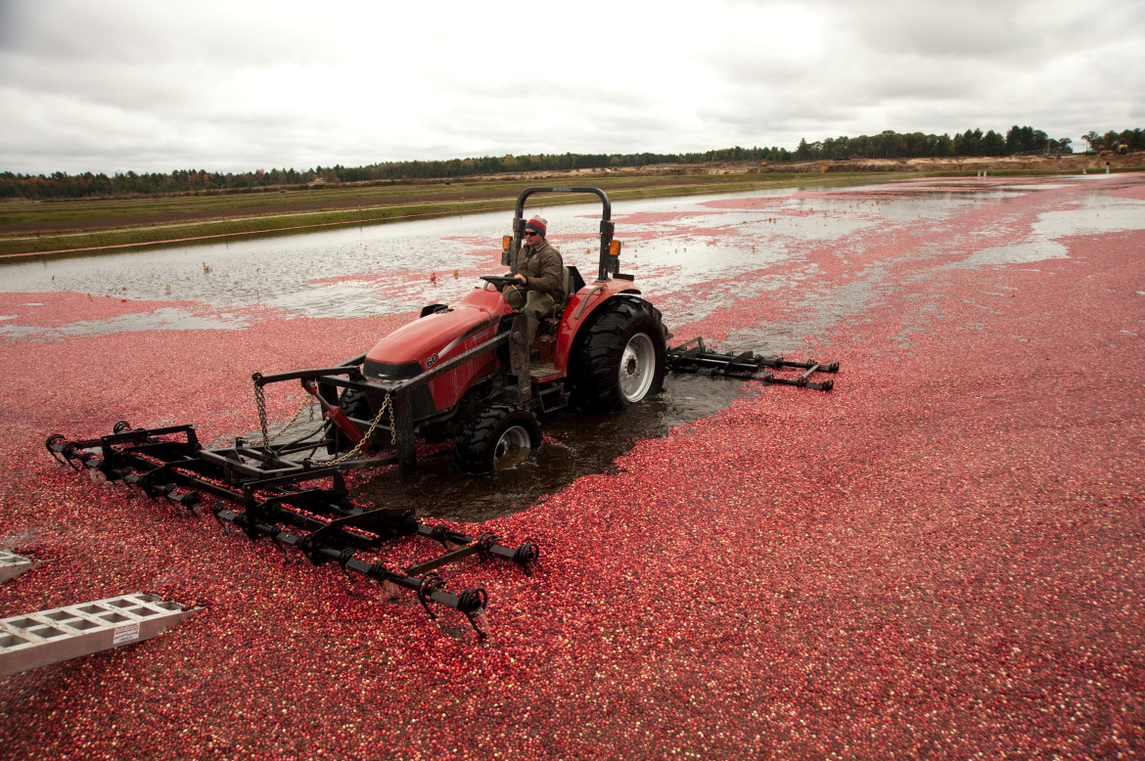
What is Industrial Sand?
For over 100 years:
  Construction
  Glass manufacturing
  Cranberry production
  Dairy production
  Unconventional oil & gas drilling

Slide 6
Industrial Sand Mining in Wisconsin
Above & below ground mining
Practices vary by site
    Rail vs trucking
    Blasting
    Fugitive dust and water runoff
Numerous permits are required
    Local, State and Federal regulation
Bottom line: Each mining operation is unique
Photo Courtesy: Smart Sand

Slide 7
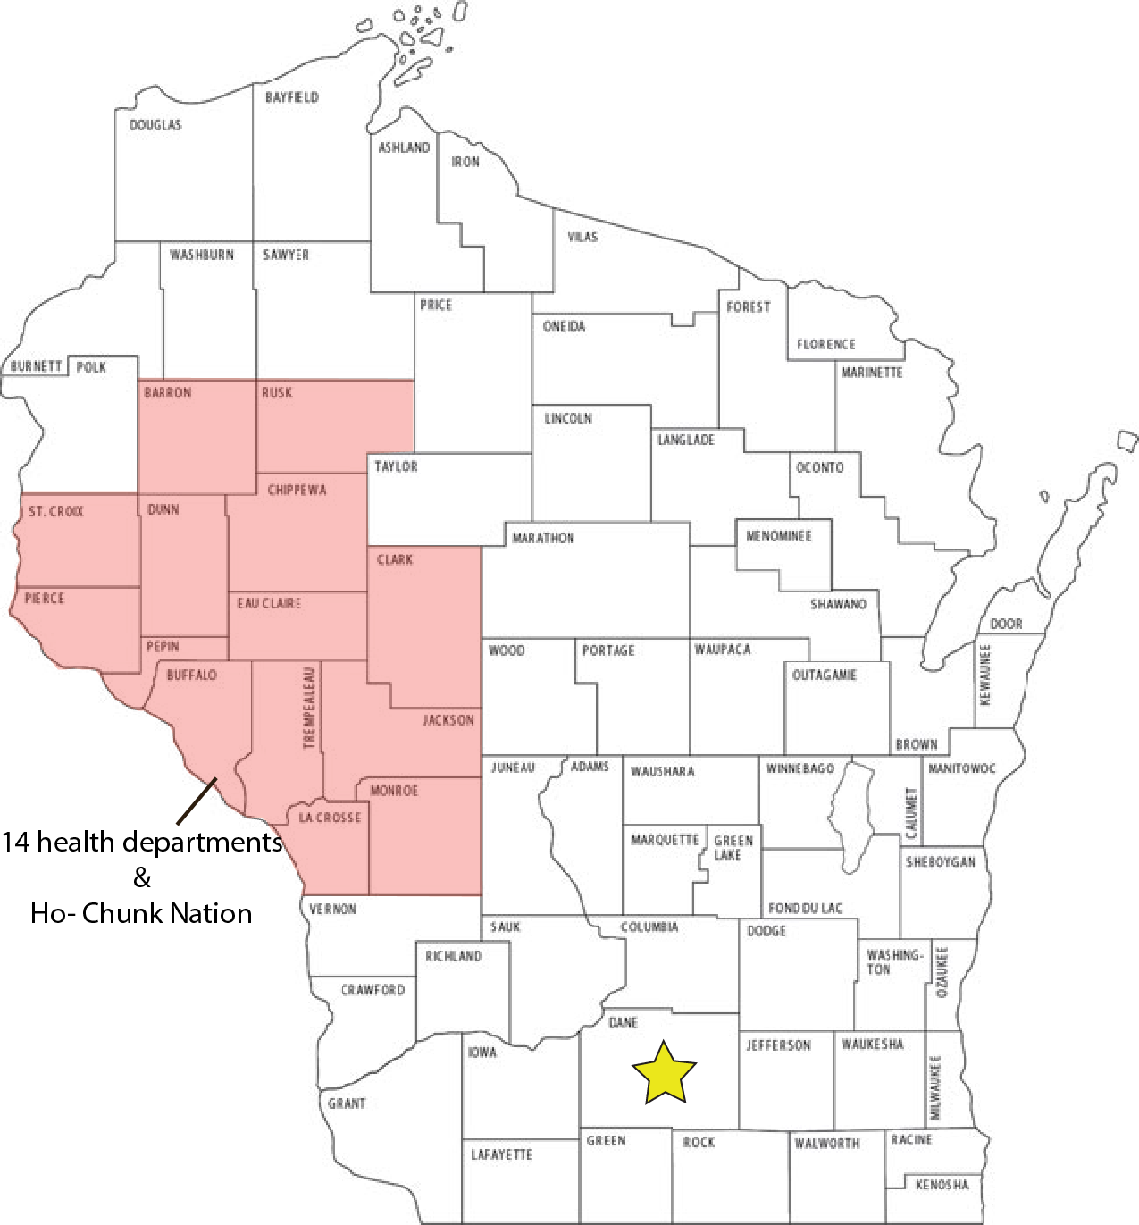
A Non-Traditional HIA
Existing and proposed mines
Variable practices
Extensive geographic range
Similar to health-focused strategic environmental assessment
14 Health departments &
Ho-Chunk Nation

Slide 8
A Non-Traditional HIA
October 2014 – March 2016 (18 Months)
Screening: Complete
  Level 1 & Level 2 partners
Scoping: Now
Air quality (inc. airborne silica)
Control of land use decisions
Ground water quality and quantity/supply
Land use/value and natural habitat
Quality of life and cultural heritage
14 Health departments &
Ho-Chunk Nation

Slide 9
A Non-Traditional HIA
October 2014 – March 2016 (18 Months)
Screening: Complete
  Level 1 & Level 2 partners
Scoping: Now
3. Assessment: August – September 2015
4. Recommendations: September 2015
5. Reporting: Final Dec ’15 – Jan ‘16
6. Monitoring: Final Evaluation March 2016
14 Health departments &
Ho-Chunk Nation

Slide 10
Opportunities and Challenges of a Regional Approach
Opportunities
HIA process is a natural fit with IWHI’s mission and structure: “Strengthening Wisconsin’s public health system through capacity building and innovation” Non-partisan, not-for profit and independent
Unique opportunity to engage LHD’s and Ho-Chunk Nation around an issue of common concern and build capacity in the region
Potential to inform decision-making and policy across a number of counties and at the tribal level
Challenges
Geographic scope
Different types, sizes and operations practices of mining operations
Rapidly changing political and economic environment
Photo Courtesy: Smart Sand

Slide 11

Questions and Comments

Slide 12
Thank You!
Audrey Boerner
Institute for Wisconsin’s Health, Inc. 749 University Row, Suite 110 Madison, Wisconsin 53705
aboerner@instituteforwihealth.org

