Slide 1


The Maryland Experience:
Using HIA Methodology to Evaluate the Public Health Impacts Associated with Unconventional Natural Gas Development and Production
Meleah Boyle, MPH, CPH
National HIA Conference
June 16-17, 2015

Slide 2
Public Health Study
On June 6, 2011, Governor O'Malley issued Executive Order (E.O.) 01.01.2011.11, which established the Marcellus Shale Safe Drilling Initiative
  The purpose of the Initiative is to assist regulators in determining whether and how gas production from the Marcellus Shale and other shale formations in Maryland can be accomplished without unacceptable risks of adverse impacts to public health, safety, the environment, and natural resources
Role of the Public Health Study
  Assess potential health impacts to inform decisions about whether to permit Unconventional Natural Gas Development and Production (UNGDP) in Maryland
  Make recommendations to limit negative health impacts if the State decides to permit UNGDP

Slide 3
HIA & the Public Health Study
HIA
Public Health Study
Screening
Scoping
Assessment
Recommendations
Reporting
Monitoring & Evaluation
Detailed Scoping
Assessment
  Baseline
  Impact
Final Report
  Monitoring & assessment recommendations
  Public health response and mitigation strategies

Slide 4

Scoping
Stakeholder engagement
  Meeting September 24, 2013 at Frostburg State University
  Website www.marcellushealth.org
  Meeting October 5, 2013 at Garrett College
Purpose: to discuss natural gas drilling and extraction in the Marcellus Shale in Western Allegany and Garrett counties
Participants included concerned community members and advocates

Slide 5
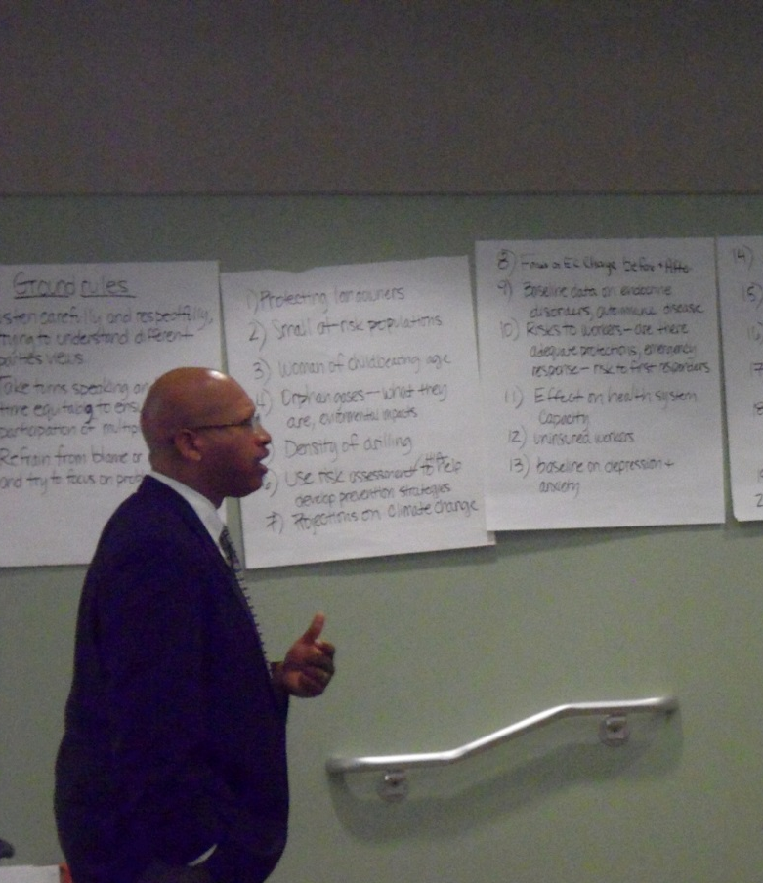
Scoping
Ten themes emerged:
  Air contamination
  Baseline health assessment
  Benefits
  Healthcare infrastructure
  Occupational issues
  Secondary impacts
  Vulnerable populations
  Water contamination
  Weather and climate change
  Zoning

Slide 6
Scoping
Review of public health-specific comments in response to the Best Management Practices Report forwarded by MDE in the Fall 2013
  113 comments were reviewed and categorized according to the key themes
  Additional topics derived from these comments
    Economic impact emerged as a new theme
    Natural disasters were added to the climate change/weather theme

Slide 7
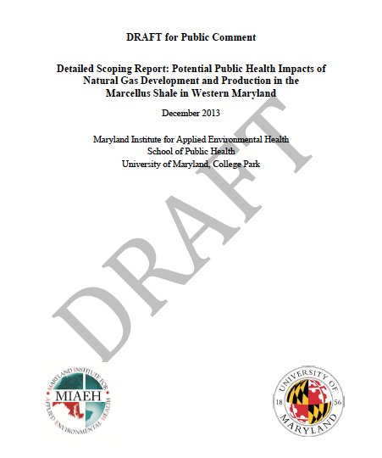
Comments on Scoping
Draft Scoping Report released for public comment on December 23, 2013 to January 23, 2014
Received 46 comments from concerned residents, environmental advocacy organizations, and the industry
Revised the study scope based on the comments

Slide 8
Baseline Assessment
Demographics
Vulnerable populations
  Vulnerable populations were identified using demographics (race, age, poverty, education, and employment), proximity to existing gas wells, well water as drinking source, access to healthcare, and major causes of morbidity and mortality
Physical determinants of health
  Chronic diseases, cancer incidence, mortality, birth outcomes (LBW, premature births, infant mortality)
Social determinants of health
  STIs, crime, injuries, mental health, substance abuse
Healthcare

Slide 9
Baseline Assessment: Data Sources
Demographic and Health Data
  2012 American Community Survey 5-year estimates
  CDC’s Community Health Status Indicators
  Behavioral Risk Factor Surveillance System (BFRSS)
  University of Wisconsin County Health Rankings and Roadmap
  National Cancer Institute’s State Cancer Profiles
  CDC Wonder
Mapping
  2012 American Community Survey 5-year estimates
  2013 Primary Medical Care Health Professional Shortage Areas
  2013 EPA-regulated facilities
  2012 ESRI USA landmark data
  1980 Basic Data Report No. 11, Garrett County Gas Well records

Slide 10
Impact Assessment
Hazard Identification
Hazards
Extensive literature review
Detailed scoping process
Site visit to Doddridge County, WV
Noise monitoring
  Inside and outside homes in Doddridge County in WVA
  Near natural gas compressor stations
Air quality
Water-related concerns (water quality, soil quality, and naturally occurring radiological materials)
Noise
Earthquakes
Social determinants of health
Healthcare infrastructure
Occupational health
Cumulative exposure/risk

Slide 11
Hazard Ranking
Evaluation Criteria | Result | Score | Description
Presence of vulnerable populations | No | 1 | Affects all populations equally
 | Yes | 2 | Disproportionately affects vulnerable populations
Duration of exposure | Short | 1 | Lasts less than 1 month
 | Medium | 2 | Lasts at least one month but less than one year
 | Long | 3 | Lasts one year or more
Frequency of exposure | Infrequent | 1 | Occurs sporadically or rarely
 | Frequent | 2 | Occurs constantly, recurrently
Likelihood of health effects | Unlikely | 0 | Prior evidence suggests exposure is not related to adverse health outcomes
 | Unknown | 1 | Evidence is inconclusive/insufficient data
 | Possible | 2 | Prior evidence suggests exposures may be associated with adverse health outcomes
 | Likely | 3 | Prior evidence suggests similar exposures to be associated with adverse health outcomes

Slide 12
Hazard Ranking
Evaluation Criteria | Result | Score | Description
Magnitude/severity of health effects | None | 0 | No adverse health effects
 | Unknown | 1 | Evidence inconclusive/insufficient data
 | Low | 2 | Causes health effects that can be quickly and easily managed, do not require medical treatment
 | Medium | 3 | Causes health effects that necessitate treatment of medical management and are reversible
 | High | 4 | Causes health effects that are chronic, irreversible or fatal
Geographic extent | Localized | 1 | Effects occur in close proximity to UNG-Development and/or Production
 | Community-wide | 2 | Effects occur across most of the community
Effectiveness of setback | Positive | 1 | Setback is anticipated to minimize health effects
 | Negative | 2 | Setback is not anticipated to minimize health effects

Slide 13
Hazard Ranking
Evaluation Criteria | Result | Score | Description
Public health impact | Low concern |  | Hazard received a score of 5-9
 | Moderately high concern |  | Hazard received a score of 10-14
 | High concern |  | Hazard received a score of 15-18
  Green: low concern that UNGDP related changes will have a negative impact on public health
  Yellow: moderately high concern that UNGDP related changes will have a negative impact on public health
  Red: high concern that UNGDP related changes will have a negative impact on public health

Slide 14
Example: Air Quality
Evaluation Criteria | Air Quality
Presence of vulnerable populations | 2
Duration of exposure | 3
Frequency of exposure | 2
Likelihood of health effects | 3
Magnitude/severity of health effects | 4
Geographic extent | 1
Effectiveness of setback | 1
Overall score | 16
Public health impact | H
Disproportionately affects vulnerable populations (leaving near site, w/o mineral rights)
Will last >1 year, particularly related to flaring and compressor stations
Continuous exposure
Air pollutants that are associated with UNGDP are known to have negative health effects in other settings
Resulting adverse health effects can be chronic and irreversible
Adverse effects more prevalent in the close proximity to source
Effective setback distance can minimize exposure
High concern that UNGDP-associated changes in air quality will negatively impact public health in MD

Slide 15
Hazard Evaluation Summary
Hazard | Level of Concern for Potential Negative Public Health Impacts
Air Quality | High
Healthcare Infrastructure | High
Occupational Health | High
Social Determinants of Health | High
Cumulative Exposures/Risks | Moderately High
Water Quality | Moderately High
Noise | Moderately High
Earthquakes | Low

Slide 16
Recommendations
52 recommendations including prevention and mitigation strategies designed to protect the public’s health
  Setback distances
  Chemical disclosure
  Environmental monitoring
  Community panels, forums, and advisory groups
  Baseline
  Health surveillance

Slide 17
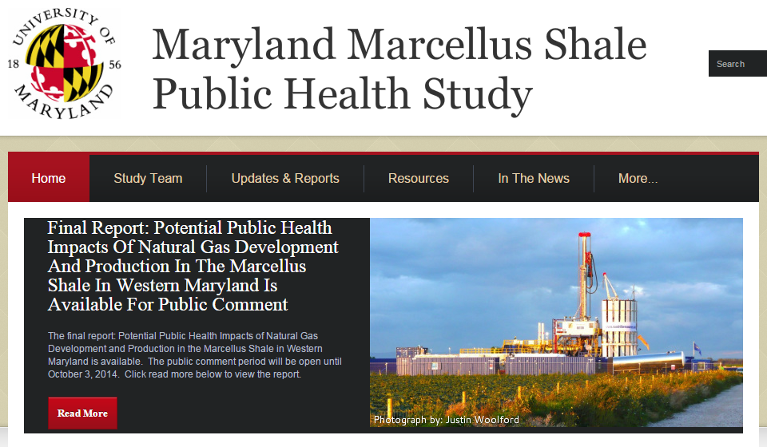
Visit www.marcellushealth.org for more information

