Slide 1
HIA and Community Engagement:
Community Member Perspectives
Stories from Torrance County, New Mexico and Baltimore, Maryland
National HIA Meeting
June 17, 2015

Slide 2

Lobos CO₂ pipeline HIA
Torrance County, New Mexico
Mark Clark – Health Promotion Specialist, NM Department of Health
Pat Lincoln – Member of Partnership for a Healthy Torrance County

Slide 3
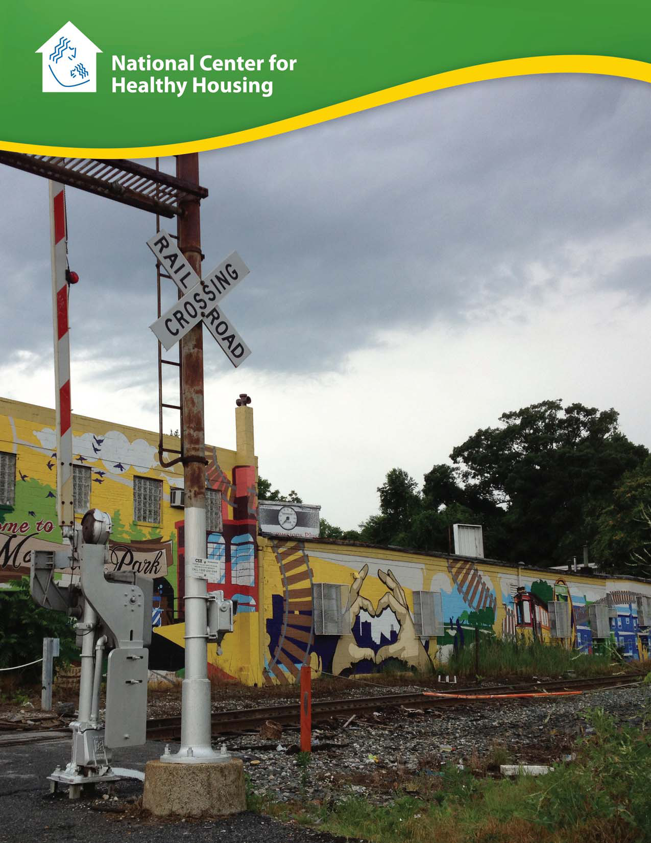
Baltimore-Washington
Rail Intermodal
Facility Health Impact Assessment

Slide 4
ACKNOWLEDGEMENTS
This project was supported by a grant from the Health Impact Project, a collaboration of the Robert Wood Johnson Foundation and The Pew Charitable Trusts, with funding from The Kresge Foundation.
Authors and Contributors:
Ruth Lindberg, Former Program Manager, National Center for Healthy Housing
Kristina Souders, Research Assistant, National Center for Healthy Housing
Rebecca Morley, Executive Director, National Center for Healthy Housing
Rajiv Bhatia, Project Consultant
Tom Rivard, Project Consultant
Judith Akoto, Project Coordinator, National Center for Healthy Housing
Jonathan Heller, Human Impact Partners
Jill Breysse, Senior Project Manager, National Center for Healthy Housing

Slide 5
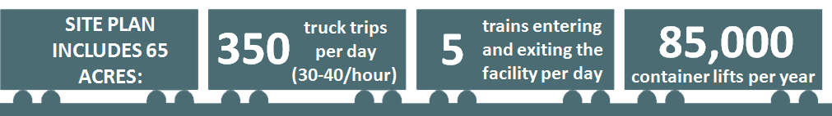
Background
Facility’s Purpose:
“To transfer goods between trucks and trains for either ‘long-haul’ rail service to markets outside of the region or ‘short-haul’ truck delivery to local warehouses, retailers and other businesses within the region”
Notes:
The purpose of the proposed Baltimore-Washington Rail Intermodal Facility at the Mount Clare Yard in southwest Baltimore is to transfer goods “between trucks and trains for either ‘long-haul’ rail service to markets outside of the region or ‘short-haul’ truck delivery to local warehouses, retailers and other businesses within the region”.
The proposed facility would include over 65 acres, produce 350 truck trips per day (up to 30-40/hour), accept 5 trains entering and exiting the facility per day, produce 85,000 container lifts per day and operate 24/7, 365 days a year.
The National Center for Healthy Housing conducted a health impact assessment (HIA) to assess the potential impacts of the development on the residents of the Morrell Park and Violetville area. The HIA also identified opportunities to mitigate potential health impacts in the facility’s design, construction, and operations.

Slide 6

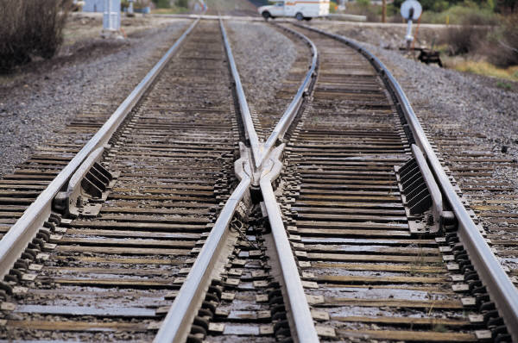
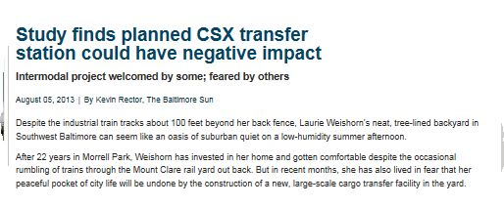
Notes:
The study found that the proposed facility would have a negative impact on an already stressed population.

Slide 7
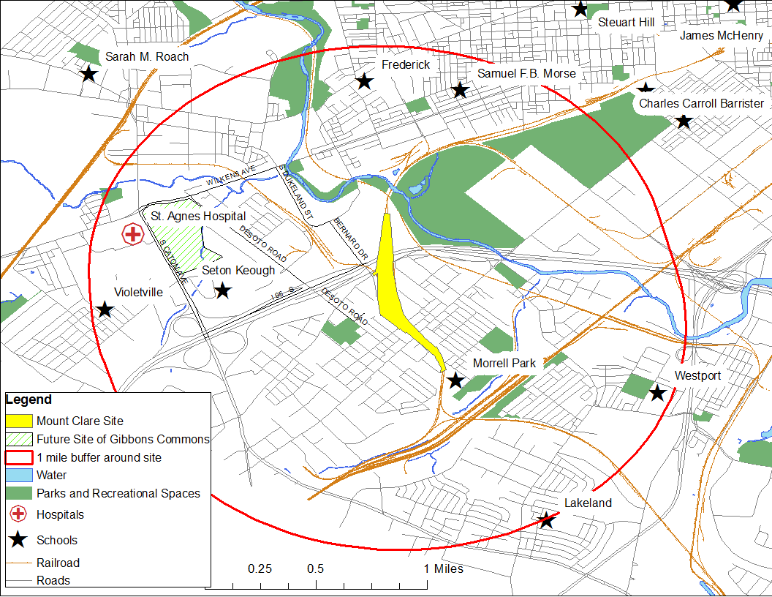
Key Players
Federal Highway Administration
CSX Corporation
MD Department of Transportation
City of Baltimore
Morrell Park and Violetville Community Associations
Residents & Community Leaders
Local Businesses
$90-$95 million site.
The state will pay for $30 million of the project. CSX will contribute $60 to $65 million.
Notes:
In the fall of 2012, MDOT and CSX announced that the facility would be constructed at CSX’s existing Mount Clare Yard in the Morrell Park neighborhood in southwest Baltimore. Unlike prior sites that were considered for the facility, the State announced that federal funds would no longer be used for the project, which meant that the federal environmental review process (including community-wide notices and meetings) would no longer be required. MDOT and CSX planned to gain support for the project through presentations at individual community association meetings.
Morrell Park has two community associations, which often focus on different areas of concern within the neighborhood. Their meetings were not heavily attended. A concern for us was that the majority of residents did not attend these meetings and were not even aware of the project. The full scope of the facility and negative impacts were not discussed and the decision making process wasn’t clear. Many of the questions and concerns raised by residents both individually and at the meetings were not thoroughly addressed, went unanswered or were simply dismissed. It was extremely frustrating. It was also clear that they intended to build the project without a meaningful, comprehensive development plan that would help stabilize the community and protect it from negative impacts. Fortunately, NCHH attended several meetings and spoke of their work on the HIA.

Slide 8
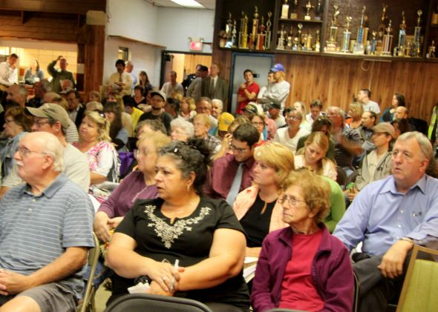
Community Involvement
Scoping Process
- Narrowed focus to six health determinants
Focus Groups
- Current neighborhood conditions
- Community involvement in
decision making process
- Opportunities and concerns
Identified Stakeholders
- Coalitions formed
Recommendations
  - Input
  - Prioritize
Notes:
Scoping Process
The scope of the HIA reflected the input and feedback generated through community forums, meetings, trainings and interviews with stakeholders and
Narrowed the focus to six health determinates: 1) air quality, 2) employment, 3) neighborhood resources (property values, schools parks and recreation spaces), 4) noise, 5) traffic safety, and 6) light.
Focus Groups
NCHH recruited focus group participants at local community association meetings. Community leaders also circulated information about focus groups through their networks and hung fliers at local shops in the neighborhood. Focus group participants shared their:
Opinions about the facility
Thoughts on community involvement (or lack of) in the site selection and decision making process
Perception of current neighborhood conditions
Opportunities and concerns about the project
Identified Stakeholders
Community residents helped NCHH identify stakeholders in the construction and operation of the proposed facility including business owners, local healthcare providers, elected officials and government departments involved in the planning and regulation process.
The associations reached out to some of the stakeholders interviewed for the HIA and created a coalition
Recommendations
Community residents had direct input into the specific recommendations presented in the HIA to help mitigate the negative impacts of the facility.
- Residents participated in on-line surveys
NCHH compiled results and prioritized recommendations

Slide 9
Community Perspectives
“I’m hoping that CSX will help us develop an economic base.”
“Our neighborhood is definitely going down. And what I think, and I hate to say it, I think this is going to make it worse.”
“We have a high incidence of lung cancer, emphysema and cardiac related issues. None of those people do well in a heavily polluted area.”
“You can't just pick up and get a job working for CSX. You got to know a little bit of something I'm sure, I mean unless maybe you're security. You can't be an engineer or you can't be a crane operator.”
Notes:
Excerpts from focus groups and interviews with residents, community leaders, business owners, local healthcare providers, environmental groups, and government personnel.

Slide 10
Morrell Park/Violetville
Demographics
Greater proportion of residents 65 and older
Median income lower than median income for the county
Health
Higher rates of age-adjusted mortality, heart disease, deaths linked to lower respiratory disease and cancer deaths
Air Quality
Current PM 2.5 levels at WHO threshold
Employment
Unemployment higher in areas surrounding facility
Facility will increase emissions of PM and other pollutants
Unemployed may not be eligible for jobs created by facility
Notes:
Community Demographics
• The Morrell Park/Violetville Community Statistical Area1 (CSA), where the proposed intermodal facility would be located, has a greater population of white residents and
residents age 65 or older than that of the city, Baltimore County, and the state as a whole. The median household income for the area is $39,931—slightly higher than the city as a whole, but substantially lower than Baltimore County ($65,411) and the state ($72,419).
Health
• The residents living in the CSA have higher rates of age-adjusted mortality and heart disease, all cancer and lung cancer deaths, and deaths linked to chronic diseases of the lower respiratory system (e.g., chronic obstructive pulmonary disease, emphysema, bronchitis, and asthma) compared with Baltimore City and Maryland residents as a whole.
Air Quality
•The introduction of the intermodal facility at the Mount Clare site will increase the frequency of freight transport moving through the surrounding residential areas, resulting in emissions of numerous hazardous chemicals. These include particulate matter (PM), nitrogen oxides (NOx), sulfur oxides (SOx), volatile organic compounds (VOCs), and carbon monoxide (CO).
• Our air quality analysis examined the baseline levels of particulate matter less than 2.5 micrometers in diameter (PM2.5). We found that the area surrounding the proposed site is currently in attainment with the U.S. Environmental Protection Agency’s (EPA’s) National Ambient Air Quality (NAAQ) standard for PM2.5, but is already level with the more health protective World Health Organization (WHO) air quality threshold for the pollutant. Measuring from the nearest air quality monitoring station (4 miles away), the present conditions in the community for PM2.5 annually average 10 micrograms per cubic meter (μg/m3), which compares with EPA’s annual NAAQ standard of 12 μg/m3 and the WHO annual guideline of 10 ug/m3 (World Health Organization, 2000).
• Using conservative models2, we found that air quality near the proposed site will worsen due to increased truck traffic. If trucks were concentrated in two peak hour periods (morning and evening), the maximum additional exposure of residents to PM2.5 would be an estimated 0.8 μg/m3 during a peak period on any given day.
• Using data from the census block groups surrounding the proposed site location for 3,933 individuals over age 30, we calculated the excess annual mortality rate attributable to PM2.5 exposure that could result from the facility. The maximum modeled changes in air
Employment
• The current unemployment rates in two of the census tracts surrounding the proposed facility are substantially higher than those of the city of Baltimore and the state of Maryland when comparing demographically similar populations. For example, unemployment rates of white residents in Morrell Park/Violetville census tracts 2502.06 and 2503.03 (9.3% and 15.7%, respectively) are significantly higher than those in both the city of Baltimore and Maryland (6.5% and 5.5%, respectively). Similarly, 31.5% of African-Americans in census tract 2503.03 are unemployed, compared with 16.4% of African-Americans in the city and 11.0% in the state.
• A study by Towson University predicted that the intermodal facility will create 45 jobs onsite, which will be transferred directly from existing jobs at the Seagirt Marine Terminal. The study estimated that the facility will produce 192 direct jobs for contractors who transport goods, 490 jobs during the construction phase, and 84 jobs induced from spending in local economies (Irani et al., 2012). Focus group findings revealed concerns that those who are unemployed or underemployed in the community may not be eligible for the jobs that are created by the facility due to a misalignment in skills and training.
Neighborhood Resources
• Based on the literature, we predict the facility could decrease residential property values for homes adjacent to the proposed site. Studies show a correlation between increased roadway traffic and diminished residential property values. Parts of the CSA are already rated as stressed housing markets by the City of Baltimore. Decrements in housing value could further exacerbate the market conditions in certain parts of the CSA.
• Increased traffic on truck transit routes to the Mount Clare site is a potential threat to the use of park spaces, including a small memorial garden on Washington Boulevard. In addition, Gibbons Commons, which is expected to be a significant community asset with its recreational facilities and a baseball field, is slated for construction on Wilkens Avenue, one of the roads that will be used as a thoroughfare for facility truck traffic.
Noise
• Focus group participants describe the current neighborhood conditions as quiet and peaceful. CSX is completing a noise study to predict changes in noise levels caused by operation of the facility, but these data were not available at the time of publication.
• A causal effect of noise on annoyance5 has been well established at 50-55 dBA (Berglund et al., 1999), and sleep disturbance begins at 55-60 dBA. For comparison, a truck with more than three axels going 37 mph creates 83 dBA of noise (Ellebjerg, et al., 2008). Facility operations are expected to produce an average of 300 additional truck trips through the Morrell Park/Violetville neighborhoods daily.
• Sensitive receptors6 that line Wilkens Avenue – a high school, a hospital, and senior care facilities – will not have any barrier to the increased noise emissions of trucks moving to and from the facility. The new facilities of Gibbons Commons, which are expected to include green spaces, recreational facilities, and grand housing (housing for grandparents raising their grandchildren), will also sit along the intended truck access route for the facility.
Traffic Safety
• The Baltimore City Department of Transportation’s Traffic Impact Study of the proposed facility indicates that the baseline conditions of traffic already push the threshold of acceptable quality; the Level of Service rating at the intersection of Caton Avenue and Wilkens Avenue is currently a ‘D,’ which is the considered the lowest acceptable rating of quality of service for Baltimore City intersections.
• Focus group participants predicted that the addition of trucks that will accompany the operation of the new intermodal facility will exacerbate their current traffic problems with congestion. Safety was a concern, as drivers were worried about sharing roadways with more tractor trailers. Efforts to obtain baseline vehicular crash data from the City of Baltimore for the Morrell Park/Violetville area were unsuccessful and therefore quantitative predictions of the impact of the increased truck traffic on injuries and fatalities are not provided in this report.
Light
• Lighting was raised by several focus group participants as an issue of concern. Homeowners with properties directly adjacent to the Mount Clare Yard described concerns about light from the facility site flooding their properties at night. Residents also described negative impacts on privacy and safety attributable to the lighting and hours of facility operation.

Slide 11
Morrell Park/Violetville
Neighborhood Resources
Property values could be affected in already stressed market
Increased traffic may impact use of park spaces
Noise
Sensitive receptors (schools, hospitals senior care facility) will not have any barrier to mitigate increase noise emissions
Traffic Safety
Baseline traffic safety conditions already poor
Light
Concerns about light flooding adjacent properties at night and about impacts on privacy
Concerns about increased traffic congestion and safety

Slide 12


The Bottom Line
The facility may worsen air quality and increase disease, injury, and death
Tax revenues will be dispersed around the state while residents surrounding the site will bear the lion’s share of the negative impacts
dd
Opportunities exist to protect health in the facility’s design, construction, and operations
Notes:
9,000 residents live in Morrell Park/Violetville, a community disproportionately impacted by heart disease, cancer, and lower respiratory disease

Slide 13
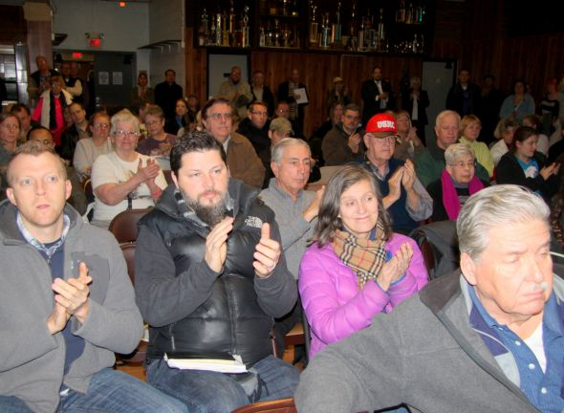
Community Empowerment
Raised Awareness
United Community and
Associations
Coalitions Formed
HIA Widely Distributed
Increased Communications
Notes:
The HIA was presented at several community meetings. The HIA validated our concerns about the negative impacts the facility would have on Morrell Park and surrounding communities, and because of that, it empowered us to have a stronger voice and gather momentum.
-
It helped raise awareness and united the community associations
Coalitions were formed with other communities and businesses
We increased communications and shared the HIA with CSX, MDOT State and City officials, other community associations and the press
Data, maps, results and recommendations from the HIA were used in our flyers, petition, letter and email campaign
The associations sent numerous requests to CSX and MDOT outlining their issues and concerns and called for a community wide meeting with CSX and MDOT to discuss the project in detail with the community, present studies on the impacts of the facility and answer our questions and concerns.
HIA was an important component in our lobbying efforts of the General Assembly and Baltimore Delegation

Slide 14
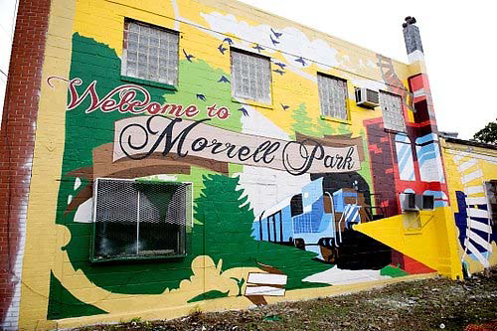
Lasting Impact
Successful Outcome
Community Involvement
Increased Association
Membership
Notes:
On August 28, 2014, the Maryland Department of Transportation (MDOT) announced that it had terminated its agreement with CSX to attempt relocation of the Baltimore Rail Intermodal Facility to Morrell Park and had pulled all state funding from the CSX project. Needless to say, the community was relieved to say the least.
There has been a lasting impact gained from the community’s participation in the HIA. Residents have been empowered by having their voices heard. Community involvement in promoting the health and safety of the neighborhood has increased as has membership in both Morrell Park associations.
We are endebted to NCHH for its interest in our community and for conducting the HIA—it has been invaluable to the community.

Slide 15
HIA and Community Engagement:
Community Member Perspectives
Thank you!
Questions?

