Slide 1
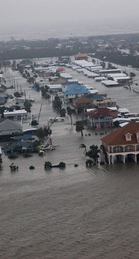
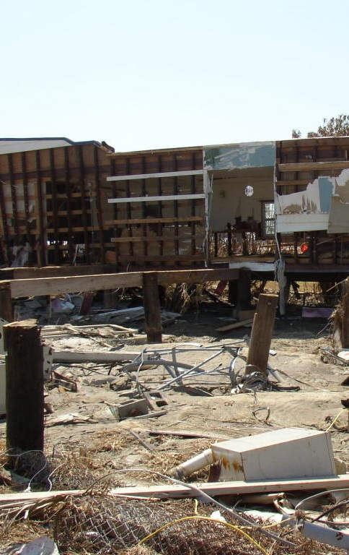
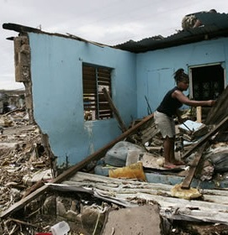
Improving Healthy Neighborhoods and Housing in Galveston, Texas
National HIA Meeting 2015
Jimmy Dills, MUP MPH
Georgia Health Policy Center
jdills@gsu.edu

Slide 2
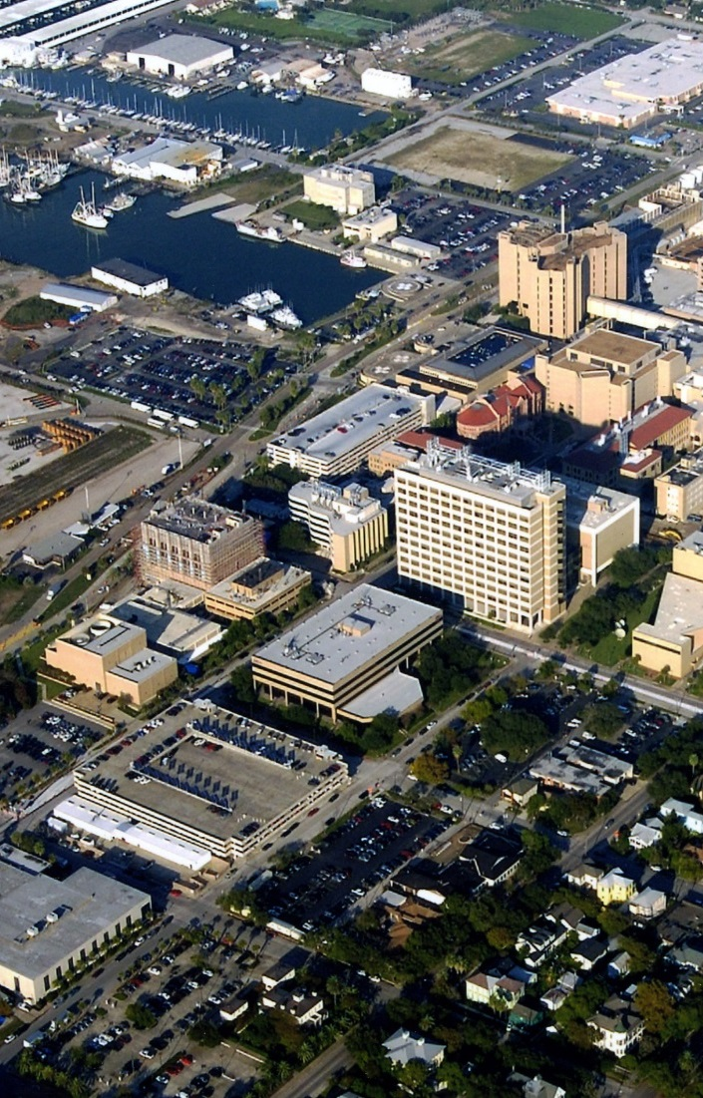
Acknowledgments
Research project developed at the request of the Galveston Housing Authority Board of Directors, and the State of Texas General Land Office
Conducted by the Georgia Health Policy Center and the Center to Eliminate Health Disparities at University of Texas Medical Branch in Galveston
Supported by a grant from the Health Impact Project, a collaboration of the Robert Wood Johnson Foundation and The Pew Charitable Trusts with funding from The Kresge Foundation

Slide 3
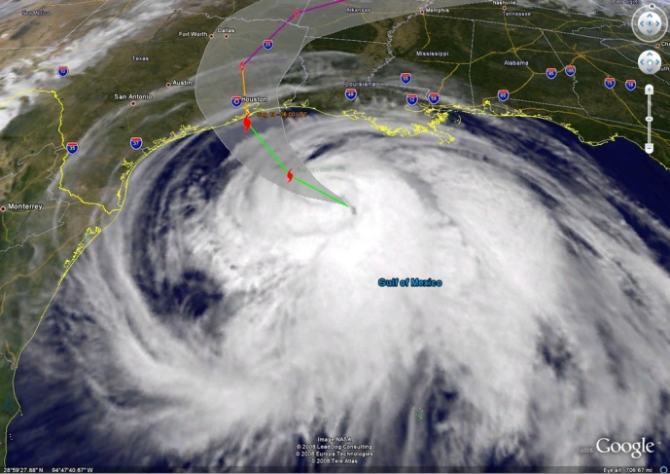
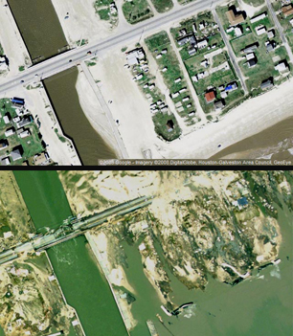
Background
Hurricane Ike hit Galveston, Texas, in 2008, damaging 75% of the housing and buildings on the Island, including 569 units of public housing.
Redevelopment was the subject of contentious city election and federal fair housing mandates.
The City of Galveston and Galveston Housing Authority agreed to rebuild some public housing through mixed-income developments
Texas General Land Office to oversee the development and management of additional scattered site housing units.

Slide 4
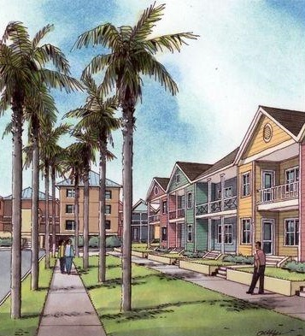
Purpose and key questions
Provide information related to healthy neighborhood environments, and strategies for enhancing the health of public housing residents and Galveston residents in general
Original research question:
  Which potential scattered site locations in the City of Galveston present the best options for supporting health for public housing residents?
Added research question:
  Which interventions related to the neighborhood-level built environment could most improve the health of City of Galveston residents?
Notes:
Including whether to build the housing

Slide 5
Stakeholders:
Community Steering Committee
Port of Galveston
Galveston Alliance of Island Neighborhoods
UTMB Community Health Network and Institute for the Medical Humanities
Gulf Coast Interfaith
Galveston Island Community Research Advisory Committee
NAACP
Galveston Island Restorative Justice Coalition
Sobriety High
City of Galveston City Council
St. Vincent’s House
Nia Cultural Center
First Baptist Church of Galveston
Galveston Housing Recovery Committee
LULAC
Galveston North Side Task Force
Galveston Chamber of Commerce
City of Galveston Department of Planning and Community Development
City of Galveston Families, Children and Youth Board
Galveston County Health District

Slide 6
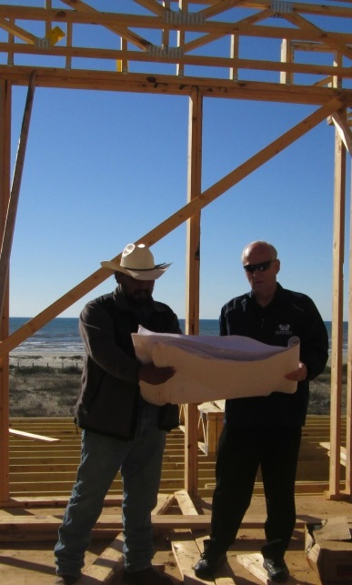
Demonstrating Value
Health and economic development reinforce each other:
  Healthy, thriving, desirable neighborhoods are critical to local economic development
  Equitable economic development tends to strengthen the health of neighborhoods
The qualities that make neighborhoods desirable largely overlap with health
Businesses play a significant role in shaping the health of communities
Indicators relate to quality of neighborhoods and quality of life
Notes:
REVIEW AGAINST LATER COMMENT
-support a participatory workforce
I will review this slide and add some data on ROI for community investments (see APHA video)

Slide 7
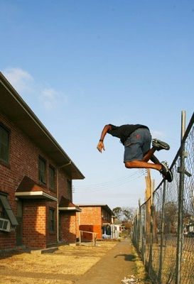
Demonstrating Value
Health District/UTMB/Health care providers: reduce readmissions, recurring problems and wasted health care resources; improve population health
North side task force: all these elements are relevant to the upcoming redevelopment plan for the North side neighborhood
Social justice advocates: moves neighborhoods toward more equitable structures and supports positive social exchange, better health, achievement of basic needs, etc.
Housing advocates: provides guided process for selecting and improving scattered sites to support health and well-being

Slide 8
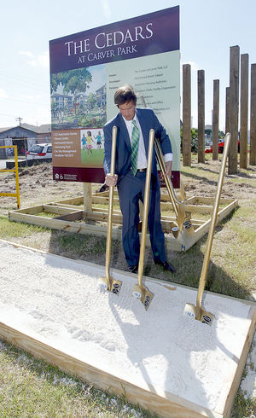
Demonstrating Value
City Officials and Planning Dept: can help prioritize infrastructure investments, either across city, or by district, or by intervention or health issue
Police Department: a number of interventions reduce violence and injuries, prevent crime; some indicators would help support dedication of police resources to high priority community issues, reduce need for “broken window” strategies, and improve community/police relations

Slide 9
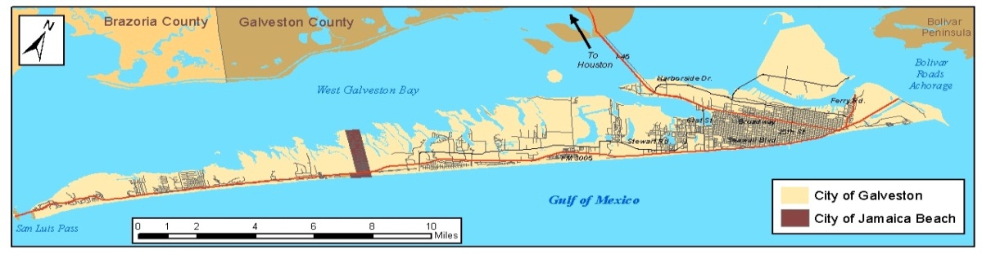

Methods
Analyzed secondary data within the Galveston city limits, Jamaica Beach, and Pelican Island.
Data were available at the point, parcel, census block, or census tract level
16 Neighborhood-level indicators reported at the census block level, using regression models to make census block estimations when only census tract data was available.
7 Block-level and Unit-level indicators recommended for primary data collection

Slide 10
Assessment Topics
Population density
Concentrated poverty
Segregation
Elevation above base flood level
Proximity to parks
Proximity to recreation facilities
Proximity to public elementary schools
Proximity to licensed childcare
Proximity to health care services
Proximity to affordable healthy food outlets and concentration of unhealthy food outlets
Concentration of businesses permitted to sell alcohol for off-site consumption
Presence of pedestrian safety measures
Proximity to truck routes
Proximity to industrial areas
Presence of environmental hazards
Proximity to bus route
Tree canopy
Sidewalk quality
Neighborhood disorder
Traffic calming
Resident pride and security
Lead exposure
Crime prevention through environmental design

Slide 11
Modeling Mitigations
Top 20%
Top 20%
Top 20%
Top 20%
Top 20%
All Blocks
Added Blocks
Top 40%
Threshold cumulative score
Set the Threshold
Broaden the Scope
Making the Best Better
Decrease Tolerance
All Blocks

Slide 12
Findings
Table 9. Top 20% Cut-Point Values in Galveston
Indicator | Top 20% Cut Point
Proximity to Truck Routes | 0.4 miles
Density of Alcohol Outlets | 2.26 outlets / 1,000 people
Proximity to Recreation Facilities | 2 miles
Table 10. Impact on number of high scoring census blocks if individual indicators are mitigated to 80th percentile level
Indicator | Number of Added Census blocks | Percent of Census blocks Added | Percent of Total Census blocks in Galveston
Proximity to Truck Routes | 192 | 55% | 31.0%
Density of Alcohol Outlets | 49 | 14% | 22.8%
Proximity to Recreation Facilities | 49 | 14% | 22.8%

Slide 13
Findings
Table 11: Impact of fully addressing various indicators in terms of general neighborhood development and health.
Indicator | Threshold | # of Census Blocks | Est. Population Living in These Blocks (2010 Census) | Percentage of Population (2010 Census – 47,743)
Not Near to Recreation Facilities | 1 mile | 933 | 30,425 | 63.7%
Have at Least 1 Alcohol Outlet (off-site consumption) Nearby | ¼ mile | 1,123 | 29,316 | 61.4%
Close to Truck & High Traffic Routes | 300 meters | 770 | 20,780 | 43.5%

Slide 14
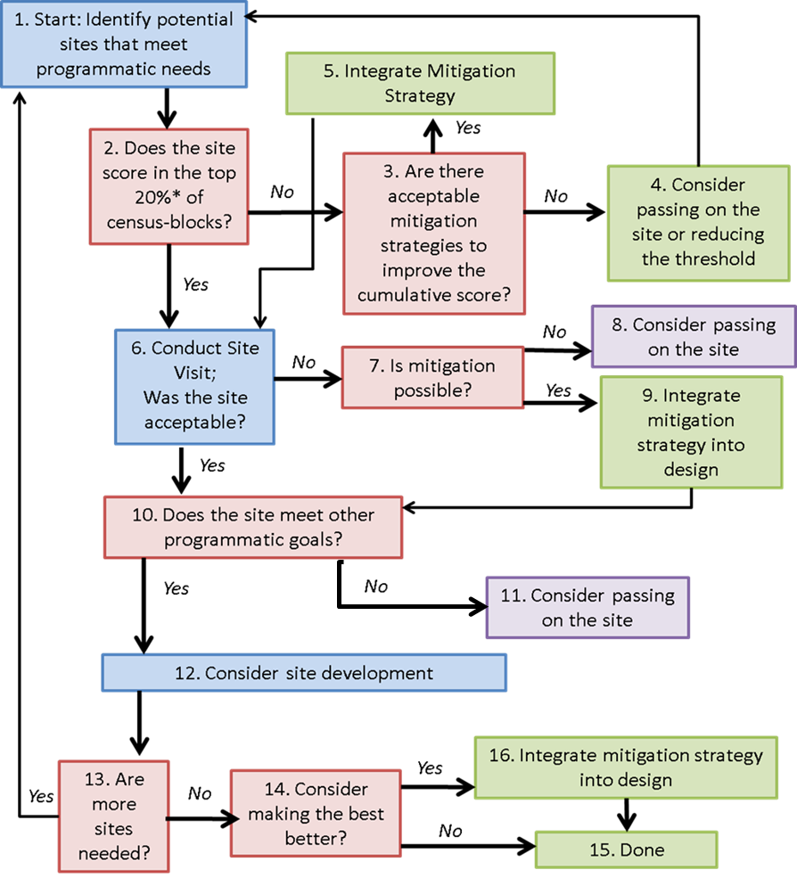
Recommendations
Follow an organized process for incorporating health impact profiles and specific plans to address negative health impacts through mitigation into the process for selecting scattered sites.
Conduct Block-level inspections.
Incorporate unit-level inspection standards related to lead exposure and crime prevention.
Evaluate the feasibility of unit-level health mitigations for sites that score poorly on specific indicators.

Slide 15
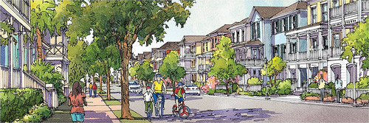
Impacts
GLO’s intention to incorporate the analysis and methodology into their scattered site selection process indicates a direct impact on future housing decisions.
Relationships developed between the members of the CSC and their increased awareness of connections between housing and community health point to a more subtle, but potentially far reaching, impact on the level of discourse on the topic in the Galveston community

Slide 16
Summary
High profile and contentious issue
HIA process as a way to build relationships and provide new perspectives
Demonstrating value to different stakeholders
Built a methodology based on health to be incorporated into housing decisions
Applicability beyond public housing

