Slide 1

HIA and State Policy Making: The Public Health Institute Model
Erin Marziale
Director of Network Engagement
June 18, 2015

Slide 2

What is a Public Health Institute?

Slide 3


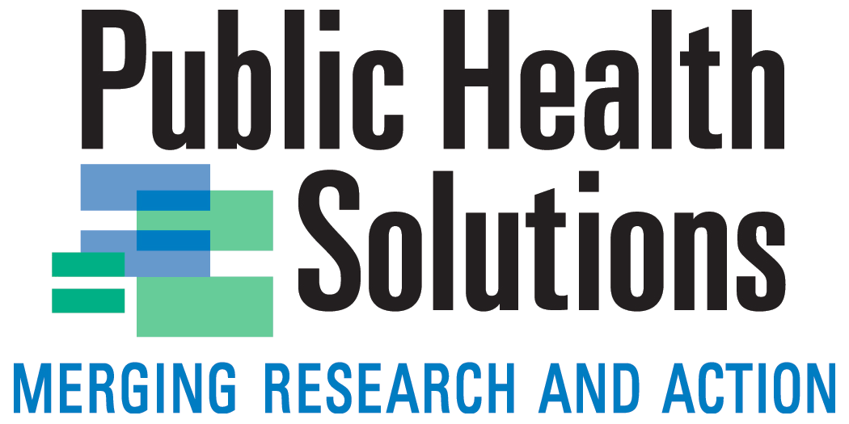
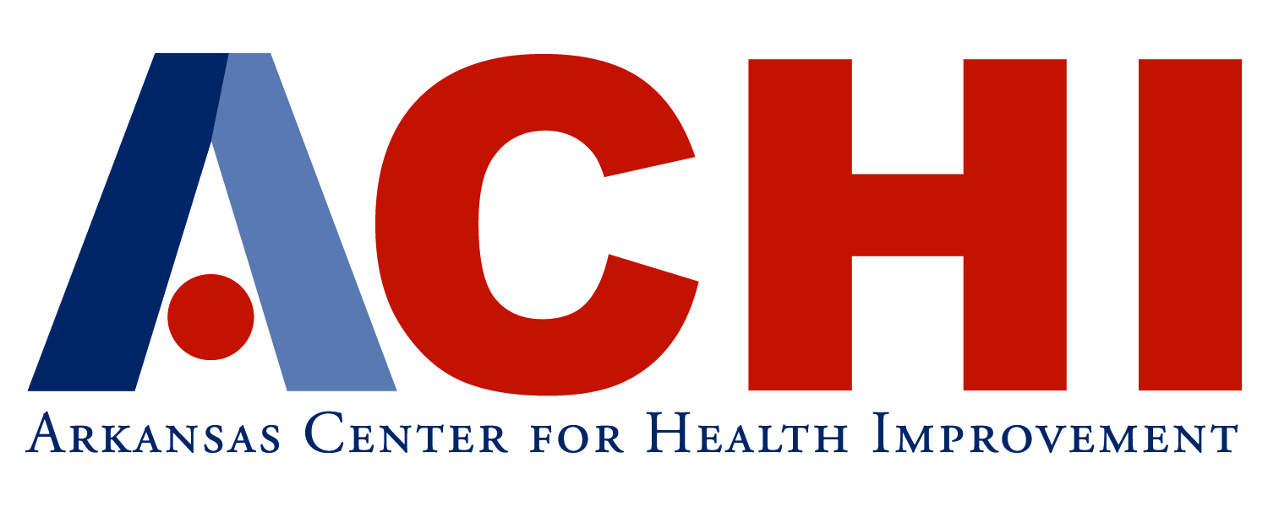
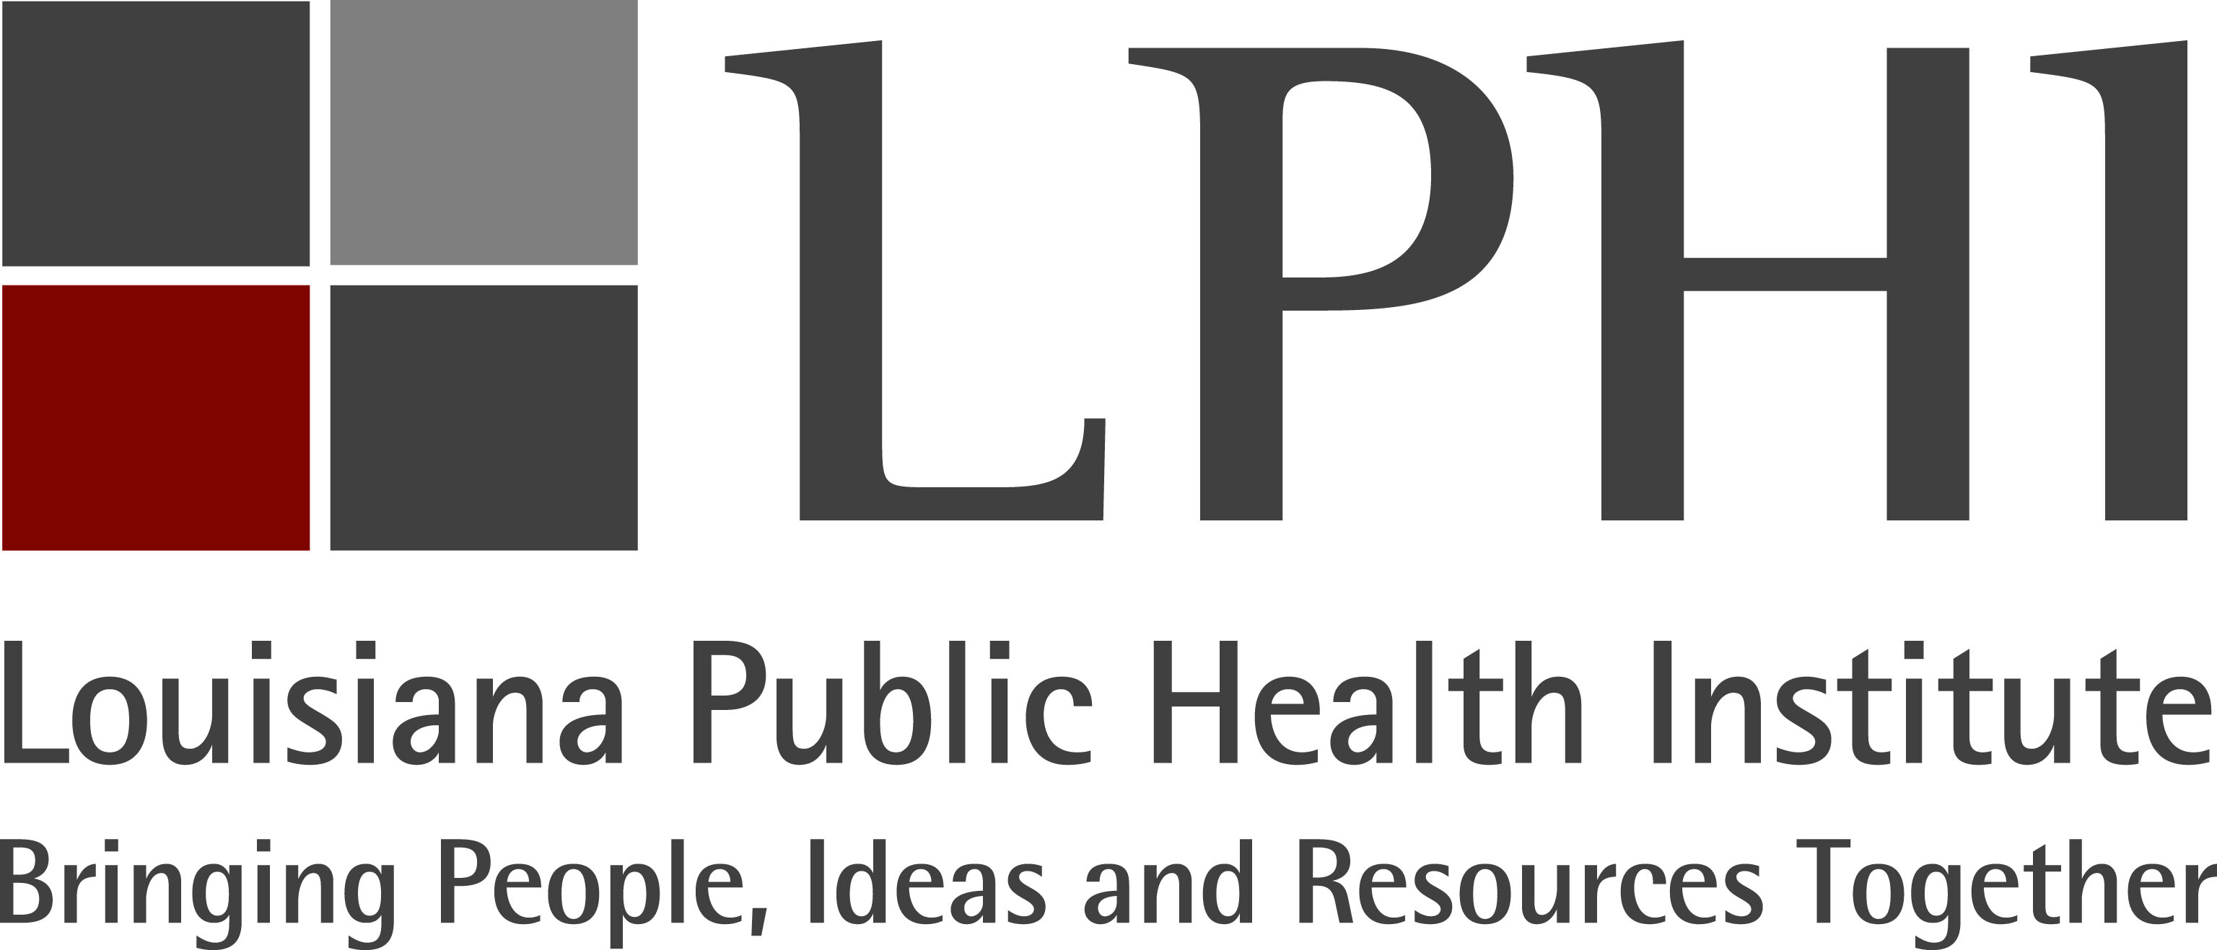
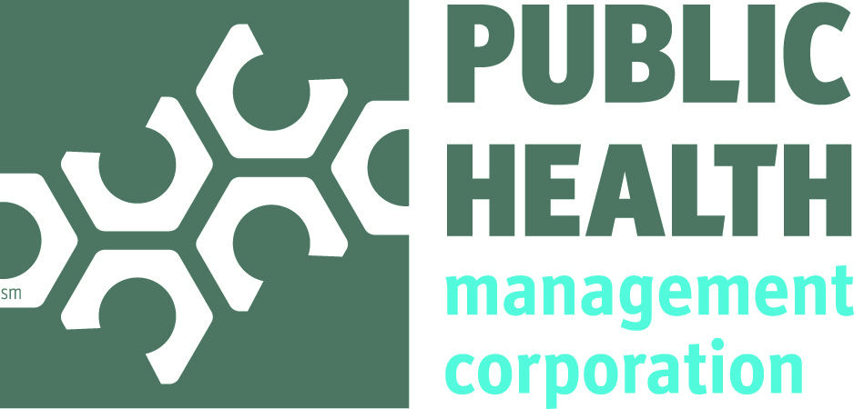
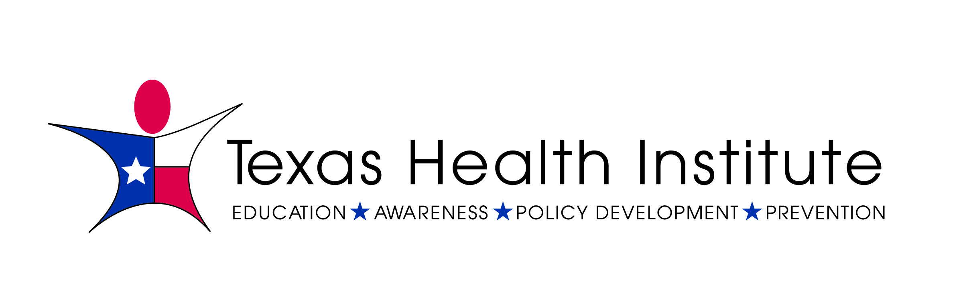







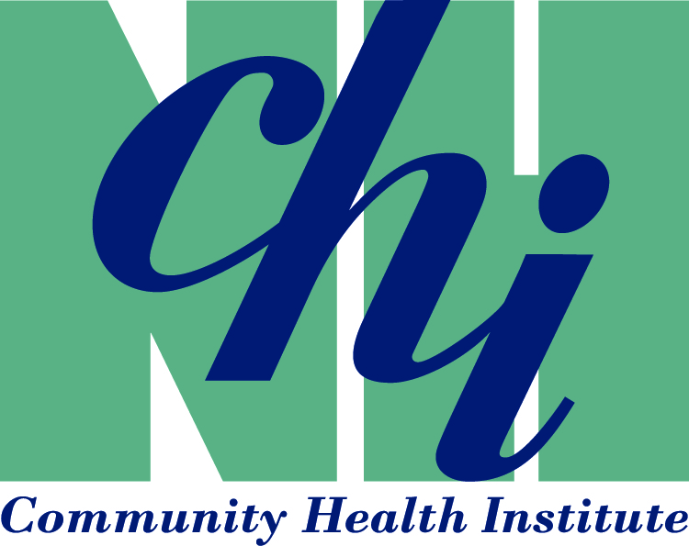










WHO ARE THESE PUBLIC HEALTH INSTITUTES…?
PUBLIC HEALTH INSTITUTES
Notes:
Public health institutes are nonprofit organizations that improve the public's health by fostering innovation, leveraging resources, and building partnerships across sectors, including government agencies, communities, the health care delivery system, media, and academia.

Slide 4
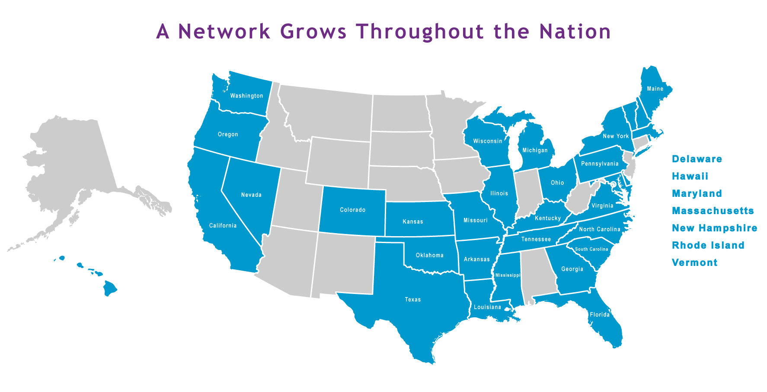
Notes:
PHIs of stability and added capacity at the state level. Hiring on behalf of state health department, design and manage programs, convene state-wide coalitions, bring new resources to the state. Offer institutional knowledge and a buffer from the changing political winds…

Slide 5

Here we go again…
Notes:
And speaking of changing political winds!
UWPHI example

Slide 6

Why Public Health Institutes?
GROWING RECOGNITION THAT PUBLIC HEALTH IS NOT THE EXCLUSIVE ROLE OF GOVERNMENT
INCREASED FOCUS ON INTERSECTORAL WORK TO ADDRESS SOCIAL DETERMINANTS OF HEALTH
GOVERNMENTS , FOUNDATIONS, AND OTHER ORGANIZATIONS REALIZE THEY CAN ENGAGE PHIs TO HELP THEM DO THINGS MORE EFFICIENTLY.
A. Move quickly with less bureaucracy
B. Hire staff
C. Give Voice
D. Build partnerships
E. Re-grant and manage subcontractors
F. Act as Fiscal Agent
Notes:
NEED TO FINISH SLIDE

Slide 7
PHI Capacity Survey
Survey was launched March 26th and closed around April 14
It was conducted using Qualtrics
Survey was sent to staff at each NNPHI member institute. When known, the survey was sent specifically to the HIA-related staff
Members were asked to select one representative to complete the survey
Received 26 responses total

Slide 8
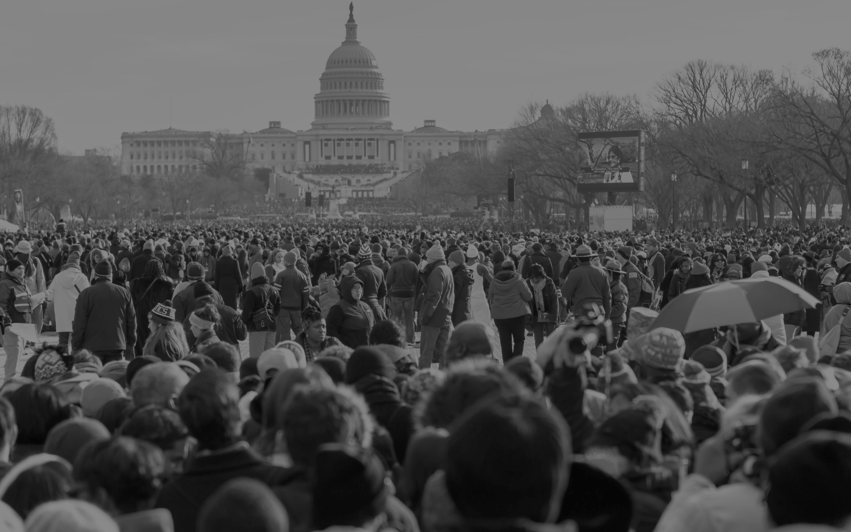
What we heard:
Value of HIA on the state level
“HIAs help people understand and commit to the idea that a policy might be affecting health”

Slide 9
What we heard:
Value of HIA on the state level
One interviewee explained that HIAs helped her engage in conversations about challenging issues with legislators or policymakers and those in areas traditionally considered non-health sectors. “This [the HIA] was a way to talk to them about something very concrete,” she said.

Slide 10


Key Findings
88% said their PHI incorporated HIA as an ongoing line of business
42%- Organization is involved in conducting/contributing to HIAs
27% - Organization has received training in HIA but has not conducted HIA
31% - Organization has not participated in training or HIA but is interested
0%- Organization is not interested in HIA
N= 26 (66% of NNPHI membership)
Notes:
Training to HIA tipping point: Funding and resources

Slide 11
Key Findings
Importance of authentic community engagement
Building bridges between sectors
“Neutrality”
Notes:
PHIs reported that an important benefit of the use of sound HIA methods is the advancement of authentic community engagement, which enhances community connectivity with other population health initiatives beyond the scope of individual HIAs. Nationally, PHI staff has supported the development of stakeholder engagement tools National Network of Public Health Institutes I www.nnphi.org I October 2014 10 and resources. PHI-designed trainings focus on community engagement as a theme throughout the HIA process, not just one or two steps, with practical strategies for authentic community engagement. 82% stated their HIA work has led to new partnerships, primarily with State/local health departments, community development corporations, advocacy organizations, local government, businesses and others.
PHIs have conducted HIAs primarily on the built environment and housing with a few related to agriculture and food, labor and employment, transportation and other topics. PHIs reported that there are several topics/sectors they are interested in or well-positioned to focus on for future HIAs, including agriculture and food, built environment, housing, physical activity, public services, transportation, education, climate change, labor and employment and others such as corrections
3. Generally, PHIs fall across a spectrum of education and advocacy as it relates to public health practice. Some PHIs have a hired lobbyist on staff while others frame their role as education for policy makers, rather than advocacy. One interviewee shared, “In all our work we are focused on systems and policy . . . our whole orientation is towards this kind of work and having the tools that help us move policy in a positive direction towards better public health.” Another interviewee shared, “We convene taskforces and committees and help groups of varied stakeholders come to conclusions about what the solutions are by facilitating conversation and providing information. The resulting recommendations may be published by our organization, but we do not do advocacy – we let the recommendations speak for themselves and many of our partners are advocacy-oriented organizations. This dynamic makes HIA a perfect fit for our organization because it’s about getting people together to hear all voices, gather data and, evidence and facilitate an advisory committee in coming to recommendations.”

Slide 12

Lessons Learned 1. Scoping 2. Funding 3. Politics 4. HIA as one tool
Notes:
Scoping is often the most time consuming and financially challenging step, especially for beginning HIA practitioners. PHIs shared that they overreached on the geographic focus for the HIA (e.g., one or two neighborhoods versus whole city) and analytical boundaries, such as selecting too many areas to research within their assessment process. The ability of an organization to effectively scope the projects had dramatic impact on their success and financial viability.
Funding and resources to conduct HIAs are generally still a challenge for the field. While there are some promising models for mandating HIA in legislation or creating Health in All Policies task forces at the state or regional level that are charged with on-going HIA practice, funding for HIA is still highly variable from state to state and current public health practice struggles to fully provide resources for HIA. Among PHIs that have conducted HIA, respondents were asked how the HIAs were primarily funded. Grants from a non-profit foundation (e.g. Health Impact Project, California Endowment or Kresge) was the most common (70%), followed by NNPHI-funded (which is technically either from the CDC or Health Impact Project) (50%), Client fee for service (40%, which is likely from grant-funded HIAs on which the PHI was a sub-contractor), Grant from federal agency (e.g., CDC, HUD) (30%) and self-funded (20%). A common sentiment was that the lack of a steady stream of available funding inhibited the HIA process, specifically in developing expertise, staff and partnerships. Smaller agencies are unable to dedicate core staff positions to this, because of their inability to accurately predict funding streams. Interviewees suggested that a more sustainable and productive model would be to provide core support for organizations so that they could provide technical assistance for agencies who would like to utilize HIA as a tool, but don’t have the staff or the financial resources to implement the process.
Political resistance or complexity is often seen as a barrier to completing successful HIAs. Some decision-makers or stakeholders may not view HIA as an accepted methodology or may be opposed to applying the tool to a specific topic because of a lack of political will. Challenges may also arise when developing partnerships and engaging community members for a particular HIA. Many interviewees discussed the need to understand the political culture and context, as well as the implication of HIAs on policy decision points.
HIA is not the right tool for every decision making process. “It’s a tool. The bigger and more important work is Health in All Policies and applying right tool at the right time. Sometimes that’s HIA and sometimes it might not be.” As the field of HIA has evolved, many practitioners have begun to explore HIA 2.0 - how the tools, processes and resources within the steps of HIA can be utilized individually to support health in decision making without conducting a full HIA. NNPHI member, Public Health Institute, manages the state of California’s Health in All Policies task force. This task force has created a mechanism for high-level policy makers to incorporate health as an integrated consideration of new policy, program or project development.

Slide 13
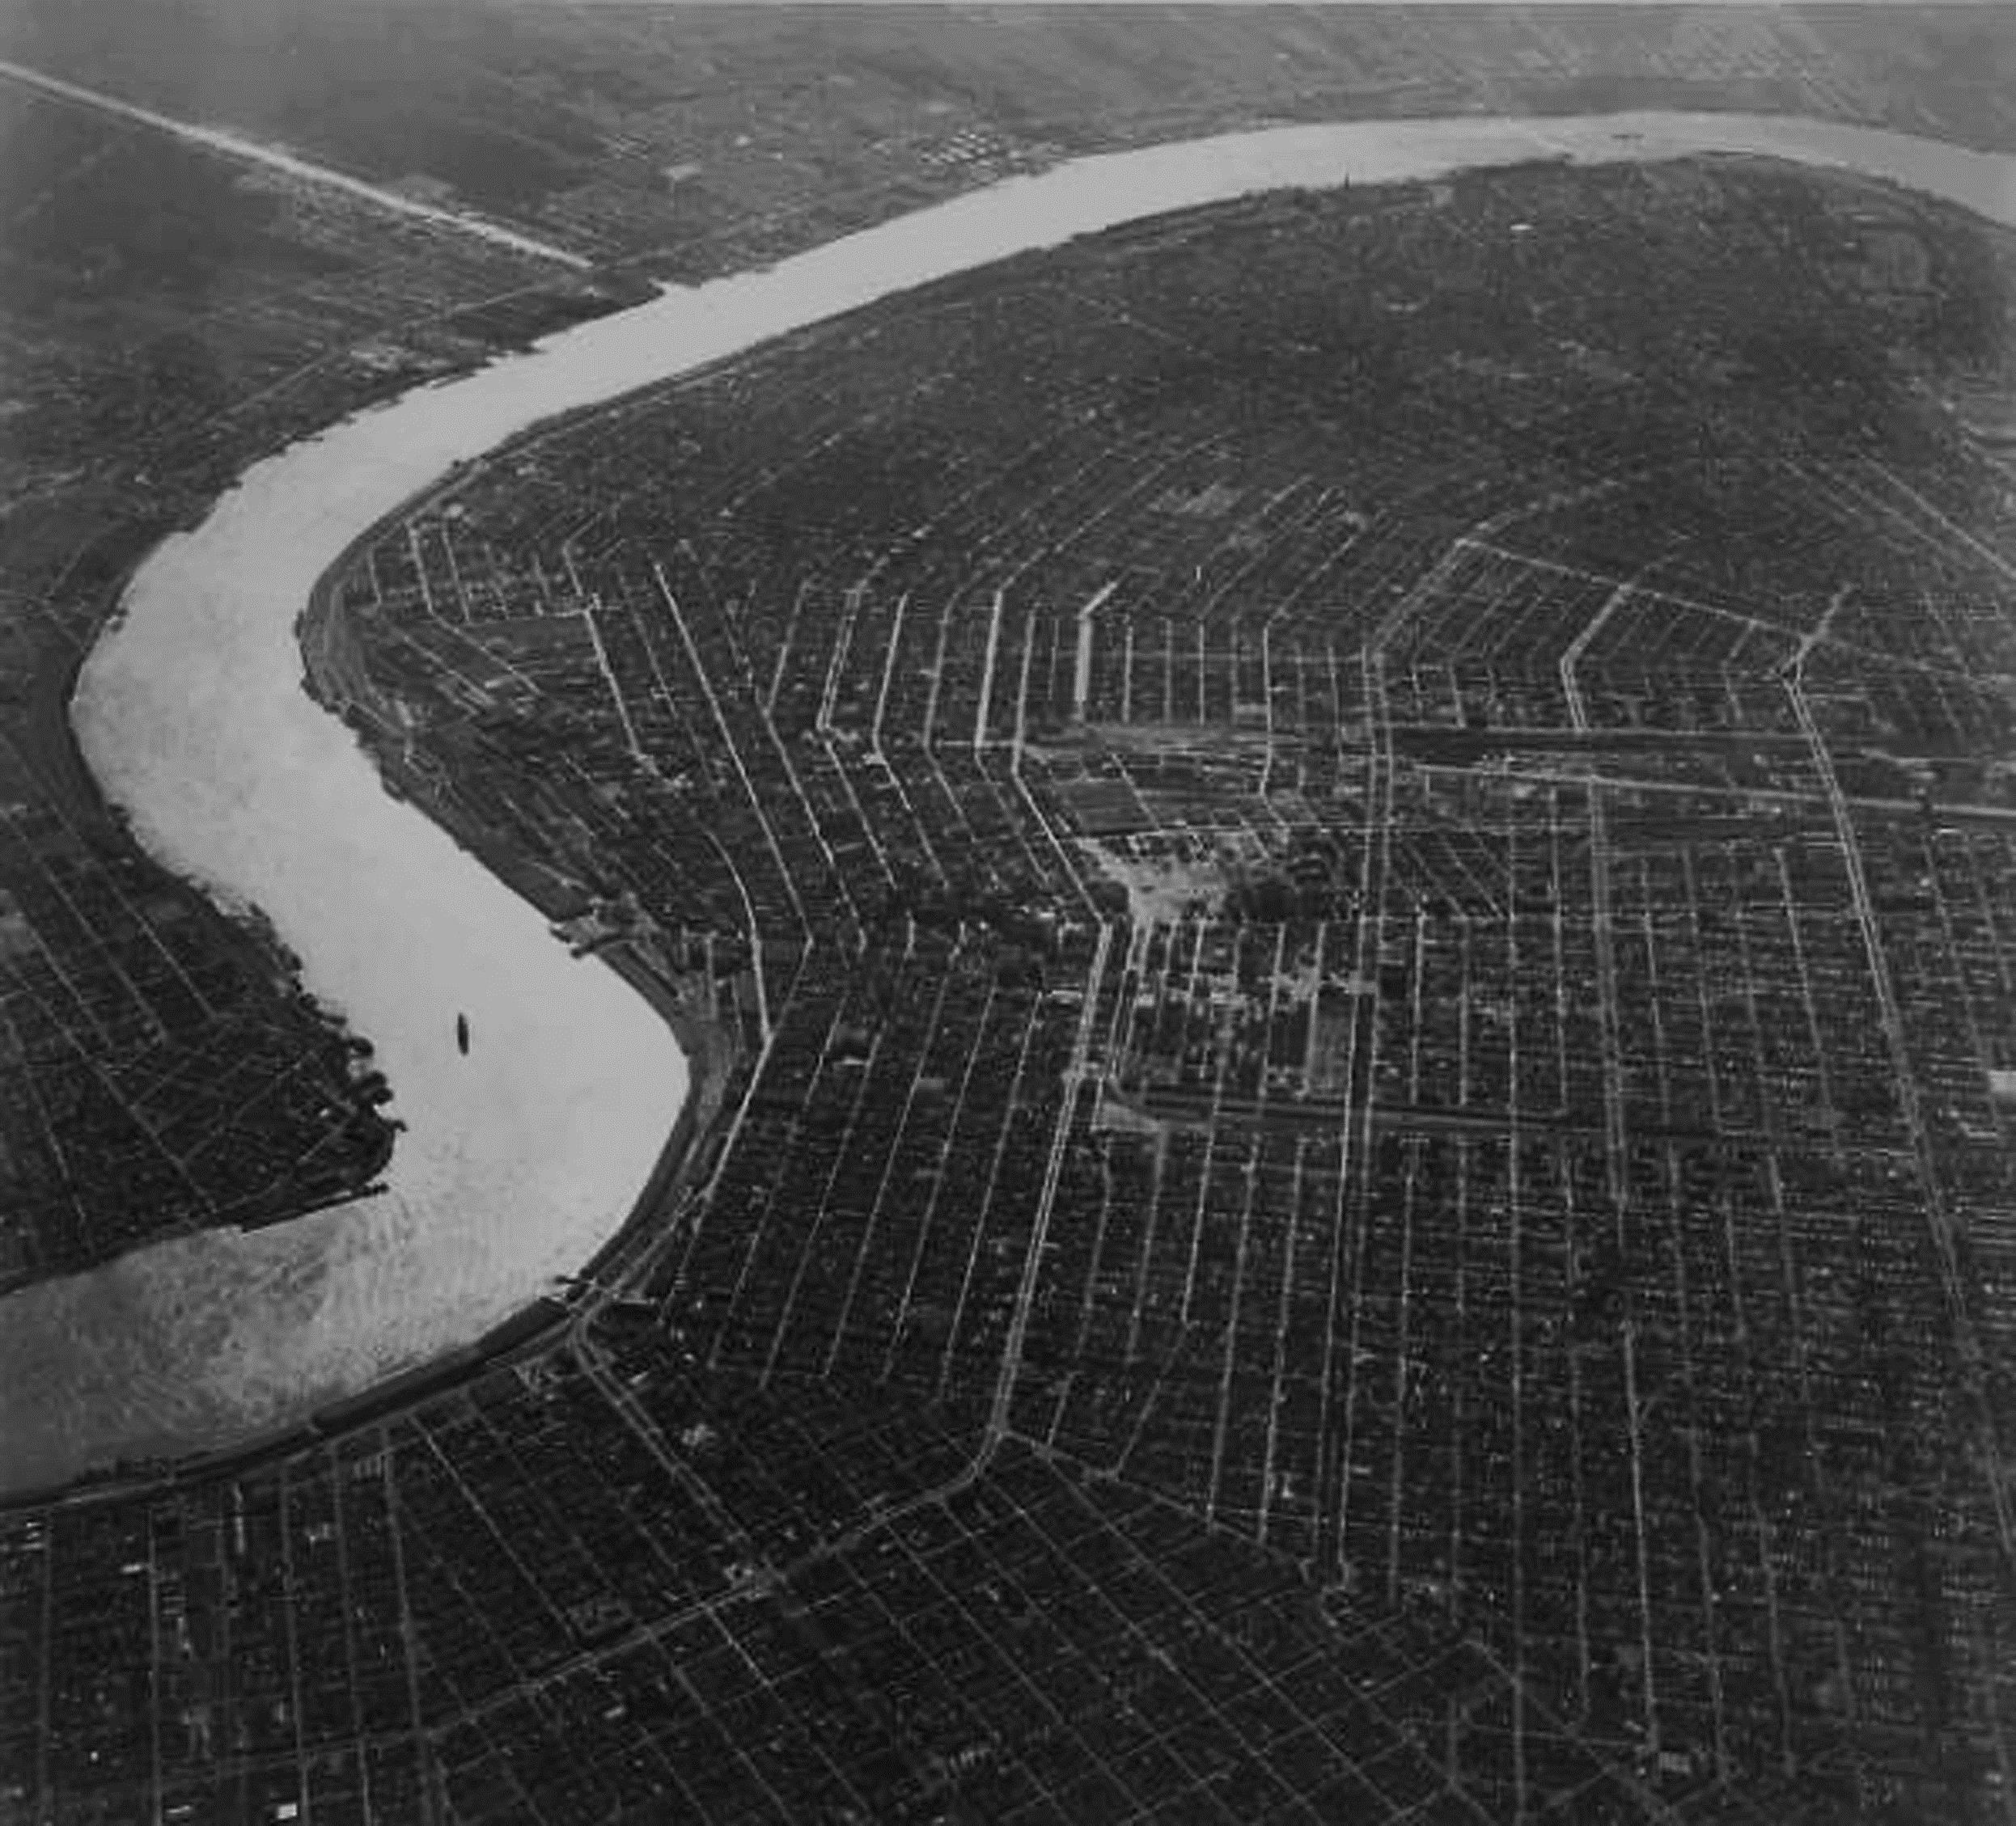

nnphi.org
emarziale@nnphi.org
New Orleans Office
1515 Poydras St., Suite 1490
New Orleans, LA 70112
888.99.NNPHI
Erin Marziale
Director, Network Enagement
Washington, DC Office
1300 Connecticut Ave, NW, Suite 510
Washington, DC 20036
@NNPHI_ORG

