Slide 1
Addressing Equity Analysis and Community Engagement at the Federal Level:
Environmental Justice Strategies, Lessons from the Field, and Opportunities for Advancement
2015 National Health Impact Assessment Meeting
June 17th, 2015
Sally Pope, CSS-Dynamac c/o U.S. EPA
The views expressed in this presentation are those of the author[s] and do not necessarily reflect the views or policies of the U.S. Environmental Protection Agency.
Notes:
Welcome
Introductions:
Sally Pope- Public Health Specialist with CSS-Dynamac, contracted with the EPA
Jonathan Keller- Co-Director of Human Impact Partners
& Florence Fulk of the EPA who is the Task Lead in the Sustainable and Healthy Communities Research program at the EPA
Quick overview of our HIA work at the EPA:
4 Case studies: 2 almost completed, 2 in the early stages of HIA.
Wrapping up 2 HIA case studies, 1 in Springfield, Massachusetts on renovations to improve environmental conditions in an elementary school & a 2nd in Atlanta Georgia on a green infrastructure project & its impacts on water quality. We have two more currently in progress, a scale-up of the Atlanta, GA green infrastructure project to the watershed level & a 2nd in Suffolk County, NY on proposed changes to onsite sewage disposal systems.
Report: A Review of HIAs in the US: EPA performed a review of 81 HIAs from the U.S. to get a clear picture of how HIAs are being implemented nationally and to identify potential areas for improving the HIA community of practice.
HIA Resource and Tool Compilation: a comprehensive list of HIA tools & resources
Report: HIA as a tool to promote environmental justice & equity at the federal level

Slide 2
HIA can inform federal decision-making processes and support environmental justice (EJ) requirements through equity analyses and community engagement
Notes:
I have been working under Flo primarily focusing on assisting the EPA in determining how to integrate HIA at the federal level, as well as supporting the other HIA activities we have going on. What I’m going to talk about today- how HIA can inform federal decision-making processes and support EJ requirements through equity analyses and community engagement- comes from the information gathered from a report we have in progress on HIA as a tool to promote equity & EJ at the federal level.

Slide 3
EJ Requirements in Federal Decision-Making
Executive Order 12898 “Federal Actions to Address Environmental Justice in Minority Populations and Low-Income Populations”
Federal Agency EJ Guidance
Notes:
There are 3 main vehicles for environmental justice requirements in federal decision-making.
This is a quick list, on which I am about to go into more detail, on federal-level EJ requirements in federal decision-making processes. These are:
Executive Order 12898 “Federal Actions to Address Environmental Justice in Minority and Low-Income Populations”
Federal Agency EJ Guidance documents developed to guide federal agencies on including environmental justice in their processes.

Slide 4
Executive Order 12898: EJ in Federal Actions
Executive Order 12898 (1994)
  Directs all federal agencies to identify and address disproportionate high and adverse human health and environmental effects of their actions on minority and low-income populations (MLI)
  Requires the consideration of EJ in all proposed federal actions subject to the National Environmental Policy Act of 1969 (NEPA)
  Presidential Memorandum
Executive Order No. 12898, 3 C.F.R. 7629. 1994.
Notes:
Executive Order 12898 issued by President Clinton in 1994 & set the standard/ requirement for EJ at the Federal level
Directs all federal agencies to identify and address disproportionate high and adverse human health and environmental effects of their actions on minority and low-income populations.
This emphasis on the disproportionate distribution of impacts & how they affect these populations really embeds equity, in one way, as a federal requirement
Requires the consideration of EJ in all proposed federal actions subject to NEPA (which is most federal action)
NEPA created the EPA and mandated environmental impact assessment at the federal level, also known as the NEPA process or environmental impact statement process, which essentially assesses all federal agency actions deemed to have significant environmental impacts as a result of the proposed action and to develop reasonable alternatives.
It is important to emphasize that health is explicitly addressed in the objectives and regulations of NEPA & in the Council on Environmental Quality (the group established within the Executive Office of the President by Congress to oversee the implementation of NEPA) guidelines for implementing NEPA, it defines the “Direct,” “Indirect,” and “Cumulative” effects to be considered in EIS as including “health”
Since this EO 12898 was issued, the consideration of EJ issues was required in all EISs
Presidential Memorandum: further emphasized the importance of using the NEPA process to promote EJ by directing federal agencies to analyze effects on MLI populations.

Slide 5
Federal Agency EJ Guidance
Executive Order 12898 directs each federal agency to develop a strategy for implementing EJ
  Develop agency-wide EJ strategy, including non-NEPA related decision-making processes and activities, to meet requirements
  Federal agencies’ each have their own guidance documents for incorporating EJ into NEPA process
  CEQ’s Environmental Justice Guidance Under the National Environmental Policy Act
Notes:
Executive Order 12898 directs each federal agency to develop a strategy for implementing EJ
Develop agency-wide EJ strategy, including non-NEPA related decision-making processes and activities (including programs & policies), to meet requirements
Strategies are updated as needed by each federal agency
Federal agencies’ each have their own guidance documents for incorporating EJ into NEPA process
CEQ- EJ Guidance Under NEPA
Provides federal-wide guidance on meeting EJ requirements in the NEPA process

Slide 6
EJ in NEPA: Council on Environmental Quality (CEQ) EJ Guidelines
Phase of NEPA Process | Opportunities/ Strategies
Scoping | Identify MLI populations; develop effective public involvement strategy; solicit participation from diverse groups of the public
Public Participation | Early and meaningful; must try to eliminate barriers for the participation of MLI populations through adaptive or innovative approaches, if necessary
Determining the Affected Environment | Define geographic scale; use demographic data to determine geographic distribution by race, ethnicity, and income; data on different patterns of living should be gathered for analysis
Analysis | Analyze how environmental and health effects are distributed throughout the affected community; include qualitative and quantitative data gathered through public participation; use language the public can easily understand
Council on Environmental Quality. 1997b, December. Environmental Justice: Guidance Under the National Environmental Policy Act. Washington, DC: Council on Environmental Quality.
Notes:
The CEQ’s EJ guidance outlined opportunities and strategies for the consideration of EJ in the various phases of the NEPA process. I don’t have time to go into these in detail, but highlights include:
Identifying MLI populations
Having early & meaningful public participation by developing a participation strategy & working to eliminate participation barriers for MLI populations
Defining the geographic scale & distribution of impacts by race, ethnicity, & income
Analyzing the distribution of environmental & health effects & using qualitative data from public participation

Slide 7
EJ in NEPA: Council on Environmental Quality (CEQ) EJ Guidelines
Phase of NEPA Process | Opportunities/ Strategies
Alternatives | Encourage community members likely to experience disproportionate adverse effects to help develop and comment on alternatives
Record of Decision | Disproportionate effects should be weighed in alternative selection; effective dissemination of EJ concerns to the public
Mitigation | Elicit views of affected populations on measures to mitigate disproportionately high and adverse health or environmental impacts on MLI populations; consider community views in development of mitigation measures
Council on Environmental Quality. 1997b, December. Environmental Justice: Guidance Under the National Environmental Policy Act. Washington, DC: Council on Environmental Quality.
Notes:
(Highlights continued):
Using public participation to develop & receives comment on alternatives
Listening to affected communities’ views on developing mitigation measures that address disproportionately high & adverse health or environmental impacts on MLI populations
Note: Health is specifically mentioned twice in the CEQ EJ Guidelines– in the analysis phase, in terms of analyzing health effects on the affected community & in the mitigation phase through eliciting the views of affected populations on mitigation measures that address disproportionately high and adverse health effects.
Research shows that health is often analyzed narrowly or, more often than not, not at all in the NEPA process

Slide 8
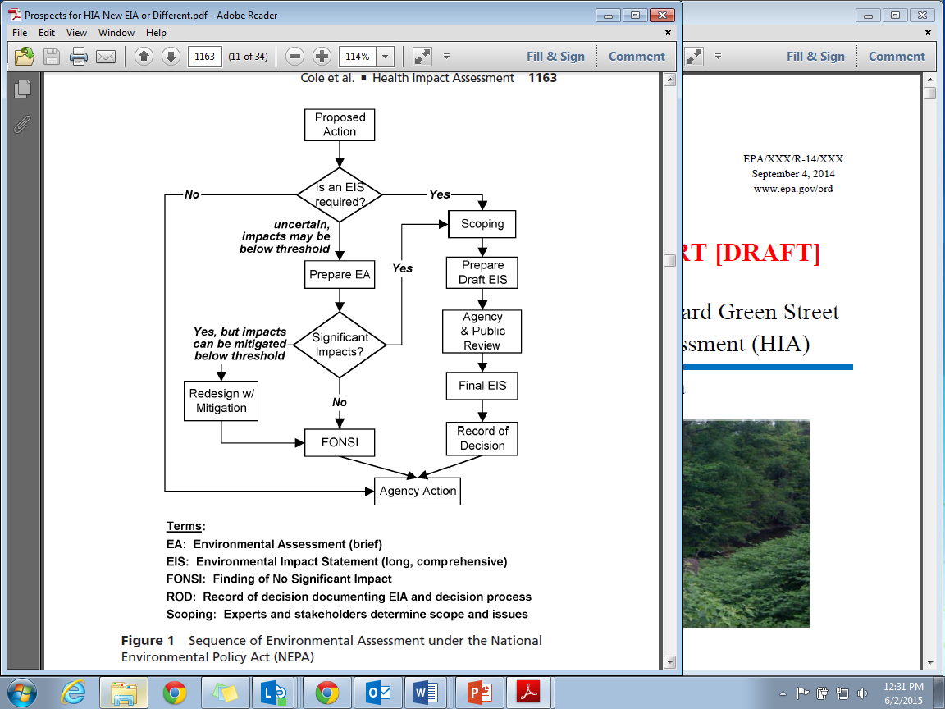
EJ in NEPA: Community Engagement
Three points of required community engagement in the NEPA process
Collaborate with public to identify issues
Minimum 45-day public comment period
Cole, B., Wilhelm, M., Long, P., Fielding, J., Kominski, G., and Morgenstern, H. 2004. Prospects for health impact assessment in the United States: new and improved environmental impact assessment or something different?. Journal of Health Politics, Policy and Law, 29(6), 1153-1186.
Minimum 30-day public comment period
Notes:
Community engagement was already built into the NEPA process (before EO 12898) in the CEQ’s Regulations for Implementing the Procedural Provisions of NEPA.
There are three required points of community engagement in the NEPA process
At the beginning of the process- Scoping
After the release of the draft EIS for a minimum 45-day comment period from which all substantive public comments must be included in the final EIS
After the release of the final EIS for a minimum 30-day comment period

Slide 9
HIA has been identified as a tool that can support federal EJ requirements
Notes:
Despite these guidance documents, agencies still face uncertainty as to how to adequately incorporate EJ into decision-making processes. HIA has been identified as a tool that can help to address these federal EJ requirements. HIA’s core values– equity, democracy, transparency, and a comprehensive assessment of health– support the principles of EJ. HIA also provides a more comprehensive assessment of human health impacts than is not typically seen in EISs, even in the EJ sections. Reviews of EISs have shown that human health effects are either not considered at all or they are only assessed very narrowly, using a biomedical approach that looks at one exposure to one contaminant resulting in one health outcome. Human health effects are rarely comprehensively assessed considering health disparities and social determinants of health.
The remainder of the presentation will cover HIAs conducted as a part of the NEPA process, i.e. HIAs that involved federal agencies. Jonathan will cover other federal HIAs in his presentation, such as HIAs that assess federal actions.

Slide 10
Federal Agency HIAs under NEPA
Federal HIAs | Federal Agencies | Federal Action | Location | Pub Date
Northeast NPR-A Supplemental EIS | BLM | Plan | Alaska | 2007
OCS Oil and Gas Leasing Program: 2007-2012 FEIS | BOEM | Program | Alaska | 2007
Red Dog Mine Extension Aqqaluk Project Final Supplemental EIS | EPA,USACE, NPS, CDC, ATSDR | Project | Alaska | 2009
Chukchi Sea Planning Area FEIS | BOEM | Plan | Alaska | 2010
Point Thomson Project EIS | USACE | Project | Alaska | 2011
Effects of Oil and Gas Activities in the Arctic Ocean Supplemental DEIS | NOAA, BOEM | Program | Alaska | 2013
EIS for Roca Honda Mine | USFS | Plan | New Mexico | 2013
Notes:
In the review conducted by EPA of HIAs at the federal level, there were 7 federal HIAs identified (out of 17 HIAs identified as having been completed or are currently in progress involving federal agencies) identified that were conducted as part of the NEPA process. They were all conducted in conjunction with the EIS for each action and were either included in the EIS, informed the health section of the EIS, or were included as an Appendix to the EIS.
The first integrated HIA/EIA was conducted in 2007
Most took place in Alaska- and it’s important to note that the EJ (MLI) populations in these HIAs/EISs were largely Native Alaskan and tribal populations & were largely the focus of assessment

Slide 11
Strategies in Federal NEPA-related HIAs to Meet EJ Requirements
  Identification of MLI populations
    Followed CEQ Guidelines for identifying MLI populations
    One HIA further identified “potentially affected communities” based on the likelihood of significant health impacts in those communities
    Community Engagement
      Representative “cooperating agencies”
      Community input included as qualitative data in assessment
      Community meetings held during the 3 points of public input in the NEPA process
Notes:
Most of the federal HIAs conducted as part of the NEPA process were rapid HIAs, so there was not the rigor in data analysis of a comprehensive HIA, but there were a number of strategies used in these HIAs to meet EJ requirements.
Identification of MLI populations
Followed CEQ Guidelines for identifying minority and low-income populations
The minority or low-income population of the affected area exceeds 50%; or
The minority or low-income population percentage of the affected area is greater than the minority population percentage in the general population or other appropriate unit of geographic analysis
One HIA further identified “potentially affected communities” based on the likelihood of significant health impacts in those communities.- within the vulnerable area identified in the EIS EJ section
Community Engagement
Representative local and regional “cooperating agencies” that the vulnerable groups felt would properly represent their concerns. participated from start to finish on the HIA/EIS
Community input was included as qualitative data in the assessment and sometimes included public testimony from previous federal actions
Community meetings were held during the three points of public input in the NEPA process

Slide 12
Strategies in Federal NEPA-related HIAs to Meet EJ Requirements
Assessment Methods
  Community input included as qualitative data
  Established the baseline health status and existing conditions for the affected community and MLI populations
  Analyzed the distribution of potential health effects across identified MLI populations with comparison groups
  Cross-referencing between the EJ and health sections in the EIS
  Risk characterization
  Mitigation Measures
    Recommend health and subsistence monitoring tracking
    Includes collaboration with local and Tribal groups on health monitoring activities
Notes:
Again, the seven Federal HIAs performed as part of the NEPA process did not conduct any new data collection, statistical assessment, or modelling as part of the Assessment. Existing data was used as well as public input.
To meet EJ requirements in Assessment:
Community input was included as qualitative data
The baseline health status and existing conditions for identified vulnerable groups were established and compared against local, state, and national conditions
The distribution of potential health effects was analyzed across identified vulnerable groups
There were cross-references between the EJ and health sections in the EIS
Risk characterization- looking at the distribution (geographic/population), direction & extent of impact, & likelihood (Point Thomson HIA) of impact
Some methodologies employed in developing mitigation measures included:
Recommendations for health and subsistence monitoring tracking
Collaboration with local and Tribal groups on health monitoring activities

Slide 13
Potential for HIA in Federal Decision-Making
Including HIA or HIA-like elements supports federal EJ requirements by:
  Identifying MLI populations
  Assessing the distribution of adverse and beneficial health effects across all groups
  Increasing community engagement and community capacity building
  Additional benefits include:
  Fulfilling NEPA requirements to assess human health impacts
  Fulfilling Executive Order 12898 requirements to identify and address human health impacts
Notes:
Including HIA or HIA-like elements supports federal EJ requirements by:
Identifying vulnerable groups- both those vulnerable to environmental impacts and health impacts
Assessing the distribution of adverse and beneficial health effects across all groups-
Increasing community engagement and community capacity building. Extensive community capacity building has been achieved in HIAs and there is the potential to build that same capacity in the federal decision-making process
Additional benefits include meeting NEPA & Executive Order 12898 requirements for identifying & addressing human health impacts
Considering that both NEPA and EO 12898 call for the assessment of human health impacts, HIA can help to meet those needs, as well as federal EJ requirements. HIA can:
Fulfill the NEPA requirements to assess human health impacts. As research shows, health is often left out or not comprehensively assessed in NEPA, although the CEQ Guidelines clearly state that the direct, indirect, and cumulative health effects should be considered. NEPA & EO 12898 focus on adverse impacts, but sticking to the principles and guidelines of HIA, both adverse and beneficial impacts would be assessed and could be communicated to the community
Fulfill Executive Order 12898 requirements to identify and address human health impacts

Slide 14
Question:
What other strategies or opportunities can you identify for the use of equity analyses and community engagement in federal HIAs to meet EJ requirements?
Notes:
Possible discussion points:
Conduct more comprehensive statistical analyses of the potential health impacts of each alternative in an integrated HIA/EIA.
Include more in-depth qualitative data collection & assessment, collaborating with community partners and/or members for data collection & analysis & placing a special focus on vulnerable groups.
Try to get leaders from affected communities to participate in the HIA as a representative voice for the needs of the affected community, be sure to include representatives of special vulnerable groups.
For a more comprehensive assessment, conduct modelling when possible to analyze the potential distribution of health impacts.
Like we heard Jonathan talk about in his presentation, for national-level assessments partner up with agencies in representative cities or communities- and here some of the methods Flo talked about could be used to locate these areas- to gather qualitative and quantitative data.

Slide 15
Thank You!
Florence Fulk
U.S. Environmental Protection Agency
fulk.florence@epa.gov
Jonathan Heller
Human Impact Partners
jch@humanimpact.org
Sally Pope
CSS-Dynamac c/o U.S. Environmental Protection Agency
pope.sally@epa.gov

