Slide 1

GIS and HIA in Cuyahoga County
Ann Stahlheber, MS, RD, LD – Cuyahoga County Board of Health

Slide 2
Use of GIS in the
Euclid TLCI HIA
Completed in 2013 –Board of Health awarded NACCHO HIA Mentorship

Slide 3
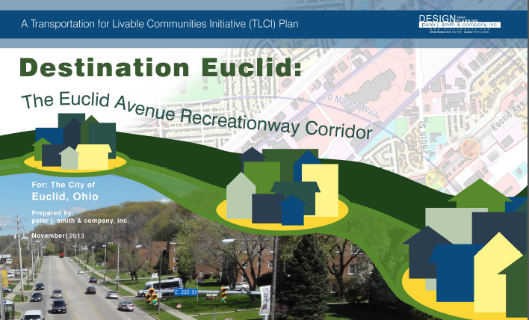
Euclid TLCI
Focus on City of Euclid Transportation for Livable Communities Plan
Transportation planning project for key intersections of the 4 mile stretch of Euclid Avenue in Euclid, Ohio
HIA Mentor – Ingham County Health Dept., Michigan

Slide 4
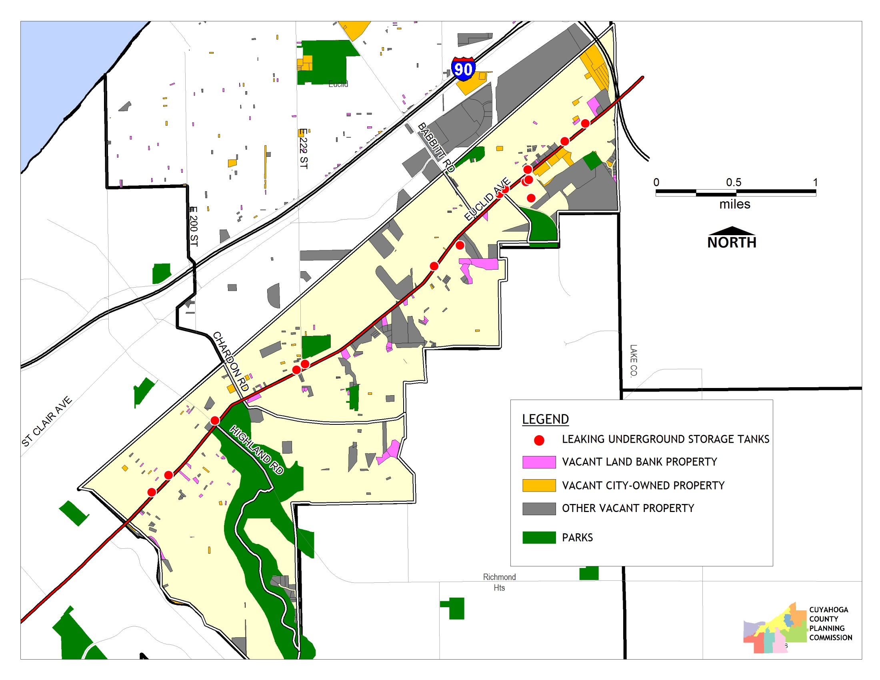
Notes:
Our HIA focus areas included vacant property, food access, and water quality. These determinants were selected from a larger list, based on community input from the first community meeting about the TLCI. Safety and Physical activity are also impacted from this plan, but were not selected since the purpose of the plan is to improve safety and increase active transportation (the benefits are already highlighted). The HIA focused on things that seemed to be both important and not apparent in the TLCI proposal.

Slide 5
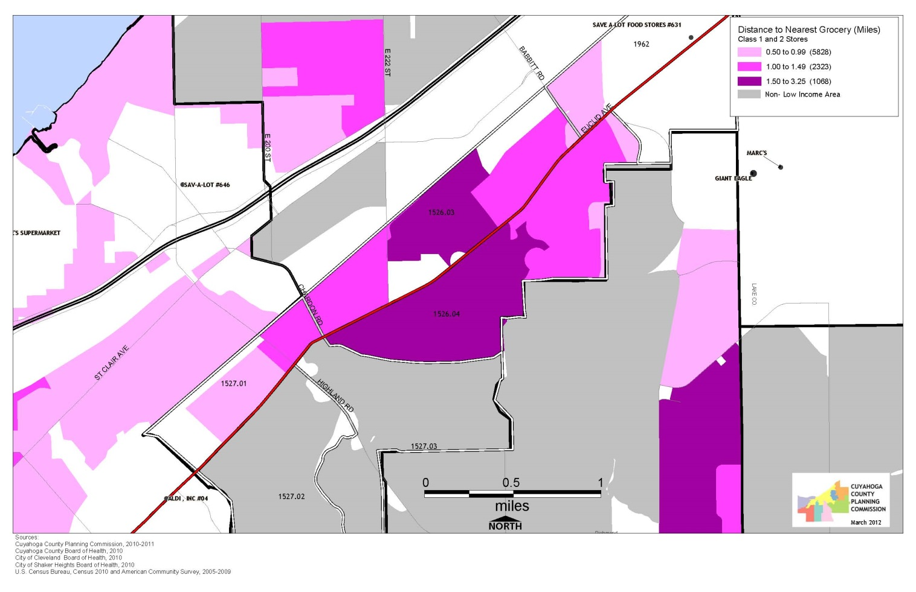

Slide 6
Euclid TLCI HIA Outcomes
Euclid city planning staff are part of the NEO HIA-P
City of Euclid leaders are now spokespeople for HIA, active transportation, and healthy food access
Northeast Ohio Area wide Coordinating Agency (NOACA) added HIA Screening into their TLCI grant applications starting in FY 2014
Euclid is currently partnering on the Eastside Greenway HIA.
Notes:
Challenges include:
Changing the mindset of partners

Slide 7


Use of GIS in the EastSide Greenway HIA
Completion in 2015bert Wood Johnson Foundation and the PEW Charitable Trusts, with funding from the Saint Luke’s Foundation.
Program grant supported by a grant from the Health Impact Project, a collaboration of the Robert Wood Johnson Foundation and the PEW Charitable Trusts, with funding from the Saint Luke’s Foundation.

Slide 8
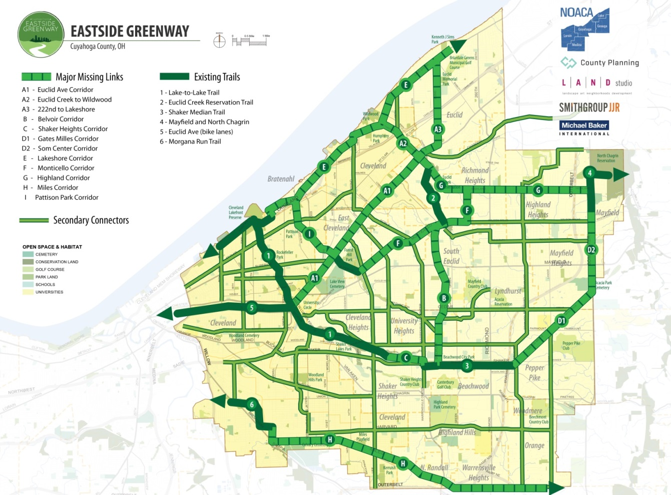
the Eastside Greenway Plan
The Eastside Greenway plan seeks to connect the east side of Cleveland with 18 Greater Cleveland municipalities through a unified trail network that will link neighborhoods to employment centers, transit and existing green spaces.

Slide 9
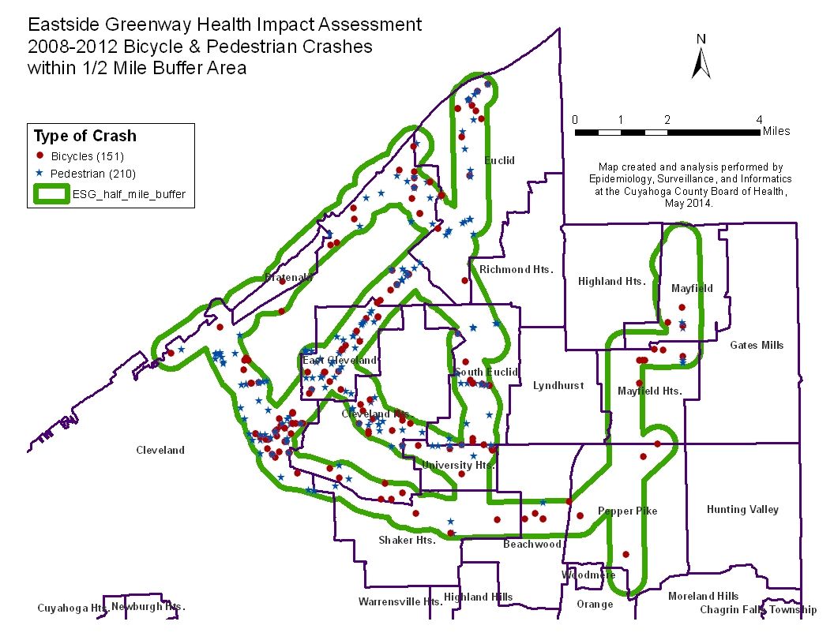
Notes:
The health focus areas include Crime/Fear of Crime, Social Cohesion, Transportation,
Physical Activity/Safety with Health Equity as a cross cutting focus.

Slide 10
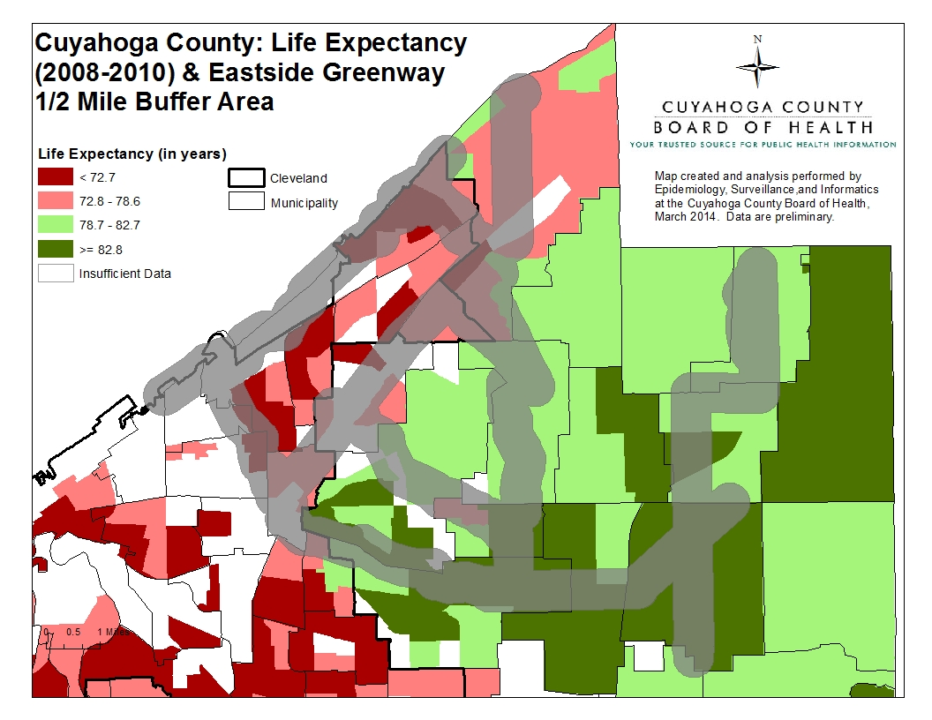
Notes:
Example of data that supports inequities in the very large eastside greenway study area and need to understand these differences in order to maximize opportunities for people to use the network.
Preliminary data from CCBH (census tract level) …close to 21 year difference in life expectancy between the lowest and highest life expectancies (Euclid)….more importantly see several areas where life expectancy disparities are greater than 10years with lowest concentrated in urban core.

Slide 11
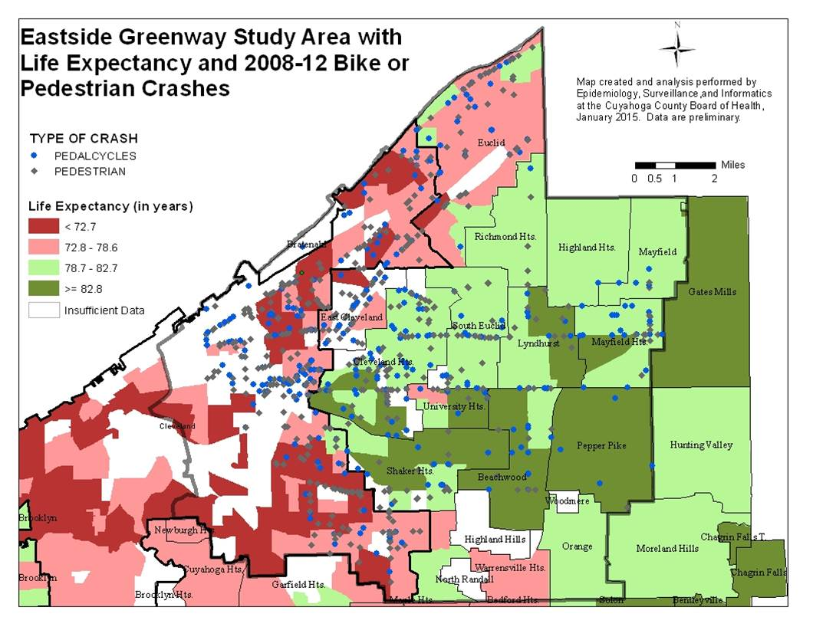

Slide 12
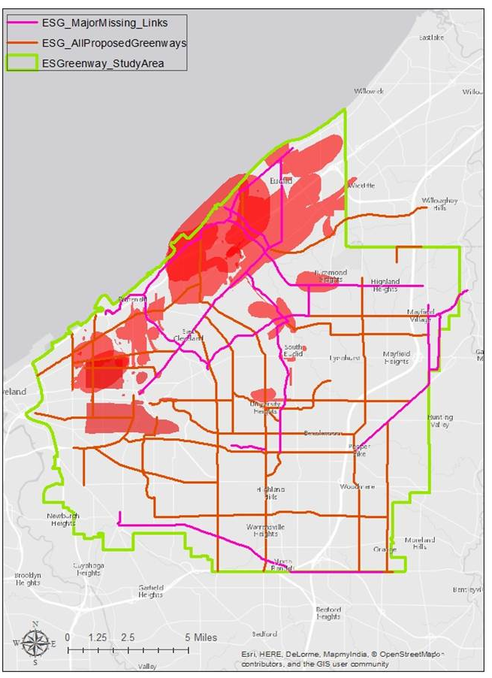


Survey Participants: Spatial Pattern of “Unsafe Spaces” by Neighborhood
Contact: Jacqueline W. Curtis, Ph.D.
jmills30@kent.edu

Slide 13
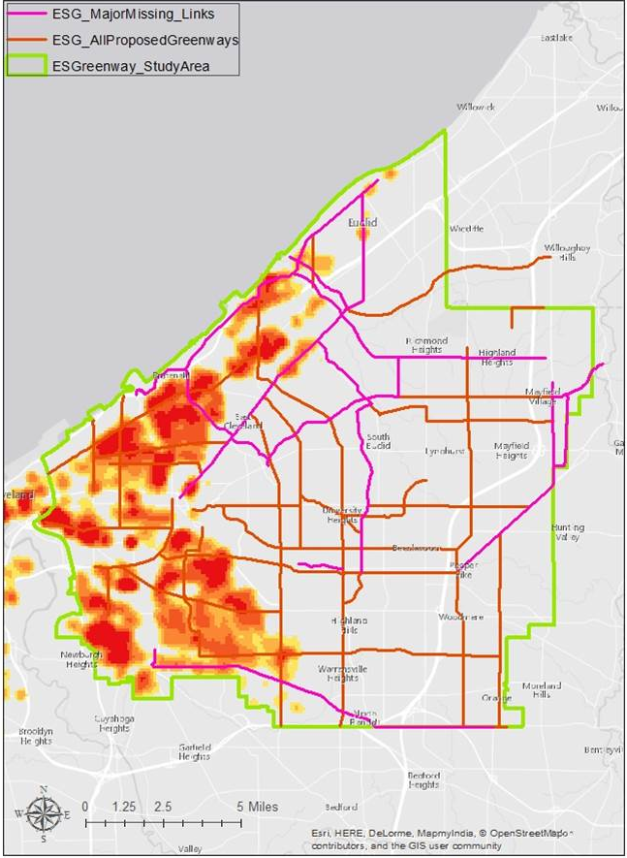
Actual Violent Crime Hotspots
Contact: Jacqueline W. Curtis, Ph.D.
jmills30@kent.edu

Slide 14
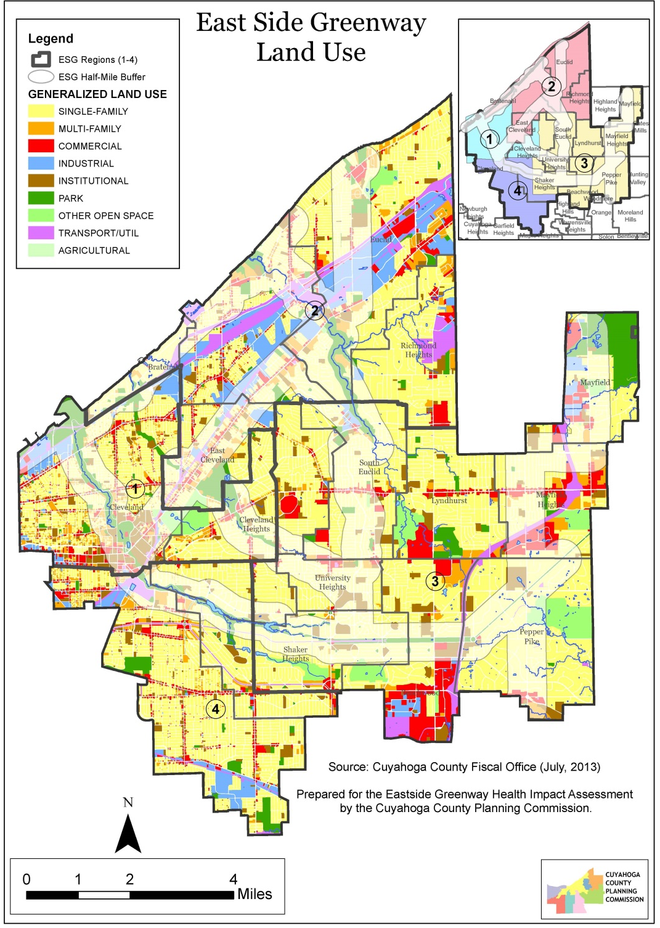
Land Use map of ESG area
Notes:
Will mention the recommendations related to the life expectancy, two crime maps, and Land Use map (physical activity-transportation) from the HIA.

Slide 15
Thank you
Ann Stahlheber, M.S., R.D., L.D.
216-201-2001 x1544
astahlheber@ccbh.net
http://neohiap.org

