Slide 1


Lessons learned from 5 Years of Oregon’s HIA Capacity Building Program
Notes:
HIA National Meeting 2015 Washington DC
Title: Lessons learned from 5 years of local HIA capacity building
The Oregon Health Authority’s HIA Program is working toward an Oregon where human health and health disparity impacts are actively considered in projects, policies, and plans across sectors. To forward that effort, the HIA Program conducts HIAs on statewide and multi-county decisions. Because many built environment decisions are made at the local level, the HIA Program also works to develop local public health department capacity to conduct HIAs on decisions within their jurisdictions. To ensure successful projects, the HIA Program provides free support through webinars, in-person trainings, and limited technical assistance. The HIA Program also opens an RFP for funding and technical assistance to support two or three local projects each year. Since 2009, the HIA Program has funded or conducted 18 HIAs on transportation, housing, land use, and sustainable energy development. The session will cover lessons learned and best practices for guiding new practitioners through rapid HIAs, ensuring local relevance and ownership of HIA products, and developing and strengthening relationships between local public health professionals and their colleagues in land use, transportation, education, and housing. The session will also highlight demonstrated impacts from five years of local health department HIAs in Oregon.

Slide 2

Oregon HIA Program HIAs
School Biomass Boiler HIA (2011)
Wind Energy Development HIA (2013)
Climate Smart Communities Scenarios HIA (2013)
Community Climate Choices HIA (2014)
Climate Smart Strategy HIA (2014)
Notes:
Draw from statewide HIA experiences
Guide local
We’ve trained more than 1000 Oregonians, including representatives from 32 county local health districts and one tribal government health department
Four two-day in person HIA 101 trainings
Nine HIA-specific HIA trainings
A 5-part series HIA 101 webinar series
HIA and Climate Change training for experienced HIA practitioners
And reached an additional 450 public health professionals at local and national presentations
More than 500 community members have been engaged on the Wind Energy in Oregon HIA

Slide 3
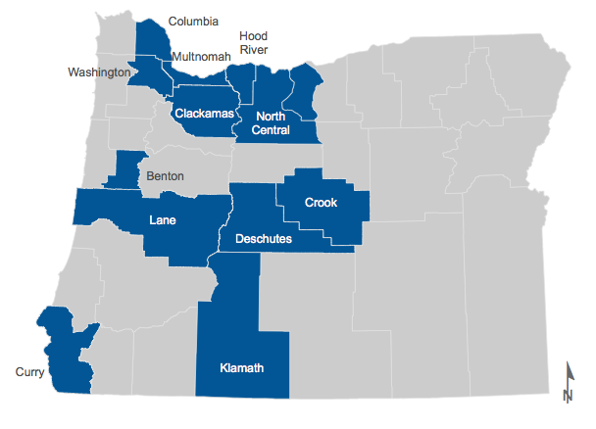
HIA In Oregon
Notes:
This map shows counties where HIAs have taken place in Oregon. There have also been several statewide HIAs. Let’s look at a couple of examples.
We’ve trained more than 1000 Oregonians, including representatives from 32 county local health districts and one tribal government health department
Four two-day in person HIA 101 trainings
Nine HIA-specific HIA trainings
A 5-part series HIA 101 webinar series
HIA and Climate Change training for experienced HIA practitioners
And reached an additional 450 public health professionals at local and national presentations
More than 500 community members have been engaged on the Wind Energy in Oregon HIA

Slide 4
Deschutes County's HIA on a chapter of the Deschutes County Comprehensive Plan 2010-2030 (2010)
Crook County's Pedestrian and Bicycle Safety HIA (2011)
Benton County HIA on Accessory Dwelling Units (2010)
Hood River County's Barrett Park Property HIA (2011)
Benton County Roundabout HIA (2012)
Washington County Bicycle and Pedestrian Facility Design HIA (2012)
Curry County Housing Stock Upgrade Initiative (2013)
Benton County Intermediate HIA: Traffic Speed on Third St., South Corvallis (2013)
Clackamas County Road Safety Audit HIA (2014)
Lane County HIA of the Eugene/Springfield Affordable Housing Strategic Plan (2014)
Washington County Augusta Lane Bicycle and Pedestrian Bridge HIA (2014)
Rainier Veteran’s Way and Hwy 30 Crossing HIA (2015, in process)
Klamath County Tobacco Retail License HIA (2015, in process)
Central Lane Climate Scenario Planning HIA (2015, in process)
Notes:
We’ve trained more than 1000 Oregonians, including representatives from 32 county local health districts and one tribal government health department
Four two-day in person HIA 101 trainings
Nine HIA-specific HIA trainings
A 5-part series HIA 101 webinar series
HIA and Climate Change training for experienced HIA practitioners
And reached an additional 450 public health professionals at local and national presentations
More than 500 community members have been engaged on the Wind Energy in Oregon HIA

Slide 5
September RFP released
October HIA 101 Webinar
November Applications due
December Decisions announced
January County projects begin
February Existing conditions report and capacity-building plan due, OHA site visits
March Final scoping plan due, including engagement
April, May OHA assessment support
June Draft assessment report doe
July Recommendations development
August Final reports submitted to OHA, lessons learned reports from counties
Small grants program
Notes:
Train before they apply (we insist that everyone go through
Take the time to engage decision-makers in project screening (Washington County), even if it means rescreening (it’s in our interest for locals to do this, even if it changes the project we’ve funded substantially)
Ensure step-by-step that the work is getting done, there are no mistakes, the county has resources necessary to do the work
Learning how to use the HIA framework takes resources, including time, training, and technical support
Be ready to rescreen, making sure to include decision-makers
Provide a clear timetable for conducting the HIA
Do a scoping training in person, including stakeholders. Use this time to frame things in social/environmental determinants of health (provides language for practitioners, and understanding for non-health partners)
Require interim reports (to catch problems/errors with the assessment (Hood River), and to ensure the report gets done
(Note about Curry, I have previously used this as an example of why an HIA report isn’t necessary, because Annette’s presentation was so powerful that it did it’s job, but now Annette’s gone and the HIA report is still being used to explain the need for funding for quality affordable housing.
We require a capacity-building report, where counties must explain who’s doing what, and also how the health department will present the materials internally.

Slide 6
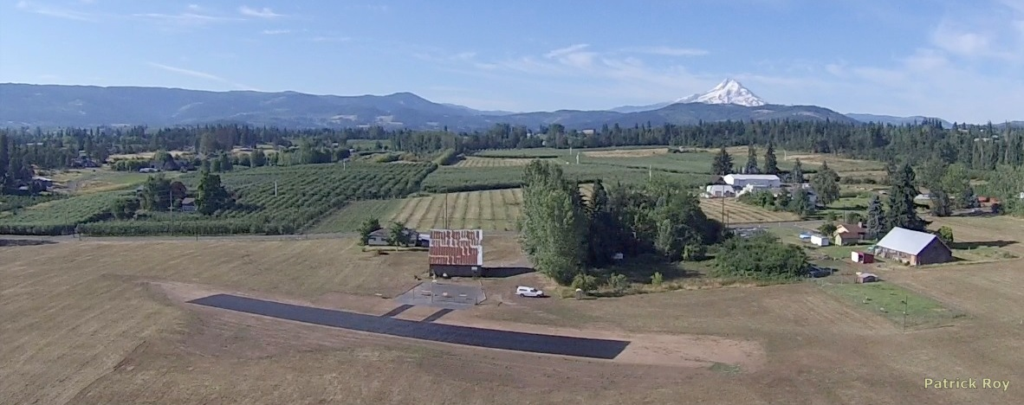
Hood River County Barrett Park HIA
Notes:
Hood River Parks and Recs’s Barrett Park property is a great example of the usefulness of assessment review. An early draft of the report revealed that the assessment team had determined that there was no risk from the likely heavy metal contamination on the former commercial orchard, and that the site would be an excellent location for a community garden. When our toxicologist reviewed the report, it was clear from initial testing that the site was not safe for gardening. The report was revised to recommend clean up, and prior to that, uses compatible with the contamination (no disturbing of the soil). Since then Columbia Gorge Aeromodelers (CGA) has been using the site for radio controlled aircraft. The site allows provides parking and access to an extended hiking trail that runs along one side of the property.
Be ready to rescreen, making sure to include decision-makers
Provide a clear timetable for conducting the HIA
Do a scoping training in person, including stakeholders. Use this time to frame things in social/environmental determinants of health (provides language for practitioners, and understanding for non-health partners)
Require interim reports (to catch problems/errors with the assessment (Hood River), and to ensure the report gets done
(Note about Curry, I have previously used this as an example of why an HIA report isn’t necessary, because Annette’s presentation was so powerful that it did it’s job, but now Annette’s gone and the HIA report is still being used to explain the need for funding for quality affordable housing.
We require a capacity-building report, where counties must explain who’s doing what, and also how the health department will present the materials internally.

Slide 7
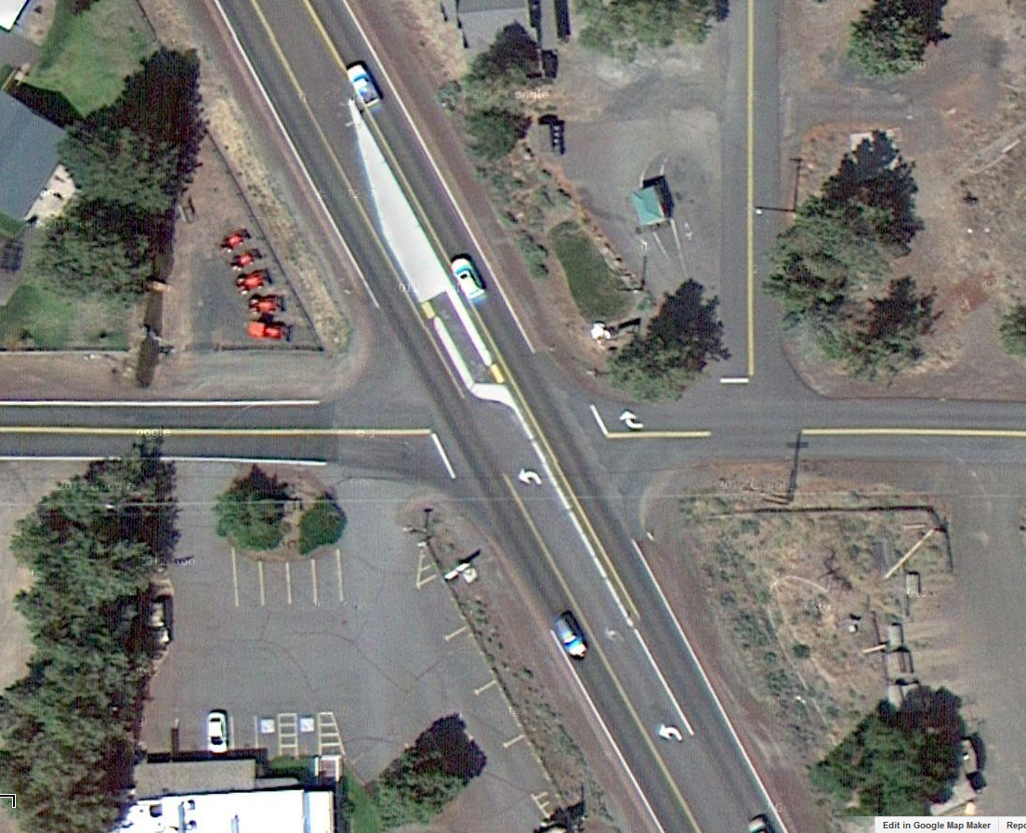
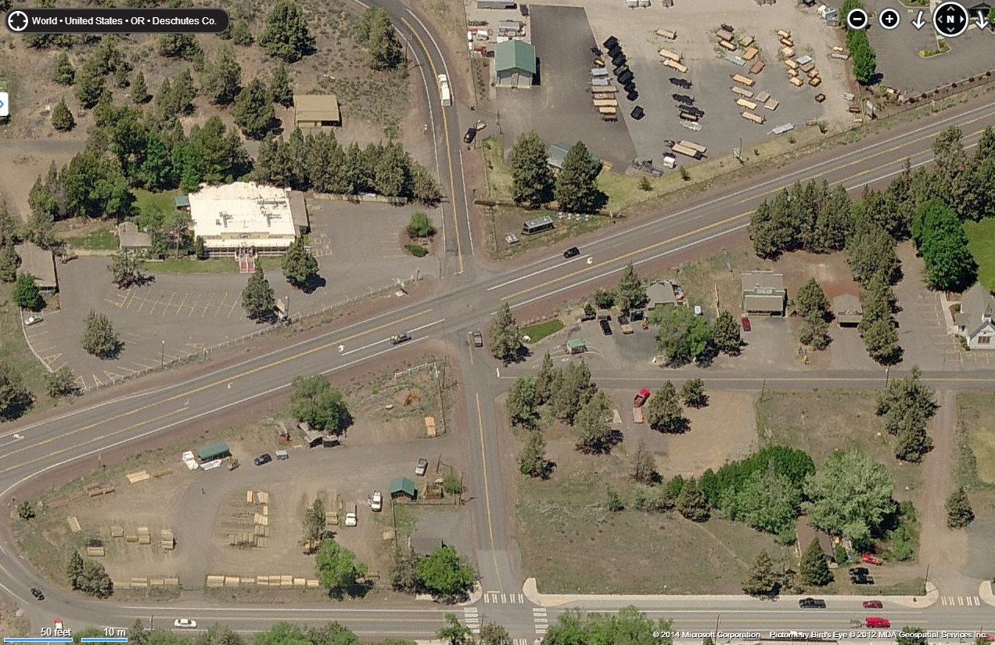
Tumalo Community Plan HIA
Notes:
Re-screen

Slide 8
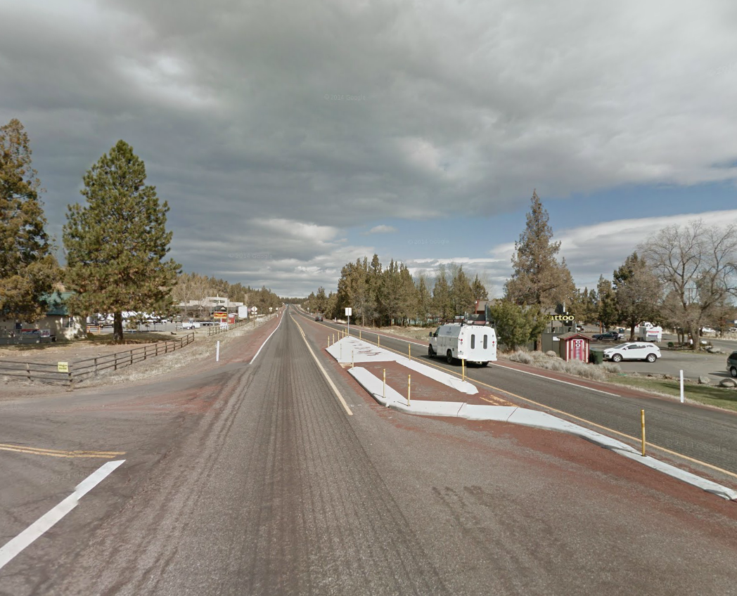
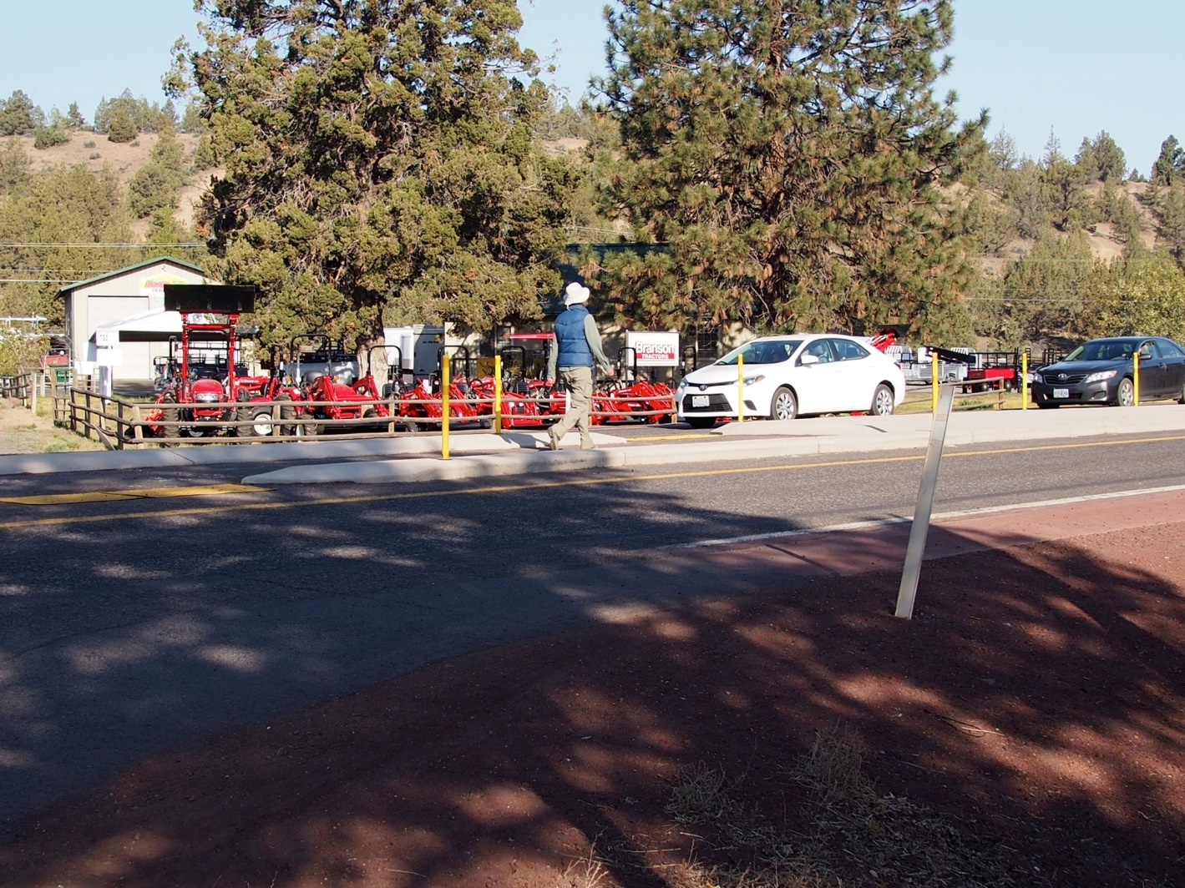
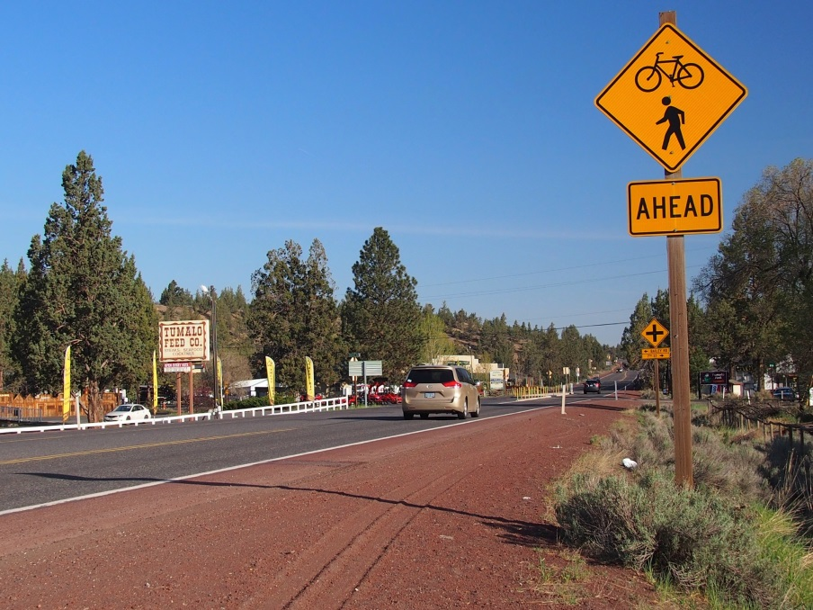
Tumalo Community Plan HIA
Notes:
The development of the Tumalo HIA has led to a variety of outcomes for the HIA team and the local community:
Many of the community needs and ideas that came up throughout the County Planning and HIA process have
been incorporated into the Tumalo Community Plan language.
Local business associations now use the HIA as an advocacy tool when speaking with transit organizations.
Due to the HIA, ...
a. Tumalo was awarded a Robert Wood Johnson grant to evaluate the long-term outcomes of the HIA
b. Strong partnerships have been cultivated between the Planning Department and County Health Services
c. The Central Oregon Intergovernmental Council worked with the Tumalo HIA team to establish a new HIA to analyze the health impacts that could stem from the regional transit plan that is under development.
d. New partnerships with underserved communities (i.e. Warm Springs Reservation) have been developed.

Slide 9
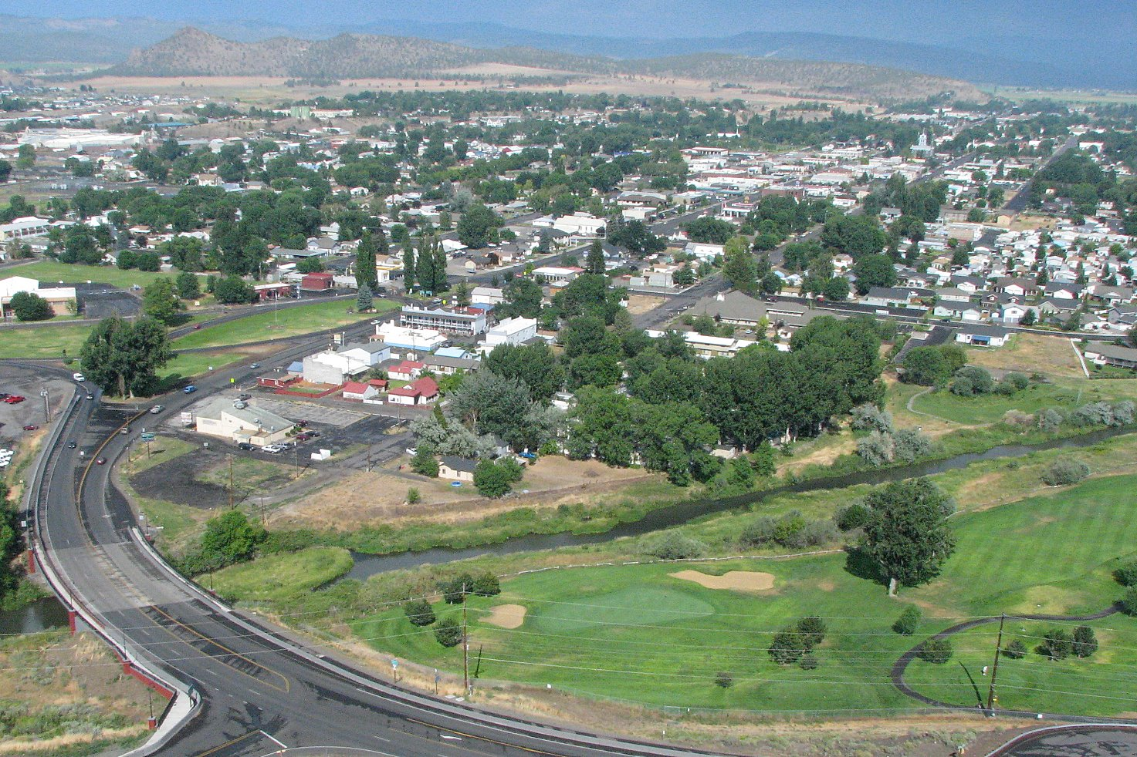
Crook County Bike & Ped Plan HIA
Wikimedia commons
Notes:
Prineville
Local data is essential
As a result of the dissemination of this HIA, the city of Prineville was awarded $530,000 from ODOT and received a $60,000 local match for a total grant of $590,000 to tear out and rebuild the existing Ochoco Creek Trail (6400 feet). According to Senior Planner Scott Elderman, “This will be a greatly improved trail as it will be constructed with base (the current one doesn‟t seem to have any), stormwater retention (to protect the creek) and will be 10 feet wide instead of the current 6 feet to better facilitate 2-way multi-use traffic”.

Slide 10
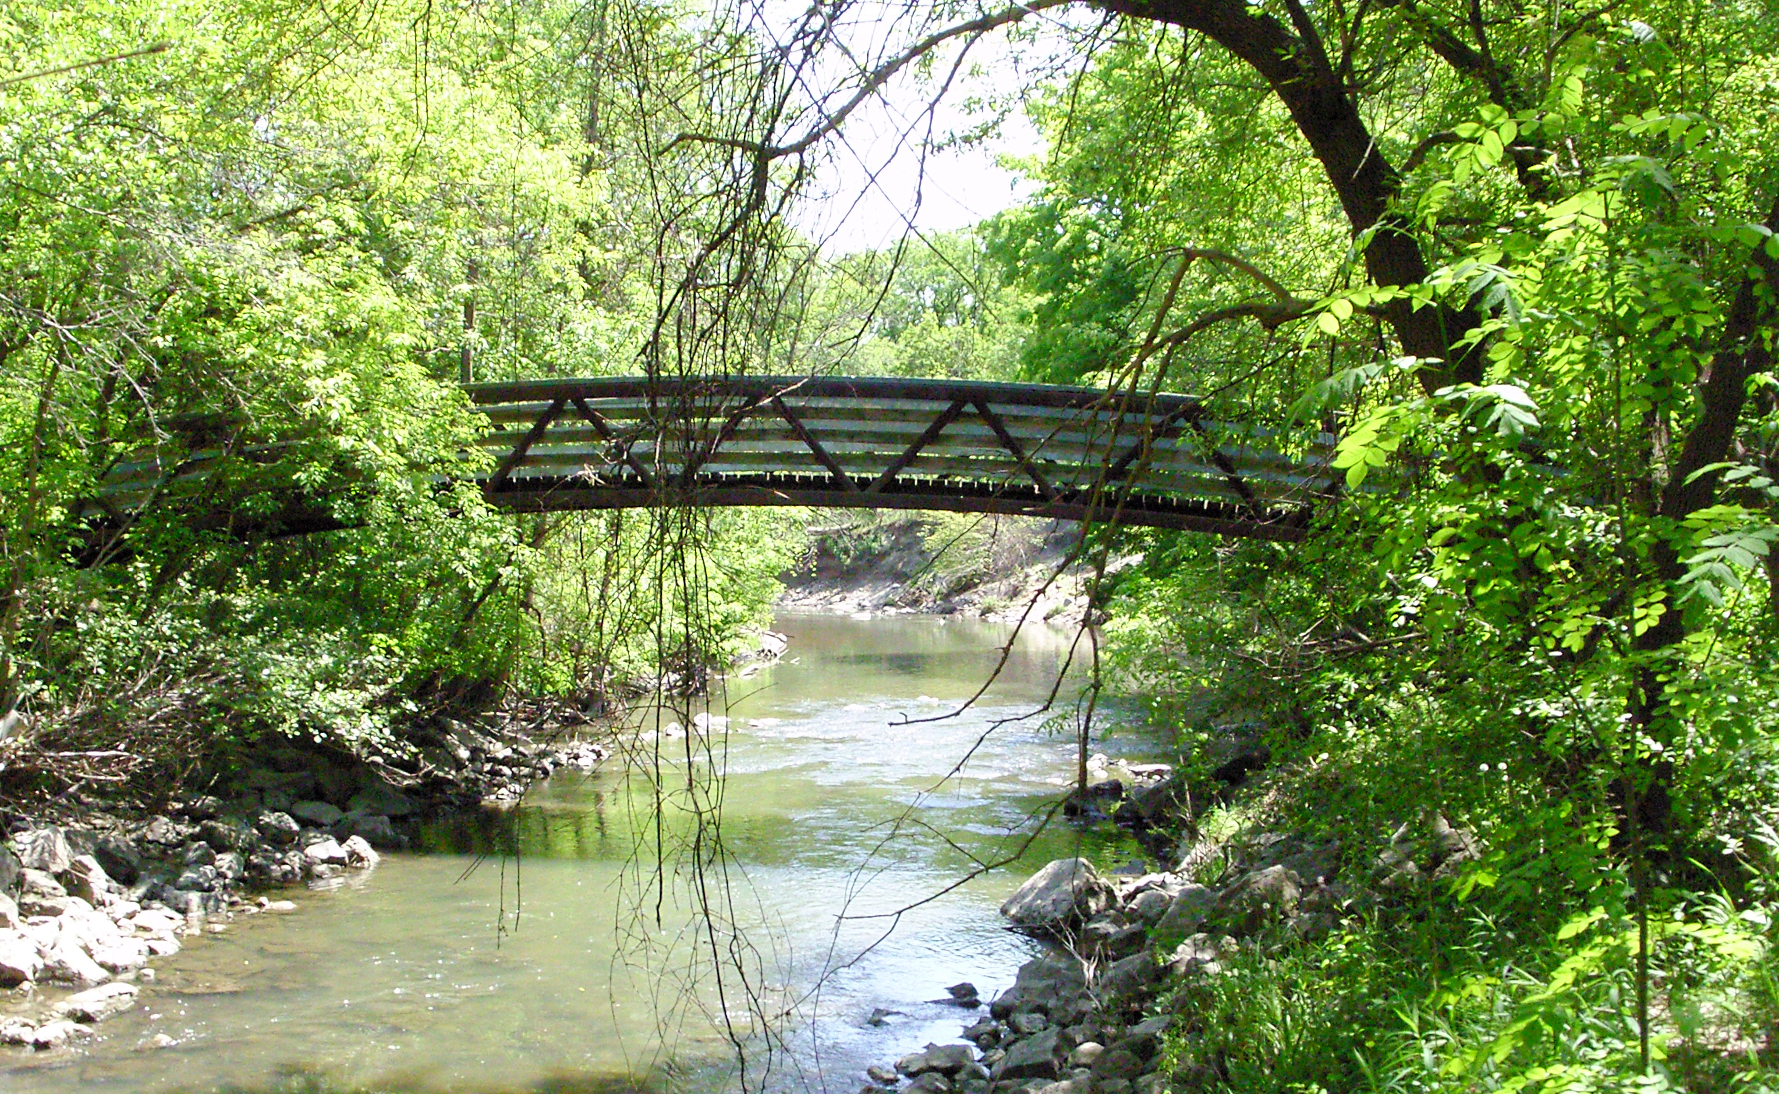
Washington County Pedestrian Bridge HIA
Notes:
Developing and strengthening relationships between local public health professionals and their colleagues in land use, transportation, education, and housing
Washington County Beaverton Creek Bridge HIA (2014)
Washington County's second HIA will inform the county-level decision to pursue placement of a bicycle and pedestrian bridge to cross Beaverton Creek and connect both sides of Augusta Lane. The proposed bridge is part of a multi-phased recommendation process to address community issues and aspirations in the Aloha-Reedville study area. The outcome of the overall Aloha-Reedville planning effort is to identify at least one key connectivity issue to address that would provide increased benefit to each school. The Beaverton Creek Bridge is the most ambitious of the connectivity recommendations but also provides the most benefit of any project in the larger recommendation.
Site visit
Do a scoping training in person, including stakeholders. Use this time to frame things in social/environmental determinants of health (provides language for practitioners, and understanding for non-health partners)
Require interim reports (to catch problems/errors with the assessment (Hood River), and to ensure the report gets done
(Note about Curry, I have previously used this as an example of why an HIA report isn’t necessary, because Annette’s presentation was so powerful that it did it’s job, but now Annette’s gone and the HIA report is still being used to explain the need for funding for quality affordable housing.
We require a capacity-building report, where counties must explain who’s doing what, and also how the health department will present the materials internally.

Slide 11
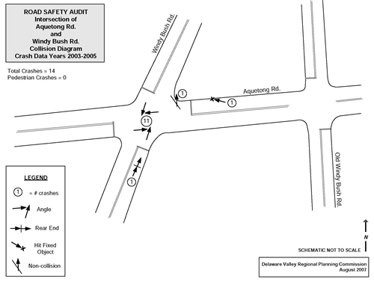
Clackamas County
Notes:
Meet your partners where they are, learn their language, spend the time understanding your partners
Clackamas County completed their project assessment and report. Then they held one final meeting to try to understand how well the HIA project team did at meeting the HIA goals, and whether or not the project added value.
All participants of OHA’s capacity building effort complete a short report answering questions intended to help the county evaluate it’s participation in the project, and also to help the OHA HIA Program improve the capacity building effort in future years.
Clackamas County Road Safety Audit HIA (2014)
Clackamas County’s first HIA will analyze the possible transportation decisions at four intersections along McLoughlin Boulevard. After concluding the HIA, Clackamas County will develop materials guiding the joint Health Impact Assessment-Road Safety Audit (HIA-RSA) process for use at other intersections/corridors in the County or around the State.
Clackamas County Health Impact Assessment Summary
The proposed project will affect transportation decisions at four intersections along McLoughlin Boulevard and propose a Health Impact Assessment-Road Safety Audit (HIA-RSA) process for use at other intersections/corridors in the County or around the State.
A Road Safety Audit (RSA) consists of a formal safety performance examination of an existing or future road or intersection by an independent multidisciplinary team of experts. Outcomes of the RSA include identification of potential roadway safety issues and improvement opportunities for all roadway users. The overall process is based on recommendations set forth by the Federal Highway Administration (http://safety.fhwa.dot.gov/rsa/). The RSA will take about 1 ½ months to complete.
Two elements comprise the project scope of work:
The first element that relates to the transportation system includes completing an RSA for a short section of McLoughlin Boulevard between SE Boardman Avenue and SE Hull Avenue. SE Boardman Avenue, SE Arista Avenue, and SE Hull Avenue are lack signals at their intersection with McLoughlin Boulevard while Jennings Avenue is signalized. The Trolley Trail multi-use path also intersects this area at Jennings Avenue. The community is concerned and the crash data supports the need for improvements to pedestrian and bicycle safety along this segment. The recommendations from the RSA would be used as input into the HIA process.
The outcome of the effort will be a transportation safety project that has the combined analysis of an RSA and HIA providing a broader context of knowledge to inform decisions about the transportation corridor and crossing treatments along this corridor. Crossing McLoughlin Boulevard at these four locations will be the primary effort of the RSA component due to budgetary constraints.
The second component of this project includes developing a proposed modification to the RSA process which factors the health impact component, or HIA piece, into the RSA process. Incorporating a health component into the engineering component will create consistency with broader federal goals around health, community and livability.

Slide 12
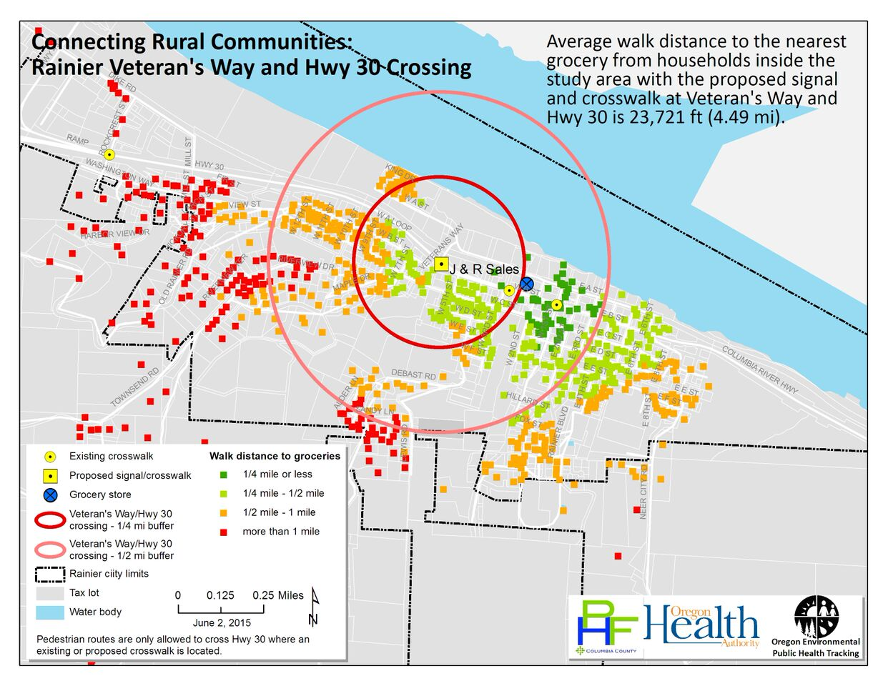

Slide 13
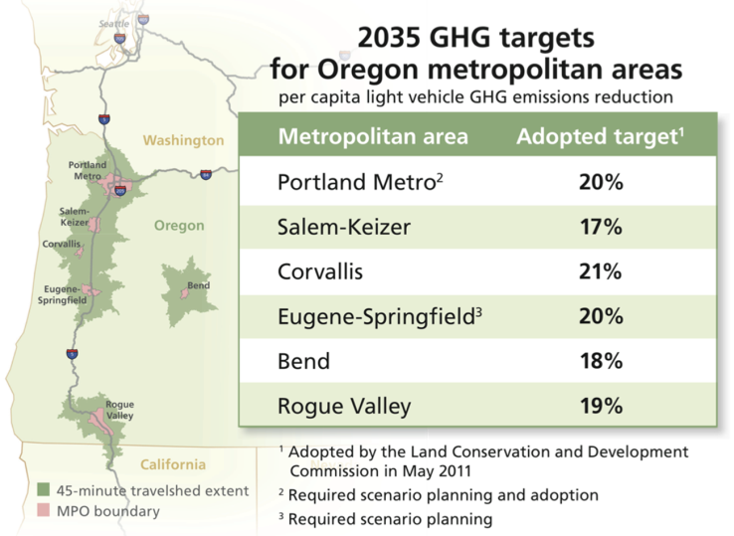
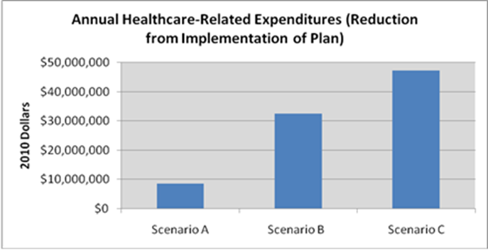
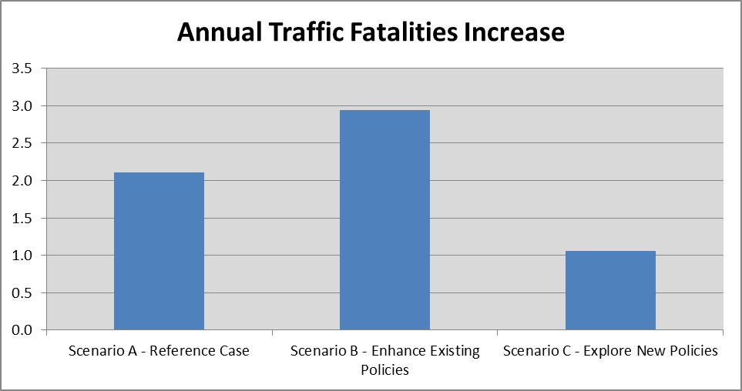
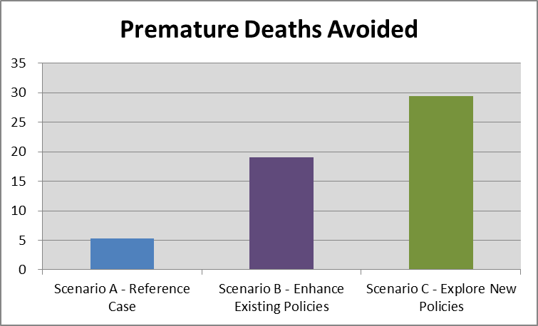
Central Lane MPO GHG Reduction HIA
Notes:
Caution: It can be challenging to leave the health analysis to the planners...

Slide 14

Klamath County Tobacco Retail License HIA
Klamath County Tobacco Retail License HIA
Notes:
Local HIA projects can impact state and national policy
TRL: While there is limited evidence that Tobacco Retail Licensing alone is an effective method to reduce youth tobacco use, TRL’s can be an effective framework for comprehensive tobacco control. Many state and local governments have TRL policies in place; Oregon is one of only nine states in the United States that do not have statewide TRL policies.¹ Furthermore, TRL’s can help support retailer compliance to youth tobacco sales laws. According to Synar data, the average minor sales compliance rate in Klamath County was 61% from 2009-2014.² During the 2013-2014 inspection season, youth decoys were able to successfully purchase tobacco 22% of the time and 32% of the time during the 2012-2013 inspection period.¹ While youth in Klamath County get tobacco products from social sources, they also report purchasing directly from retailers and have knowledge of ease of access from particular retailers.³ Despite the fact that TRL alone is not shown to be an effective tool in decreasing tobacco use, given Klamath County’s low Synar compliance rates, additional enforcement and oversight may have a positive impact in the community.

Slide 15
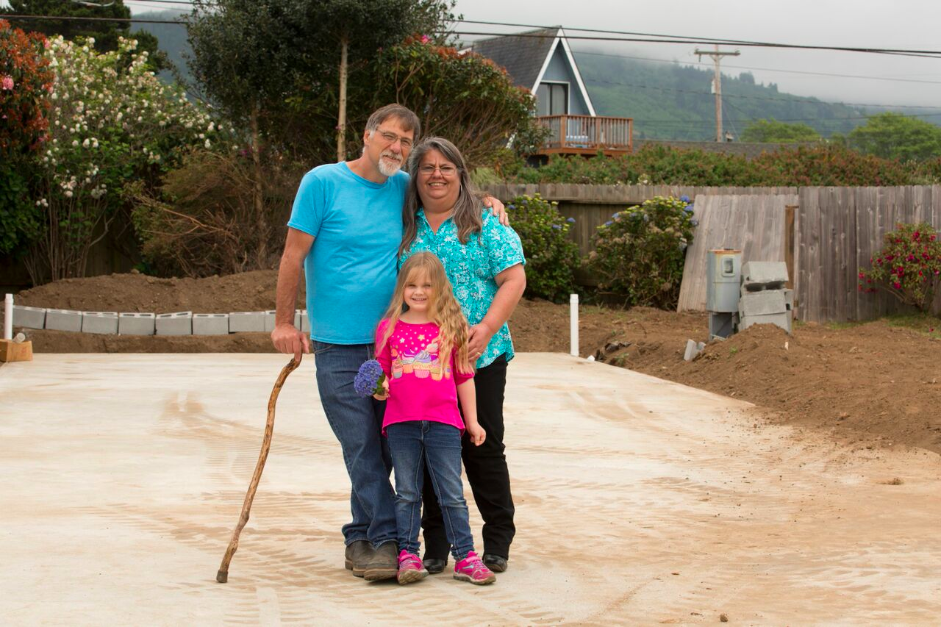
Curry Housing HIA
Notes:
In reporting the project team has to develop communication materials to communicate the HIA findings and recommendations clearly to the decision-makers and other audiences. A completed HIA involves a report that contains information about the proposed decision (and alternatives, if they exist), the community/existing conditions (including vulnerable populations), the evidence gathered during the assessment, and evidence based recommendations for improving the health outcomes for all impacted populations.
2013 Curry County Housing Stock Upgrade Initiative. The authors presented their findings and draft recommendations to a large group of stakeholders including HUD, the Oregon Manufactured Housing Business Association, housing advocates, and residents of manufactured housing. The presentation was moving, and had a large impact on the decision-makers in the room. Curry also developed a report including all necessary information, which is great because even though the lead author is no longer with Curry County, the project findings and recommendations keep being shared—something you couldn’t do with an un-taped presentation.
Housing Stock Upgrade Initiative
Provides deconstruction, disposal and recycling of aged home; i.e., proper disposal of hazardous materials (mold, asbestos, lead)
Offers incentive packages
Provides deconstruction, disposal and recycling of aged home; i.e., proper disposal of hazardous materials (mold, asbestos, lead)
Employment opportunities for decommissioning site development, project financing
Improved housing stock and real property assets
Increased tax base
Improved community aesthetics
Encourages replacement of substandard housing with energy efficient, healthful, safe and aesthetic homes.
Provides incentives to homeowners of manufactured housing in Curry County.
As an economic development initiative, creates opportunity for job creation, jump starts manufactured housing in the state, enhances public health and safety, saves energy, preserves the environment.
Will serve as a model for other counties in the state to be rolled out to Jackson, Coos and Douglas Counties in the future.

Slide 16

Political realities
Common challenges
Notes:
Common challenges
Learning HIA
Stakeholder engagement
Political realities
Impact can be slow to happen, and recognize

Slide 17
best practices for guiding new practitioners through rapid HIAs
Mandatory HIA training before applications are submitted
Be prepared to rescreen, making sure to include decision-makers
Provide a clear timetable for conducting the HIA
Do a scoping training in person, including stakeholders. Use this time to frame things in social/environmental determinants of health (provides language for practitioners, and understanding for non-health partners).
Limit scope for first-time practitioners
Develop a capacity-building report, in which HIA teams explain who’s doing what, and also how the health department will present the materials internally.
Help HIA team navigate working with interns (Intern Best Practices in Rapid HIA Toolkit)
Require interim reports (to catch problems/errors with the assessment, and to ensure the report gets done.
Offer targeted assessment support.
Learning how to use the HIA framework takes resources, including time, training, and technical support; help new practitioners keep their spirits up by helping them respond to challenges as they arise.
Prioritize local relationship development over perfection.
Notes:
Be ready to rescreen, making sure to include decision-makers
Provide a clear timetable for conducting the HIA
Do a scoping training in person, including stakeholders. Use this time to frame things in social/environmental determinants of health (provides language for practitioners, and understanding for non-health partners)
Require interim reports (to catch problems/errors with the assessment (Hood River), and to ensure the report gets done
(Note about Curry, I have previously used this as an example of why an HIA report isn’t necessary, because Annette’s presentation was so powerful that it did it’s job, but now Annette’s gone and the HIA report is still being used to explain the need for funding for quality affordable housing.
We require a capacity-building report, where counties must explain who’s doing what, and also how the health department will present the materials internally.
Use existing stakeholder engagement structures
Reach your partners where they are
An engineering solution (Clackamas)
Teaching the environ dets of health to everyone, framed as, “what in your community impacts health?, talk about the a ha moment. Hood River
Long-lasting benefits of building lateral support in your community (lead up, easy phone calls, Washington County)
Do take the time to include community voices in controversial projects (Klamath, ADU)
Do rely on free labor-but know that it comes with a cost (Benton)
Write the reports in sections (the report can live on: Curry County).
HIA projects can help make the case for funding projects (Crook County)

Slide 18
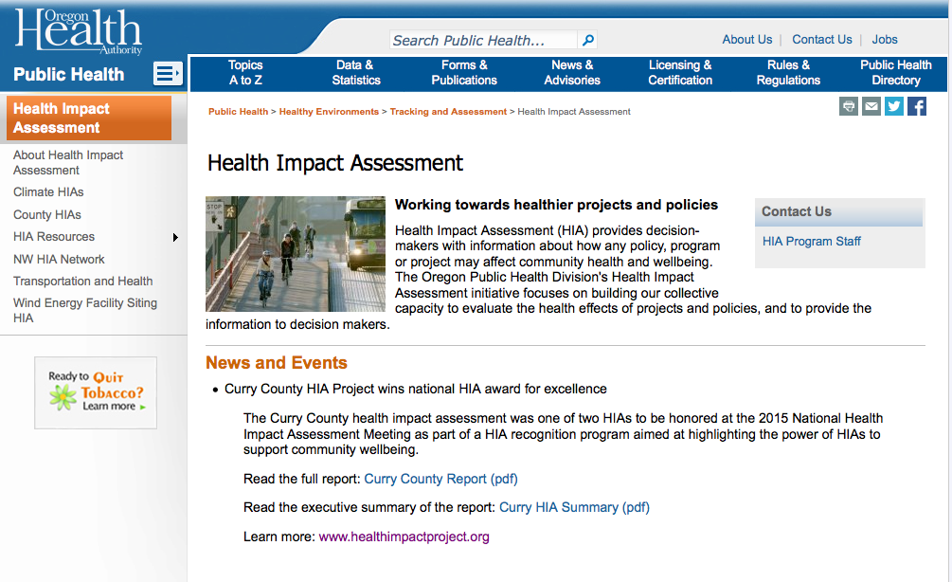
www.healthoregon.org/hia
Notes:
Before we conclude, I’d like to let you know about some opportunities to learn more about HIA or get started on your own HIA. First of all, I’d like to show you our website. On our website, you can find data resources, announcements about upcoming events and opportunities, HIAs that have been completed or are in progress in Oregon, and training resources.
On the front page of our website, you will notice that we currently have an open call for proposals for HIAs. We’re once again inviting local health departments and their partners to apply for funds to complete and HIA by next June. More details can be found in the announcement on our website, and the proposals are due by Friday 12/10
I’d also like to make you aware of the Oregon HIA Network, which is a group of professionals interested in HIA. The Network meets quarterly to share information, network, collaborate, and build capacity for HIA. The HIA Network is open to all, and you join the listserv, which now has over 300 members, by contacting me or again looking on the front page of our website.
And finally, webinars with in-depth reviews of each step are available on our website.

