Slide 1
HIA 101: Introduction to Health Impact Assessment 2015 National HIA Meeting
June 16, 2015
Emily Henke, MPH
Oregon Public Health Institute
Bethany Rogerson, MS
Health Impact Project
Notes:
Welcome and introduce Emily & Bethany, OPHI and HIP
This session is HIA 101, and will provide a very high-level overview of the HIA process. You can learn more about specific parts of the process at other sessions here at the National Meeting.
In this presentation, I will:
Provide an introduction to Health Impact Assessment
Outline the core principles and steps of HIA
Go through an example to illustrate its purpose
Bethany will give an overview of the state of the practice in the US, and how HIA has been applied
Start by seeing who’s in the room. Raise your hand if:
This is the first HIA presentation you’ve ever been to
You’ve been to an HIA 101 presentation previously
Feel comfortable describing the basic steps of HIA
You’ve attended an HIA training
Been a partner in completing an HIA

Slide 2
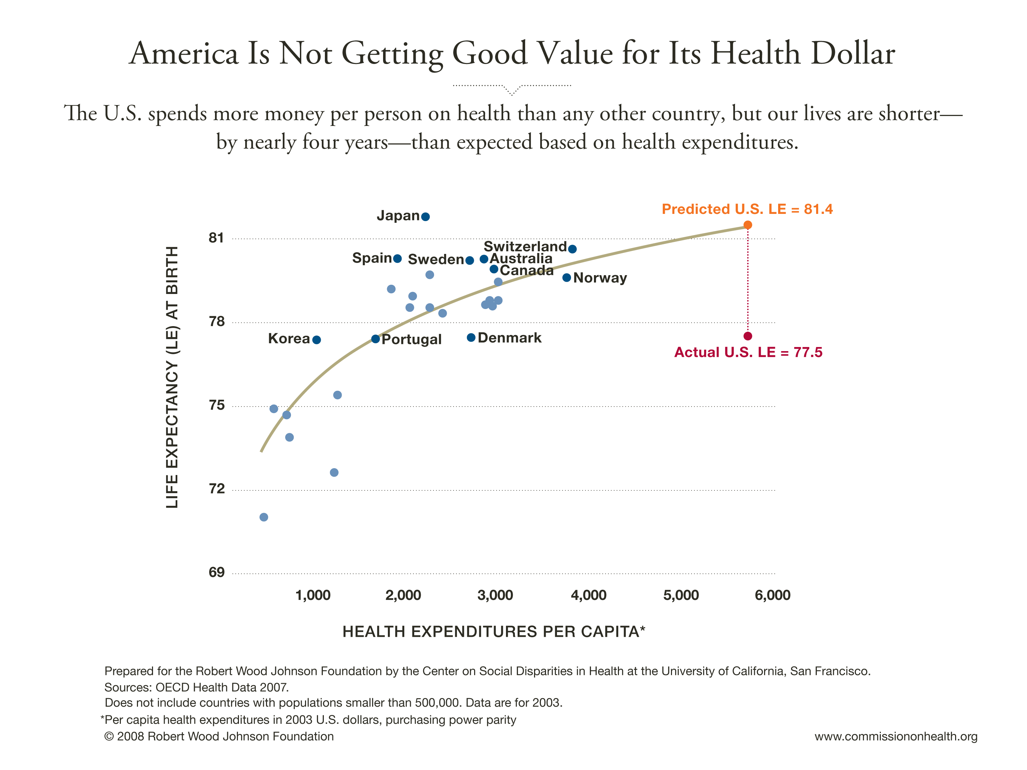
Notes:
To quickly set some context...Compared with other countries, the US spend more money per person on health than any other country. Based on what we spend, you’d expect that we live four more years than we actually do. Essentially, we’re not getting a good return on our investment in our health. We are spending a lot on health care, but…

Slide 3
Many people are less healthy than others.
What factors contribute to our health status?
Genetics (5%)
Personal Behaviors (30%)
Health Care (10%)
Social and Environmental Conditions (55%)
World Health Organization, Commission on the Social Determinants of Health (2008)
Notes:
Many factors contribute to a person’s health.
only 10% is actually related to healthcare, 5% genetics,
physical environment, health behaviors, social and economic factors = 85%

Slide 4
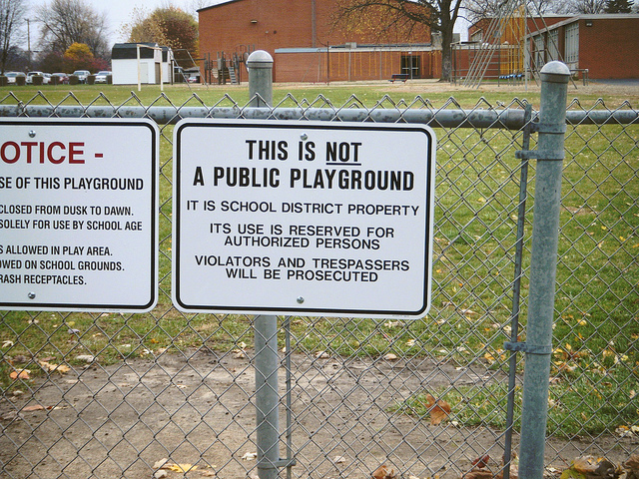
Many decisions that shape our environment don’t consider health impacts!
Notes:
So many daily policy decisions made outside of the health sector have significant health implications that sometimes go unrecognized, because health is just not on the radar screens of decision makers.
This results in missed opportunities for health benefits or increased costs down the road.

Slide 5
Tree exercise

Slide 6
Challenges to Cross-Sector Collaboration
No common language between sectors
Few formalized opportunities or requirements for collaboration
Priorities don’t necessarily match
Connections to health may not be recognized initially
Image courtesy of Stuart Miles and FreeDigitalPhotos.net.
Notes:
There are challenges, of course, to working collaboratively across sectors and to designing more holistic solutions.
It’s one thing to acknowledge, for example, that transportation is important to health; it’s entirely different to take that knowledge and figure out how to translate it into real, concrete policy changes on the ground. Transportation engineers don’t understand health data. Public health professionals don’t understand legal or technical implications of transportation work
To do this takes a practical understanding of the regulatory, political, technical, and budgetary constraints within which policy makers in other sectors—such as transportation, housing, or education—must practice.
Public health is one consideration of many; decisions involve many other considerations (funding, technical limitations, local politics, etc) context, constraints and limitations of the decision-making process.
HIA works to address these challenges by providing a forum to intentionally collaborate.

Slide 7
ONE solution
Health Impact Assessment: A structured process that uses scientific data, professional expertise, and stakeholder input to identify and evaluate public health consequences of proposals and suggests actions that could be taken to minimize adverse health impacts and optimize beneficial ones.
Source: “Improving Health in the United States: The Role of Health Impact Assessments” by the National Research Council, September 2011
Notes:
Provides a framework for community capacity-building and empowerment
Involves a broad-range of impacted people – including business, industry, community members, elected officials, and nonprofit groups.
Is an effective tool for meaningful cross-sector collaboration – provides a forum for public health and those in other sectors, such as planning, to learn each others’ languages and data, and how the two sectors can work together for the same goal.
Addressed health equity – One way HIA addresses equity is by looking at how impacts of a policy might be distributed across a population.
Increases transparency, support inclusiveness, democracy, and community engagement in the policy decision-making process

Slide 8
HIA Addresses Social Determinants of Health
affect
How might the proposed
project, plan, policy
Housing
Air quality
Noise
Safety
Social networks
Nutrition
Parks and natural space
Private goods and services
Public services
Transportation
Livelihood
Water quality
Education
Inequities
and potentially lead to predicted health outcomes?
Notes:
HIAs have been used to help housing and community development professionals consider health implications when making decisions. HIAs broadly consider environmental, social, and economic factors related to health and evaluate the potential impacts of a proposed action on the health and well-being of the community.
HIA asks how might a proposed project, plan or policy affect these determinants and lead to predicted health outcomes.

Slide 9
HIA steps and sample HIA
Rental Housing Inspection Program (RHIP)
Portland, OR
Conducted by OPHI and nonprofit and government partners
Funded by Health Impact Project
Ask me for a copy!
Notes:
I mentioned before that HIA is a structured process. We’re going to spend the next little while working through that process, which has 6 specific steps. To illustrate the steps, I’m going to introduce you to a sample HIA—one about a rental housing inspection program in Portland. This HIA was funded by the Health Impact Project and was conducted by the Oregon Public Health Institute and partners from government and nonprofit agencies. This is a very high-level description of the project, so if you’d like more information or to read the report yourself please ask me afterward. I‘d be happy to set you up with an electronic copy.

Slide 10
RHIP HIA Overview
Portland’s two inspections models:
Standard
Complaint driven
1 complaint = 1 unit inspected and improved
Enhanced
Complaint driven
1 complaint = ≥1 unit inspected and improved
More expensive
Notes:
Let’s start with a little bit of background about Portland’s RHIP and the decision this HIA sought to inform. (Add more info here).
In Portland’s standard RHIP model, which the city has used for many years in all parts of Portland, is a complaint-driven process in which inspections of housing units are triggered by complaints from tenants, neighbors, or other members of the public.
The city began to pilot an enhanced inspection model in 2010 in response to the Quality Rental Housing Workgroup’s recommendation that an enhanced model could address health-related housing conditions, particularly for vulnerable groups. In the enhanced model, inspections are still initiated by complaints, but inspections that find a certain threshold of violations can trigger inspection of additional units in the property owner’s portfolio. In 2010 this model was piloted in two areas of the city.

Slide 11
RHIP HIA Overview
The decision: City Council’s 2012/13 budget and subsequent budget decisions
Should the city fund the inspections program to allow for expansion of the enhanced inspections model?
Notes:
In 2011, the Portland City Council had to put together a budget for 2012 and 2013, and they were deciding whether or not to expand the enhanced inspection model beyond the existing pilot sites. Deciding the level to fund the inspections program, which would determine the level to which the enhanced program was expanded or contracted.
Although health issues were one of the primary motivations for the formation and direction of the QRHW and its recommendations, the City had not had the opportunity to assess the health impacts of the enhanced model relative to the standard model and determine whether it was fulfilling its purpose.
As a result, decision-makers had not been able to evaluate these impacts as they considered whether to allocate resources for maintaining, eliminating or strategically expanding the geographic coverage of the enhanced model.
The workgroup requested this HIA, and partnered with OPHI
So, this was a great opportunity for an HIA. It sought to provide this health-based information as City Councilors, city staff, and other stakeholders were working together to enact budgeting and other policy decisions that best enable the housing inspections program to protect public health.
The specific purpose of this HIA is to assess the relative health and health equity impacts of the two different rental housing inspection models that the city currently employs by determining their relative effectiveness in improving health-related housing conditions in Portland’s rental housing stock.

Slide 12
Stages of HIA: Screening
Purpose: Determines whether a decision or proposal is likely to have health effects and whether the HIA will provide useful information to stakeholders/decision makers.
BASIC CONSIDERATIONS
Is there a DECISION regarding a policy, plan, or project, CURRENTLY UNDER CONSIDERATION whose outcomes are likely to impact health?
Does the decision-making PROCESS allow for input from an HIA?
Would the HIA bring NEW INFORMATION to the decision-making process?
Can the HIA be completed within the TIMELINE for the decision, and with the RESOURCES available?
Notes:
Now let’s look at the first step in the HIA process: screening.

Slide 13
Stages of HIA: Screening
ADDITIONAL CONSIDERATIONS
What is the likelihood that the HIA findings and recommendations will RECEIVE CONSIDERATION by decision-makers?
What are the PRIMARY HEALTH DETERMINANTS likely to be impacted by the decision?
Are there other STAKEHOLDERS who are willing and able to participate in the HIA?
Does this HIA have the potential to INCREASE PARTNERSHIPS, VISIBILITY, AND SUPPORT for future HIAs and other Health in All Policies efforts in your region?
Is there the potential for VULNERABLE POPULATIONS to be more adversely affected than others?
Has a group or organization REQUESTED an HIA on a particular decision?

Slide 14
RHIP HIA: Screening
Why an HIA on rental housing inspections?
Housing = Health
Equity considerations
Inspections funding is often the first to go
Need to evaluate data regarding effectiveness of different inspections models
Stakeholder interest/support
Notes:
Now let’s go back to the RHIP HIA. Obviously this project was screened in – meaning the project team determined it would bring value to the decision-making process. Why was that?
HIA as communication tool for providing health focused evidence for decision-makers
To remind decision-makers (city councilors and administrators) that housing impacts many different health outcomes, and that rental housing also raises equity issues because of
Research has documented the many connections between housing quality and health. The ability of rental housing to support health is an important public health issue.
Quality of rental housing is also an equity issue, as vulnerable groups such as low-income individuals and ethnic and racial minorities are over represented in the tenant population, and they are at greater risk of multiple adverse health outcomes for a variety of reasons.

Slide 15
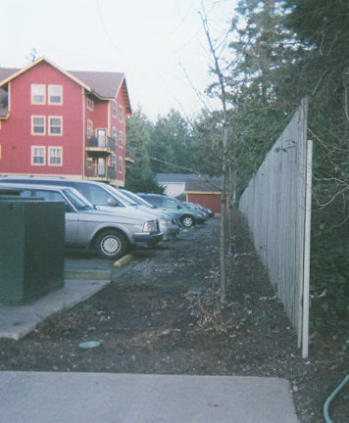
Stages of HIA: Scoping
Purpose: Establishes the scope of health effects that will be included in the HIA, the populations affected, the sources of data and the methods to be used.
Why are we doing the HIA?
How will the decision impact population health?
Who will be impacted by the decision?
Who will be involved in conducting the HIA?
How will you assess the health impacts?
Notes:
Scoping is the second step of the HIA process. In scoping, we ask mainly Why? Who? And how?
Why are we doing the HIA?
Who will be impacted by the decision and who will do the HIA?
How will the decision impact population health, and how will you assess the impacts?

Slide 16
RHIP HIA: Scoping
Key questions:
How do housing conditions and housing inspections impact health and health equity?
Literature review; local case studies
How would health and health equity be impacted by expansion or contraction of the enhanced inspections program?
Quantitative analysis of BDS tracking data
Notes:
Why: goals
Who: All renters → equity
How: Pathways

Slide 17
HEALTH DETERMINANTS
HEALTH OUTCOMES
Funding for RHIP
Exposure to indoor airborne pollutants
Mold
Gases (CO)
Asthma, allergies, headaches, reduced lung function
Exposure to physical hazards (fire, life, safety)
Physical injuries from falls, burns, or electrocution
Housing inspections
Bites, vector-borne diseases, allergies, asthma, bacterial illnesses
Sanitation
Pests (Bites, Vector-borne diseases)
Sewage
Housing conditions
Notes:
These are only some of the pathways used in this HIA. I’ve shortened the list to make the slide readable. The full pathway diagram is available in hard copy.

Slide 18
Stages of HIA: Assessment
Purpose: Describes the baseline health status of the affected population; assesses and characterizes potential impacts of the decision.
Create a profile of the population affected and existing conditions of health determinants and health outcomes.
2. Analyze and characterize the health effects of the policy or proposal under consideration.
Direction
Likelihood
Magnitude
Notes:
It is necessary to profile baseline conditions in order to predict future conditions if a proposal or policy is enacted. Analyzing and characterizing the health effects of the policy or proposal under consideration is a complicated process. We will only be able to touch on this complicated topic very briefly today, but you will have the opportunity to do more work in the deep dive session tomorrow.
Builds upon work done in the scoping phase, which identifies plausible mechanisms of health effects and the approaches for evaluating those effects.
The scoping and assessment phases are often iterative.

Slide 19
RHIP HIA: Assessment
Table ES1: Summary of health and health equity impacts of the expansion and elimination scenarios relative to the status quo
Scenario | Direction of Impact | Magnitude of Impact (i.e., how many) | Severity of Impact (i.e., how good or bad) | Equity Impacts | Strength of Causal Evidence
Expansion | + | moderate | moderate | + | ***
Elimination | - | moderate | moderate | - | ***
Recommendations (Expansion + Education + Improved Tracking) | + | major | major | ++ | ***
Notes:
Direction of Impact refers to whether the alternative will positively impact health determinants (+), negatively impact health determinants (-), or have no impact on health determinants (~).
Magnitude of Impact reflects a qualitative judgment of the size of the population of the anticipated change in health determinant effect: minor, moderate, major.
Severity of Impact reflects the nature of the effect on health determinants and its permanence: minor, moderate, major.
Equity Impact reflects a qualitative judgment of the magnitude of the anticipated change in health inequities related to housing conditions: (--)=moderate increase in health inequities related to housing(-)= minor increase in health inequities related to housing; (~)=no change; (+)=minor improvement in health equity related to housing; (++)=moderate improvement in health equity related to housing
Strength of Causal Evidence refers to the strength of the research/evidence showing causal relationship between the alternatives and the health determinants: * = plausible but insufficient evidence; ** = likely but more evidence needed; *** = high degree of confidence in causal relationship. A causal effect means that the effect is likely to occur, irrespective of the magnitude and severity.
Effects characterization summary
Did a lot of research and generated lots of findings, had to find a way to communicate them easily and effectively. Followe best practices, developed this table that allows us to easily show characterization of impacts. Alos provided guide to strength of evidence.
Simple way of conveying findings. 3 different scenarios, characterized the scenarios by looking at top row for each.
Added third scenario.

Slide 20
RHIP HIA: Assessment
There are strong connections between housing, health and equity
The current inspections program faces challenges in meeting community needs, and
The enhanced inspections model holds promise for better achieving health and health equity in Portland.
Notes:
Key findings were intentionally simple statements that would be easy to communicate. The intention was for stakeholders to have easy talking points. You’ll see later that the same applied to the recommendations this project generated.
Make it easy for stakeholders and decision makers to use the information you’re providing them – digestable.

Slide 21
Stages of HIA: Recommendations
Purpose: suggest design alternatives that could be implemented to improve health or potential actions to manage health effects
Mitigation | Actions intended to mitigate adverse health impacts identified during assessment
Enhancement | Actions intended to improve health by amending the policy, plan, or project under question
Adoption | Actions for the decision-makers regarding whether or not to adopt one of the proposed scenarios
Need for additional data or future studies | Actions for addressing knowledge gaps and uncertainties identified during the assessment phase

Slide 22
RHIP HIA: Recommendations
A strategic expansion of the enhanced inspections model to other parts of Portland
Tenant and property owner/manager education through the housing inspection program; and
A more robust system of tracking inspections.
Notes:
Again, these are simple, easy-to-communicate messages that summarize the recommendations generated by the HIA process.

Slide 23
Stages of HIA: Reporting and Communications
Purpose: Communicate findings and recommendations to decision-makers and stakeholders.
Two primary components:
Communications Plan
Reporting Materials
Notes:
There are two primary components of communications and reporting. First, a communications plan. In this plan an HIA team determines its:
Audience
Messages
Materials
Messengers
Who will do what and when
Who is your audience? What is your message? Who are your messengers? What materials will they need and when will they need them?
And then the reporting materials. This would be your final report, as well as an executive summary, project one-pager, talking points, a press release, presentations and other communications tools that are helpful.

Slide 24
RHIP HIA: Reporting and Communications
The RHIP HIA project team identified these opportunities to disseminate the report:
Public events
Steering committee member networks
City Council members
Media
Post budget update

Slide 25
RHIP HIA: Reporting and Communications

Slide 26
Stages of HIA: Evaluation and Monitoring
Purpose: Determines “success” of HIA and ultimate changes in health determinants and outcomes.
Includes monitoring the implementation of HIA recommendations
Evaluation can be of process, impact or outcomes

Slide 27
Stages of HIA: Evaluation and Monitoring
RHIP HIA had 6 evaluation questions:
Did the HIA follow best practices and use lessons for ongoing QI?
Did SC and stakeholders gain knowledge and capacity to influence RHI?
Did SC members gain HIA capacity?
PROCESS
Did HIA have impact on the decision-making process?
Will HIA methods be used by decision makers in future?
Plan for ongoing monitoring of actions related to RHI
IMPACT
Notes:
Prior to the start of the assessment, OPHI developed an evaluation plan to ensure that the HIA met established practice standards and that there was a continued effort for quality improvement throughout the process. The evaluation plan was also designed to assist OPHI staff in measuring the impacts of the HIA and in identifying improvement areas for future assessment efforts.
Prior to developing the evaluation plan, OPHI established six evaluation goals. Three of these goals focused on addressing the HIA process while the other three focused on the HIA impact. To assess the extent to which each goal was met, OPHI identified and implemented five evaluation tools: a practice standards checklist, a stakeholder survey, a steering committee survey, and a decision-maker interview.
Prior to the start of the assessment, OPHI developed an evaluation plan to ensure that the HIA met established practice standards and that there was a continued effort for quality improvement throughout the process. The evaluation plan was also designed to assist OPHI staff in measuring the impacts of the HIA and in identifying improvement areas for future assessment efforts.
To assess the extent to which each goal was met, OPHI identified and implemented five evaluation tools: a practice standards checklist, a stakeholder survey, a steering committee survey, and a decision-maker interview.
After the implementation of the final evaluation tool, it was determined that five of the six goals were met. One of the goals was partially met due to low stakeholder survey response rate. After thorough analysis of the information gathered from the evaluation tools, OPHI concluded the following:
The rental housing inspection program HIA followed established best practices.
OPHI utilized findings from the practice standards checklist to improve the HIA process.
While final HIA report was not released in time to directly impact the budgeting process, the HIA team did release a draft Executive Summary for Public Comment prior to the finalization of the city’s 2012-13 budget. According to feedback from city council staff, this document played a role in convincing city council to maintain current funding levels for the inspections program instead of implementing the funding reductions identified in initial budget drafts.
The HIA findings have been useful for decision-makers and will definitely impact future budgetary decisions regarding the renewal of the rental inspection program.
The HIA has impacted the decision-makers’ understanding of the equity implications stemming from the rental housing inspection program.
The HIA improved knowledge and capacity for Steering Committee members.

Slide 28
State of HIA practice in the US
Notes:
In terms of outcomes, it’s been successful in maintaining fundings, and in subsequent years is still used as a decision making tool. In the current budget, they’re adding three new positions- inspectors. Much of the reason for this was that they developed simple messaging materials, so it’s a greatdocument to pickup and advocate with .
Now I’m going to hand it off to Bethany from the Health Impact Project to give you a brief overview of what’s going on with HIA throughout the US.

Slide 29
Completed HIAs, 2007(N = 27)
MN
1
MA
2
CO
1
NJ
1
CA 15
y
GA
3
FL
1
AK
3

Slide 30
Completed HIAs, 2009 (N=54)
Health Impact Project Founded
WA
4
MT
1
OR
2
MN
5
MA
2
MI
1
PA
1
OH
1
CO
2
NJ
1
CA 25
MD
1
GA
4
FL
1
AK
3

Slide 31
Completed and In Progress HIAs
2015 (N = 345)
WA
11
NH
4
ME
2
MT
2
OR
24
MN 21
WI
11
NY
2
MA
17
MI 11
PA
4
CT
4
NV
1
NE
6
IL
6
IN
4
OH
11
CO
13
NJ
5
CA 69
KS
3
MO
4
WV
1
KY 3
VA 2
DE
1
AZ
6
TN 6
NC 13
NM
6
SC
2
DC
1
MD
6
GA 11
TX
6
LA
2
Maps created through a partnership between Health Impact Project and the Centers for Disease Control and Prevention’s Healthy Community Design Initiative.
FL
8
AK 18
Puerto Rico: 1
Federal HIAs: 8
HI
2
Notes:
When we launched the Health Impact Project in 2009, there were 62 health impact assessments in progress or completed. Today there are well over 345. The Health Impact Project has funded 100 of these HIAs. As you can see from the map, there are several places in the country where we have not worked, and so in the coming year, the project will strategically outreach to these places to promote and invest in HIA.

Slide 32
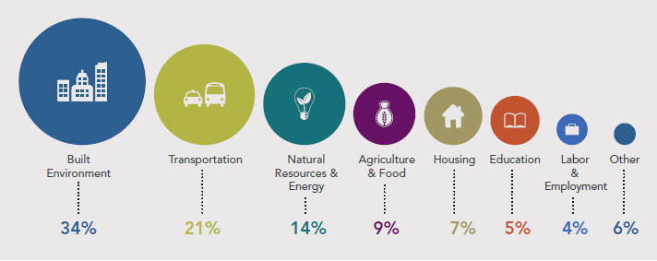
What Topics Have HIAs Addressed?
Notes:
Some built environment, transportation, and energy-focused HIAs have included a housing element.
Housing HIAs cover wide range of topics: housing affordability, zoning and planning decisions, energy assistance, housing inspections, building codes, and community design elements. Many focus on specific housing features, such as home energy delivery systems, or programs and policies that directly affect housing, like rental voucher programs, affordable housing inspections, local building codes, or code enforcement programs.
Opportunities exist to increase the use of HIA in housing decisions concerning policies, projects, and plans.

Slide 33
Who Leads the Work on HIAs?
Notes:
Here is a recent breakdown of the types of organizations who lead HIAs. As you can see, government agencies have done the majority of HIAs in the US.
There is a diversity of entities that do HIA . . .
Often times HIA arises from community concerns and is conducted by non profit organizations. HIA is also carried out by local and state government agencies, companies, or universities.
Non-profit organizations
Community groups affected by a decision
Local and state government agencies
Public health, transportation, environmental health, planning departments
Universities & research institutions
Industry/business community/private sector
Housing professionals, including state housing finance agencies, public housing authorities, and community development organizations, planning officials, and elected representatives, have gained capacity to lead HIAs.

Slide 34
Decision-Making Levels for HIA
3% Other
7% Federal
18% State
7% Regional
53% Local

Slide 35
The Value of HIA: Policymakers
The HIA has helped neutralize conflict by bringing different groups and disciplines together.
HIA helps me win.
It does all the work on the front end; nobody is angry, because all the concerns have been addressed.
Janet Miller
Wichita city council member
Joe Cimperman
Cleveland City Councilmember
The HIA revealed gaps in the data we needed to make good decisions.
HIA is a tool to help us figure out where to … use limited resources to benefit the greatest number of people.
Stacie McIntosh
U.S. Bureau of Land Management
Denise Provost
Massachusetts State Representative
Notes:
One of the best ways to understand the value of HIA is to hear from the policymakers who have benefited form their findings. These are quotes gathered from a policymaker panel at our recent national HIA meeting.
The HIA revealed gaps in the data
The HIA has helped neutralize conflict
[How] to … use limited resources to benefit the greatest number of people
An HIA is a Rosetta Stone…it’s a translator
HIA helps me win

Slide 36
Take-home points: What an HIA is…
A structured, but flexible, process that:
Predicts anticipated health outcomes of a decision/project
Translates that information into recommendations for balanced, well-informed policies
Helps you weigh trade-offs and understand the direct and indirect health impacts of your work
HIA’s purpose is to improve health, track unintended consequences and mitigate risk

Slide 37
Take-home points: What an HIA is not…
It’s not used to make the case for why a policy, program or project should be proposed.
It’s not an assessment to understand the impacts of a program or policy once it has been implemented.
It’s not a community assessment tool (i.e., MAPP, CHIP, CHA), but those are used during assessment stage of HIA.
HIA is the framework that translates that data into well-informed policies

Slide 38
Questions?

Slide 39
HIA 101: Introduction to Health Impact Assessment 2015 National HIA Meeting
June 16, 2015
Emily Henke, MPH
Oregon Public Health Institute
Bethany Rogerson, MS
Health Impact Project
Notes:
Health Impact Project is a collaboration of RWJF and Pew. We are thrilled to be working with Enterprise and USBC on this effort.
Later in the presentation you’ll hear more about Criteria 1.2a and b, which are inspired by health impact assessment (or HIA). My goal today is to provide background to better understand the process or toll on which the criteria is based.
In my presentation, I will:
Provide an introduction to Health Impact Assessment
Given an overview of how it has been applied
Outline the core principles and steps of HIA
Go through an example to illustrate its purpose

