Slide 1

HEALTHY DESIGN FOR HEALTHY COMMUNITIES
ReinventPHX Project:
The Role of GIS
Dean Brennan, FAICP
St. Luke’s Health Initiatives Health Team

Slide 2
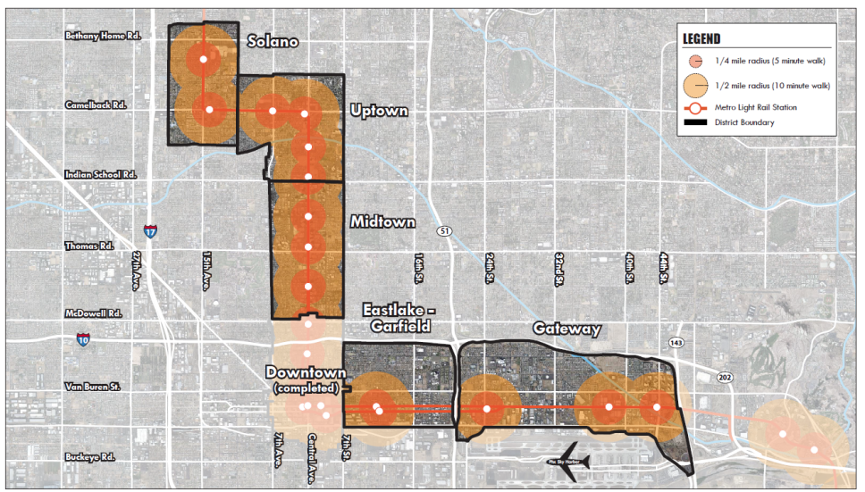
ReinventPHX
Transit Oriented Districts
HUD Sustainable Communities Grant
Light Rail Corridor – 20 miles
Six Transit Oriented Districts
ReinventPHX Plan includes 6 Elements – Land Use; Mobility; Housing; Economic Development; Green Infrastructure; Health
Five HIA Prepared by St. Luke’s Health Initiatives Health Team

Slide 3
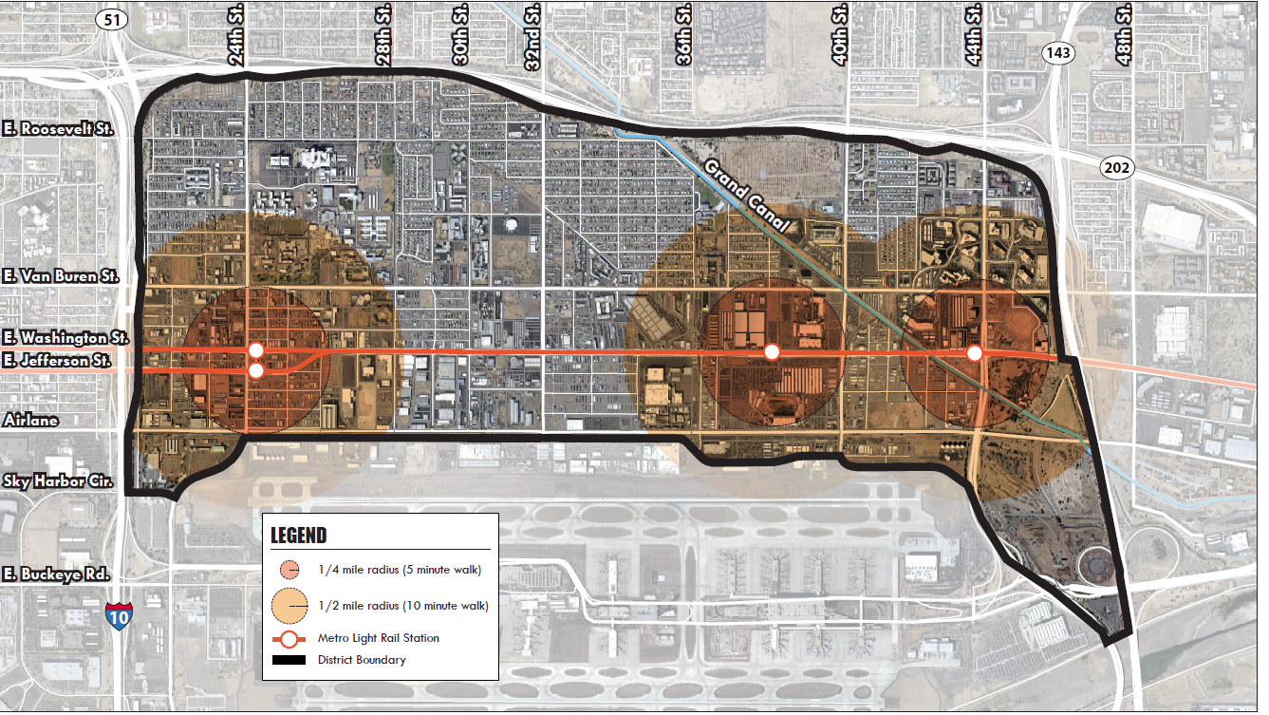
Gateway Transit Oriented District

Slide 4
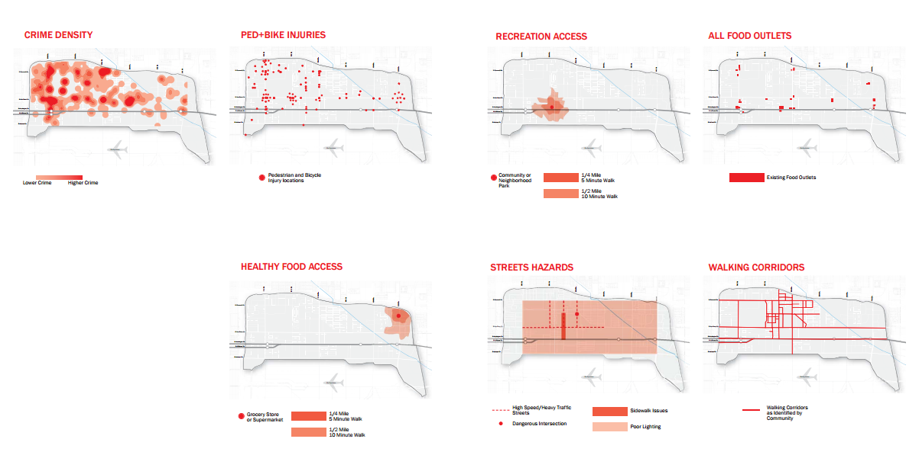
Assessment Mapping

Slide 5
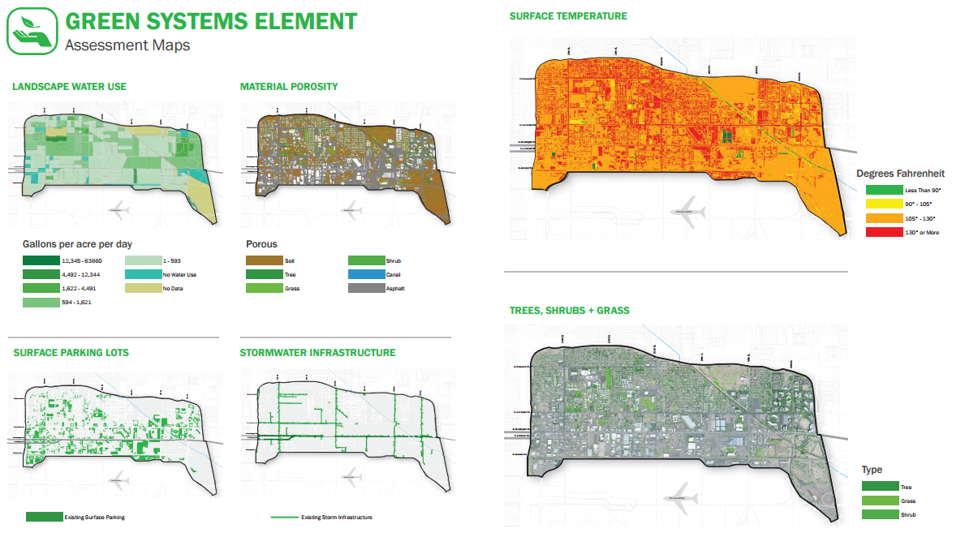
Assessment Mapping

Slide 6
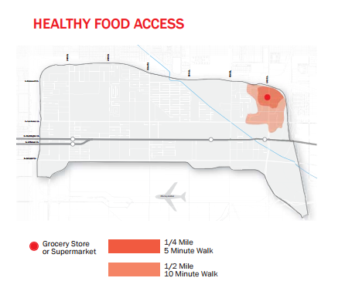
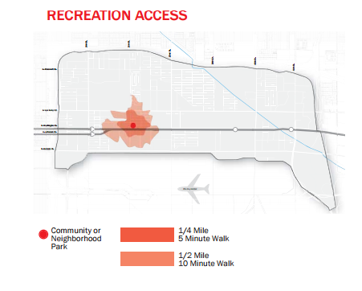
Assessment Mapping

Slide 7
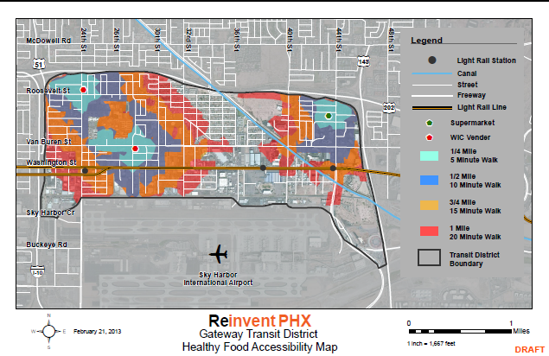
Data Collected:
Access to Healthy Food
Street network analysis
Review of aerial maps and ground truthing
Site visits to WIC stores
Community workshops
Community survey

Slide 8
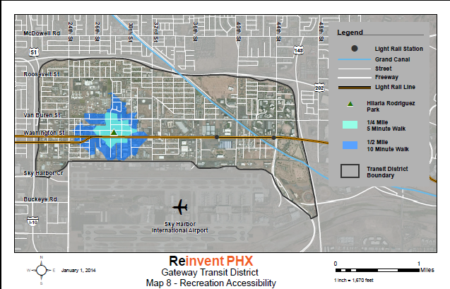
Data Collected:
Access to Recreation
Street network analysis
Park audits by residents
Community workshops
Community survey

Slide 9
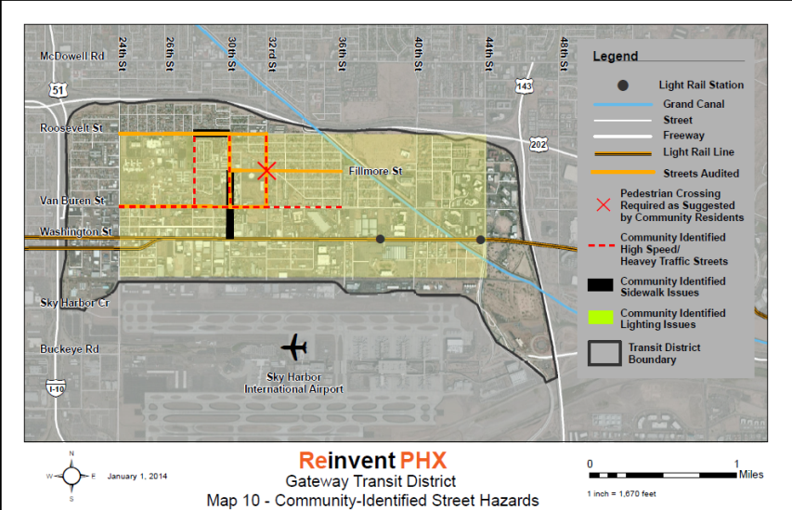
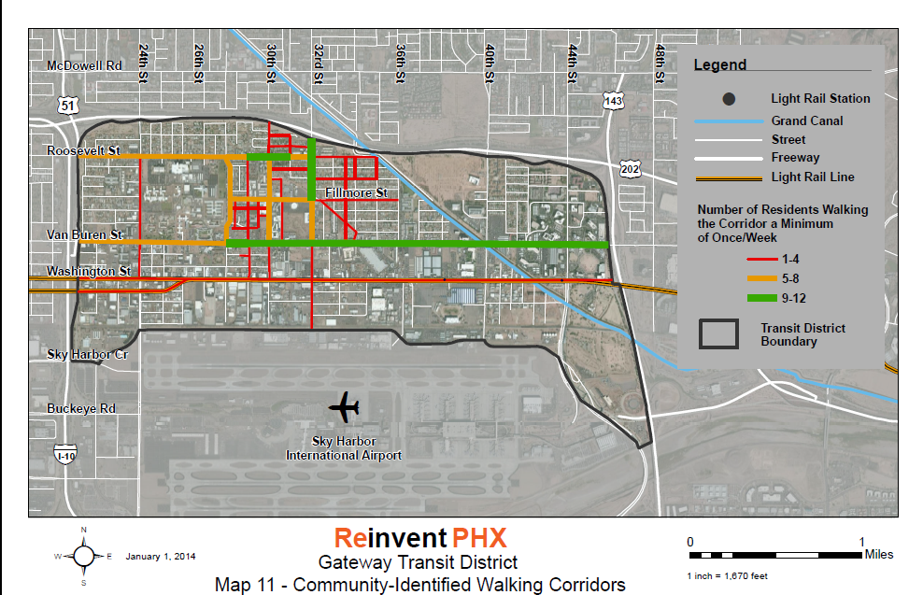
Street Hazards & Walking Corridors

Slide 10
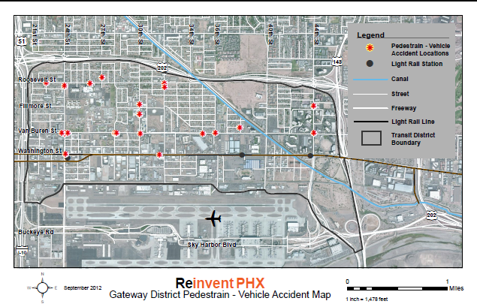
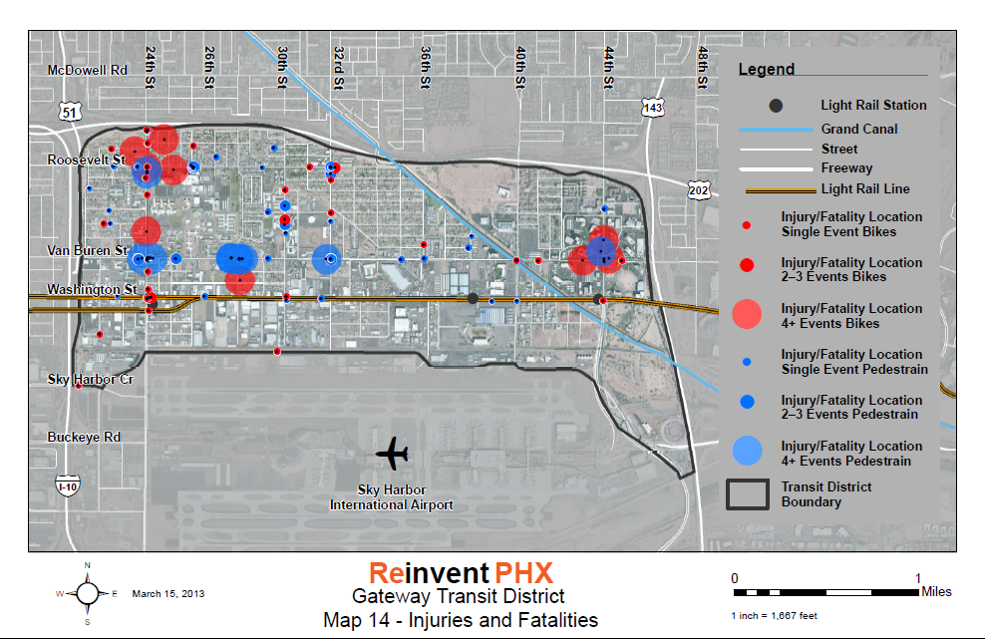
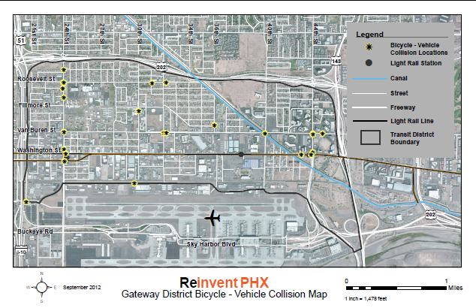
Pedestrian, Bicycle Injuries & Fatalities Hotspots
Pedestrian Incident Locations
=
“HOTSPOTS”
Bicyclist Incident Locations

Slide 11
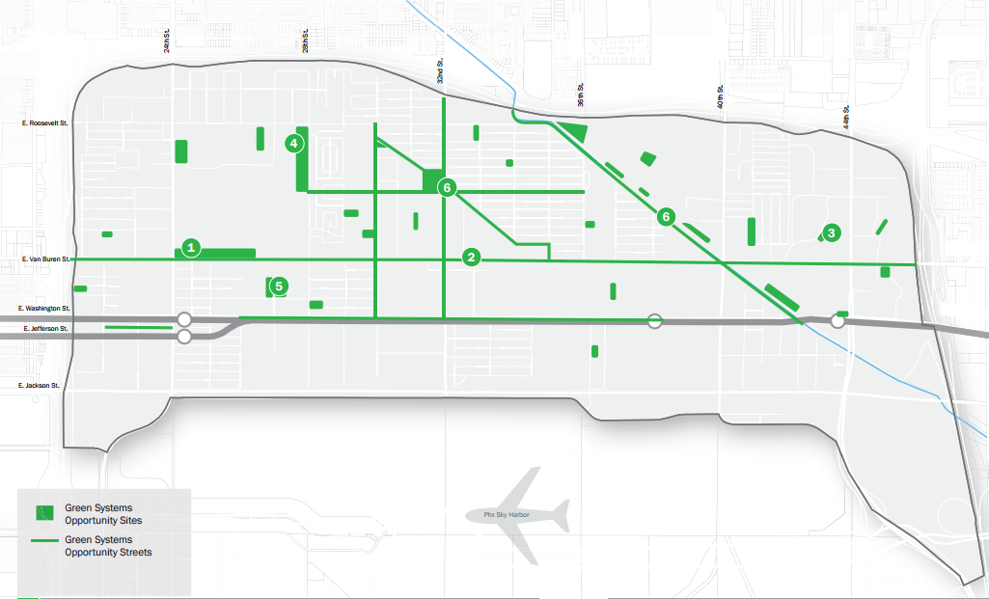
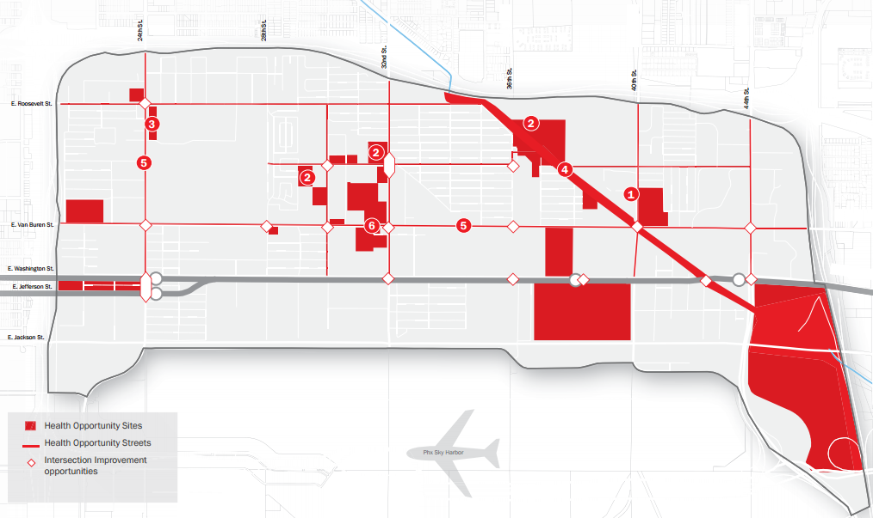
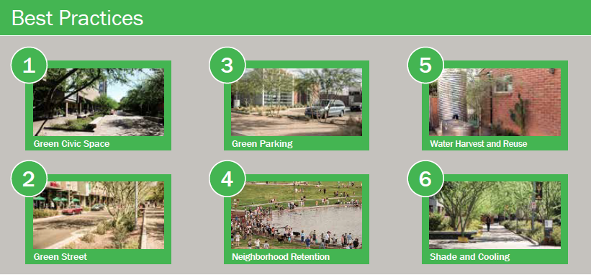
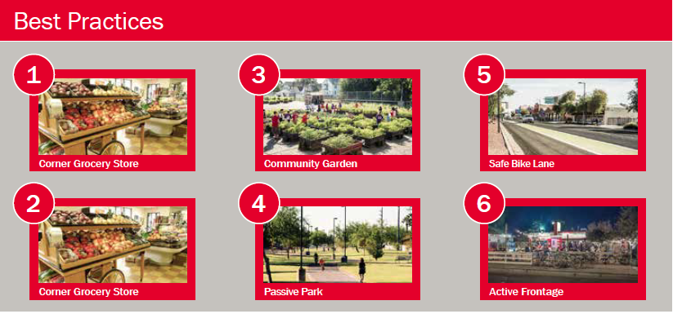
Opportunity Sites Mapping

Slide 12
HEALTHY DESIGN FOR HEALTHY COMMUNITIES
THANK YOU
Dean Brennan, FAICP
St. Luke’s Health Initiatives Health Team
dbrennan.plc@cox.net
reinventphx.org

