Slide 1


Community Workshops
Reinvent PHX
An Engaging Process
Case Study
Midtown
Transit
District
Phoenix, AZ

Slide 2
Ernesto Fonseca, PhD
The Elemental Group, LLC
Kim Steele
The Elemental Group, LLC
Pam Goslar, PhD
St. Joseph's Hospital & Medical Center
Dean Brennan, FAICP
Project for Livable Communities
C.J. Eisenbarth Hager
St. Luke’s Health Initiatives
Mimi Majumdar Narayan, PhD
Catalyst Consulting
Health Team

Slide 3
THE PROCESS
1
2
3
VISIONING: 15 MIN
During this segment participants will be introduced to the study area, goals and priorities, and the materials for the workshop such as maps, icons or survey.
MAPPING: 1 HR 15 MIN
This is a facilitator led activity, working with workshop participants to pinpoint elements relevant to the identified goals and priorities. During this segment, participants work with maps, discuss assets, liabilities, and aspirations.
SURVEY & DEBRIEF: 45 MIN
During this facilitator led activity, participants map routes where they walk or bike, or use their scooters. They also respond to a survey addressing questions related to demographics, eating habits, physical activity, shopping and public transportation.

Slide 4
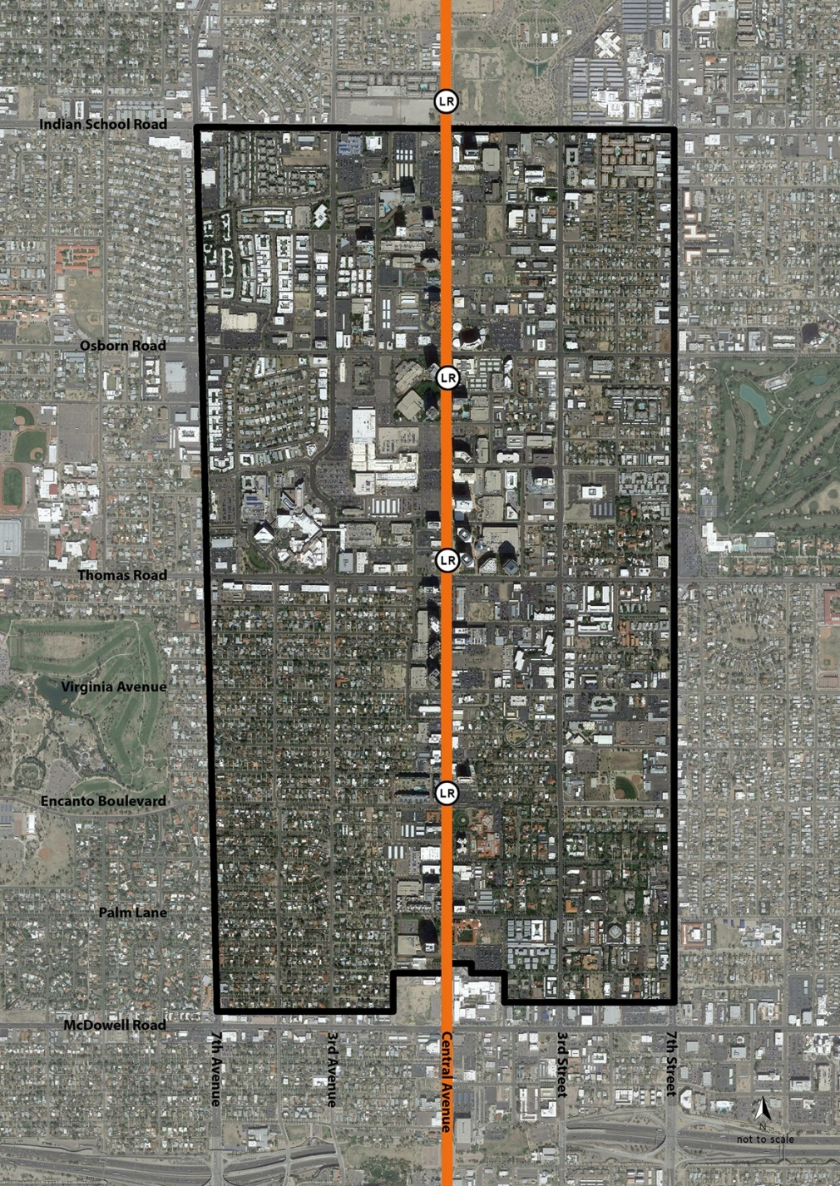
Conversation Topics
Review SLHI Health Team Process
Overview of Workshop Findings
Overview of Safe Streets Findings
Overview of Investments for Priority Areas
Midtown Transit District: Phoenix

Slide 5
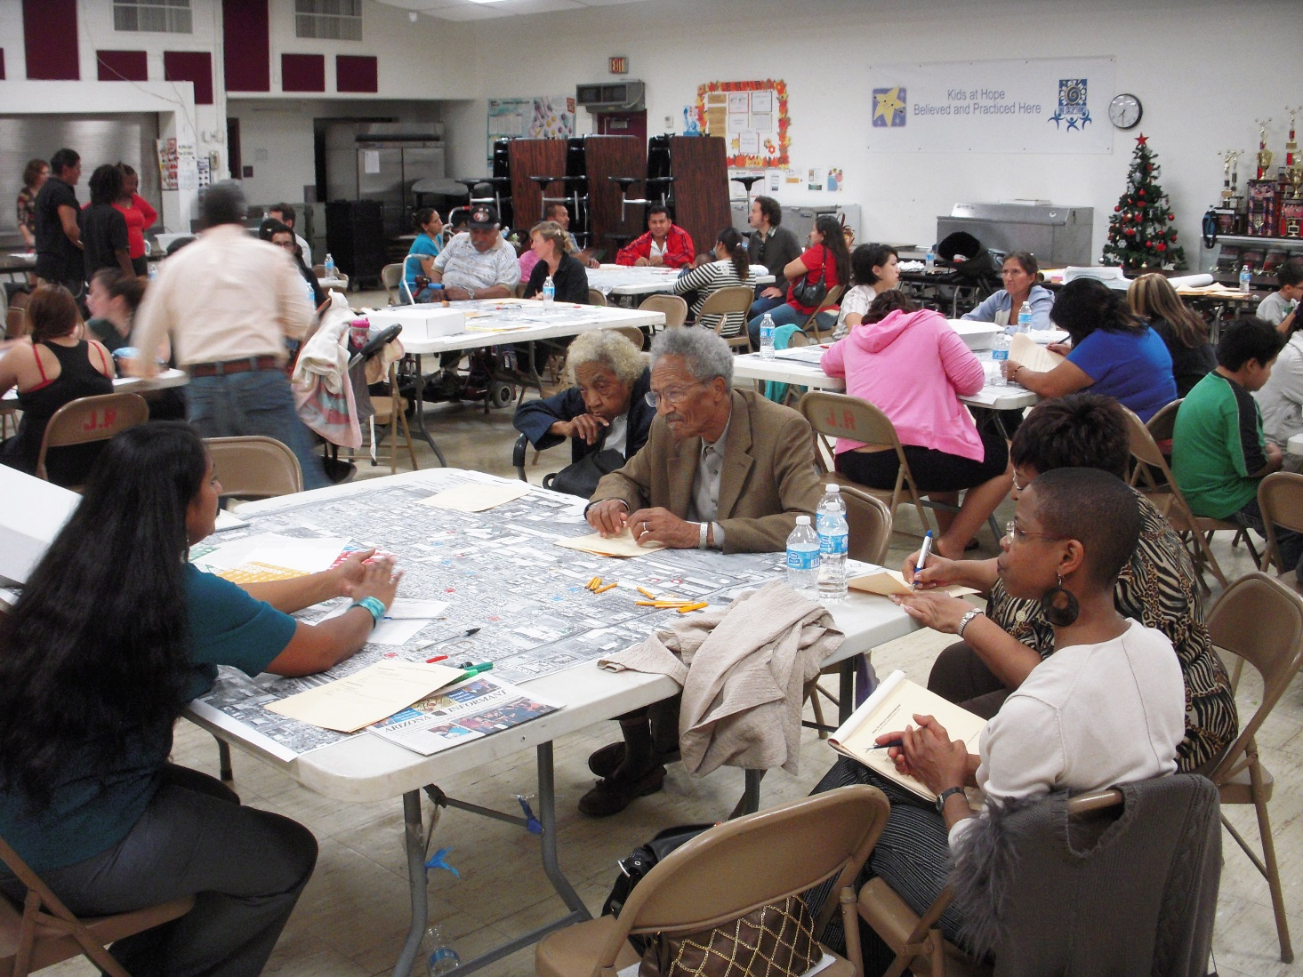
Health Team Process
Neighborhood Maps
Walking & Biking Maps
Injury Research & Mapping
Icons
Survey
Data synthesis
Final mapping data
Community Workshop

Slide 6
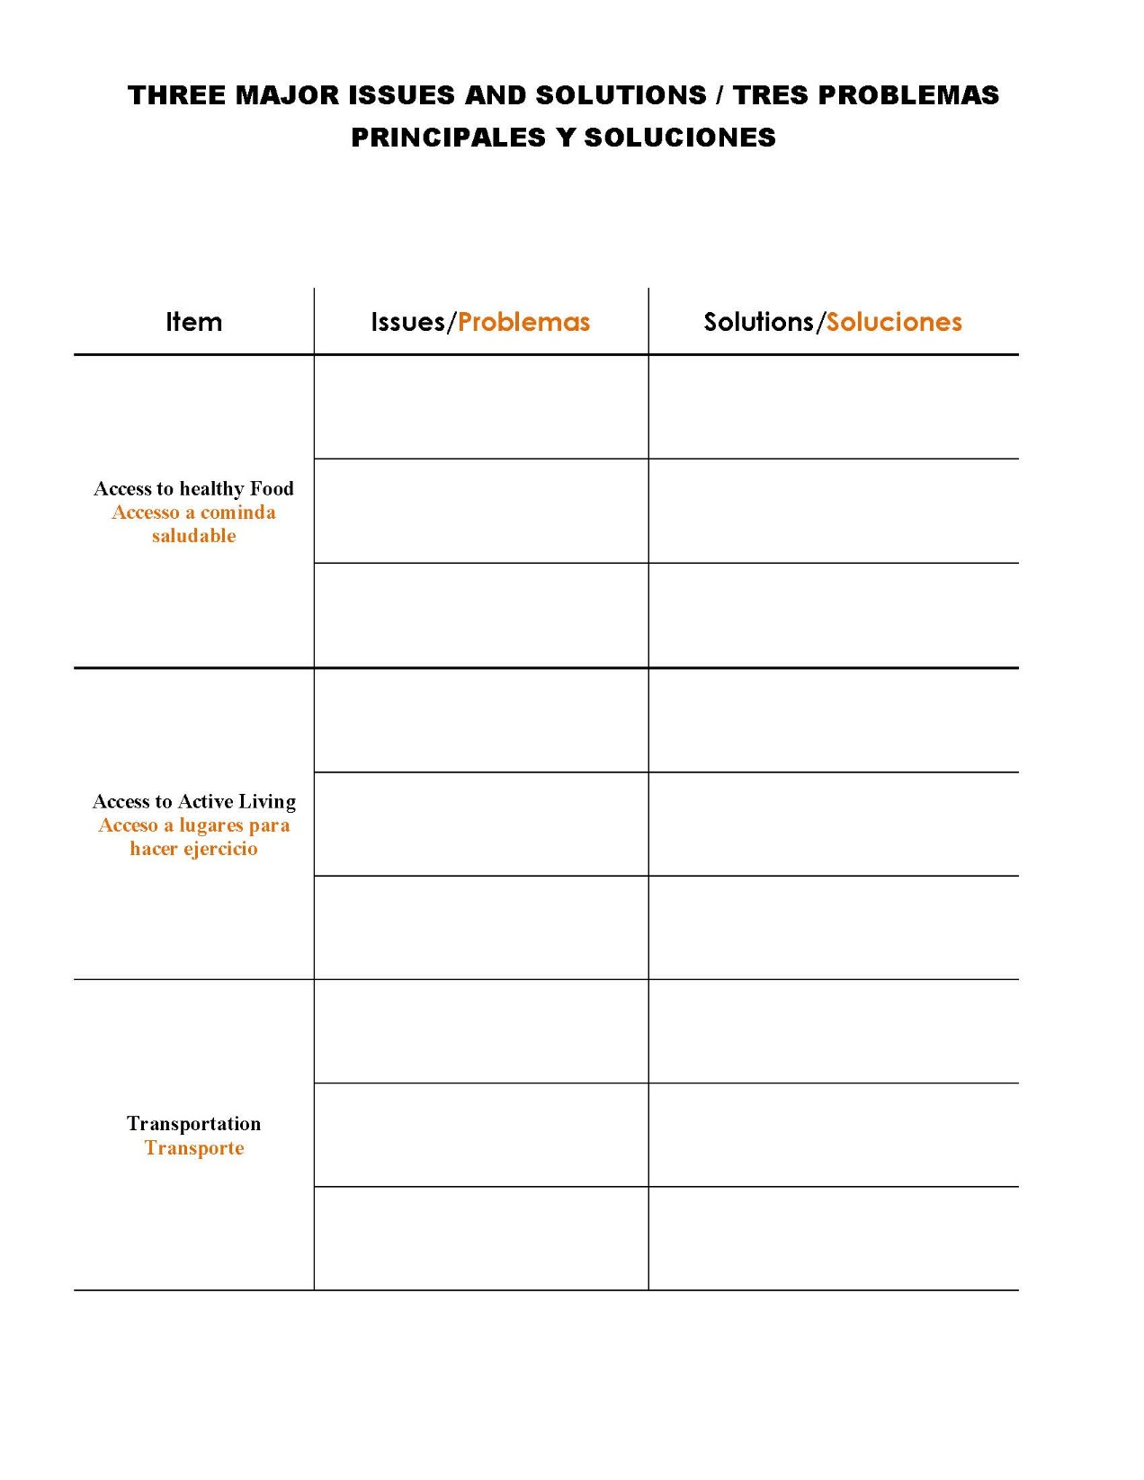
Sample Survey

Slide 7












ASSETS LIABILITIES DESIRES
Sample Icons

Slide 8
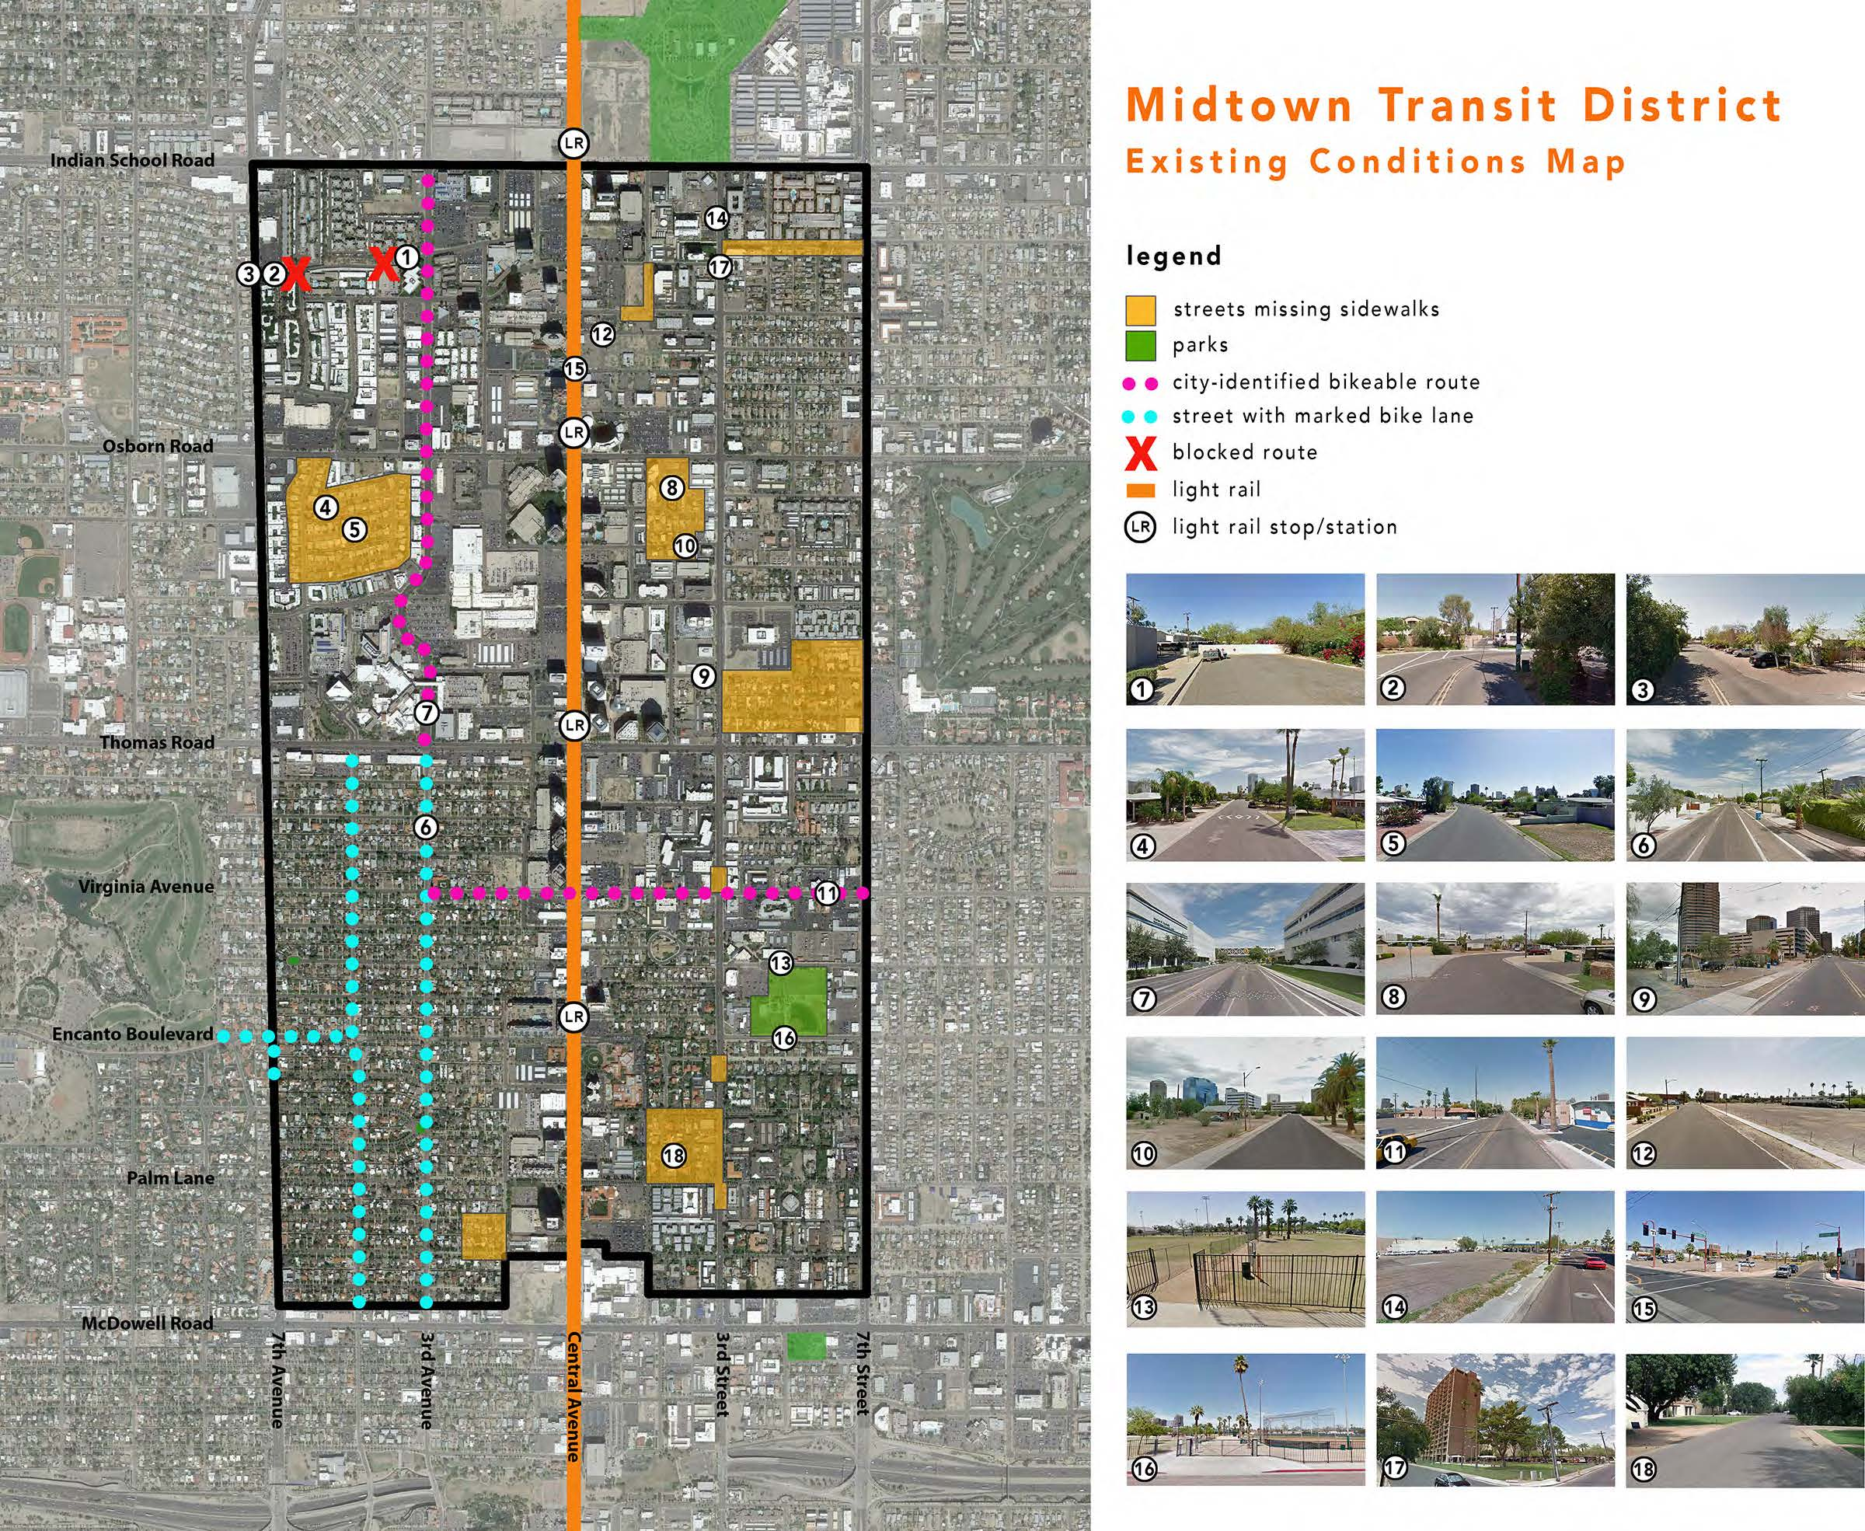

Slide 9
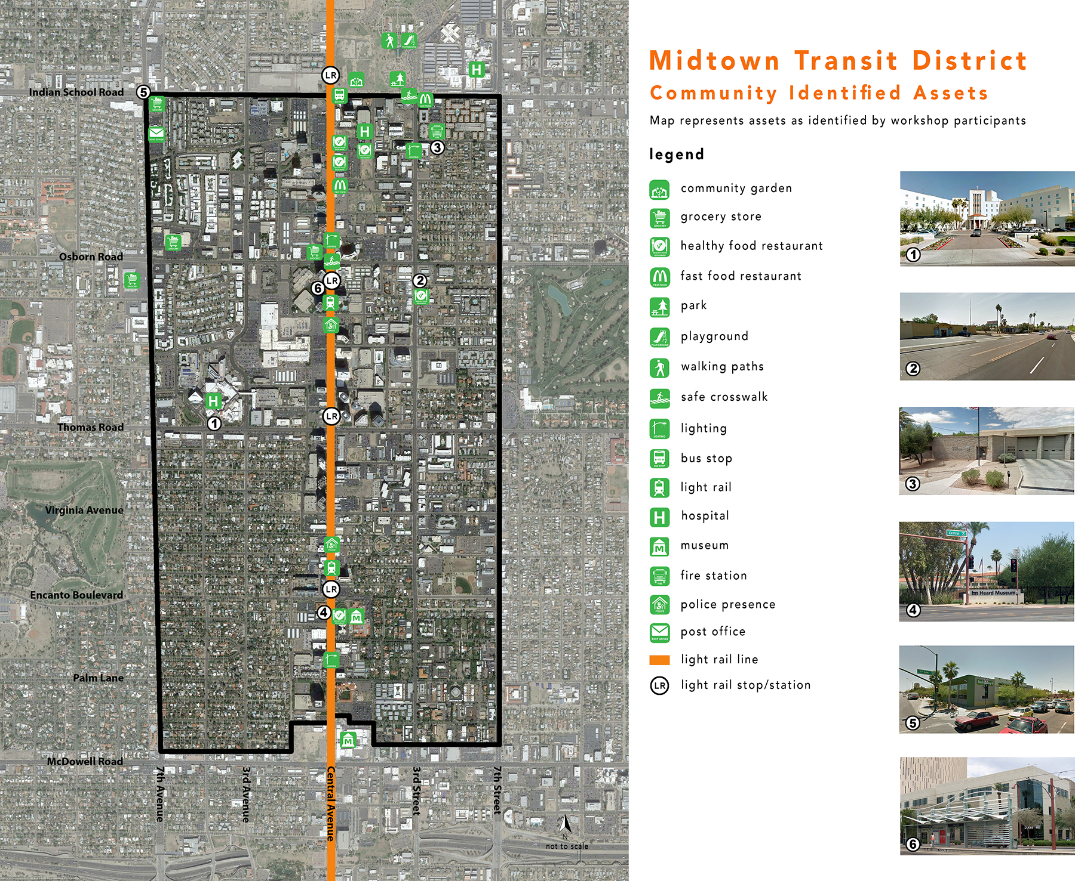

Slide 10
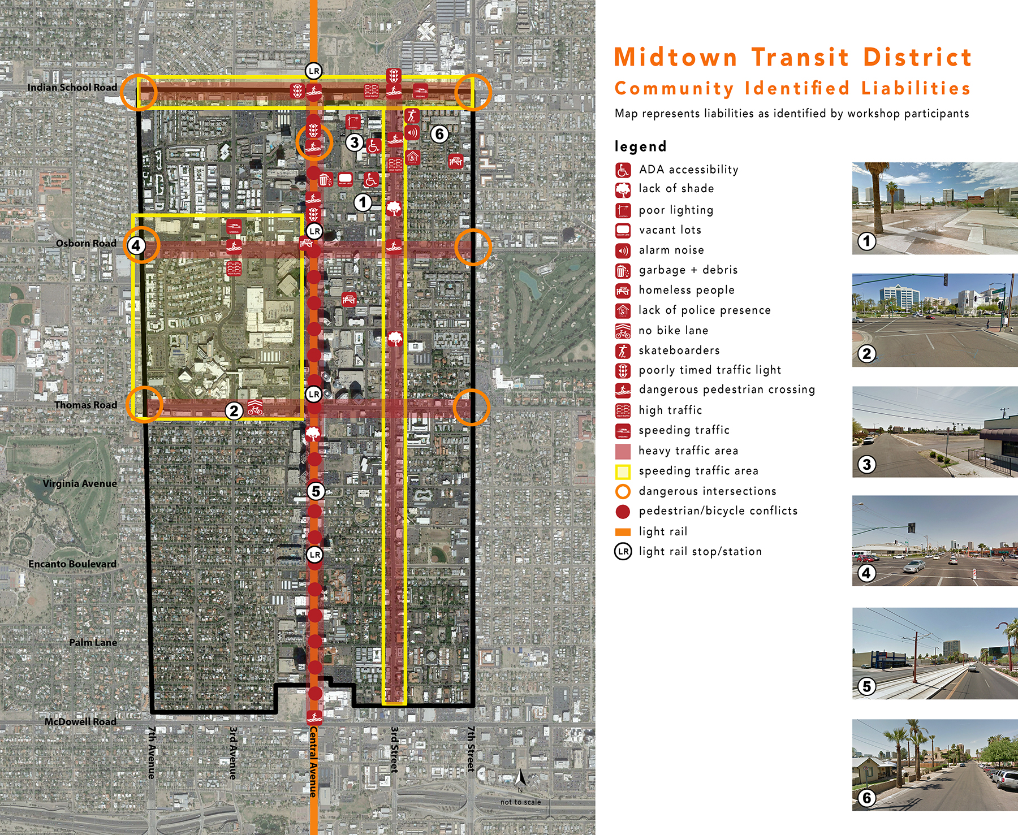

Slide 11
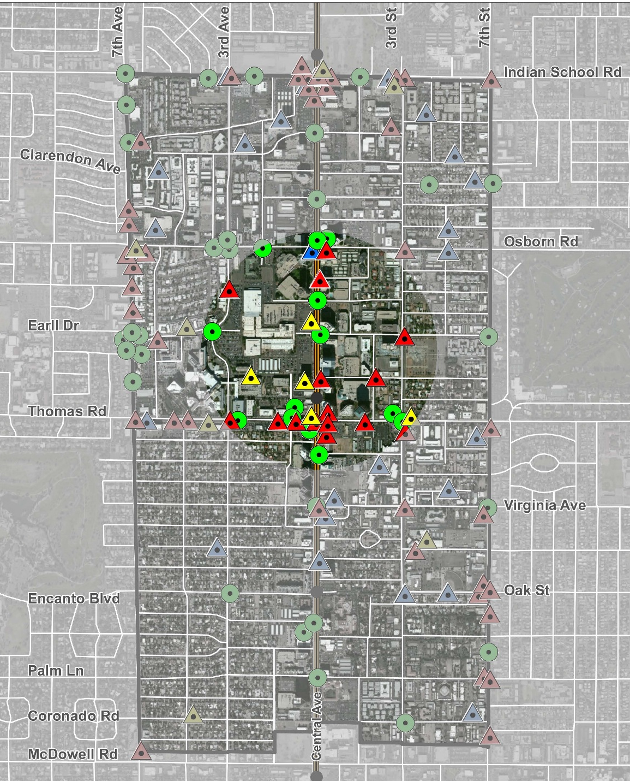
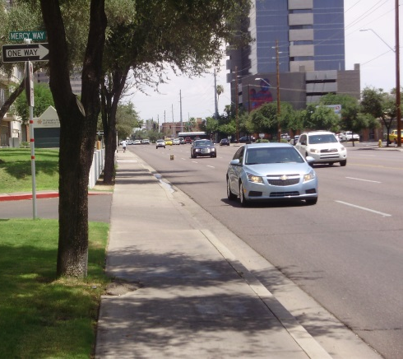
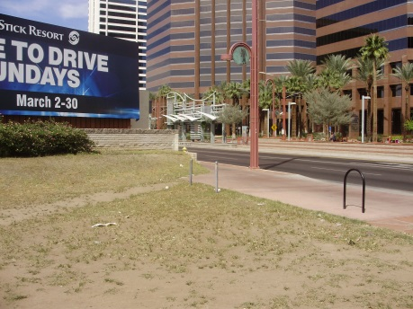
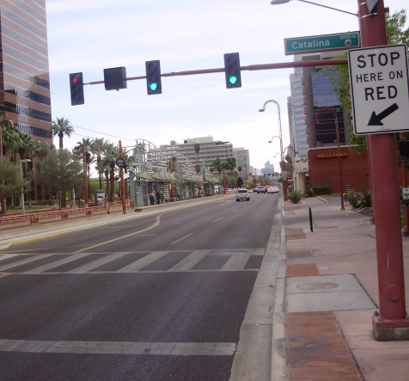
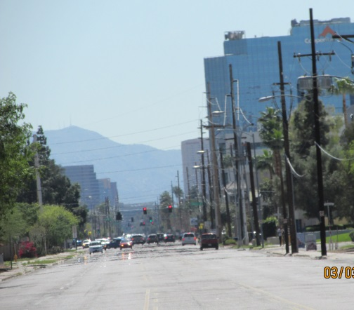
Midtown Transit District
Injury Focus Area

Slide 12
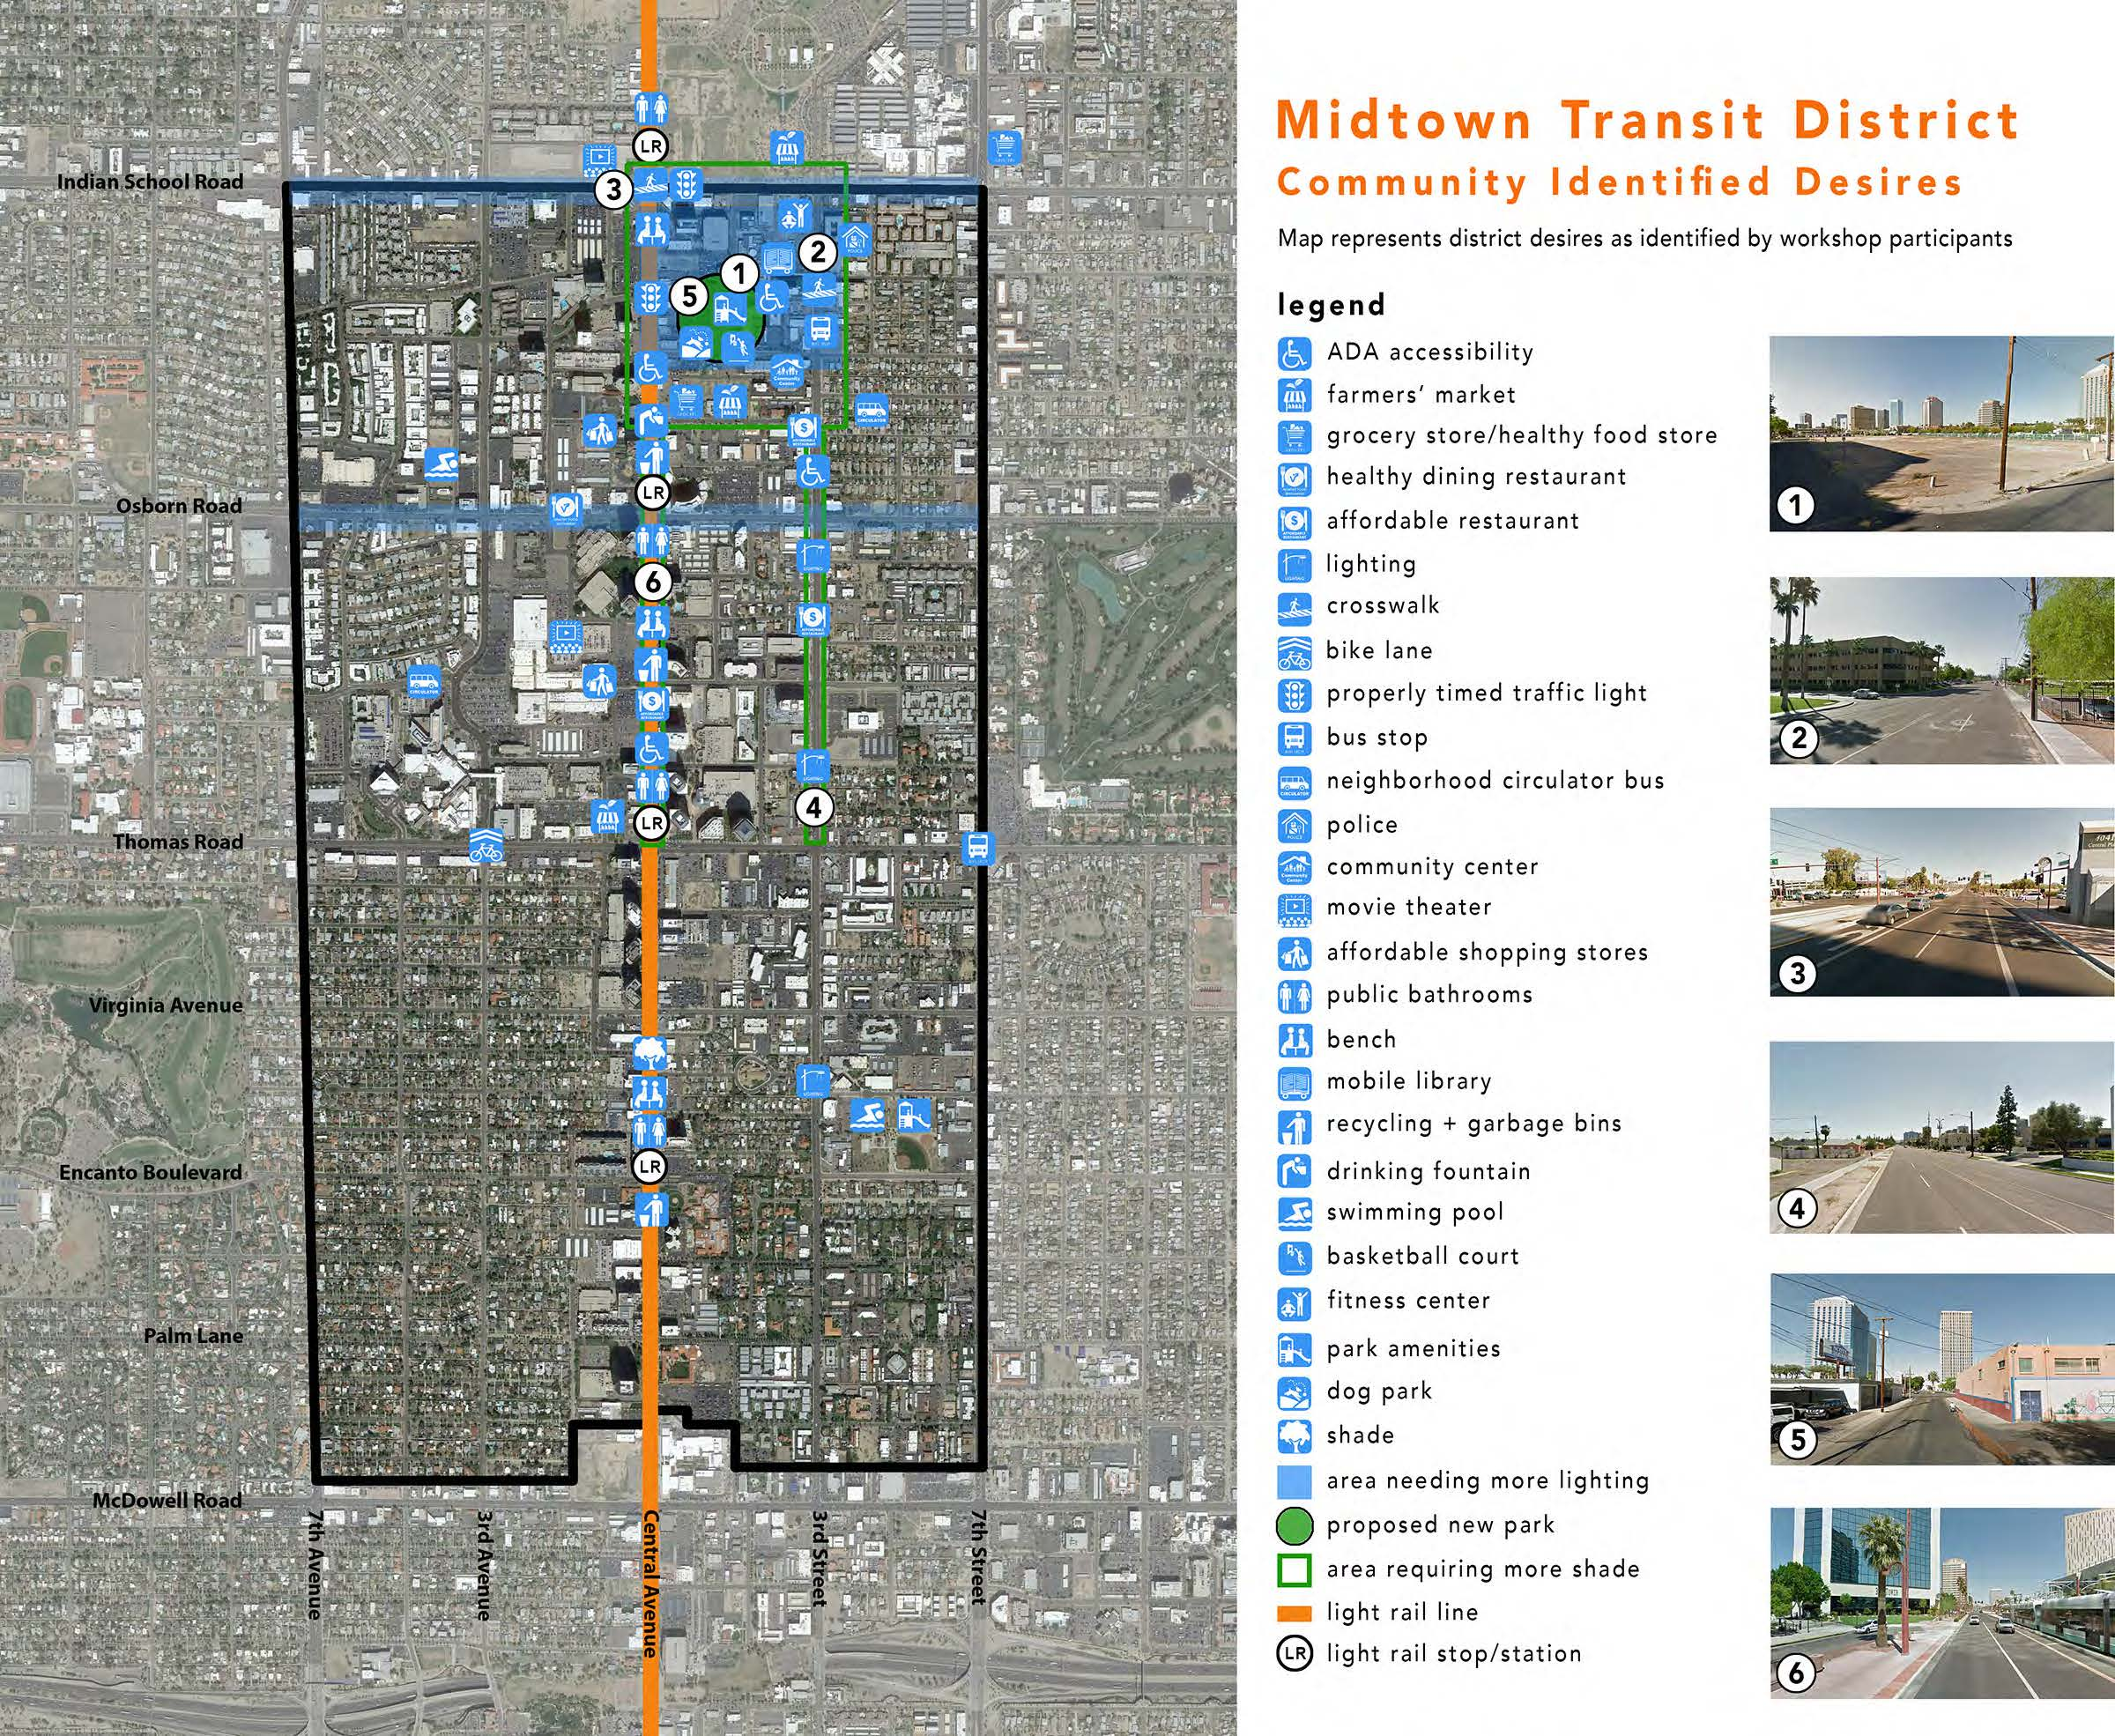

Slide 13
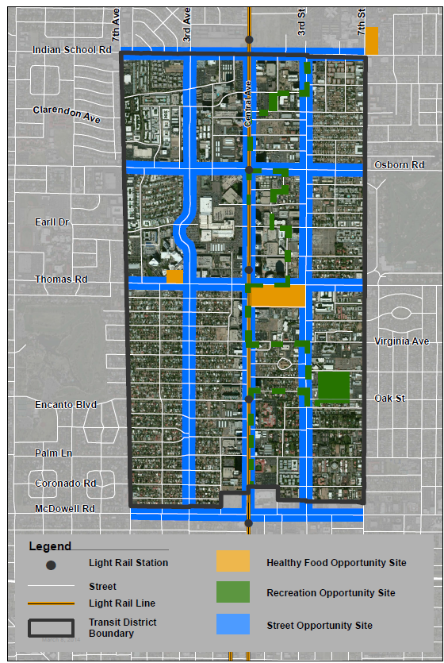
Midtown Transit District
Identified Opportunity Sites:
Healthy Food
Recreation
Street
Midtown
Transit
District
Opportunities Sites

Slide 14
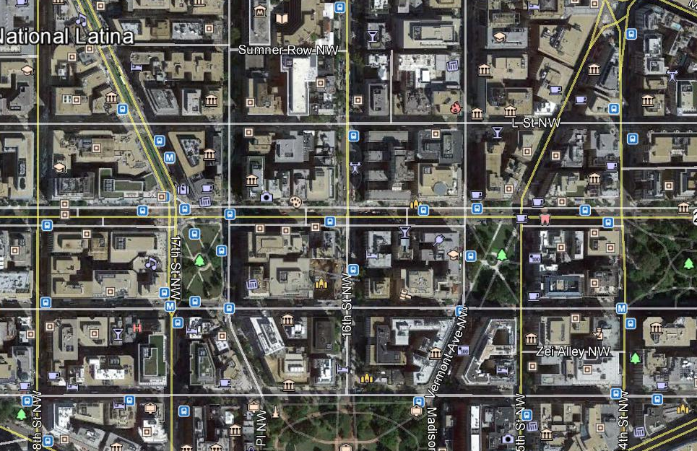
HANDS ON ACTIVITY

Slide 15


4200 North Central Avenue
Phoenix, Arizona 85012
480.202.0044
ernesto.fonseca@elementalgroup.net
kim.steele@elementalgroup.net
www.elementalgroup.net
2929 North Central Avenue, Suite 1550
Phoenix, Arizona 85012
602.385.6500
info@slhi.org
www.slhi.org
350 West Thomas Road
Phoenix, Arizona 85013
602. 406-5192
pam.goslar@dignityhealth.org
www.dignityhealth.org/stjosephs
Thank you!

