Slide 1
Endeavors in Transportation Health Impact Assessment
LCDR Joseph Ralph, MPH, CHES
Healthy Community Design Initiative
June 2015
National Center for Environmental Health
Healthy Community Design Initiative
Notes:
Good evening. Thank you for coming out to hear a little bit about Health Impact Assessments. I am going to talk a bit about how my program at CDC engages in Health Impact Assessments and how we fit into this growing network of organizations and champions for HIA.
To me, HIA seems like a natural activity. As children, part of our development includes learning how our decisions might impact our health. My kids as infants seemed to learn that if they poke themselves in the eye, it hurts. As toddlers, they learned if they run down a stair they might fall. Typically, we apply the lessons we learn to other situations, although as my 2 year old often demonstrates with his constantly scraped knees, it sometimes takes a bit of time.
As adults, HIA is also similar to another experience – a pre-operative physical. Say you’re scheduled to have your knee worked on. Prior to the surgery, you go through an assessment of your systems – heart, lungs, kidneys – to make sure that the surgery will not make these problems worse and to identify any need for medications or other supportive care that can reduce the risk of adverse health events. HIAs are like our pre-op physicals for community decisions.
Another key component of HIA is community engagement and working across different sectors with people we may not already know. If you give me a little leeway, I’d like to try an brief exercise. Can you all stand up – this helps with the public health component – turn to your neighbor, and, for the next minute, tell each other who you are and why you’re interested in HIA?

Slide 2
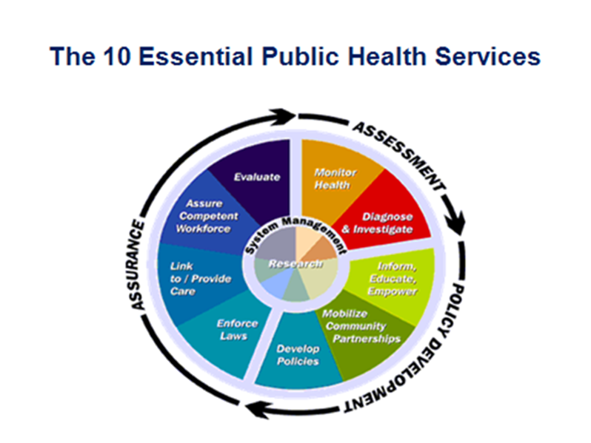
Notes:
I want to take a step back and provide a broad view of public health because it could help with identifying how and where HIAs fit in. This is a schematic of the 10 essential public health services. Whether the problem is an infectious disease or a environmental issue, this broad framework provides an idea of how public health practitioners tackle problems.
At the core of the framework is research – all decisions reflect the best available evidence and research is conducted to address gaps in knowledge. The assessment component is what many people think of public health work – counting diseases or risk factors or investigating when an outbreak or other problem arises. Assessment is no where near the end of the pathway. To make improvements and try to fix the problem, public health works on policy development and then works on assurance activities to make sure that the structures are in place for the policy to be implemented effectively.
HIA meshes well with these activities. The final product of an HIA is a set of recommendations that can inform the development of policies. Other 10 essential services are also involved. HIAs draw on a body of research, they pull data from assessment activities in the study area, they pull people together to gather stakeholder input and provide education. And many of them evaluate the impact that they have had.
-What public health does

Slide 3
Healthy Community Design Initiative (HCDI):
Prevent disease and injury by creating environments that provide the opportunity to safely walk, bicycle, or use public transit.
  Public health surveillance and translation
  Education
  Strategic partnerships
  HIA practice support
  Targeted research and evaluation
Notes:
I work in a group called the Healthy Community Design Initiative, or HCDI. Our mission is to ……
Our program grew to embrace HIAs not because we are focused on promoting HIA, but because of the effectiveness HIA can have on transportation and land-use decisions.

Slide 4
Transportation and Health Opportunities
Increase physical activity
Reduce injuries
Reduce air pollution exposure
Improve access
Reduce health disparities
Notes:
The transportation environment has a number of different opportunities for improving health. These include…..
HIA fits well into this mix because there is a body of research for these challenges – some of it could be expanded. Also, the solutions for one component may impact another component, so there is a need to balance and prioritize outcomes.

Slide 5
Opportunities for Including Health in Transportation
Projects
  Checklist
  Modeling
  Health Impact Assessment (HIA) – rapid to comprehensive
Long range planning
  Health sector participation
  Surveys
  HIA
  Health goal setting
Implementation
  Project selection criteria
  Performance measures or evaluation criteria

Slide 6
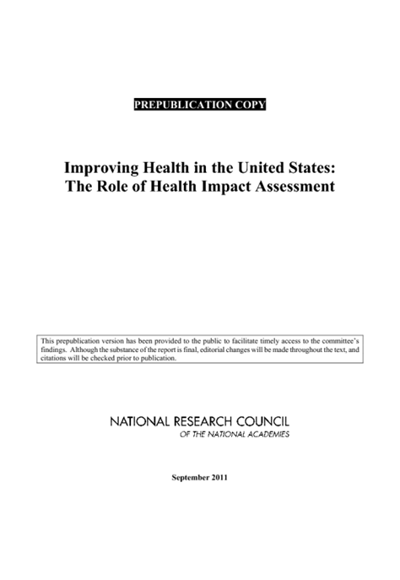
Health Impact Assessments
Health Impact Assessment (HIA)
  HIA is a systematic process that uses an array of data sources and analytic methods and considers input from stakeholders to determine the potential effects of a proposed policy, plan, program, or project on the health of a population and the distribution of those effects within the population. HIA provides recommendations on monitoring and managing those effects. - National Research Council, 2011
Steps
  Screening
  Scoping
  Risk Assessment
  Recommendations
  Reporting
  Evaluation

Slide 7
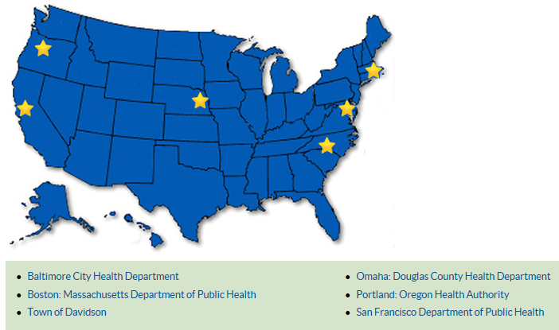
Grantee Locations
Notes:
Grantee locations. Information described from annual reports and summaries.
http://www.cdc.gov/healthyplaces/stories/default.htm

Slide 8
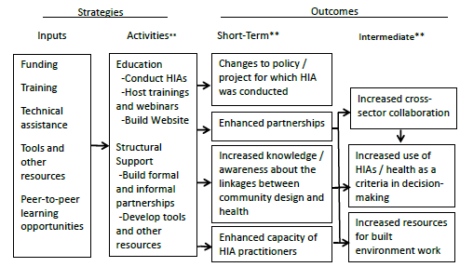
Logic Model
**Measured
Notes:
Some of the major activities that our recipients must complete each year include:
Conduct three HIAs targeted at a transportation or land-use
Build formal and informal partnerships to establish a steering committee and implement infrastructure or policies
Conduct a minimum of two trainings on HIA and healthy community design
Develop and maintain a publicly accessible webpage
Develop a metric and track both the number of pedestrian and bicyclist injuries and the number of pedestrian and bicyclist trips (or a proxy) in the areas in which HIAs are performed, and the ratio of the two

Slide 9
Impacts
54 completed HIAs impacted an estimated 4.4 million people.
Completed 56 trainings that impacted 32 states and for over 1796 professionals
Created over 120 strategic partnerships
Developed key tools and resources including:
  New methodology for examining the impact of changes on urban corridor speed
  Geo-database of Social Determinants of Health indicators
  Healthy Community Design Toolkit
Notes:
Impacts of Health Impact Assessment to Foster Healthy Community Design
- 54 HIAs completed improving the health outcomes of transportation and land-use decisions for an estimated 4.4 million people.
- Completed 56 trainings that impacted 32 states and for over 1796 professionals
- Created over 120 strategic partnerships with state and local organizations
- A new methodology for examining the impact of changes on urban corridor speed
A relational geo-database of Social Determinants of Health indicators to serve as the foundation for a future Baltimore Healthy Development Measurement Tool.
HCD Toolkit identifies key “Leverage Points” in local community design, planning and development to facilitate the complicated process of making communities healthier

Slide 10
Transportation HIAs
Completed 22 HIAs on transportation decisions including:
  Specific facilities
  Corridor plans
  Street design
  Transit oriented development (TOD)
Notes:
Of the 54 total HIAs, 22 targeted transportation decisions (remainder on land-use issues) Description of HIAs related to transportation. Some are projects, others are plans.

Slide 11
Example Individual HIA Success Stories
Faster implementation of project
  Road diet, Douglas County, NE
HIA used to obtain implementation funding
  Bicycle and pedestrian plan, Crook County, OR
Prioritization of projects include health consideration
  Active transportation plan, Davidson, NC
Notes:
Description of each individual success story. Note that continued follow-up in current HIA communities, and multi-year work allowed the HIA to transition to impact.

Slide 12
Common Practices
Trainings targeting specific HIAs
Continued monitoring of initial HIAs
Exploration of quantitative assessment methods
Links to other public health programs
Notes:
Practices in addition to requirements of the FOA – (HIA, Website, Advisory panel, )

Slide 13
Smaller Scale
Improve access to data and research findings
Examine project impacts using HIA and provide recommendations
Transportation and land-use changes supporting health
Impact: 54 HIAs completed through cooperative agreement impacting 4.4M people
Legend: Dark blue = completed in at least one place. Light blue = in progress. Grey = not yet started. Green = outcome
Notes:
Next slides are on how transportation and land-use HIAs can fit into a broader framework.
Review legend
HIA can be one mechanism to inform transportation and land-use choices. They rely on access to data and research findings, at least informal connections between health and transportation, and decision-makers willing to receive the HIA findings. Through this route -

Slide 14
Medium Scale
Modify regional surveys and identify other data to provide inputs to transportation and health models
Model different scenarios to provide estimates of health impact
Transportation and land-use changes supporting health
Impact: Increase from 3% to 70% of projects selected for construction contained bicycling or pedestrian infrastructure.
Legend: Dark blue = completed in at least one place. Light blue = in progress. Grey = not yet started. Green = outcome
Notes:
Medium scale
Some of our HIA grantees have begun to engage in efforts beyond individual HIAs. These efforts can include partnering to obtain data that can provide inputs to quantitative assessments or models.
In Nashville, the MPO was able to use this effort already to achieve an increase from 3% to 70% of projects selected for construction that contained bike/ped infrastructure. Worked with them to calibrate the Integrated Transportation and Health Impact Model which is presented in another session.

Slide 15
Larger Scale
Help national data align with health and transportation decision-making
Use experience with models and HIAs to develop options for analysis supported by new national data
Transportation and land-use changes supporting health
Impact: Over 25 million people live in places with new transportation policies informed by Bicycling and Walking in the United States Benchmarking Report.
Legend: Dark blue = completed. Light blue = in progress. Grey = not yet started. Green = outcome
Notes:
Larger scale efforts could include helping align national data with health and transportation decision-making. Some preliminary work has already been completed with the Benchmarking Report.
The experiences at the local and regional levels might provide perspective on how to make larger scale efforts work.

Slide 16
Thank You
LCDR Joseph Ralph, MPH, CHES
CMQ8@cdc.gov
National Center for Environmental Health
Division of Emergency and Environmental Health Services
Notes:
Thank you for your time.

