Slide 1

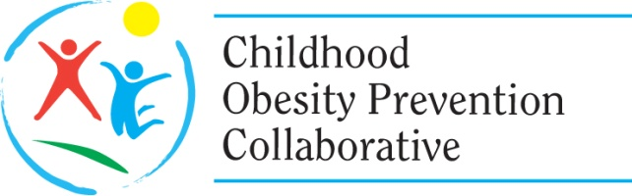
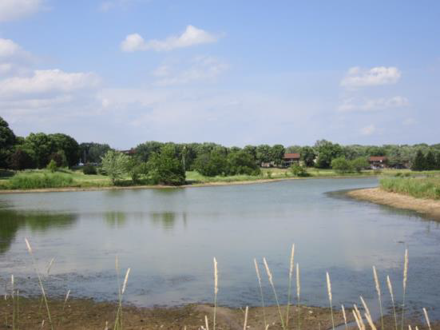
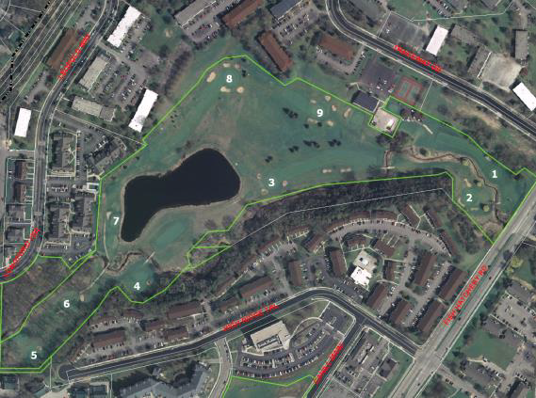
Fitchburg Nine Springs
Health Impact Assessment
Notes:
1

Slide 2

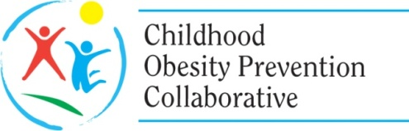


Health Equity in Our Communities
The goal of our HIA was to work collaboratively with community members to bring health into the planning process for the future use of the Nine Springs Golf Course property.
Community Advisory Committee
local residents
community faith leaders
neighborhood advocates
school staff
Notes:
We became involved in this Health Impact Assessment in the summer of 2013 when we learned that the City of Fitchburg (south of Madison) was going to be voting on the use of a golf course (subsidized by the city) set in the middle of low-income housing. This was brought to our attention by a Fitchburg alder who saw this as an equity issue for those living around the golf course, as there was a perceived lack of access to open green space and play space for the neighborhood.
An estimated 3,500 people live within walking distance (1/4 mile)
An estimated 8,525 people live within biking distance (1/2 mile) of the golf course.
We attended the HIA conference in September, 2013 and were already struck by the tension posed by using the HIA as a tool to provide valuable information on a political decision VERSUS using the HIA as a community engagement tool to share an opinion or an expressed direction on the decision.
2

Slide 3
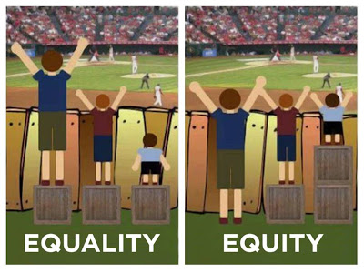
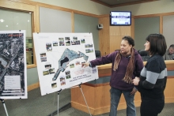
The Process
Screening
transparent with key partners about equity and inclusion practices
held one-on-one meetings and formed the Community Advisory Committee (CAC) and Technical Advisory Committee (TAC)
Scoping
worked with CAC to identify and prioritize key health factors
CAC developed the research questions
TAC provided data sources for the CAC
Notes:
As we mentioned, our intent was to bring the voice of the neighbors to the decision. Equity was a key factor in our HIA, as the affected neighbors were primarily Spanish speaking Latino and historically did not have a voice in political decisions.
This morning we will highlight the ways we have infused health equity into each step of the HIA process.
Screening
We investigated the use of an HIA with key stakeholders. The city administrator informed us that we needed to be unbiased. We agreed that this was the intent of the tool but the community resident would lead the process because we were operating through the equity lens.
To this end, we immediately partnered with a community engagement group to do door-to-door invitations for public meetings. Additionally, we hired an interpreter for these meetings and worked with the City to translated materials into Spanish.
Screening
In September 2013, the HIA Leadership team formed a Community Advisory Committee (CAC), and a Technical Advisory Committee (TAC) to assist staff with the HIA efforts. The CAC provides an opportunity for resident engagement and was comprised of organizations that serve the study area such as Neighborhood Associations, churches and schools or individuals that live within a ½ mile radius of the golf course.
We had a member of each group sit on the others to ensure fair and equitable representation and voice.
The CAC and the TAC were formed to provide guidance throughout the six steps of the HIA. Their involvement included providing technical expertise, connection to residents and local community leaders, and guidance on important decisions. Since health was not a factor being considered in the Master Planning process, the formation of the two advisory committees was effective in raising awareness about these impacts on the community.
scoping
The CAC was comprised of community members who identified priority impacts on their health if the land was converted into a park OR if it remained a golf course.
The CAC also developed questions for our one on one stakeholder interviews.
3

Slide 4
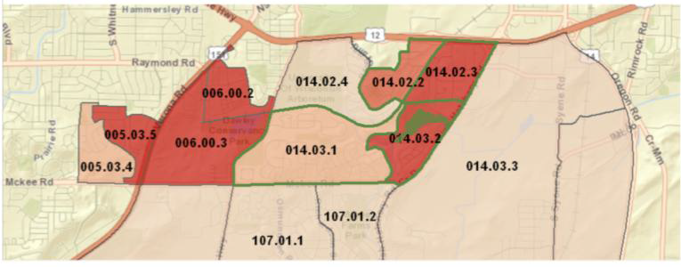
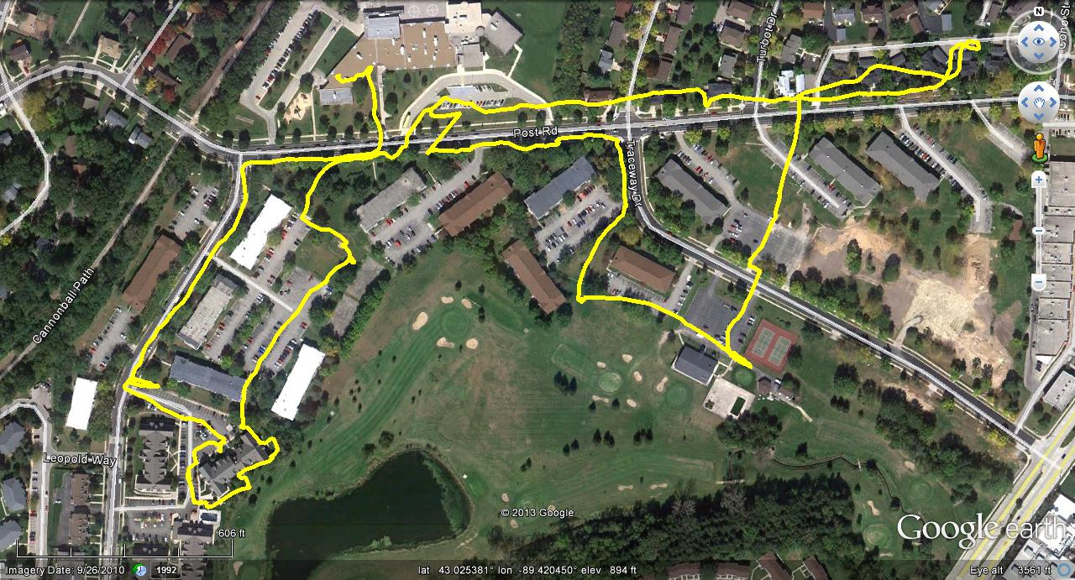
The Process
Assessment
Collection and review of peer-reviewed literature
Analyses of population health data for the City of Fitchburg and Dane County
Qualitative data collection
Equity Assessment toolkit
CAC members presented qualitative data results and analysis at multiple Commission and Common Council meetings
Notes:
Assessment
Quantitative:
PHINEX: Public Health Information Exchange system
The area surrounding the golf course lies within the Fitchburg census block group (014.03.2) ranked #1 for obesity.
Nearly 1 in 4 (24%) children ages 2-17 in this area are obese.
Qualitative:
Key informant interviews with decision-makers and other stakeholders
A focus group discussion with individuals who golf at the Nine Springs Golf Course.
Participatory Photo-mapping by youth attending a local afterschool program
A community survey
Our key intent of this phase was to elicit feedback from the community on their current neighborhood existing conditions regarding priority issues the CAC identified including: environmental health, access to physical activity, community safety, and social cohesion.
This was important as we completed an Equity Assessment using the City of Madison Racial Equity and Social Justice toolkit - where we worked with the CAC to start the recommendation prioritization process. The Equity Assessment also highlighted that regardless of whether the Master Park Plan is implemented or the Nine Springs Golf Course is maintained, language and cultural barriers between nearby residents and local government can impede communication regarding any potential changes in the property as well as available uses and regulations on the property.
4

Slide 5
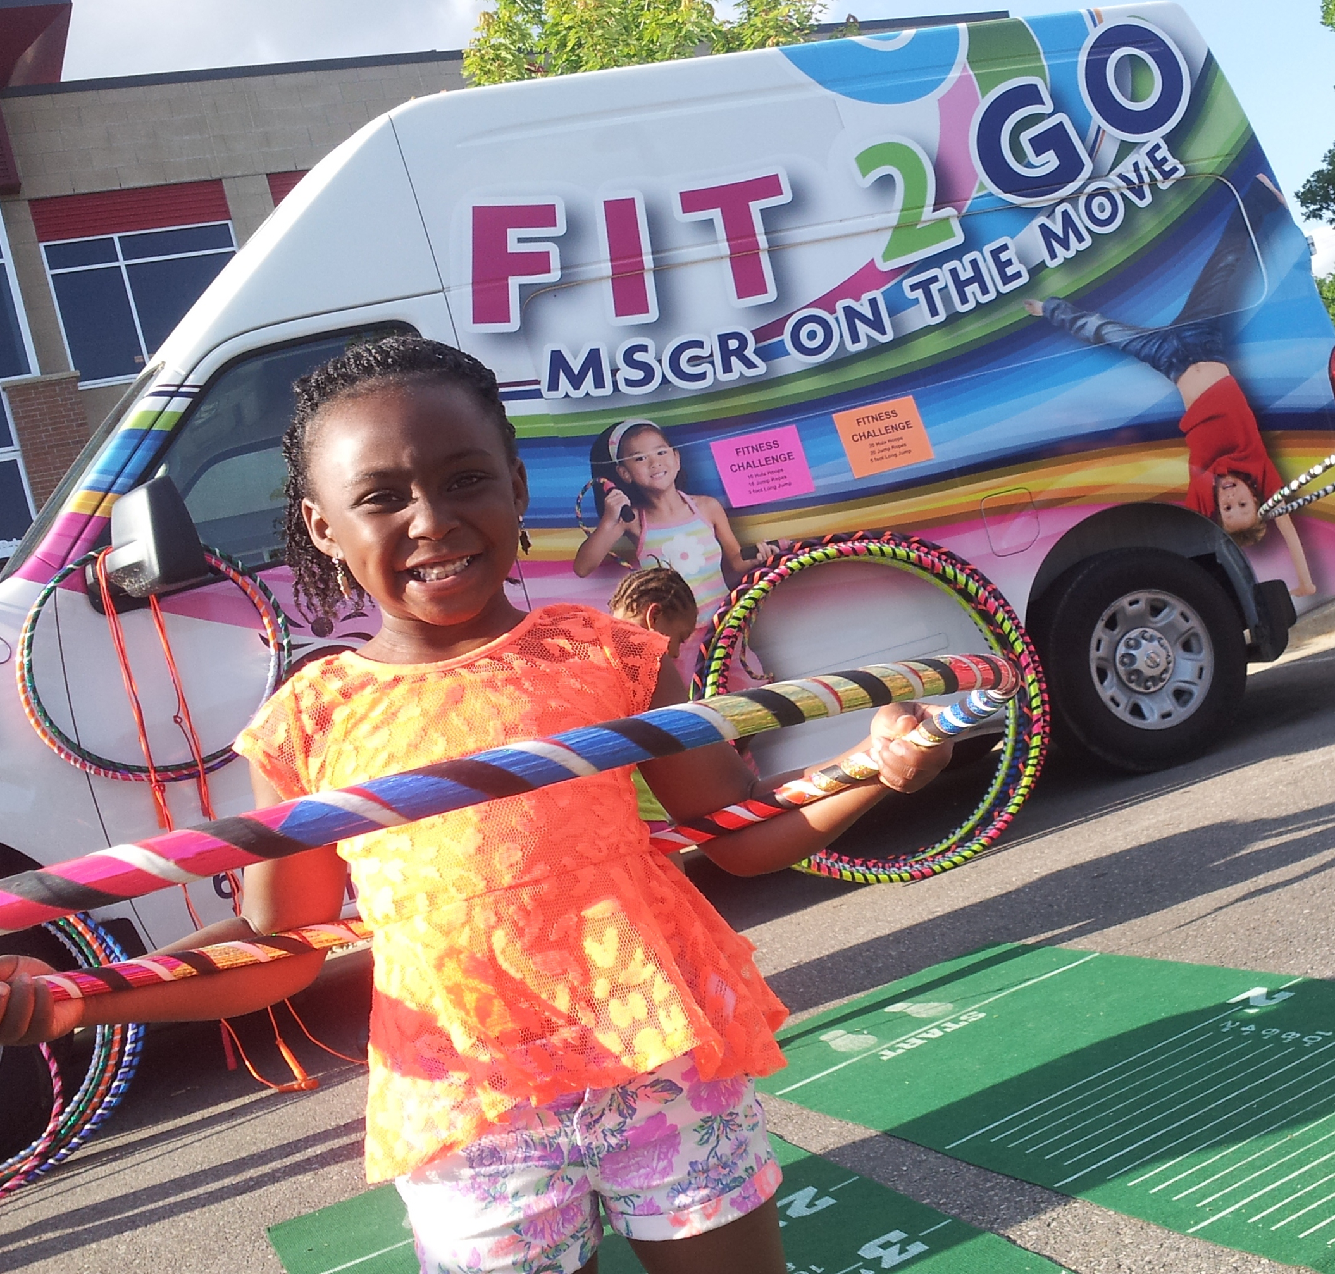
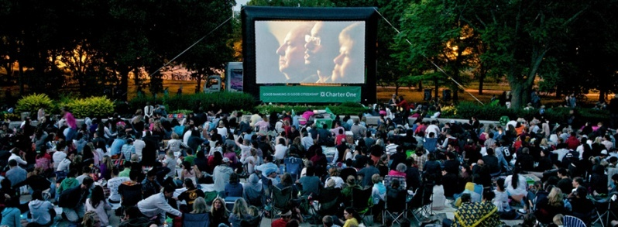
The Process
Recommendations
included two sets of recommendations based on the direction of the decision
HIA staff and CAC members participated in meetings with residents and other key stakeholders to review, revise and prioritize recommendations
Reporting
CAC members presented to the Common Council before the vote
Evaluation and Monitoring
integrated this work into the work of an existing neighborhood association
continued to work with city to provide access to physical activity in this area
Notes:
Recommendations
Regardless of the ultimate decision, the CAC prioritized equity around the main HIA priorities:
Strengthening community engagement to support utilization of the green space and increase social cohesion
Increasing low or no cost opportunities for physical activity
Increasing the perception of safety of the neighborhood
Protecting the health of the local environment.
Reporting - CAC members presented at numerous Park commission meetings, as well as the Common Council before the vote. Some CAC members also met with Council members 1:1 before the vote. Public Health and COPC intentionally “staffed” these report-outs, while the CAC owned the recommendations.
Evaluation/Monitoring
CAC worked on neighborhood movie night
Fit2Go Van visited isolated community
5

Slide 6
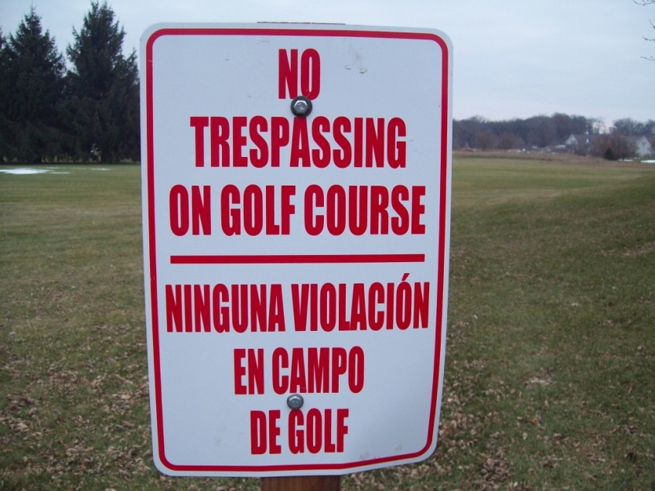
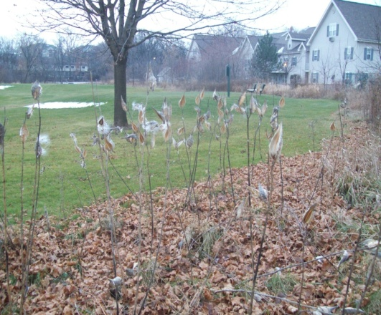
Evaluation: Community Voice
"This was my first time participating in an HIA, and I learned so much about my community, how to gather data and apply it in a report…finding new talents and gifts in myself, and meeting new people who took the time to listen"
– CAC member
"The CAC was a very beneficial part of the process, and I think involving people in the community is very important"
– HIA participant
"I think that the CAC formation has already had really profound effects in the community development and it can continue to grow after the HIA is finished"
– HIA participant
Notes:
6

