Slide 1
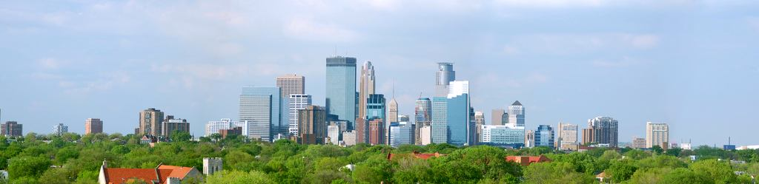

Twin Cities Air Pollution and Health
Urban Air Quality and Health Initiative
May 2015
Notes:
Do not use shading for titles or text

Slide 2
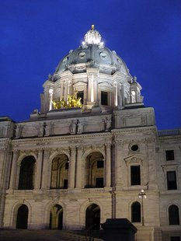
Legislative Directive
Concern over relationship between air quality and health
2013 Session directs MDH and MPCA to study trends and community impacts
Twin Cities area targeted:
    High risk populations
    Air quality data available

Slide 3
Initiative Deliverables
Technical report on air quality and related health hazards
    Presents scientific evidence/data
Community Toolkit
    Creates a central location for information, data, and action steps
Health Impact Assessment
    Gather community input on air quality issues through an HIA on Green Zones in Minneapolis

Slide 4

State Agency Participants
MPCA Staff
  Air Assessment Section
  Environmental Justice Coordinator
MDH Staff
  Environmental Surveillance and Assessment Section
  Chronic Disease & Environmental Epidemiology Section
Notes:
Who’s riding? Air Assessment Section – Mary Jean Fenkse, Frank Kohlasch, myself, David Bael, Kristie Ellickson, Greg Pratt, Mary Williams, Dorian Kvale; EJ Coordinator – Ned Brooks
MDH Environmental Surveillance and Assessment Section – Dan Symonik, Kristin Raab, Linden Weiswerda
MDH Chronic Disease & Environmental Epidemiology – Jean Johnson, Chuck Stroebel, Wendy Brunner (asthma staff)
Steering team, comprised of supervisors/managers and other staff from both agencies meet monthly to provide direction to the core team, who work on the deliverables of this initiative that I’ll later describe.

Slide 5
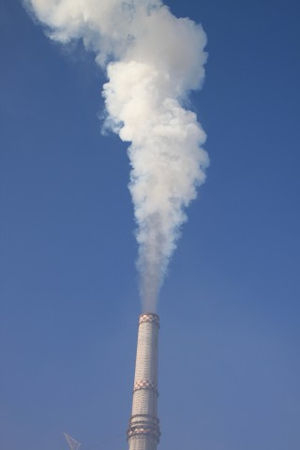
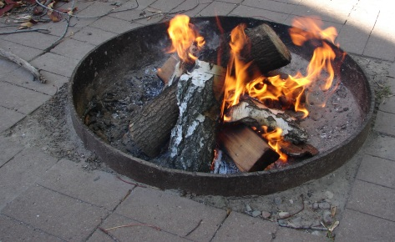
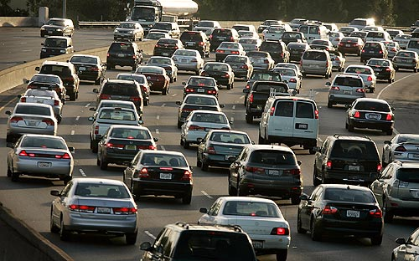
Health Impact Assessment
Focused on communities in the Twin Cities with the highest burden of poor air quality and poor respiratory health
Inform decision-makers about the effects of policies on the health of people
Makes specific recommendations to improve health outcomes
Notes:
Health Impact Assessment
Process used by organizations and community groups to provide decision-makers with information about how any policy, program or project may affect the health of people. Considers many factors as guided by community input regarding the pathways and )
MDH is working with Nexus Community Partners to provide HIA assistance through a sole-source contract. Re-grantor, rather than RFP, to communities in E. St. Paul, North Minneapolis or South Minneapolis.

Slide 6
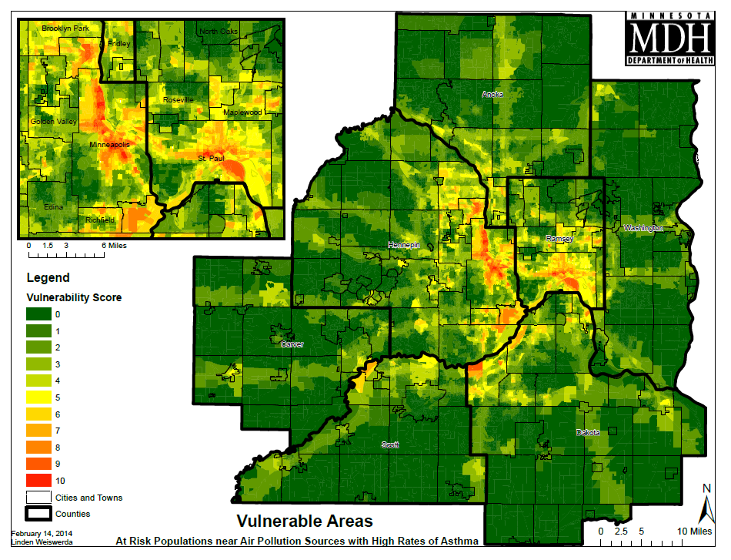
Assessment of Risks
Used GIS to overlap risk layers and estimate vulnerability score in determining HIA study area

Slide 7
Assessment of Risks
Used GIS to overlap risk layers and estimate vulnerability score in determining HIA study area

Slide 8
Funding Process
Minnesota Department of Health
Nexus Community Partners
-Hope Community
-Land Stewardship Project
-Waite House
-Isuroon
-Center for Earth, Energy and Democracy
Minnesota Department of Health
RFP Winner
Carries out HIA Project
Issues RFP
Contract issued
for HIA Funds
Funds re-granted
into smaller amounts
to multiple organizations

Slide 9

HIA Partners

Slide 10
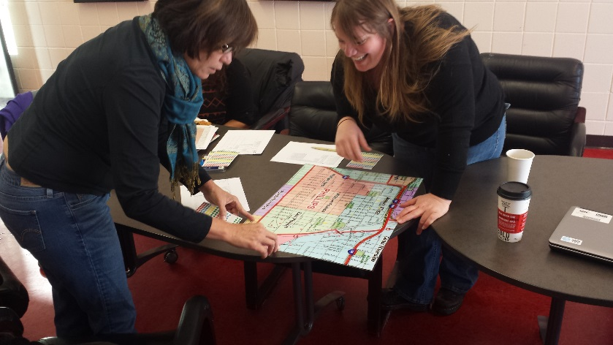
Community Engagement Model
Meetings held in the community
Inclusive rather than competitive
Funding provided, though not much
Decisions by consensus

Slide 11
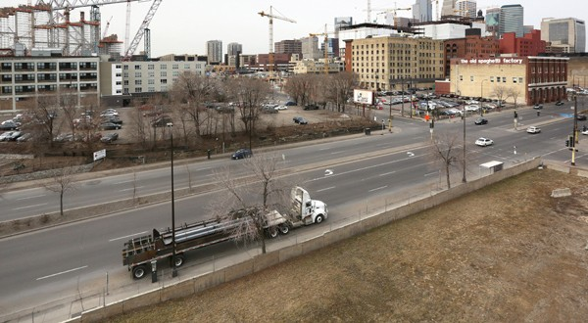
HIA on Minneapolis Green Zones
Target public and private investment in neighborhoods with the highest levels of pollution and environmental degradation
Ensure environmental justice included in plans

Slide 12
Primary Issues Examined by HIA
Healthy Air Quality
    Ozone and PM_{2.5} primary contaminants
    Greater impacts to elderly, children, poor, unhealthy
Affordable, Safe, Quality Housing
    City code enforcement
    Healthy Home = dry, clean, pest-free, ventilated, safe, contaminant free, maintained
Energy Justice/Equity
    Residential Energy Use
    Local economic impact and opportunity

Slide 13

Next Steps
Community partners will keep meeting and pursue additional funding to continue the collaboration
Encourage Minneapolis to create Green Zone
Continue to address health inequities
More state agency collaboration

Slide 14

Conclusions
Actively engaging impacted communities takes time, but results in a better solution
Green Zones can help mitigate environmental hazards and inequities
Air pollution impacts mirror established health disparities

Slide 15
Contact Information
Linden Weiswerda
Principal Planner
Climate & Health Program
Minnesota Department of Health
651-201-4924
linden.weiswerda@state.mn.us

