Slide 1
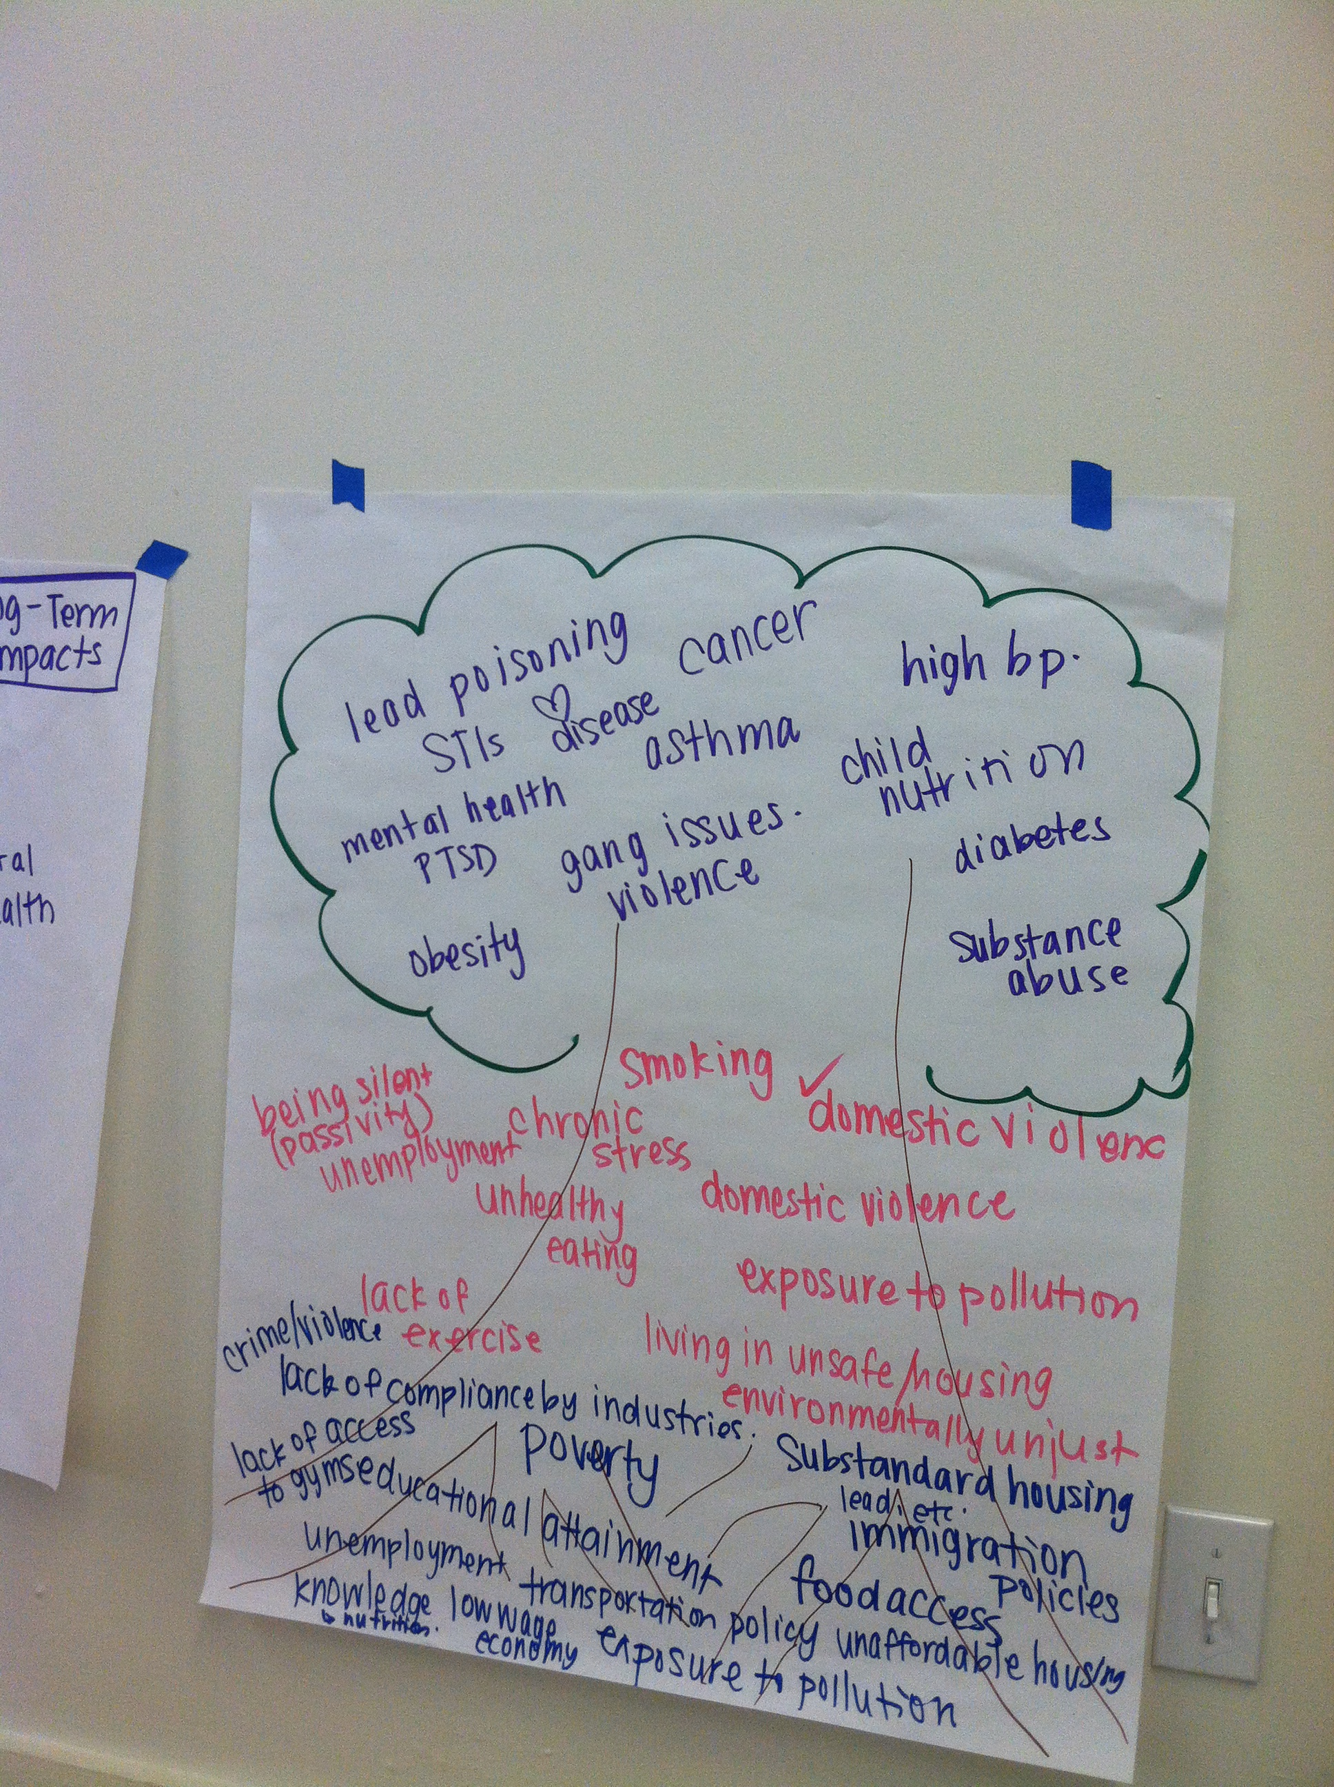
HIA + Community Engagement
A Journey towards Deeper Engagement and integration of empathy
2015 National Health impact assessment meeting
Notes:
Image from Scoping session

Slide 2
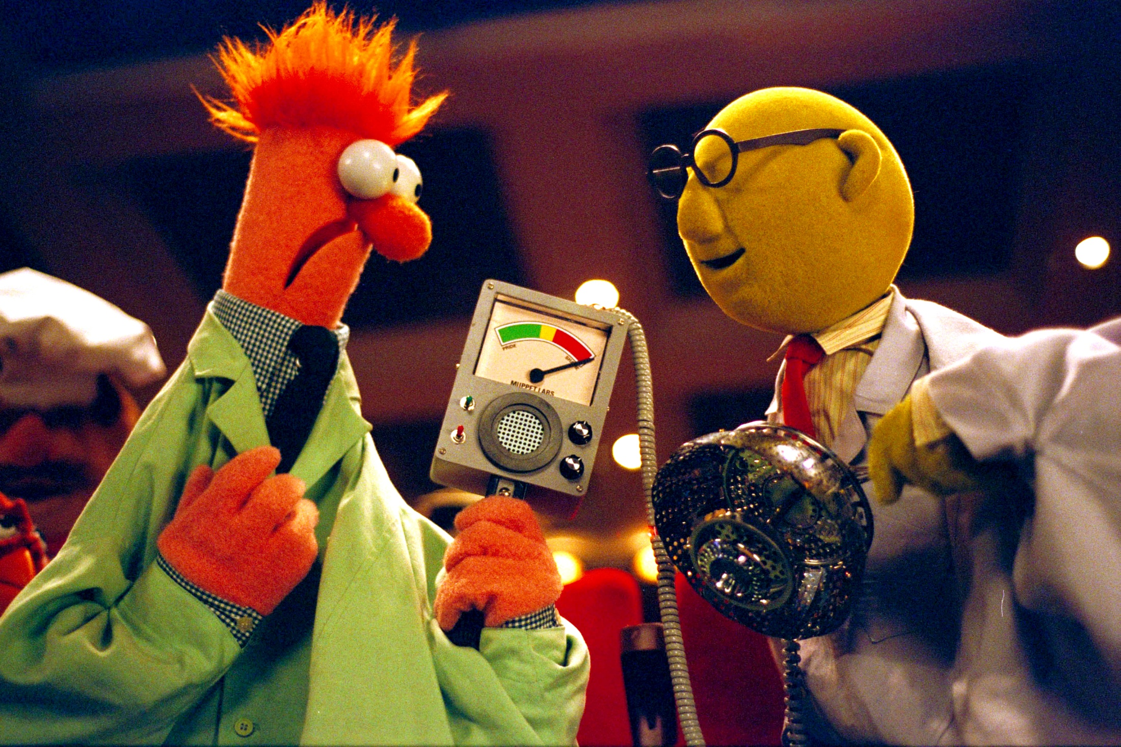
http://img2.wikia.nocookie.net/__cb20091211232717/muppet/images/d/d3/VMX-Beaker%26Bunsen.jpg
Notes:
Image from RWJF Time to Act

Slide 3
people
process
Notes:
Pull from Executive Summary

Slide 4
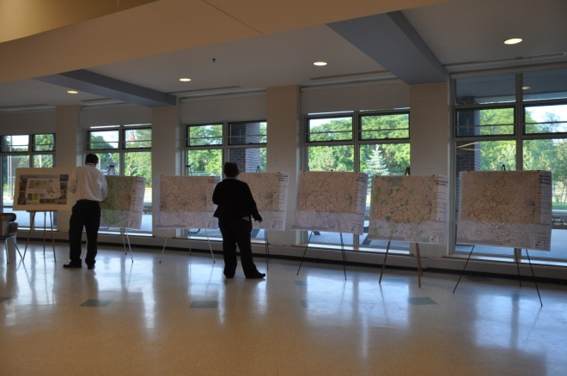
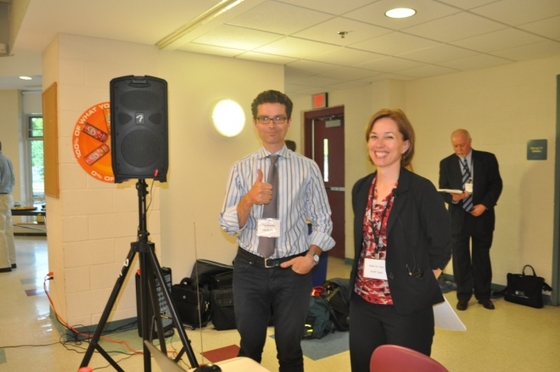
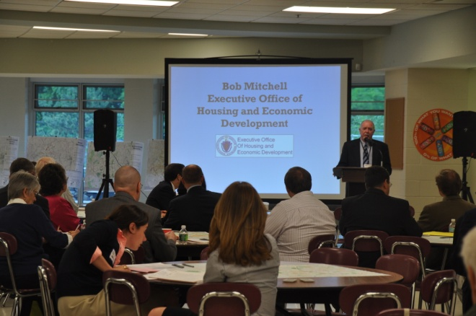
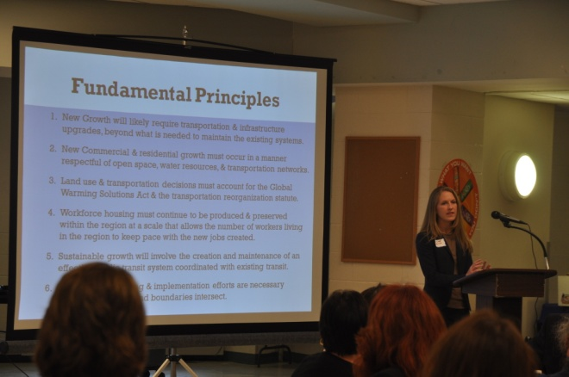

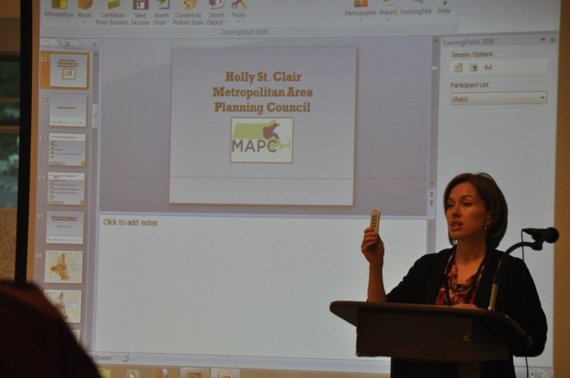
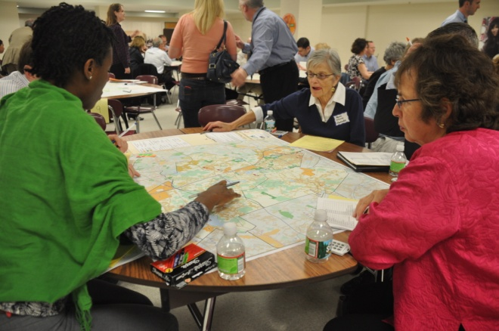
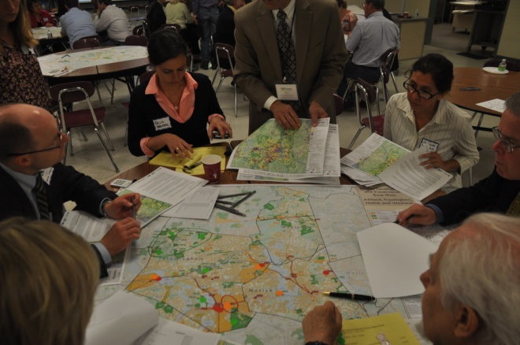
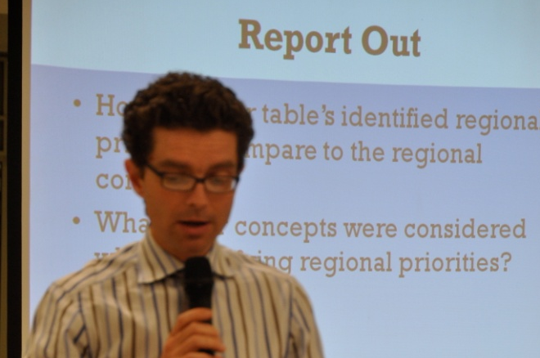
This is what it looked like
This is what it looked like
Notes:
Pull from Executive Summary

Slide 5
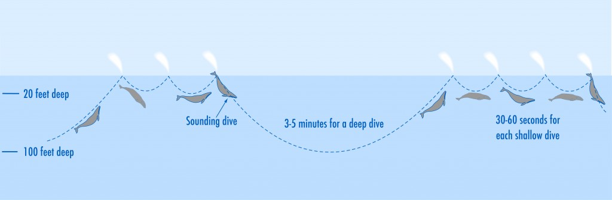
This is probably what it really looked like
There they are
2-6 months
Hurry Up and tell us what you think
Where’d they go
http://scrippsblogs.ucsd.edu/onboard/files/2012/01/sounding-diagram1-1024x335.jpg

Slide 6


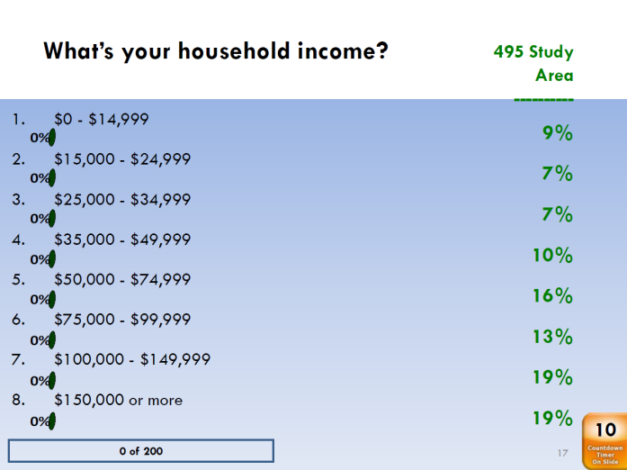

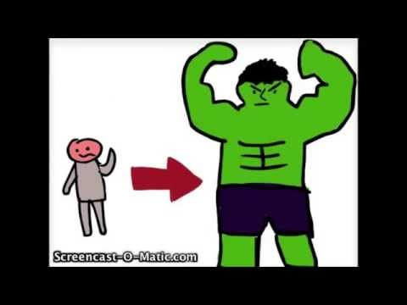
What were the results
http://images.sodahead.com/polls/002505109/338454844_bl12_312_this_or_that_01_xlarge.jpeg
http://techpubs.sgi.com/library/dynaweb_docs/0650/SGI_EndUser/books/Octane2_OG/sgi_html/figures/sysshutdown.gif
http://www.sellbetter.ca/wp-content/uploads/2015/05/blinder.jpg
Marieke van Lankvelt
Notes:
Weak’ outcomes
Small range of solutions presented
Process and content was specific
Who as in room
Who was empowered

Slide 7
push
pull
Notes:
Pull from Executive Summary

Slide 8
affected
efficacy
Notes:
Pull from Executive Summary

Slide 9
sympathy
empathy
Notes:
Pull from Executive Summary

Slide 10
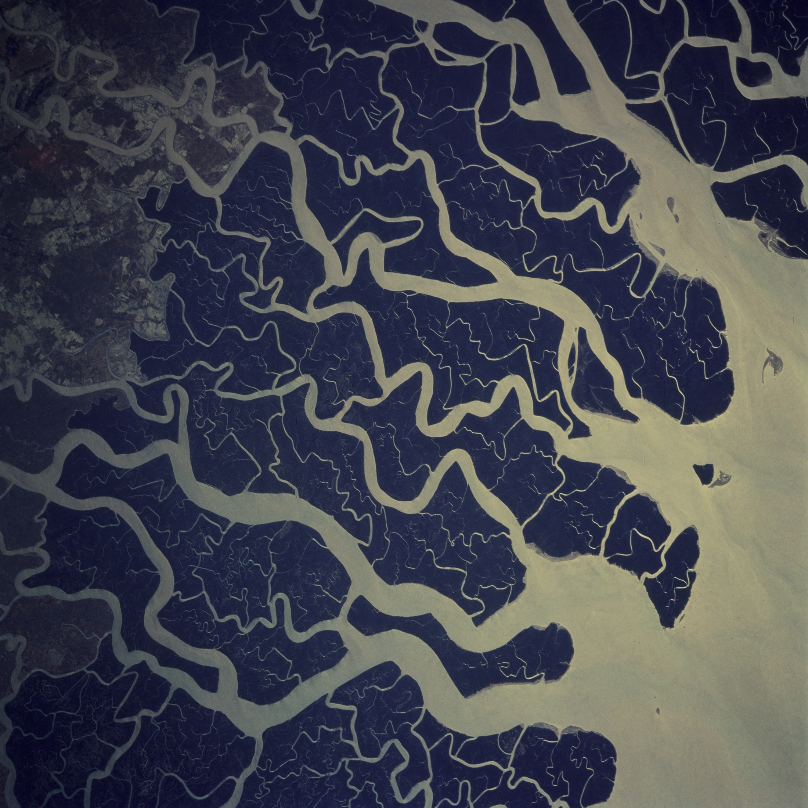
Confluence
https://farm3.staticflickr.com/2927/14610275771_de27385d55_o_d.jpg

Slide 11
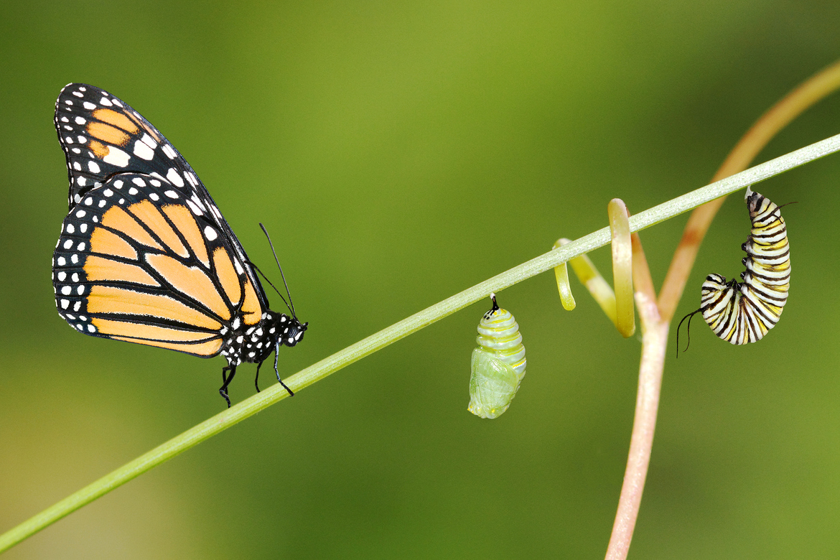
Planning model >>> Public health model

Slide 12
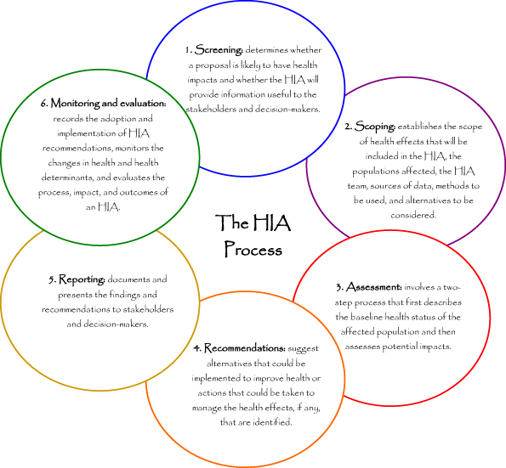
HIA process
http://www.healthimpactnc.com/wp-content/uploads/2012/11/HIA-Process-Diagram.jpg

Slide 13
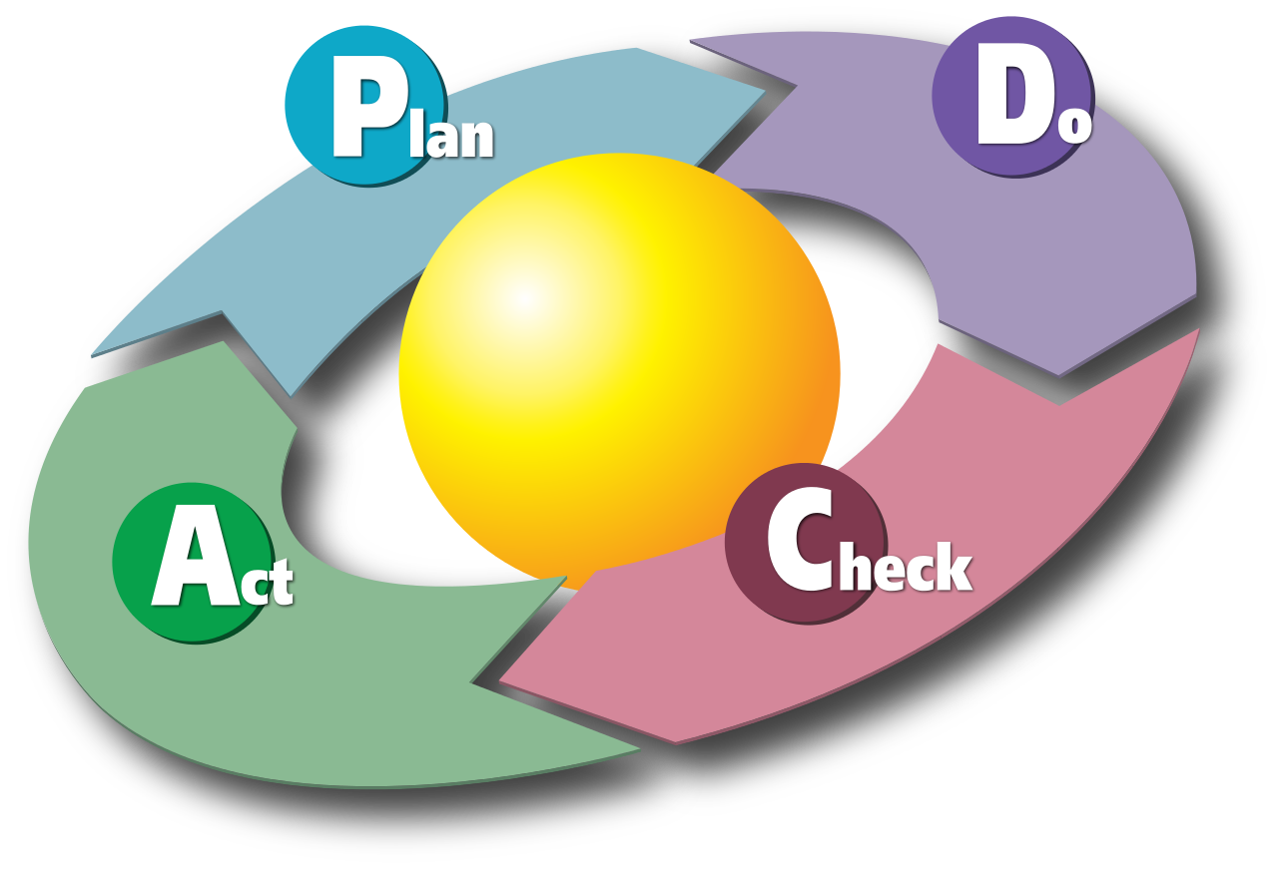
Quality Improvement
http://upload.wikimedia.org/wikipedia/commons/thumb/7/7a/PDCA_Cycle.svg/1280px-PDCA_Cycle.svg.png

Slide 14
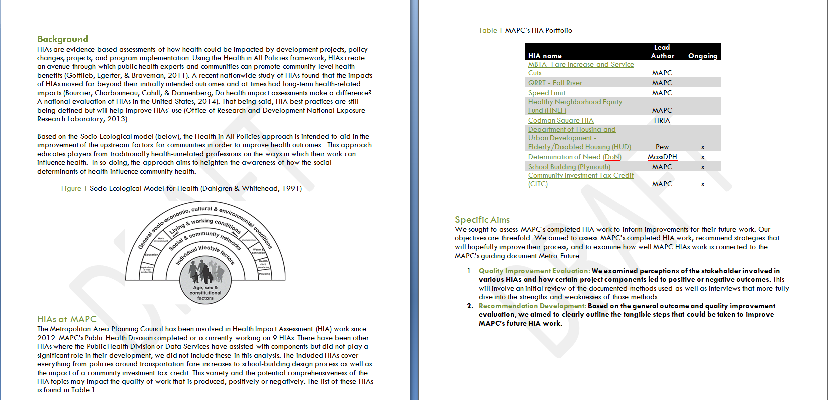
Process Evaluation

Slide 15
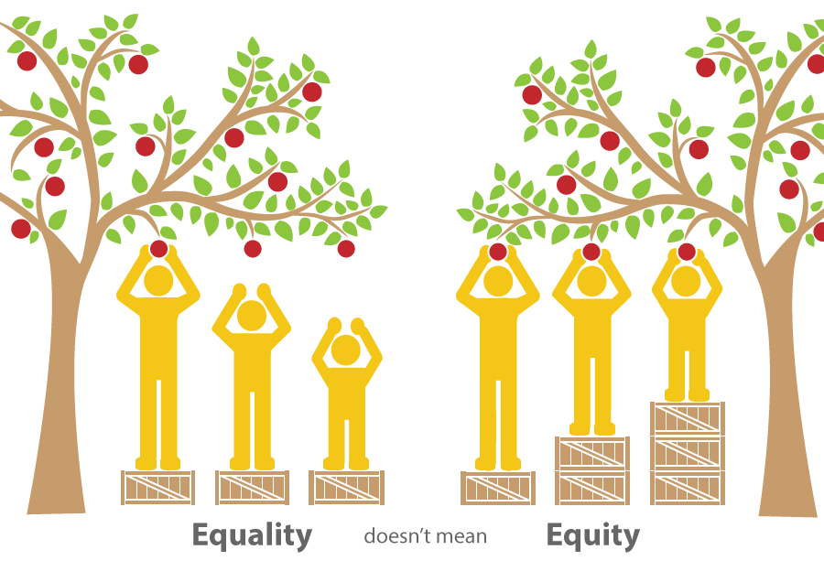
Thriving and fair
http://www.communityview.ca/images/2014_health_equity_SHR_health_equity.png

Slide 16
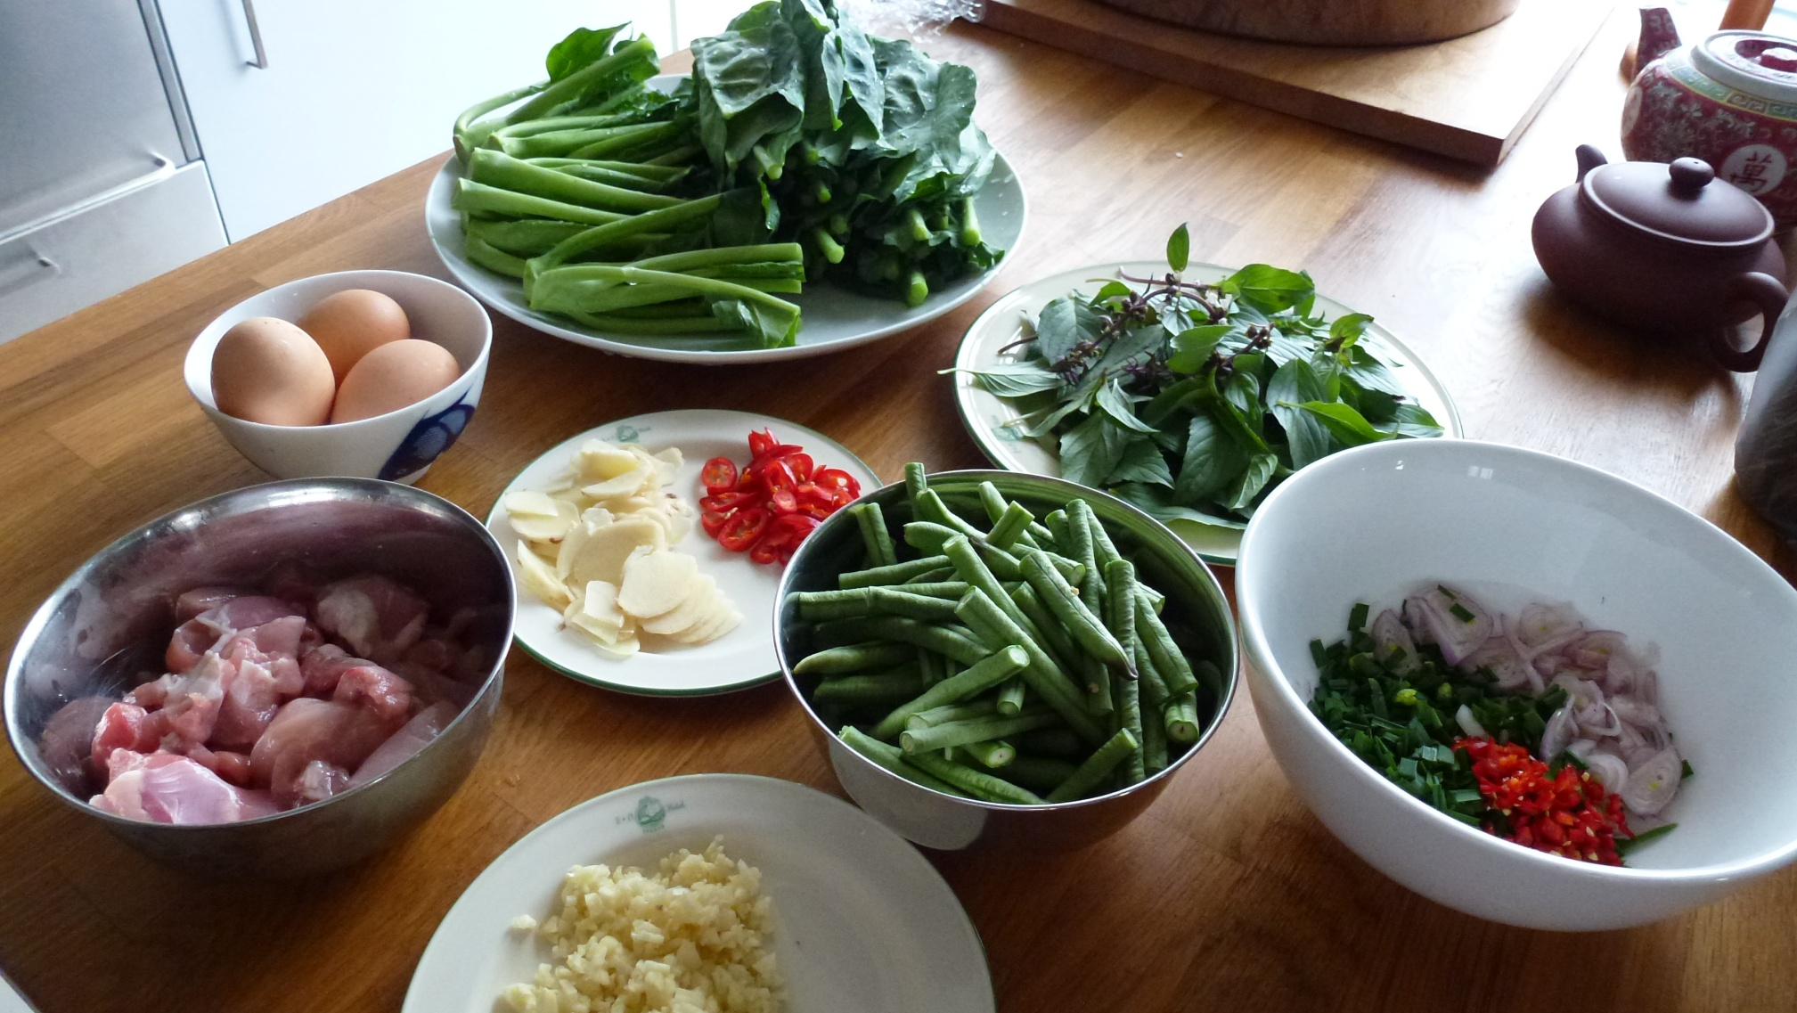
How are we doing it differently
http://www.healthimpactnc.com/wp-content/uploads/2012/11/HIA-Process-Diagram.jpg

Slide 17
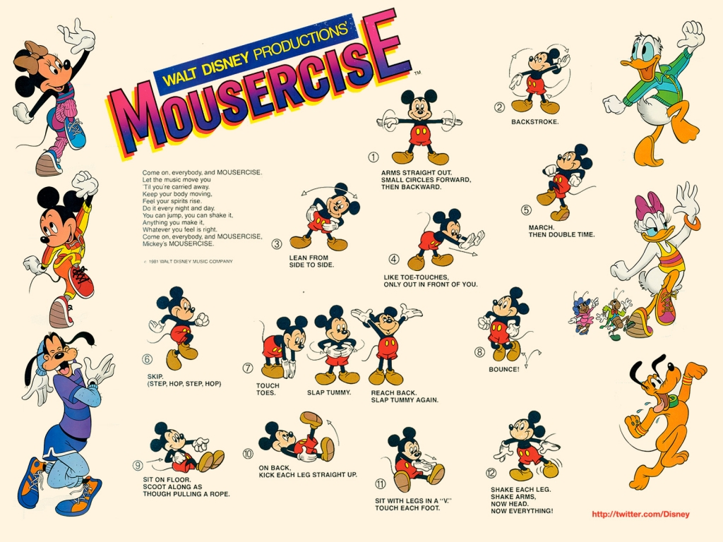
Warming folks up
http://pensandomagro.net/wp-content/uploads/2012/01/mousercise.jpg

Slide 18

Recognizing that walls aren’t necessary
http://digitalonq.com/2014/05/02/pass-the-kool-aid-oh-yeah/

Slide 19
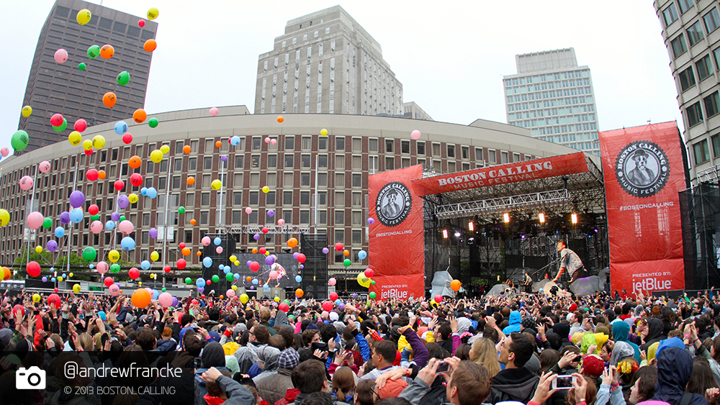
Meeting where people are

Slide 20
There they are
0.5-1 month
Let’s have on ongoing discussion
We know when we will hear back
Constant, continuous
http://scrippsblogs.ucsd.edu/onboard/files/2012/01/sounding-diagram1-1024x335.jpg

Slide 21
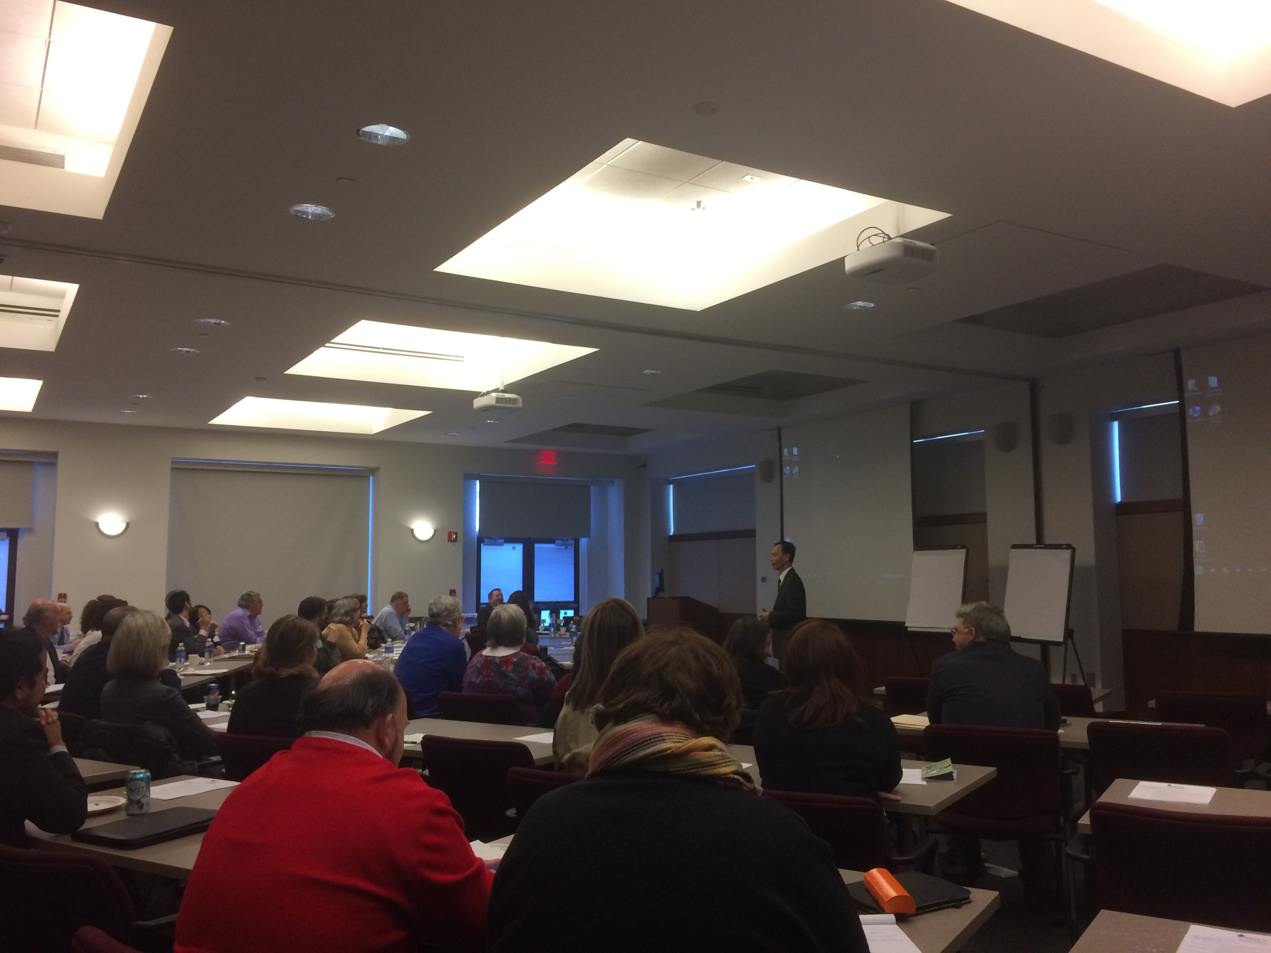
Small Business TA HIA
http://www.healthimpactnc.com/wp-content/uploads/2012/11/HIA-Process-Diagram.jpg
http://pensandomagro.net/wp-content/uploads/2012/01/mousercise.jpg

Slide 22

Building Health Neighborhoods work with Community Health Workers
http://www.healthimpactnc.com/wp-content/uploads/2012/11/HIA-Process-Diagram.jpg
http://pensandomagro.net/wp-content/uploads/2012/01/mousercise.jpg

Slide 23
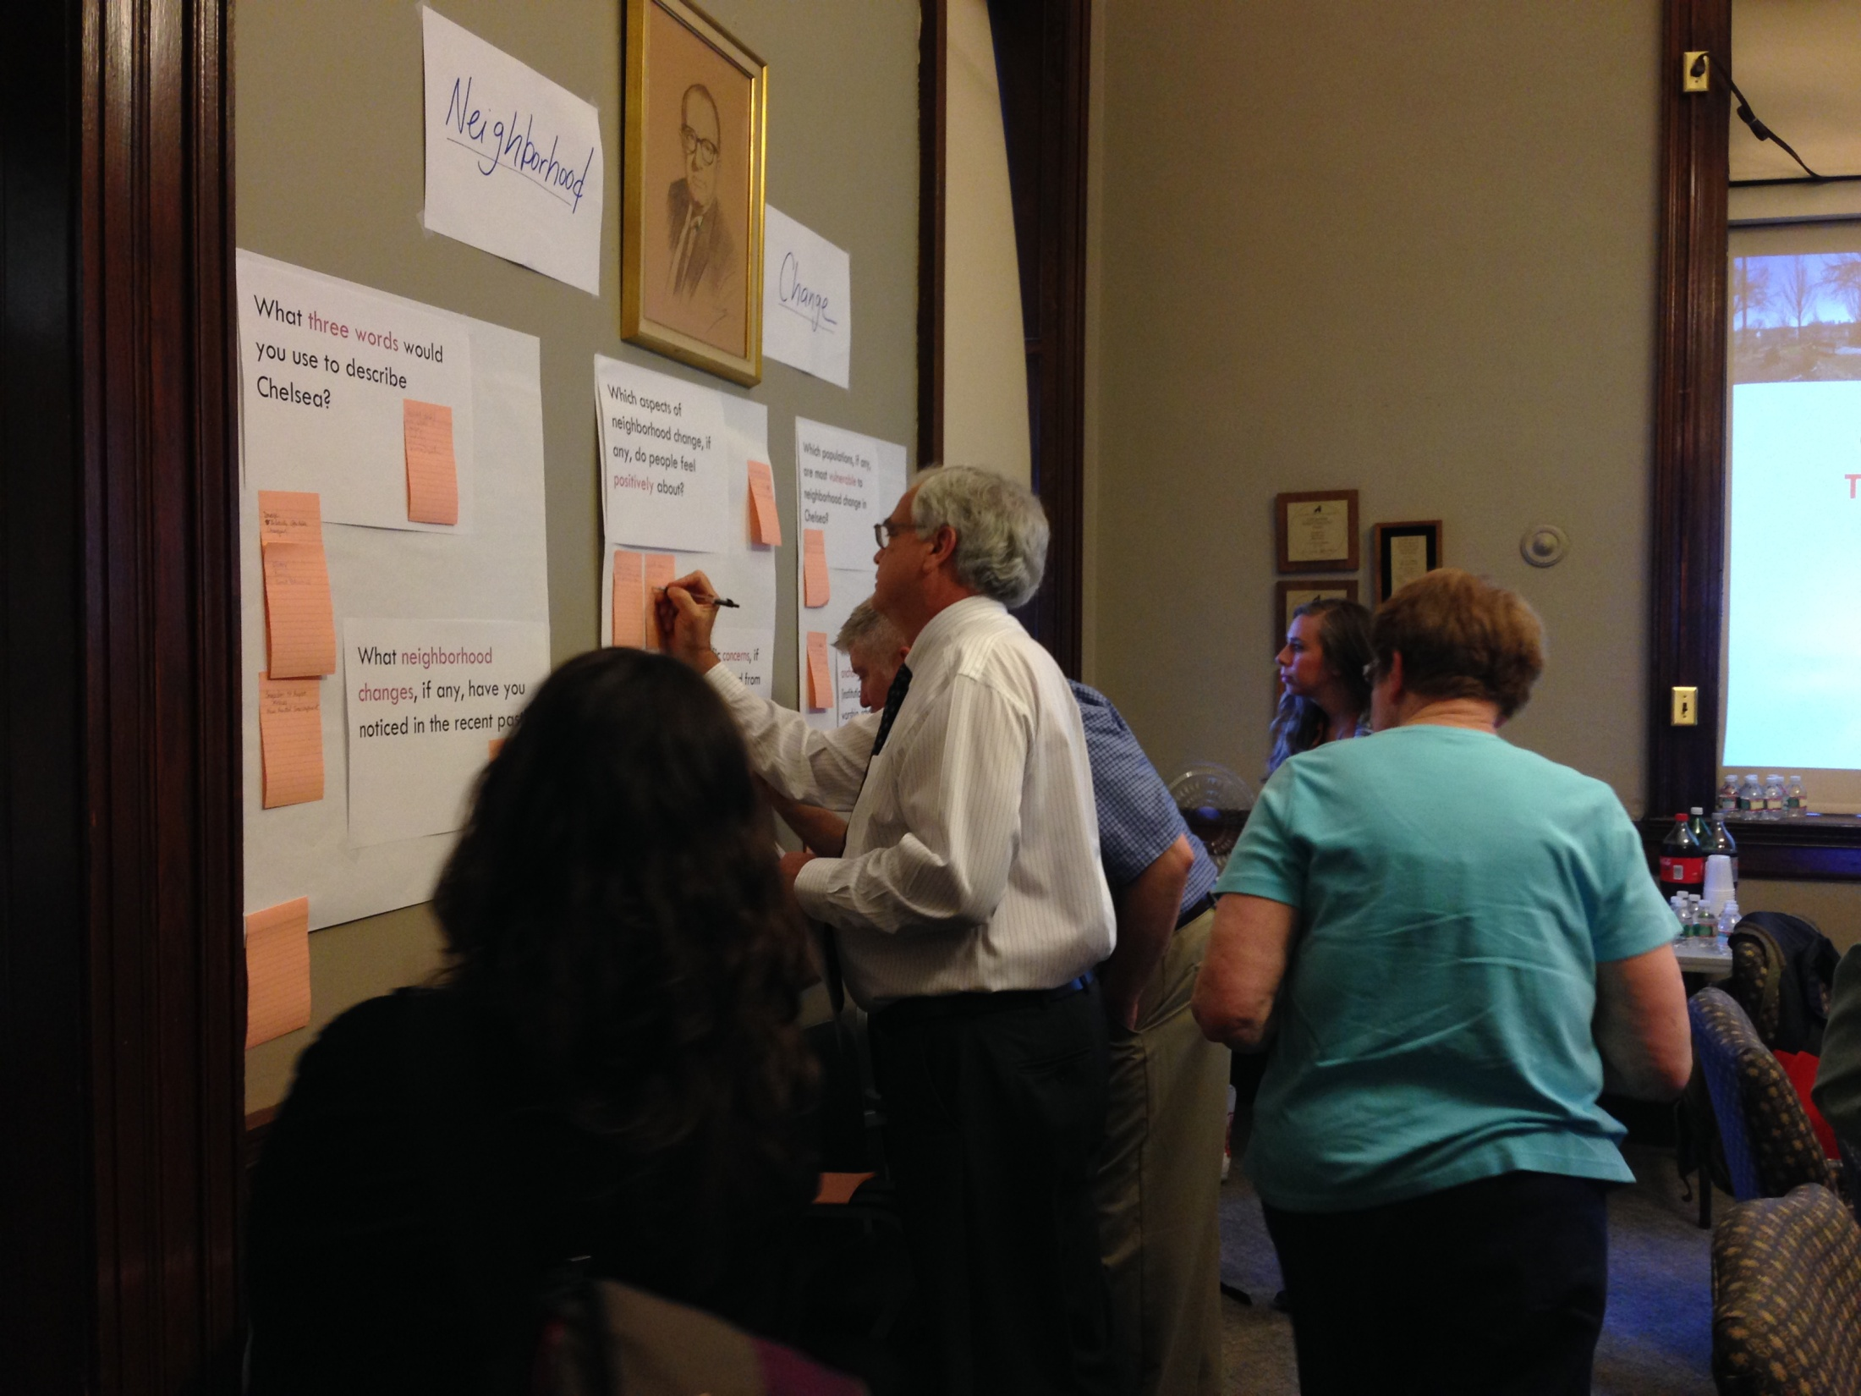
Chelsea TOD HIA
http://www.healthimpactnc.com/wp-content/uploads/2012/11/HIA-Process-Diagram.jpg
http://pensandomagro.net/wp-content/uploads/2012/01/mousercise.jpg

Slide 24
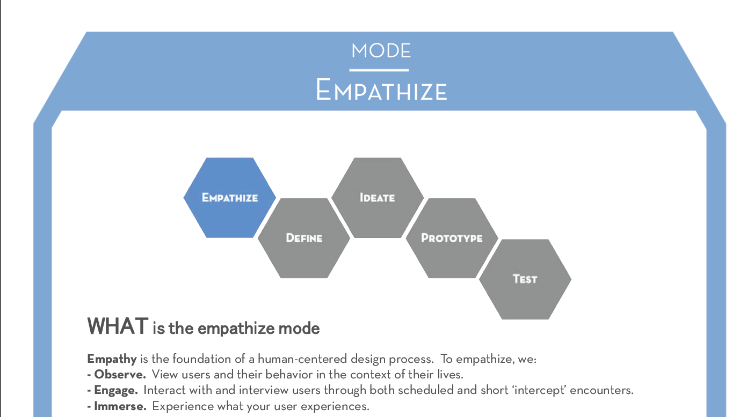
Start with empathy
bootcamp bootleg, stanford d.school

Slide 25
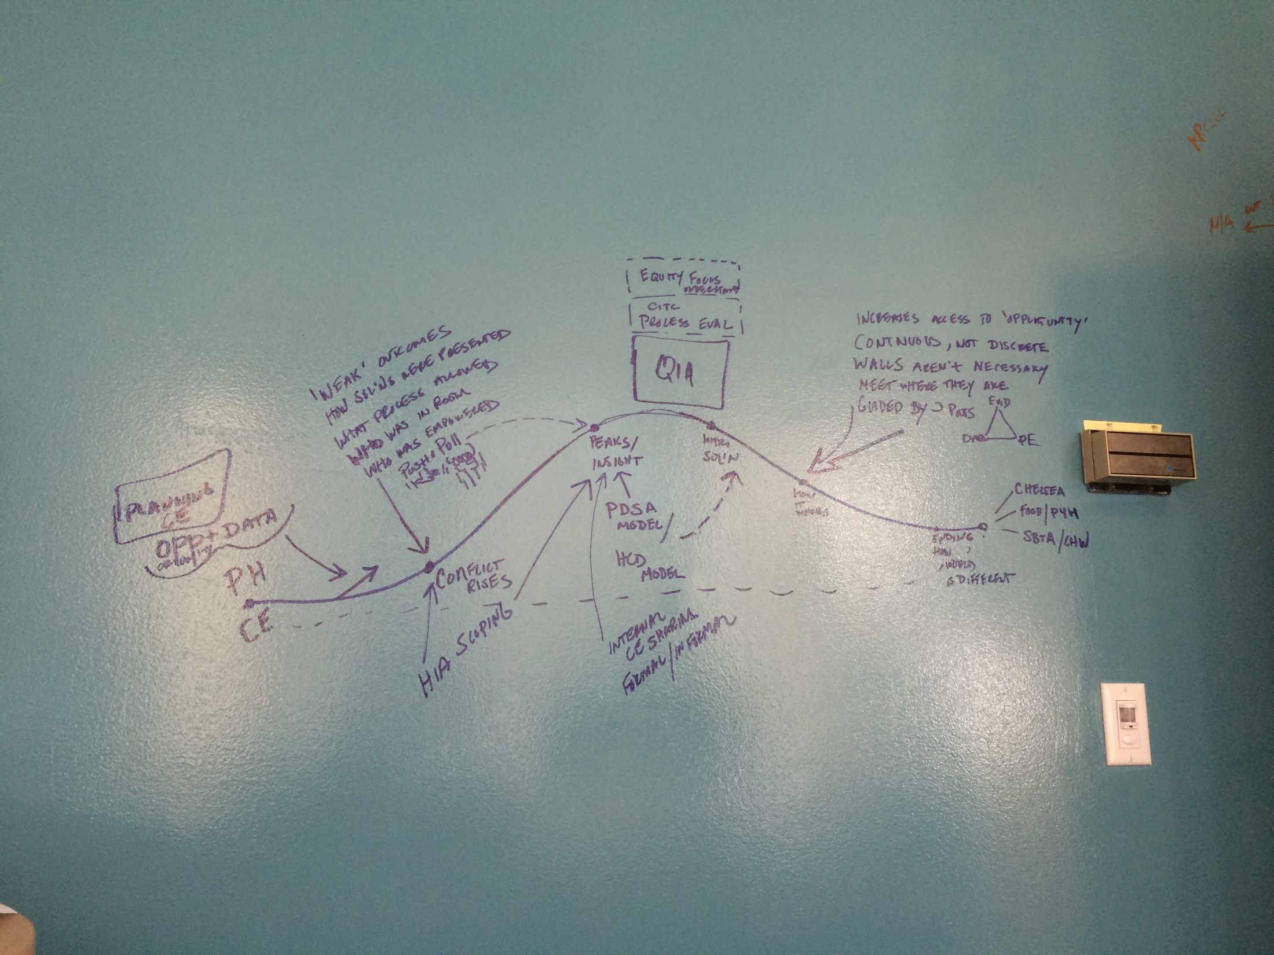
“hero’s” journey

Slide 26
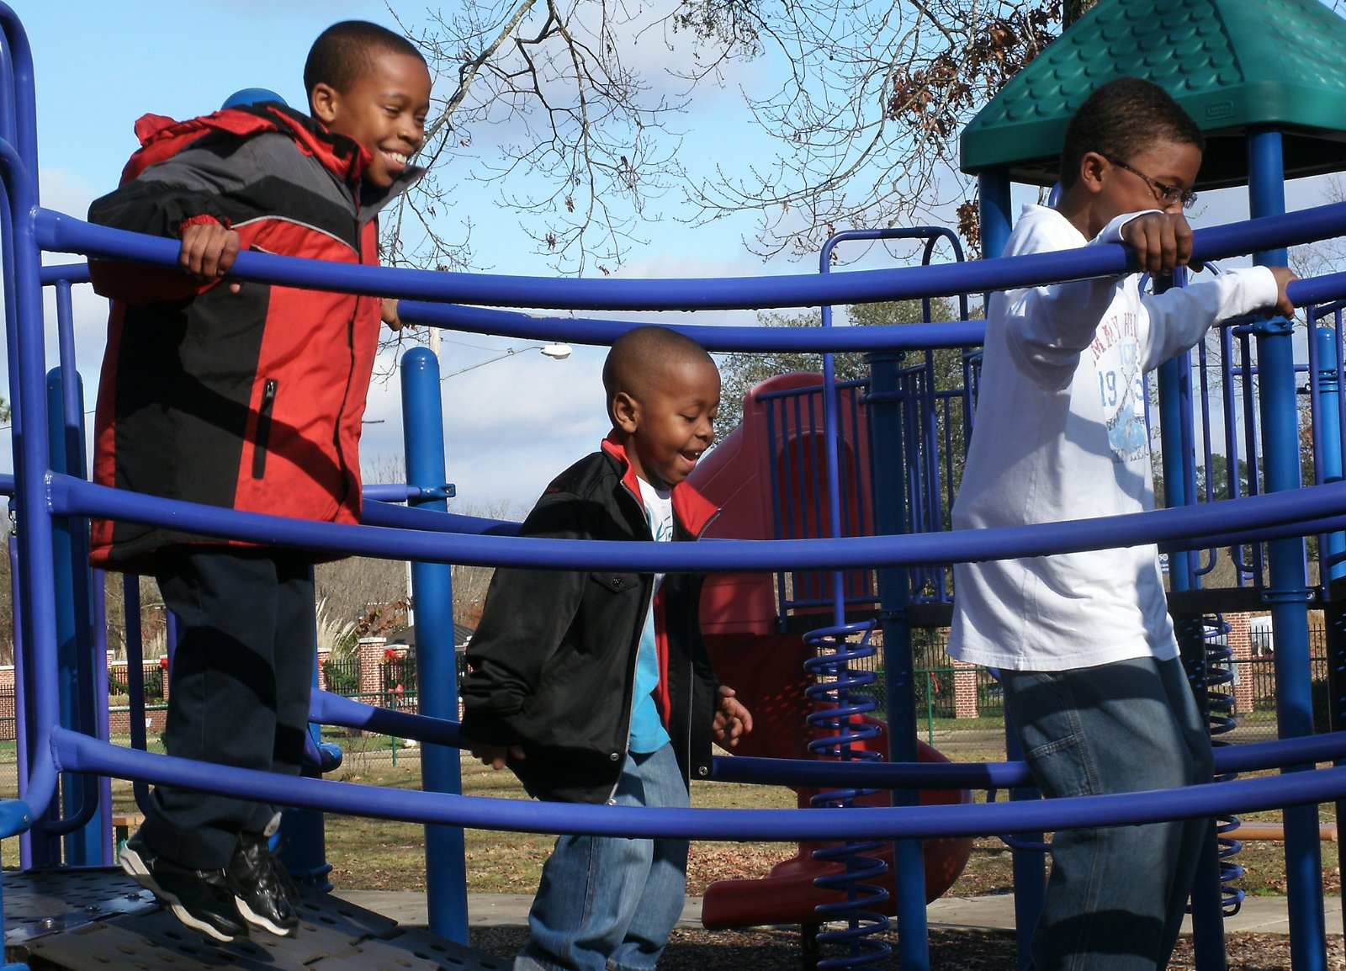
Health begins where we live, learn, work and play – our Community
Notes:
Healthy community http://www.rwjf.org/content/rwjf/en/about-rwjf/newsroom/newsroom-content/2013/07/mississippi--signs-of-progress/_jcr_content/left_75_par/imagelarge.no.size.img.jpg/1373115583170.jpg

