Slide 1

Using HIA in Brownfield Redevelopment

Slide 2
Minnesota Brownfields
A 501c3 non-profit organization with the mission is promote, through education, research, and partnerships, the efficient cleanup and reuse of contaminated land as a means of generating economic growth, strengthening communities and enabling sustainable land use and development.
Notes:
@ end of slide, ask audience to raise hand if they know what a brownfield is

Slide 3
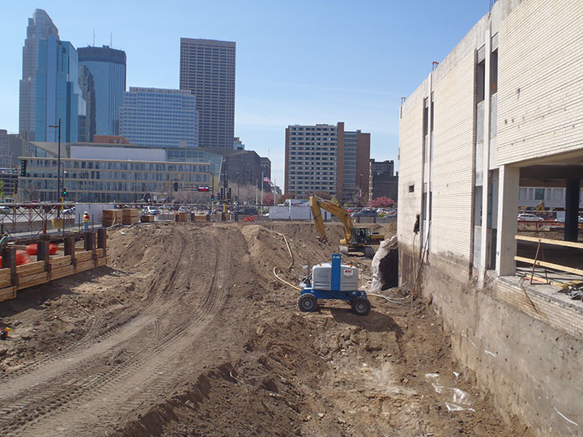
... what is a brownfield??
Environmental Protection Agency definition: real property, the expansion, redevelopment, or reuse of which may be complicated by the presence or potential presence of a hazardous substance, pollutant, or contaminant

Slide 4
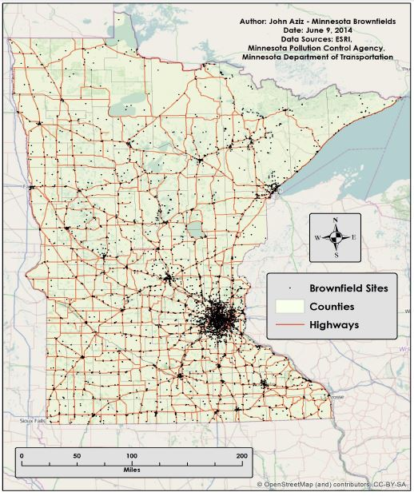

Slide 5
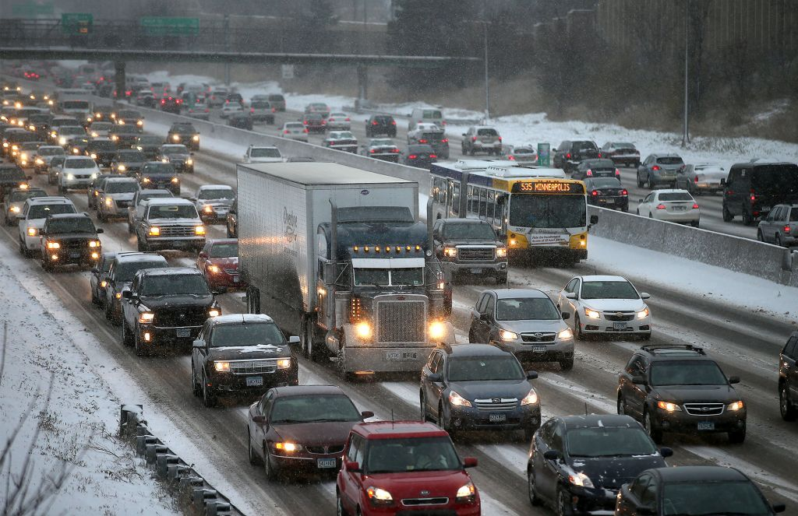
8% of millennials would consider living in a place that requires a car to get around.
- Smart Growth America
Notes:
population of millennials (75.3 million)= more than baby boomers (74 million) where will these people fit? in-fill development, brownfield redevelopment

Slide 6
Why is community input important?
Brownfield redevelopment can remove environmental threats and add tax base to neighborhoods and communities, but worries of gentrification remain
By incorporating input from communities surrounding brownfield sites, redevelopment can better cater to the communities’ needs

Slide 7
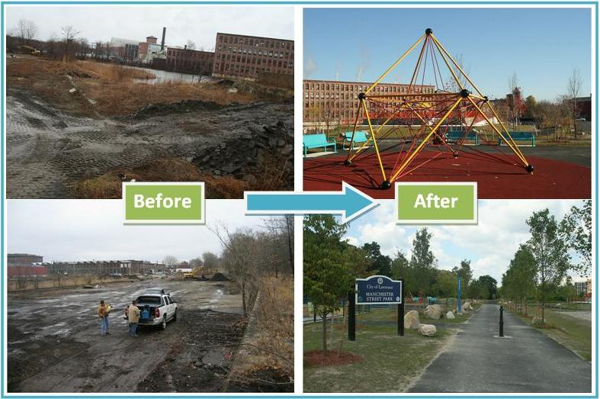
How can brownfield redevelopment improve a community?
Manchester Street Park, Lawrence KS
Notes:
social cohesion, access to healthy food (through community gardens & grocers), increased air quality, access to parks and greenspace, removal of broken window theory, job creation, etc

Slide 8
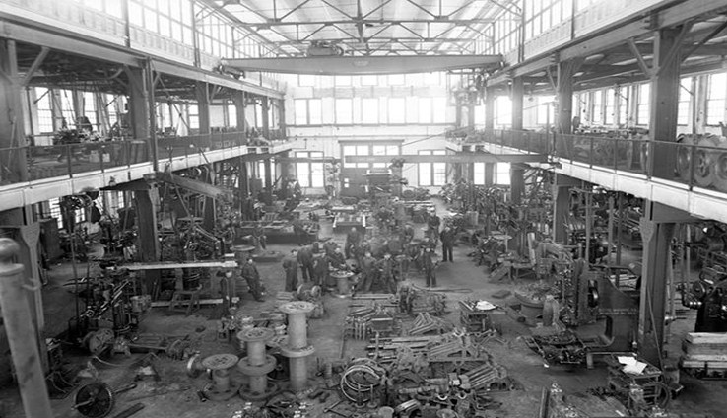
“[Lincoln Park] had the highest number of brownfields when [Duluth] did an inventory on three neighborhoods along the St. Louis River corridor. There was blight and crime in the Lincoln Park neighborhood. [Clyde Park] gave the Lincoln Park neighborhood a shot in the arm, and put the neighborhood in motion to see its potential.”
- Heidi Timm Bijold & Ross Lovely, Duluth Economic Development Authority
Notes:
Lincoln Park= food desert, Clyde rehab sparks redevelopment

Slide 9
HIA Tool Development
Tool is intended to be used by planners, developers, economic development professionals, consultants, architects, etc. to aid in redevelopment planning
Questions and indicators were obtained through a review of current HIAs in the US and analyzed as they pertain to brownfield redevelopment
Indicator categories include building design and housing, transportation, land use

Slide 10
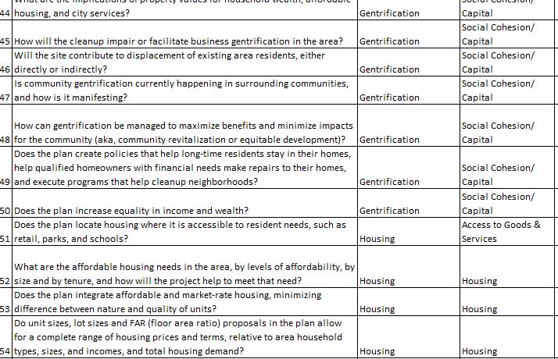


Slide 11
HIA Survey Timeline
2013- Minnesota Brownfields and Minnesota Department of Health partnered with a U of M grad student to develop set of questions and health indicators
2014- piloted the survey in a health impact assessment in Duluth, MN
2014- present- researching online platform for hosting tool. Will use new tool in Western Ports Area Neighborhood in Duluth in Fall 2015, thanks in part to funds from an EPA Area-Wide Assessment Grant.

Slide 12
Necessary Qualities for Tool
Ability for other organizations and users to download the questions with all of the logic so that they may disseminate it to their own audience
Low-maintenance: small nonprofit with limited budget and staff time- want tool to be able to run itself once set up

Slide 13
HIA Tool Platform
Have been researching best online platform for survey
Initially piloted in Survey Monkey- both free and paid version lack necessary features
Received quotes from various groups- all out of price range/timeline
Working with Qualtrics to develop tool- main inhibitor is cost
Seeking feedback and suggestions for tool hosting!

Slide 14
How does the tool work?
Link to survey tool:
https://umn.qualtrics.com/SE/?SID=SV_7VbrNxiqmcdCfuR

Slide 15


Questions?
Thank you!
www.mnbrownfields.org
nbrown@mnbrownfields.org

