Slide 1


Stakeholders’ Role in HIA Oil Drilling and Development Project in California
Dr. Mary McDaniel, Kathleen Souweine, Dr. Christopher Ollson, Lindsay McCallum
June 17, 2015
Notes:
HIA Report: Info on meetings, times meetings were held, and number of people attending!!!!

Slide 2
Learning Objectives
Practical tools for stakeholder engagement in a community-level HIA
Benefits of stakeholder engagement in real practice
See how basic strategies of communication apply well to HIA

Slide 3
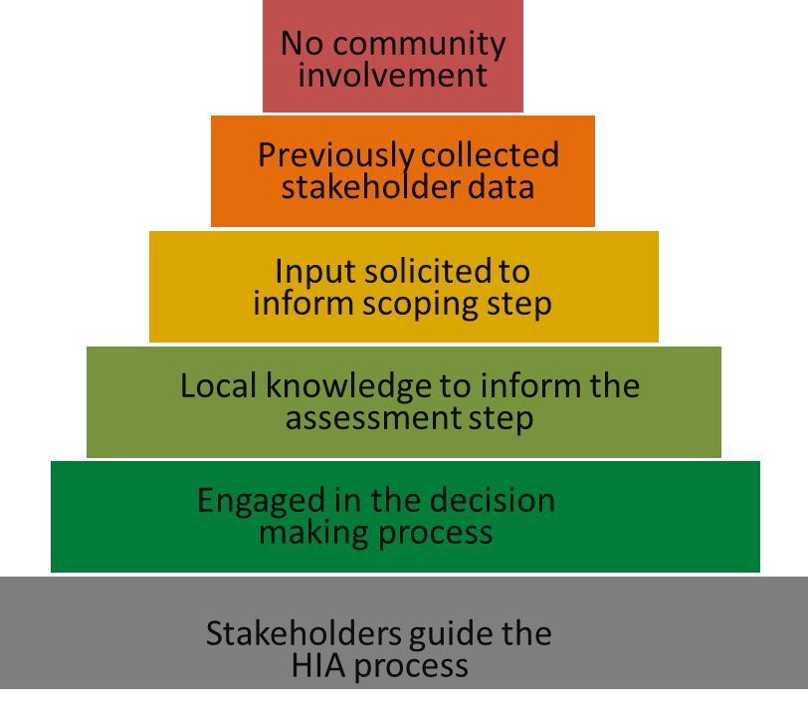
Stakeholder Engagement
Meaningful and inclusive participation of diverse stakeholders is an important component of HIA
Level and quality of stakeholder engagement varies widely (USEPA 2013)
Notes:
Each HIA should have a specific engagement and participation approach that utilizes available participatory or deliberative methods suitable to the needs of stakeholders and context
Guidance on when, how, and to what extent should communities be involved is limited
Best Practices for Stakeholder Participation in Health Impact Assessments (March 2012)
Stakeholder engagement is widely recognized as a fundamental element of Health Impact Assessment
(HIA) but the extent of stakeholder engagement varies widely in HIA practice.

Slide 4
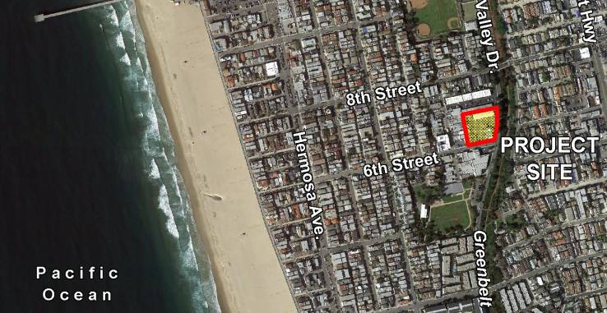
Oil Drilling Project in Hermosa Beach, CA
Proposed project for 30 wells drilled on a 1.3 acre site, completed in 4 phases over 30-35 years
Project site in densely populated town close to residences and the beach
Notes:
Phase 1: Site Preparation (6 months) – Demolition and construction, including installation of >30 ft sound attenuation wall
Phase 2: Oil Drilling & Testing (1 year) - Conduct tests on 3 wells to determine productivity and economic viability
Phase 3: Final Design & Construction (1.5 years): Utilize the information collected in Phase 2 to create a final drilling program, prepare site, and construct production facilities/pipelines
Phase 4: Development Drilling & Operation (2.5 years drilling + ongoing operation for ~30 years): Drill additional 30 wells production up to 8,000 barrels/day crude oil

Slide 5

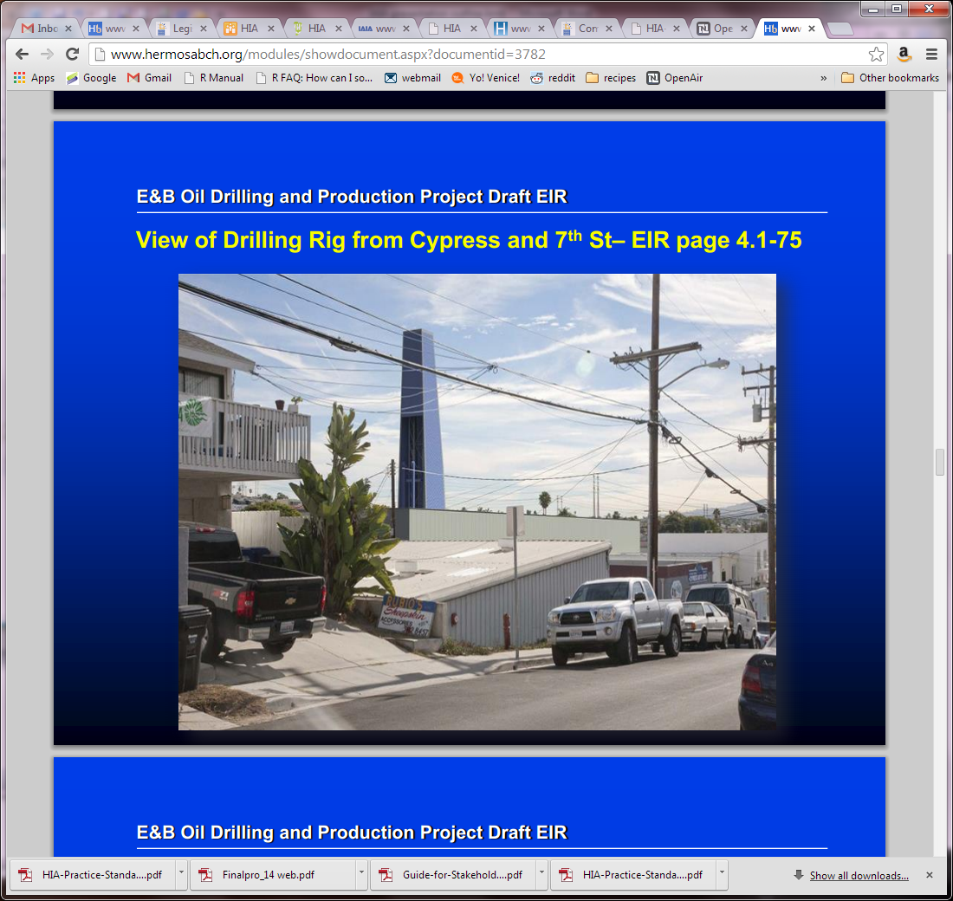
“The Best Little Beach City”
Small city in LA County
20,000 people
1.43 square miles
Highly educated
Affluent
Active residents
Relatively young
demographic
Notes:
Reputation for being a small scenic town/friendly beach community (~20,000 ppl)
Clean streets, parks, and beaches
Health conscious community that values exercising and spending time outdoors (surfing and volleyball!)
Accessible city government with active citizen involvement
Safe environment, low crime rate
Known for green/sustainable activities and carbon neutral goal
Schools have a high reputation and benefit from community involvement (residents have high educational attainment -75% college grads)
Bars that attract party crowds at night
Highly educated, affluent community with relatively young demographic
Average house price >$1M USD

Slide 6
People To Decide
Hermosa beach residents to decide whether to repeal the existing ban on oil drilling
Repealing the ban would allow the project to move forward
Or with the ban the City owes the oil company $17.5 million
City initiated public decision-making process with three impact assessments:
HIA
EIR
CBA
Notes:
** venndiagram
If voters repeal the ban, the City will allow drilling at the maintenance yard
If voters refuse to lift the ban, the City will owe $17.5 million dollars
To inform voters about potential health, social and economic impacts, the City agreed to conduct both a Health Impact Assessment (HIA) and Cost-Benefit Analysis to supplement the required Environmental Impact Report (EIR). City government does not have a stance on the project.

Slide 7
Stakeholders
Residents (population = 20,000)
Community-based organizations
Oil company
Elected officials (City Council)
Small businesses
Public agencies (schools, police department, fire department)
Notes:
Stakeholders are individuals or organizations who stand to gain or lose from a decision or process
Vulnerable populations were not of high concern

Slide 8
Engaging Stakeholders During all Stages
1.
Screening
Decide if a HIA is feasible, timely and adds value to the decision-making process
2.
Scoping
Create a plan that defines priority issues, research questions and methods, and participant roles
3.
Assessment
Provide profile of existing conditions, evaluation of potential health impacts, and evidence-based recommendations
4.
Reporting
Develop HIA report and communicate findings and recommendations
5.
Evaluation/Monitoring
Track the impact of HIA on decision, decision-making process, and health determinants
Notes:
Just a snapshot to introduce the next few slides

Slide 9
1.
Screening
Decide if a HIA is feasible, timely and adds value to the decision-making process
City and citizen concern that the legally-required EIR would not adequately address potential health issues
Oil company questioned what HIA, an “undefined document” could add that EIR would not address

Slide 10
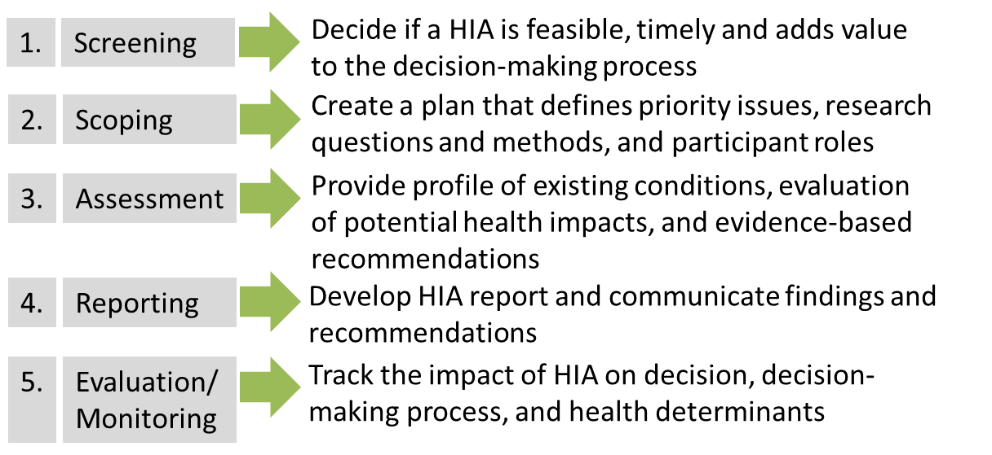


2.
Scoping
Create a plan that defines priority issues, research questions and methods, and participant roles
Open house kick-off event at the Community Center with a “passport” sticker book (HIA, EIR, CBA)
Scoping meeting
Online survey to solicit input
Notes:
Open house was on a Saturday 9 am to 2 pm, at a Community Center which is centrally located and walkable from anywhere in the City
An HIA scoping meeting was held to elicit community feedback regarding potential health concerns of interest. The HIA public scoping meeting was held on a weeknight from 7 pm to 10 pm at the Community Theater located in the center of town. To accommodate those who were unable to attend in person, the scoping meeting was broadcast on a local television station and the videotape posted on the City website. Following the scoping meeting, public comments (both written and oral) were Received. The scoping meeting was facilitated by City Staff and was well-attended (approximately 400 people).
All public opportunities for engagement were advertised to the community via multiple outlets including postcard mailers, announcements in the local newspaper, banners in public spaces, and e-mail blasts to the City mailing list.

Slide 11
Online Survey
292 Responses
Notes:
Allowed for a ranking of project-related health concerns
Online survey appropriate for limited time and resources Combination of close-ended and open-ended responses
The issues of most concern include explosions/spills, impacts to the ocean or beach, soil contamination, air quality, odor and surface water contamination. Possible vibration impacts, parking problems and lights are also priority issues, but overall concern is lower relative to other issues. A total of 73 survey participants also specified other areas of concern that are not listed in Table 3-1. Among the most common free response answers, concerns include hydrogen sulfide, cancer, traffic accidents, and sensitivity of children to environmental exposures.

Slide 12
Health Determinants
1. Particulate matter
(PM)
3. Nitrogen dioxide (NO₂)
2. Toxic Air Contaminants
(TAC)
4. Odor
Air Quality
5. Surface water
6. Soil particulates
Water and Soil
7. Oil spill
8. Well blowout
Upset Scenario
9. Noise emissions
10. Light emissions
Noise and Lighting
11. Traffic safety
12. Perceived traffic hazards
Traffic
13. Property Values
15. Access to recreation/ green space
17. Aesthetics
14. Education funding
16. Social cohesion
18. Political Involvement
Community Livability
Notes:
Emphasis on community livability

Slide 13
Provide profile of existing conditions, evaluation of potential health impacts, and evidence-based recommendations
3.
Assessment
Used local data sources as part of the evidence base
Quality of life committee provided baseline information about community livability
Health District Reports
Local University provided the baseline cancer assessment
One-on-one interviews
Notes:
The City formed a quality of life committee as part a process of facilitating communication between key residents and the City on a number of large decisions (including the proposed Project).
NOISE: Two types of sounds (wind chimes and foghorns) are heard frequently in the neighborhood and do not cause annoyance
GREEN SPACES: Desire to increase children’s beach play areas
EDUCATION: Parents and teachers work in a collaborative environment that is supportive of students

Slide 14
Develop HIA report and communicate findings and recommendations
4.
Reporting
Presentations of draft findings with Q&A sessions
Public comment period on draft report
Other meetings with activist groups, City Council, and oil company
Two final open houses on final HIA prior to vote
Notes:
Draft and final reports were disseminated to the community via the web and paper copies available too
All public opportunities for engagement were advertised to the community via multiple outlets including postcard mailers, announcements in the local newspaper, banners in public spaces,
and e-mail blasts to the City mailing list.

Slide 15

Basic strategies of communication are essential for HIA engagement
Communicating with Stakeholders 101

Slide 16

How to Engage Stakeholders
1
2
They have to trust you.
They need to like you.
People decide within 30 seconds whether they trust you!
People like people who appear to like them
Notes:
In some populations or cultures, it can take a longer period of time to develop a
relationship of trust. Stakeholders may themselves be uninterested in participating
because of either burnout or mistrust.

Slide 17



What are your Stakeholders Like?
Active Public
Seeking to affect decisions and make its views known
Attentive Public
Relatively aware
Passive Public
Largely unaware
Notes:
Know your audience

Slide 18





Most Communication is Unspoken
Think about how you deliver your statements, not just the words you use.
Notes:
Most people are visual learners, not auditory learners

Slide 19
How Can You Better Communicate?
Identify and understand stakeholder values, perceptions and concerns
Understand the importance of trust and credibility
Select channels that target your audience
Ensure that expectations of stakeholders as a result of their participation are accurate
Evaluate your efforts!
Notes:
Contextual elements that are important to consider include available time of stakeholders, language and literacy
constraints, cultural nuances, community centers for meetings, etc.

Slide 20
Conclusions
A diversity of stakeholder involvement is important at every HIA stage
Stakeholder engagement resulted in addressing health concerns important to the public
Integration with EIR process allowed for sharing engagement opportunities
Open dialogue and communication with community improved the results of this HIA
Notes:
Local data is also important and community was able to provide a unique perspective that may have been missed
If all groups are not open to the HIA process then the outcome won’t reflect issues of all the stakeholders
Note that in this example a lot of time and resources were dedicated to stakeholder engagement – but it was shared with the 2 other studies
Stakeholder participation is most successful when all groups and interests are able to meaningfully influence the process and outcome

Slide 21

Notes:
Ultimately the measure was voted down

Slide 22


Thank You!
Kathleen Souweine, MPH
ksouweine@intrinsik.com

Slide 23
Discussion Questions
Can anyone provide examples of effective engagement methods in your experience conducting HIAs?
Should community members ever be compensated for time spent participating on HIAs?
Stakeholder engagement takes significant time and resources, is stakeholder engagement possible for rapid HIAs?

