Slide 1


HIA Methodology for an Oil Drilling and Development Project in California
Lindsay McCallum, Kathleen Souweine, Mary McDaniel, Chris Ollson
National HIA Meeting
June 2015

Slide 2
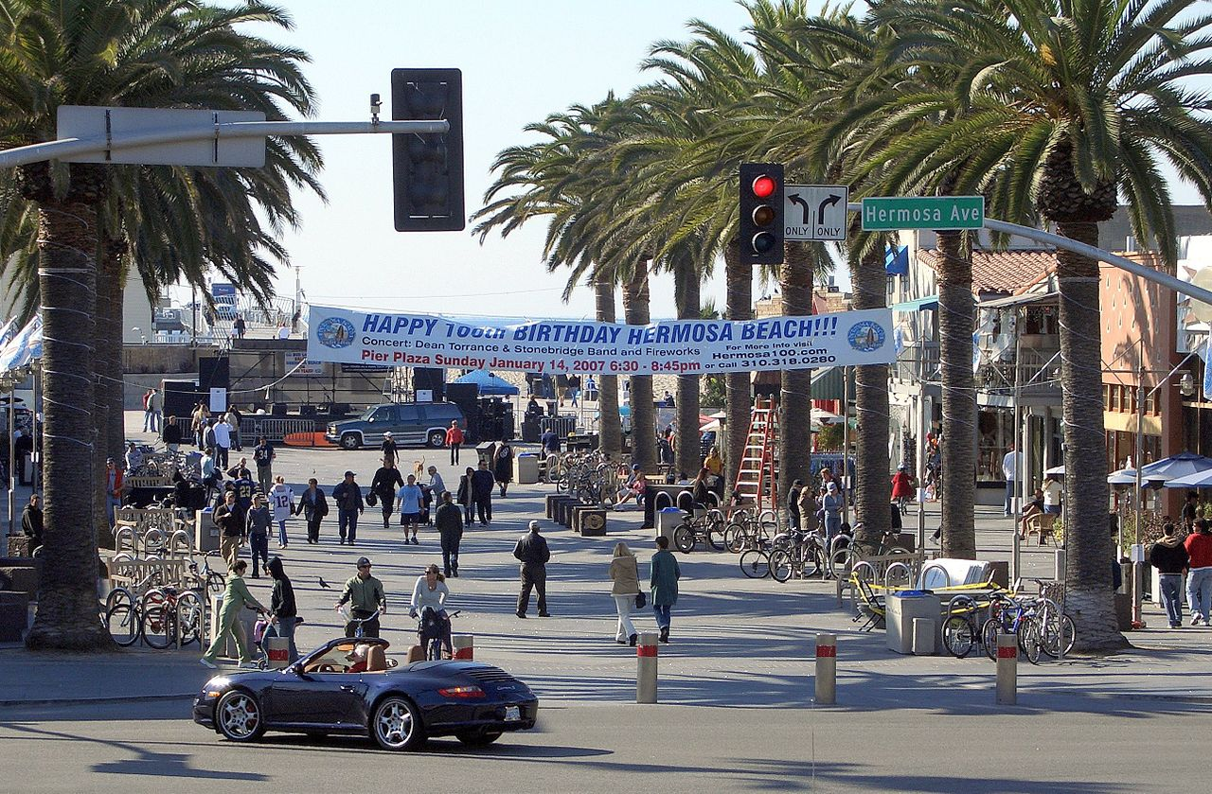
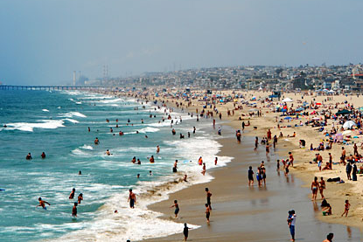
Hermosa Beach
“The best little beach city”
Location: Coastal Los Angeles, California
  Population = 20,000; Land area = 1.43 square miles
Highly educated, affluent community with relatively young demographic
  Average house price >$1 Million USD

Slide 3





Hermosa Beach HIA
THE PROJECT: the proposed E&B Oil Development Project consists of drilling 30 oil wells on a 1.3-acre site located on the current City Maintenance Yard property.
THE ISSUE: election held to allow City of Hermosa Beach residents to decide whether to repeal the existing ban on oil drilling.

Slide 4

Scoping the HIA
Through consultation with community members, the HIA identified six major categories and 17 determinants of health in relation to the proposed Project:
Air Quality
Water and Soil Quality
Upset Conditions
Noise and Light Emissions
Traffic
Community Livability

Slide 5
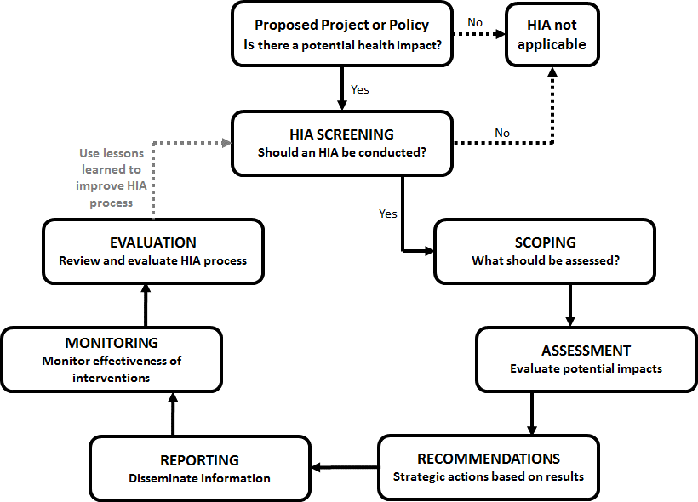
Steps of an HIA

Slide 6
Key Objectives
Reproducible
Peer Review
Evidence Based
Consistent Approach
Transparent Decision-making
Community Input
Well Defined Matrix

Slide 7
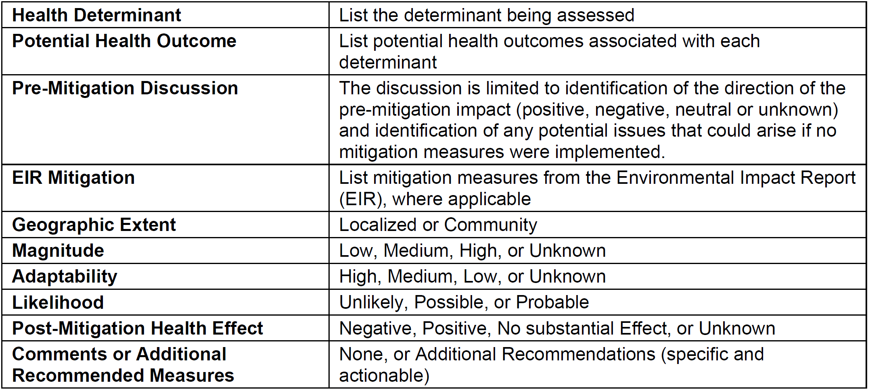
HIA Evaluation Matrix

Slide 8
Decision Making Framework
H = high; M = medium; L = low; U = unlikely; P = possible; R = probable

Slide 9
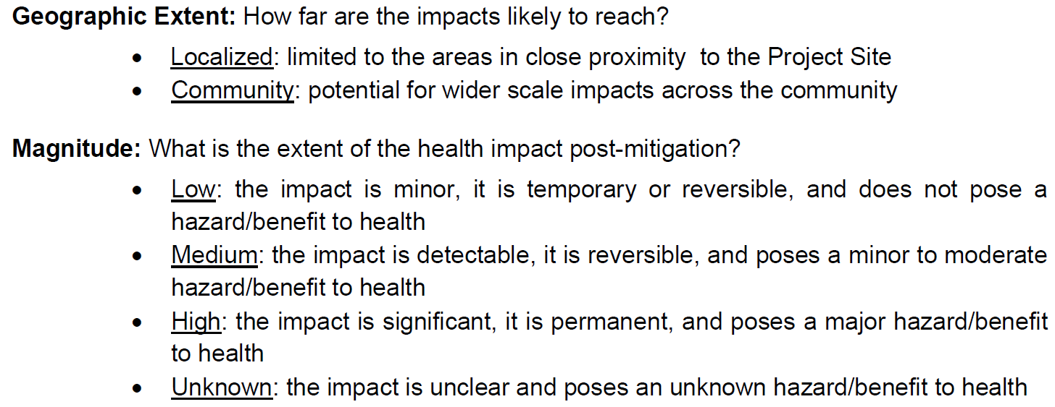
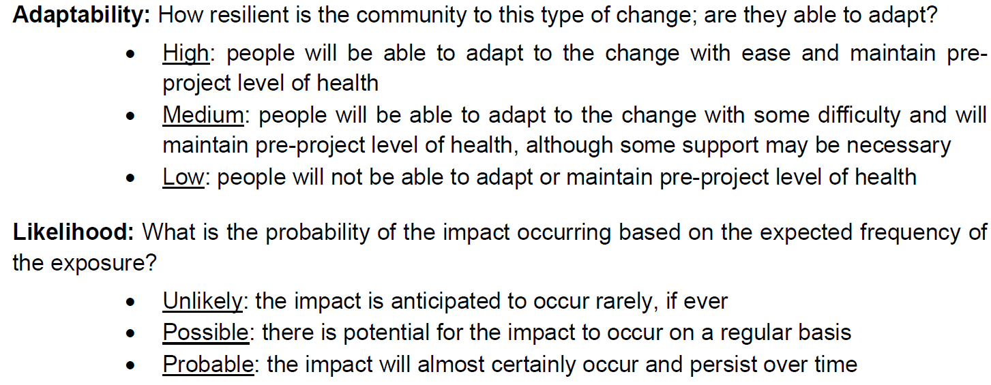
How does it work? (Example: Noise)
After conducting a thorough evidence-based assessment using available noise data and noise/health thresholds from the literature and reputable international agencies, noise impacts (pipeline construction phase) were classified as:
Then use the decision-making framework to determine the ‘post-mitigation’ health effect (i.e., positive, negative, neutral)

Slide 10
How does it work? (Example: Noise)
H = high; M = medium; L = low; U = unlikely; P = possible; R = probable

Slide 11

HIA Results

Slide 12

Overall Conclusion
“Based on the proposed mitigation measures in the EIR and additional recommendations provided in the HIA, we do not believe that the Project will have a substantial effect on community health in Hermosa Beach.” - Final HIA (September 2014)
Outcome of the Vote???

Slide 13

THANK YOU!
Lindsay McCallum, Ph.D. (Candidate)
Environmental Health Scientist
Intrinsik Environmental Sciences Inc.
University of Toronto
lmccallum@intrinsik.com
Co-authors:
Kathleen Souweine
Mary McDaniel
Chris Ollson

