Slide 1


Monitoring and Evaluation: Current Status and Opportunities for Improvement
3rd Annual National HIA Meeting • June 16, 2015
Justicia Rhodus Kim Gilhuly Andrew Dannenberg
CSS-Dynamac c/o U.S. EPA Human Impact Partners University of Washington,
Cincinnati, Ohio Oakland, California School of Public Health Seattle, Washington
The views expressed in this presentation are those of the author[s] and do not necessarily reflect the views or policies of the U.S. Environmental Protection Agency.

Slide 2
The HIA Process
Screening
Scoping
Assessment
Recommendations
Reporting
Monitoring & Evaluation
2

Slide 3
Monitoring and Evaluation Objectives
Monitoring
To monitor or track the data necessary to inform HIA evaluation
Evaluation
To evaluate:
the process of conducting the HIA
impacts on the decision-making process and implementation of the decision
impacts of the decision on health outcomes

Slide 4
Types of Evaluation in HIA
PROCESS EVALUATION evaluates whether the HIA was carried out as planned and in accordance with applicable standards
It typically looks at:
effectiveness in meeting HIA goals
successes and challenges
lessons learned
who was involved
strengths and weaknesses
effectiveness in meeting practice standards
engagement and communication with stakeholders

Slide 5
Types of Evaluation in HIA
IMPACT EVALUATION evaluates the
impacts of the HIA on the decision and decision-
making process, as well as the decision-making
climate, in general
It typically looks at:
Discussion of HIA findings in decision-making
Recommendations adoption
Decision implementation
Capacity and collaboration building
How awareness and consideration of health changed in the decision-making climate as a result of HIA
How HIA institutionalization changed as a result of HIA

Slide 6
Types of Evaluation in HIA
OUTCOME EVALUATION evaluates the impact of the decision implementation on health
It typically looks at:
And requires:
  On-going monitoring of health data
Impact on health determinants
Impact on health status
Impact on health behavior
Early warning signs of unexpected consequences
Validity and precision of health impact predictions
Notes:
Outcome evaluation considers the effects of the decision as a whole, thus it is generally not possible to attribute outcomes to HIA recommendations because they are implemented with the decision.

Slide 7
Monitoring & Evaluation
Timeline
HIA Process Evaluation
HIA Impact Evaluation
HIA Outcome Evaluation
Final decision informed by HIA
Monitoring
“Evaluation of the HIA process, impacts, and outcomes is necessary for field development and practice improvement.”

Slide 8
Monitoring and Evaluation Plan: An HIA Minimum Element
“HIA proposes indicators, actions, and responsible parties, where indicated, for a plan to monitor the implementation of recommendations, as well as health effects and outcomes of the proposal.”
The Minimum Elements and Practice Standards also provide guidelines (practice standards) for monitoring and evaluation.

Slide 9
Status of Monitoring and
Evaluation in HIA
“In practice, most HIAs do not include process, impact, or outcome evaluation; this has been attributed to a lack of interest, time, and resources in the case of process and impact evaluation and to the length of time (often many years) required for observing changes related to implementation.”
– National Research Council 2011
“Monitoring is one of the least well developed of all the phases of HIA practice.”
– Ross, Orenstein, & Botchwey 2014
Notes:
NRC 2011 – Report titled “Improving Health in the United States: The Role of Health Impact Assessment”
Ross, Orenstein, & Botchwey 2014 – Book titled “Health Impact Assessment in the United States”

Slide 10
Status of Monitoring and
Evaluation in HIA
“Just over half (13/23) of HIA reports described intentions, plans, or results of monitoring and evaluation.”
– Schuchter, Bhatia, Corburn, & Seto 2014
“All three forms of evaluation were lacking in the (81) reviewed HIAs… Proposed plans for impact and/or outcome evaluation were present in only 29 of the HIAs.”
– EPA Review 2013
Notes:
- Schuchter, Bhatia, Corburn, & Seto 2014 – Environmental Impact Assessment Review journal article titled “Health impact assessment in the United States: Has practice followed standards?”
- Rhodus, Fulk, Autrey, O’Shea, and Roth – “A Review of Health Impact Assessments in the U.S.: Current State-of-Science, Best Practices, and Areas for Improvement

Slide 11

Benefits of Monitoring and Evaluation
Holds partners and agencies accountable
Tests the validity and precision of health impact predictions made in Assessment
Adds to the body of knowledge/ evidence base
Provides early warning of unforeseen results/impacts
Empowers communities when they are involved in monitoring

Slide 12
Benefits of Monitoring and Evaluation
Provides a way to circle back to the community and stakeholders
Provides a better understanding
of the value of HIA (inform decision-making and protect and promote health)
Lessons learned to improve the HIA process and field overall
Supports future HIAs and Health in All Policies
Strengthens the HIA profile in public health and other fields

Slide 13

Challenges of Monitoring and Evaluation
Difficult to measure impact on
health outcomes
  Challenging due to the long time horizons for change
  Many causal relationships with
  health outcomes
  Difficult to determine what impact the
  HIA itself had on a health outcome
  Difficult to differentiate whether the outcome is due to the impact of
  the decision or HIA
  recommendations

Slide 14
Challenges of Monitoring and Evaluation
Lack of funding/resources
Lack of planning/time allocated
Responsibility for implementation (especially long-term monitoring)
External (political/organizational) resistance, pushback, or unrealistic expectations
Selection of indicators– choose wisely
Lack of implementation/ documentation in HIA (few to no
good examples)

Slide 15
Examples of Monitoring and
Evaluation in HIA
Planning and Implementation
2010 Hawai’i County Agriculture Development Plan Health Impact Assessment
Healthy Corridor for All – St Paul Transit Oriented Development HIA
Eastside Greenway Health Impact Assessment: Protecting Health and Equity in All Policies

Slide 16

Hawai’i Agriculture Development Plan HIA
Assessed three policies:
  Increased institutional purchase of locally
  grown food
  Commercial expansion
  of locally grown food
  Promotion of home, community, and school gardening
Notes:
A project of The Kohala Center in collaboration with Kaiser Permanente Center for Health Research, Hawai‘i and the Hawai‘i Department of Agriculture and funded by the Health Impact Project—a collaboration of the Robert Wood Johnson Foundation and The Pew Charitable Trusts

Slide 17
Hawai’i Agriculture Development Plan HIA
Monitoring Plan
Link Indicators to Recommendations
  Identified indicators to be monitored, agency responsible for monitoring, and timing for recommendations in each of the three policies assessed
  Recommendations were very thoughtful, specific, and extensively vetted among stakeholders
  Monitoring Plan was, at the time, created with no input; developed simply as an HIA requirement

Slide 18
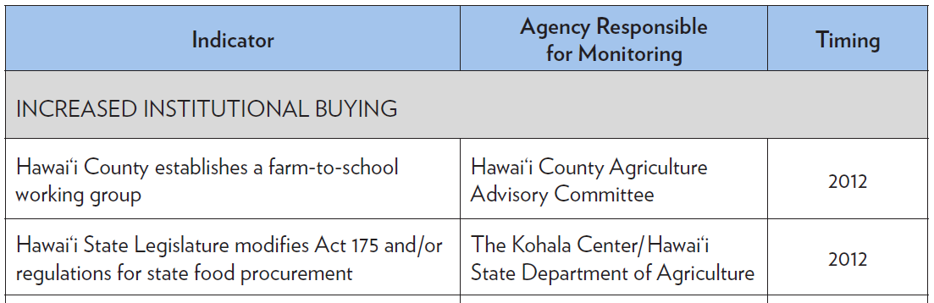
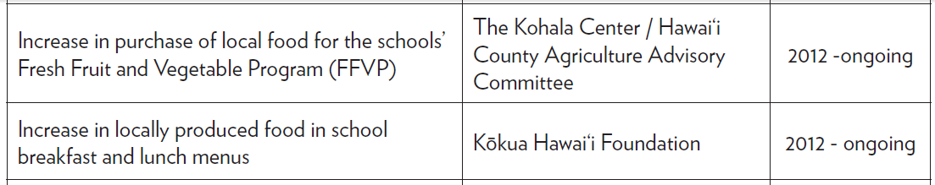
Hawai’i Agriculture Development Plan HIA
Monitoring Plan
HIA Recommendations
Convene a working group to facilitate Farm to School under the auspice of the Agricultural Advisory Commission
State legislature should modify Act 175 SHL 2009 and/or procedures to remove barriers to local produce procurement by Dept. of Educ. and state agencies
Dept. of Educ. School Food Authorities should utilize funds under USDA’s FFVP to purchase local produce
Dept. of Educ. School Food Service Branch, together with culinary experts, should revise school lunch and breakfast menus to incorporate locally produced foods

Slide 19
Hawai’i Agriculture Development Plan HIA
Challenges in Monitoring
Data hard to come by (State Agriculture Committee positions defunded due to budget)
Lack of funding for monitoring
Timelines in monitoring plan were not accurate
Successes in Monitoring
Kohala Center has a vested interest in recommendation implementation, so they are slowly “chipping away at the monitoring plan.”
Kohala Center got USDA grants to increase local food production and purchase; using some to help fund monitoring

Slide 20
Hawai’i Agriculture Development Plan HIA
Lessons Learned in Monitoring
Identify who will implement recommendations and work with them (as the responsible parties for monitoring) to develop the Monitoring Plan to ensure feasibility
Identify a lead organization to track and report results
Even when an agency/org tracks the data as part of its job, someone must be responsible for gathering all tracked indicators together
In most cases, unrealistic to expect HIA practitioners to monitor; must be an agency/ org with a vested interest in implementation

Slide 21

Healthy Corridors for All – St Paul Transit HIA
Examined rezoning
proposal along the St.
Paul portion of the
Central Corridor Light
Rail Transit Line
Three priorities: Healthy economy, Affordable healthy housing, Safe and sustainable transport
50 indicators selected for the research plan/examined in Assessment
  Measurable, available,
  able to answer
  research question, relevant, adequate
  time and
  resources

Slide 22
Healthy Corridors for All – St Paul Transit HIA
Monitoring Plan
Link Assessment to Monitoring and Evaluation
  To monitor the impact of rezoning, a subset of
  the 50 indicators used in Assessment (n=13) were
  selected for data collection at 5-year intervals
    Targeted the highest priority objective for Community Steering Committee:
    Protecting against the negative impacts of gentrification
    Identified indicators to be monitored, monitoring questions, and organization responsible for
    collecting data

Slide 23
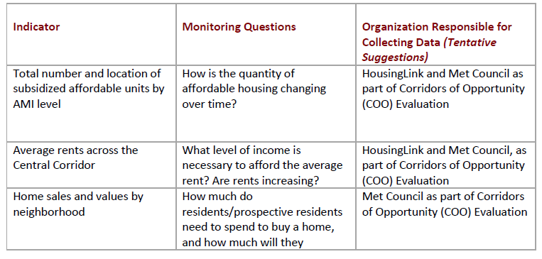
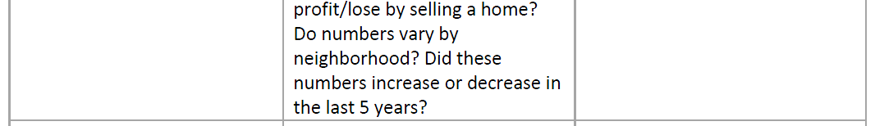
Healthy Corridors for All – St Paul Transit HIA
Monitoring Plan

Slide 24
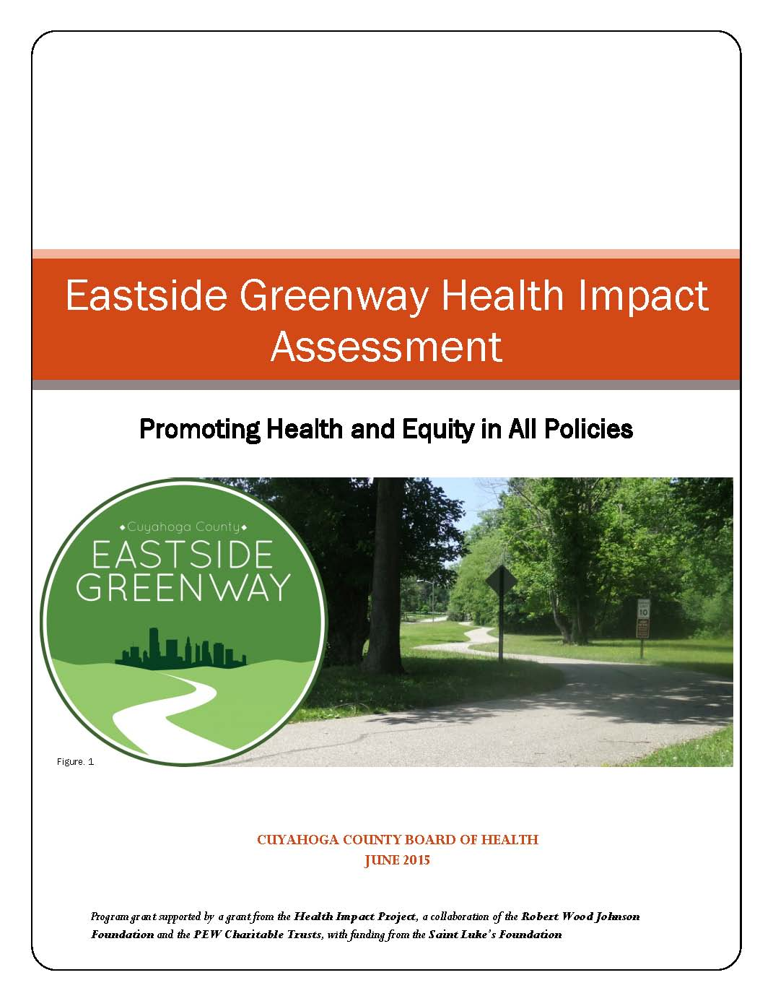
Eastside Greenway HIA
Assessed creation of a multi-use path
  Connected some existing trails + created new ones
  Would result in ~ 30 mile stretch of trail
  Runs through 17 municipalities
  Municipalities very different: SES, race
  Focus on equity in implementation
Cuyahoga County, Ohio (Cleveland, Ohio and suburbs)

Slide 25
Eastside Greenway HIA
Monitoring Plan
Use Health Determinants and Health Behaviors as Indicators of Health Impact
A Tale of One Indicator: Usage
  Vital tie from health determinants (is trail constructed and connected?) to health outcomes (physical activity)
No data available in Assessment
Cuyahoga County Board of Health (CCBH) was able to leverage other funding to dedicate to collecting baseline and monitoring usage data

Slide 26
Eastside Greenway HIA
A Tale of One Indicator: Usage
Funding from various parties with a vested interest in tracking usage of trail
  Transportation for Livable Communities Initiative (TLCI) through Metropolitan Planning Organization
  Metroparks
  CCBH Healthy Communities funding
Funding leveraged in part because this indicator was part of the official HIA Monitoring Plan

Slide 27
Improving Implementation of
Monitoring and Evaluation
Best Practices
Essential Elements of a Monitoring and Evaluation Plan
SOPHIA Working Group convened at the 2014 HIA of the Americas Workshop for improving the practice of monitoring and evaluation in HIA

Slide 28

Best Practices in Monitoring and Evaluation
Think of monitoring and evaluation early in the
HIA process
Bring the right people to the table to put together and vet the monitoring and evaluation plan
  Those with critical data
  Decision-makers
  Stakeholders/those affected
  Those with technical knowledge/experts
  Client or proponent for whom you
  are doing the project
  Those who will implement it

Slide 29
Best Practices in Monitoring and Evaluation
Consider/seek funding for monitoring and evaluation
Engage stakeholders and the community
Include in the HIA Report, or at a minimum acknowledge, plans for impact and outcome evaluation
If impact and/or outcome evaluation
is infeasible, the HIA should discuss the limitation(s) preventing monitoring and evaluation

Slide 30
Best Practices in Monitoring and Evaluation
Identify indicators that can be
used in assessment and monitoring and evaluation
When possible, include data that are routinely collected and available over time
Link indicators to recommendations
Use health determinants and health behaviors as indicators for health impact

Slide 31
Best Practices in Monitoring and Evaluation
Identifying an action or notification if monitoring indicates a negative impact or is trending to negative
Include recommendations for/prioritize monitoring and evaluation efforts
Communicate limitations, strengths, and value of monitoring and evaluation
Report results of monitoring and evaluation

Slide 32

Best Practices in Monitoring and Evaluation
Think of Monitoring and Evaluation Early
During Scoping, consider how to build process evaluation into the HIA process
During Scoping and Assessment, look for potential data, approaches, indicators, metrics, and performance measures that could be used in both assessment and monitoring and evaluation

Slide 33

Best Practices in Monitoring and Evaluation
Seek Opportunities to Fund Creatively
Consider/seek funding for monitoring and evaluation
  Parse out portion of your HIA
  grant/funding for monitoring
  Use other funding sources
  creatively
  Seek grants for monitoring,
  knowing that it will help implementation
  Ensure other community organizations get funding for their part in monitoring

Slide 34

Best Practices in Monitoring and Evaluation
Link Assessment with Monitoring and Evaluation
Indicators, metrics, and performance measures in the health, social,
environment, and economic sectors
provide an opportunity to link the HIA assessment with a post-decision
monitoring plan

Slide 35
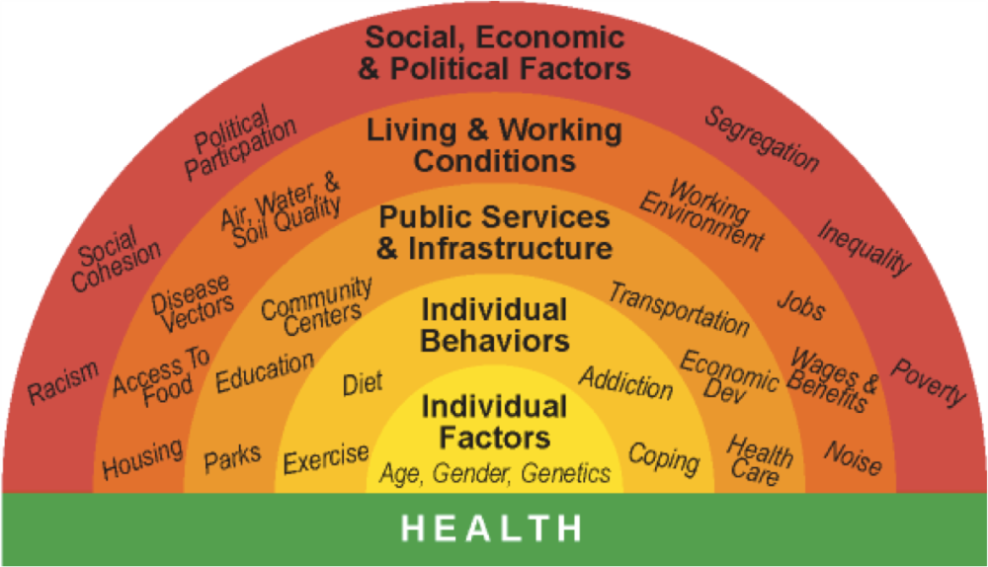
Best Practices in Monitoring and Evaluation
Use Health Determinants and Health Behaviors as Indicators of Health Impacts
Indicators can include:
  Health status
  Health behaviors
  Health determinants

Slide 36

Best Practices in Monitoring and Evaluation
Engage Stakeholders and the Community
Meaningfully include stakeholders in planning monitoring and evaluation
Some of the inherent challenges in monitoring and evaluation can be addressed by leveraging resources and using stakeholders and the community in conducting monitoring and evaluation

Slide 37

Essential Elements of a Monitoring and Evaluation Plan
Goals of monitoring and evaluation
Resources and responsible actor(s)
Questions/outcomes to be addressed
Indicators for monitoring
  SMART - Specific, Measurable, Attainable, Realistic, Timely
  Tied to HIA Recommendations
  Based on a common set of relationship factors/indicators
  related to the field
  Qualitative reporting/measures
  (squishy indicators)

Slide 38
Essential Elements of a Monitoring and Evaluation Plan
Frequency/duration of monitoring
and reporting out
Monitoring/data collection methods
Triggers or thresholds that may lead to review and adaptation in decision implementation
Plans for communication, reporting, and dissemination of results

Slide 39
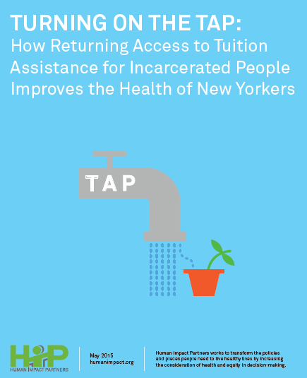
What Would Monitoring and Evaluation Look Like?
Monitoring and Evaluation Large Group Exercise

Slide 40
Monitoring and Evaluation Large Group Exercise
Using the Recommendations listed on following slide:
Suggest indicators for monitoring and who could be the responsible agency or organization
Discuss the value of tracking this data in implementation
How would you report out the results of monitoring to ensure transparency, accountability, and that adjustments are made along the way of implementation?

Slide 41
Monitoring and Evaluation Large Group Exercise
Tuition Assistance Program (TAP) HIA Recommendations
NY legislature should restore TAP funding for qualified incarcerated people
Department of Corrections (DOC) should provide space, security, technology and other resources to ensure successful college programs
DOC should allow and honor educational holds to limit transfers of students to different prisons
College providers should meet rigorous academic standards

Slide 42


Wrap Up and Charge
It is our that you leave this session with a
better understanding of how to plan for and implement
monitoring and evaluation in HIA
Justicia Rhodus
CSS-Dynamac c/o US EPA
rhodus.justicia@epa.gov
Kim Gilhuly
Human Impact Partners
kim@humanimpact.org
Andrew Dannenberg
University of Washington School of Public Health
adannen@uw.edu

