Slide 1




Health as a Language for Democracy: Omaha’s Experience
Andy Wessel, MPH

Slide 2
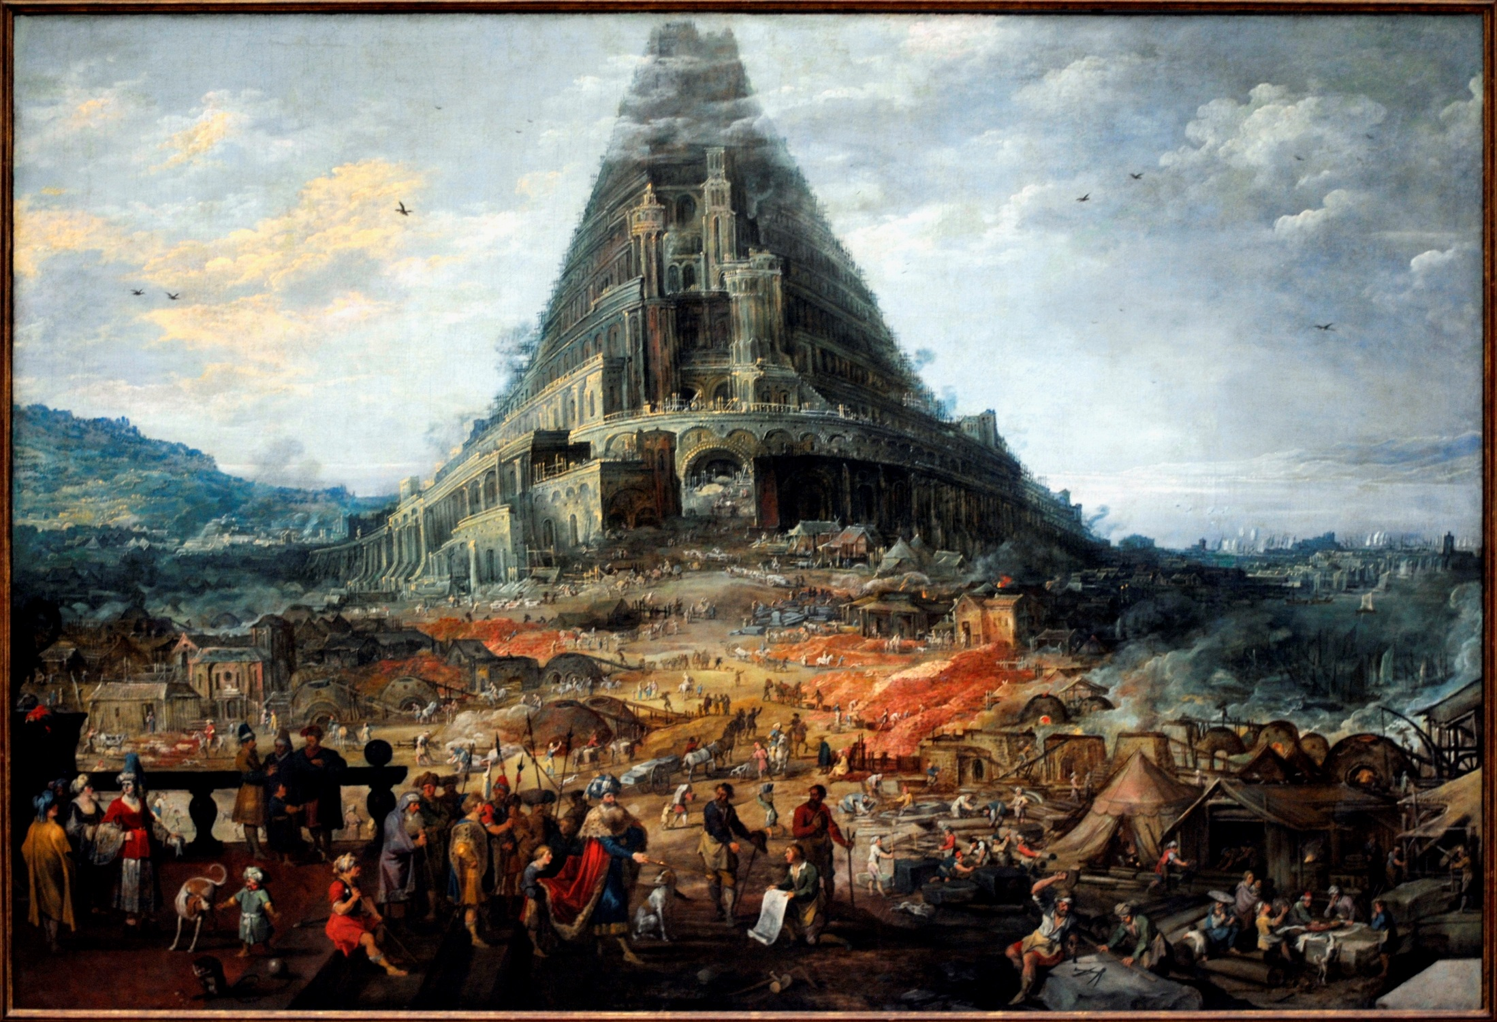
The Tower of Babel by Joos de Momper

Slide 3
Announce and Defend

Slide 4
Announce and Defend

Slide 5
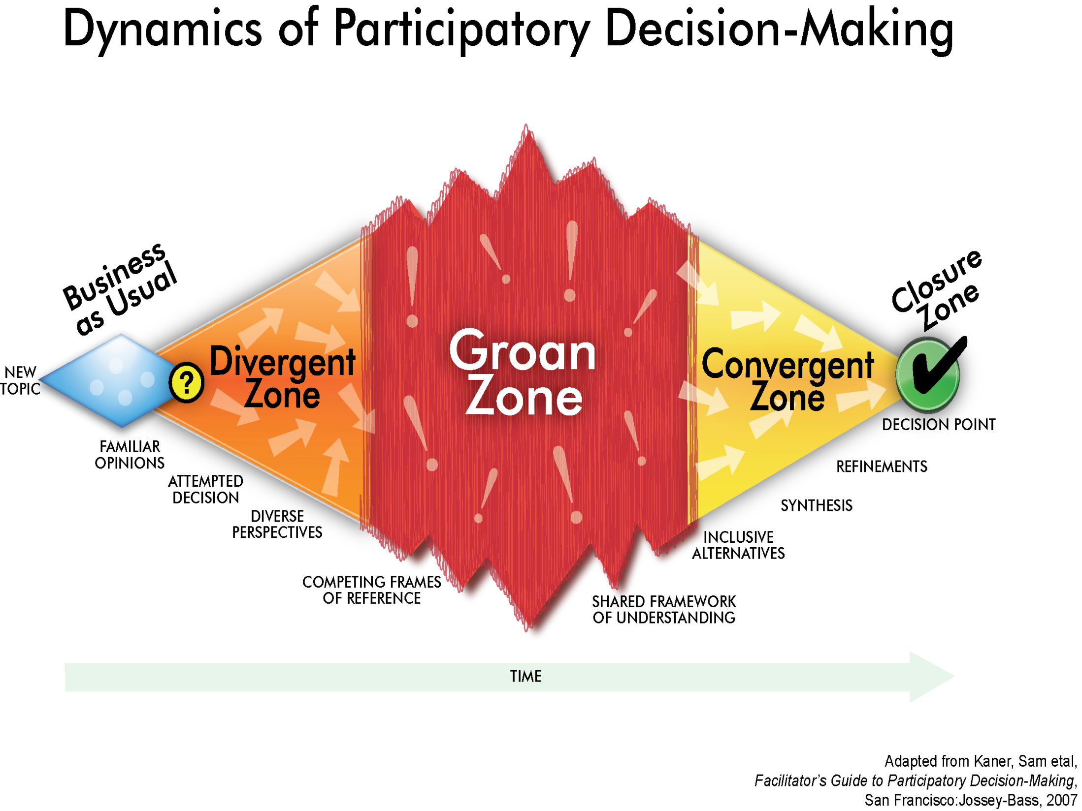

Slide 6
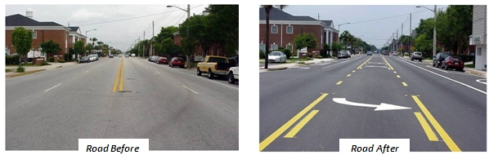
South 24th Street Road Diet

Slide 7
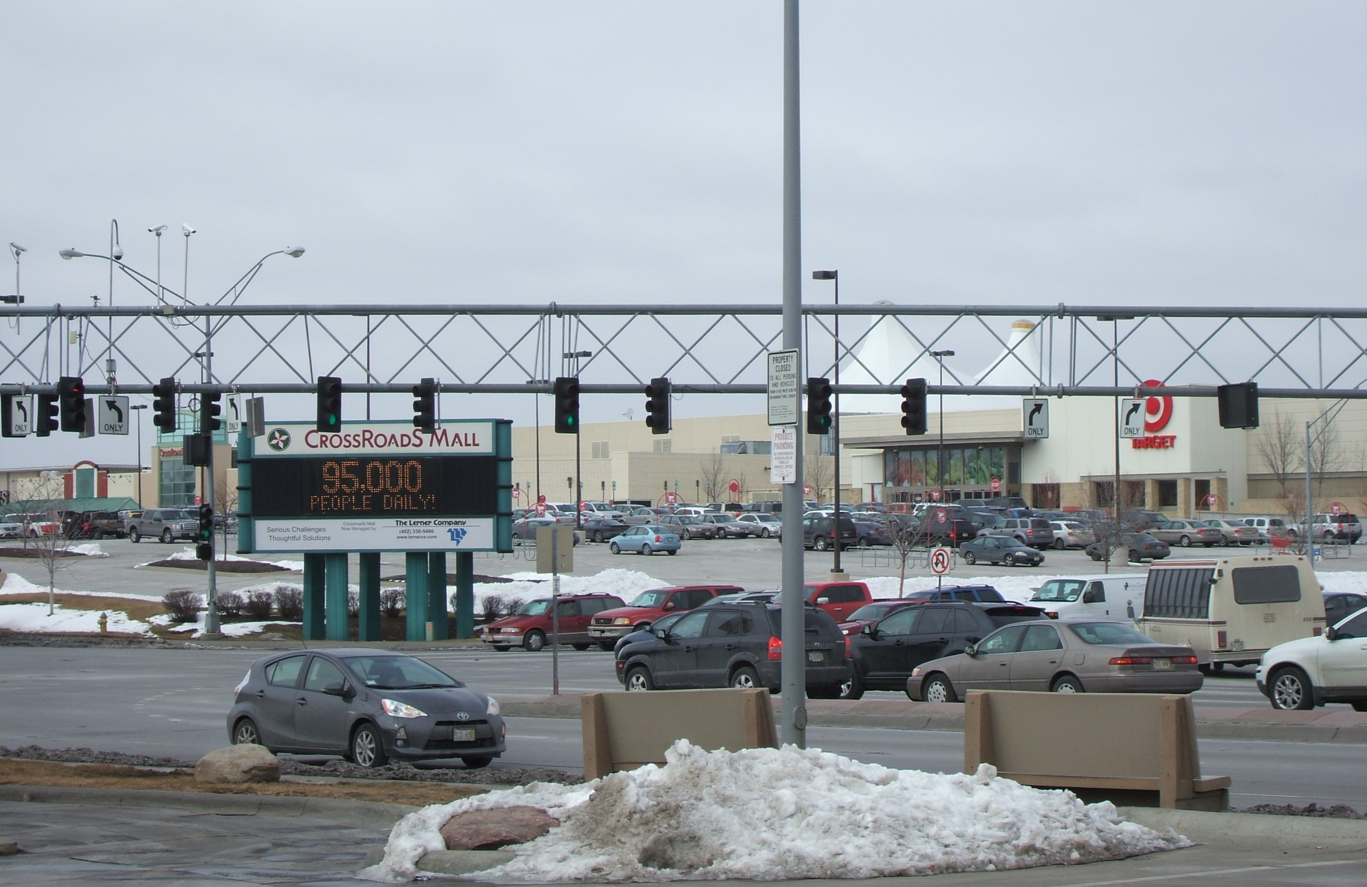
Crossroads Mall

Slide 8
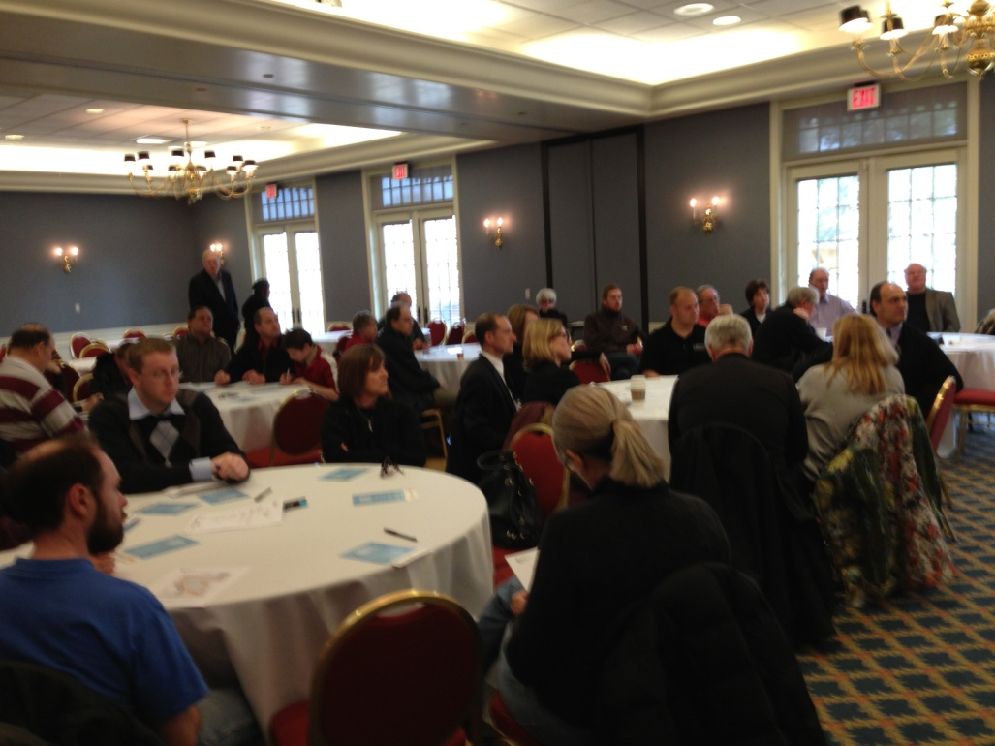
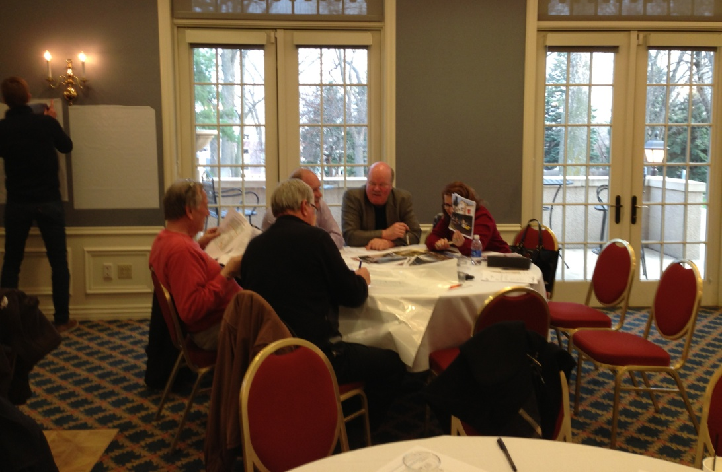
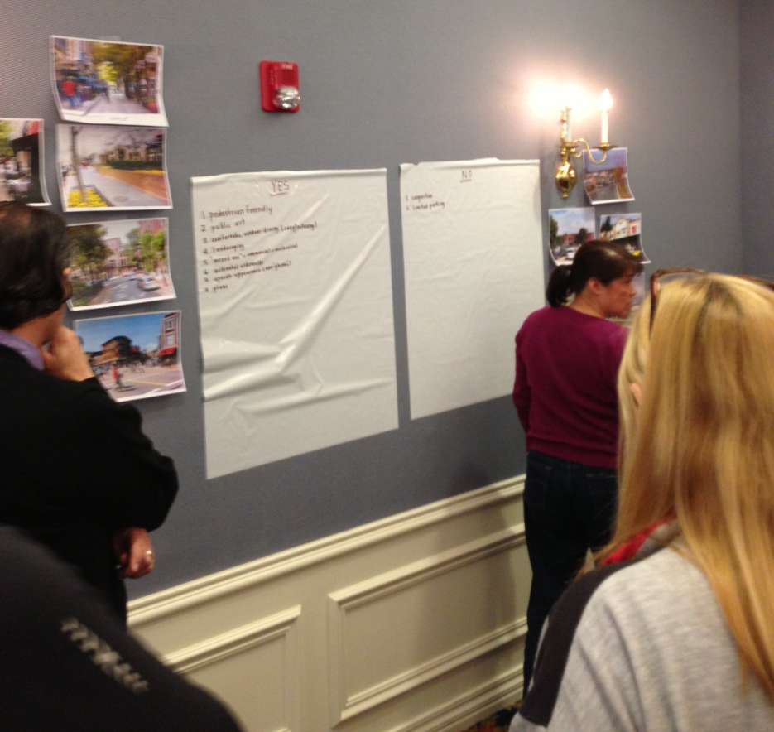
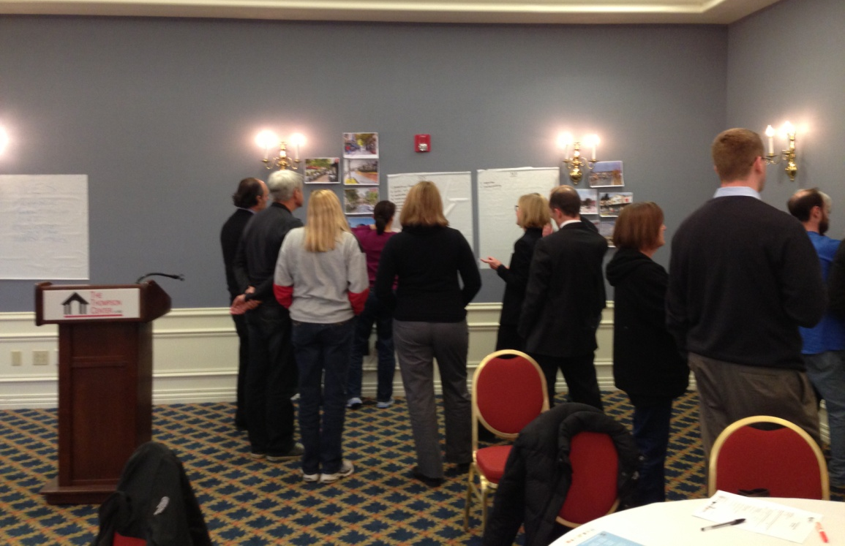

Slide 9
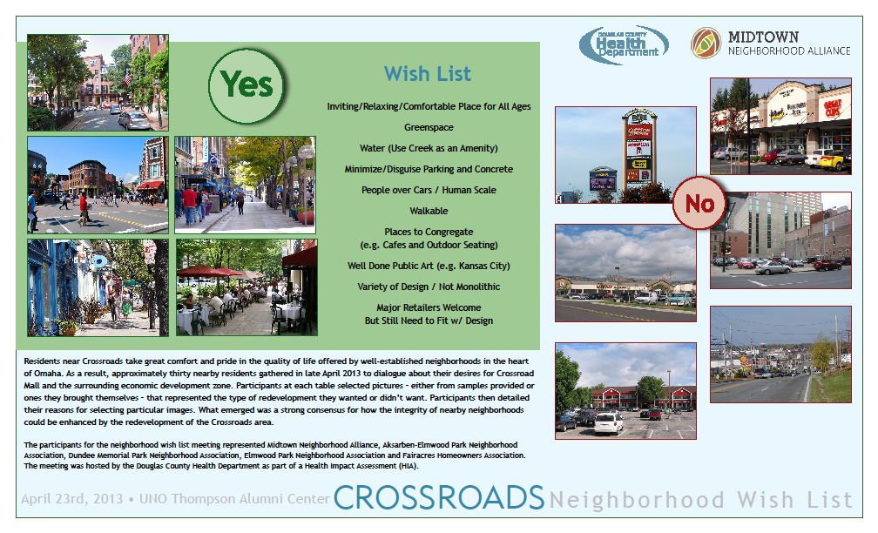

Slide 10
Lessons Learned from our Neighborhood Engagement Workshop

Slide 11


Slide 13
Community Engagement Takeaways
Key Findings | Key Recommendations
Barriers typically exist around language and perspective that make it difficult to develop shared solutions (Tower of Babel Effect) | Brand (public) health as a language and perspective that can bridge silos and improve communication
Engagement is about coming to the community with questions at the heart of the decision (instead of trying to come to them with the right answers) | Develop effective ways for involving more people in answering the question(s) posed by the decision being made Interviews (1 on 1s) Surveys Small Group Meetings Workshops
Planners, engineers and even developers typically want to do right by the community but they lack the facilitation skills and relationships to do early neighborhood engagement | Develop democracy (facilitation) skills Crucial Conversations Technology of Participation (ToP) Intentionally develop relationships with community organizers and base-builders

