Slide 1
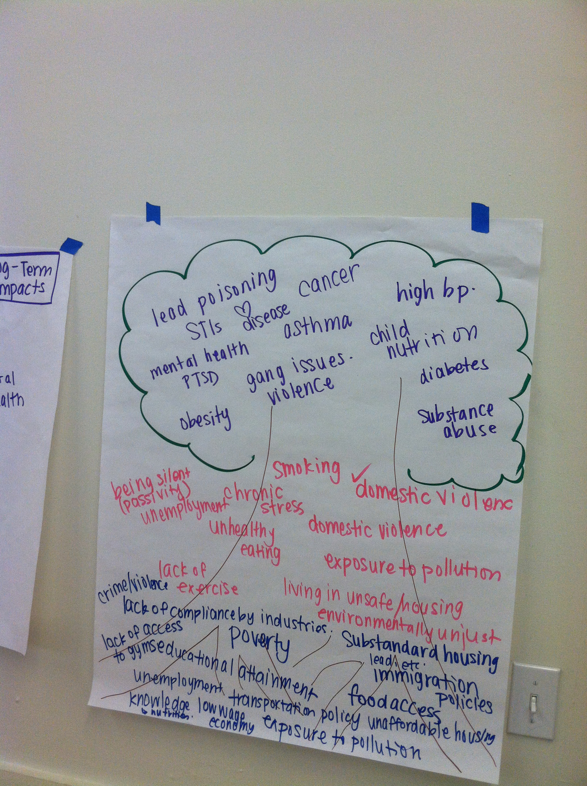

Community development + Health How can we leverage Community Development in a Multi-Sectoral Partnership?
National HIA Meeting 2015
Washington, DC
Ben Wood, Noémie Sportiche
Notes:
Image from Scoping session

Slide 2
Lessons Learned and Questions to Ask
Potential partners to engage
Strategies for multi-sector engagement
Funding sources to leverage
Further resources required
Avenues for future research
Challenges to collaboration
Notes:
Frame these as what we think about when engaging in a project and how they came from our experiences with the three projects we will present about. Then ask them to brainstorm their questions/issues as they relate to working in the broad content area of community development and health.

Slide 3
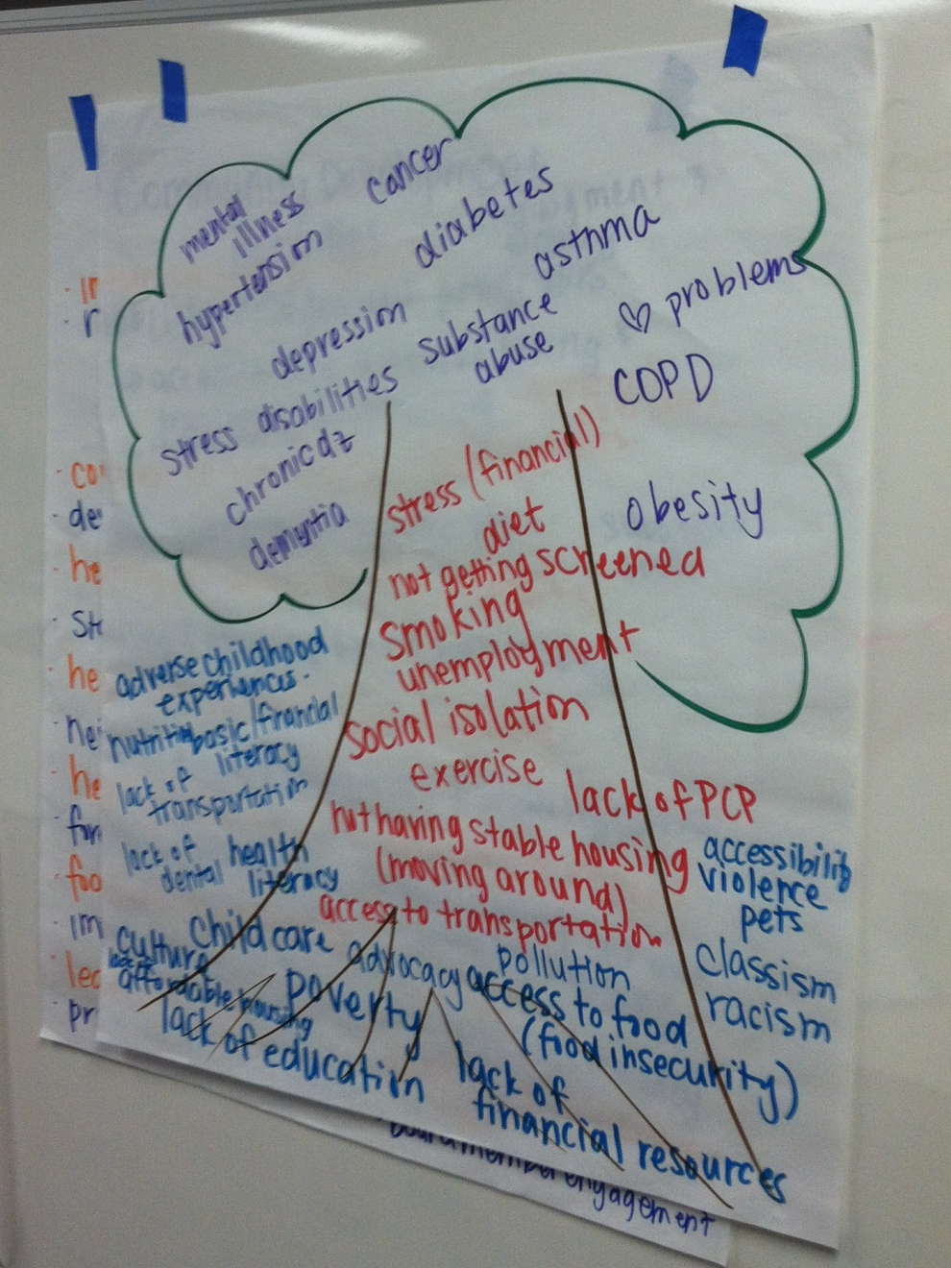
One tool in the toolbox: Health Impact Assessments
Notes:
AA
Here is the HIA field’s formal definition of the process
HIA Definition:
A systematic process that uses an array of data sources and analytic methods and considers input from stakeholders to determine the potential effects of a proposed policy, plan, program or project on the health of a population and the distribution of those effects within the population. HIA provides recommendations on monitoring and managing those effects.

Slide 4
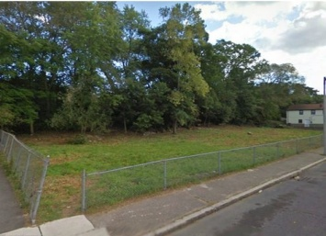
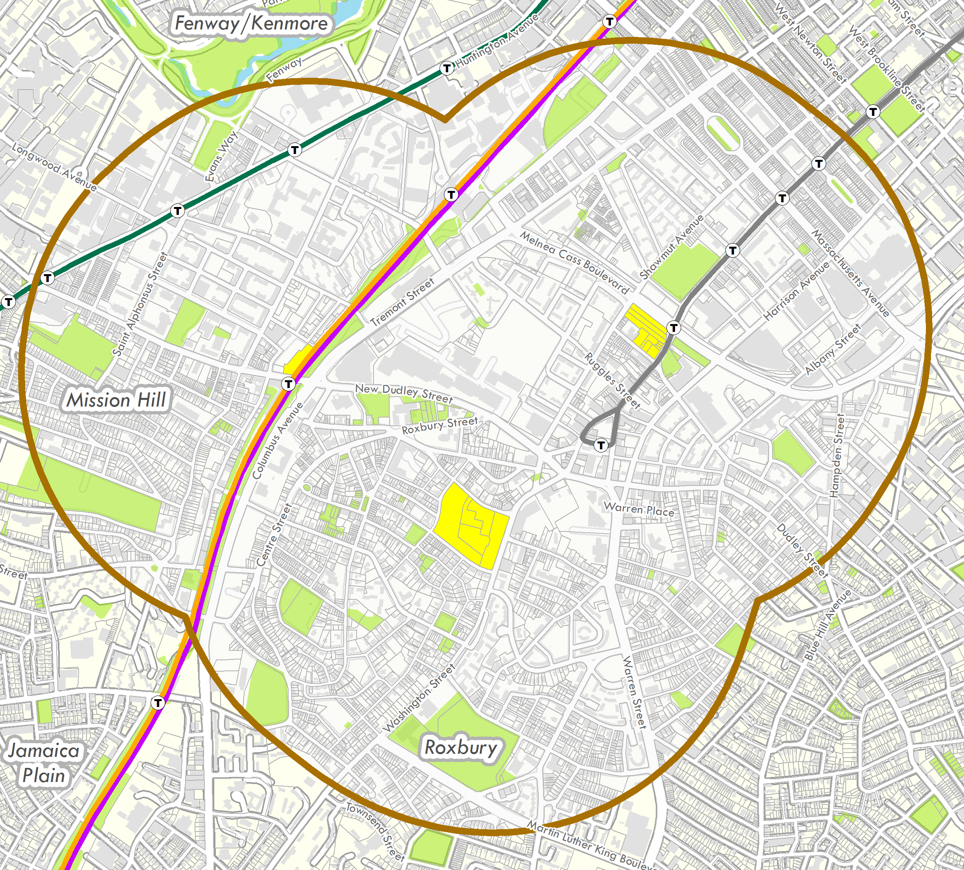
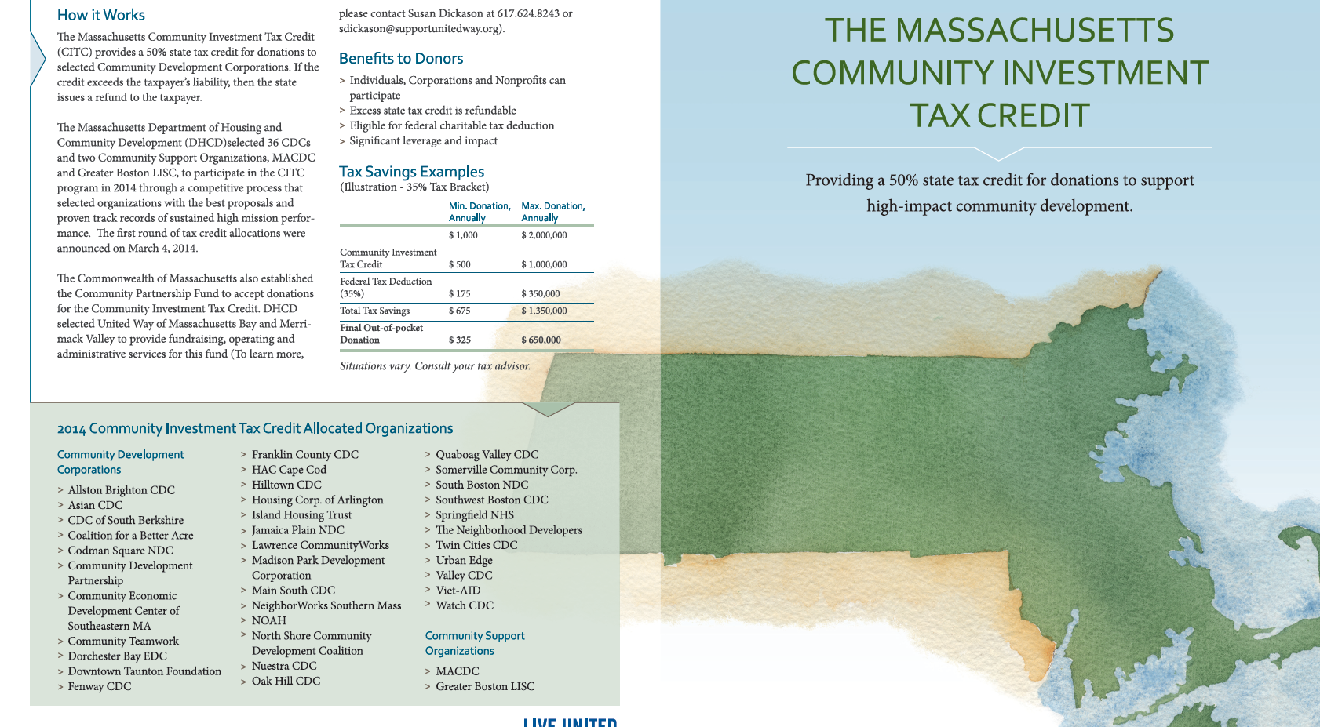
Using Health Impact Assessments to Establish a Partnership
The Oasis on Ballou HIA
One lot
The Healthy Neighborhood Equity Fund (HNEF) HIA
A neighborhood
The Community Investment Tax Credit (CITC) HIA
A state policy

Slide 5
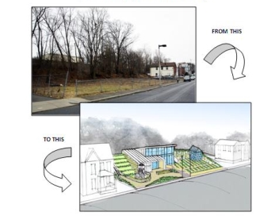
Oasis on Ballou HIA
Goals of the HIA
1. To build capacity among stakeholders (individuals and organizations) to understand and utilize the HIA process
2. To empower the CSNDC and Woodrow Mountain residents (“The Friends”) to envision and plan for the redevelopment of the vacant 100 Ballou Avenue site with an explicit consideration of the health impacts of the site
Findings
Potential for positive impacts on levels of physical activity, healthy food access and healthy eating, social interaction and social cohesion.
Potential negative impacts include exposure to soil toxins, injuries, and crime.
Overall, the HIA found that Oasis on Ballou would have significant positive impacts on the health of local residents if designed according to the recommendations and resources presented in the report.

Slide 6
Lessons learned (Oasis on Ballou)
Lessons about working with a CDC:
Brought the community to the table easily
Lessons about the scale of the project:
Impactful but best use of resources? Why we wanted to move towards a different level of decision-making

Slide 7
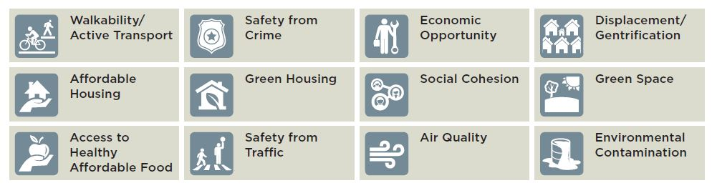
HNEF HIA: defining and measuring healthy neighborhoods
CLF & MHIC proposed$30 million private equity fund for investors who want social returns
Used HIA of 3 proposed developments in Roxbury as case study to answer:
What defines a healthy neighborhood?
How do we measure it?
Developed methods to measure impact via12 pathways

Slide 8
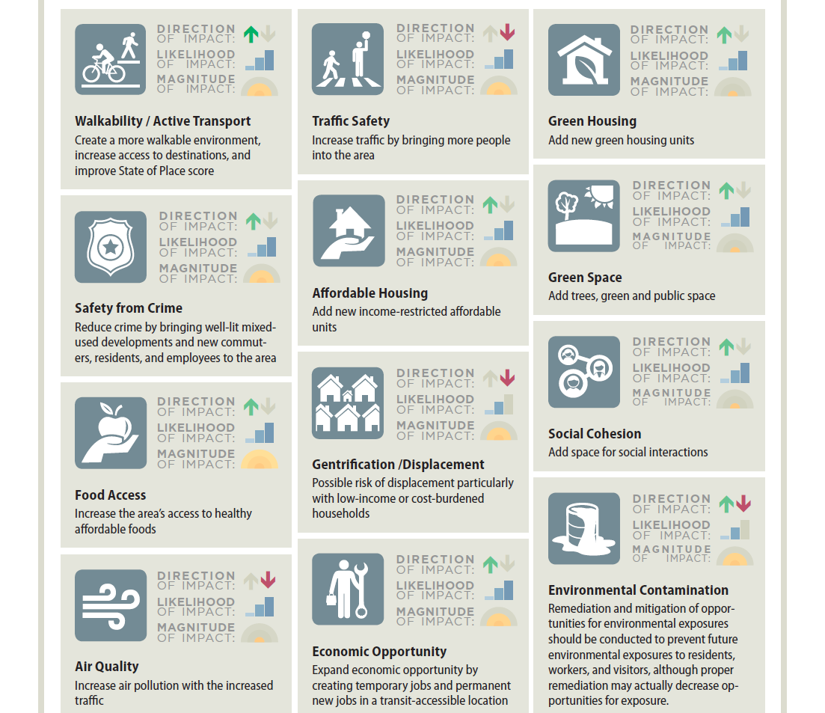
Results:
Indicators were refined based on these findings
CLF piloting metrics now in Boston and Chelsea
Findings informing current neighborhood work

Slide 9
Lessons learned (HNEF)
Lessons about working with a CDC:
Again, brought the community to the table easily
Investment in social justice related concerns by the developer (e.g. displacement) meshed with values of HIA
Lessons about the scale of the project:
Size of projects likely have potential for transformational community (and therefore health) impact.
Success in informing the HNEF led us to think about ways to inform community development in even broader ways.

Slide 10




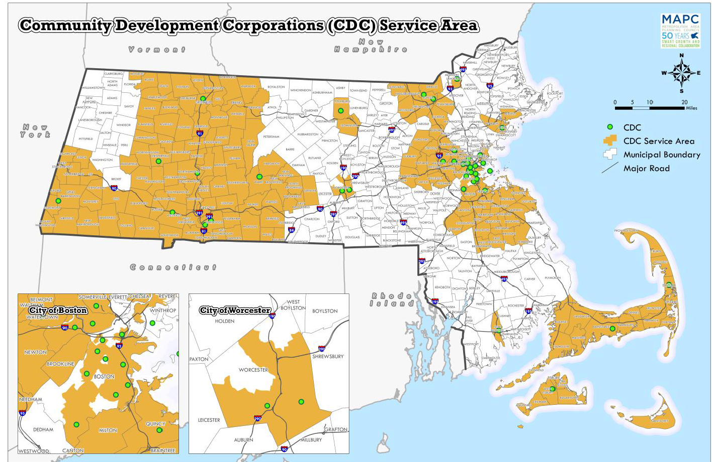
CITC HIA: An HIA of the Community Investment Tax Credit Program
Physical
Development
Economic
Development
Two Goals:
To comprehensively link CDC activities to health
To look at how CITC funding might change CDC activities and through that, health
CDC leadership very involved
Outcomes suggested meaningful health impacts primarily targeted at vulnerable populations
Asset
Development
Community Organizing,
Building, & Empowerment
Notes:
Looked holistically at demographic, environmental, and health conditions, which we defined broadly to include mental, physical, and social health.
2 scoping sessions: 1 in Boston, 1 in Western Mass, to get ensure representation from urban, rural, and gateway CDCs.

Slide 11
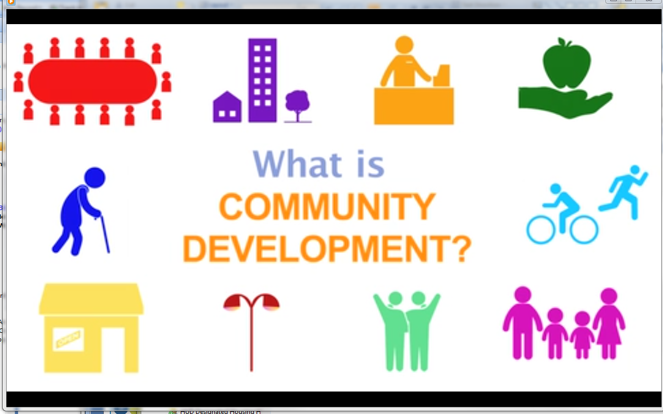
Results and Follow up
As with our other HIAs:
Executive Summary and HIA Report
Stakeholder engagement
New Approach and Tools based on lessons learned:
White Paper
Videos
Promotional
Educational
Data
Presentations and Trainings
Notes:
Communications tools for partnership building and dissemination

Slide 12
Lessons learned (CITC)
Lessons about working with DHCD (government entity):
Engaged but not invested in the same way as decision-makers in the previous projects (evidenced by length of review time of draft recommendations)
Working with the MACDC versus individual CDCs
They have their own agenda; mostly fits with the values of HIA but as an advocacy group need to pay attention to this
Lessons about the scale of the project:
Scale made for difficult methodological questions
More theoretical than project level HIAs which was difficult mostly from a communication perspective

Slide 13
Looking back: What was critical to our success so far overall
Being open to feedback throughout the HIA process—use it as a partnership building tool
CDC leadership buy in through project partnership
Trainings and engaging exercises
Developing simple, useful, and engaging communication tools for dissemination
Emphasizing potential resource (including funding) opportunities that come with health frame

Slide 14
Health starts—long before illness—in our homes, schools, and jobs.
Notes:
Image from RWJF Time to Act

Slide 15
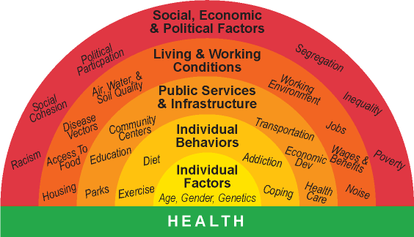
An engagement tool

Slide 16
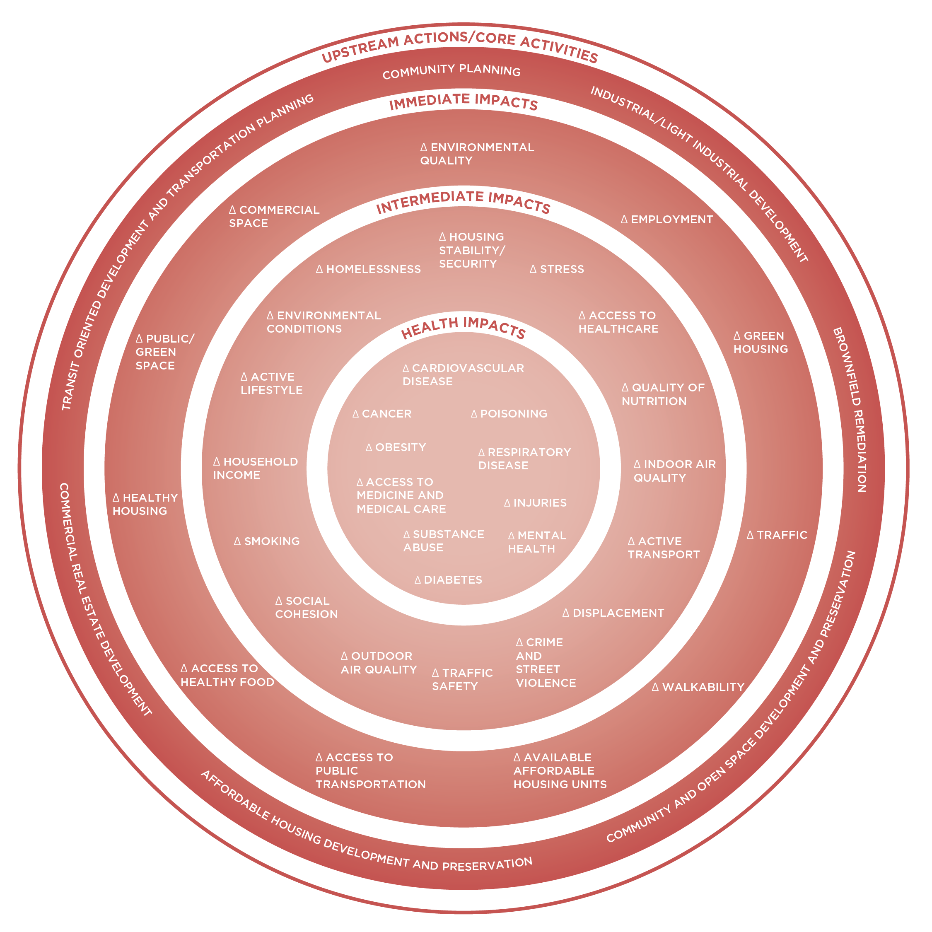
Physical Development and Community Planning

Slide 17
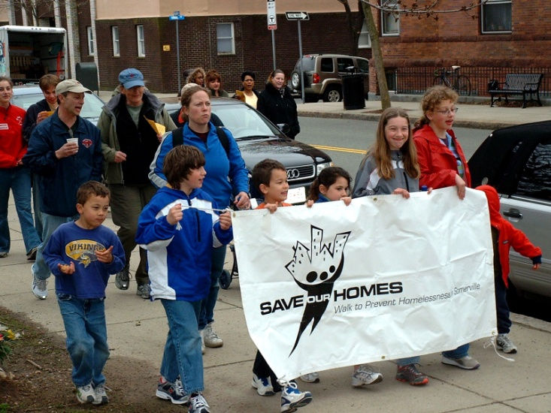
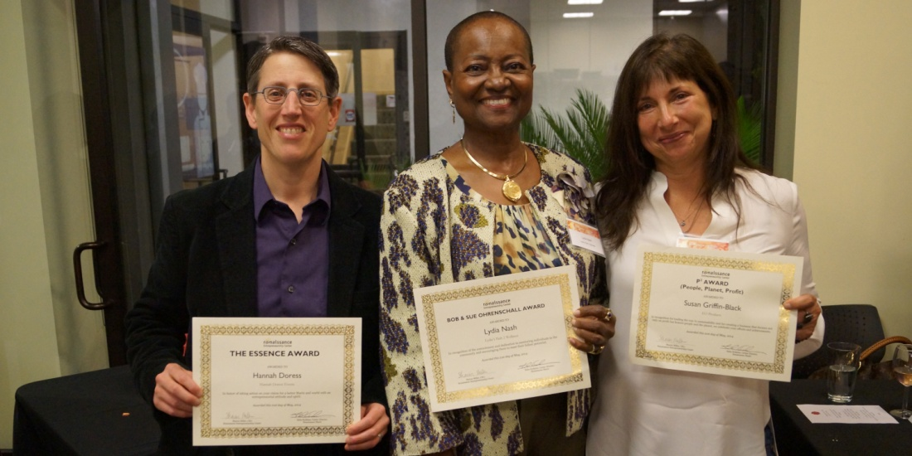
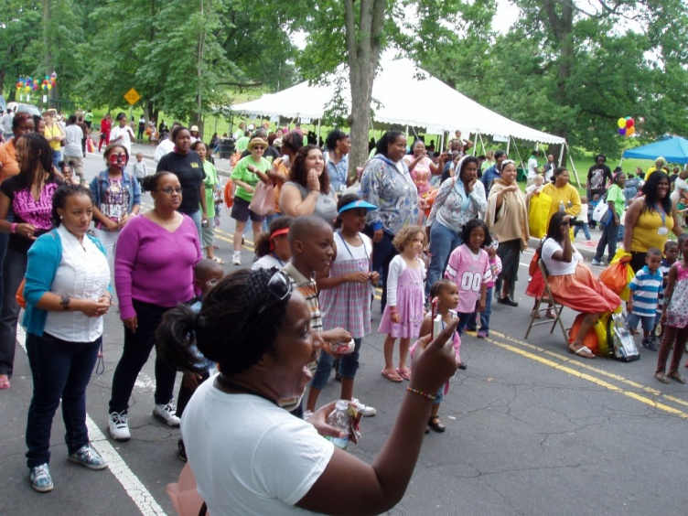


Slide 18
Lessons Learned and Questions to Ask
Potential partners to engage
Strategies for multi-sector engagement
Funding sources to leverage
Further resources required
Avenues for future research
Challenges to collaboration
Notes:
Put these back up and then have them get in small groups to answer these questions in their contexts or do a large group exercise depending on numbers

Slide 19

Communicating the Value of + Health
[Insert Video]

