Slide 1
Health Impact Assessment of the Shawnee Fossil Plant
Deborah Payne, MPH

Slide 2
Acknowledgements
The Health Impact Project, a collaboration of the Robert Wood Johnson Foundation and the Pew Charitable Trusts.
Local community stakeholders, the HIA advisory committee, the Purchase District Health Department, TVA, Synapse Economics, and the Georgia Health Policy Center.
The views expressed are those of the author(s) and do not necessarily reflect the views of The Pew Charitable Trusts or the Robert Wood Johnson Foundation.

Slide 3
Screening
Shawnee Fossil Plant under evaluation for plant retrofit or retirement.
Social Factors of health:
Employment and Economy affect access to income for housing, nutrition and health insurance
Environmental factors of health:
Air and water quality can affect rates of asthma, heart disease, low birth weight, and cancer.

Slide 4
Scoping
Employment
Who would be impacted by a plant retirement? Retrofit?
How many jobs would be lost with retirement?
How would transitions be managed?
Local Economy
How much does the Shawnee plant contribute to school and county taxes?
How would a reduction in employees affect school enrollment?

Slide 5
Scoping
Air
What amount of pollution does Shawnee contribute to the air?
Who is affected by poor air quality?
How would a retrofit affect air quality?
Water
How does Shawnee currently affect water quality?
How would a retrofit affect water quality?
Who is affected by poor water quality?
What would be done to clean up existing water contamination?

Slide 6
Assessment:
Employment and Health
The Shawnee Fossil Plant employs approximately 300 individuals.
Additional retrofits required for the plant might build in as many as 350 additional jobs.
Maximum potential job loss from retirement: 750 jobs in 2018 and 2019 ($37.5 million in income)
Minimum job loss of 440 jobs in 2017 ($24.1 million in income).

Slide 7
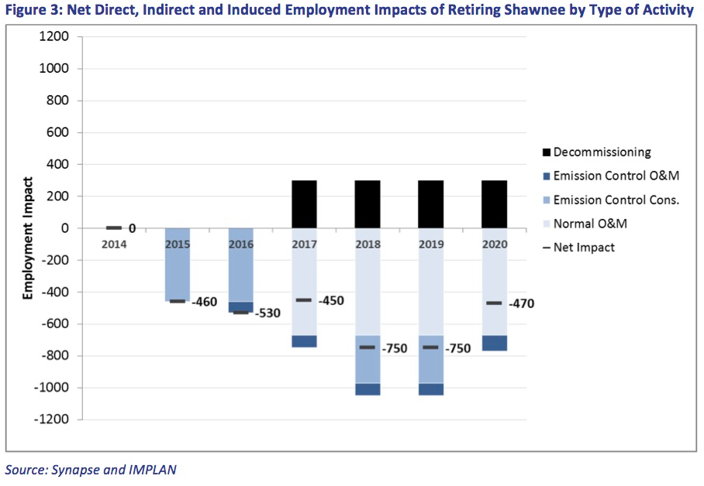

Slide 8
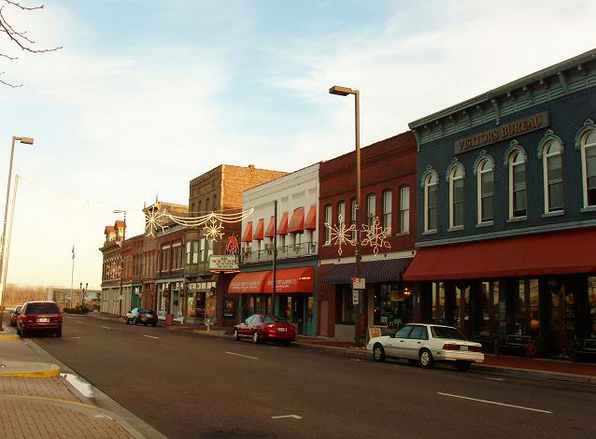
Local Economy and health
Closure of the Shawnee Fossil Plant would reduce the $1.1 million in payment-in-lieu-of-tax financial contribution provided to the County.
Shawnee’s workers are also responsible for $300,000 in payroll taxes paid to the county leading to potential impact funding for police, fire forces and EMS, critical for public safety.
TVA contributed $3,713,739.97 to the McCracken County School budget for the 2014 fiscal year. Such funds play a role in ensuring the quality of education and sustainability of the school.

Slide 10
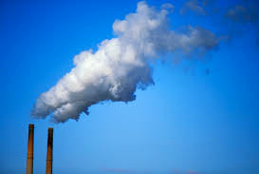
Air Quality and health
The prevalence of asthma in adults in Ballard County is 16% while it is 15% in McCracken County.
The prevalence of asthma in the region for children is 15.8%, greater than the Kentucky rate of 10.7% and the national rate of 8.4%.
The Shawnee plant is the main source of air pollution in the area according to TRI data.

Slide 11
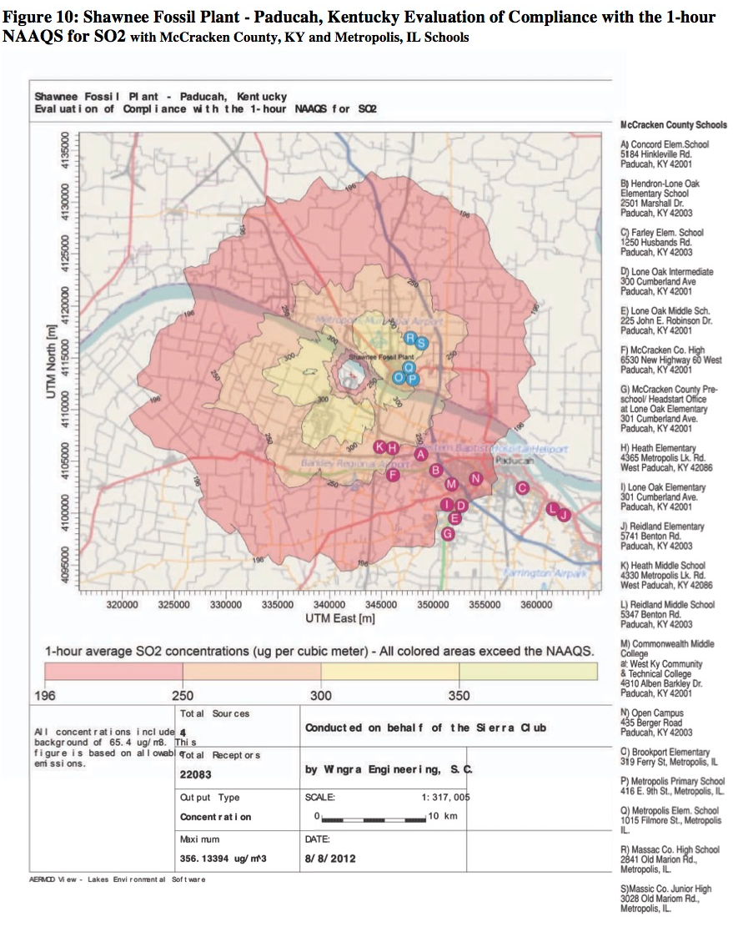

Slide 12
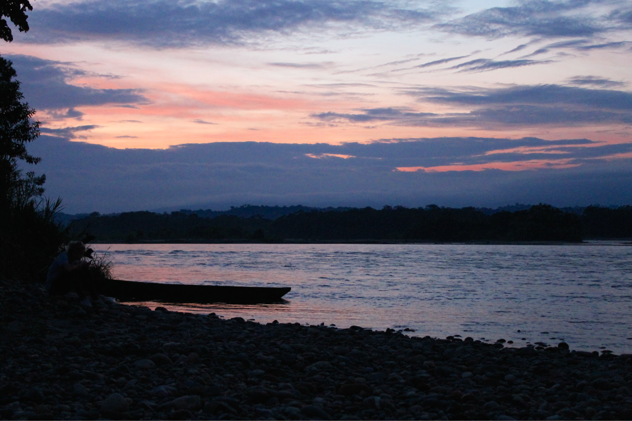
Water Quality and health
Coal plants generate large amounts coal ash.
Metals commonly found in coal ash: arsenic, manganese, boron, chromium, and selenium.
Consumption of untreated ground water or fish contaminated by heavy metals can impact public health.
Aquifers under the Shawnee plant have been contaminated by coal ash.

Slide 13
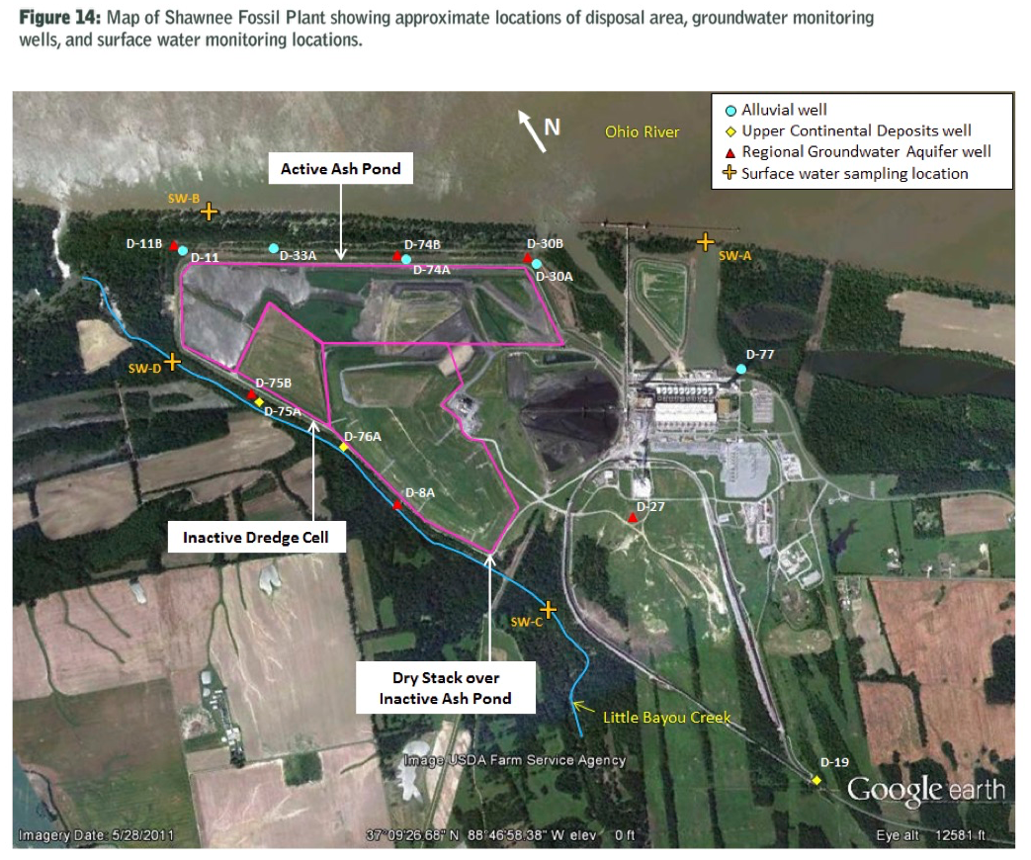

Slide 14
Recommendations
Communicate with local Area Development District, County Judge Executive, and other local leaders around intentions of plant retirement.
Create strong transition plans for current employees.
Implement air quality monitoring system at schools using AQI.
Replace fish advisory signage at a lake near the plant.

Slide 15
Reporting
Release to state and local papers.
Radio interview on NPR.
Face to face communication with TVA.
Follow up meetings with Purchase Area Development District, Purchase District Health Department.

Slide 16
Monitoring and Evaluation
Review of TVA’s integrated resource plan addressing long term plans around Shawnee Fossil Plant.
Continued communication with Purchase District Health Department on school air monitoring plan.
Posting of signage at local fishing lake.

Slide 17
Thank you
Deborah Payne, MPH
deborah@kyenvironmentalfoundation.org
859-986-0868
www.kyenvironmentalfoundation.org

