Slide 1


Slide 2

Presenters:
Sarah Tennyson, MPH
Regional Coordinator
MountainWise Partnership
Don Kostelec, AICP
Principal
Kostelec Planning
Chris Danley,
Principal
Vitruvian Planning

Slide 3
Making healthy living easier through providing…
Opportunities for physical activity
Access to local fresh fruits and vegetables
Support for tobacco-free places
Access to services for chronic disease management
By honoring traditions and embracing natural resources, we can make the healthy choice the easy choice.

Slide 4
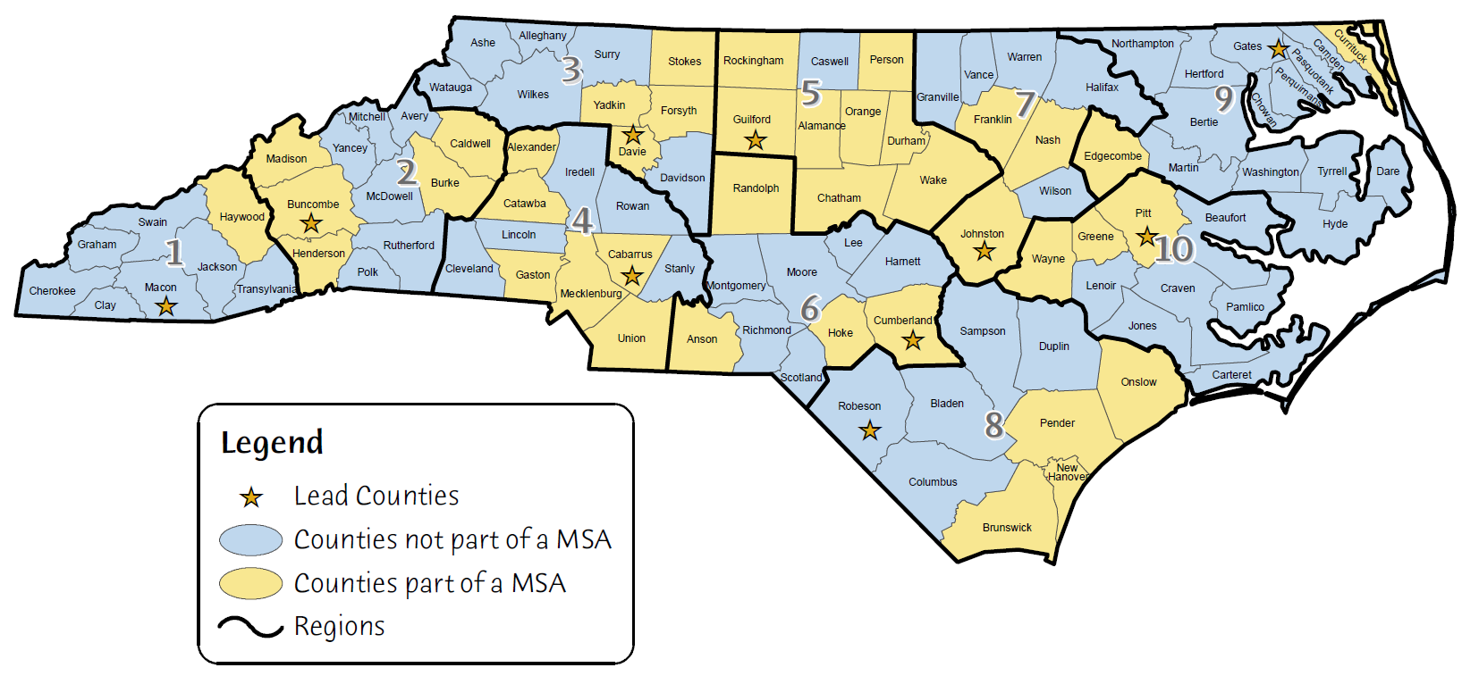
CTG in North Carolina
12 Priority Areas that focus on healthy eating, active living, tobacco-free living
Most of the evidence-base is in an urban setting, for example
Healthy Corner Stores in Philadelphia and Baltimore
Smoke-free Multi Unit Housing in cities in Minneapolis
Health Considerations in Comprehensive plans in Portland

Slide 5

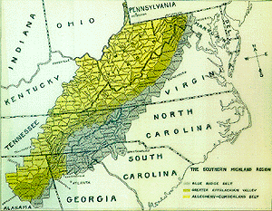
Snapshot of SW North Carolina
Rural (largest population appx. 58,000, smallest appx. 8,500)
Economically distressed Tier 1 &2 Counties
High Rates of Unemployment
High poverty rate
Poor Health Outcomes
Plentiful natural resources
2014 NC Department of Commerce
2012 PRC Community Health Assessment

Slide 6
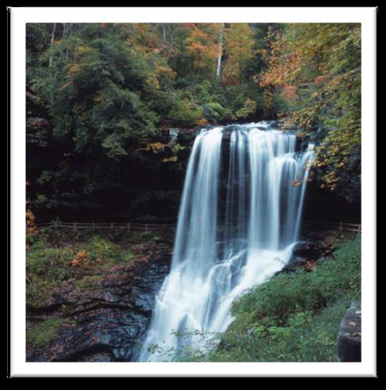
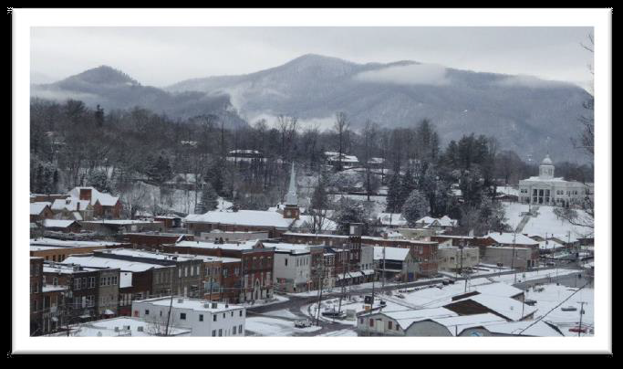
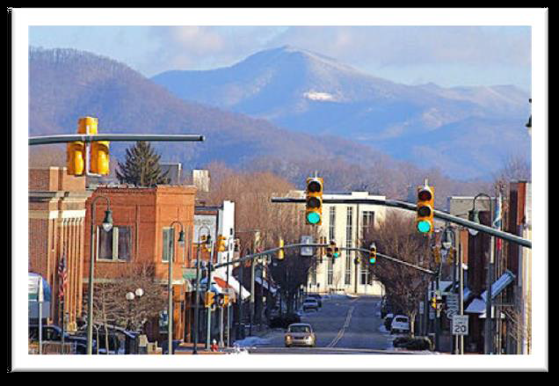


Slide 7

Planning for Health: Partnerships that Work
Background
Most of the evidence base is in an urban setting, how do we make this relevant to rural Southwestern North Carolina
Many of our counties have no planning staff/boards and no zoning
Wanted to become a model for best practice for planning/public health partnerships in a rural region
Made the decision to move forward with a Regional approach rather than county specific
Decided a Health Impact Assessment would be an effective way for Public Health to have a seat at the larger decision making table

Slide 8
Implementation
Partnered with the Southwestern Planning and Economic Development Commission (Regional Council of Government) was better positioned to handle this kind of regional project
Because of the sensitive political climate and to ensure support, a letter of support was required from each county manager to move forward

Slide 9

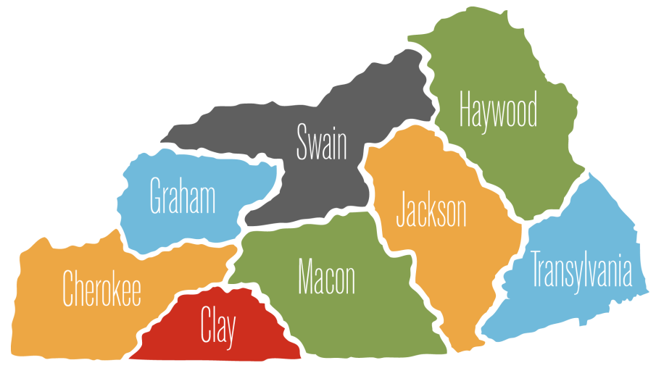

Slide 10
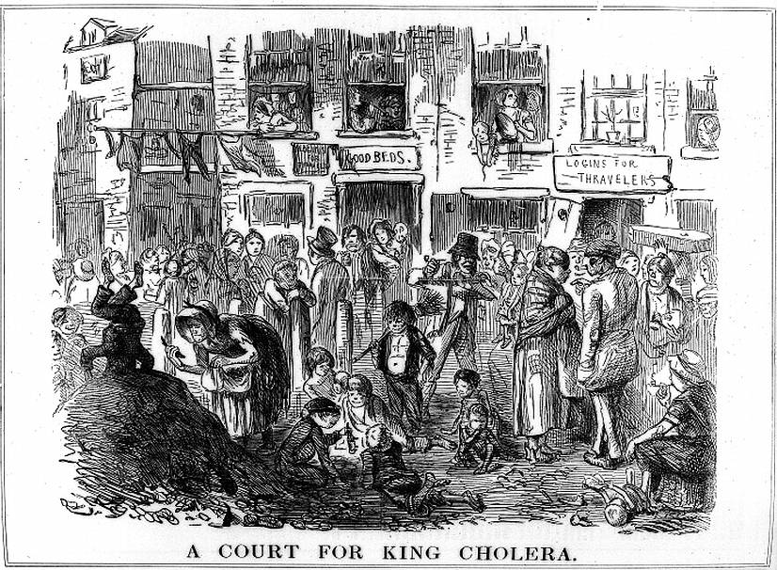

Slide 11
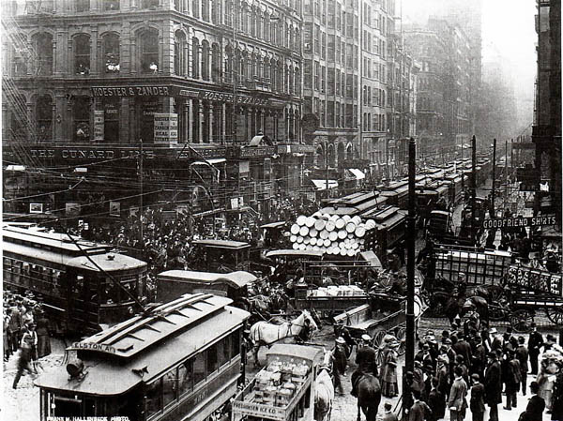

Slide 12
The MountainWise HIA: MountainElements
8-county HIA aimed at assessing proposed actions related to planning efforts across the region, including:
Comprehensive Plans (adopted or being developed)
Other Plans: Recreation, Econ. Development, Transportation, etc.
Produce 8 Health & Wellness Chapters for each county’s Comprehensive Plan (where applicable)

Slide 13
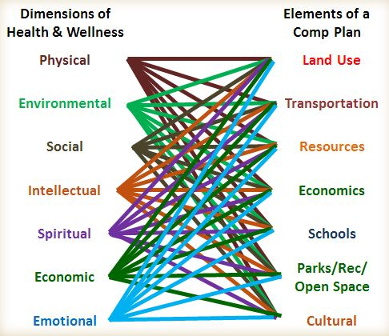

Slide 14
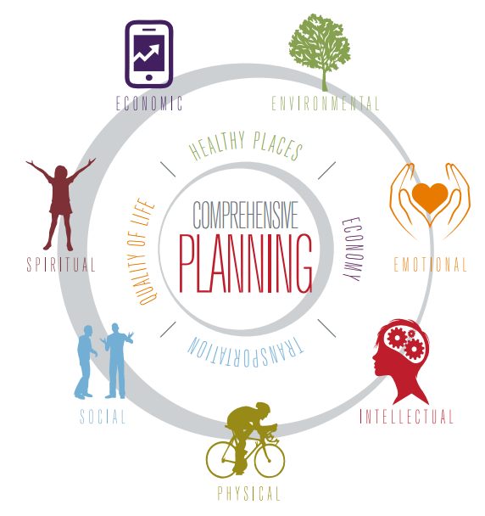

Slide 15
The 7 Dimensions of Health
Physical- the ability to maintain a healthy quality of life that allows us to get through our daily activities without undue fatigue or physical stress. .. ability to recognize that our behaviors impact our wellness.. adopting healthful habits while avoiding destructive habits will lead to optimal Physical Wellness.
Social- the ability to relate to and connect with other people in our world…establish and maintain positive relationships with family, friends and co-workers
Economic (Occupational)-is the ability to get fulfillment from our jobs or career fields while still maintaining balance in our lives. Our desire to contribute in our careers to make a positive impact on the organizations we work in and to society as a whole.

Slide 16
The 7 Dimensions of Health
Environmental- the ability to recognize our own responsibility for the quality of the air, the water and the land that surrounds us. The ability to make a positive impact on the quality of our environment, be it our homes, our communities or our planet.
Spiritual- the ability to establish peace and harmony in our lives. The ability to develop congruency between values and actions and to realize a common purpose that binds creation together.
Emotional- the ability to understand ourselves and cope with the challenges life can bring. The ability to acknowledge and share feelings of anger, fear, sadness or stress; hope, love, joy and happiness in a productive manner.
Intellectual- the ability to open our minds to new ideas and experiences that can be applied to personal decisions, group interaction and community betterment. The desire to learn new concepts, improve skills and seek challenges in pursuit of lifelong learning.

Slide 17
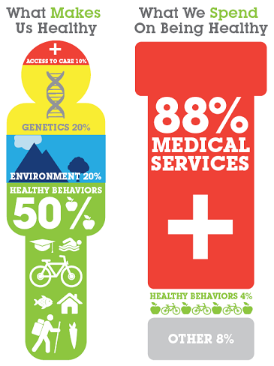
Four-Pronged Assessment/Evaluation
Existing Plans
evaluation through lens of 7 dimensions of health/wellness
Mapping via Census & SCHS data to identify “Hot Spots”
Budget/finance analysis via Financial Reports (CAFRs), budget
Policy Evaluation, primary NC context (few sub or zoning ordinances in WNC)

Slide 18
Demographic Data
Total Population
Population Density
% African American Population
% Hispanic Population
% Below Poverty
% High School Graduation
% Population Spending >30% on Housing
% of Household on Food Stamps

Slide 19
Health Considerations
Health Care Workers
% of Population w/Low Access to Grocery Stores
Heart Disease Mortality Rate per 100K People
Stroke Mortality Rate per 100K People
Cancer Rates per 100K People

Slide 20
Comprehensive Plans
Land Use
Transportation
Economic Development
Environment, Health and Culture
Schools
Open Space, Recreation

Slide 21


Community Health Assessments

Slide 22


Community Health Implementation

Slide 23
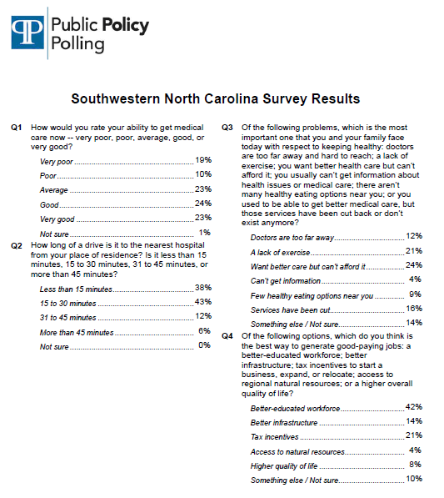
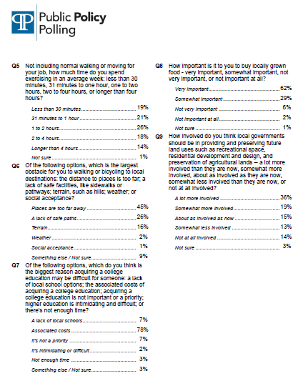
Surveys

Slide 24
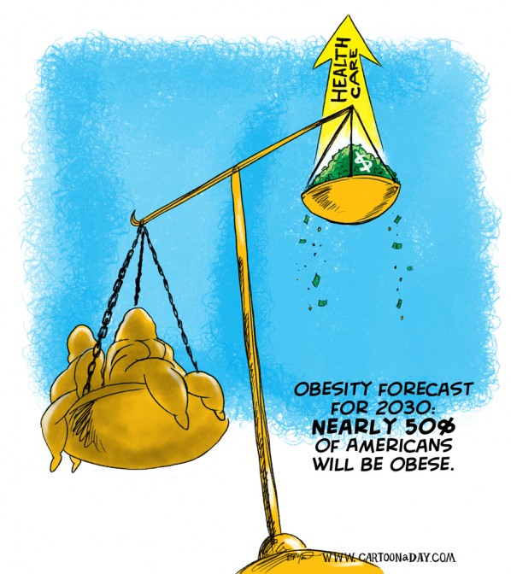

Slide 25
North Carolina General Statutes
Chapter 160A. Cities and Towns.
Part 2. Subdivision Regulation.
§ 160A‑372. Contents and requirements of ordinance.
(a) A subdivision control ordinance may provide for the orderly growth and development of the city; for the coordination of transportation networks and utilities within proposed subdivisions with existing or planned streets and highways and with other public facilities; … and rights‑of‑way or easements for street and utility purposes including the dedication of rights‑of‑way … and for the distribution of population and traffic in a manner that will avoid congestion and overcrowding and will create conditions that substantially promote public health, safety, and the general welfare.

Slide 26
North Carolina General Statutes
§ 160A‑383. Purposes in view.
Zoning regulations shall be designed to promote the public health, safety, and general welfare. To that end, the regulations may address, among other things, the following public purposes: to provide adequate light and air; to prevent the overcrowding of land; to avoid undue concentration of population; to lessen congestion in the streets; to secure safety from fire, panic, and dangers; and to facilitate the efficient and adequate provision of transportation, water, sewerage, schools, parks, and other public requirements.

Slide 27

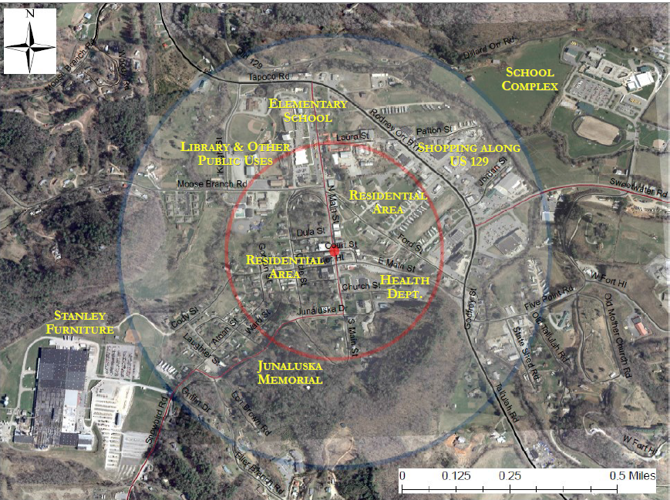
Park, Transportation, Sub Area Plans

Slide 28
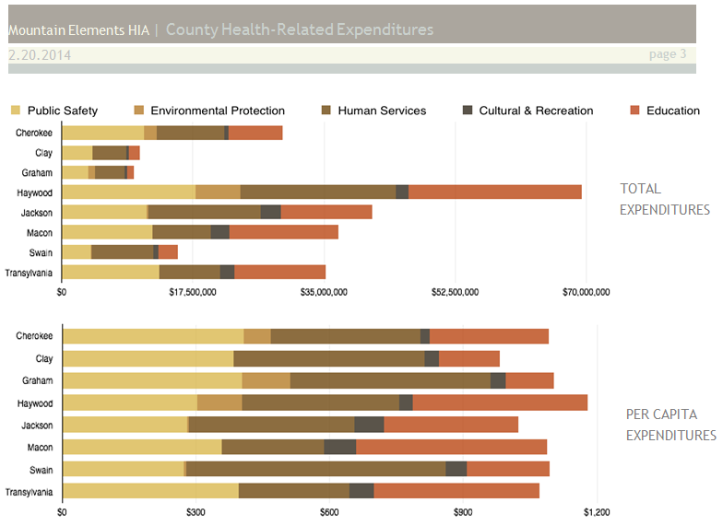
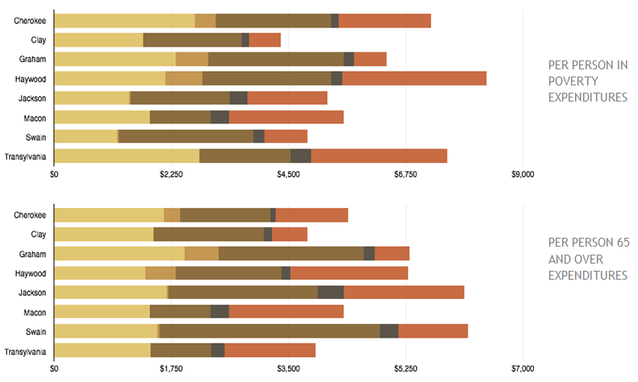
Budget Review

Slide 30
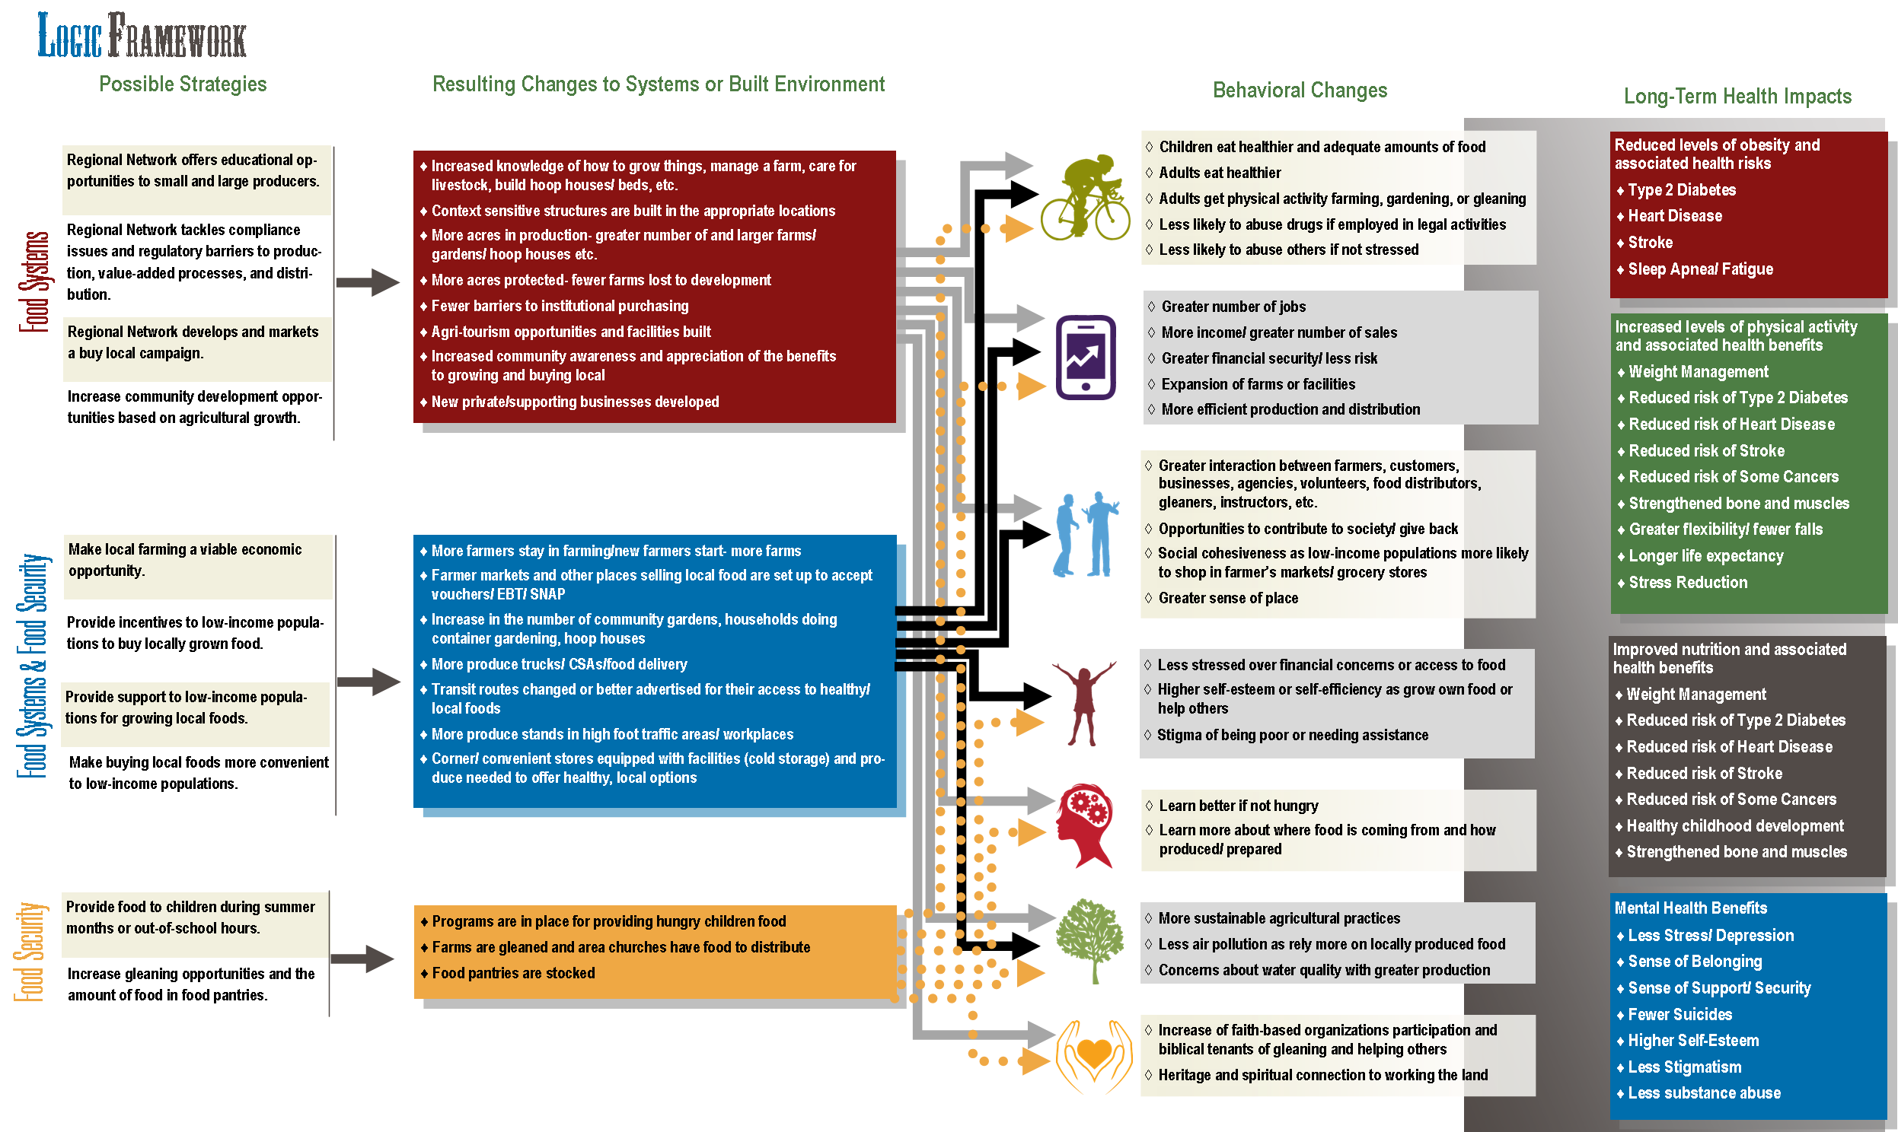

Slide 31
Major Findings:
Growing local food initiatives and preservation of agriculture land may improve nutrition
Agricultural land preservation & focused land use planning are keys to healthy food systems

Slide 32
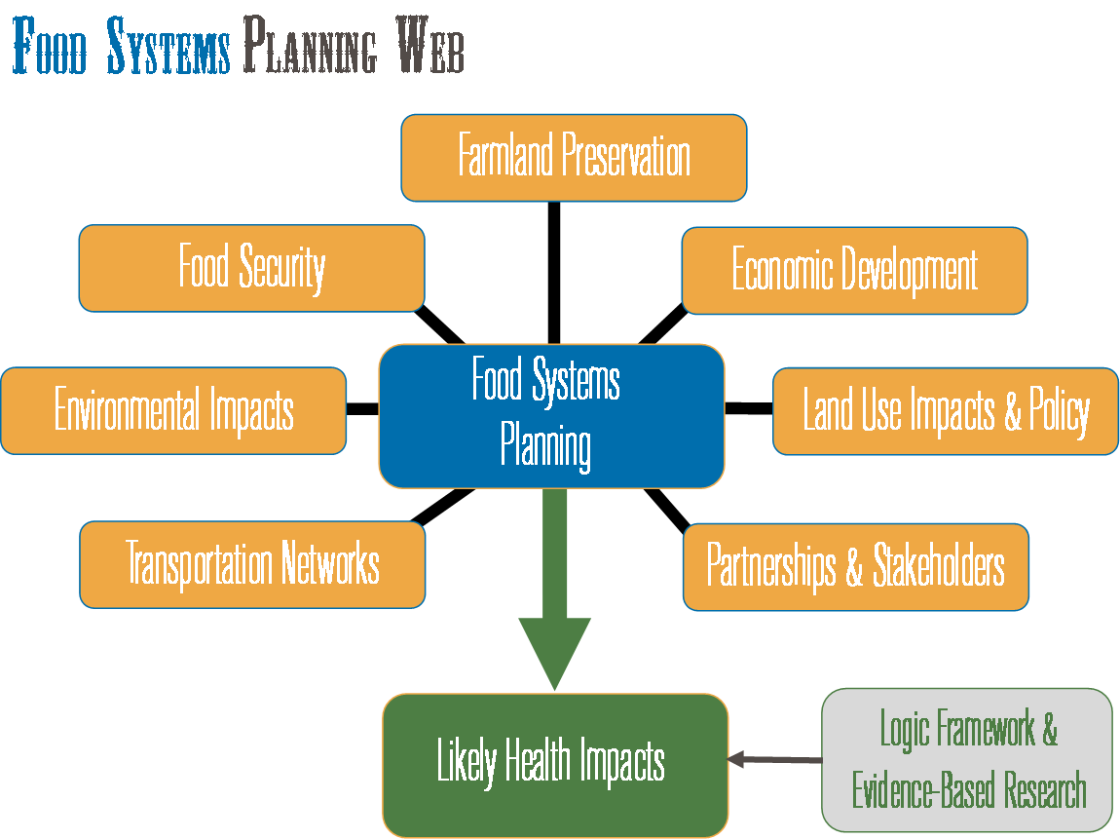

Slide 33
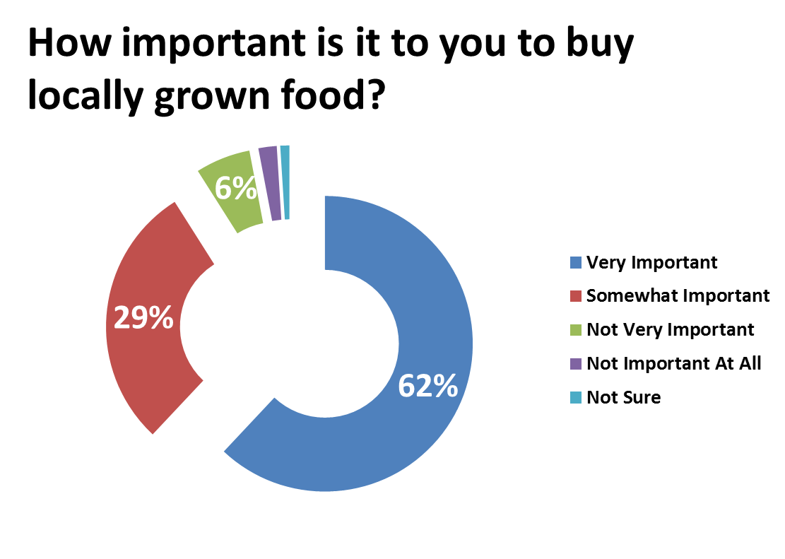

Slide 34
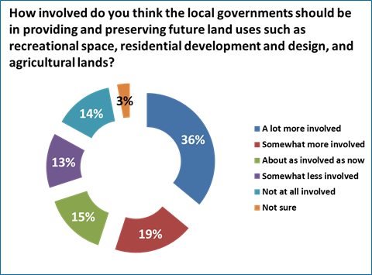

Slide 35
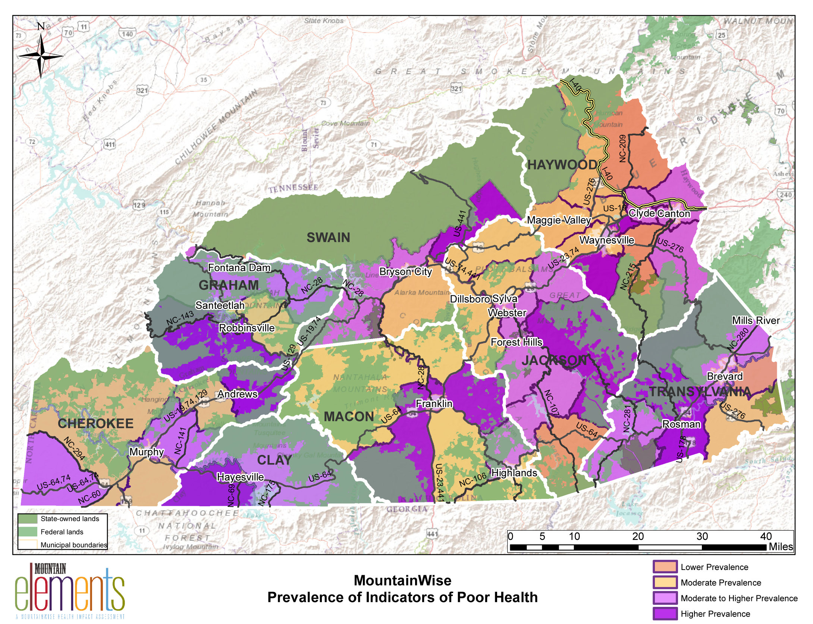
Hot Spots

Slide 36
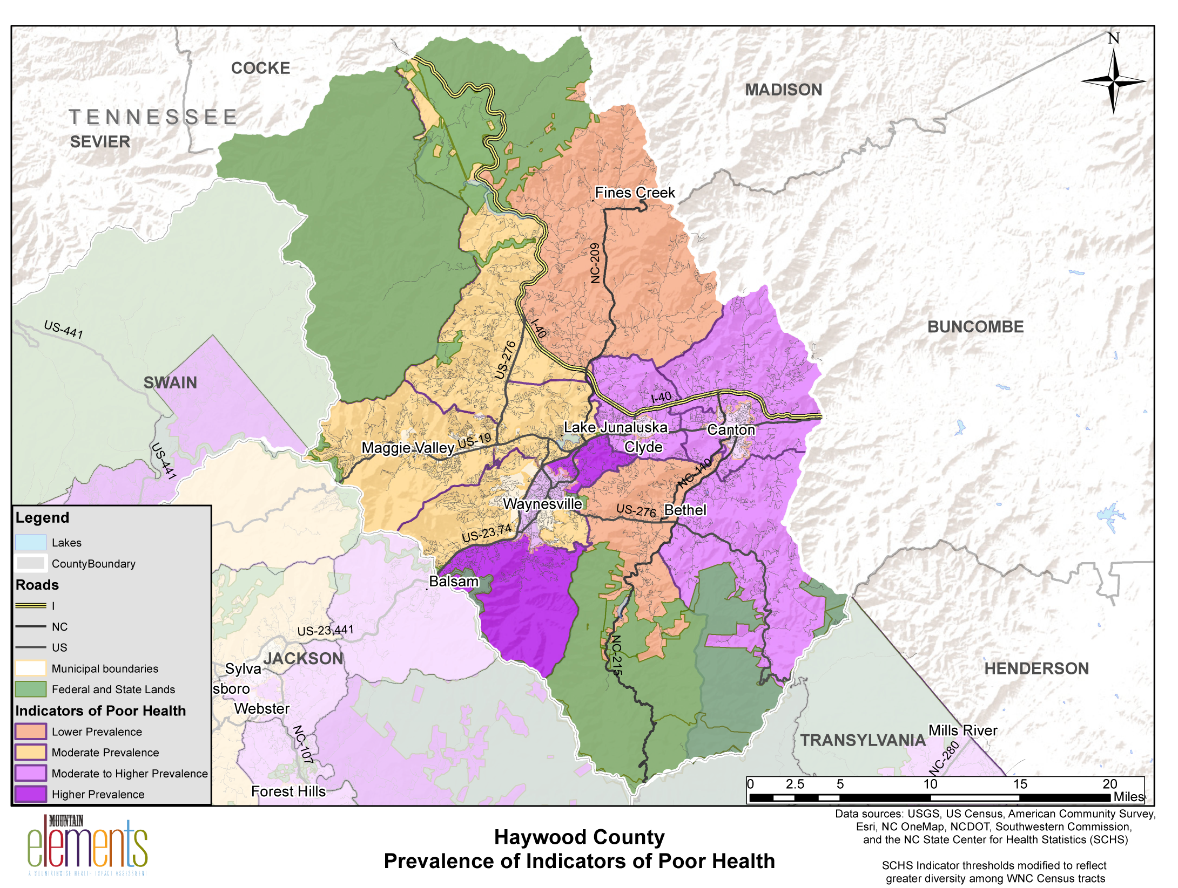

Slide 37
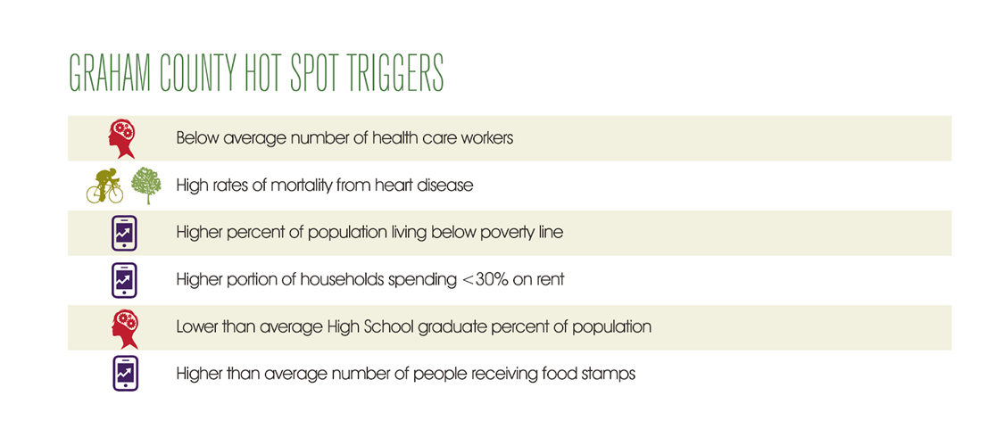

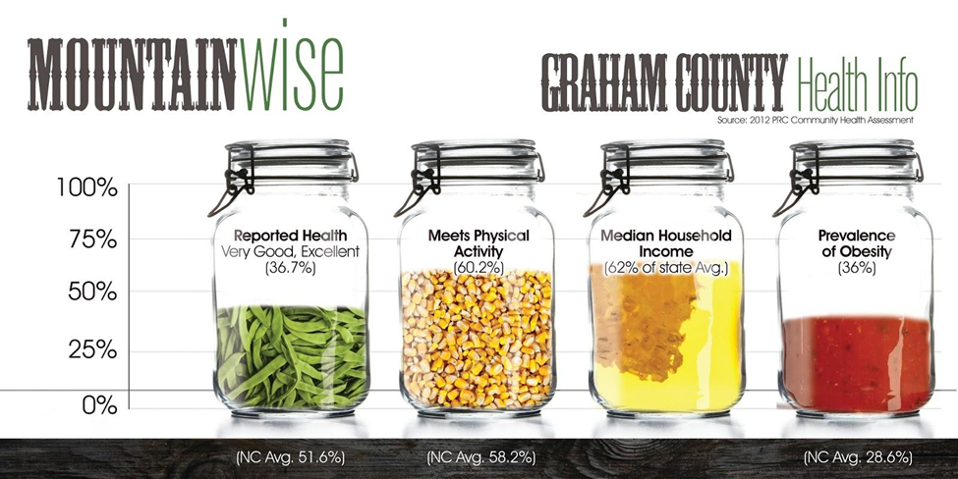

Slide 38
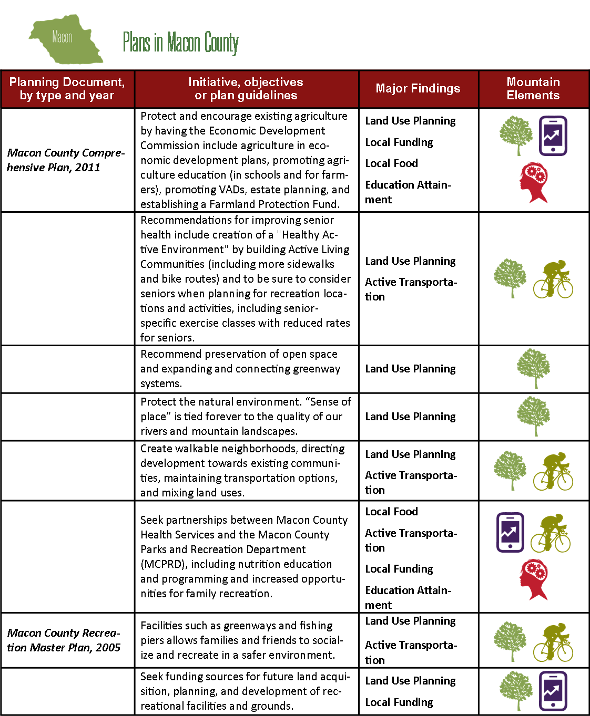

Slide 39
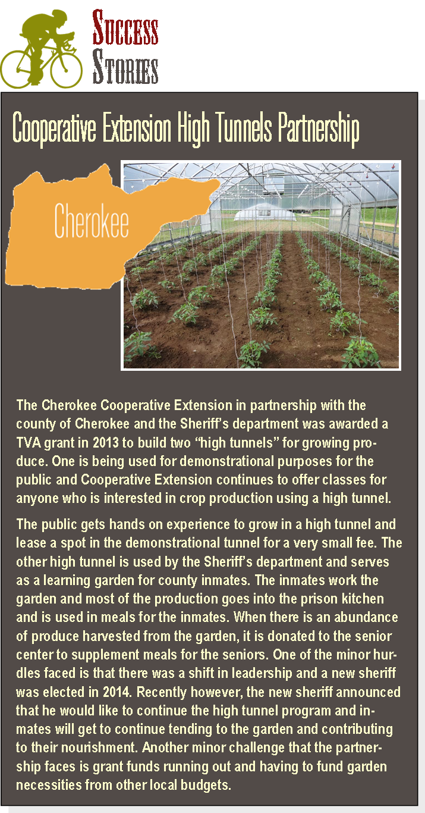


Slide 40
Assessment:
Little momentum in the region for zoning or more rigorous land use policy.
Concerns over access to care and unemployment.
Major momentum in the region for Food Systems Planning.
Uncertainty over future of federal and state funding support for health programs, transportation, and economic development.

Slide 41
Other Findings:
Active transportation options can improve physical activity rates
Income disparities will fuel health inequalities
Continued federal funding reliance could have negative repercussions
Education attainment levels may hinder future health improvements
Communities are in need of local, small town and rural community activity hubs
Limited access to care prevents early detection and prevention

