Slide 1
HIA 101
Getting Out of the Weeds: Using Marketing & Communications to Advance the HIA Reporting Process
@FranKritz
@JeremySThompson

Slide 2
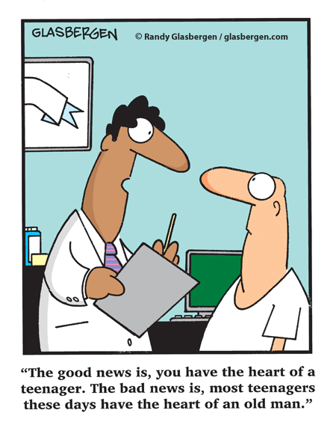

Slide 3
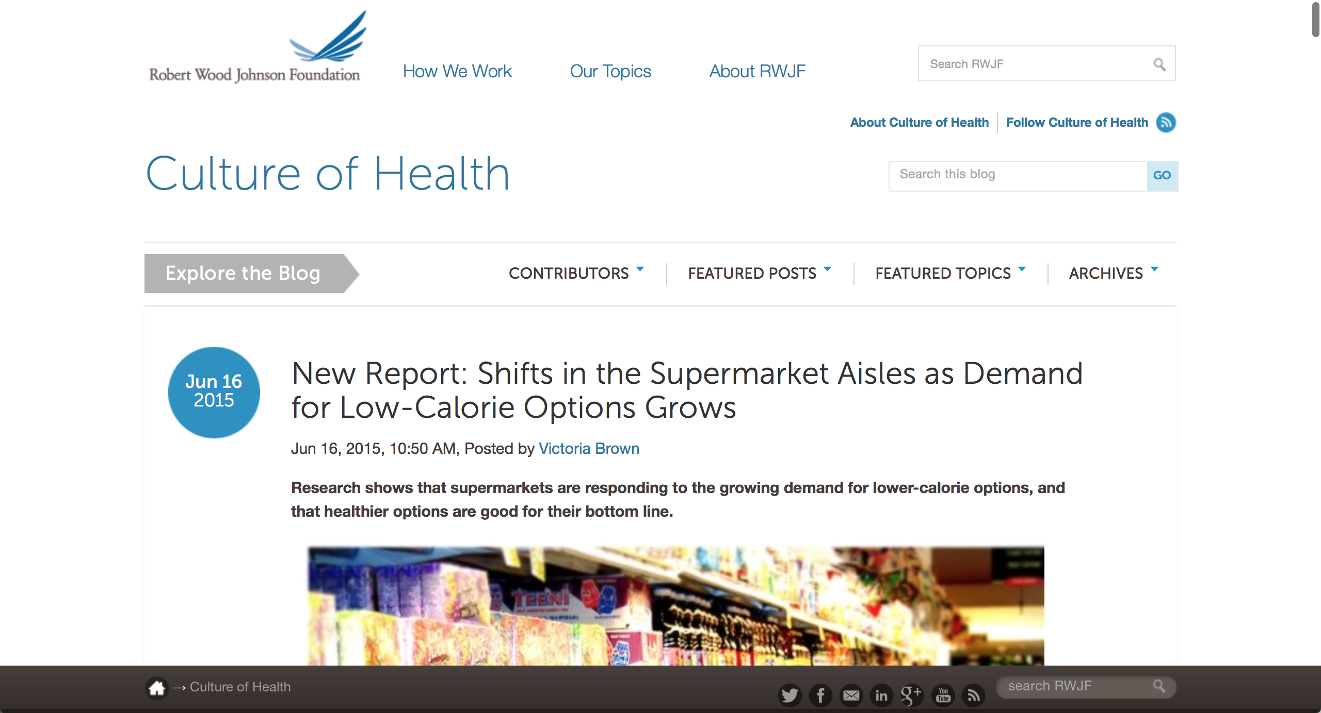

Slide 4
Screening
Scoping
Assessing Risks & Benefits
Developing Recommendations
Reporting
Monitoring & Evaluating

Slide 5
Reporting
Representing the results to decision-makers

Slide 6


Slide 8
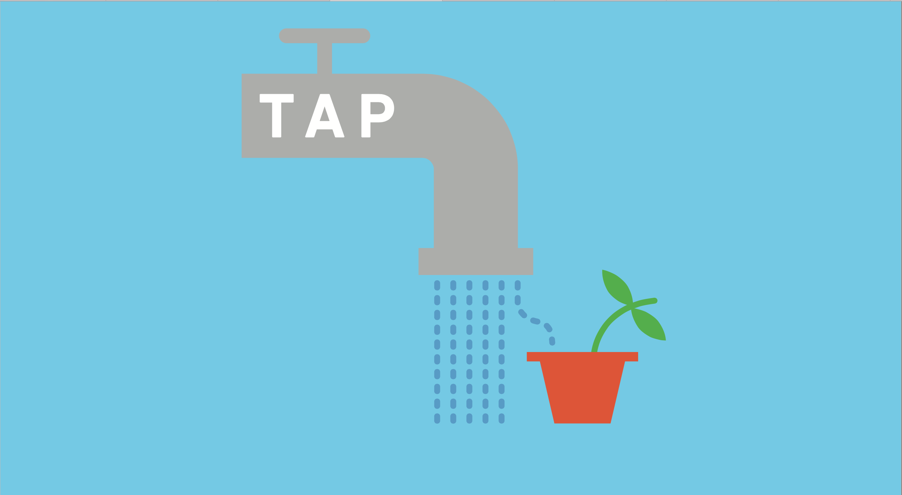

Slide 10
The National Research Council defines HIA as “a systematic process that uses an array of data sources and analytic methods, and considers input from stakeholders to determine the potential effects of a proposed policy, plan, program, or project on the health of a population and the distribution of those effects within the population. HIA provides recommendations on monitoring and managing those effects.”

Slide 11
The CDC puts it more simply: Doctors advise their patients on how they can stay healthy. In many ways, Health Impact Assessment (HIA) provides the same advice to communities. This advice helps communities make informed choices about improving public health through community design.

Slide 12
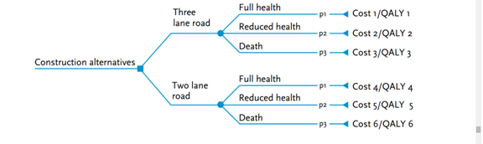

Slide 14
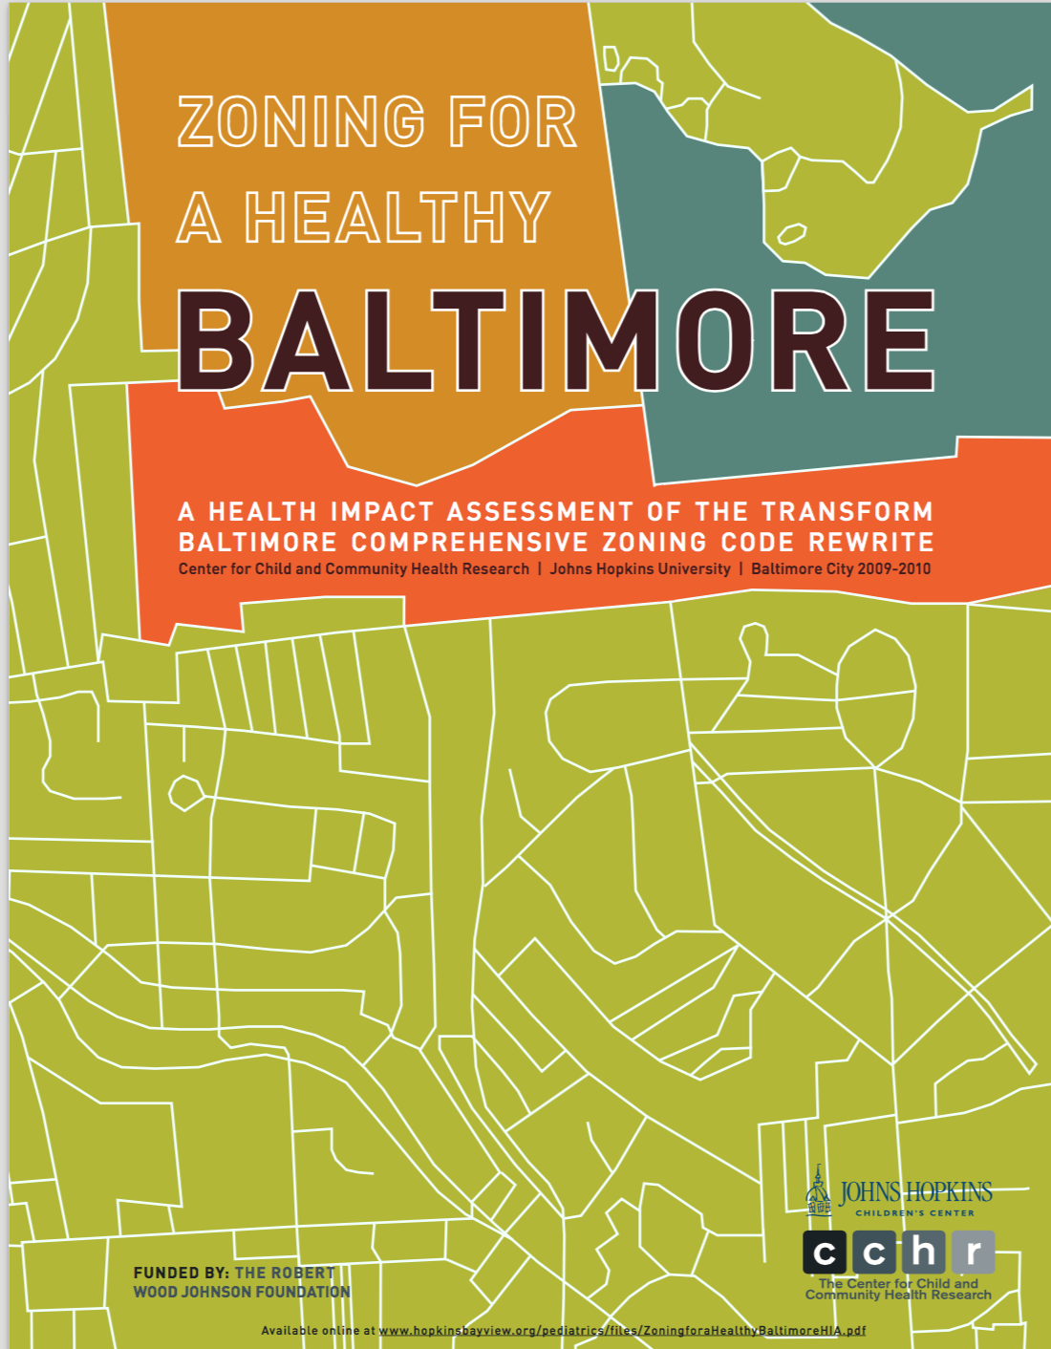

Slide 16
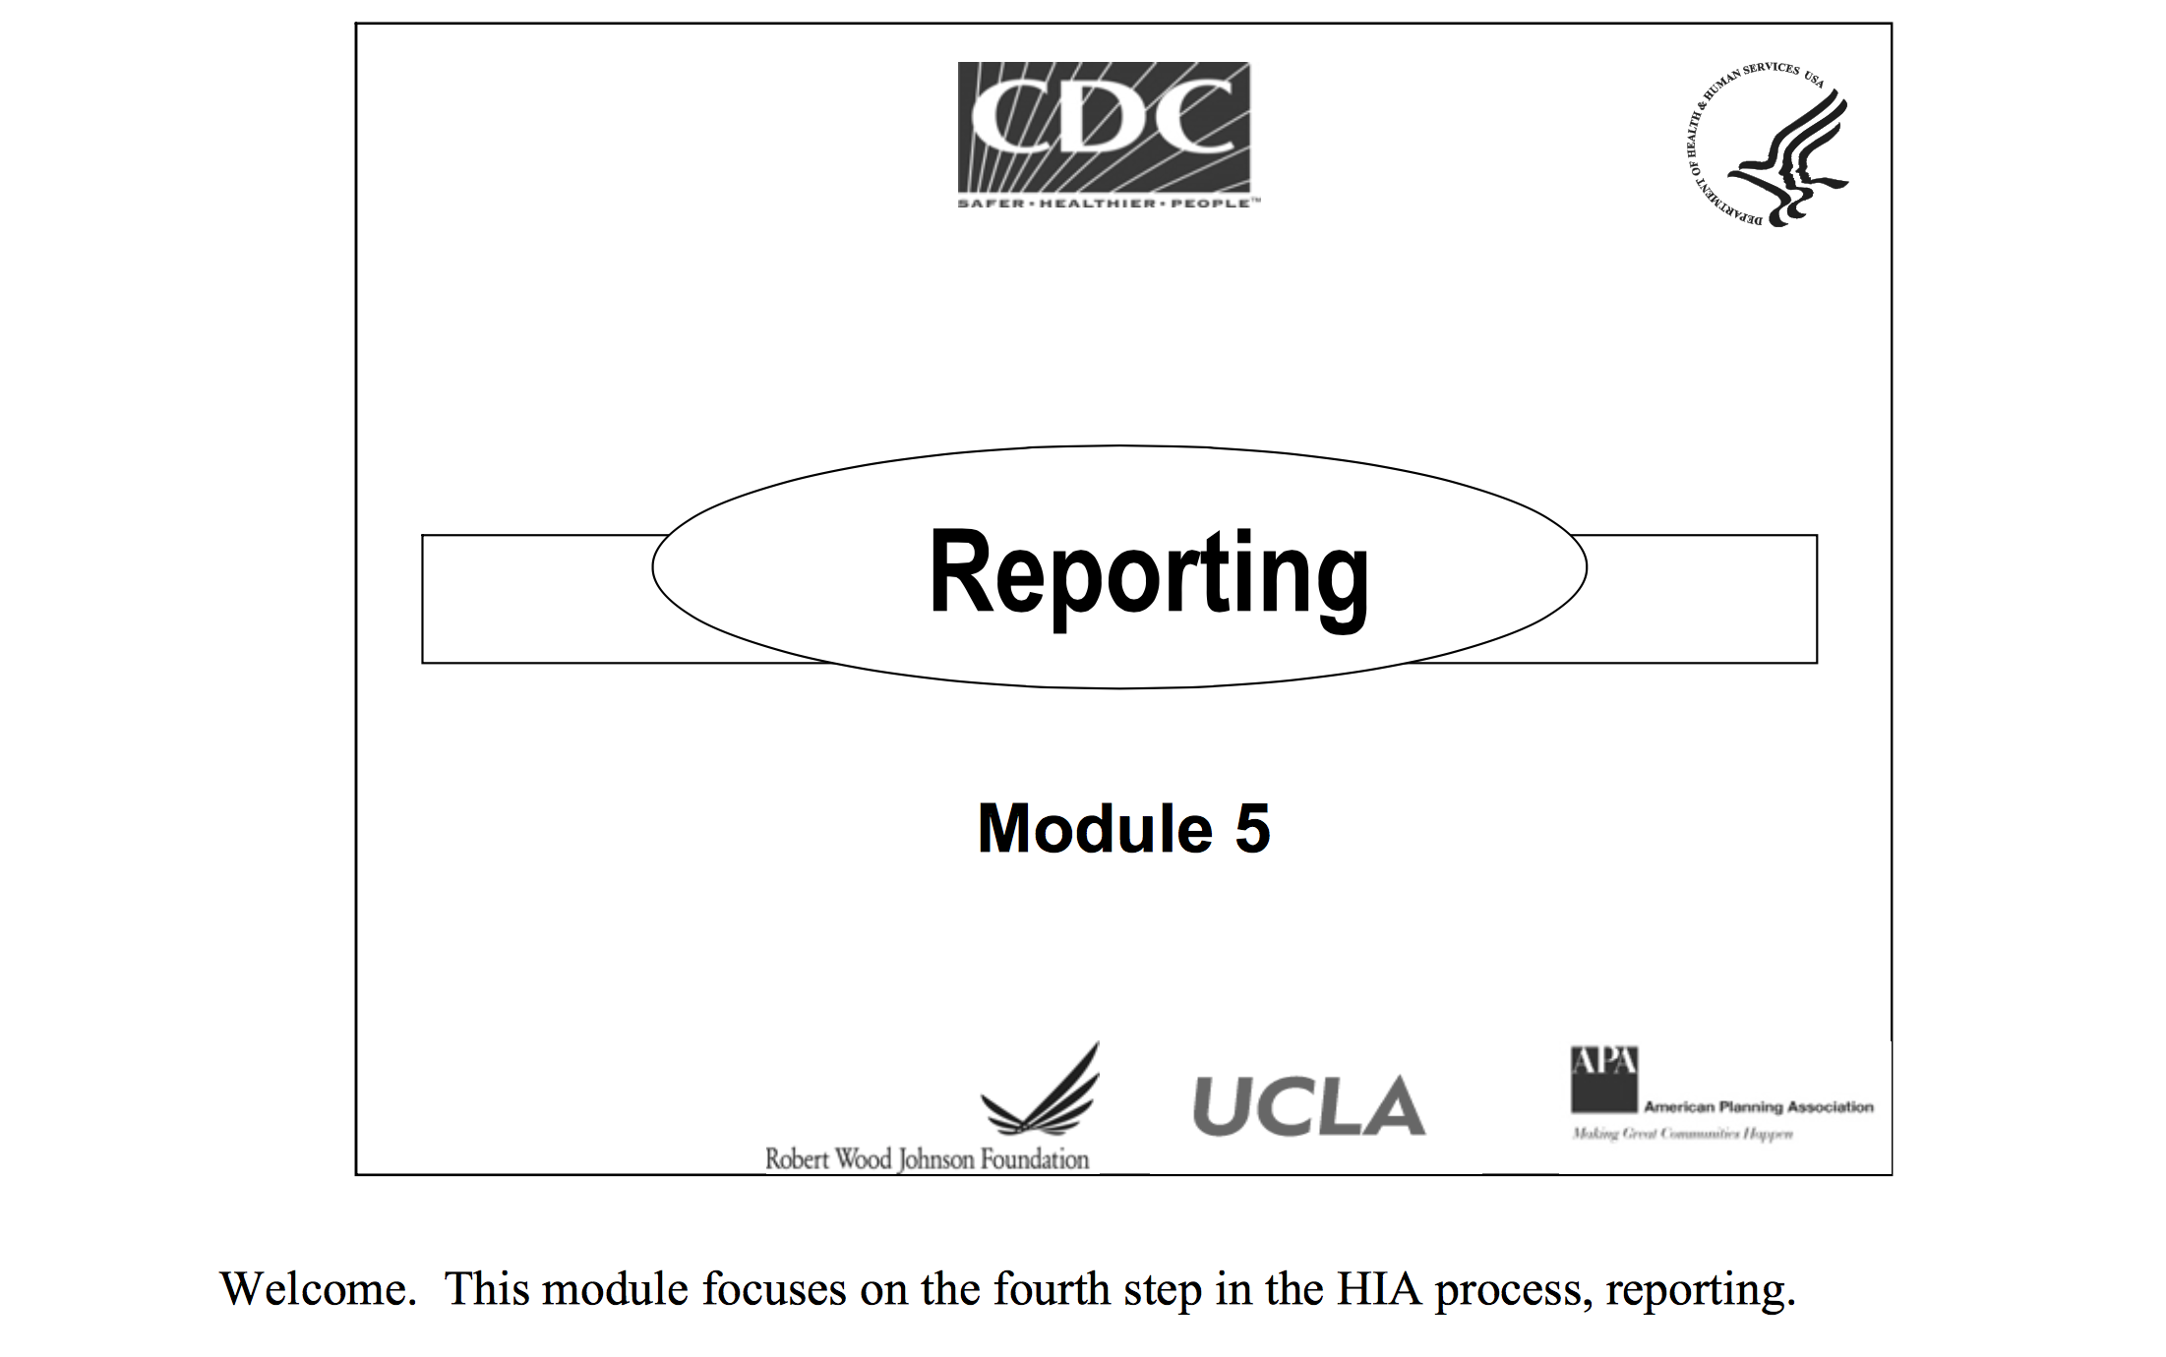

Slide 17
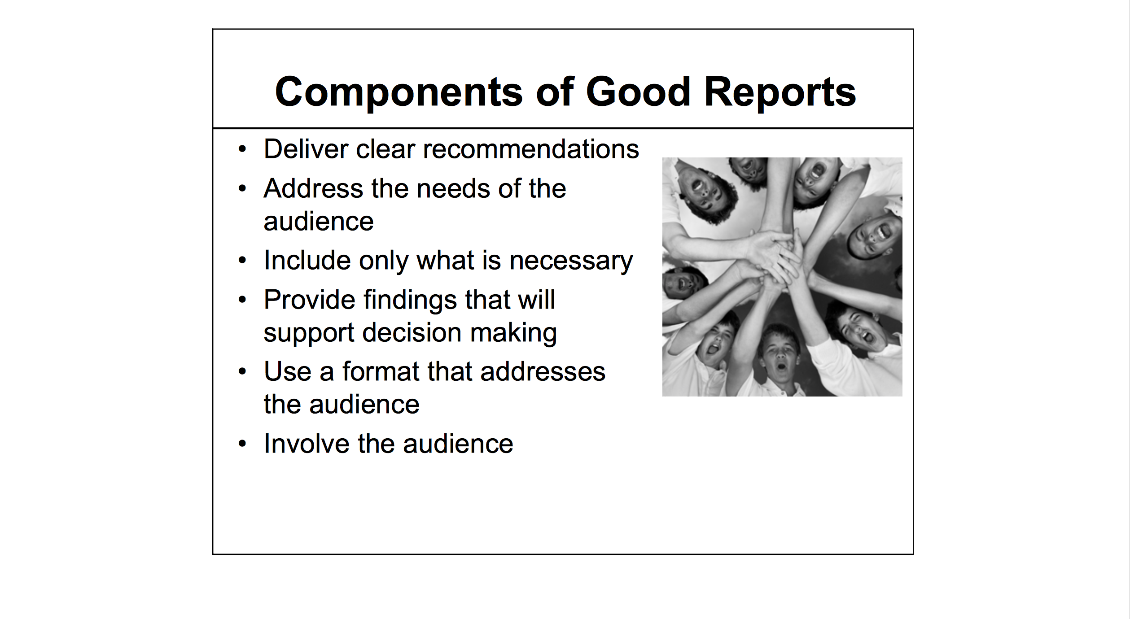

Slide 18
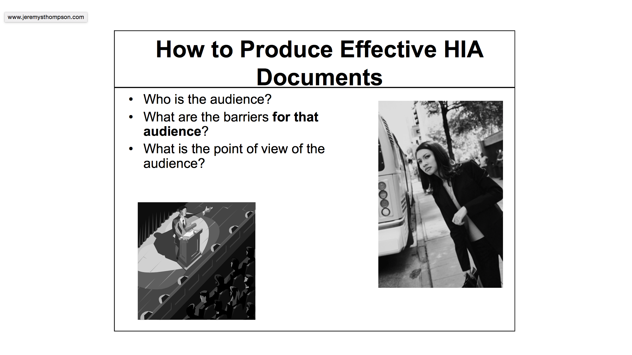

Slide 19
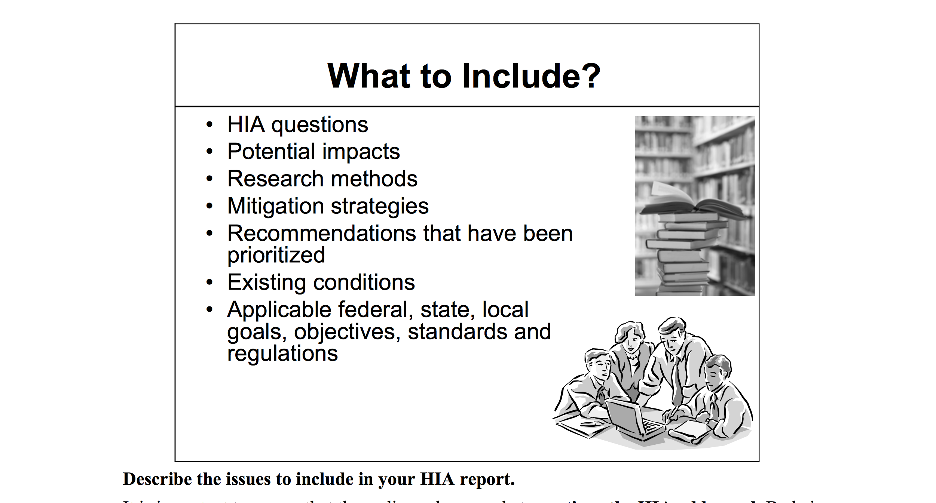

Slide 20
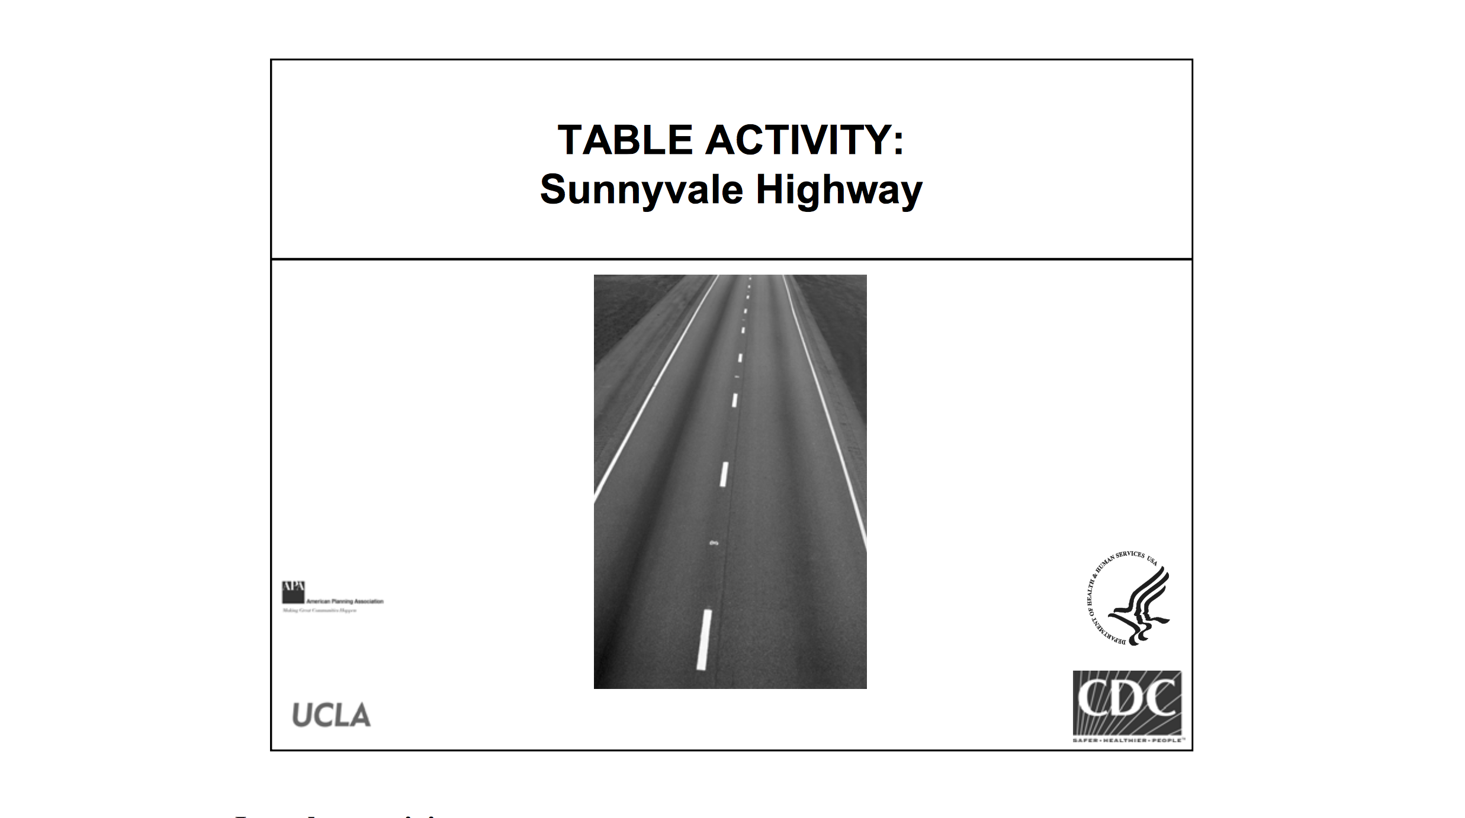

Slide 21
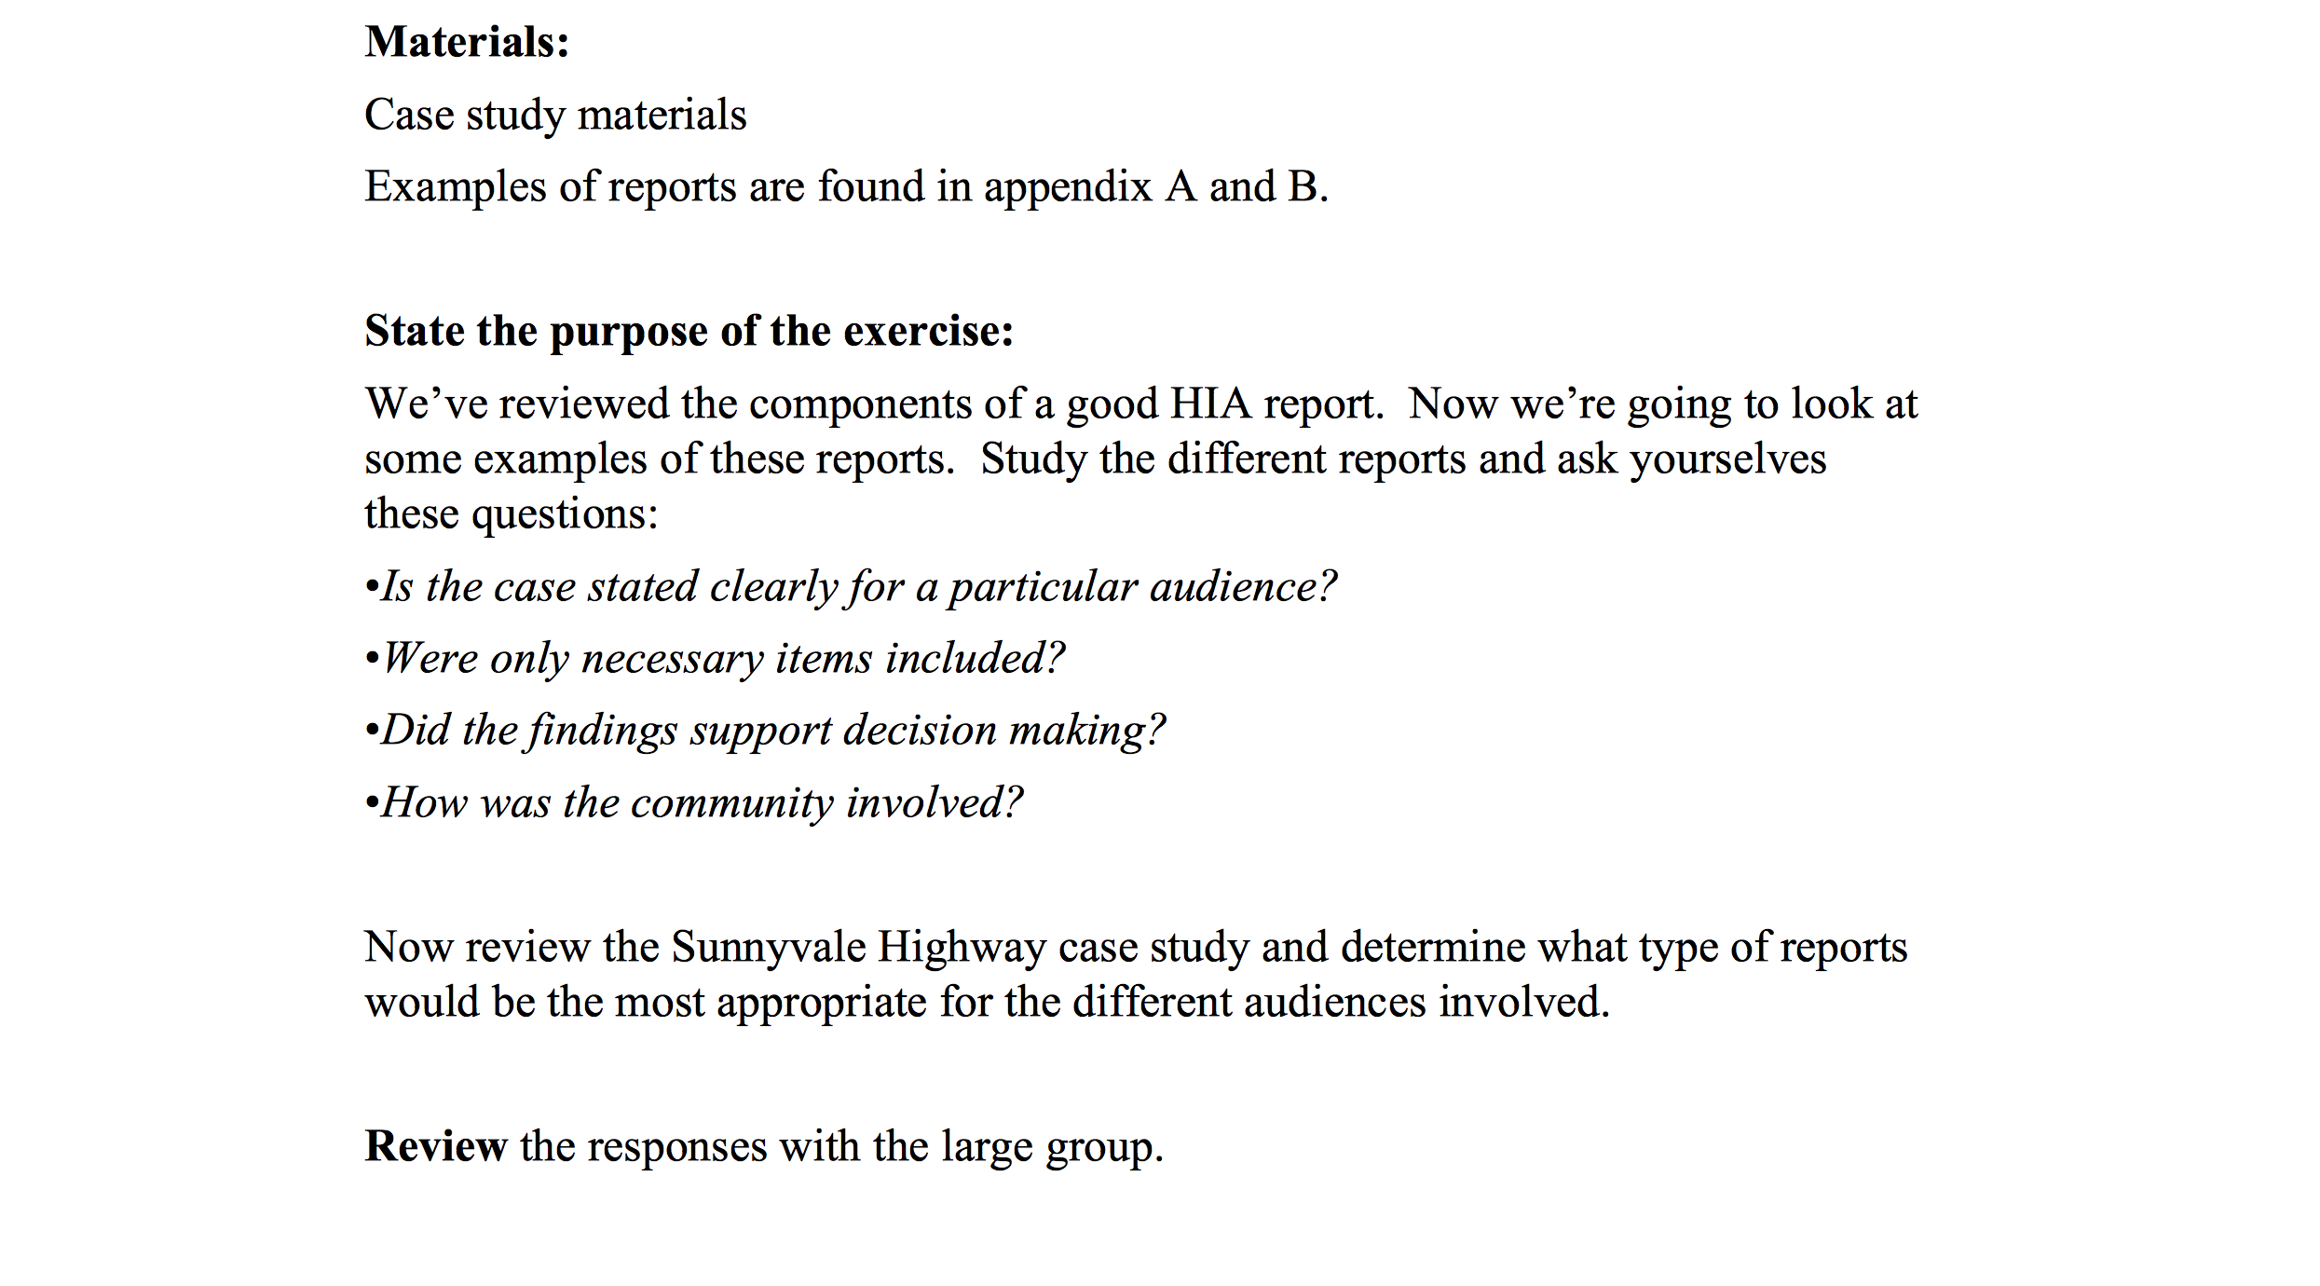

Slide 22
HIP is in the New York Times!
-3.6.2013

Slide 23
Jeremy S. Thompson
Digital Media Strategist

Slide 24
Twitter
Twitter is a free social networking microblogging service that allows registered members to broadcast short posts called tweets.

Slide 25
Twitter
Saying all you can in 140 Characters or less and if you add a link things get really crazy… don’t get me started with photos, infographics, GIF’s…

Slide 26


Slide 27
Bite-sized

