Slide 1


Scoping: The Building Blocks for HIA
HIA 101 Track
3rd Annual National HIA Meeting
Tuesday, June 16, 2015
Lauren Adkins, MPH, CPH
CSS-Dynamac
Steve White, MURP
Oregon Public Health Institute
The views expressed in this presentation are those of the author[s] and do not necessarily reflect the views or policies of the U.S. Environmental Protection Agency or the Oregon Public Health Institute.
Notes:
Hello and welcome everyone to this full session. My Name is Lauren Adkins and for the past two years I have been working as a contractor to the U.S. Environmental Protection Agency providing support for EPA’s HIA initiatives. Prior to working as a contractor, I had participated in different types of health assessments through my graduate studies and internship, but was not familiar with the specific HIA process. I started at CSS-Dynamac in the middle of the Scoping step for the Gerena Community School HIA and during Screening of the Boone Boulevard HIA. Since then, I have helped development and implement two additional HIAs, and developed and facilitated HIA trainings for fellow public health practitioners, local government officials, and FEMA. I am accompanied today, by Steve White from Oregon Public Health Institute.
Steve White (intro).
(If time available) Really quick, I would like to provide some background on EPA’s involvement in HIA. Many communities across the United States are facing issues related to aging infrastructure, limited financial resources, and impaired natural resources. EPA is developing and testing models, tools, and best practices to help communities move towards more sustainable and healthy states. EPA’s Sustainable and Healthy Communities Research Program is evaluating HIA as one of many decision-support tools for providing science-based resources and information to decision-makers.

Slide 2
Session Purpose
This presentation is designed for the HIA 101 Track for new and potential HIA practitioners. The most important step for any study is the planning step. In HIA, planning occurs in Scoping, which sets the stage for the rest of the Assessment. Many different processes occur simultaneously.
Objectives:
Build capacity to develop and complete the Scoping step.
Expand knowledge of HIA resources available to expedite the Scoping step.
Raise awareness for the level of involvement and resources needed to complete the Scoping step.
Notes:
This session was developed entirely from the perspective of lessons learned as a new practitioner in the HIA field of practice. The most important step for any study is the planning step. In HIA, the planning step occurs in Scoping. Even for well-practiced researchers, the Scoping step can appear daunting and time-consuming. Nevertheless, Scoping sets the stage for the Assessment. Insufficient planning in the Scoping step can lead to challenges later in the HIA, such as complications in executing the analyses and interpretations of the data, excessive iterations, and missed deadlines.
Our objectives today are to help build capacity to develop and complete the Scoping step and to expand our knowledge of the resources available for this critical point in the process. By the end of this session, we hope you will have a raised awareness of the level of involvement and resources needed to complete the tasks associated with this step. In addition, we would like to share our experience and lessons learned to provide you with some tips and tricks for navigating potential challenges during this step.

Slide 3
Case Study Overview
Proctor Creek’s Boone Boulevard Green Street Project Health Impact Assessment (Atlanta, Georgia)
Notes:
As we progress through this presentation, we will be revisiting an example scope from an EPA-led HIA case study to support discussions and a group activity. You can also refer back to the handout provided for more information.

Slide 4

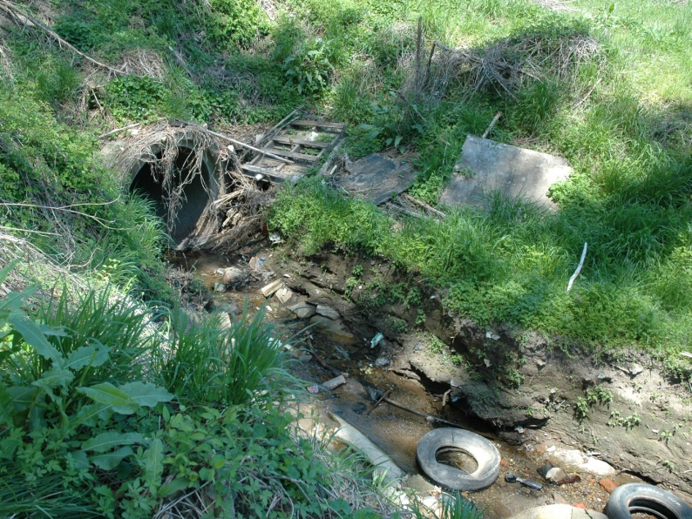
HIA Case Study
EPA led an HIA that evaluated the proposed Boone Boulevard Green Street Project sited in the headwaters of Proctor Creek in Atlanta, Georgia.
Problems Facing Community:
Pervasive flooding
Impaired water quality
Illegal dumping
Blight (derelict and vacant properties)
Aging infrastructure
Notes:
Most areas within the City of Atlanta use a combined sewer system in which stormwater and sanitary sewer discharge flows together through an underground conveyance system to a treatment facility. However, during periods of heavy rainfall or snow these systems bypass the treatment facility and discharge directly into a nearby waterbody, widely referred to as a combined sewer overflow (CSO) event. Proctor Creek is one of the many streams and rivers in the Atlanta metropolitan area that is on the state’s list of impaired waters due to urban runoff and CSO events. The City of Atlanta adopted green infrastructure as one of many approaches to help address issues with Atlanta’s impaired waters and received funding from the EPA to develop a conceptual plan for implementing green infrastructure. The resulting plan became the proposed Boone Boulevard Green Street Project, which involved converting impervious roadway into rain gardens and pervious bike lanes. From 2013 to 2015, EPA led a comprehensive HIA that evaluated the proposed project and provided recommendations to the City of Atlanta that would manage potential impacts to health.

Slide 5
Scoping: The Second Step
Screening
Scoping
Assessment
Recommendations
Reporting
Monitoring
and Evaluation
Notes:
First, I would like to start with the general concept of “scoping.” What does it mean? Scope can be defined (by Merriam-Webster) as = the intention ~ the extent of treatment, activity or influence ~ the range of operation ~ and is also synonymous with “aim” or “target.” In HIA, Scoping encompasses the aim of the assessment (i.e., what the assessment will evaluate and how it intends to do so). It is important to remember that the Scoping step is only the second step in the process. HIA Project Teams should not dwell too long on this step, because it could result in too little time left to adequately address tasks later on in the process.

Slide 6
Scoping Tasks
Scoping Tasks
  Establishing the goals of the HIA
  Determining the individuals/team that will conduct the HIA, participant roles, and plans for stakeholder involvement
Examining stakeholder concerns and pathways by which the decision could impact population health, including population and vulnerable groups likely to be affected
    Setting the scope of the HIA, including the timeline, analytic plan, research questions, impacts to be considered, and communication and reporting strategies
    Determining methods, sources of evidence, and data types that will be used in assessment
Notes:
These are the main tasks associated with the Scoping step. (Read the tasks.)

Slide 7

Two Overarching Workflows:
Helpful Tips and Tricks:
Separate duties to save time.
Project Management
Identifying HIA goals and resources needed to achieve them
Establishing roles and rules for HIA participants
Outline communications strategy and plan for process evaluation
Study Design
Identifying pathways of impact and focus (high priority) areas of the study
Developing research questions
Selecting indicators, data sources, and analysis methods
(HIA Leadership Team)
(HIA Research Team)
HIA Project Team
Notes:
One trick to help make this list of tasks to be done in Scoping more manageable is to group those that are related. The tasks associated with the Scoping step fall into two overarching workflow processes: project management and study design. Grouping the tasks allows the HIA Project Team to discern the types of roles and potential skills needed to complete each task. For example, some HIAs establish a leadership team or steering committee that perform the tasks related to the management side of the HIA; while a research team focuses more on the design and implementation of the assessment. Separating duties by workflow also allows them to be completed simultaneously and saves time.
Now, I would like to turn it over to Steve White, from Oregon Public Health Institute, who will step us through the tasks related to project management.

Slide 8
Tasks related to Project Management
Steve White, Oregon Public Health Institute
Notes:
Time should be 3:25 PM, there are 20 minutes alloted for the next 15 slides.

Slide 9
Tasks Related to Project Management
Developing HIA project goals
Identifying and obtaining resources needed
Establishing roles and responsibilities
  Key considerations for managing expectations
Developing a communications strategy/plan
HIA quality assurance
  Designing the process evaluation
Notes:
Here are some of the key items related to project management that are, or should be, addressed in Scoping. I’ll go through each one of these, describing key considerations and highlighting tools and other resources where appropriate.

Slide 10
Developing HIA Project Goals
Good goals are:
Achievable
Measurable—you can know if they’ve been achieved
HIA Goals often focus on:
Informing the decision
Capacity-building
Partnerships
HIA Goals from the Case Study:
Add a vehicle for equitable inclusion of all stakeholders in the decision-making process.
Assess the effectiveness of the proposed green infrastructure project and raise awareness of the environmental, economic, and societal impacts related to health.
Provide recommendations to the proposed project that incorporate approaches to stormwater management, ecosystem restoration, and community revitalization.
Increase transparency, local accountability, community empowerment, and ownership of the proposed plan through meaningful stakeholder engagement.
Helpful Tips and Tricks:
Involve key stakeholders to the best extent and as early as possible.
Notes:
(Click to see each of the 4 goals from the HIA case study.)

Slide 11
Identifying and Obtaining Resources
Timing
  Build in buffer periods in the HIA timeline to avoid missed deadlines.
  Review other HIAs to see how long they took, given the health impacts appraised and the level of stakeholder engagement.
Funding
  If possible, use existing and publically-available tools, data, and methods.
  Ensure enough funding to cover unexpected expenses.
Personnel and other resources
  Consider existing and new partnerships to gain access to needed resources.
Helpful Tips and Tricks:
Bring the right people to the table.
Helpful Tips and Tricks:
Don’t reinvent the wheel.
Notes:
In the latest review of HIAs performed in the U.S., Bourcier et al (2015) found that “one of the biggest challenges to successful HIAs include underestimating the level of effort required” to complete an HIA. One recommendation from the review included “paying more attention to the needs of vulnerable populations by focusing on practical factors such as the resources and skills needed and the HIA timeline.”
Timing
For most HIAs, the Scoping step lasts from 1 month (for rapid HIAs) to 5 months (for comprehensive HIAs). In comparison, the entire HIA process can last 4 months (for rapid HIAs) to 24 months or more (for comprehensive HIAs). The variation in timelines depends on how many health impacts are appraised, the extent and duration of stakeholder engagement, whether HIA training or other workshops are conducted, and whether unexpected challenges arise, such as project delays.
Funding
Because HIA can be described as a spectrum of practice, there is no standard cost for conducting an HIA. HIA budgets should be tailored at an individual basis. For example, rapid HIAs that consider a few health impacts can cost as little as $10,000, while comprehensive HIAs can cost upwards of $150,000.¹ Expenses can include costs of providing food, beverages, and renting space for stakeholder meetings, travel for HIA meetings, compensating HIA Project Team members and/or community participants, hiring contractors to perform data collection and analysis and develop survey tools and/or reports, etc.
If outside technical assistance is needed, then extra funding will have to be secured. There are funding vehicles for HIA technical assistance through third-party organizations, like the CDC and/or Human Impact Project (a collaboration between the Pew Charitable Trusts and Robert Wood Johnson Foundation). Two of the EPA-led HIAs received HIA technical assistance from Oregon Public Health Institute (Steve White) and Georgia Health Policy Center, which were funded through a cooperative agreement with the CDC. Contractors were secured for the EPA-led HIAs through grant funding from EPA’s Regional Sustainability and Environmental Sciences research program. Thus, grant-writing was a skillset needed to complete that HIA.
Investigators can cut expenses and/or expedite the process by using tools and information already developed. In a review published in the American Journal of Preventive Medicine, Dannenberg et al (2008) found that “fewer resources may be needed to conduct new HIAs if investigators can draw on the literature reviews and methods from similar HIAs previously completed in the U.S., noting the differences in local environment and decision specifications.” HIA leads also must consider whether there is enough funding in case the HIA timeline is extended. If not, the HIA leads should implement extra precautions to ensure the timeline is met and/or identify potential back-up funding vehicles.
Personnel
Bringing the right people to the table means including stakeholders, decision-makers, those with critical data, those with technical knowledge and experience with the specific topics being examined in the assessment.
Footnotes:
¹ For more information, visit: http://www.humanimpact.org/new-to-hia/faq/#cost.

Slide 12
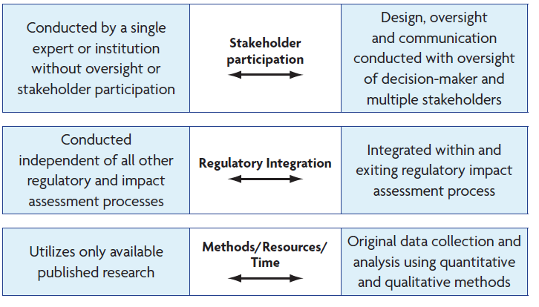

Slide 13

Establishing Roles and Responsibilities
Establish:
Who is doing what
How different stakeholders can be involved
  Advisory/Steering Committee
  HIA Project Team
  Community Working Group
Helpful Tips and Tricks:
Use a Rules of Engagement (ROE) agreement, Memorandum of Understanding (MOU), or similar document to manage roles and responsibilities.
Notes:
Establishing the HIA Project Team is dependent on who initiated the HIA and whether there are requirements and/or limitations to developing materials, gaining access to data, communicating with the public, etc. HIA leads need to consider the ways or mechanisms in which stakeholders will participate in the HIA. If the HIA was initiated by the decision-makers, will community stakeholders participate directly through the HIA Project Team or indirectly through an Advisory Committee? If the HIA is conducted by a grassroots organization, wouldn’t it be beneficial to have the decision-maker serve on an Advisory Committee to ensure the HIA recommendations are feasible? In the latest review of HIAs performed in the U.S., Bourcier et al (2015) found that “the composition of the HIA team is crucial, since successful HIAs rely on many kinds of expertise and require sustained collaborative effort.” An HIA Technical Advisor can be immensely helpful in ensuring the success and completion of the HIA, especially if the team that initiated the HIA has little to no experience with the process.
It is also important to understand that each person working on the HIA project may have their own set of initiatives and expectations for participating in the HIA. This can lead to a state of “herding cats,” which can prove difficult to maneuver and time consuming. Bourcier et al (2015) recommends “focusing on practical factors and how shared expectations are developed and managed” to improve the conduct of HIAs. One of the best ways to manage expectations among HIA participants is to develop and implement a Rules of Engagement Agreement early in the project. The ROE Agreement is a documented contract among team members that outlines: a) basic courtesies and ground rules for participating, b) details about operations and how the HIA will be managed (i.e., how project decisions will be made and how conflicts will be resolved), and c) the roles and responsibilities for which members will be held accountable. Once this document is drafted, it should be posted and signed by the HIA participants, especially those on the HIA Project Team. For an example ROE agreement, visit Appendix A of the report for the Healthy Corridor for All HIA in St. Paul, Minnesota.

Slide 14
Common HIA Roles and Skills Needed
Common HIA Roles | Skills Needed to Fulfill Role
Community Liaison | Team member with knowledge of the community and access to the community social and formal networks (e.g., community leader, historian, member of a community organization, long-time resident).
Public Health Researcher(s) | Team member(s) with knowledge of basic public health principles and mediating factors that influence health (e.g., public health professional, physician, health educator).
Project Leader(s) | Team member(s) who is well versed and has experience managing teams with multiple skills/fields of expertise, leading meetings and discussions, organizing action items, and establishing project goals, frameworks, timelines, and a communications plan.
HIA Technical Advisor | Team member or advisor who has extensive knowledge and experience conducting and evaluating HIAs, including lessons learned and best practices.
Researcher(s) | Team member(s) with experience planning and conducting research who can perform literature reviews, risk assessments, and develop and test research questions/hypotheses (e.g., epidemiologist, community health researcher)
Writer/Editor(s) | Team member(s) with experience writing and evaluating scientific papers and producing reports and materials for different audiences and reading levels.
Subject Matter Expert(s)* | Team member(s) with experience and knowledge about the specific fields of expertise that will be evaluated in the assessment (usually members of a steering or advisory committee).
Notes:
This is a table listing common roles found in an HIA and the skills needed to fulfill those roles.

Slide 15
Scoping Tool: Stakeholder Analysis Worksheet
Source: Stakeholder Participation Working Group of the 2010 HIA of the Americas Workshop. (2012) “Guidance and Best Practices for Stakeholder Participation in HIA (version 1.0).”
Notes:
One of the many organizational tools that are available through the guidance report on stakeholder participation in HIA, is the Stakeholder Analysis Worksheet. This matrix helps HIA project leaders establish who the key players are (i.e., the key stakeholder groups) and the specific information needed to discern the level of participation and/or engagement in the HIA. For each group, HIA project leaders should identify a point of contact, the value they could bring to the HIA, the role they could perform, and what influential factors may be in play (i.e., their interests and/or concerns about the HIA and/or decision, the influence/power they have on the final decision, etc.), and when and how they should be engaged.

Slide 16
Managing Expectations
Develop goals of the HIA collaboratively.
Focus on what/who is needed to inform the decision.
Discuss anticipated “inputs” and “outputs.”
Remember: HIA is part science, part art.
Communicate with stakeholders throughout the project.
Question for the audience
Notes:
Question for the audience: “What additional strategy could you employ to help manage expectations of the HIA?”

Slide 17
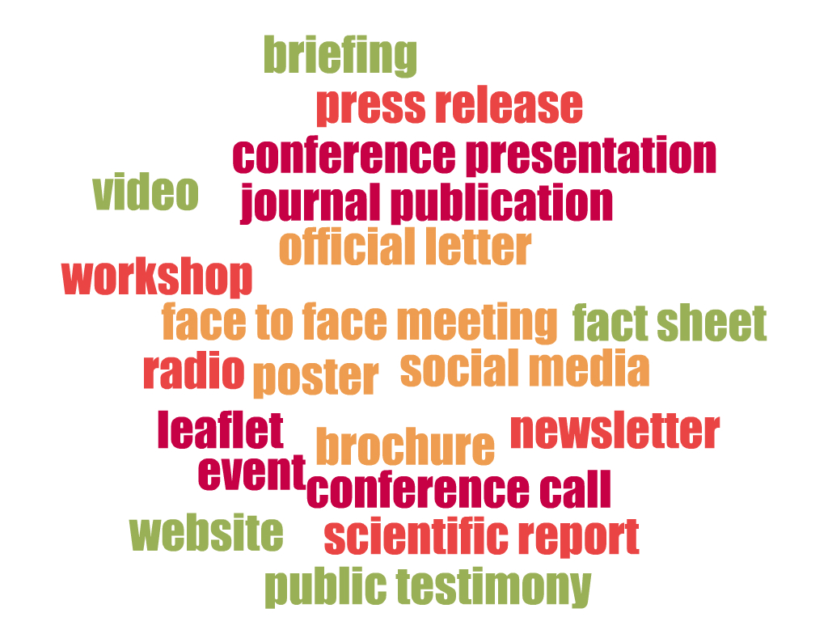
Developing a Communications Plan
Helpful Tips and Tricks:
Assign one point of contact to streamline communications.
Essential elements:
Define objectives, principles, and key messages for communicating;
Identify and rank target audiences; and
Outline working plan, including activities, budget, deadline/ timeframe, and success criteria.
Medina, Sylvia. (2006)“Communications Strategy for Health Impact Assessments: Meeting Policy-Makers' Information Needs.” Epidemiology. 17(6):S79-S80.
Notes:
The HIA Minimum Elements and Practice Standards (version 3.0) states that “Each HIA should have a specific engagement and participation approach that uses participatory or deliberative methods suitable to the needs of stakeholders and context.” Furthermore, a plan should be developed that “establishes the methods that will be utilized to promote stakeholder participation (i.e., a communications plan).”
What are the essential elements to a good (effective) communications plan? A good communications strategy has:
Defined and detailed objectives for communicating, including the principles underpinning the communications strategy and key messages to convey.
Detailed descriptions of target audience (categorized) and user groups (i.e., who is receiving the information), including what they need to know and the contact information and/or point of contact
Rankings of the target audience by importance; and
The preferred and/or appropriate channel of communication (e.g., e-mail updates, website, newsletter, etc.)
It can be helpful to have a table showing the planned meetings by stakeholder group, meeting purpose, and date. There are several formats to choose from when communicating with stakeholders. It helps to get the preferred format from the stakeholder you are trying to communicate with and/or decide which format is more appropriate. For example, most community residents are not going to look through a 200 page scientific report. A more appropriate medium could be fact sheets, newsletters, brochures, YouTube videos, etc. that are easier to manage. During the budget process, public officials may not have time to schedule a full day meeting for the HIA Project Team to present on HIA findings and recommendations. Thus, an official letter or executive summary with that information may prove more suitable to getting the main points across to the decision-maker in an appropriate and timely fashion. It should be noted that HIA project managers should include multiple mediums for communication and even consider different languages, if appropriate. (The word cloud was developed using the free, online word cloud tool from http://www.abcya.com/.)

Slide 18
Scoping Tool: Communications Strategy and Plan
Who is your Audience? | What key messages will resonate based on audience values/ barriers?* | What is the best format for this audience? | When and how will you share materials? | Who is the best messenger for this audience? | Who is responsible for this communication?
Table provided by Steve White, Oregon Public Health Institute
Notes:
There are numerous templates and other tools available for developing a communications plan for your study. Templates have been developed by government agencies¹, nonprofits², and HIA organizations, such as the Society of Practitioners of HIA (SOPHIA) and Human Impact Partners. The template shown on the slide is one that was developed and commonly used by Oregon Public Health Institute.
Footnotes:
¹ This graphic was taken from the Communications Strategy Template developed and published in August 2014 by the Delaware State Office of Management and Budget, Department of Human Resources Management.
² The World Wildlife Fund also has a nice Program/Project Communications Strategy Template, as does the Center for First Nations Governance in Canada.

Slide 19
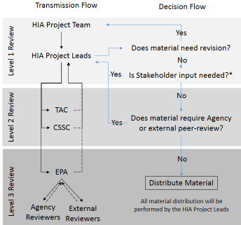
Scoping Tool: Dissemination Plan
Helpful Tips and Tricks:
Outlining a dissemination plan helps keep everyone on the same page.
Graphic from the EPA-led HIA on proposed code changes to the Sanitation Code in Suffolk County, New York.
TAC= Technical Advisory Committee
CSSC= Community Stakeholder Steering Committee
Notes:
One of the biggest lessons learned from implementing a federally-led HIA is developing a decision-tree for how information will be shared and to whom it will be shared. There can be differences between government agencies and among the different levels of a government agency on how and when information can be shared. Outlining a plan for disseminating information and/or products of the HIA can help avoid potential miscommunication and/or misunderstanding among the HIA Project Team and between the HIA Project Team and external groups.
The graphic shown, which was taken from the Rules of Engagement Memo for the EPA-led HIA in Suffolk County, New York, illustrates how information is shared among the key parties involved in the HIA and how the decision is made to distribute that information. The HIA Project Team develops the informational material and transmits it to the HIA Project Leads. The HIA Project Leads then decide whether the information needs further revision (level 1 review) or if it is ready to be distributed. If the information needs input from stakeholders, then it will be sent to the Technical Advisory Committee and/or Community Stakeholder Steering Committee and undergo level 2 review. Once stakeholder input is received and incorporated in the informational materials, the HIA Project Leads then decide whether the information needs to be reviewed internally by the agency or externally by peers. If the answer is no, then the informational material is ready to be distributed. If the answer is yes, then the informational materials is sent by the HIA Project Leads to the appropriate reviewers.

Slide 20


HIA Quality Assurance
Helpful Tips and Tricks:
Utilize an HIA Advisor.
Available at:
http://hiasociety.org/wp-content/uploads/
2013/11/HIA-Practice-Standards-September-2014.pdf
Available at: http://www.nap.edu/openbook.
php?record_id=13229&page=1
Notes:
As with any other project or study, HIA project leaders need to consider how the HIA Project Team intends to ensure the quality and/or validity of the process. There are many guides, reviews, and tools available to help practitioners ensure the HIA upholds the core practice principals: democracy in the decision-making, equity in the opportunity for healthy living, sustainable development, transparent and ethical use of the evidence, and a comprehensive approach to public health. The Minimum Elements and Practice Standards for Health Impact Assessment (Version 3) was issued by the North American HIA Practice Standards Working Group in 2014 and identifies essential elements that constitute an HIA and practice benchmarks for how best to conduct an HIA. The National Research Council was tasked to develop a framework, terminology, and guidance for conducting HIAs, and in 2011, the NRC issued Improving Health in the United States: The Role of Health Impact Assessment - a report that defines and describes the elements of HIA, the challenges to its practice, and the approaches to advancing it and integrating it into today’s decision-making processes. Lessons learned from previous HIAs recommend having an HIA advisor on the HIA Project Team to help guide the process along and ensure that minimum elements and practice standards are met as the HIA progresses. This helps to reduce potential “fixes” later and avoid potential short-comings of the HIA.

Slide 21
Designing the Process Evaluation
A process evaluation documents and analyzes the early development and actual implementation of the HIA, assessing whether strategies were implemented as planned and whether expected output was actually produced.
Considerations for Process Evaluation:
Did the HIA follow best practices?
Did the HIA adhere to the plan for implementation?
Were the HIA Project goals achieved?
Helpful Tips and Tricks:
Process evaluation can be completed as the project progresses, and can help inform mid-course corrections and improvements.
Notes:
A general standard of HIA practice includes establishing “a plan for external and public review. Each HIA process should begin with explicit written goals that can be used to evaluate the success and impacts of an HIA” (HIA Practice Standards Working Group 2014). This task should be completed early in the process so HIA project leads can establish contracts and compensation (if needed) for peer-reviewers. HIA project leads should be aware of existing Agency and/or funding vehicle requirements for the review process, which can vary in intensity and timing. For example, EPA serves not only as a research center, but also as a regulator. Because of this, any materials produced by an EPA-led project must undergo an Agency review prior to being published. Thus, extra time needs to be allocated for the internal review process, in addition to the time needed for the HIA Project Team to review and finalize HIA materials.

Slide 22
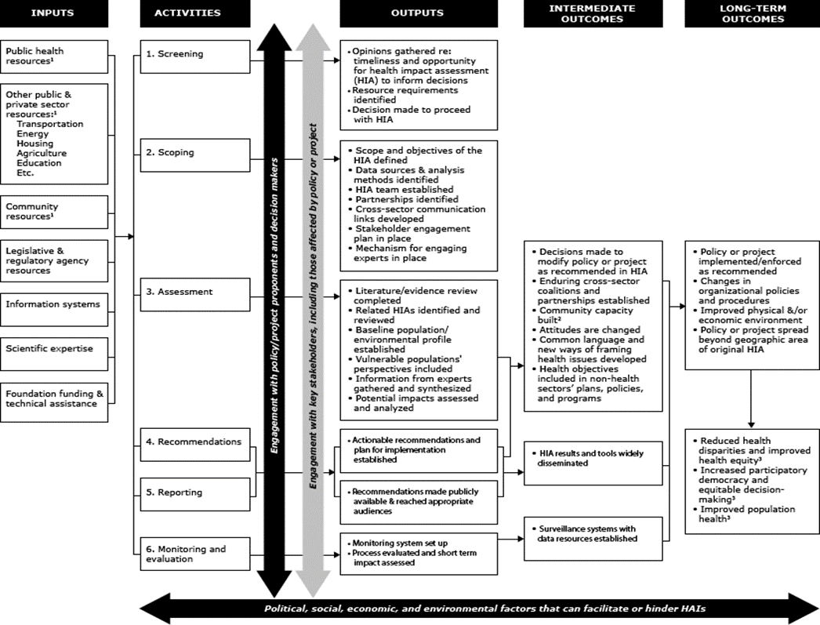
Scoping Tool: Logic Model
Source: Bourcier et al (2015)
Notes:
Developing a logic model for your HIA provides a relatively easy-to-understand visual for those trying to understand what the HIA plans to use to achieve its intended outcomes. Logic models can also prove helpful when trying to enlist support for and/or participation in the HIA, because it specifies the resources needed, the activities that will occur, and what the anticipated outcomes of the HIA are in a quick and easy-to-understand graphic.

Slide 23
Tasks related to Study Design
Lauren Adkins, CSS-Dynamac
Notes:
Time should be 3:45 PM, there are 20 minutes alloted for the next 13 slides.

Slide 24
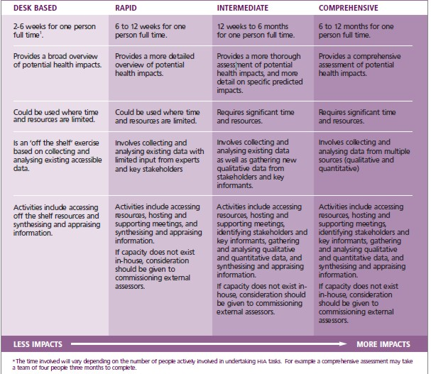
Types of HIA
- Figure adapted from: Harris, Harris-Roxas, Harris, and Kemp. 2007. Health Impact Assessment: A Practical Guide.
Notes:
The breadth of health impacts appraised can depend greatly on how much time and how many resources are available to complete the assessment. In general, there are 4 types of HIAs. The desk-based and rapid HIAs are typically limited by the time available, and thus only look at a few health impacts or look at the health impacts of interest in a broader, less detailed manner. There is usually no time for new data collection when performing a desk-based or rapid HIA; thus practitioners must rely on the evidence and data available. Intermediate HIAs may be limited by time and/or funding and thus are usually completed within 12 weeks to 6 months. Intermediate HIAs provide a more thorough or in-depth assessment of health impacts compared to rapid HIAs and may involve some new data collection through focus groups and/or interviews with key stakeholders. Comprehensive HIAs are more extensive and typically require 6 months or more to complete. More time allows the HIA to look at more health impacts of interest and/or provide a more in-depth analysis of health impacts. Comprehensive HIAs typically have more time for stakeholder engagement and collecting data (which requires more detailed data collection and analysis plans and may even require an internal review board approval). It is important to note that more stakeholder engagement and collecting new data will also require more funding.

Slide 25
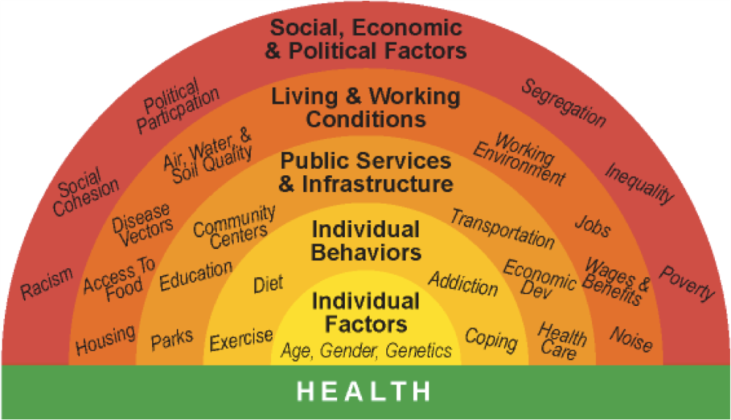
In a nutshell, HIAs:
Evaluate a proposed policy, plan, program, or project
affect
lead to
health outcomes
provide recommendations
Notes:
In a nutshell, all HIAs evaluate a proposed policy, plan, program or project for its potential to affect determinants of health and lead to health outcomes, and then provides recommendations for managing those impacts.

Slide 26
Pathways of Impact
Identify the pathways through which the proposed project, plan, policy, or program is expected to affect health.
HIAs examine two sets of linkages for each identified pathway:
How the proposed decision will affect determinants of health, and
How changes in those determinants will affect health outcomes.
Question for the audience
Proposed Decision
Determinants of Health
Health
Outcomes
6/16/2015
Notes:
The first task related to designing the assessment is to identify the potential (theoretical) pathways through which the proposal could affect health, including direct and indirect impacts.
Question for the Audience: “Given the plan to reduce lanes and add streetscaping, how might the proposed project affect health of street users?” (Give the audience a few minutes to respond.)

Slide 27
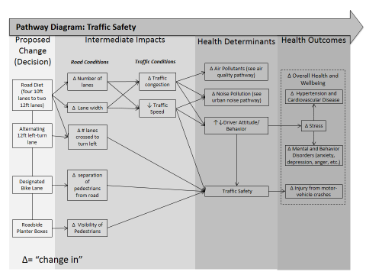
Scoping Tool: Pathway Diagrams and Logic Framework
Notes:
The most widely used tool or method in the Scoping step of HIA is the pathway diagram (first graphic). A pathway diagram is a theory-based graphic that displays a step-by-step mechanism through which the proposal may affect health.¹ For example, investigators may postulate that implementing a road diet will directly change the number and width of lanes. That change may indirectly lead to more traffic congestion along that route and less speeding vehicles. Those two intermediate impacts can affect driver attitude and/or behavior and ultimately traffic safety for other drivers and pedestrians. As you consider other potential pathways of impact, you begin to notice how a single proposal could relate to multiple pathways. The second graphic illustrates the compilation of all of the pathways through which a proposal could lead to health outcomes. This is often called a logic framework (not to be confused with a logic model).²

Slide 28

Identifying the Focus of Your Study
Start comprehensive.
  Ask “what are all of the potential impacts?”
Establish priorities.
  Identify the main concerns/interests.
  Solicit and utilize stakeholder input.
Select the health impacts to be appraised.
  Ask “what can be accomplished with the resources available?”
Helpful Tips and Tricks:
Make sure the scope of impacts is achievable with the funding, personnel, and timing available.
Notes:
It is important to recognize that the HIA may not be able to assess all the potential pathways identified. The next task is to narrow down the scope of the assessment to the health impacts that are most important and achievable with the resources available. The HIA Project Team needs to decide how to discern which health impacts are more important than others. There are several criteria that have been used in previous HIAs to do this, including a) whether the health impact was a major concern for stakeholders (community residents and/or decision-makers), b) whether there is enough evidence that supports the pathway identified, and c) whether there are enough data available to analyze and/or make predictions. Once the health impacts are ranked, the HIA Project Team should select those health impacts that will be appraised in the Assessment step.
Stakeholder engagement is most critical at this stage in the process, because the scope of the HIA can determine how useable the HIA will be to the varying stakeholder groups. For example, if the HIA appraises the health impacts that have been a major concern among community stakeholders, then the information gleamed from the HIA could be used to advocate for needs of the community.

Slide 29
Developing Research Questions (RQs)
Guidelines: RQs should be clear and focused.
  Define segments of the analysis (baseline vs. impact).
  Leave room for analysis.
  Ask open-ended questions: how, what, why, etc.
  Use research questions that can be repeated.
RQs can be quantitative or qualitative.
Question for the audience
Notes:
Research questions are used to guide study design by helping to identify the information you want the study to provide. In HIA, research questions are segmented to provide information about the baseline conditions and the predicted changes that will result from the proposal. Questions that are too broad can result in too much time spent trying to answer the question and/or do not provide enough guidance for structuring the analysis.¹ For example, try to answer the question “how will implementing green infrastructure affect health?” (wait for audience) This question is too broad, lends itself to too much theoretical answers and could lead the investigator on a “wild goose chase.” Questions that are too specific may lead to little to no need for performing an analysis. For example, how could you answer the question: “How many residents live near the proposed green street project?” (wait for audience) A quick internet search of the number of residents in the area could answer that question, thus no further analysis needed and the information gained is not very insightful. It is also important to consider how impacts will be monitored after the HIA is completed. Making research questions that can be re-tested will help with developing the monitoring plan down the road. Research questions can be answered using both numeric data or non-numeric data. For example, research questions related to how much pollution will change after the proposal has been implemented may use sampling data and mathematical modeling to compare changes in concentrations. Research questions related to how perceptions may change after the proposal is implemented may use community surveys, focus groups, and/or other qualitative data collection methods.
Question for the audience: “How would you frame a research question so that the assessment will tell you how the rate of traffic collisions will change after the proposed project is implemented.” (wait for audience’s response)
(Additional information) It helps to pick a general topic first and do a preliminary search of the literature to determine what is known about the topic. For example, ask “how is green infrastructure related to flooding?” The investigator can do a quick reference search and find that green infrastructure is used to capture and treat stormwater. However, the efficiency of green infrastructure to capture and treat stormwater can depend on the type of technology used, the soil type of the area, the meteorological conditions of the area, and the size of the project. Thus, more analysis is needed to figure out just how well the proposed project can achieve its purpose(s). An appropriate research question may be “how efficient will the proposed project be at capturing 100% of stormwater from a precipitation event in the study area?”
Footnotes:
¹ The following information (above) is reflective of the recommendations for designing research questions, given by the Thompson Writing Program at Duke University in Durham, North Carolina.

Slide 30
Identifying Indicators
Selection depends on the research question
HIAs predict changes in a health determinant, health behavior, and/or health outcome
  Identify indicator (proxy or metric)
  Establish baseline for comparison
Health Determinant | Example Indicator
Air Quality | Particulate matter < 10 μm (PM₁₀)
Greenspace | Percentage vegetation-covered surface area
Traffic Safety | Motor vehicle crashes (average) per year
Noise Pollution | Ambient noise decibels (dB(A))
Safety/Security | Level of perceived neighborhood security
Notes:
Indicators are values used to measure the status of a condition or outcome of interest. Indicators can be numeric or non-numeric. For example, researchers trying to capture the current state of neighborhood security among residents might use a survey tool with ranking scale (from 1 to 10) or categorical values (high, medium, low). In HIA, researchers can predict changes in health status or (most often) predict changes in health determinants and health behaviors. When trying to estimate these changes, investigators need to choose appropriate indicators for use in establishing a baseline. It is important to note that “metric” is a standard of measurement (always numeric), whereas “indicator” is a proxy value that represents an observation (can be numeric or non-numeric). For example, the presence of particulate matter less than 10 microns can be used to indicate air quality.
(Additional information) Another indicator is the quality adjusted life years, which is a product of the number of years a person lives, adjusted for the reduction in quality of life caused by an illness that a person experiences (ranging from 1.0 completely healthy to 0.0 near death). This measure is used to compare changes in health status between different populations or scenarios (Swedish National Institute of Public Health 2008). This measure is easier to calculate if investigators use existing data from surveys or interview instruments.¹ In comparison, disability adjusted life years is a product of the number of years of life adjusted for reduced functional status which does not have to be illness-related (ranging from 0.0 no disability to 1.0 full disability). This measure is used to compare changes in functional status between different populations or scenarios (Swedish National Institute of Public Health 2008). DALYs measure the absence of disability or the loss of social participation. It is important to note that using QALY and DALY does not account for other life changes and/or health-related behaviors, so there is inherent assumption that all other factors remain constant.
Footnotes:
¹ EQ-5D™ (a trade mark of the EuroQol Group) is a widely used survey instrument in Europe that is applicable to a wide range of health conditions and treatments, it provides a simple descriptive profile and a single index value for health status.

Slide 31






Identifying Data Sources
  Socioeconomic Data Sources:
    U.S. Census Bureau
    U.S. Department of Housing and Urban Development
    U.S. Department of Labor
    Local population/housing/labor/economic surveys
    Health Data Sources:
    Centers for Disease Control and Prevention (CDC)
    Healthy People 2020 (DATA2020 Interactive Data Tool)
    State, County, or Local Health Department surveys
Helpful Tips and Tricks:
When possible, use data that are routinely collected and available over time.
Notes:
(Additional information)
Examples of data sources from the U.S. Census Bureau include:
Interactive Population Search/Map
American Fact Finder
American Community Survey
American Housing Survey Dataset
Economic Census
Longitudinal Employment and Household Dynamics
Examples of data sources from the U.S. Department of Housing and Urban Development (HUD):
Interactive Thematic Maps
Fair Market Rents
Special Tabulations of Households
Examples of data sources from the CDC:
Behavioral Risk Factor Surveillance System (BRFSS)
Youth Risk Behavior Surveillance System (YRBSS)
National Health and Nutrition Examination Survey
(NHANES)
National Health Interview Survey (NHIS)
Diabetes Data and Trends
Other Potential Data Sources on Existing Conditions:
Federal and/or state departments of Environmental Quality/ Environmental Protection databases
Maps and GIS Repositories (U.S. Geological Survey, National Hydrography Dataset, etc.)
County Sheriff and Police Departments
County Planning Department
County Department of Public Works
County Department of Parks, Recreation, and Conservation
County Auditor
Department of Transportation

Slide 32
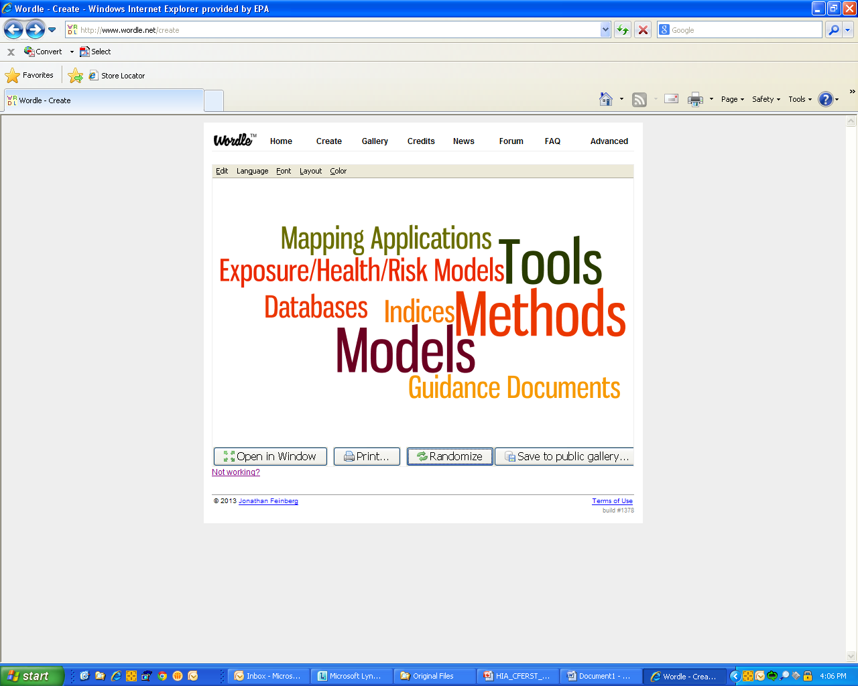
Identifying Analysis Methods (Quantitative)
Quantitative Risk Assessment (QRA)
Meta-analysis from existing literature studies
Mathematical (epidemiological) models/formulas
GIS-based (geospatial) analysis
Statistical analysis
Cost-benefit analysis
Computerized dispersion models
Notes:
“Traditional epidemiologic studies focus on estimating the causal relation between one or more exposures and the occurrence of a single disease or health outcome in a population, HIAs focus on the combined impact of one or more interventions (e.g. policies) on multiple health outcomes.”¹ It is important to consider that the analysis methods chosen in an HIA are often limited by the data, time and resources available. Although quantitative methods can provide the most objective and reliable information, they can also be costly and time-consuming. That being said, quantitative methods have been used in HIA to estimate changes in health determinants and/or health outcomes. (list a few)
(Additional information) There are guides and other resources available that help HIA practitioners select appropriate methods and design quantitative methods, such as the 2008 “Guide to Quantitative Methods in HIA” from the Swedish National Institute of Public Health, the 2005 publication from Verrman et al in Journal of Epidemiologic and Community health, and other resources in EPA’s HIA Resource and Tool Compilation (bookmark).
Footnotes:
¹ Source: UCLA School of Public Health. Accessed 6-2-15 <http://www.ph.ucla.edu/hs/health-impact/models.htm>.

Slide 33

Identifying Analysis Methods (Qualitative)
Literature review
Coding and categorizing data from participant observations, focus groups, interviews, etc.
Case study review (forensic diagnostics)
Delphi method (qualitative judgments by professionals/ experts)
Notes:
Most HIAs utilize qualitative analysis methods, such as literature reviews, participant observation, interviews and focus groups, forensic review of other case studies, etc. The Delphi method is a commonly used method for qualitatively characterizing health impacts. Professionals/experts discuss together all of the evidence gathered from the assessment and rank the predicted health impacts based on pre-determined criteria, such as direction, likelihood, magnitude, severity, and distribution.

Slide 34
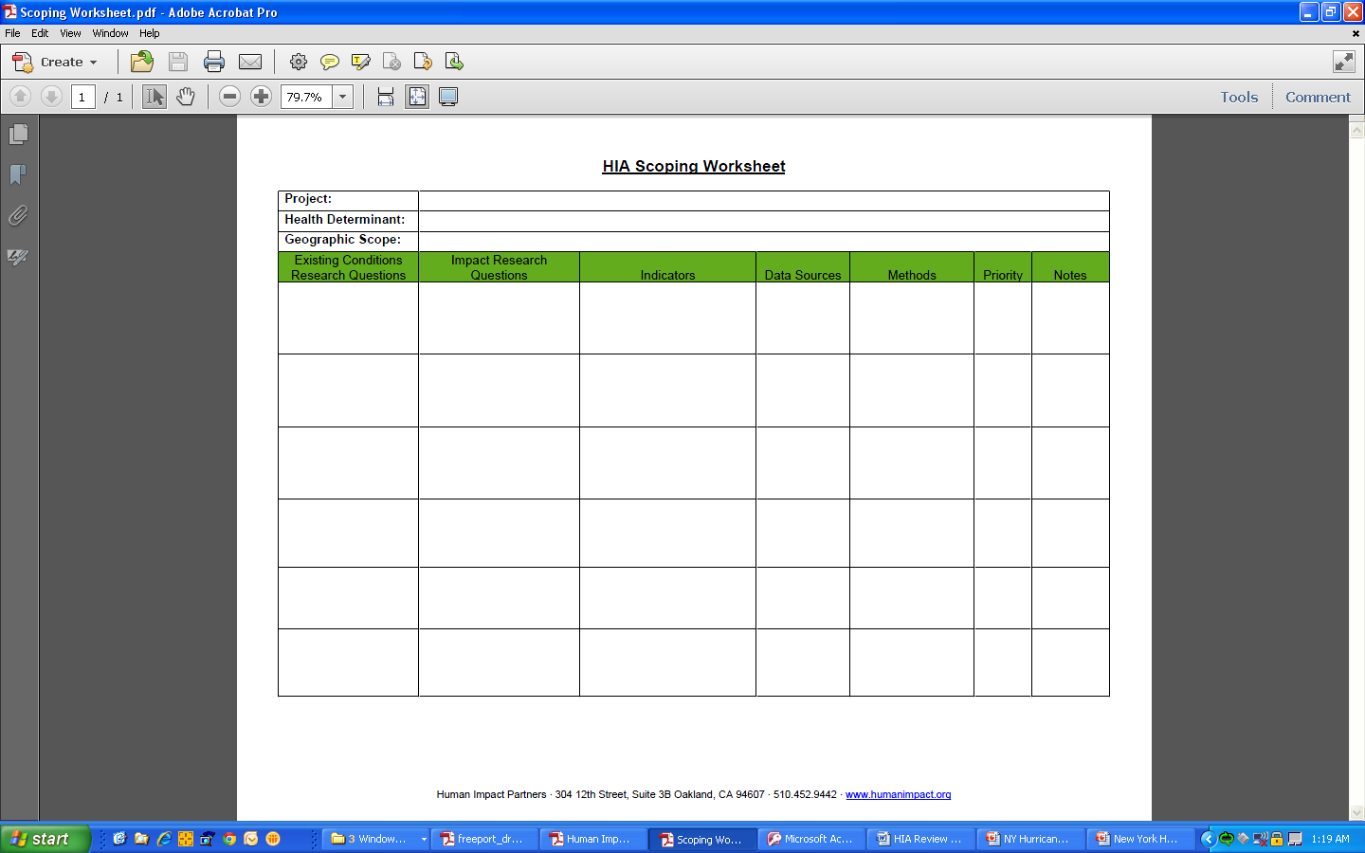
Scoping Tool: HIA Scoping Worksheet
Helpful Tips and Tricks:
Identify indicators, data sources, and methods that can be used for both Assessment and Monitoring and Evaluation
Notes:
A very useful tool for organizing the “scope” of health impacts appraised is the scoping worksheet, developed by Human Impact Partners. The Scoping Worksheet helps the HIA Project Team outline the study questions related to the health impact of interest, the indicators that will be used to measure or predict changes, the sources where data will be obtained, and the methods used to measure and/or predict changes.
It is helpful to look for potential data, approaches, indicators, and metrics that can be used in both Assessment and Monitoring and Evaluation. When evaluating the impact of the decision implementation on health in Monitoring and Evaluation, this allows changes in these indicators to be easily observed.

Slide 35
Identifying Limitations and Assumptions
Quantitative Methods
Qualitative Methods
Estimations
Easier to replicate
Focus is on “scientific data”
Limited by sample
More objective
Ways to address limitations and assumptions:
Sensitivity analysis
Monte-carlo simulations
Characterizations
Not readily replicable
Focus is on “stakeholders' input”
Limited by representation
More subjective
Notes:
For any study design, it is important for the HIA Project Team to consider the potential limitations of the assessment and any uncertainties for which assumptions are made. Considering these aspects will help the HIA Project Team manage expectations of the information that will come from the assessment and choose appropriate methods to help inform the decision.
(Additional information) For example, when using predictive modeling and/or statistical analysis, there will always be an element of inherent randomness, or the presence of potential confounders that limit the ability of the model to predict exact changes that will occur. Furthermore, tests are run under the assumption that all other factors or conditions remain unchanged. Thus, the results are often described as “estimates” and predict what may happen, not what will happen. When dealing with non-numeric data, investigators must qualitatively characterize the changes that may occur, which (most often) are based on professional experience or expert opinion. Not providing concrete numeric predictions is often a criticism of HIA. However, qualitative methods allow for the consideration of pragmatic and context-specific information to inform decisions.
(More additional information)
Sensitivity analysis is a technique used to determine how different values of an independent variable will impact a particular dependent variable under a given set of assumptions. In this method, investigators substitute alternative decisions or ranges of values for decisions (such as choosing over 70 years of age instead of 65 years to represent elderly) to see if the outcome will still be the same. Monte Carlo simulation performs risk analysis by building models of possible results by substituting a range of values for any variable that has inherent uncertainty. It then calculates results over and over, each time using a different set of random values from the probability functions. Employing Monte Carlo simulation (also known as the Monte Carlo Method) lets you see all the possible outcomes of your decisions and assess the impact of risk, allowing for better decision-making under uncertainty.

Slide 36
Group Activity and Discussion
Notes:
Time should be 4:05 PM, there is 15 minutes alloted for the group activity.

Slide 37
Activity for the Audience
Using the Boone Boulevard Green Street HIA case study, fill out the following HIA Scoping Worksheet for “Traffic Safety.”
Notes:
For the group activity, the audience will be asked to fill out the scoping worksheet for the proposed project’s potential to affect “traffic safety.” (Pass out the group activity handout.)

Slide 38
HIA Case Study Pathway Diagram
Notes:
(Leave this slide up as we talk through the scoping worksheet.) To aid in this activity, we are providing the pathway diagram for Traffic Safety, from the HIA case study.

Slide 39
HIA Scoping Worksheet
Study Questions | Data Needed (Indicators) | Publically Available? | Data Sources and/or Tools | Analysis Methods
What characteristics of the built and natural environment contribute to traffic safety? Does implementing green infrastructure along a street (i.e., streetscaping) improve traffic safety? | Exposure to injury from motor-vehicles | Yes | Empirical Literature | Use peer-reviewed literature to qualitatively assess impact of road diet and streetscaping on traffic safety and choosing active modes of transportation (i.e., walking and bicycling).
What are the existing traffic conditions and traffic safety practices present along the project site? | Speed limit Average annual daily traffic (AADT) Safety practices (e.g., speed bumps, pedestrian and cycling infrastructure, etc.) | Yes | GA─DOT, Georgia State Traffic and Report Statistics (STARS) GA─DPH, OASIS 2006-2010 dataset | Use direct observations to inventory the traffic safety practices that exist along the proposed project site. Access traffic data and calculate daily traffic volumes. Use the OASIS mapping tool to select and download maps of ER visits related to motor-vehicle crashes by Census tract.
Is the proposed Green Street Project designed to improve traffic safety? | [Blank] | [Blank] | Proposed project conceptual design (Tetra Tech 2013) | Review evidence and (qualitatively) characterize health impacts related to traffic safety.
Notes:
(If time, go through the actual scoping worksheet for traffic safety from the HIA case study.)

Slide 40
Questions and Answers
Notes:
Time should be 4:20 PM, there is 5 minutes left for Q & A from audience.

Slide 41
Session Wrap-up
Notes:
Time should be 4:25 PM, there is 5 minutes left for wrap up.

Slide 42
Common Challenges
Challenges
Successful Strategies
Underestimation of time and resources needed
Competing time demands of HIA participants and key stakeholder groups
Changes in decision-maker priorities and politics
Creating a diverse team with varying skills and experiences
Continuous and consistent involvement of key stakeholder groups
Timely, appropriate, and compelling messaging
Notes:
Over 300 HIAs have been completed or are in progress in the U.S. (Health Impact Project 2014). Reviews of completed HIAs have highlighted common challenges and successful strategies for navigating this critical HIA step.

Slide 43
Resources Available
Society of Practitioners of HIA
  http://hiasociety.org/?page_id=31
Human Impact Partners
  http://www.humanimpact.org/capacity-building/hia-tools-and-resources/
UCLA’s HIA Clearinghouse and Learning Center
  http://www.hiaguide.org/training/training-guides/ucla-hia-training-manual
World Health Organization (international)
  http://www.who.int/hia/tools/en/
Notes:
There is a lot of help out there. Throughout this presentation, we referred to tools already available for HIA practitioners to help move the HIA forward through the Scoping step. We would like to share with you where you can find these resources. If you cannot find a tool or resource you like, you can look elsewhere across the globe where HIAs are being implemented. Furthermore, the Scoping step is similar across the different areas of study, so you could even find resources in other fields.
For instance, in Western Australia, the Department of Health has endorsed the integration of human health risk assessments into environmental impact assessments and health impact assessments during the planning stages of new developments and to evaluate activities where potential risks to health are being considered. In 2010, the Department of Health of Western Australia, with support from other departments, consulting firms, and Curtin University Department of Health, developed a guidance framework for the Scoping step.

Slide 44
Closing Remarks
Scoping is the most critical step in the HIA process.
  Separate duties to save time.
  Engage key stakeholders to the best extent and as early as possible.
There are many resources, tools, and guides to help you develop and complete this step.
  Don’t reinvent the wheel.
  Utilize an HIA Advisor
HIA is part science, part art.
  Use a ROE Agreement.
  Assign one point of contact.
  Make sure the scope of impacts is achievable with the data, time, and resources available.

Slide 45

Thank You!
Lauren Adkins
adkins.lauren@epa.gov
513-569-7218
Steve White
steve@ophi.org
503-227-5502 x228
Notes:
We want to thank each of you for participating in this session. We hope this session was helpful and enjoyable to you. Please feel free to contact us with any additional questions or comments you may have about this presentation and enjoy the rest of the program!

