Slide 1

Evaluation of Health Impact Assessments Related to Labor and Employment
Hee Yon Sohng, MD
June 16th, 2015

Slide 2
Links between employment and health
Terms of employment
Employment Conditions
  Full employment
  Job security
  Paid leave (sick, maternity)
  Benefits (access to health care)
  Wellness programs
Hazards and exposures of the workplace
Physical and Mental Health
  Work-related injuries/illnesses
  Communicable disease
  Absenteeism
  Depression/anxiety
  Cardiovascular disease
Working Conditions
  Chemical, biological, & physical hazards
  Ergonomics
  Psychosocial (stress, autonomy)
  Hours/sleep deprivation
  Job satisfaction

Slide 3
U.S. HIAs by Sector, through 2013
Source: The Pew Charitable Trusts

Slide 4
AIMS
Describe the range of health issues addressed by employment-related HIAs
Evaluate the process of conducting a labor-related HIA
Identify knowledge gaps and provide recommendations for next steps for employement-related HIAs

Slide 5
METHODS
Cross-sectional study of employment-related HIAs
HIA identified by various databases
  US: Pew/Health Impact Project and UCLA Clearinghouse
  HIA Connect (mostly Australia)
  HIA Gateway (UK)
  IMPACT (UK)
  New Zealand Ministry of Health
  CHETRE (Australia)
  Wales Health Impact Assessment Unit

Slide 6
Inclusion Criteria
Prospective
Central purpose of HIA is related to labor and employment
Conducted 2004 – 2014
Full report available in English
Coded for
  typology, funding, geography, date, methods, depth, health and employment issues addressed
Notes:
Not available for SE Asia, Canada, Netherlands, Sweden, Finland, Norway, African countries
was 1) prospective; 2) a report was completed and available for download; 3) employment or labor issues was a discrete component of the HIA described in the title or Executive Summary; and 4) the central purpose of the HIA is related to labor and employment. Reports were excluded if the HIA did not describe a specific policy or proposal

Slide 7
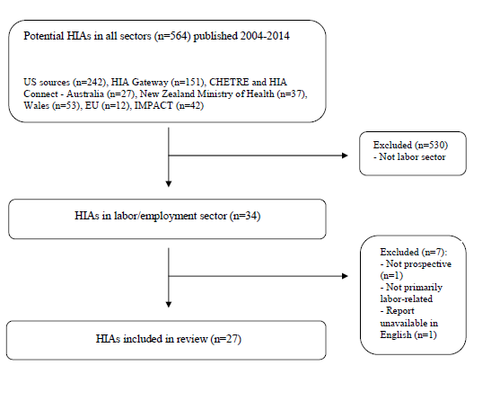
Inclusion/exclusion criteria

Slide 8
Process evaluation
Adapted from Minimum Elements and Practice Standards for Health Impact Assessment, September 2014
Focus on standards emphasizing :
  equity, ethical use of evidence, democracy, and comprehensive approach to health
  Addresses 5 of 6 key steps (excluded screening)
10 standards scored from 0 to 2 (total score possible 20)

Slide 9
Table 1: Descriptive characteristics
HIA Characteristic | Category | n (%)
Location | United Kingdom Europe (not UK) US New Zealand US territory | 7 (25.9%) 4 (15%) 14 (52%) 1 (4%) 1 (4%)
Year completed | 2004-05 2006-07 2008-09: 2010-11 2012-13 2014 | 6 (22%) 2 (7%) 8 (30%) 5 (19%) 4 (15%) 2 (7%)
Proposal type | Policy Project Program | 8 (67%) 5 (22%) 4 (15%)
Reason for HIA | Decision support Advocacy | 17 (63%) 10 (37%)
Depth | Rapid Intermediate Comprehensive | 7 (26%) 6 (22%) 14 (52%)
Funding (may sum to > 100% as HIA can have multiple funding sources) | Foundation Government Unknown University | 10 (37%) 15 (56%) 4 (5%) 1 (4%)

Slide 10
Table 2: HIA by year and country
Year | Region/country | Frequency
2004 | Europe UK | 4 1
2005 | UK | 1
2006 | UK | 1
2007 | UK | 1
2008 | UK US | 3 1
2009 | US | 6
2010 | NZ | 1
2011 | US | 3
2012 | US | 1
2013 | US US territory | 2 1
2014 | US | 2

Slide 11
Key Findings
Most employment-related HIAs
  Conducted for policy (67%)
  Decision-support (63%)
    Formal inclusion or partnership with decision makers
  > 50% at least partially government-funded
  Majority comprehensive HIA

Slide 12
Key Findings
Employment conditions most commonly addressed
  Wages (n=9), hiring/retraining/layoff (n=8), paid sick leave (n=6), flexible employment policy (n=5), pay equity (n=3)
  Several series of HIAs performed by one parent group on one topic
Few assessed working conditions (n=5)
  Two tracked rates of disability/work-related injury
Health effects
  “Psychosocial” effects/stress/morale (n=10), communicable disease (n=5), mental health (n=5), substance abuse (n=2)
Notes:
HEALTH OUTCOMES
Control /well-being/stress/morale
Mental health
Substance abuse
Absenteeism
Communicable disease
10
5
2
6
5

Slide 13
Methods Used in HIA Review
Rapid
Literature review
Secondary data analysis
Mathematical modeling
Primary data collection
  Focus groups
  Interviews
  Surveys
Comprehensive

Slide 14
Table 2: Process evaluation
 | Mean score for each standards category (out of 2)
HIA Depth | Scoping | Baseline health data | Systematic review | Direction of impact | Strength of evidence | Vulnerable populations | Recommendations | Stakeholder process | Evaluation plan | Monitoring plan | Summary Score (out of 20)
Rapid (n=7) | 1.0 | 0.6 | 1.0 | 1.1 | 0.6 | 0.7 | 0.9 | 1.1 | 0.1 | 0.1 | 7.3
Intermediate (n=6) | 1.0 | 1.5 | 1.3 | 1.5 | 0.8 | 1.2 | 1.0 | 1.5 | 0.2 | 0.0 | 10.0
Comprehensive (n=14) | 1.8 | 1.9 | 1.8 | 1.8 | 1.4 | 1.6 | 1.4 | 1.7 | 0.9 | 0.8 | 15.1
Mean (n=27) | 1.4 | 1.4 | 1.5 | 1.6 | 1.1 | 1.3 | 1.2 | 1.5 | 0.5 | 0.4 | 11.9

Slide 15
HIA Case study:
Wisconsin Transitional Jobs Program
Broad range of health indicators & outcomes measured
  Indicators: income, diet, substance use, incarceration, recidivism, social capital, family cohesion, self-efficacy
  Outcomes: chronic disease, mental health, domestic violence, birth outcomes, child mental health, child physical health
Methods thorough
  Literature review, secondary data analysis, primary data collection: surveyed participants of program (n=141)
Recommendations specific, including evaluation plan
  Targeted to audience: legislators, implementing agencies, contractors
  Recommendations for how and what data to collect for evaluation
Notes:
Health impact of transitional jobs program on participants, families, and children
Secondary data analysis:
he Survey of the Health of Wisconsin (SHOW), a state-wide public health survey that is operated by the University of Wisconsin School of Medicine and Public Health. SHOW uses a variety of health assessments methods to capture information about the health of Wisconsin residents. These These assessments include: in-person interviews, paper questionnaires, computer-assisted surveys, physical measurements and laboratory tests. SHOW measures a broad range of health information. Conditions and health-related characteristics captured in the data include high blood pressure and high cholesterol, nutrition and exercise habits, access to health care, health care utilization and other health related behaviors

Slide 16
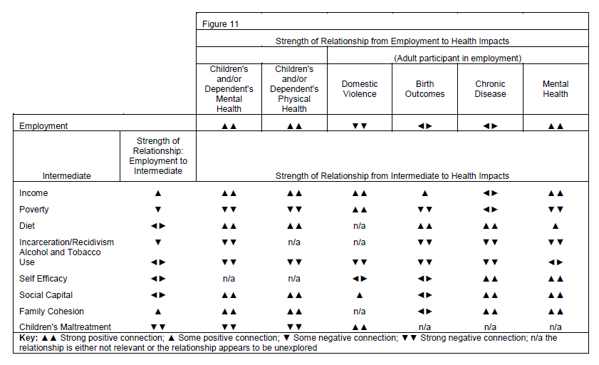
Source: Feder, E., & Moran, C. (2013). Transitional Jobs Programs: A Health Impact Assessment.

Slide 17
DISCUSSION
Employment-related HIA represent small proportion of HIA activity (4.5%)
Most recent employment-related HIA activity occurring in US
HIA series – can apply findings from one HIA on subsequent HIAs in different cities/states/countries
Evaluation and monitoring still lagging
Notes:
Continued growth of employment-related HIAs holds promise for improved collaboration with public health and labor advocates

Slide 18
Limitations
Generalizable?
  Limited HIAs from outside the US
  Only English language reviewed
  Not all HIAs published
  Does not capture all HIA activity (Canada, Scandinavian countries, Africa, South America, Thailand)
Single rater
Descriptive study: evaluated process, not impact or outcome

Slide 19
Future Directions
Potential for collaboration with public health and labor advocates
Standardize process evaluation
Strategies to decrease “start-up costs” of HIA
  Coordinate around key issues: flexible labor markets, paid sick leave, minimum wage
  Allows pooling of data, resources, expertise

Slide 20
Acknowledgements
MPH committee members:
  William Daniell
  Andrew Dannenberg
  Edmund Seto

