Slide 1
Lessons Learned from Practice in Health Impact Assessment National HIA Meeting Wednesday June 17, 2015
Sheena Smith, Analyst, MPP
ssmith@khi.org
(785) 233-5443
Kansas Health Institute
Notes:
Introduction of Speakers and KHI as an organization

Slide 2

What to Expect
Rationale for Stakeholder Engagement
Stakeholder Engagement Throughout the HIA Process
Kansas Examples
Discussion
Notes:
What and HIA is and What an HIA is Not
Examples of HIAs at the State and Local Level (Kansas and Georgia?)
Lessons Learned from these HIAs
Community Engagement
Screening, Scoping, Assessment, Recommendations, Reporting
Example HIA of Incorporating Lessons Learned: KHI Medical Marijuana HIA
Background on how the HIA came about
Literature Review Methodology
Qualitative Methodology
Vulnerability Score
Teaching HIA to Practitioners
Georgia Health Policy Center
TBD
Kansas Health Institute
TBD
Q & A Session
E

Slide 3
Rationale for Stakeholder Engagement

Slide 4

Stakeholder Engagement is a Minimum Requirement for HIA
HIA involves and engages stakeholders affected by the proposal, particularly vulnerable populations.
Society of Practitioners of HIA (SOPHIA) – hiasociety.org

Slide 5
Why Conduct Stakeholder Engagement in HIA?
Health Impact Assessments:
Help policymakers fully understand the health effects of proposed laws, regulations and programs
Provide practical and relevant recommendations that incorporate stakeholder input
Increase policymaker awareness of constituents’ perspectives
Notes:
Help policymakers fully understand the health effects of proposed laws, regulations and programs
Identify positive and negative health impacts
Issues that will be affected more
Provide practical and relevant recommendations
Can be considered during the decision-making process
Bring constituents perspectives

Slide 6
How Can Stakeholders Use Health Impact Assessments?
Request HIAs on selected policies (e.g., policies with diverse health effects)
Use information from HIAs to encourage or make changes to the proposed legislation
Participate in carrying out recommendations

Slide 7
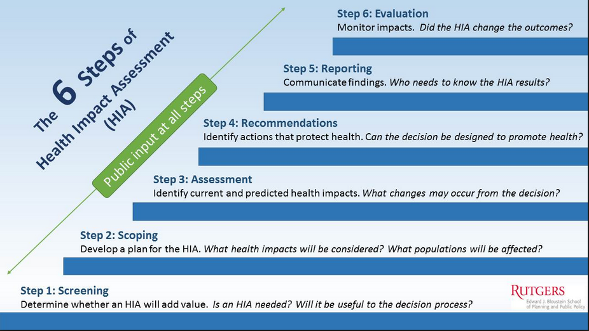
Stakeholder Engagement Throughout the HIA Process

Slide 8
Stakeholder Engagement: A Roadmap
Purpose
Involves policymakers, implementers and
those affected by policy studied
Identifying Appropriate Stakeholders |  | Incorporating Feedback
1. | Utilize partners in the state or community to contact stakeholders and form advisory panel | Hold community meetings or one-on-one meetings to inform stakeholders and advisory panel
2. | Research topic appropriate leaders in the community and reach out (e.g. Transit HIA: agency leaders, city council, planners, riders, business owners, aging, health departments, etc.) | Send out frequent email updates to stakeholders for suggestions
3. | Develop a list and inform stakeholders | Provide draft report sections (if appropriate) for comments.
4. | Conduct Key Informant Interviews with stakeholders | Collect information on policy perspectives for reporting and HIA process for evaluation purposes.
Notes:
Examples: Two discussion meetings in SEK, one in Topeka
Two at night, one in the afternoon
Provided information about HIA, answered questions from community, addressed concerns
Aimed to build trust and awareness

Slide 9
Stakeholder Engagement Throughout the HIA Process
Stakeholder Engagement during Screening
1. Identify Upcoming Policy
Review legislative topics from prior session(s)
Review media coverage
Identify potential committees/ legislators key to preferred topic
Notes:
State Challenges: No definite way to ensure the legislation will be introduced, tight timeline (session lasts 90 days), Kansas is a rural state with few urban areas (difficult for data collection, engagement), learning curve for legislators from non-health related committees.
Local – Identifying local policies is time intensive and requires extensive partnerships around the state; Local leaders may not be as familiar with HIA; Emphasizing how it will impact the community is key; Adjustments may be necessary, as local bodies are on various timelines and have an ongoing decision-making cycle (Transit Example – pushed the vote).

Slide 10
Stakeholder Engagement Throughout the HIA Process
Stakeholder Engagement during Screening
2. Screen Political Environment
Review state media coverage
Talk to stakeholders/decision-makers
Review issue history
Identify “proponents” and “opponents”
Elections
Notes:
State Challenges: No definite way to ensure the legislation will be introduced, tight timeline (session lasts 90 days), Kansas is a rural state with few urban areas (difficult for data collection, engagement), learning curve for legislators from non-health related committees.
Local – Identifying local policies is time intensive and requires extensive partnerships around the state; Local leaders may not be as familiar with HIA; Emphasizing how it will impact the community is key; Adjustments may be necessary, as local bodies are on various timelines and have an ongoing decision-making cycle (Transit Example – pushed the vote).

Slide 11
Stakeholder Engagement Throughout the HIA Process
Stakeholder Engagement during Screening
3. Identify timeline
Review legislative process (deadlines to introduce legislation). Keep in mind exempted committees
Monitor legislative calendar
Engage relevant stakeholders/decision-makers
Notes:
State Challenges: No definite way to ensure the legislation will be introduced, tight timeline (session lasts 90 days), Kansas is a rural state with few urban areas (difficult for data collection, engagement), learning curve for legislators from non-health related committees.

Slide 12
Stakeholder Engagement Throughout the HIA Process
Stakeholder Engagement during Scoping
Begin to Identify Health Impacts
Select Advisory Panel
Involve state and community stakeholders
Use existing testimony to identify factors
Consider state-wide populations and local populations as needed
Notes:
State Challenges: No definite way to ensure the legislation will be introduced, tight timeline (session lasts 90 days), Kansas is a rural state with few urban areas (difficult for data collection, engagement), learning curve for legislators from non-health related committees.
Local – Identifying local policies is time intensive and requires extensive partnerships around the state; Local leaders may not be as familiar with HIA; Emphasizing how it will impact the community is key; Adjustments may be necessary, as local bodies are on various timelines and have an ongoing decision-making cycle (Transit Example – pushed the vote).

Slide 13
Stakeholder Engagement Strategies during Scoping
Legislative Breakfast
Community Meetings
Regular HIA Updates
Key Informant Interviews
HIA Advisory Panel
Informal Conversations
Notes:
Is there the potential for different sub-groups within the community to be more adversely affected than others?
Policies might affect some populations more than others. HIAs can describe the impacted groups and the potential impacts. This information could help decision-makers to prioritize their resources.

Slide 14
Stakeholder Engagement Strategies during Scoping
HIA Advisory Panel
Various members representative of a variety of sectors
Tailor group to specific HIA
AP can provide feedback at all stages of HIA
State level may not have as many community members
Advisory Panel members help keep stakeholder meeting attendees engaged
Notes:
(e.g. Corporate Agriculture HIA AP is made up of proponents, opponents, academia, experts)

Slide 15
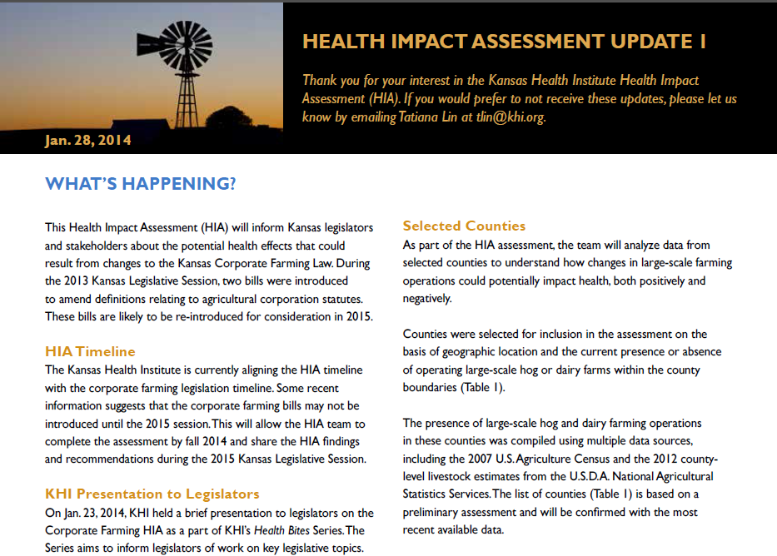
Stakeholder Engagement Throughout the HIA Process
HIA Update
Purpose
Provide information about ongoing HIA activities
Seek feedback from community members
Allows stakeholders to continue to be involved in the project

Slide 16
Stakeholder Engagement Throughout the HIA Process
Stakeholder Engagement during Assessment
Obtain Consensus among Stakeholders
Analyze qualitative information gained from key informant interviews
Share draft findings of assessment with Advisory Panel
Share draft findings of assessment with decision-makers if applicable
Be transparent about methods
Incorporate feedback as appropriate
Notes:
State Challenges: No definite way to ensure the legislation will be introduced, tight timeline (session lasts 90 days), Kansas is a rural state with few urban areas (difficult for data collection, engagement), learning curve for legislators from non-health related committees.
Local – Identifying local policies is time intensive and requires extensive partnerships around the state; Local leaders may not be as familiar with HIA; Emphasizing how it will impact the community is key; Adjustments may be necessary, as local bodies are on various timelines and have an ongoing decision-making cycle (Transit Example – pushed the vote).

Slide 17
Stakeholder Engagement Strategies during Assessment
Transparency is important to alleviate concerns
You will not always have all the data you’d like to have
There will not be always consensus on the predicted health effects of the project or policy under consideration
There may not be consensus on how “strong” the evidence is.

Slide 18
Stakeholder Engagement Throughout the HIA Process
Stakeholder Engagement during Recommendations
Develop Practical and Feasible Recommendations
Identify “implementers” - a mix of state and local-level players (e.g., legislators, private business, state agency)
If necessary, create broader recommendations, as implementation plan may be less clear
Advisory Panel is key but may not include all implementers
Prioritize recommendations according to stakeholder preferences
Notes:
State Challenges: No definite way to ensure the legislation will be introduced, tight timeline (session lasts 90 days), Kansas is a rural state with few urban areas (difficult for data collection, engagement), learning curve for legislators from non-health related committees.
Local – Identifying local policies is time intensive and requires extensive partnerships around the state; Local leaders may not be as familiar with HIA; Emphasizing how it will impact the community is key; Adjustments may be necessary, as local bodies are on various timelines and have an ongoing decision-making cycle (Transit Example – pushed the vote).

Slide 19
Stakeholder Engagement Throughout the HIA Process
Stakeholder Engagement during Reporting
Disseminate Report to Decision-makers and Stakeholders
Include formatting, pictures, graphics and tables that are easy to understand for a lay audience.
Customize Delivery (Hand deliver report to key committee members, testimony)
Tailor executive summary to decision-makers (Ensure key messages will resonate with policymakers)
Remain flexible during and after reporting process (Testify during multiple sessions if legislation is still pending)
Notes:
Provide specific examples of each.

Slide 20
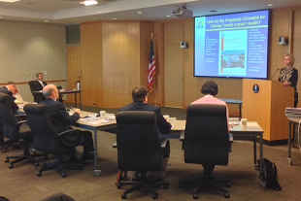
Stakeholder Engagement Throughout the HIA Process
Stakeholder Engagement Strategies During Reporting:
Testimony
Memo to decision-makers
Webinar
Issue Brief
Stakeholder/Community Presentations
Engage the media

Slide 21
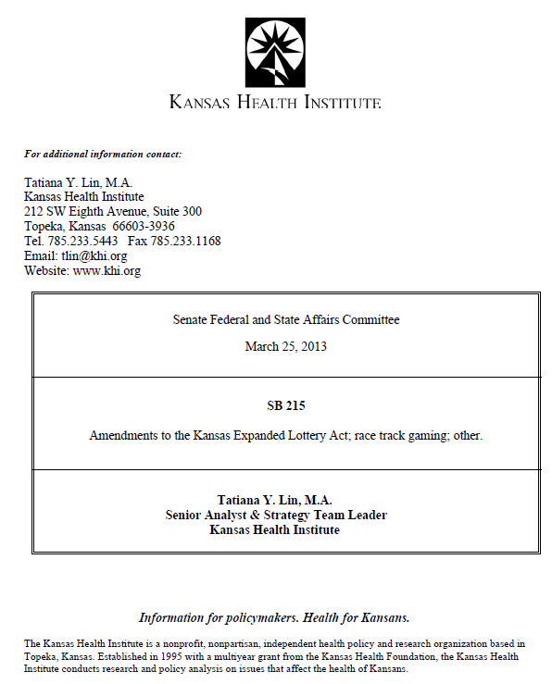
Providing Testimony
Summarize key points in testimony
Testify before key committees
Share materials with testimony (e.g., pathway diagram)

Slide 22

Engaging the Media in your HIA
Press Release
Op-Ed
Interviews

Slide 23
Examples of Stakeholder Engagement in Kansas

Slide 24

HIA on Changes to the
Kansas Corporate Farming Law (2014)
Opportunity Inform decision-making on legislation that could increase the number of in-state and out-of-state agribusinesses (large-scale swine and dairy farms)
Policymakers Kansas Legislature
Key Committees
Senate Agriculture, Natural Resources
House Agriculture and Natural Resources
Health Impacts
Economic (e.g. employment)
Environmental (e.g. water quality and quantity)
Societal (e.g. community cohesion)
Notes:
Opportunity to inform a state-level decision that could result in multiple health impacts
Diversity of arguments/opinions; state level HIA which has a larger pool of stakeholders to consider
Health hasn’t been a large part of past/current considerations
Community/stakeholders/policymakers have a vested interest in the issue

Slide 25
HIA on Changes to the
Kansas Corporate Farming Law
Stakeholder Engagement
Challenge | Solution | Lesson
HIA topic is controversial | Engage stakeholders across party lines and sectors, be transparent about limitations and funding sources | Leave sufficient time to gain buy-in from stakeholders
Stakeholders are wary of participating in the process | Hold individual meetings with stakeholders to provide information and answer any questions; Give everyone an opportunity to provide feedback and leave room for discussion | Personal communication and transparency is effective; Include feedback even if it is not supportive of the HIA
Stakeholders are divided on the topic | Provide equal time and opportunities for each stakeholder to provide feedback; View any information received from stakeholders equally | Ensure every stakeholder feels their opinions are respected and taken into consideration
Notes:
Strategies included: listening sessions, attend first meeting with no obligation to continue, remain updated on the project, provide feedback at every phase through multiple avenues, comment on report draft, provide a letter from organization to be included in the report with HIA practitioner’s response.
Held health bites: Extend opportunities for policymakers across party lines to make connections; understand key decision-makers
Accepting materials according to HIA standards, applying everything equally to all members across the board, allowing for feedback, etc.
This spans through every step of the HIA.

Slide 26
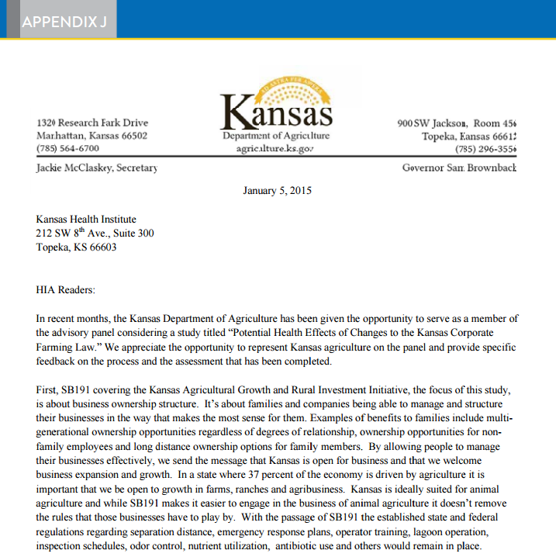
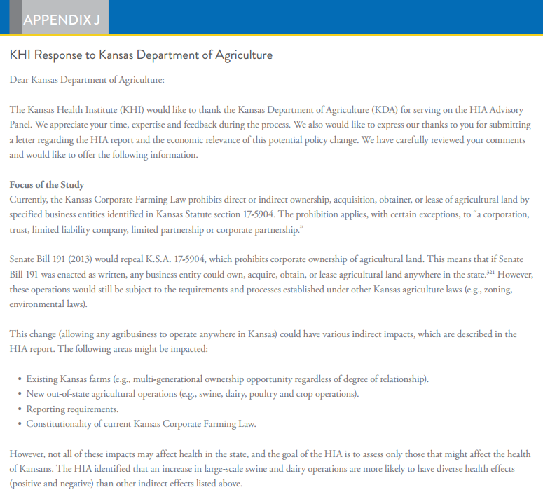
Advisory Panel Letter in the HIA Report
KHI Response to KS Dept. of Agriculture

Slide 27

HIA on Proposed
Changes to Kansas Lottery Act (2012)
Opportunity
Inform decision-making on legislation that proposed to reduce investment requirement to build a casino in the Southeast Kansas Gaming Zone (e.g. Cherokee and Crawford Counties).
Policymakers
Kansas Legislature
Key Committees
Senate and House Committees on Federal and State Affairs
Health Impacts
Job creation
Tourism
State and local revenue
Exposure to secondhand smoke
Increases in traffic accidents, gambling addiction, divorce and suicide
Notes:
Legislation passed in 2014.

Slide 28
HIA on Proposed
Changes to Kansas Lottery Act
Stakeholder Engagement
Challenge | Solution | Lesson
Community members are not supportive of an HIA being conducted | Identify local champions in the community and have them inform others about the HIA | Understand how to engage various communities before acting
 | Work with local partners to convince the community to engage in the process (e.g. Local Health Department; Salvation Army) | Adapt strategies when others do not work well; Evaluate whether efforts were effective
Notes:
Opportunity to inform a state-level decision that could result in multiple health impacts; also included two local communities.
Issue: Posted meeting notices publicly, newspapers ,etc. Community members were hostile and wary of an organization they were not familiar with doing this work.

Slide 29
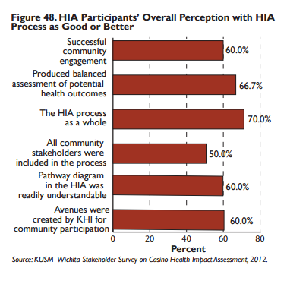

HIA on Proposed
Changes to Kansas Lottery Act
Notes:
Taking time with community members to explain the process and being responsive to feedback is important. Evaluating whether the process adequately engaged stakeholders is also good for continuing to learn from past experiences and improve upon them.

Slide 30


Contact
Sheena L. Smith, M.P.P
ssmith@khi.org
785-233-5443
Informing Policy. Improving Health

