Slide 1
The State of HIA at Local Health Departments: NACCHO’s HIA Capacity Building Program
Sandra F. Whitehead, PhD
Senior Director of Community Health Promotion
National HIA Conference
June 18, 2015
With credit to Tina Yuen, Consultant

Slide 2
LHDs Participating in HIA Nationally

Slide 4
NACCHO’s HIA Program
Since 2010, NACCHO has supported HIA practice among 17 LHDs in 14 states by providing
  funding
  technical assistance,
  mentorship opportunities
  training
Thirteen were paired with an experienced mentor that provided additional training, assistance and guidance over the project period.

Slide 5
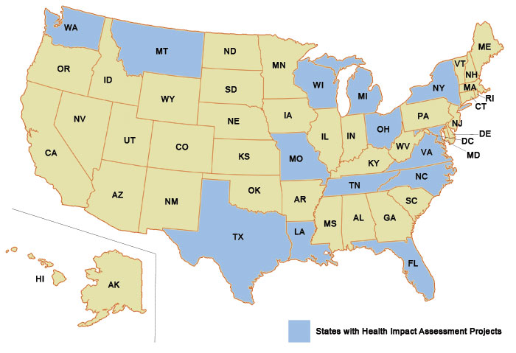
Location of HIA Capacity Building Sites

Slide 6

Factors that Led to Increased HIA Capacity
Increased awareness of the connections among non-health sector issues and health impacts
Increased number of trained staff
New partnerships and collaborations
Technical assistance and support

Slide 7

Partnership and Collaboration
New partnerships were formed by 83% of LHDs, and 58% stated that existing partnerships were strengthened
Over half of the LHDs formed new partnerships with community-based groups or organizations

Slide 8

Adoption of Recommendations
Over half of the LHDs responded at least one of their recommendations was accepted in full
Around 17% reported that one or more of the recommendations proposed were modified before being accepted

Slide 9
Challenges and Barriers
Primary challenges were limited internal staff capacity, staff turnover, lack of funding or resources to conduct HIA, and navigating new partnerships and relationships
Barriers to partnerships were time constraints, funding, and competing priorities
About 25% of LHDs noted challenges related to the fear of political backlash based on their recommendations
Notes:
These political concerns impacted the ability of the LHD to make strong HIA recommendations, as well as the success of the HIA itself.

Slide 10

Continuation of HIA beyond the Grant Period
75% stated that they are likely or extremely likely to lead future HIAs
83% stated that they are likely or extremely likely to participate in future HIAs, but not necessarily lead the effort
Two respondents stated engagement in future HIAs is dependent on funding

Slide 11

Continuation of HIA beyond the Grant Period
25% stated that they have incorporated HIAs into their LHD’s core functions or are planning to do so
Two respondents said that they are applying for funding to support engagement in HIAs

Slide 12
Sustainability of HIA Funding
Notes:
When asked about funding future HIAs, the majority of surveyed respondents identified a mix of sources their health department is likely to use. In-kind donations are defined as the giving of goods and services other than cash grants.

Slide 13

Recommendations for Practice from NACCHO Grantees
Educate decision makers and community partners about the HIA process before you start including roles and expectations

Slide 14

Recommendations for Practice from NACCHO Grantees
Create a communications plan in the beginning of the HIA, tailoring messages to the audience and being mindful of timing

Slide 15

Recommendations for Practice from NACCHO Grantees
Succession planning for turnover
Staff capacity
Partnerships based on personal relationships
Competing priorities for staff time
Partner burn-out

Slide 16
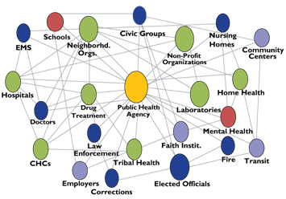
Recommendations for Practice from NACCHO Grantees
Create sustainable bonds with partners which will outlast the HIA
Regular meetings
Integration of committee memberships
Add attendees from different levels of the organizations

Slide 17
NACCHO Resources
Webinar HIA 101 (one hour)
HIA 201 on-site training
General technical assistance
Opportunity for peer review through the Community of Practice
Web resources: http://www.naccho.org/topics/environmental/health-impact-assessment/

Slide 18

Sandra Whitehead, PhD
Senior Director of Community Health Promotion
National Association of County & City Health Officials
1100 17th Street, NW
Seventh Floor
Washington, DC 20036
Direct (202) 507-4233
Main (202) 783-5550
Fax (202) 783-1583
Email swhitehead@naccho.org
www.naccho.org

