Slide 1
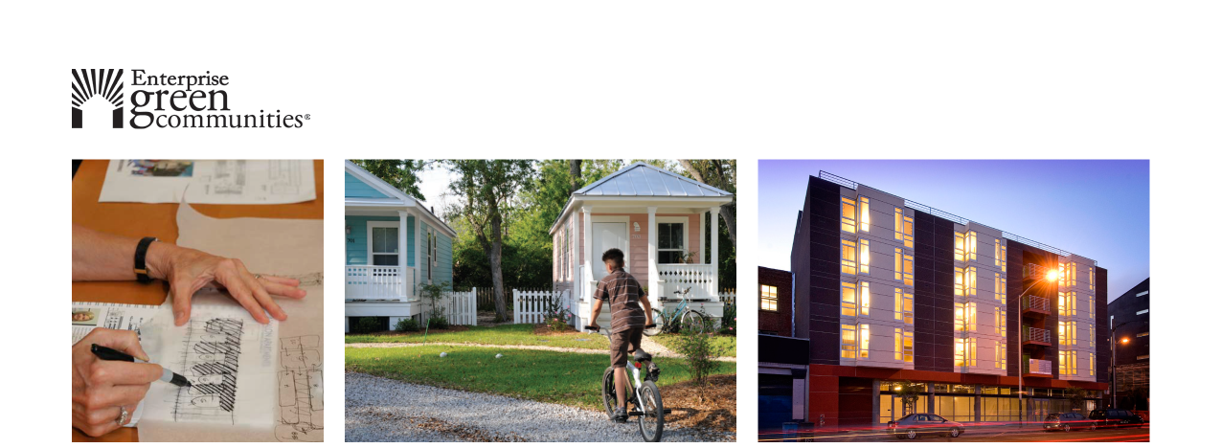

Incorporating Health Considerations into Community Development Projects

Slide 2

Agenda
The Collaborative – Health Impact Project + USGBC + Green Communities
Introduction to the new Enterprise Green Communities Criterion
Interactive Charrette
Consider a prioritized health issue
Evaluate design decision
Identify relevant metrics and a realistic monitoring mechanism
Questions + Answers
Notes:
KRISTA

Slide 3
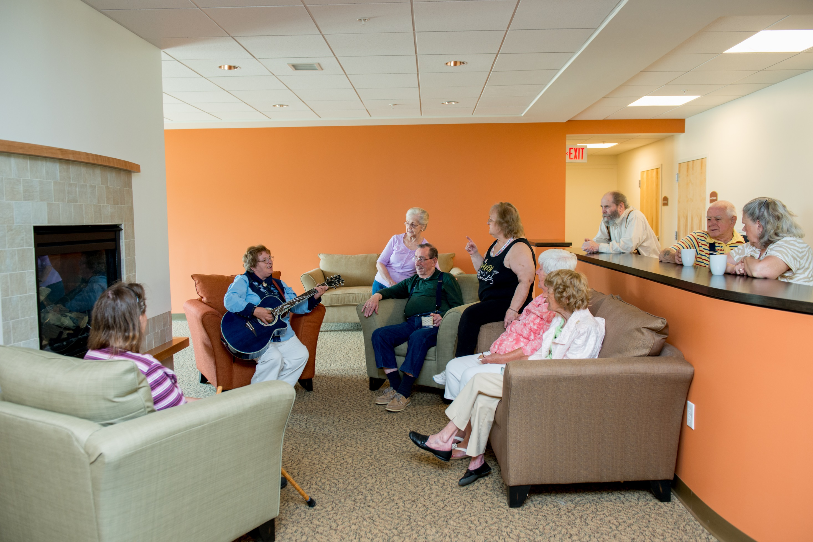

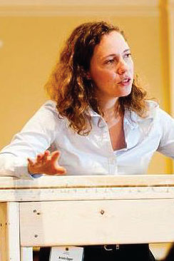

Today’s Speakers
Kelly Worden, MPH
United States Green Building Council (USGBC)
Krista Egger
Enterprise Green Communities
Ray Demers
Enterprise Green Communities
Notes:
KRISTA

Slide 4
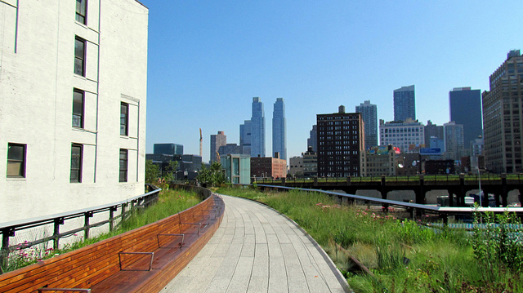
NYC High Line
Photo: David Berkowitz, Creative Commons

Slide 5
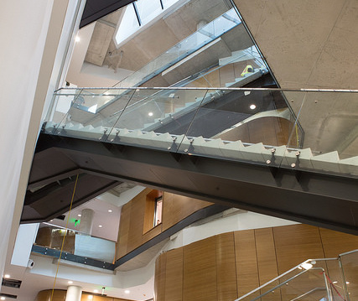
Active Design Stairwell Milken Institute School of Public Health LEED Platinum Photo: GW University

Slide 6
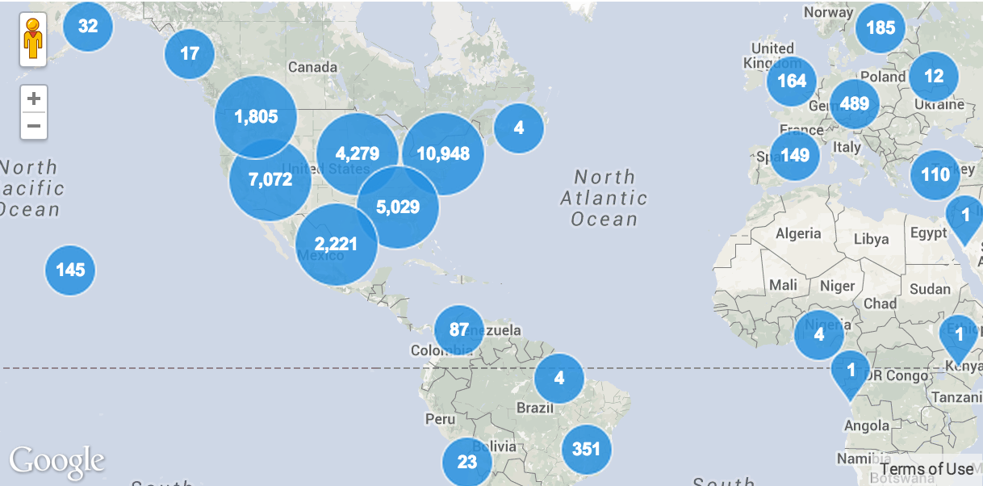
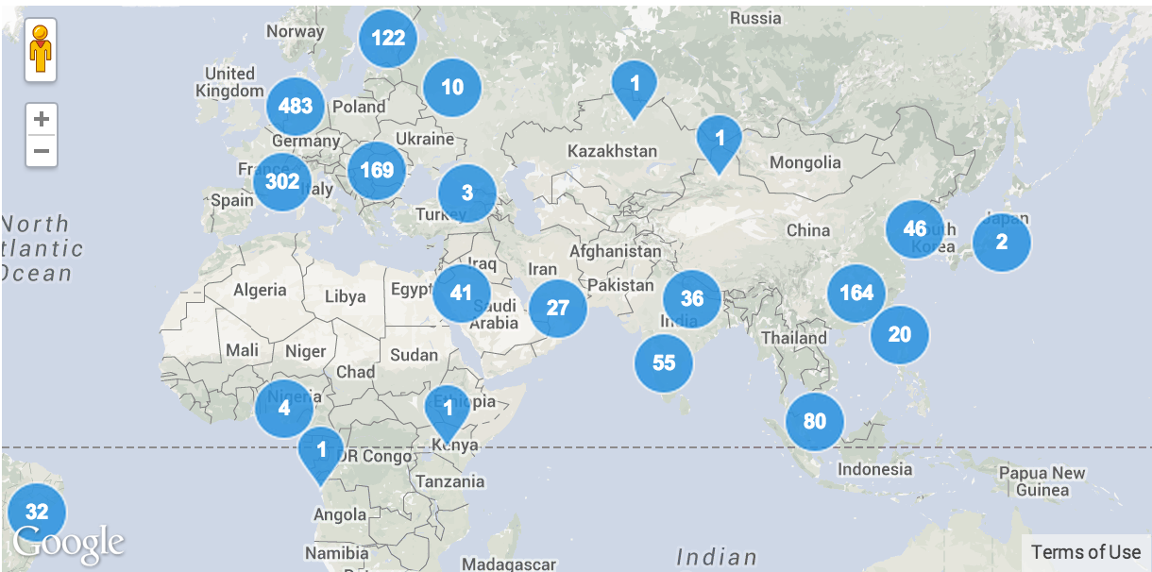
More than 20,000 LEED certified projects in the world
Source: GBIG http://www.gbig.org/collections/14544

Slide 7
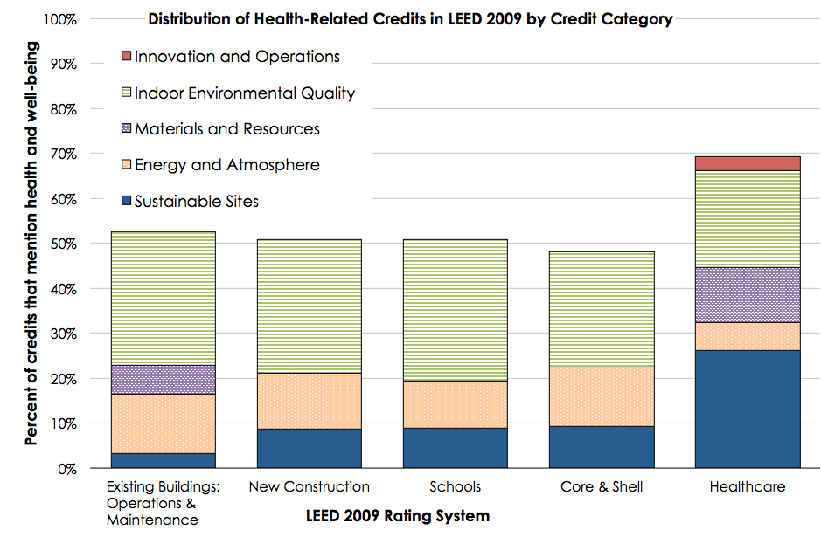

Slide 8
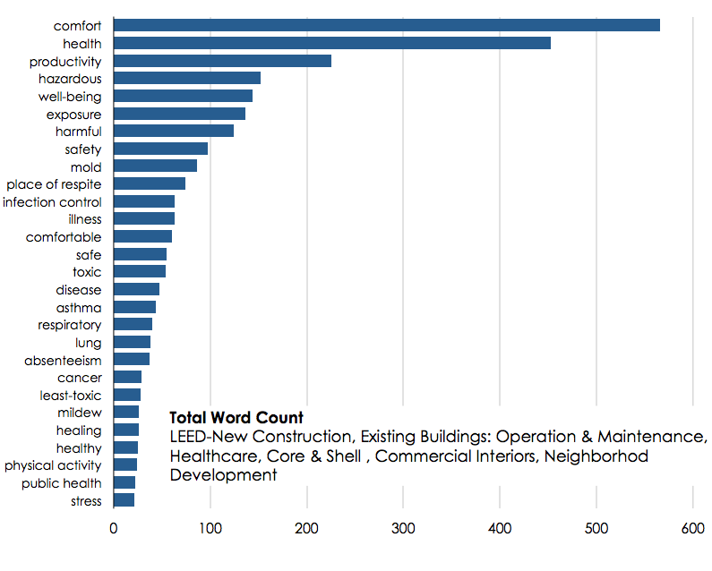

Slide 9
Green building today
Many “health-intended” prerequisites and credits but:
No systematic prioritization process
No recognition of community and occupant health needs
No direct role for health professionals

Slide 10
Need
An integrative process for improving health, well-being, and occupant experience.

Slide 11
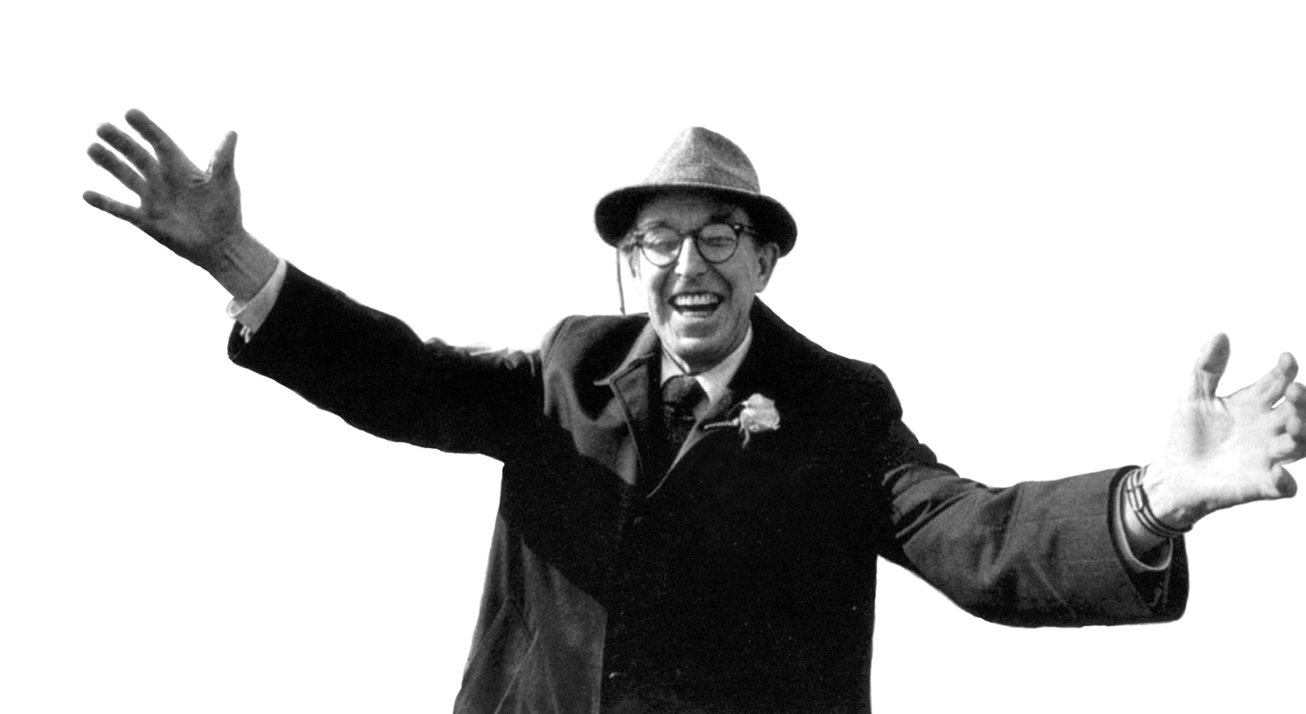
“We believe, because it is true, that people are affected by their environment, by space and scale, by color and texture, by nature and beauty, that they can be uplifted, made to feel important.”
Jim Rouse | Founder
We can't just settle for doing some housing, finding some jobs or building some human support systems. We must do it all – decent housing in decent neighborhoods for everyone.
Jim Rouse | Founder
“Job training, crime prevention, education and health care, as well as affordable housing, are all part of the solution. We cannot serious improve the lives of people unless we do all these at one time.”
Jim Rouse | Founder
Notes:
KRISTA - INTRO of ENTERPRISE
In communities across the country, rents are rising, wages are stagnating and working families are finding it harder to afford a decent place to call home. As a result, a record number of families are barely scraping by, living just one unforeseen event away from disaster.
On any given night, there are more than 600,000 people living on the streets or in homeless shelters. Nearly a quarter of them are children. A much larger group – nearly 19 million families – pays more than half of their monthly income on housing, often leaving them one paycheck away from losing their homes. They are the near-homeless – the next-homeless – and many are left with impossible choices like paying rent or buying groceries.
We know that where you live has a profound impact on the person you become. Without a safe, stable home, families living in poverty simply don't have the chance to strive and succeed. In that way, housing is much more than shelter – it's a platform, the essential first rung on the ladder of opportunity. But that rung is beyond the reach of too many families today.
Over the past three decades, we've learned what it takes to lift families out of housing insecurity and give them a fair shot at success. It takes homes that are affordable and available where the need is most acute. It takes homes that are healthy, well-designed and sustainable. And it takes homes that are connected to jobs, health care, good schools, transit and other opportunities
Since 1982, we've invested $16 billion in all 50 states, helped build or preserve nearly 320,000 homes and touched millions of lives.

Slide 12
Enterprise Green Communities is transforming the way America thinks about, designs, builds, and rehabilitates affordable housing.
Green building integrates materials and methods that promote environmental quality, economic vitality, and social benefits through design, construction and operations of the built environment.
Enterprise Green Communities aligns affordable housing investment strategies with environmentally responsive building practices.
Notes:
KRISTA
Intro to Green Communities

Slide 13

Notes:
RAY
Intro to the Green Criteria
Certifications in 39 stats & DC
Integrated into affordable housing funding streams in 22 states and 7 local/municipal
Green Communities works with our other national initiatives to elevate best-practices perfected within our local market offices across the country to drive affordable housing development.

Slide 14
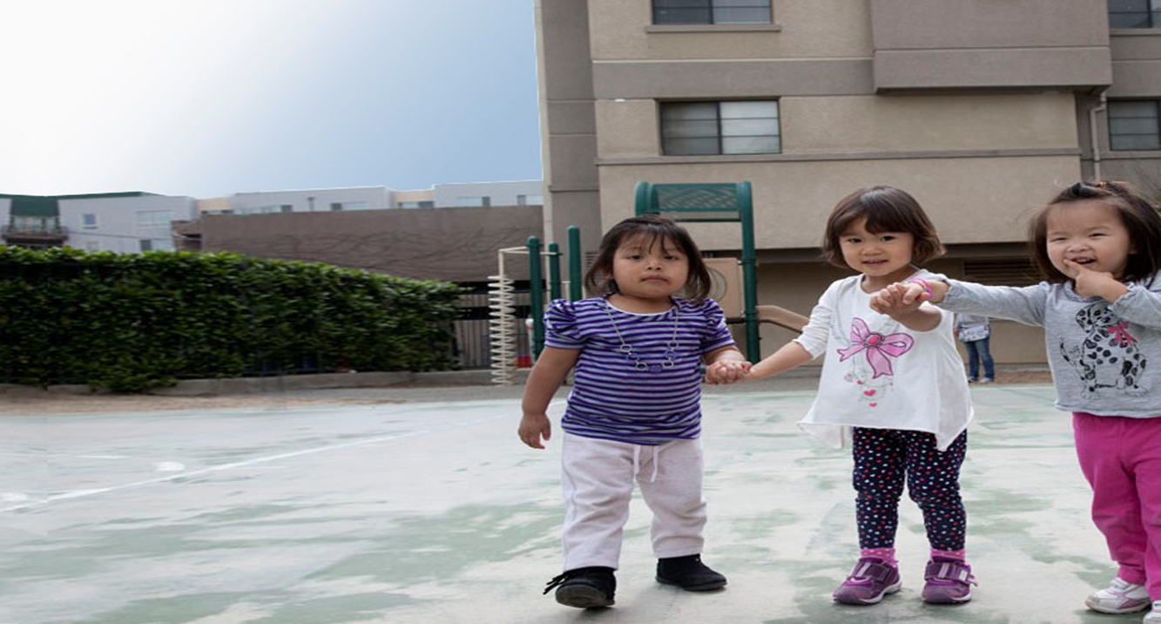
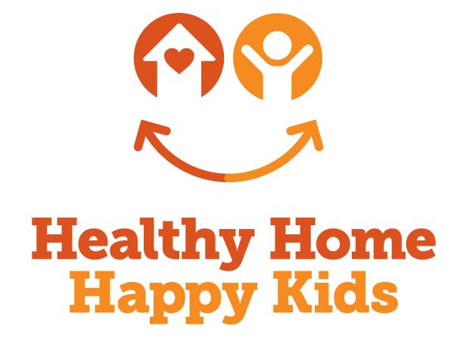
What Enterprise has done…
Enterprise + Health
Research
National Health Study
Breathe-Easy Homes
Viking Terrace
Watts-to-Wellbeing
Various collaborations with NCHH
Direct Assistance
Leading Age
Universal Design (UD) Specifications
Direct Assistance
CG w/ Leading Age
UD Specifications
United health?!?
Research
Health Study [GRAB LOGO]
Breathe Easy Homes
Viking Terrace
Watts-to-Wellbeing
Various collaborations w/ NCHH (check in on this)
Notes:
RAY
We pulled heavily from our past and current health-related research and work.
{Feeds into roadmap}

Slide 15
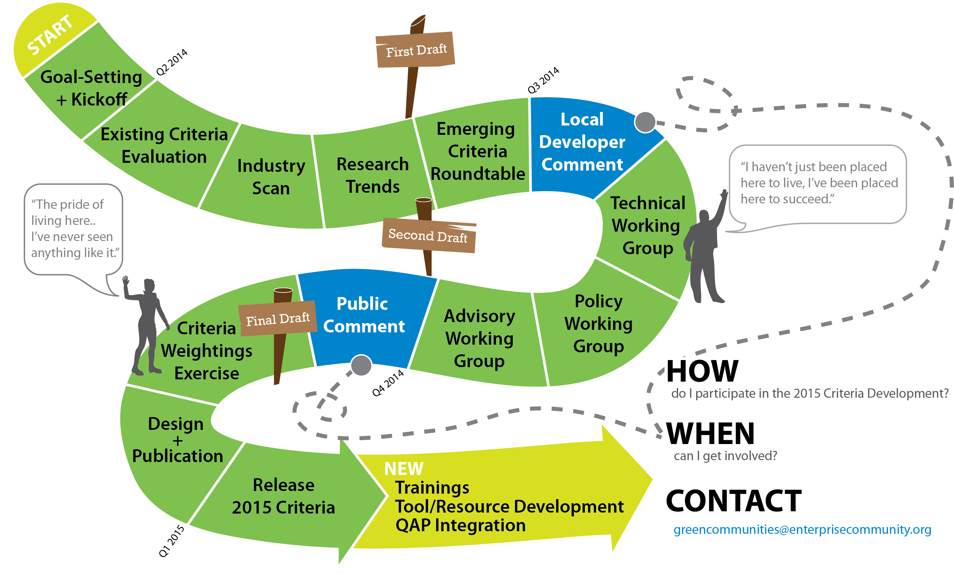
Overview of the 2015 Criteria Development Process
Notes:
RAY

Slide 16








Integrative Design
Operations, Maintenance
+ Resident Engagement
Location +
Neighborhood Fabric
Healthy Living
Environment
Site Improvements
Materials
Water Conservation
Energy Efficiency
Notes:
RAY

Slide 17
2015 Criteria: What’s New?
The 2015 Criteria requires that seekers of EGC certification assess, and address, community health characteristics and relevant resilience measures during the integrative design process.
For projects pursuing Certification, energy and water data will not simply be collected by Enterprise, but will also be managed by each project owner in a manner that influences project operations.
Projects pursuing Certification must explore best practices of TOD, offering means to connect to community amenities, and Resilience, in more meaningful ways that ever before.
Notes:
RAY

Slide 18
New Credits & Criteria

Slide 19
Criterion 1.2a:
Resident Health + Wellbeing: Design for Health

Slide 20
Inspiration
Integrative Process

Slide 21

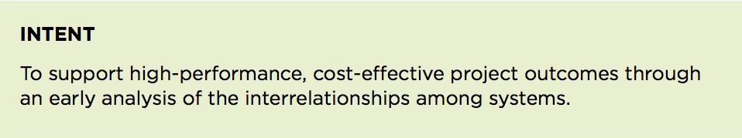

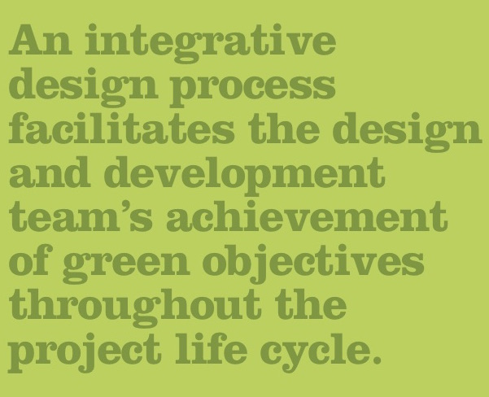
LEED v4
2011 Enterprise Green Communities Criteria

Slide 22
Inspiration
Health Impact Assessment

Slide 23
#1: Population Needs Assessment
Population: Health for whom?
Needs: What health challenges?
Assessment: What process? What expertise?

Slide 24
#2: Prioritize Strategies
Dozens of opportunities:
Location and transportation
Site design
Energy & Atmosphere
Indoor environmental quality
Materials & Resources
Pilot Credits

Slide 25
Ramp
Recognizing Good, Better, and Best process and performance

Slide 26
Good
“DIY” population needs assessment
Systematic prioritization of strategies

Slide 27
Enterprise Criterion 1.2a Resident Health and Well-being: Design for Health
Collect readily available data
Identify relevant Resident Health Campaign
Identify design and programming factors to optimize health
Incorporate at least one optional criterion

Slide 28
Enterprise Criterion 1.2a Resident Health and Well-being: Design for Health
Collect readily available data
Community engagement process
Local health departments
Resident surveys
Reports from local health professionals
Resident Health Campaigns | Source (s) of Information | Building Designs and Programming that Influence Physical and Mental Health | Related Criteria
Asthma and Respiratory Health |  | Outdoor air quality Indoor air quality Indoor humidity and temperature Mold Plant allergens Use of toxic / carcinogenic products Smoking Access to affordable chronic disease management services and resources Presence of pest | MANDATORY 5.1a-d Building Performance Standard 5.3 Sizing of Heating and Cooling Equipment 6.7a Environmentally Preferable Flooring * * * OPTIONAL 6.5 Certified, Salvaged, and Engineered Wood Products 6.7b Environmentally Preferable Flooring: Throughout Building 6.10 Asthmagen-Free Materials 7.16 Smoke-Free Building

Slide 29
Enterprise Criterion 1.2a Resident Health and Well-being: Design for Health
Identify relevant Resident Health Campaign
Utilize data collected in step 1 to select the most impactful
Resident Health Campaign from the table provided
Resident Health Campaigns | Source (s) of Information | Building Designs and Programming that Influence Physical and Mental Health | Related Criteria
Asthma and Respiratory Health |  | Outdoor air quality Indoor air quality Indoor humidity and temperature Mold Plant allergens Use of toxic / carcinogenic products Smoking Access to affordable chronic disease management services and resources Presence of pest | MANDATORY 5.1a-d Building Performance Standard 5.3 Sizing of Heating and Cooling Equipment 6.7a Environmentally Preferable Flooring * * * OPTIONAL 6.5 Certified, Salvaged, and Engineered Wood Products 6.7b Environmentally Preferable Flooring: Throughout Building 6.10 Asthmagen-Free Materials 7.16 Smoke-Free Building

Slide 30
Enterprise Criterion 1.2a Resident Health and Well-being: Design for Health
Identify design and programming factors to
optimize health
Utilize the table provided in the criterion and information from community stakeholders to prioritize design and programming strategies
Enterprise Criterion 1.2a Resident Health and Well-being: Design for Health
Identify design and programming factors to optimize health
Utilize the table provided in the criterion and information from community stakeholders to prioritize design and programming strategies
Resident Health Campaigns | Source (s) of Information | Building Designs and Programming that Influence Physical and Mental Health | Related Criteria
Asthma and Respiratory Health |  | Outdoor air quality Indoor air quality Indoor humidity and temperature Mold Plant allergens Use of toxic / carcinogenic products Smoking Access to affordable chronic disease management services and resources Presence of pest | MANDATORY 5.1a-d Building Performance Standard 5.3 Sizing of Heating and Cooling Equipment 6.7a Environmentally Preferable Flooring * * * OPTIONAL 6.5 Certified, Salvaged, and Engineered Wood Products 6.7b Environmentally Preferable Flooring: Throughout Building 6.10 Asthmagen-Free Materials 7.16 Smoke-Free Building

Slide 31
Enterprise Criterion 1.2a Resident Health and Well-being: Design for Health
Incorporate at least one optional criterion
Identified within the Resident Health Campaign in the table provided
Enterprise Criterion 1.2a Resident Health and Well-being: Design for Health
Incorporate at least one optional criterion
Identified within the Resident Health Campaign in the table provided
Resident Health Campaigns | Source (s) of Information | Building Designs and Programming that Influence Physical and Mental Health | Related Criteria
Asthma and Respiratory Health |  | Outdoor air quality Indoor air quality Indoor humidity and temperature Mold Plant allergens Use of toxic / carcinogenic products Smoking Access to affordable chronic disease management services and resources Presence of pest | MANDATORY 5.1a-d Building Performance Standard 5.3 Sizing of Heating and Cooling Equipment 6.7a Environmentally Preferable Flooring * * * OPTIONAL 6.5 Certified, Salvaged, and Engineered Wood Products 6.7b Environmentally Preferable Flooring: Throughout Building 6.10 Asthmagen-Free Materials 7.16 Smoke-Free Building

Slide 32
Better
Consultation with health professionals
Robust population needs assessment
Systematic prioritization of strategies

Slide 33
Criterion 1.2b:
Resident Health + Wellbeing: Health Action Plan

Slide 34
Enterprise Criterion 1.2b Resident Health and Well-being: Health Action Plan
Step 1:
Create a Health Action Plan
Step 2:
Project Implementation and Monitoring

Slide 35
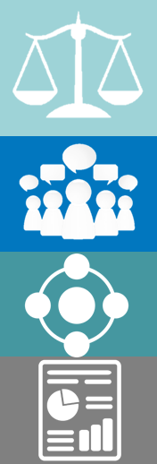
Enterprise Criterion 1.2b Resident Health and Well-being: Health Action Plan
Create a Health Action Plan
Purpose =
prioritize actions to protect and promote health
Participants =
public health professionals + community stakeholders
Process =
Information + feedback + plan development
Products =
Health issues + engagement + selected actions

Slide 36
Enterprise Criterion 1.2b Resident Health and Well-being: Health Action Plan
Create a Health Action Plan
Key Health Issue and Population Group | Potential Interventions | Examples of Strategies | Strategy Selected (Yes/No) | Implementation | Rationale
Childhood asthma | Eliminate or reduce use of potential asthmagens | Prioritize specification of hard surface flooring | Yes | Specification of linoleum for kitchens; cork flooring for bedrooms | Evidence-based strategy to address health issue; addresses health equity.
Childhood obesity | Prioritize features that promote physical activity | Playground | Yes | Include 100 sq. ft. playground as part of project | Local, safe space for physical activity; fills community-identified need.

Slide 37
Enterprise Criterion 1.2b Resident Health and Well-being: Health Action Plan
Project Implementation and Monitoring
Purpose =
Monitor and evaluate progress
Participants =
Project team
Process =
Document + demonstrate + develop
Products =
Modifications + monitoring plan

Slide 38
Enterprise Criterion 1.2b Resident Health and Well-being: Health Action Plan
Project Implementation and Monitoring
Information identified in step 1 |  |  | Information collected in step 2
Population Need | Selected Intervention | Selected Strategy | Potential Performance Metric | Selected Performance Metrics | Responsible Individuals and/or Organizations | Frequency
Childhood obesity | Prioritize features that promote physical activity | Playground | Design lighting Operations well-lit at all hours Health participation in physical activity events | Design compliance with Criterion 5.5 Operations lighting density Health participation rates at scheduled events | Design architect to certify lighting specs Operations maintenance technician Health residential services coordinator | Design to be certified in final plan Operations quarterly Health quarterly

Slide 39
Interactive Charrette

Slide 40
Community Needs Assessment
Your project team identifies the following needs:
40% of the population does not meet the daily recommended levels of physical activity
30% of children under 12 experience at least one acute asthma event per month
45% of the population has insufficient vegetable and fruit intake

Slide 41
Design Decisions
As the HIA Practitioner, you will work with the design team to identify synergies across strategies to maximize environmental and health benefits.
Consider the following design decisions:
Stairs and common spaces
Sidewalks, playground infrastructure and green space
Materials selection: flooring and paints
Access to fresh foods
Ventilation

Slide 42
Design Decisions: Reality
Keeping in mind the cost constraints felt by most project teams, consider the following:
Re-planning the building circulation costs $$
Asthmagen-free materials may be more costly to purchase, install, and maintain.
Playground infrastructure and site features tend to get value engineered (VE’d) out due to cost
Low-VOC materials may require more frequent cleaning with less-toxic products
Improved ventilation systems cost $$$, and require a well-trained operations staff.

Slide 43
Define a realistic monitoring mechanism
Points to consider:
Cost
Available expertise
Responsible parties
Reporting mechanism
Ability to sustain monitoring over time

Slide 44
Q + A

Slide 45
THANK YOU

