Slide 1
How the PATH Act Can Rejuvenate Antibiotic R & D
July 2015
PRABHAVATHI FERNANDES, PhD
Founder, President and CEO

Slide 2
Need to Increase Investment in Antibiotics
GAIN Act helps
Antibiotic Developers
DEMAND
for NEW ANTIBIOTICS:
Increasing Antibiotic Resistance to
Generic Drugs
New Regulatory Guidance,
Increased Development Efforts,
Increased Pharma Interest
VOLUME
SUPPLY
of NEW ANTIBIOTICS:
Few Products Approved / In Development
TIME

Slide 3
Barriers to Antibiotic Development
Competition for investment dollars with drugs that are taken chronically and do not cure
  In contrast, antibiotics are acute care drugs which cure in 5-10 days
With increasing antibiotic resistance, it is important to get the treatment right, the first time
  Failure with older antibiotics could cost lives
There are only a few drugs in the pipeline to meet unmet needs
Antibiotic trials are difficult to enroll as these are acute infections, that
  Must be treated quickly
  Prior antibiotic exposure can confound results
  Mortality from underlying disease can confound results
Although antibiotic resistance is increasing, large clinical trials, limited to resistant bacteria, are not possible
Therefore the PATH Act is needed to assure a supply of new antibiotics for patients with multi-drug resistant pathogens
WSJ Aug 1, 2012
3

Slide 4
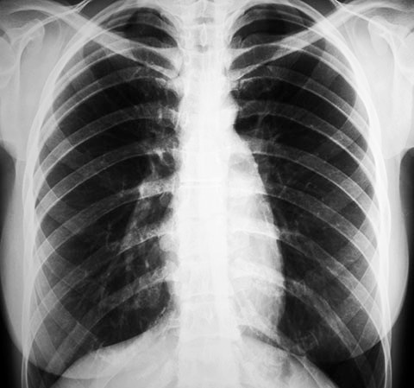

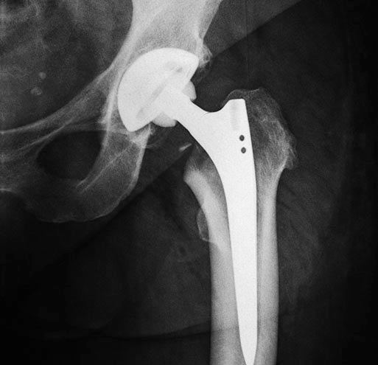
Two Differentiated Antibiotics in Late Stage Clinical Development
SOLITHROMYCIN
Oral, IV and Pediatric suspension
- Bacterial Pneumonia
TAKSTATM
Refractory Bone and Joint Infections
and Skin Infections
1st Phase 3 trial is complete 2nd Phase 3 trial has completed enrollment | Founded - 2006 | Phase 2 complete
NDA expected 2016 | ∼ $430MM raised | Phase 3 being initiated
∼ $200ΜΜ cost to date | IPO 2012 Nasdaq: CEMP | ∼ $25ΜΜ to date

Slide 5


Funded by BARDA
BARDA has provided a life-line of support to develop antibiotics to several companies
Solithromycin for use in the event of a bioterror threat
Pediatric use – Solithromycin could provide protection against bioterror pathogens for children upon approval
  Solithromycin is the first antibiotic in 28 years for respiratory tract infections. It is being developed as oral capsules, intravenous and pediatric suspension to provide convenience and dosing flexibility for children

Slide 6

Cost of Development – Not Favorable to Investment
Cost of two Phase 3 trials for Solithromycin ∼ $140MM
Large Phase 3 trials can take 3 years - runway for investor risk is too long
Development up to Phase 3 cost ∼ $60MM
Large trials are expensive – time and cost
and simply not possible for multi-drug resistant bacteria
PATH Act
Could make it economically feasible to develop antibiotics and importantly make it feasible to conduct trials for antibiotics targeting limited populations of resistant pathogens
Limited revenue
Cost

Slide 7
Streamlined Antibacterial Drug Development
Streamlined drug development for antibacterials implies using the totality of data from
  In vitro activity
  Efficacy and pharmacokinetics and pharmacodynamic data in animal models (PK/PD)
  Translational medicinal chemistry
  Clinical trials data against resistant pathogens and in scientifically valid infections
Limited use could be expanded after years of clinical experience – about 4 years
  Companies can work with FDA and health care providers in a systematic fashion to gather data that could lift this restriction
Larger trials will continue for drugs that do not address limited numbers of drug resistant pathogens
7

Slide 8
Streamlined Trials: Advantages and Disadvantages
Advantages:
  Lower cost, shorter time to be available for patients, extended patent life, makes it feasible to develop drugs for multi-resistant pathogens that are currently not common
Disadvantages:
Less clear clinical data, unclear safety, off-label use
The real question is “Does streamlined development for limited use compromise efficacy/safety data?“
Physicians have learned to effectively use the older antibiotics that were approved with streamlined development in spite of safety issues with each of them
Running large clinical trials is not the only way to reveal safety issues
Without the PATH approach effective antibiotics will not be available for some patients with life-threatening infections - This is a far greater risk than those posed by streamlined development
8

Slide 9
Managing After Approval of Antibiotic in a Streamlined Program
Must be restricted for use within a narrow indication (limited use)
How to limit use:
  Penalty to company if marketed off label – This law already exists
Proposed solution to managing safety risk
  Companies are already set up for post marketing surveillance systems
  Surveillance can be conducted as for orphan drugs or drugs for rare diseases
    Surveillance is a key part of PATH
  Hospitals can be responsible for minimizing off-label use – stewardship programs
  CMS has just announced stewardship programs for long term facilities – similar programs for acute care hospitals are expected
  Physician education is an important tool to avoid inappropriate off-label use – Awareness of limited population labeling
  If the plan is to expand use then the product must be tested in a wider population
  Evaluation of benefit/risk on an ongoing basis by an independent body of physicians/hospitalists/pharmacists
9

Slide 10
Appropriate Pricing
Appropriate pricing will benefit economics and stewardship and drive investment in Antibiotic R & D
Premium pricing will help make up for limited use
Premium price will decrease use – delay future antibiotic resistance
Premium pricing will ensure that LPAD drugs are used only for patients with unmet needs
These are acute care drugs for unmet needs, minimizing access concerns from premium pricing

Slide 11
We look forward to your support for the PATH Act
Thank you!

