Slide 1
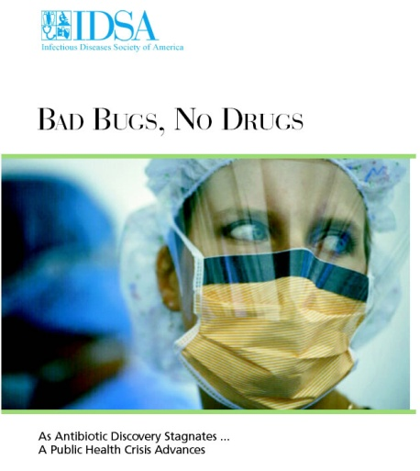
The Need for New Antibiotics
Helen Boucher, MD, FACP, FIDSA
Associate Professor, Tufts Medical Center
Tufts University School of Medicine
Member, Antimicrobial Resistance Committee, IDSA
July 28, 2015

Slide 2
IDSA Membership
10,000+ strong
Majority physicians
providing clinical care
2
Notes:
Let me quickly give you background on who IDSA represents and why the Society began championing the need for new antibiotics.
As IDSA members are seeing more and more patients with serious infections that are resistant to current antibiotics, IDSA decided it must step in to advocate on our patients’ behalf, push for change and put a human face on the antibiotic resistance problem.
We do not take any pharmaceutical funding to support these advocacy efforts

Slide 3
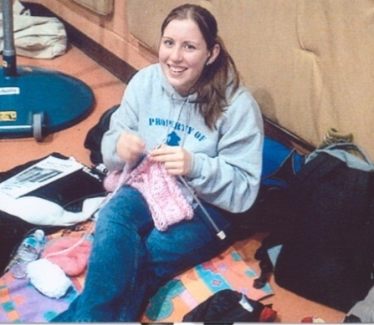
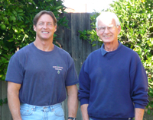
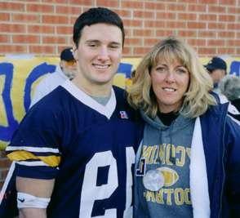
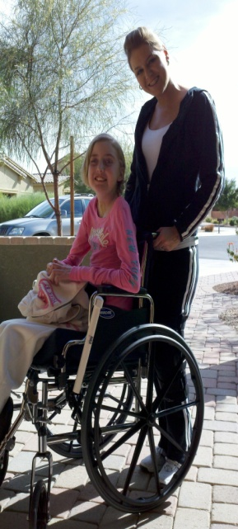
Lives Devastated/Lost Due to Antibiotic Resistant Infections
Premature Death
Life-altering Disability
Premature Death
Life-Altering Disability
Rebecca Lohsen (17 yr)--Dead
Mariana Bridi da Costa
(22 yr)--Dead
Tom Dukes: colostomy, lost 8” colon
Carlos Don
(12 yr)--Dead
Ricky Lannetti
(21 yr)--Dead
Addie Rerecich, 11yo
Double lung transplant
Stroke, nearly blind
$6 million hospital bill
www.AntibioticsNow.org
3
Notes:
Sampling of patient stories on IDSA’s webiste showing real people who have lost their live or suffered a life-altering disability due to a serious infection for which we did not have effective antibiotics. One of these patients—Addie Rerecich—will be featured in a short video that we will play at the conclusion of my talk today.

Slide 4
The Need for New Antibiotics Case
46 year old man with endstage cardiomyopathy (weakened heart muscle), diabetes, obesity
Heart unable to pump sufficiently; LVAD (pumping device) placed 3/31/11
Works full time
Married, sons aged 14 and 15
May, 2011 – local infection; oral abx
December, 2011 – new brown foul smelling discharge
managed with wound care and oral antibiotics

Slide 5
Case (continued)
Sept, 2013 – LVAD complications – new LVAD 9/25/13
Three months later (Dec, 2013)…
Pain, redness and drainage from LVAD
MSSA
Treated with IV cefazolin, then cephalexin
Slow improvement followed by worsening
Feb, 2014 blood cultures + skin infection
Wound with new E. coli
May, 2014 – worsening drainage; wound cultures + P. aeruginosa and Corynebacterium spp.
Progress
Slow response to IV therapy
Transition to oral ciprofloxacin + clindamycin (June, 2014)

Slide 6
Case (continued)
Improved to the point that antibiotics were stopped December, 2014
March, 2015 – pain and increased drainage; wound + P. aeruginosa (panS), E. coli, Corynebacterium spp.
Admitted, iv meropenem, vancomycin thru 4/10/15
5/11/15 – presented with pain, increased drainage, elevated white blood cells, inflammation
Admitted, IV ABX

Slide 7
Case (continued)
Late May, 2015
P. aeruginosa – 2 strains
Both resistant to ciprofloxacin (last oral option)
1 resistant to meropenem, susceptible to tobra, amikacin (toxic to kidneys)
Early June, 2015
Increased pain and drainage despite ongoing abx
Not a candidate for other antibiotics
Not a candidate for LVAD exchange
Not a candidate for transplant
Discharged to hospice

Slide 8
Antibiotic Resistance Threats Grow
Centers for Disease Control and Prevention (CDC) Report
Conservative estimates indicate that over 2 million Americans are infected and sickened every year by antibiotic resistant bacteria and at least 23,000 die.
The actual numbers are likely far higher
Notes:
The stories I just shared with you are representative of a much larger and growing problem.

Slide 9
Carbapenem-Resistant Enterbacteriaceae (CRE)
One example of an “urgent threat” according to CDC
9,000 drug resistant infections and 600 deaths per year
Resistant to all or nearly all currently available antibiotics
CDC confirmed CRE in healthcare facilities in 44 states
About 4% of U.S. short-stay hospitals had at least one patient with a serious CRE infection during the first half of 2012. About 18% of long-term acute care hospitals had one
Up to half of all bloodstream infections caused by CRE result in death
2015 CRE outbreaks related to duodenoscopes in CA, WA

Slide 10
New Type of CRE Posing Additional Threats
Some resistant bacteria, like CRE, are particularly difficult to treat because they produce enzymes that destroy powerful antibiotics. Most CRE in the U.S.—including the type in the 2011 NIH Clinical Center outbreak that sickened 18 and killed 11—produce Klebsiella pneumoniae carbapenemase (KPC)
However, New Delhi metallo-β-lactamase (NDM)–producing CRE have the potential to add to this burden
2009-2012: 27 patients with NDM-producing CRE in the US confirmed by CDC
2013-2014: 69 patients with NDM-producing CRE in the US (44 were from IL)
NDM is reported most commonly in India (where it is believed to have originated) and Pakistan, but is spreading worldwide as people travel
Notes:
Note significant spread from the 2009-2012 timeframe to the 2013-2014 timeframe

Slide 11
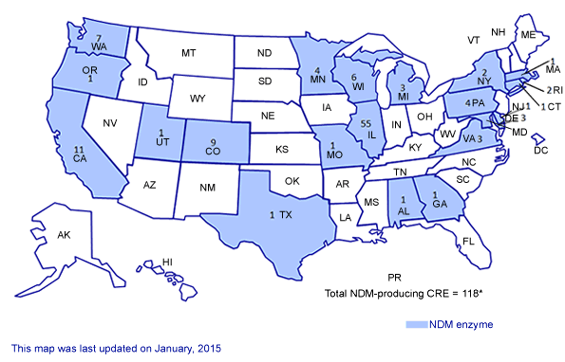
NDM-Producing CRE, January 2015
Centers for Disease Control and Prevention

Slide 12
Antibiotic Resistance: Current Realities for Patients and Physicians
The only antibiotic remaining to treat many Gram-negative bacterial infections (like CRE) is Colistin
Colistin is toxic; it causes kidney failure; its efficacy is questionable
Gram-negative bacteria are now developing resistance to Colistin
Current alternatives for these patients: “Do you want to die, or to be on dialysis for the rest of your life or until you can get a kidney transplant?”
12

Slide 13
Antibiotic-Resistant Bacteria: Economic Burden
Antibiotic resistant bacterial infections result in:
Additional $21-34 billion cost annually to US healthcare system
Additional 8 million hospital days
New antibiotics to address unmet needs could allow us to safely and effectively treat patients and discharge them more rapidly, saving considerable cost
RR Roberts, CID 2009:49, 1175-1184;
PD Maudlin, AAC 2010:54, 109-115
13

Slide 14
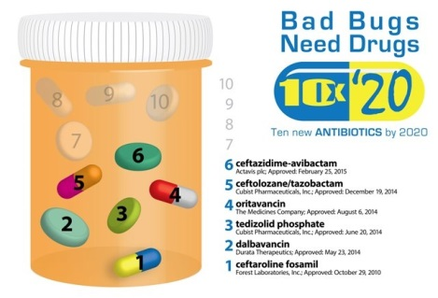
Status of IDSA 10 x ‘20 Initiative
Progress, thanks to Congressional action, but significant unmet needs remain
CID April, 2010; http://www.idsociety.org/10x20/

Slide 15
New Antibiotics: The PATH Forward
Key barrier to developing antibiotics for unmet needs (like CRE): Inability to find patients and funding for traditional, large scale clinical trials
Bipartisan PATH Act, S. 185, would make these trials feasible by establishing a new Limited Population Antibacterial Drug FDA approval pathway. (Similar legislation already approved by the House with overwhelming bipartisan support.)
Many safeguards (in PATH and other policy initiatives) to ensure these drugs are safe and effective and used appropriately
Bottom line: Without the PATH Act, many of the antibiotics patients need will not be able to be developed
Notes:
Next two speakers will speak in much more detail about the barriers to developing new antibiotics—particularly those that address unmet need and bipartisan legislation called the Promise for Antibiotics and Therapeutics for Health (PATH) Act and how it can help. Just quickly introducing those topics here.
Elaborate a little on why patients with resistant infections are difficult to enroll.

Slide 16
IDSA’s Goal: New Antibiotics to Save Lives
Prior generations gave us the gift of antibiotics
Today, we have a moral obligation to ensure a robust, renewable antibiotic pipeline for current and future generations
The PATH Act, S. 185, is a critical component of this effort. Thanks to Senators Orrin Hatch and Michael Bennet for their leadership
16
Notes:
IDSA working broadly with all government and non-government stakeholders to combat resistance in a multitude of ways. But we desperately need new antibiotics or we will continue losing our war against resistant bacteria.

Slide 17
Case
47 year old female school teacher presents with pain upon urination, lower abdominal pain
Started on standard oral therapy - ciprofloxacin
Two days later she comes back and appears ill with ongoing new chills, nausea and back pain
High fever, exam notable for new right flank tenderness
Urine shows signs of infection
Labs: elevated white blood cells
Therapy advanced to guideline therapy for kidney infection; she looked well enough to go home
One dose IV ceftriaxone, then oral bactrim
http://cid.oxfordjournals.org/content/52/5/e103.full.pdf+html

Slide 18
Case continued… Two days later
Substantially worse, acutely ill, high fever, low BP, requires hospitalization for intravenous hydration as unable to eat or drink; 2 episodes of vomiting
Exam – elevated HR, ill appearing, worsening right flank tenderness
Despite antibiotic therapy, urine culture grows K. pneumoniae, ESBL producing
Resistant to ciprofloxacin, ceftriaxone, TMP/SMX
Admitted to hospital and treated with imi/meropenem

Slide 19
Lessons from this case
Infections caused by resistant pathogens are serious and not entirely uncommon
This could happen to you or your children

