Slide 1


FOOD & FUND$
Keepin’ It Healthy
Notes:
Today we will are talking about healthy fundraising!

Slide 2



July 1,
2014
JOT IT DOWN!
Notes:
Last summer, the USDA published Smart Snacks in School nutrition standards for all foods and beverages sold to students during the school day, as required by the Healthy Hunger-Free Kids Act of 2010. The standards build on the healthy changes seen in school cafeterias around the country over the past two years, and these nutrition standards will go into effect July 1, 2014…which is right around the corner!

Slide 3
Entire school day
Entire school campus
All products SOLD
NOT foods served
NOT evenings, weekends or community events
Notes:
Smart Snacks in School nutrition standards:
Will cover all foods and beverages SOLD to students outside of the breakfast and lunch programs. Smart Snacks apply to all foods and beverages SOLD to students – including vending machines, a la carte, school stores, snack carts AND fundraising
Covers the entire school day, which is defined as midnight before to 30 minutes after the end of the school day.
Covers the entire school campus.
Will NOT cover foods served, such as celebrations.
Will NOT cover evening, weekend or community events.

Slide 4

a
FUNDRAISERS
School Day Only
Exemptions set by State Agencies
No Limit on Products that Meet
Notes:
Foods and beverages sold as fundraisers during the school day are also subject to the Smart Snacks nutrition standards.
State agencies will have the opportunity to set a number of infrequent food or beverage fundraisers that are exempt from the standards. However, even exempted fundraisers will not be allowed to be sold in competition with the breakfast or lunch programs in the food service area during meal service. If the state agency does not set a number of exempted food and beverage fundraisers, then ZERO exempted fundraisers will be allowed.
There are no limits on foods and beverages sold as fundraisers that meet the standards. There are also no limits on non-food fundraising.

Slide 5
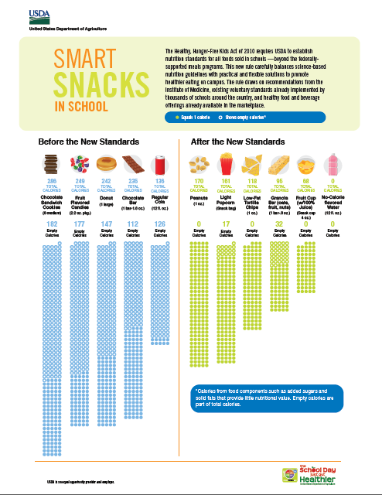
Notes:
USDA’s Smart Snacks in School Infographic is a nice representation of the types of competitive foods and beverages currently allowed and how those will change once Smart Snacks is in place July 1.
You might recognize some of the items on the left as items that may currently be sold as fundraisers. When Smart Snacks go into effect, these items will no longer be allowed. Try some of the foods on the right, such as popcorn, instead!

Slide 6
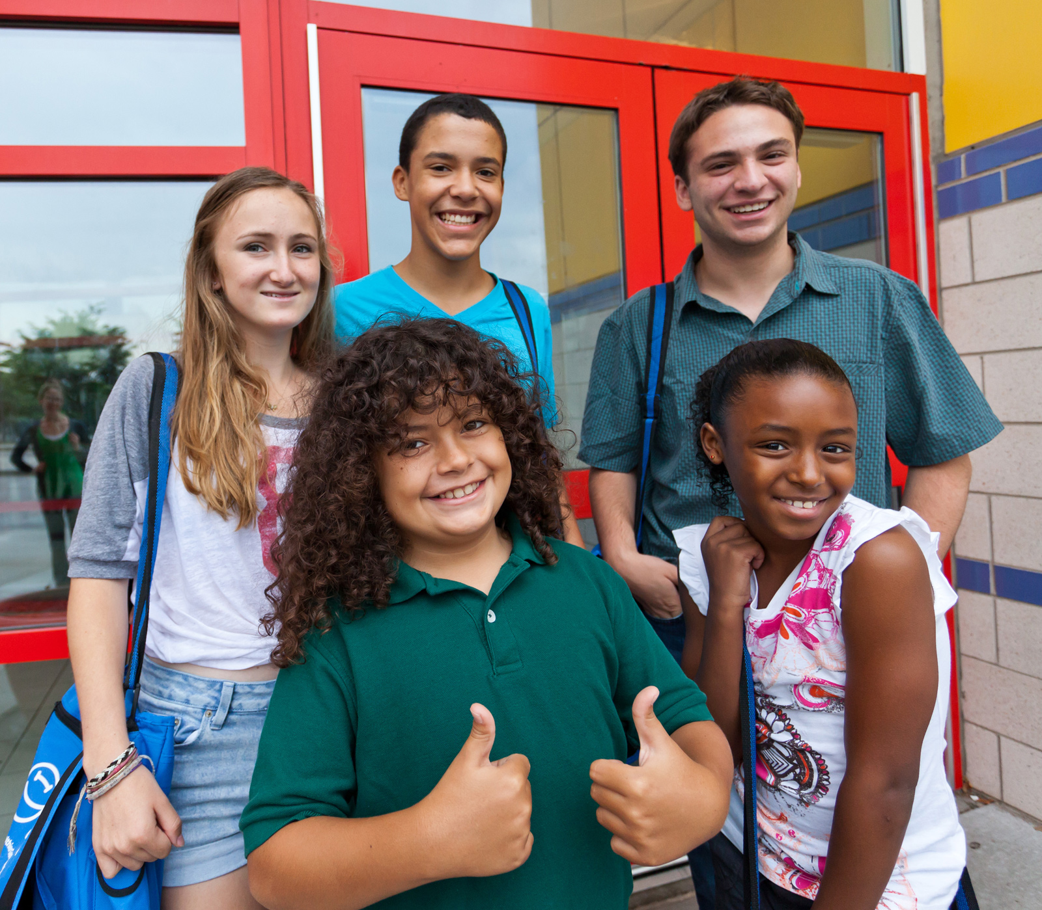

Fundraisers can
be successful
without undermining
the message.
Notes:
Promoting healthy options during meal or snack times while allowing regular unhealthy fundraisers sends youth conflicting messages. Fundraisers can be successful and engage youth, the community, the school building and out-of-school time programs in meaningful ways without undermining healthy eating messages.
Let’s explore some non-food fundraising ideas.

Slide 7
NON-FOOD
FUNDRAISING
Notes:
There are no restrictions on non-food fundraising, so consider some of these ideas!

Slide 8
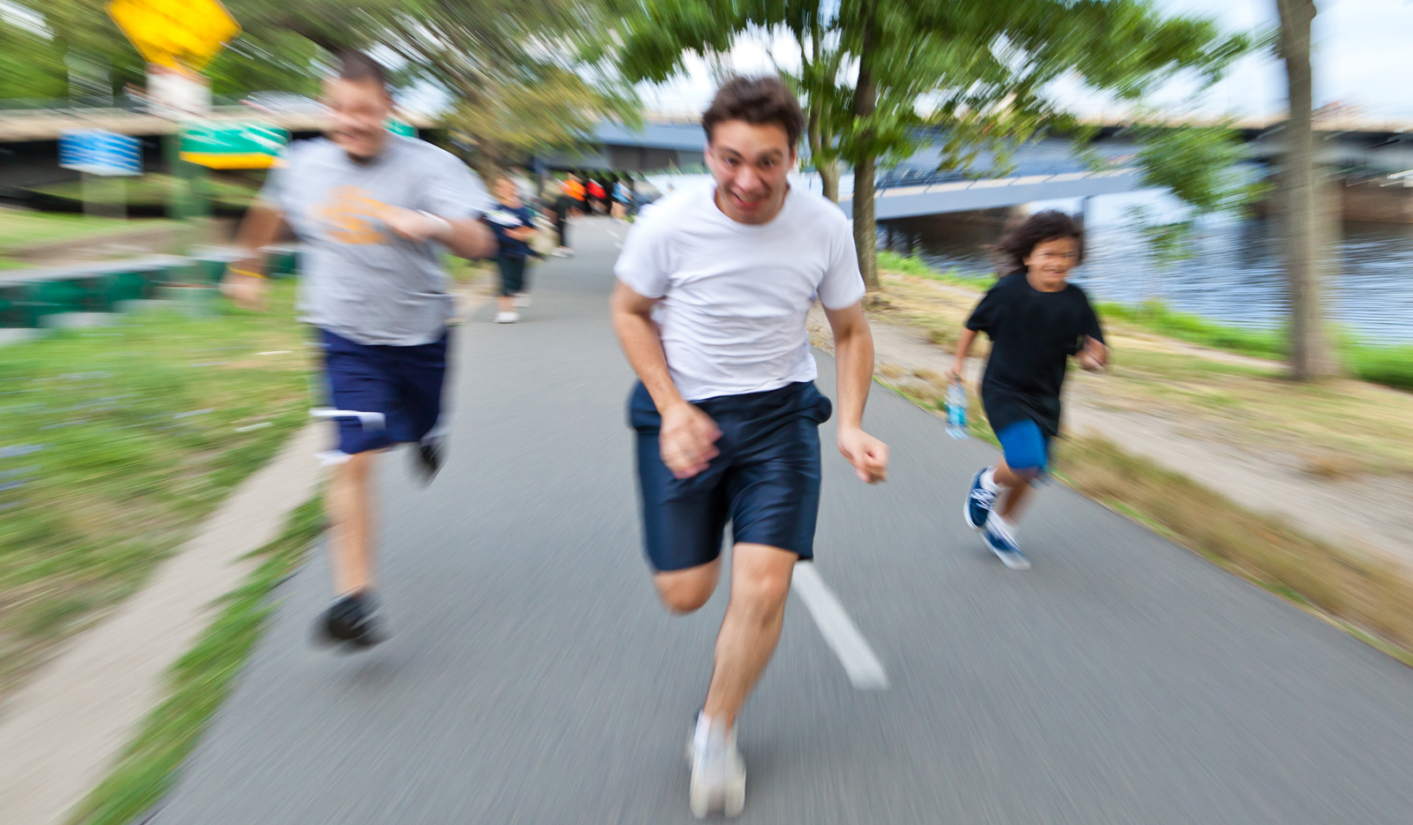
GET ACTIVE
Notes:
Hold an activity-based fundraiser! Try one of the following:
▪ Walk-, Run-, Bike-, Dance-, Skate-A-Thons!
▪ A dance
▪ Skating rink events
▪ Jump rope or hula hoop competition
▪ Team sport tournament (encourage youth and families to join)
-Softball, kickball or volleyball
▪ Field day (encourage youth and families to form teams)
Or try holding a 5K – this is a great way to not only raise funds, but also include the whole community. Many schools are beginning to hold a 5K as one large fundraisers that meets the funding needs of their whole school community.

Slide 9
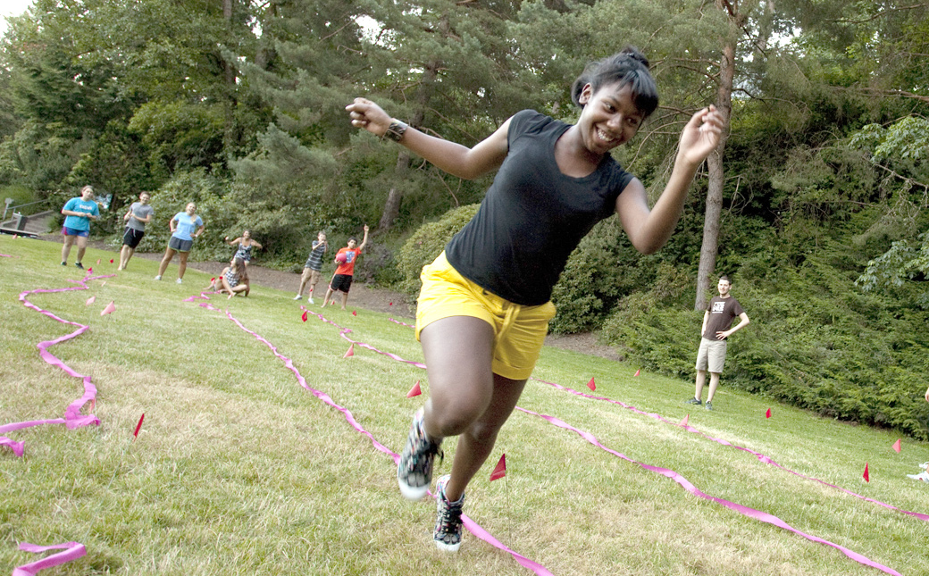
MAKE IT AN EVENT
Notes:
Have a Talent show - Charge admission for a talent show (sell school or site promotional items at the event). Or other events, like craft fairs or art shows featuring students creations.

Slide 10
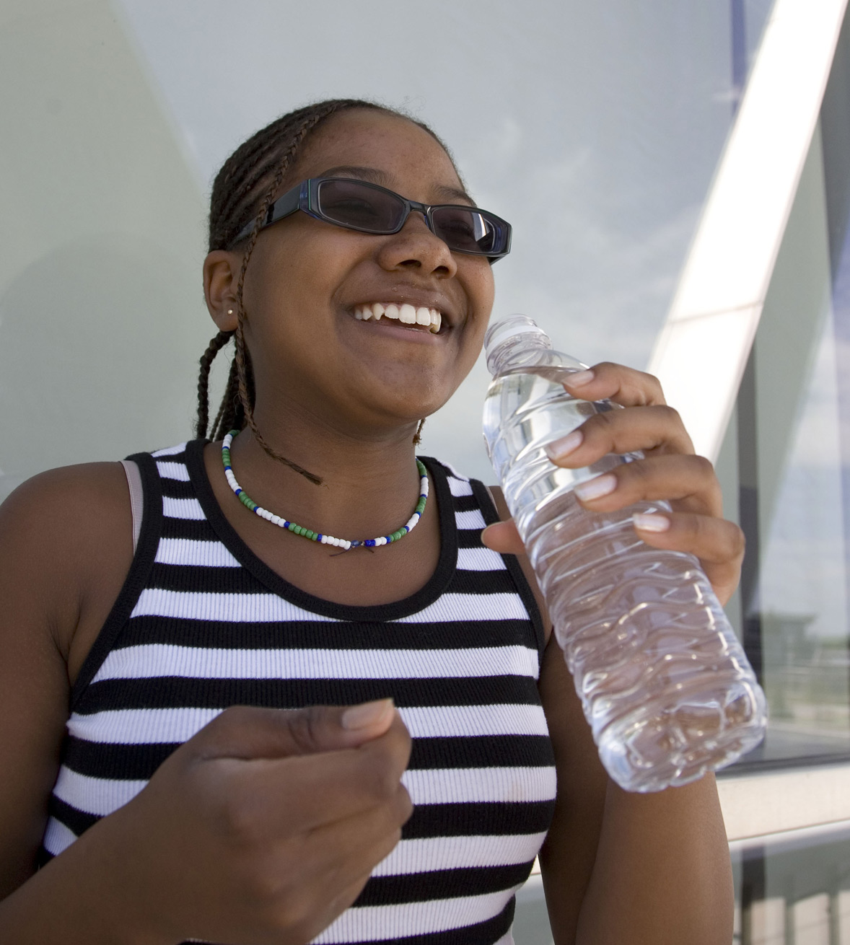

SELL PROMOTIONAL ITEMS
Notes:
Sell school or site promotional items - Consider tying the sale of specific items to other events or campaigns, such as selling water bottles to go along with a school, site or community wide campaign to encourage drinking more water!
To go along with being active, consider selling small physical activity equipment, such as hacky sacks, jump rope, balls or hula hoops.

Slide 11

INVOLVE THE COMMUNITY
Notes:
Ask the community for support for your fundraiser. Can they…
Donate a certain portion of sales from a given date or time to the school or site? (ensure the services or products are healthy!)
Donate items or services for live or silent auctions (such as vacation packages, lawn care, baby-sitting or lunch with a local celebrity)?
Donate products, services or tickets for events as prizes for a raffle drawing? This might include items such as tickets to movies, sporting events, concerts or amusement parks and gift certificates or vouchers for everyday services like a car wash, dry-cleaning, lawn mowing or even snow shoveling!

Slide 12

SELL AD SPACE
Notes:
Sell ad space in the school newspaper or newsletter to local businesses.

Slide 13

CREATE THEME BASKETS
Notes:
Sell theme baskets full of non-food items for holidays or special events. Encourage youth to come up with the contents of the baskets, take orders ahead of time and let youth put the baskets together.

Slide 14
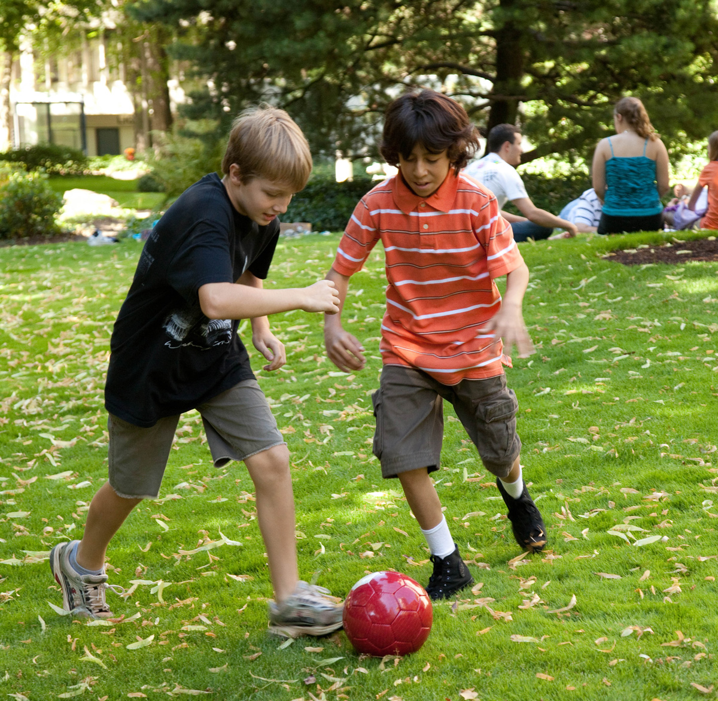
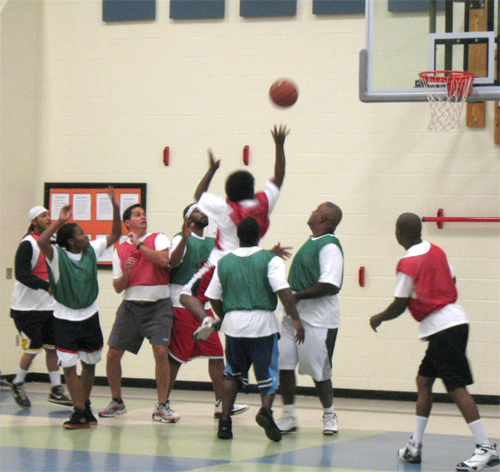
< Woodstock, IL
Woodstock 200 SD
Fitness Event
< Charlotte, NC
Idlewild Elementary
Teachers vs.
Parents Game
Notes:
Ildewild Elementary School in Charlotte, NC, raised $800 for physical education equipment by pitting their teachers against parents in a basketball game and selling tickets to an eager crowd.
The Woodstock 200 School District in Woodstock, IL decided to host a district wide fundraiser to help all schools raise money for wellness efforts. The Fit for the Future event started with a three mile walk, followed by exhibits, speakers and activities. Students asked for pledges for the walk and families chipped in $5 to attend. The district raised more than $10,000 which was given back to the schools for physical education equipment.

Slide 15
FOOD-RELATED
FUNDRAISING
“Taste of Your Town”
Cookbooks
Cooking Competition
Healthy Community Event
Cooking Classes
Grocery Store Tours
Notes:
Consider the following “food-related” fundraiser:
Invite local chefs or restaurants to donate healthy appetizers for a “Taste of Your Town” event and charge for admission
Hold a family celebration night focused on healthy eating and physical activity and charge for admission. Are their local groups who like to cook, such as ladies groups, dads groups or youth groups? Let these local chefs prepare a healthy community meal and charge by the plate. Ask local grocery stores to donate food. Think about healthy options that could be served. Having a cookout? Consider turkey burgers, whole grain buns and sides full of fruits and vegetables. Having a pizza party? Consider giving everyone a personal cheese pizza and having available a vegetable bar where they can pile on their favorite vegetable toppings. Try fruit pizza for dessert! Serve water or 100% fruit juice. Market the night as a family fit night! Check out the Alliance’s Healthy Community Events playbook for more ideas on planning a healthy community event.
Sell cookbooks full of healthy recipes – ask a local registered dietitian to approve the recipes. Let students and staff submit recipes.
Ask a local chef, cooking instructor or registered dietitian to donate their time to do a healthy cooking demonstration or teach a healthy cooking class. Charge for admission.
Hold a community wide youth cooking show or competition and charge for admission. Ask local businesses and grocery stores to help with the cost of the food and supplies.
Ask a registered dietitian to donate their time to do grocery store tours and charge for admission.

Slide 16
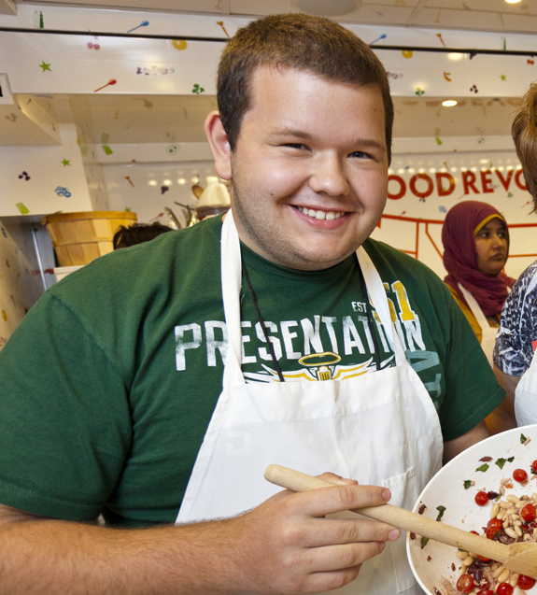
< Plainfield, NJ
Millville Sr.
High School
Healthy Cookbooks
Notes:
At Millville Senior High School in Plainfield, NJ the wellness council decided to hit two birds with one stone by working to improve employee wellness with a healthy cookbook while raising money for student scholarships. Students helped provide the art work for the cookbook. The cookbook was such a hit that they are doing it again this year, with recipes that are more appealing to their student population.

Slide 17
ACTION STEPS
TALK TO YOUR SCHOOL GROUPS
POLICY
ENGAGE STUDENTS
(provide them with
alternatives)
(activity or non-food?)
(research ideas)
BUDGET
DECIDE ON ACTIVITY OR SERVICE
(consider one for all)
(revenue and expenses?)
Notes:
Let’s discuss some action steps to take today.
Talk with PTO/PTA/PTSA representatives, principal, coaches, school and booster clubs, out-of-school time site/program staff, parents and food service staff about healthier fundraising options. Provide them with examples of alternatives.
Write a policy that fundraisers are activity-based or only include non-food items.
Enlist students to research and develop healthy, profitable fundraising ideas.
Consider bringing all groups that participate in fundraising to develop one budget and one fundraising plan for the whole school year that clearly outlines everyone’s need, then come up with a fundraiser to meet all of those needs, such as a 5K.
If doing one big fundraiser, decide as a group what that will be. Is it an activity? Product? Service? Consider the following if doing one large fundraiser:
- What is the estimated revenue from the fundraiser?
- What are the estimated expenses?
- When will the fundraiser occur?
- What is the estimated number of hours students, staff and/or parents will be expected to participate?
- Clearly outline what will be expected from students, staff and/or parents.

Slide 18

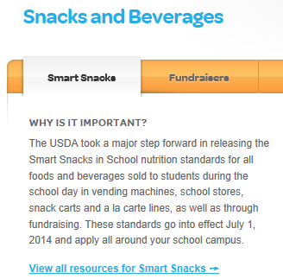
BROWSE RESOURCES
healthiergeneration.org/
smartsnacks
Notes:
Let the Alliance for a Healthier Generation help you get started now so you are ready when Smart Snacks go into effect July 1, 2014. They have experts, tools and resources to help guide you through implementing the new nutrition standards for competitive foods and beverages.

Slide 19
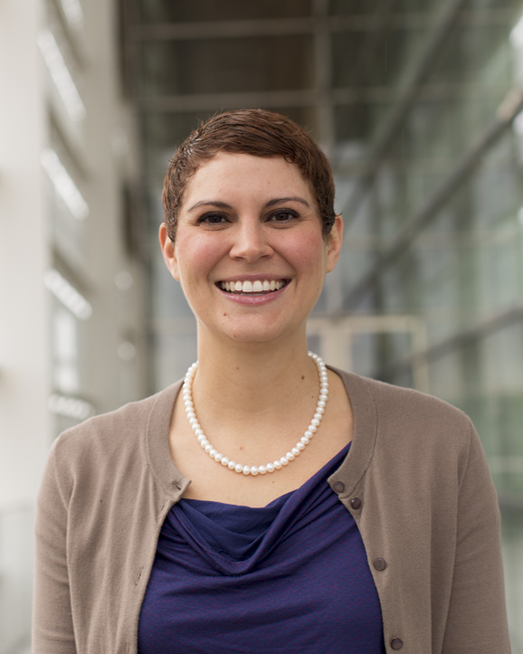
Jill R. Turley, MS, RD/LD, SNS
National Nutrition Advisor
jill.turley@healthiergeneration.org
Notes:
Please reach out to Jill Turley, National Nutrition Advisor at the Alliance for a Healthier Generation, with questions about Smart Snacks in School nutrition standards. Jill can also help you get started implementing change TODAY!

Slide 20

Notes:
Thank you for your time today.

