Slide 1
“Innovative Approaches to
Accessing, Extracting and Aggregating Electronic Health Data”
Avalere • Published July 17, 2015
Webinar: September 15, 2015

Slide 2
Welcome
Moderators
Josh Rising, MD, Director, Healthcare Programs, The Pew Charitable Trusts
Kristi Mitchell, MPH Senior Vice President Avalere Health, LLC
Angela Franklin, JD, Senior Officer, Drugs and Medical Devices, The Pew Charitable Trusts
Registry Panelists
Kathleen M. Hewitt, MSN, RN, CPHQ, Associate Vice President American College of Cardiology (ACC), National Cardiovascular Data Registry (NCDR)
William L. Rich, III, MD, Medical Director of Heath Policy, American Academy of Ophthalmology (AAO), IRIS Registry

Slide 3
Webinar Agenda
About Pew, Avalere
Study overview
Registry perspectives
Moderated discussion

Slide 4
Participate!
Click “Chat” to open the chat function
Please type in your question or comments
Questions and comments appear here
Type questions here

Slide 5
The Pew Charitable Trusts
Pew is an independent, non-profit research and public policy organization.
Pew seeks to enhance medical device safety and foster device innovation that benefits patients.
Unique device identifier (UDI)
Medical device registries
Accelerating device innovation

Slide 6
Avalere Brings Creative Solutions to Healthcare Strategy
Avalere aims to bring innovative solutions to complex problems in an environment that demands a fresh perspective and new approaches

Slide 7
Study overview
Innovative Approaches to Accessing, Extracting
and Aggregating Electronic Health Data

Slide 8
Innovative Approaches to Accessing, Extracting and Aggregating Electronic Health Records Data
AVALERE CONDUCTED RESEARCH ON BEHALF OF PEW TO ASSESS BARRIERS AND ENABLERS FOR MEDICAL DEVICE REGISTRIES TO EXTRACT AND AGGREGATE EHR DATA
Project Task | Objectives
Conceptual Framework | Conducted literature search to identify the most relevant documents to review Collected resident expert insight to fill any gaps in literature search
Collect Medical Device Registry Data | Developed interview guide to structure the conversation Reviewed registry-focused publicly available literature Conducted interviews with individuals from medical device registries: American College of Cardiology (ACC): National Cardiovascular Data Registry CathPCI Registry American Society for Plastic Surgeons (ASPS) and the Food and Drug Administration (FDA): National Breast Implant Registry (NBIR) American Joint Replacement Registry (AJRR) American Academy of Ophthalmology (AAO): IRIS Registry Kaiser Permanente: Total Joint Replacement Registry (TJRR)
Conduct Analysis | Used information collected to develop registry profiles that compare and contrast challenges associated with data collection, extraction and aggregation
Final Report | Developed a final report that: Identifies barriers and innovations for each registry as they relate to data collection, extraction and aggregation Compares these barriers and innovations across the other registries to understand similarities and differences Makes public policy recommendations based on the findings
The final report can be accessed here

Slide 9
Research Results: Policy Recommendations
Domains | Solutions and Policy Recommendations
Lack of commonly adopted data standards | Industry or research organizations could create a public-private sector committee to develop and implement data governance for medical device registries, including a common data model for data exchange The federal government (e.g. ONC, FDA) could consider developing a multi-stakeholder national registry governance body, which certifies registries based on the standards and approaches used and also participates in international registry groups
Multiple vendor proprietary platforms that lack interoperability | The ONC could finalize its proposed revised 2015 Edition Certification Criteria “data portability” certification criterion to incorporate the ability to send data extracts to third-party clinical data registries in its Certified EHR Technology (CEHRT) definition The federal government could build on recently enacted interoperability and information sharing provisions in MACRA and incentivize vendors that utilize open data standards and registries that participate in knowledge sharing networks, especially internationally
Insufficient medical device data validation practices | Research organizations could provide policy and/or technical guidance to support routine registry data validation processes and audits A public-private stakeholder committee could formalize processes for certifying registries that adopt and adhere to leading practices for data validation to ensure quality
Need to incorporate UDI into the EHR | FDA could lead a public-private effort to develop and implement national UDI strategy CMS and ONC could finalize Meaningful Use 3 and the 2015 Edition Certification Criteria to include incentives for UDI adoption by device manufacturers, EHR vendors and providers
Maintaining patient privacy while building longitudinal records | The federal government, state health departments, and/or research foundations could convene groups to examine and harmonize existing privacy regulations as suggested in recent legislative proposals. Per recent legislative proposals, the federal government could amend current HIPAA privacy and security and Common Rule regulations to better support protection of patient data as data sharing increases on behalf of public health research

Slide 10
Registry perspectives
Innovative Approaches to Accessing, Extracting
and Aggregating Electronic Health Data

Slide 11
Innovative Approaches to Accessing, Extracting and Aggregating Electronic Health Data
Kathleen Hewitt, MSN, RN, CPHQ
Associate Vice President, NCDR

Slide 12
Agenda
Introduction to NCDR
NCDR Today – Data Capture & Exchange
Enabling direct EMR integration

Slide 13
National Cardiovascular Data Registry
Nearly 20 years of experience
Largest outcomes-based cardiovascular patient data repository in the world
Ten registries

Slide 14
NCDR: Not Just Data
Standard data elements and definitions
Clinical
Data
Database
Quality
Assessment
Quality
Improvement
Clinical
Research
Meaningful Role in Clinical Practice /
U.S. Healthcare Reform
Bufalino VJ, Masoudi FA, et al. Circulation. 2011;123:2167-2179

Slide 15
>2,500 hospitals
>3,500 cardiologists
>40 million clinical records
LAAO Registry – Winter 2015/2016
AF Ablation Registry – Spring 2016

Slide 16
Name | Disease or Device | Facility | Sites | Patient Records
PINNACLE | Coronary artery disease, heart failure, atrial fibrillation, hypertension, diabetes, peripheral arterial disease | Outpatient | 445 | 15,000,000
Diabetes | Diabetes and cardiometabolic care | Outpatient | enrolling now | --
CathPCI | Percutaneous coronary interventions Diagnostic catheterizations | Hospital/Free Standing | 1,730 | 17,000,000
ICD | Implantable cardioverter defibrillators | Hospital | 1,815 | 1,500,000
ACTION-GWTG | Acute coronary syndrome STEMI and NSTEMI | Hospital/EMS | 1030 | 920,000
PVI | Carotid artery revascularization Lower extremity | Hospital/Free Standing | 214 | 340,000 (CAS & CEA)
IMPACT | Congenital heart disease Pediatric and Adult | Hospital | 100 | 40,000
STS/ACC TVT | Transcatheter Valve Therapy | Hospital | 400 | 28,000

Slide 17
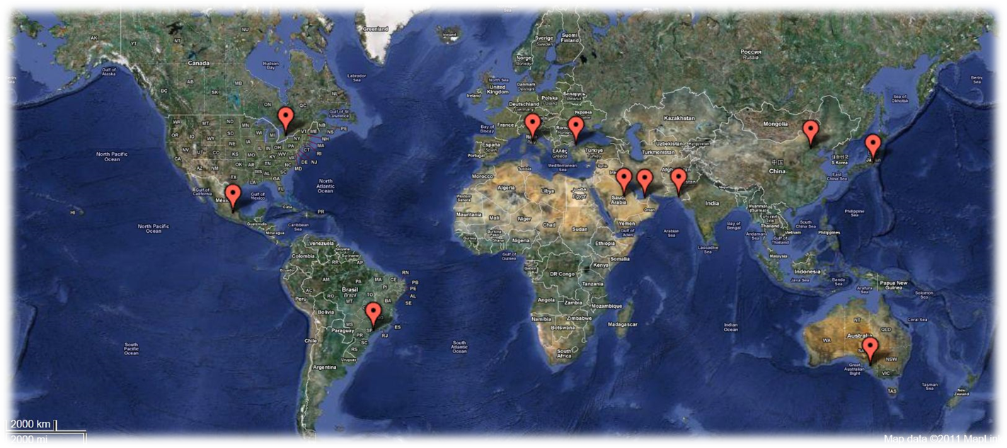
NCDR Global

Slide 18
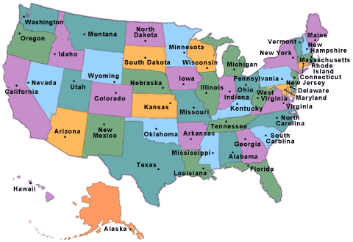
Notes:
17

Slide 19
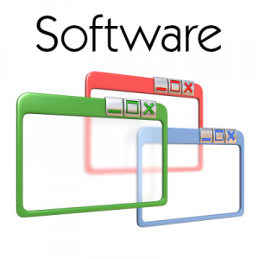
Data are collected once and used for many purposes
STAKEHOLDERS
Administrators
Providers
Regulators
Consumers
Researchers
Payors
Registry Platform:
Evidence-Based Performance Measures
Benchmark Analyses
Data Quality Program
QI Network
DATA USES
Reimbursement
Retro and Prospective Research
Evidence based medicine
Surveillance
Health system & practice monitoring
Quality and performance improvement
Public reporting for consumers
State and federal quality improvement
Software Vendors
Data Capture

Slide 20
Enabling direct EMR integration
Goals & Objectives
Overarching Goal is:
Registry participation to be more about performance and outcome measurement and not about data collection
Improve time-to-market for new evidence-based data capture needs
Capture data once – REALLY!
Save time and $$$

Slide 21
Say goodbye to data collection Hello “data capture”
STAKEHOLDERS
Administrators
Providers
Regulators
Consumers
Researchers
Payors
Registry Platform:
Evidence-Based Performance Measures
QI Network
Data Quality Program
Retrospective and Prospective Research Infrastructure
Public Reporting
DATA USES
Reimbursement
Retro and Prospective Research
Evidence based medicine
Surveillance
Health system & practice monitoring
Quality and performance improvement
Public reporting for consumers
State and federal quality improvement

Slide 22
There’s data everyone!
STAKEHOLDERS
Administrators
Providers
Regulators
Consumers
Researchers
Payors
Health Info Exchange
Registry Platform:
Evidence-Based Performance Measures
QI Network
Data Quality Program
Retrospective and Prospective Research Infrastructure
Public Reporting
DATA USES
Patient Reported Outcomes
Reimbursement
Retro and Prospective Research
Evidence based medicine
Surveillance
Health system & practice monitoring
Quality and performance improvement
Public reporting for consumers
State and federal quality improvement
Remote Devices
Labs
Cost

Slide 23
Patient Centered Data Model
Common In-Hospital
Events
CAS
Medications
ICD
Labs
H & P
AFib
PVI
Patient
TVT
IMPACT
(structural)
DxCath
PCI
ACS/MI

Slide 24
The interconnected future of NCDR depends on standards

Slide 25
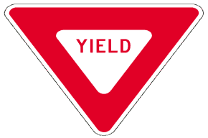
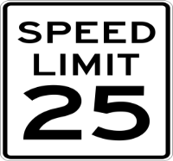
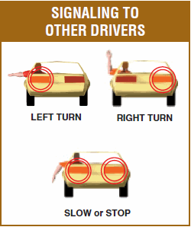
Why Standards?
Standards are an agreed upon set of rules
Provide common set of definitions
Help us to act and communicate with each other

Slide 26
Types of Standards
3 General Buckets of Clinical Data Standards
Messaging standards
Defines how data is carried from one place to another
Document standards
Describes the structure of data
Data translation & mapping
Ensures that both the sender and receiver of medical information agree on the meaning of data
Examples: HL-7, PIX, PDQ, HTTP, HTTPS, SFTP
Examples: HL-7, ADT, CCD, CDR, XML, DICOM
Examples: ICD,CPT, LOINC, SNOMED, NDC

Slide 27
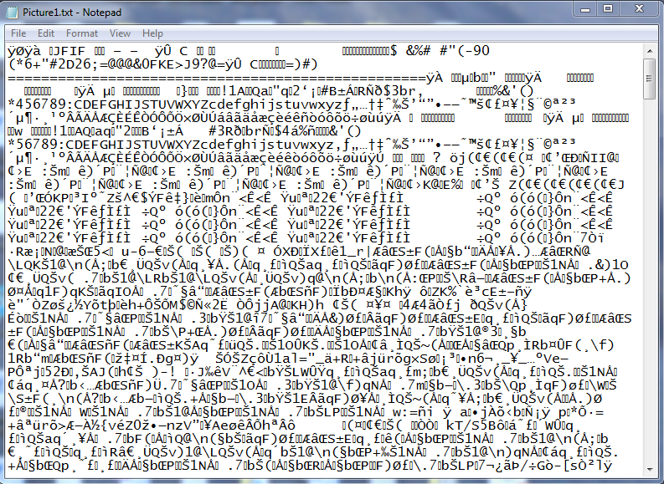
Without Standards
Without a common set of rules to define how to read digital images, this is how your vacation pictures would look

Slide 28
Journey to EHR Integration

Slide 29
EHR Integration
[ project ]

Slide 30
Strategic Objectives
CathPCI
PVI
ACTION
Unified Model
Harmonize existing registry dictionaries into a single registry agnostic specification
Adopt industry standard terminologies and coding systems
Incorporate within EHR certification
Adopt a single abstract transmission format
Industry Standards

Slide 31
Expected Benefits
Minimize labor and technology costs associated with development of additional registries
Reduce data collection burdens while expanding information content and shrinking latency
Minimize inconsistencies across registries
Better integration with healthcare systems and products that support standards
One step closer to EHR integration

Slide 32
Potential Challenges
Optimized for machine data extraction and not web data entry
Maintaining compatibility with legacy registry versions
Completely new implementation by vendors
Data standard maintenance
Data quality

Slide 33
The grass isn’t always greener
Data quality will rely on standardized clinical documentation
Develop standards
New documentation standards for clinicians

Slide 34
Innovative Approaches to Accessing, Extracting and Aggregating Electronic Health Data
Kathleen Hewitt, MSN, RN, CPHQ
Associate Vice President, NCDR

Slide 35
The Development of a Clinical Registry
The IRIS Registry: Intelligent Research in Sight.

Slide 36
William L. Rich III, MD, FACS
Medical Director of Health Policy
American Academy of Ophthalmology

Slide 37
Introduction to the IRIS™ Registry
IRIS™ Registry (Intelligent Research In Sight), the nation’s first comprehensive eye disease clinical registry:
Enables ophthalmologists across the country to use clinical data to improve care delivery and patient outcomes.
Uses scientifically valid and HIPAA-compliant methods to collect data from patient records – directly from electronic health record systems using a systems integrator.
Helps ophthalmology practices meet the requirements of the federal Physician Quality Reporting System, measure resource use and outcomes of interventions-surgery, biologics and devices

Slide 38
Principles
Ophthalmologists own their data.
Ophthalmologists give permission for data to be distributed and reported.
Academy owns aggregated data.
Data protection/security/quality and audits in place.

Slide 39
Keys to Successful Clinical Registry Development
Physician engagement in the measure development and design
Robust value proposition
No impact on workflow

Slide 40
Enhancing engagement
Measures must be inclusive of as many members and patients as possible ( from pediatrics to Medicare, chronic/acute conditions to interventions). Value proposition must be broad based-private practice, academic groups, multispecialty groups, solo practitioners
Data dictionary with 900+ data points
Robust measures result in key data elements in the registry not present in the EHR

Slide 41
IRIS Chronology
November 2011-registry task force formed
February 2012-development plan presented to Board
November 2012- Board approves funding
December 2012-December 2013-measures selected and tested, communication strategy delineated, data dictionary established

Slide 42
Launch March 2014
Goal: 2200 ophthalmologists by 2017 with 18 million patients

Slide 43
IRIS Status August 2015
32 different EHR systems integrated
2 Epic Academic Medical Centers with signed contracts and active discussions on integration
80% of ophthalmologist on EHR participating in IRIS

Slide 44
September 1, 2015

Slide 45
IRIS 2015 Projection
In 2015 - doubling of integrated docs on EHR to 6,000 and total of 8,000 utilizing IRIS for quality reporting
New goal? 8,000 docs and 48 million patients by 2017
If we reach this new goal in 2017 the number of patient visits that year will approach 152 million.

Slide 46
Value Proposition
Financial
MOC-Part IV
Better outcomes
Research
Informing public policy
Population Health
Surveillance

Slide 47
Improved Outcomes

Slide 48
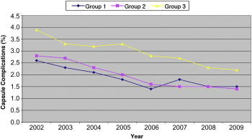
602,553 cataract surgeries
Multivariate analysis: age, poor preop visual acuity, glaucoma diagnosis, lower volume hospitals.
Overtime, all decreased.
Lundstrom M, et al. Decreasing rate of capsule complications in cataract surgery : Eight-year study of incidence, risk factors, and data validity by the Swedish National Cataract Register
JCRS, Volume 37, Issue 10, 2011, 1762 - 1767

Slide 49
EUREQUO project: European Registry of Quality Outcomes for Cataract and Refractive Surgery 368,258 cataract surgeries
Variable | 20/40 or Better | 20/20 No. of pts
without ocular comorbidity | 98.2 % | 69.9 % | 274,155
with ocular comorbidity | 82.6 | 35.9 | 94,103
Comorbidity
Macular degeneration | 80.7 | 30.2 | 35,029
Glaucoma | 89.7 | 47.2 | 21,088
Diabetic retinopathy | 83.7 | 37.8 | 11,299
Amblyopia | 58.7 | 16.1 | 6,650
Other | 81.1 | 34.8 | 27,214

Slide 50
Research

Slide 51
Randomized Registry Trial
The Randomized Registry Trial-The Next Disruptive Technology in Clinical Research --Lauer & D’Agostino, NEJM, Sept 2013
Time for recruitment and costs were dramatically less in the randomized registry arm of the trial.
The incremental cost of the Thrombus Aspiration in ST-Elevation Myocardial Infarction in Scandinavia (TASTE) trial was $300,000, or $50 for each participant who underwent randomization!

Slide 52
Inform Public Policy
Avastin Compounding

Slide 53
Endophthalmitis Rate
Drug | Injections | %
Avastin | 478,381 | 0.12%
Lucentis | 245,381 | 0.09%
Eylea | 103,390 | 0.12%

Slide 54
Population Health

Slide 55
Improved Population Health
Research
Evidence
Guidelines
Protocols
Improved Pop Health

Slide 56
Population Health
CDC Vision Health Surveillance Project
PCORI- CER proposal
CMS Transformation Network
NEI Infectious Disease Proposal

Slide 57
Surveillance
Devices and Drugs

Slide 58
PEW: Future Directions for Medical Device Registries
60% of Class III devices have mandated post market surveillance and only 6% are performed by independent specialty registries.
UDIs ( Unique Device Identifiers) will be included in EHRs in 2015?
Longitudinal EHR based registries ( Pinnacle, IRIS) have the capability to follow devices at the longitudinal point of care and can detect early signals. Patient reported outcome tools can pick up early symptoms before device failure occurs.
Data should be made publicly available

Slide 59
IRIS and UDIs
If CDC mandates UDIs in certified EHR fields in the next year, IRIS can extract them
Currently IRIS collects device data inputted into a surgical template that is uploaded to the registry
The majority of devices are inserted in ASCs without EHRs

Slide 60
Overcoming Hurdles
Inadequate data points in EHRs-*
Validation of data-*
Data blocking: vendor fees & refusal to allow export of data-ongoing battle with two large vendors
Importing UDI

Slide 61
Moderated discussion
Innovative Approaches to Accessing, Extracting
and Aggregating Electronic Health Data

Slide 62
Participate!
Click “Chat” to open the chat function
Please type in your question or comments
Questions and comments appear here
Type questions here

Slide 63
Discussion with Panelists
Kathleen M. Hewitt, MSN, RN, CPHQ, Associate Vice President American College of Cardiology (ACC), National Cardiovascular Data Registry (NCDR)
William L. Rich, III, MD, Medical Director of Health Policy, American Academy of Ophthalmology (AAO), IRIS Registry
Moderators:
Josh Rising, MD, Director, Healthcare Programs, The Pew Charitable Trusts
Kristi Mitchell, MPH Senior Vice President Avalere Health, LLC
Participate!
Please type in your
question or comments

Slide 64
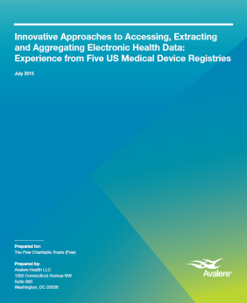
Stay Informed!
Available at
avalere.com

Slide 65
Thank you!
Josh Rising, MD, Director, Healthcare Programs, The Pew Charitable Trusts
Angela Franklin, JD, Senior Officer, Drugs and Medical Devices The Pew Charitable Trusts
Kristi Mitchell, MPH Senior Vice President Avalere Health, LLC

