Slide 1
Iowa City Gateway
October 30, 2018
Notes:
[This slide will be visible during the first part of the open house]

Slide 2
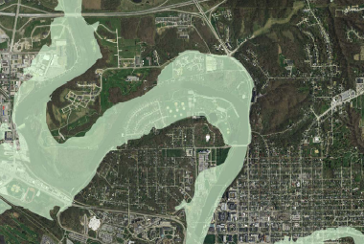
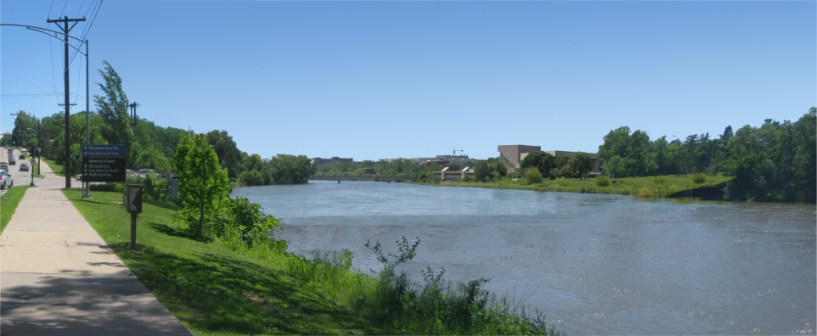
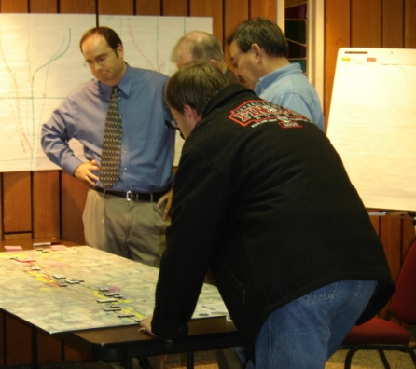
Today’s Meeting
Project Need & the history of the Iowa River
Project funding
Planning Process
Construction and Results
Notes:
Welcome
We are here tonight to:
Introduce the project
Explain the process
Hear your feedback on project goals
Listen to your thoughts, comments and concerns about the project.
We have a brief presentation to go through, and then we will return to the open house format so that you can provide input, ask questions and share your ideas with the team.

Slide 3
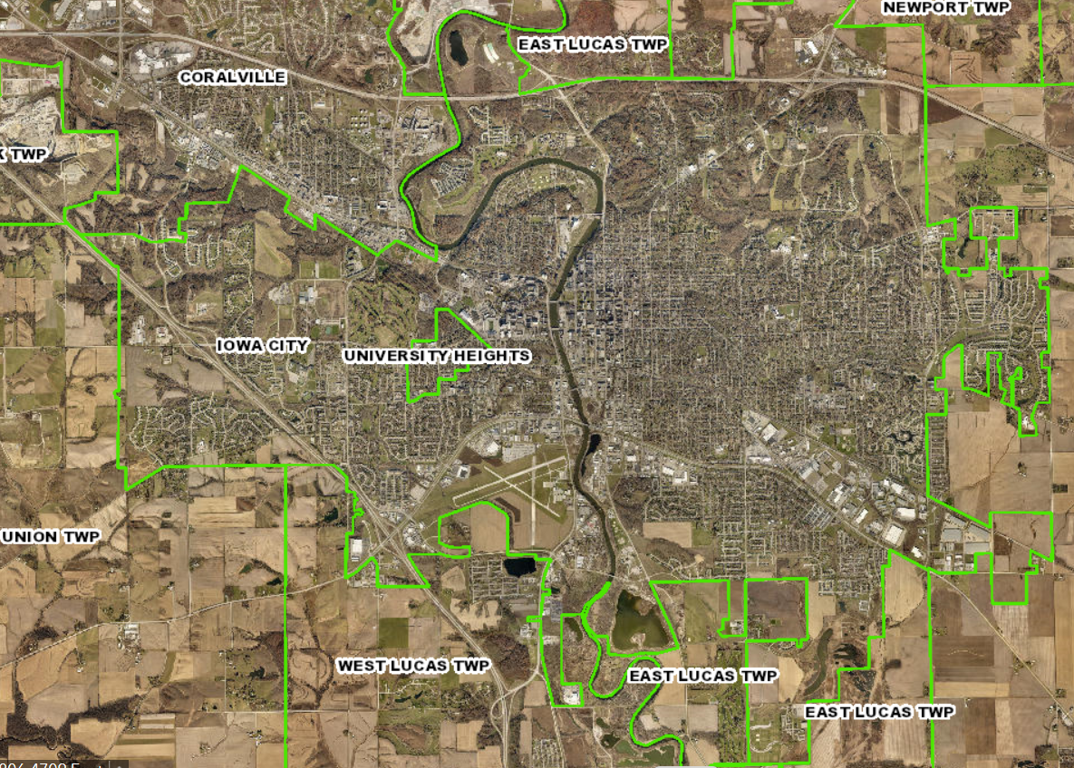
Iowa City

Slide 4
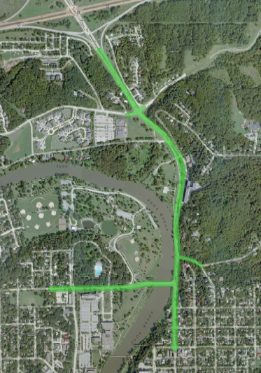
Study Area
Dubuque Street is the principal entrance to Iowa City from I-80.
25,500+ cars travel it daily to access Downtown Iowa City, the UI campus and area hospitals and clinics.
Park Road is one of six arterial road crossings of the Iowa River in Iowa City.
Dubuque Street
Park Road
Notes:
The project is located generally between I-80 and downtown.
There are a number of other projects going on that we will be coordinating with over the course of the project.

Slide 5
Nearby Projects
These projects were recently completed or in construction during the Planning Phase:
University of Iowa
  Hancher Auditorium Replacement
  Mayflower Flood Mitigation Project
Iowa City
  Iowa River Corridor Trail Pedestrian Bridge over I-80
Iowa DOT
  I-80/Dubuque Street Interchange
Dubuque Street
Park Road
Notes:
The project is located generally between I-80 and downtown.
There are a number of other projects going on that we will be coordinating with over the course of the project.

Slide 6
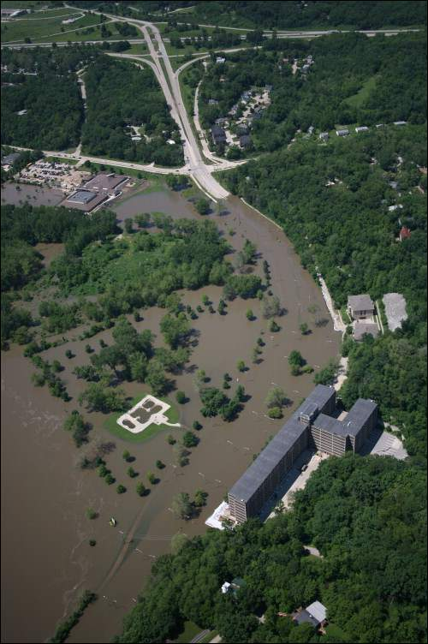
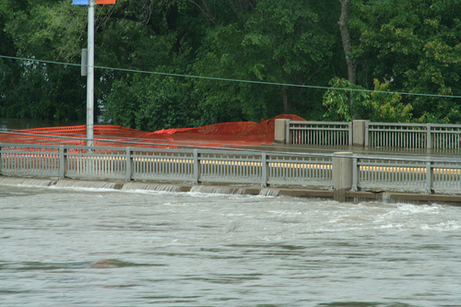
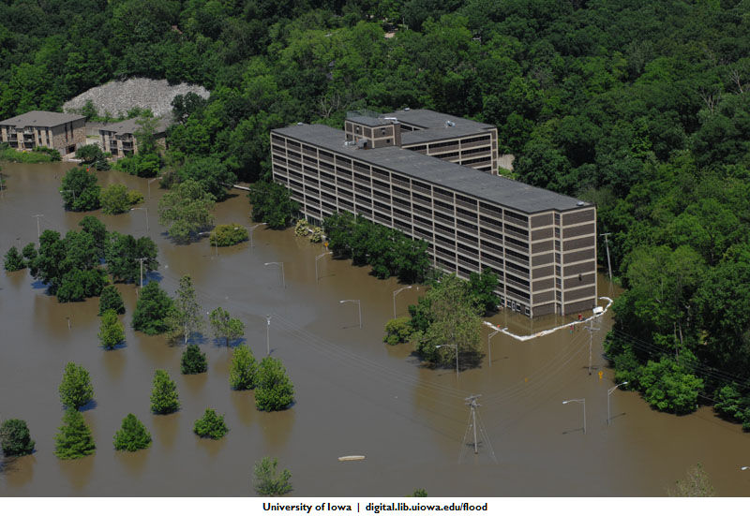
Project Need

Slide 7
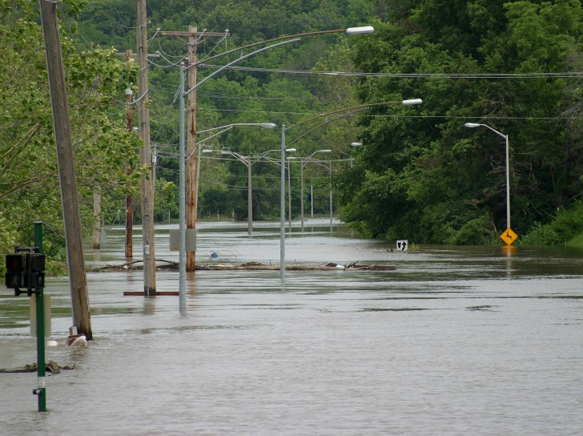
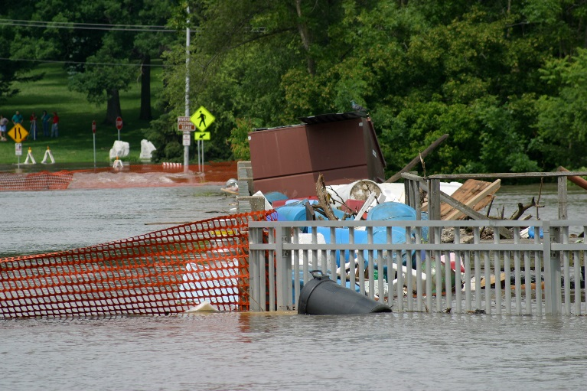
Project Need: Historic Floods
A history of flooding:
Severe floods closed Dubuque Street for 54 days in 1993 and for a month in 2008
The existing low elevation of Dubuque Street caused it to be the first arterial street closed during a flood event.
The flood of 2008 also closed and inundated Park Road Bridge. The old Park Road Bridge caused 14” of observed backwater.
Dubuque St
Park Rd Bridge

Slide 8
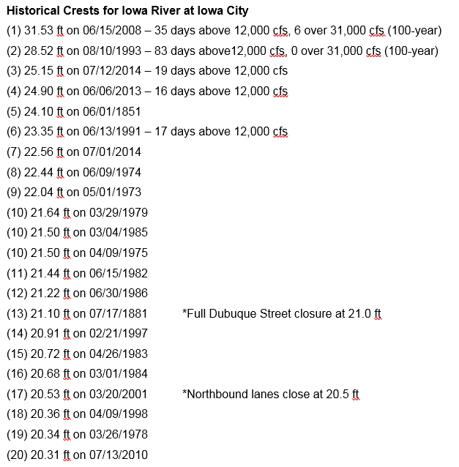
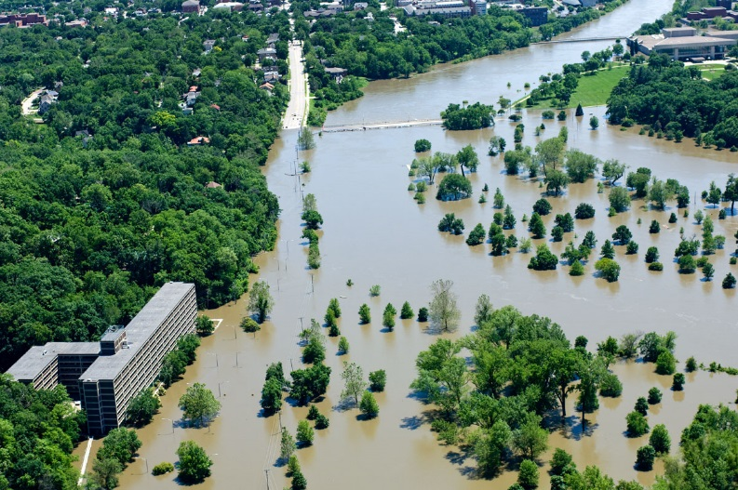
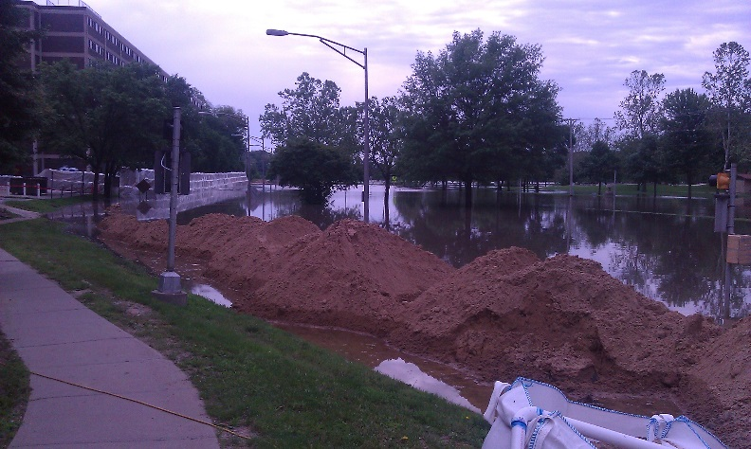
Project Need: Historic Floods
2008
2014

Slide 9
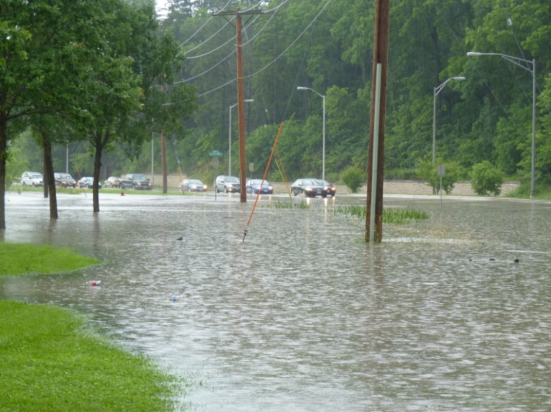
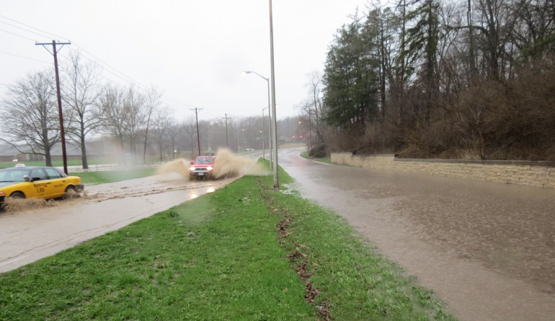
Project Need: Flash Flooding
A history of flooding:
Locally heavy rainfall events cause flooding and closures of Dubuque Street
Reduced Storm Sewer Capacity
Increase runoff storage

Slide 10
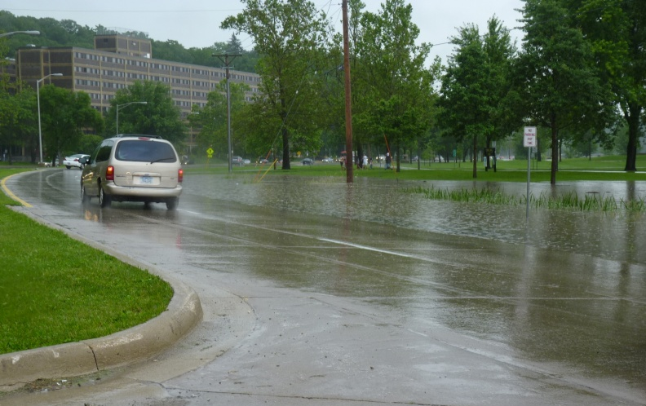
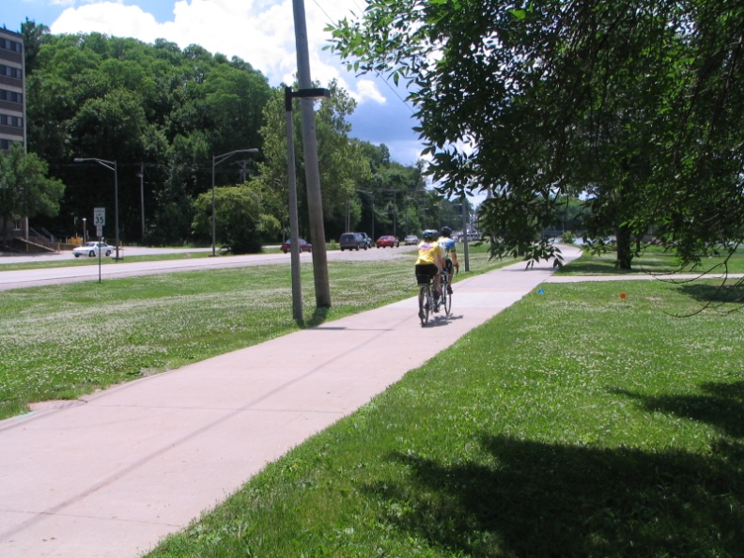
Iowa City Gateway
The project is planned to:
Reduce closures of Dubuque Street and Park Road Bridge due to (1) localized flash floods and (2) historic Iowa River flood events
Minimize upstream flood backwater caused by the existing Park Road Bridge – 14” observed in 2008
Better serve transit, pedestrians and bicyclists
Preserve and enhance the natural entry to Iowa City from I-80

Slide 11
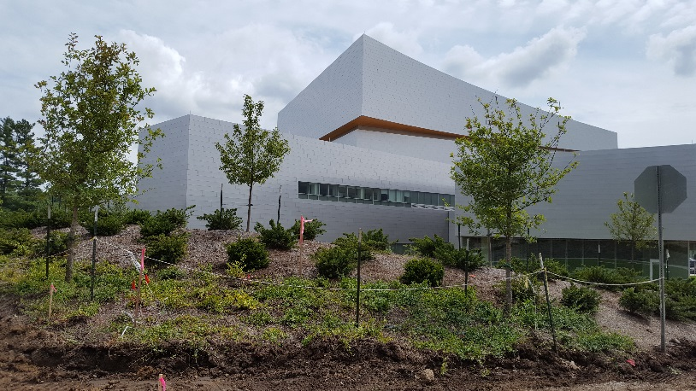
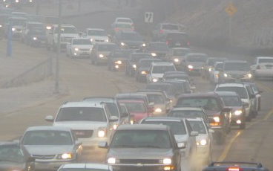
Iowa City Gateway
Other Objectives:
Maintain emergency access to north Iowa City and adjoining Johnson County
Integrate aesthetic features with the new Hancher Auditorium, Mayflower Flood Mitigation and provide 3 lanes on Park Road.
Improve infrastructure – pavement, storm sewer, water main, etc.
Upgrade trunk sanitary sewer
Reduce congestion at the Dubuque St – Park Road intersection.

Slide 12
Funding Sources
Gateway Project - $40,553,000 Million
  U.S. Department of Commerce, Economic Development Administration – $3 Million
  Transportation, Housing & Urban Development – $1.5 Million
  SAFETEA-LU Surface Transportation Program – $6 Million
  Local Option Sales Tax – $25.8 Million
  G.O. Bonds – $18.7 Million
Notes:
THUD Appropriation

Slide 13





Technical Advisory Committee
Notes:
These are our partners in developing the project.

Slide 14
Phase 1: Plan
Develop a federally-approved alternative for final design and construction of improvements via NEPA study.
The NEPA process :
  Identified a recommended alternative
  Provided opportunities for public input into the final concept
  Documented community impacts, commitments, etc.
NEPA Process/Time
Initial alternatives
Purpose and Need
Community Input
Reasonable alternatives
Impact Evaluation
Community Input
Preferred alternative
Agency Review
Community Input
Recommended alternative
Notes:
The first phase is the completion of the planning process that is required for projects that get federal funding or permits. At the end of the planning process, we will have an approved concept for improvements.
The EA Process will (read bullets):

Slide 15

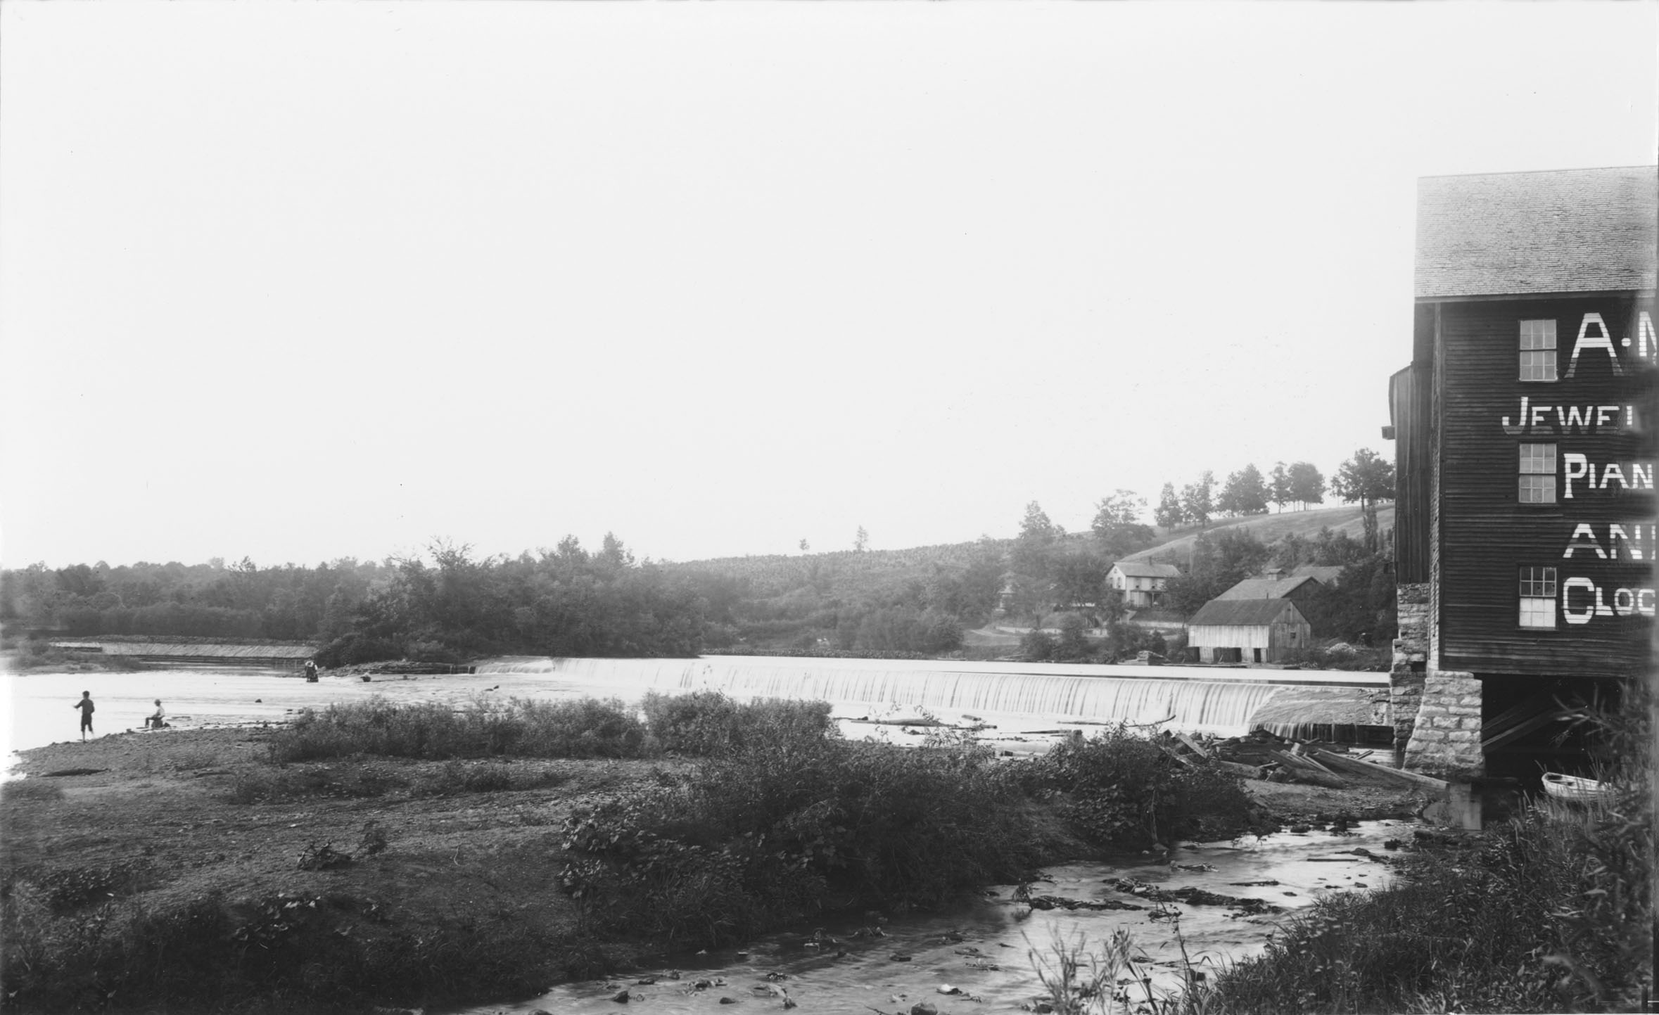
Plan Outcomes
  18 month process was actually 3 years.
  1 year of City Council involvement with 7 work session meetings
Conceptual design
A vision for the corridor
Potential impacts, avoidance and mitigation plans
  Project commitments
  Cost estimates
Notes:
The EA will detail a number of critical elements for the project (read bullets)

Slide 16
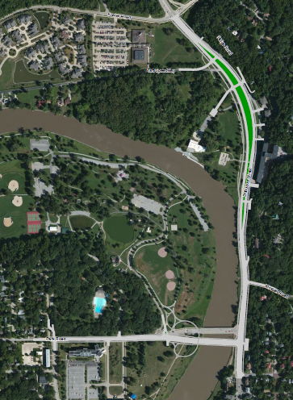
Preferred Alternative
  Elevate roadway 1 foot above 100 year floodplain within the existing corridor
  Improve bike/ped/trail connections
  Maintain parkway feel
  New bridge
    Low steel to pass 200 year flood
    5 lanes of travel
    Longer span
    Located south of existing Park Road Bridge
    Through Arch Concrete Bridge

Slide 17
Do Nothing Option
The following work would still need to occur:
  Reconstruct North Corridor Trunk Sewer
  Replace Dubuque Street pavement
  Replacement / Major Repair of Park Road Bridge
  Widen Park Road to three lanes to Riverside Drive
  Right turn lane at SB Dubuque Street to WB Park Road
  Upgrade aging water, storm sewer, lighting, overhead utilities
  $32 Million

Slide 18
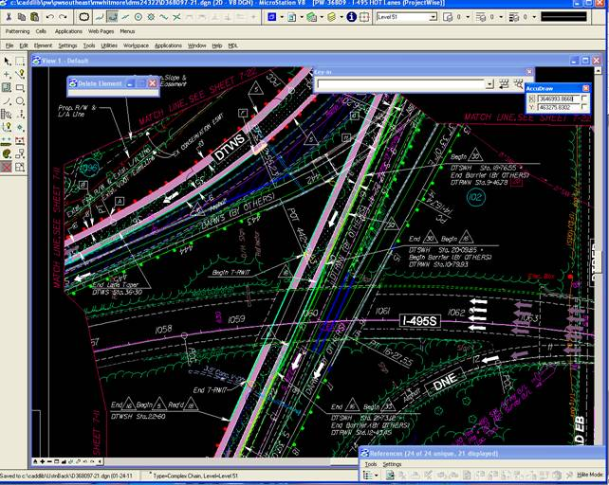
Phase 2: Design
As soon as the recommendations in Phase 1 had federal approval, work began on detailed design.
Final design and engineering took 12 months.
Notes:
Phase 2 is design. As design is completed, we’ll know exactly where and what we will be building.

Slide 19
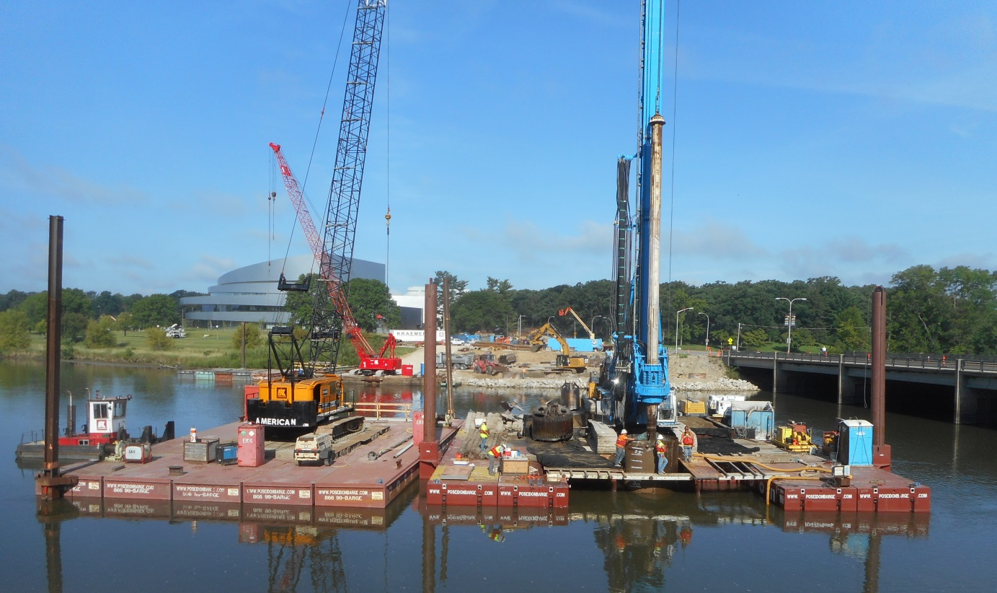
Phase 3: Build
Construction began May 31, 2016
Notes:
Phase 3 is when you will see actual construction underway. We don’t yet know what the improvements will look like. However, as we move towards construction, we will work to make sure that you will be informed about what to expect once construction starts.

Slide 20
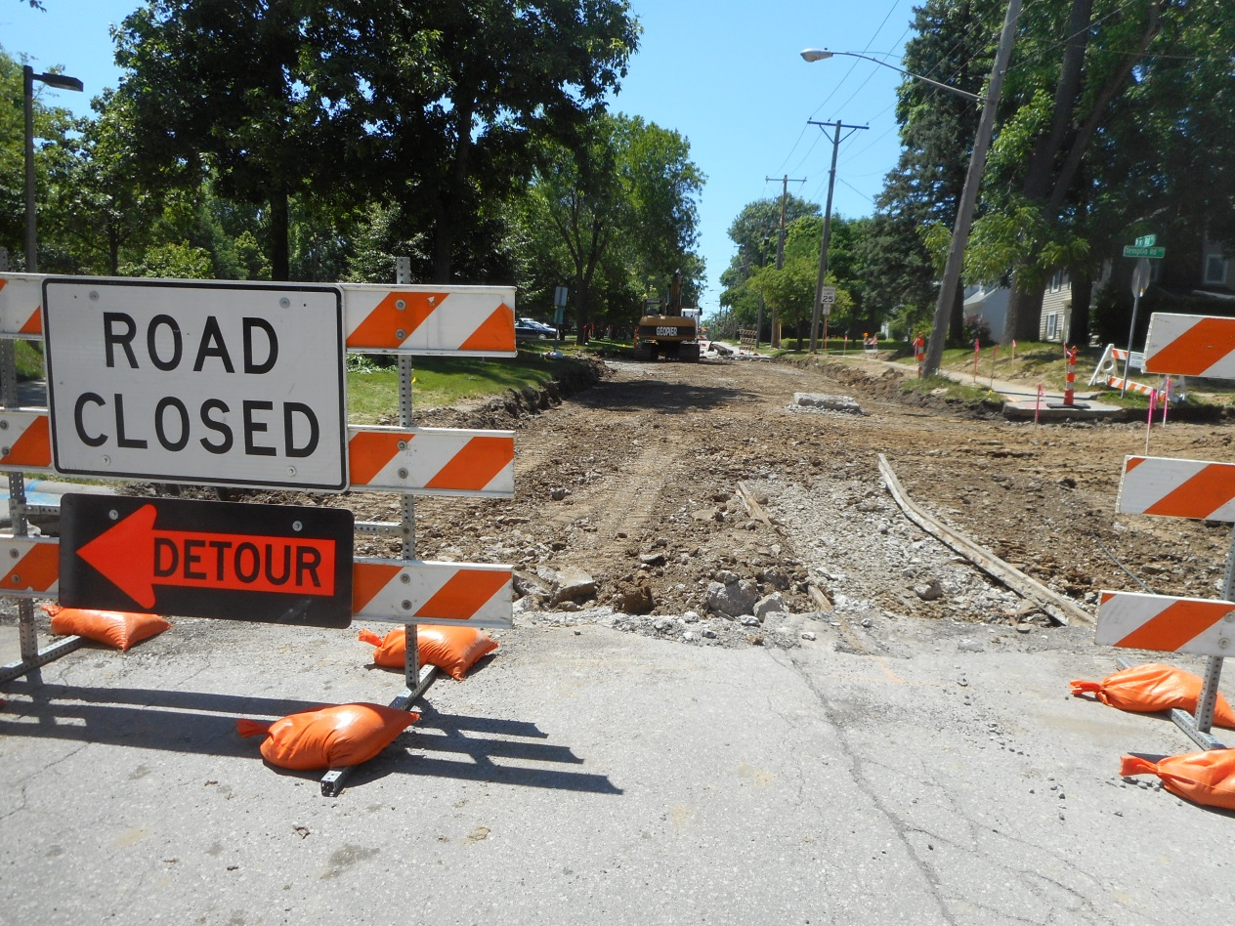
Park Road Construction

Slide 21
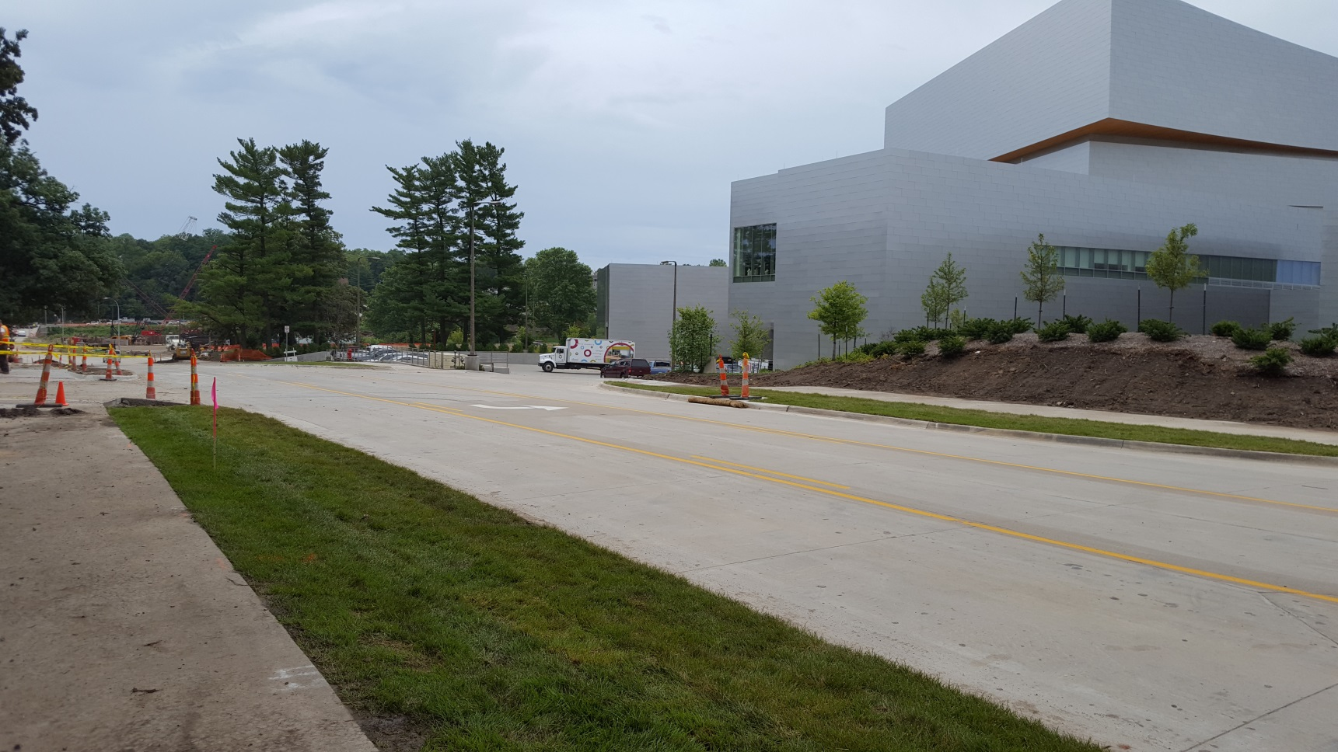
Park Road Construction

Slide 22
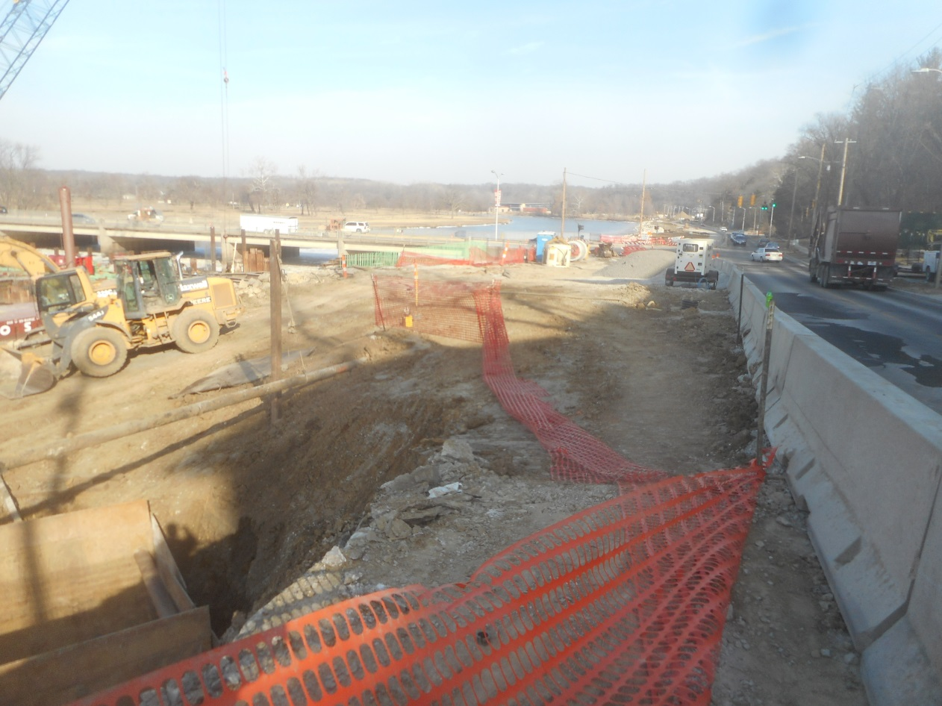
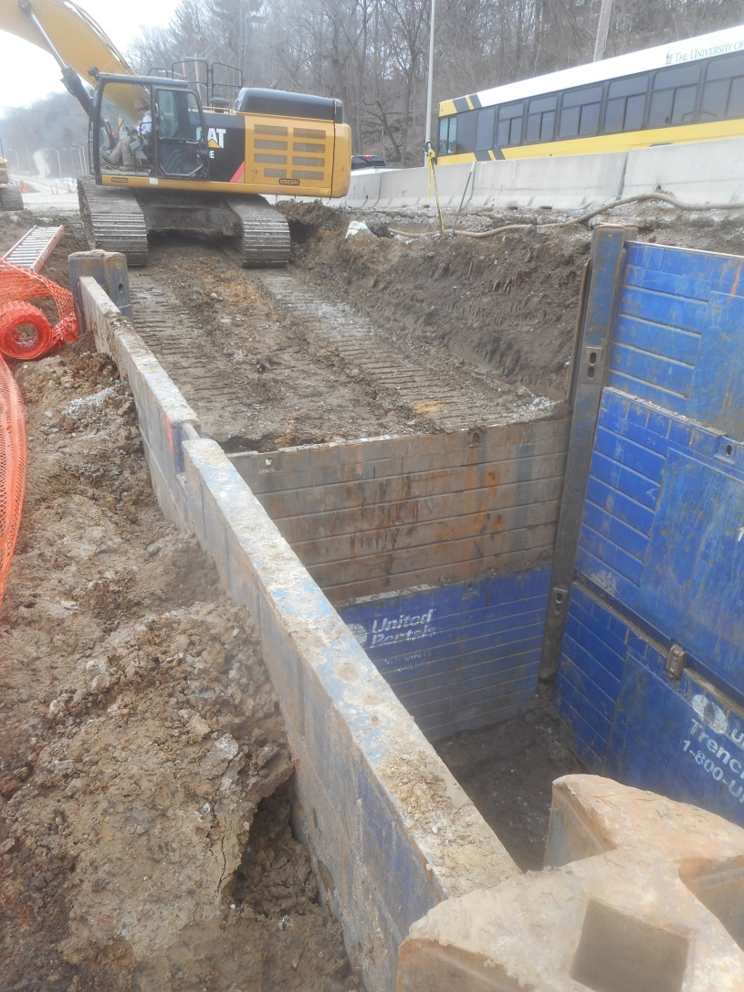
Dubuque Street Construction
Notes:
10/19, 1st stage of temporary paving.

Slide 23
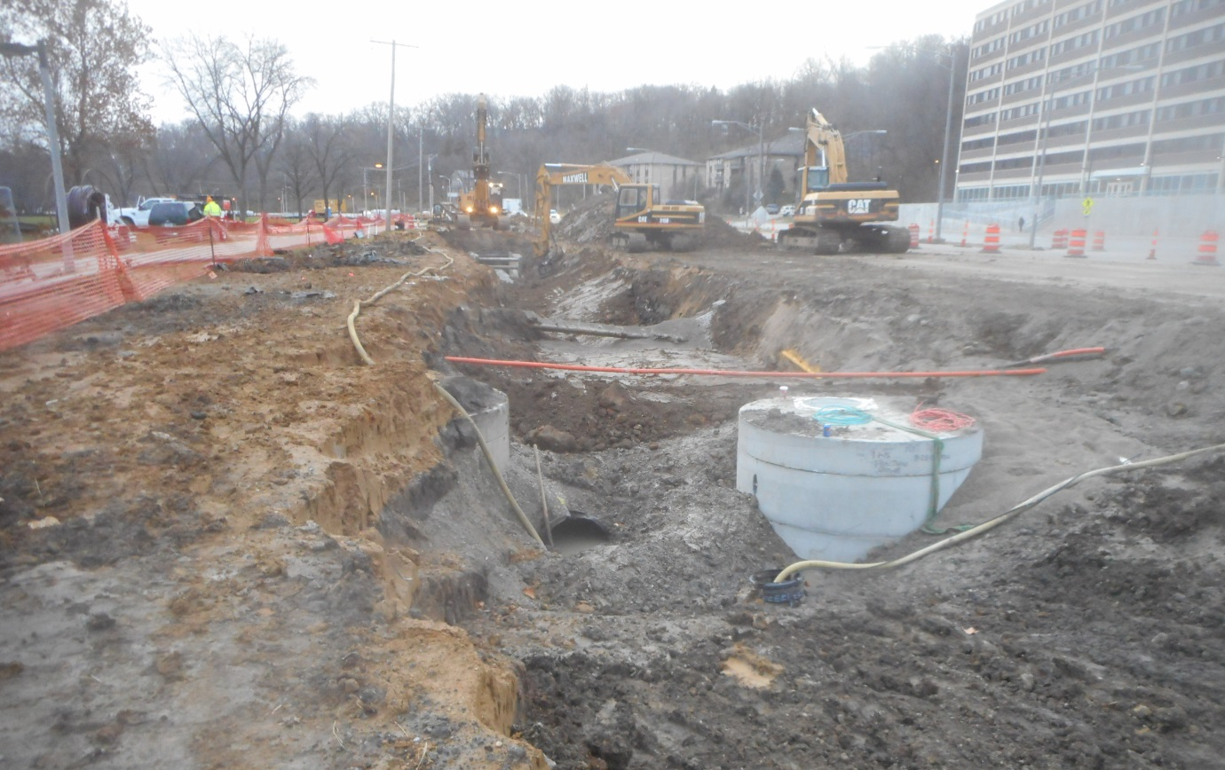
Dubuque Street Construction
Notes:
10/19, 1st stage of temporary paving.

Slide 24
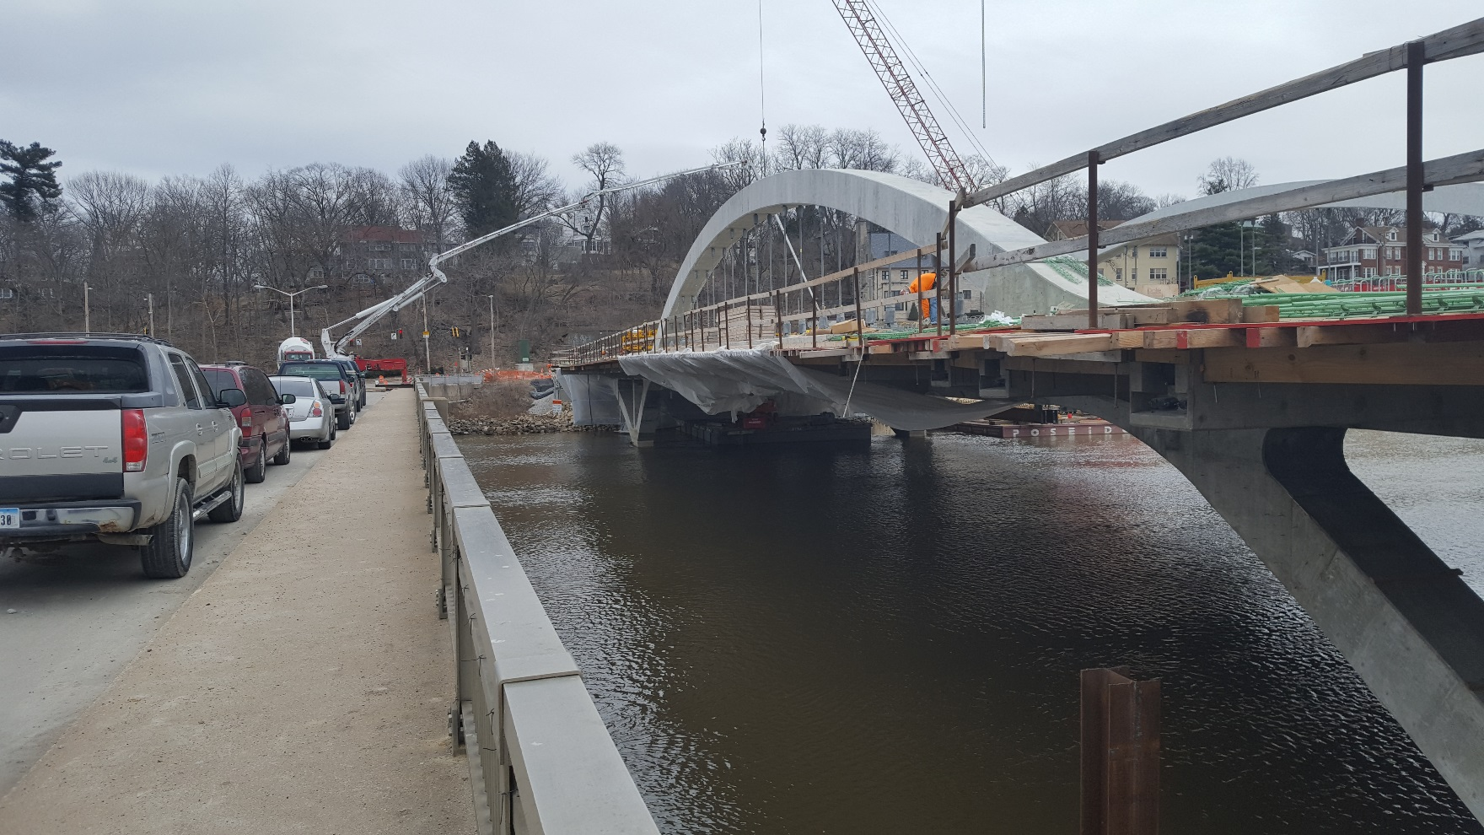
Park Road Bridge Construction
Notes:
10/19, 1st stage of temporary paving.

Slide 25
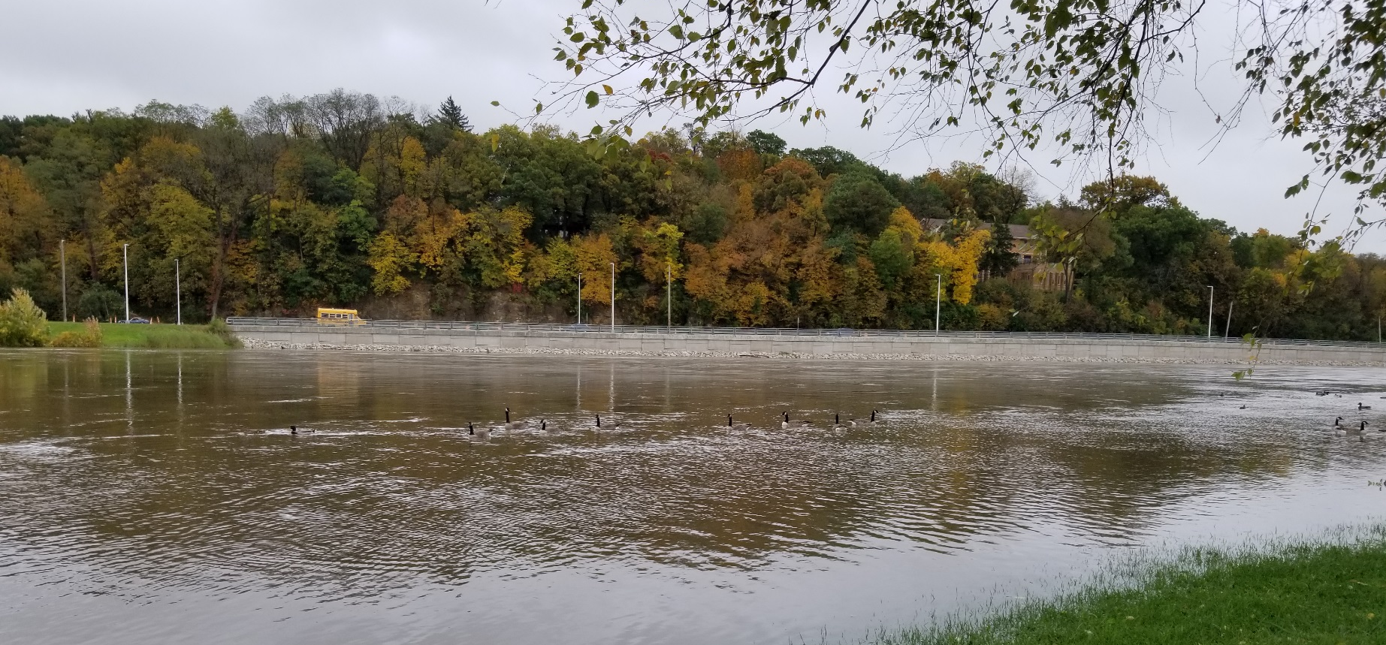
Current Project Status

Slide 26
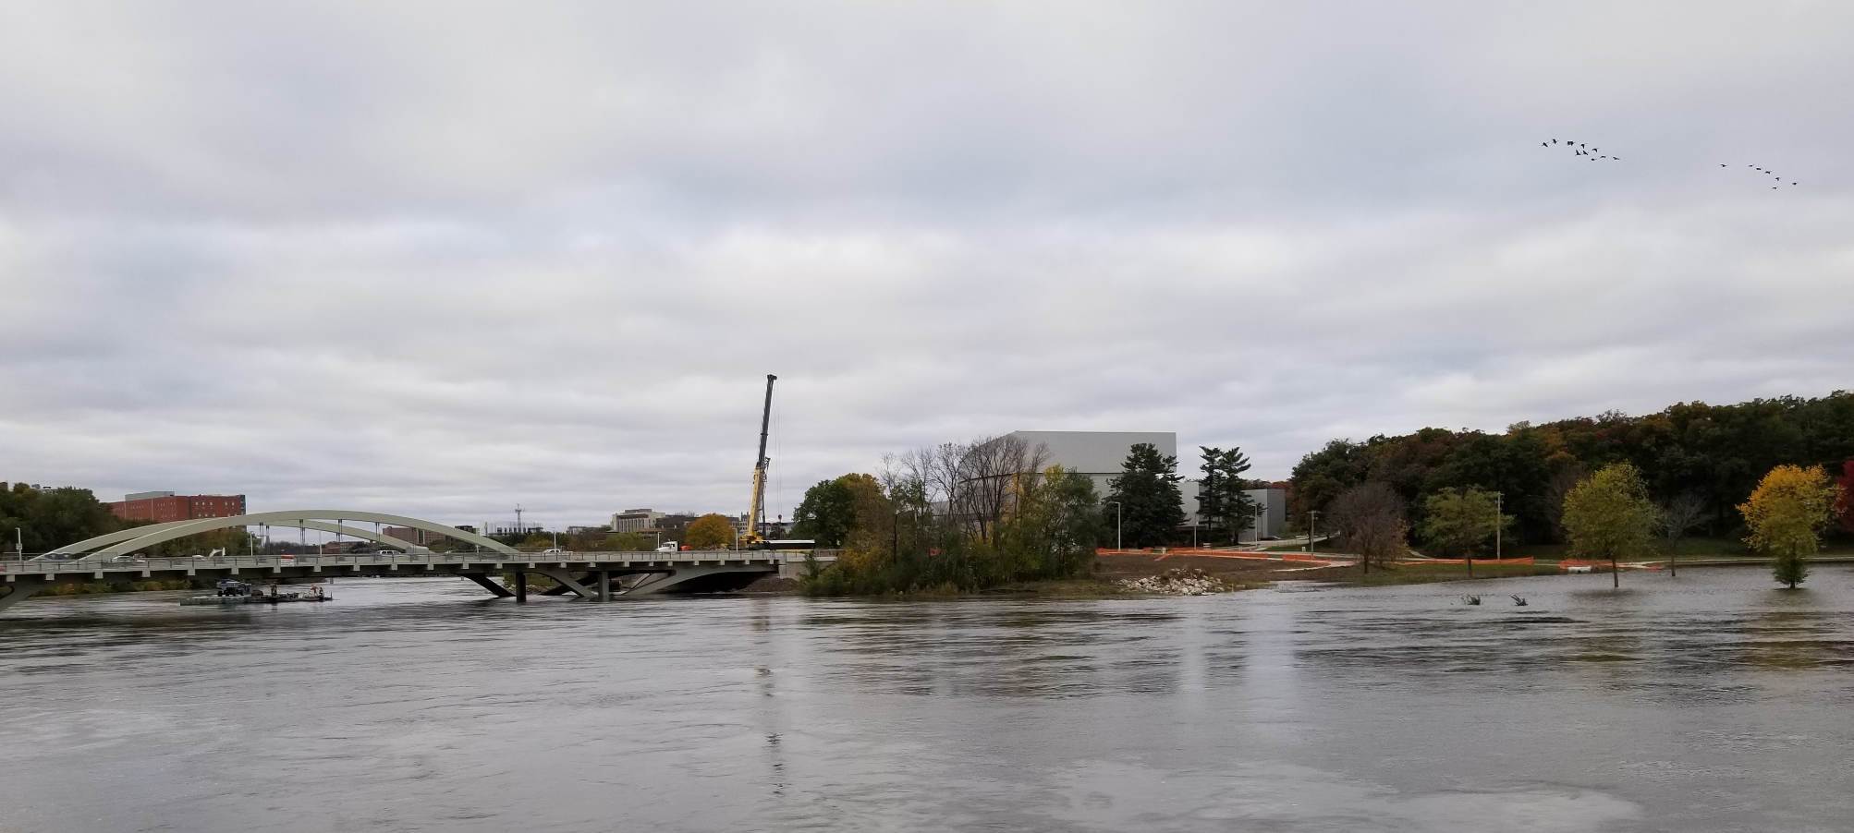
Current Project Status

Slide 27
Thank you for your time and interest!
Notes:
We so appreciate your time and interest in the project. We’ll adjourn to the open house, now. Please join the team members at the various stations to ask questions and give your input.

