Slide 1
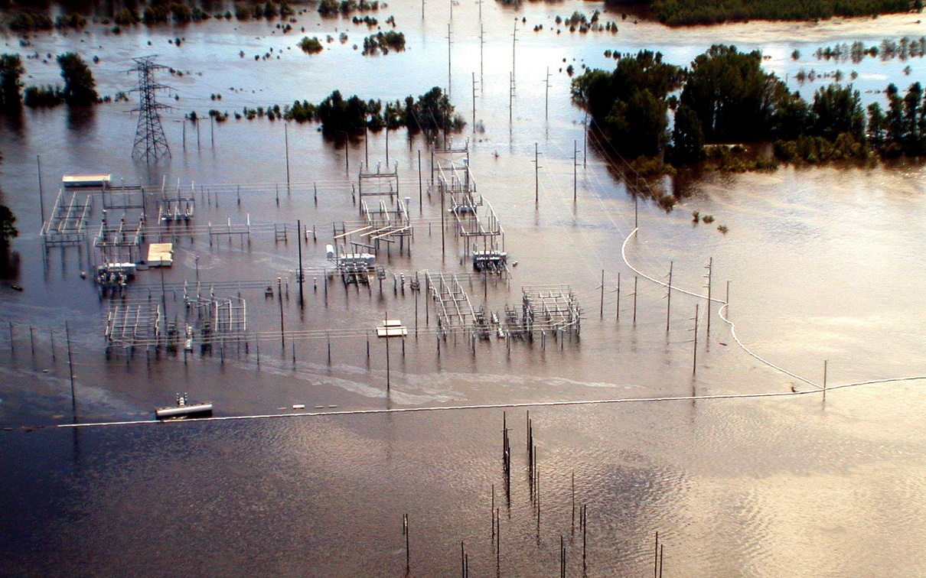

Natural Hazard Mitigation Saves:
Utilities and Transportation Infrastructure
#MitigationSaves
October 30, 2018

Slide 2
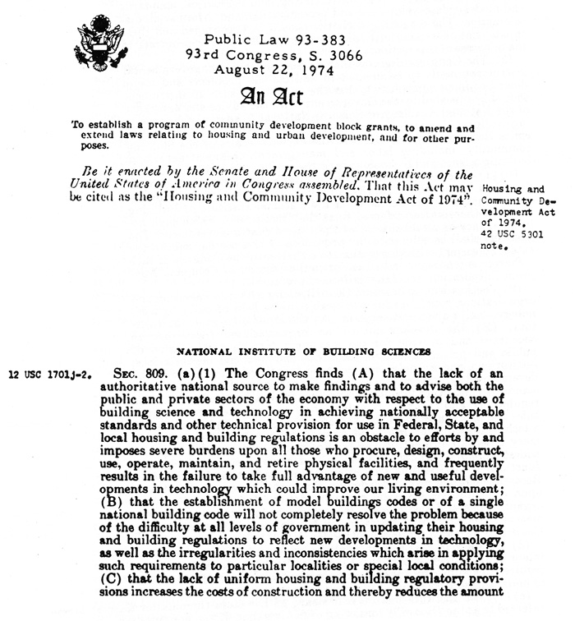
Notes:
Through the foresight of Congress, the Institute was created in 1974 to bring the public and private sector together to serve as an authoritative source for the building industry. Through examination and dissemination of codes, standards and other guidance, the Institute was charged to improve the built environment.

Slide 3
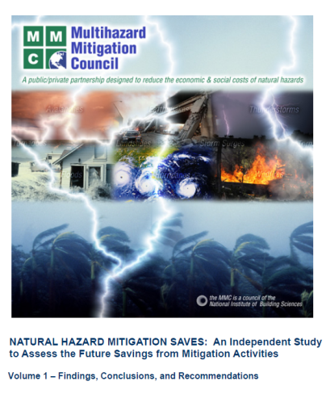
Natural Hazard Mitigation Saves:
An Independent Study to Assess the Future Savings from Mitigation Activities (2005)
“Money spent on reducing the risk of natural hazards is a sound investment. On average, a dollar spent by FEMA on hazard mitigation provides the nation about $4 in future benefits.”

Slide 4
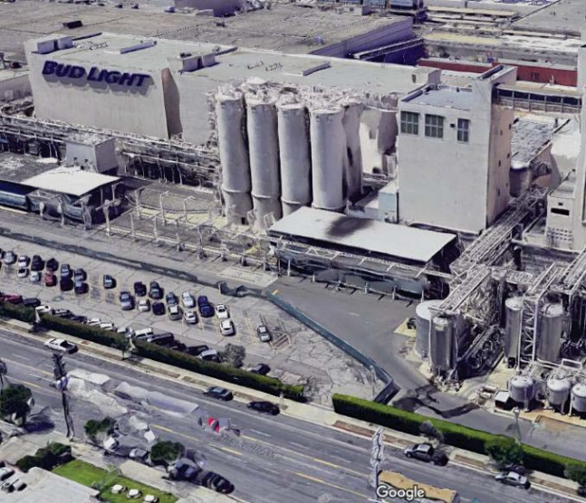
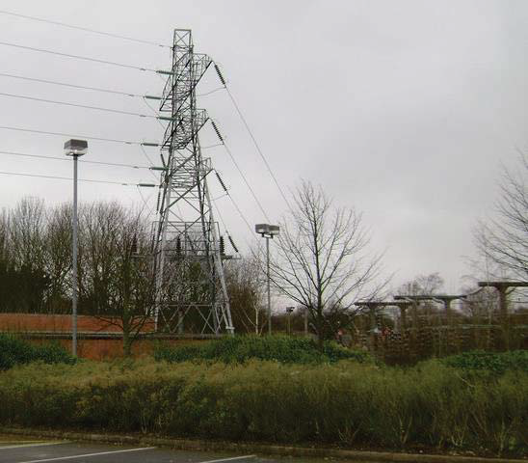
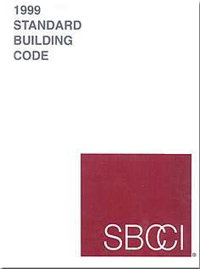
A Valuable Contribution . . . But Questions Remained
Private Sector Initiatives
Lifelines
Building Codes

Slide 5
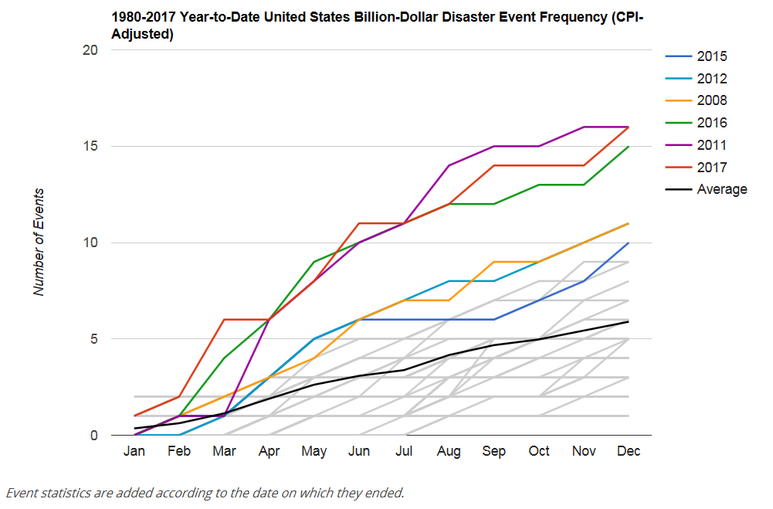
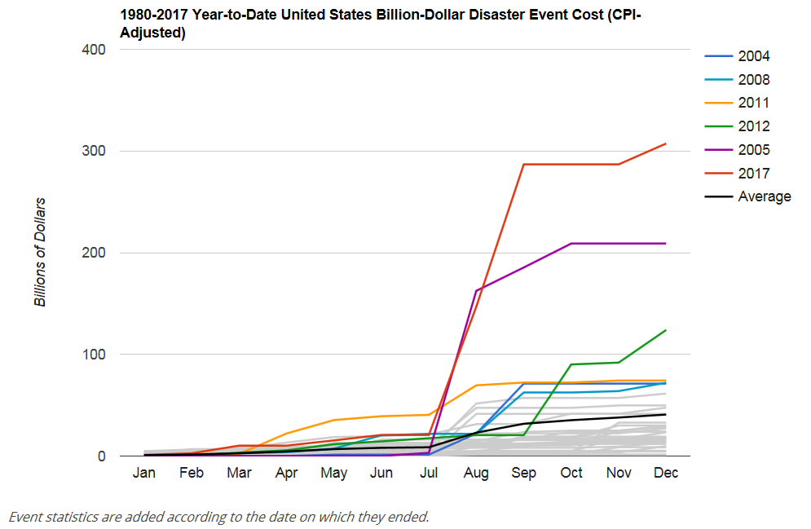
A Lot Has Happened Since 2005. . .

Slide 6
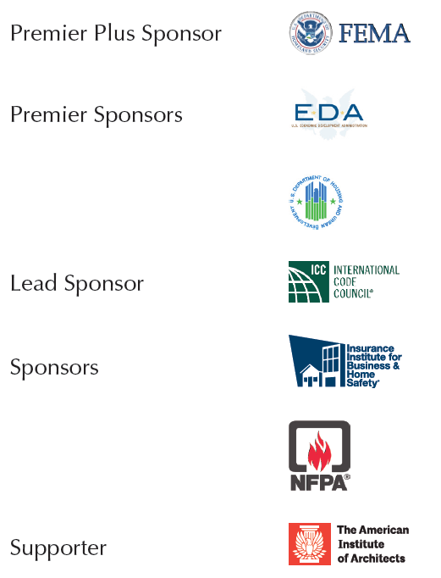
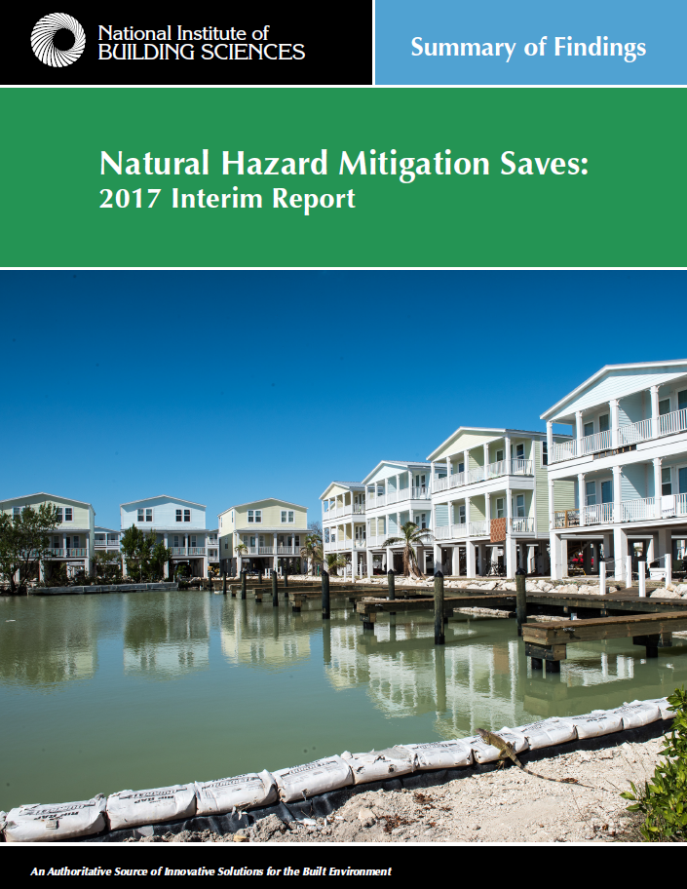

Slide 7




















Experts

Slide 8
Natural Hazard Mitigation Saves: 2017 Interim Report
Findings
Federal grants: The impacts of 23 years of federal mitigation grants provided by the Federal Emergency Management Agency (FEMA), Economic Development Administration (EDA) and Department of Housing and Urban Development (HUD), resulting in a national benefit of $6 for every $1 invested.
Exceed code requirements: The costs and benefits of designing all new construction to exceed select provisions in the 2015 International Building Code (IBC) and the 2015 International Residential Code (IRC) and the implementation of the 2015 International Wildland-Urban Interface Code (IWUIC). This resulted in a national benefit of $4 for every $1 invested.

Slide 9
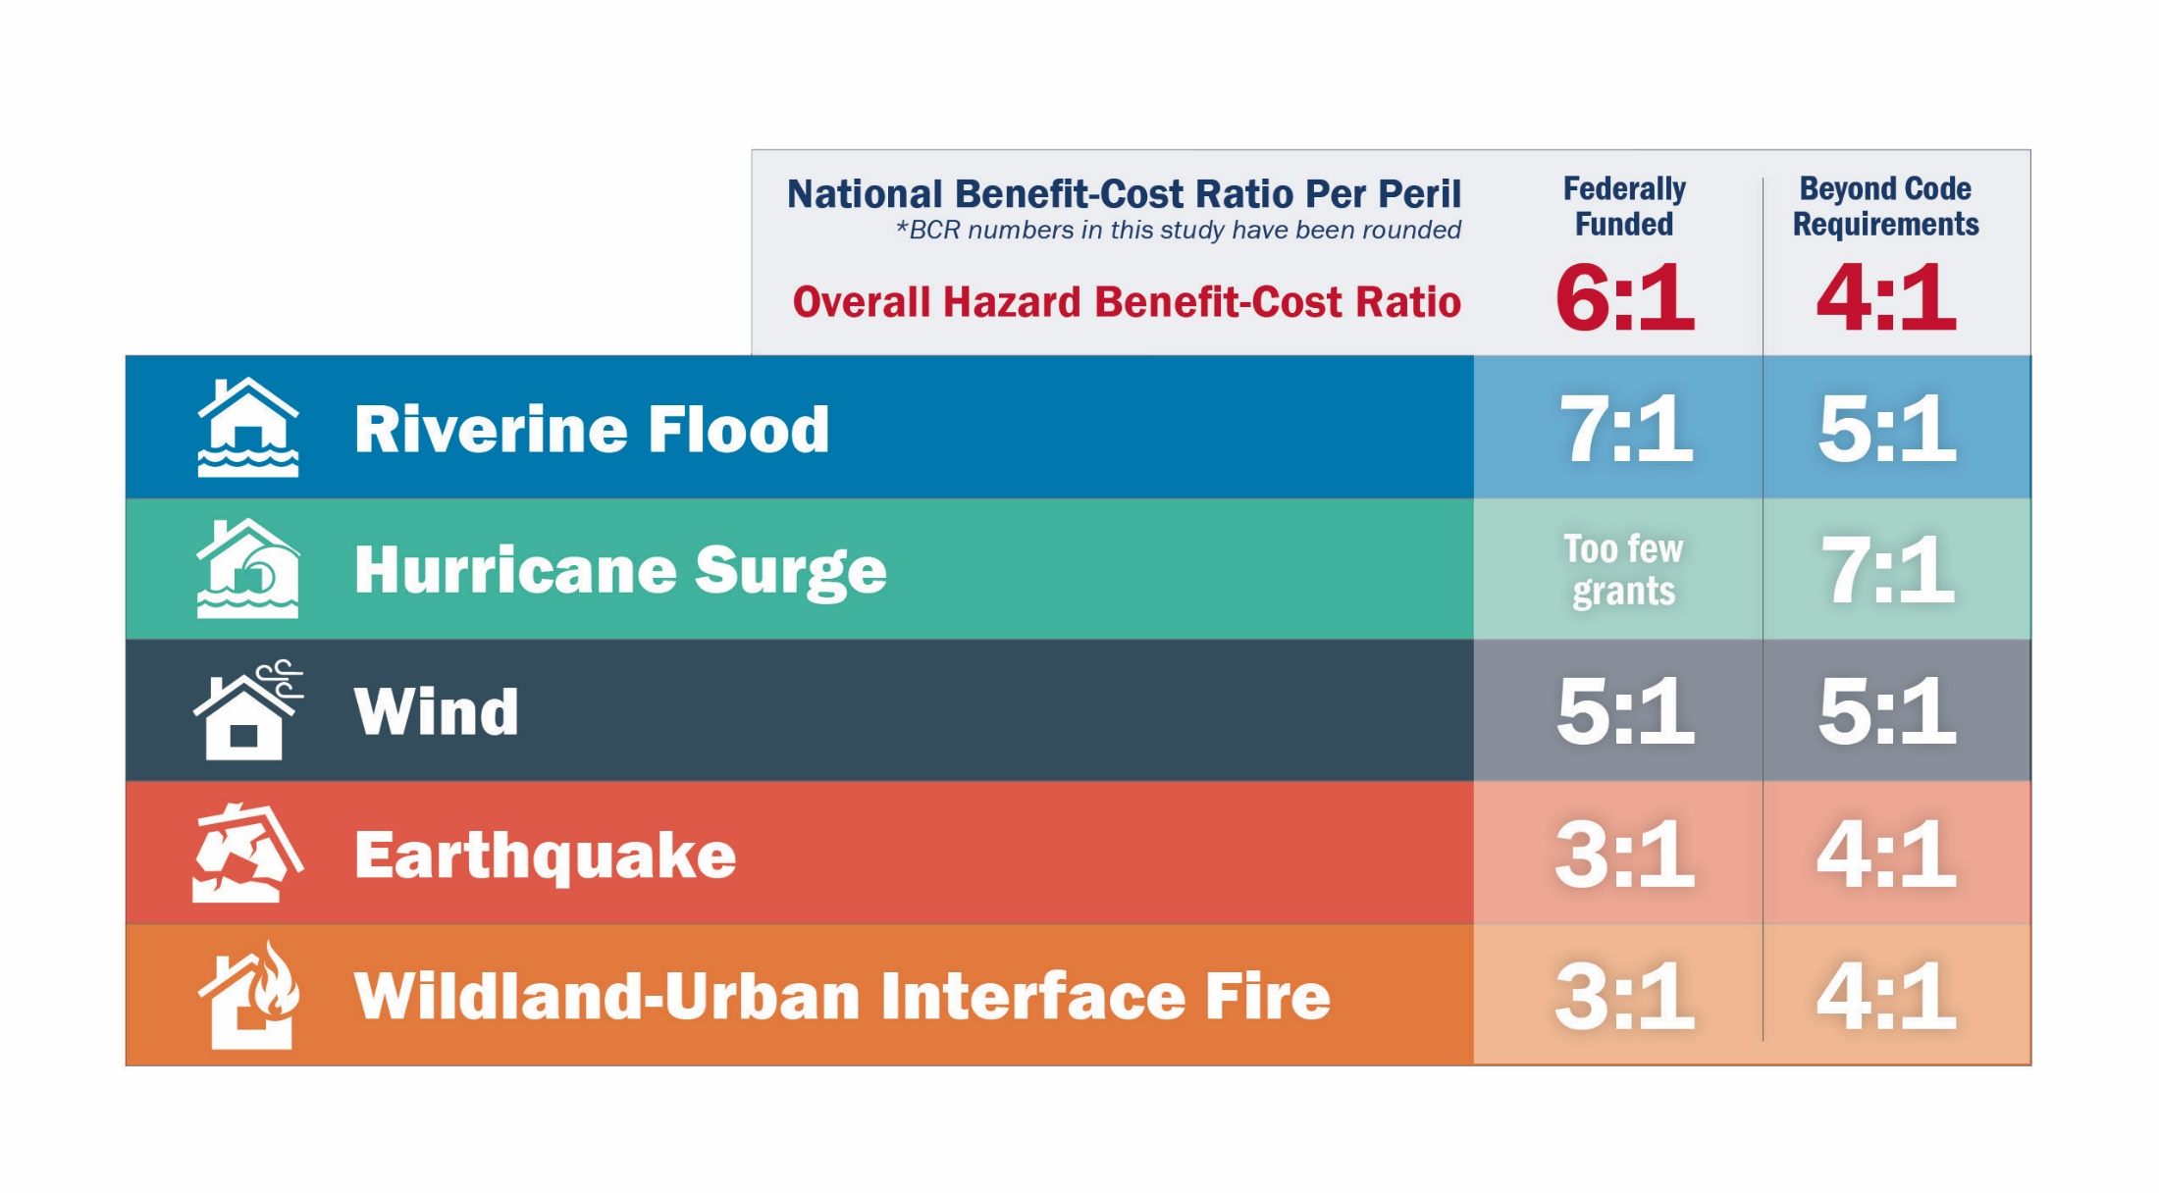
Benefit Cost Ratios by Hazard and Mitigation Measure

Slide 10
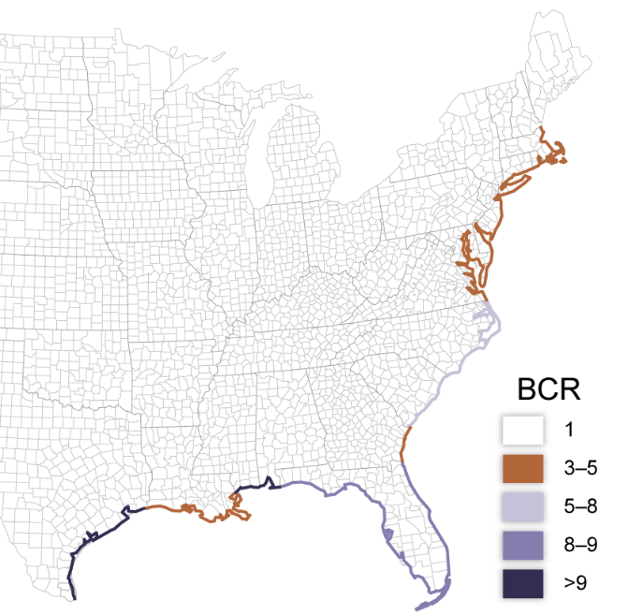
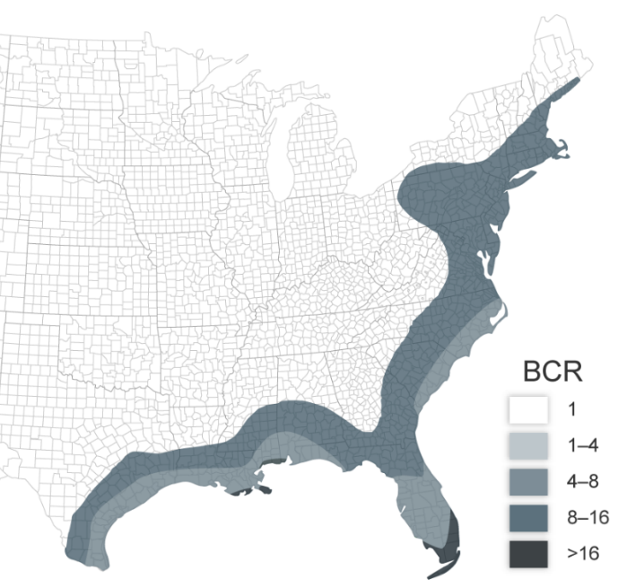
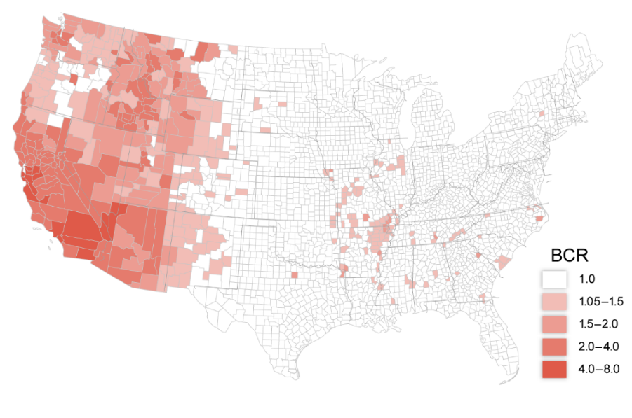
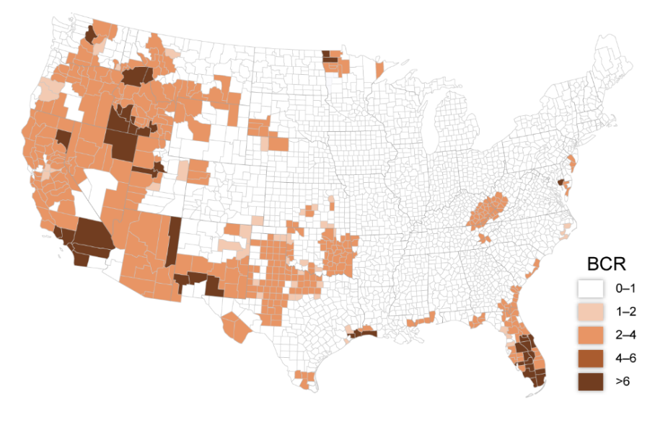
BCR for Coastal Flooding Mitigation
BCRs at the State & Local Level
Note: National-level maps for flood and tornado risk are not available, so state or local BCRs cannot be plotted.
BCR for Hurricane Wind Mitigation
BCR for Earthquake Mitigation
BCR for Wildfire Mitigation
Notes:
We’ve even drilled down to the state or county level to assist decision makers in identifying where implementation of measures exceeding building code provisions are likely to be beneficial. As architects, you have the opportunity to engage clients in identifying their risks and helping them evaluate what level of investment makes sense to help them mitigate that risk.

Slide 11


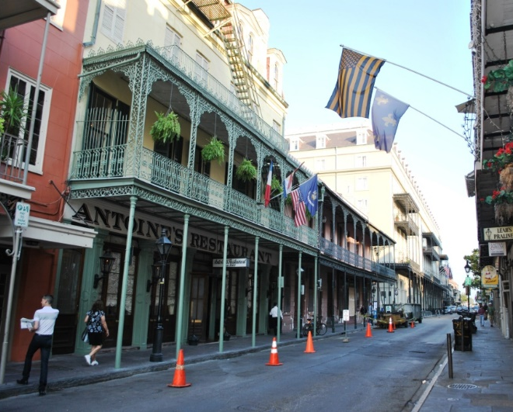

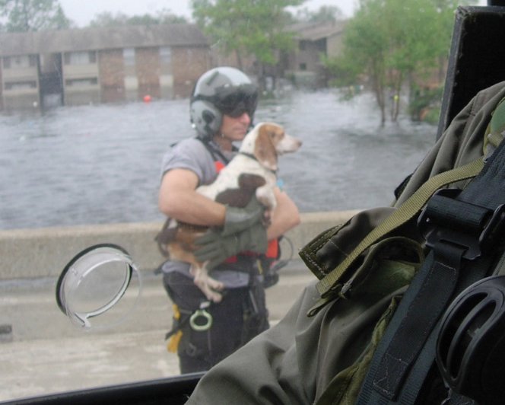
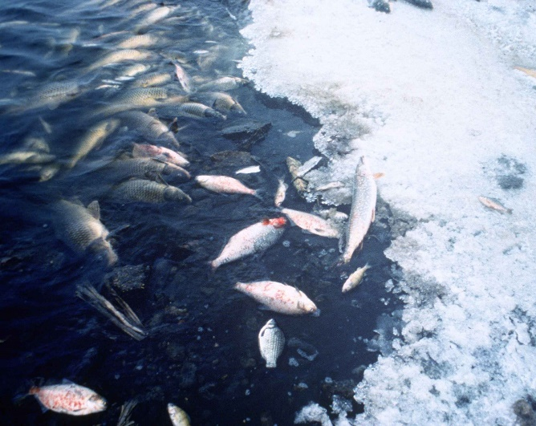
Some Benefits Cannot Be Estimated, so BCRs May Be Low
Elisa.rolle
Matty1378
Notes:
Disaster researchers have not yet produced a systematic method to quantify all losses that occur in a disaster. Disasters disconnect people from friends, schools, work and familiar places. They ruin family photos and heirlooms and alter relationships. Large disasters may cause permanent harm to culture and one’s way of life, and impact the most socially and financially marginal people. Disasters may have long-term consequences for health and collective wellbeing. These events also often hurt and kill pets and destroy natural ecosystems that are integral parts of communities. Disasters clearly disrupt life’s arc in ways that are hard to express, let alone assign monetary worth. Mitigation saves more than is estimated here
School photo: public domain; http://www.amc.af.mil/News/Commentaries/Display/Article/149303/we-can-really-learn-from-kids/
Photo album photo: https://commons.wikimedia.org/wiki/File:Family-album.jpg, public domain
Bourbon St photo: CC-BY-SA3.0, https://en.wikipedia.org/wiki/French_Quarter#/media/File:French_Quarter_example_of_late_18th-century_Spanish_architecture_built_after_the_Great_Fires_of_1788_and_1794.jpg
Homeless man: CC-BY-SA3.0, https://commons.wikimedia.org/wiki/File:Homeless_Man.jpg
Pet being rescued: http://www.patrick.af.mil/News/Features/Display/Article/810367/rescue-wing-airmen-celebrate-a-heros-life-a-beagle-who-stole-their-hearts/, public domain
Ecosystem damage: https://commons.wikimedia.org/wiki/File:Fish_kill_pollution.jpg, public domain

Slide 12
Mitigation Measures in MSv2
1 - Overall framework and integration of subsequent modules
2A – Design and build new buildings to exceed code minima
2B – Adopt and enforce building codes
3 - Retrofit of existing facilities
4 - Business continuity planning and disaster recovery
5 - Utility and transportation infrastructure mitigation
6A - Federal mitigation grants and loans
6B – Non-building specific activities by federal agencies to mitigate hazard
(← sole focus of MSv1)

Slide 13
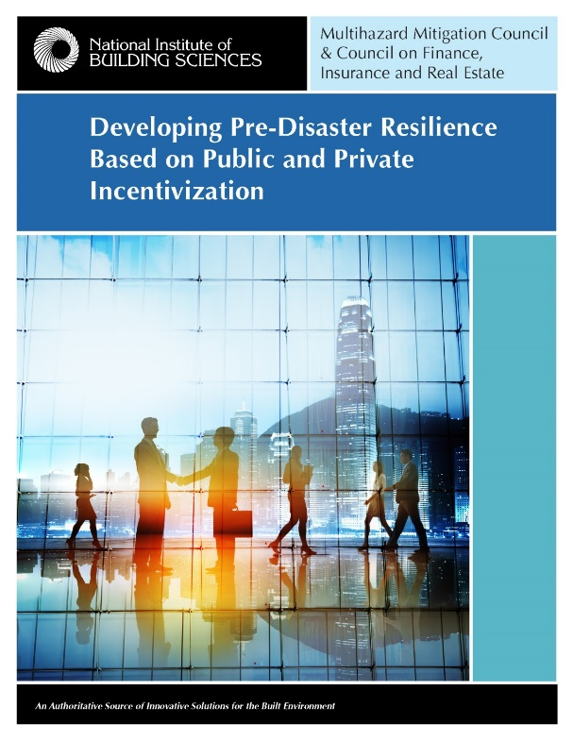
Pre-Disaster Resilience Based on Public and Private Incentivization
The most cost-effective manner to achieve resilience is through a holistic and integrated
set of public, private and hybrid
incentivization programs including mortgages, insurance, finance, tax incentives and credits, and grants

Slide 14
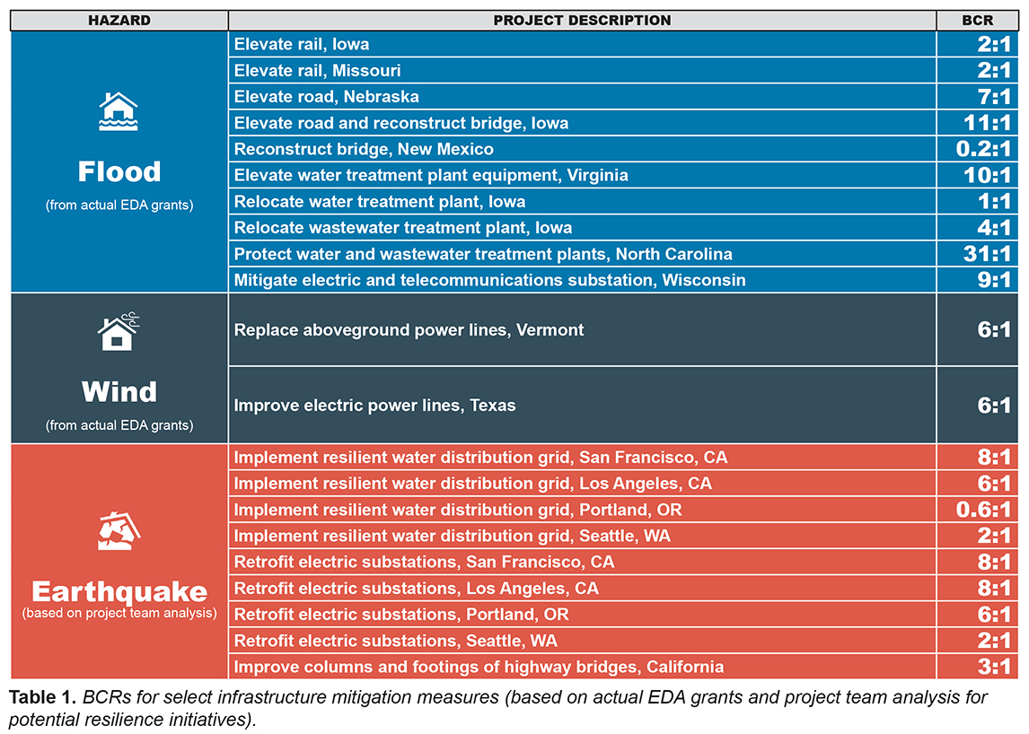
Utilities & Transportation Infrastructure

Slide 15
Sample Infrastructure Projects
Elevate Rail in Coralville, Iowa.
Relocate Iowa City, IA, Wastewater Treatment Plant out of Floodplain
Relocate Reedsburg, WI Substation
Flood Protection for Greenville, NC, Water and Wastewater Treatment Plants

Slide 16
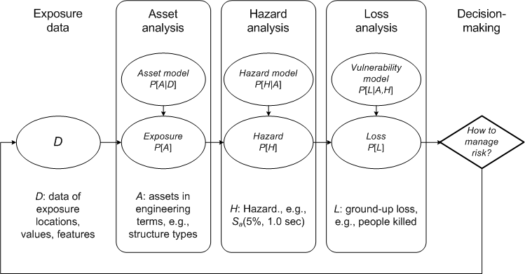
Common Framework of Probabilistic Risk Analysis

Slide 17
Elevate Rail in Coralville, Iowa
A grant of $7.8 million in 2010 USD to elevate rail next to the Iowa River and to elevate nearby trails.
The elevated rail bed protects rail traffic along the line: approximately 2 trains per day, according to the US Federal Railroad Administration (FRA).
The elevated rail bed and elevated trails are also intended to act as levees to protect buildings along the city’s Iowa River shoreline near the rail bed.

Slide 18
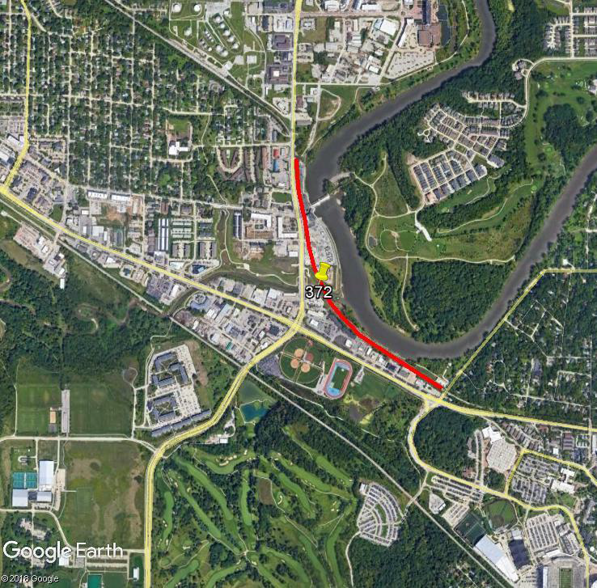
Elevate Rail in Coralville, Iowa

Slide 19
Elevate Rail in Coralville, Iowa
1.5 million sq. ft. of buildings in approximately equal proportions of dwellings and workplaces.
Using a replacement cost of $200/ft2, plus 50 percent added for content value, $460 million in protected property conservatively estimated.
Satellite imagery suggest traffic flow of 25,000 trips per day.

Slide 20
Elevate Rail in Coralville, Iowa
Considering a 100-year project life, and a cost-of-borrowing discount rate of 2.17%, the project produces $17 million in benefit at a cost of $8.3 million, for an overall benefit-cost ratio of $2.05 saved per $1.00 invested, i.e., 2.0 to 1.
The estimate may be overly conservative because it is unclear from satellite imagery how far the flood protection extends from the rail line.
Most of the benefits are from reduced property loss.
Using higher discount rates of 3% and 7%, the benefit-cost ratios are lower: 1.7 and 0.9, respectively.

Slide 21
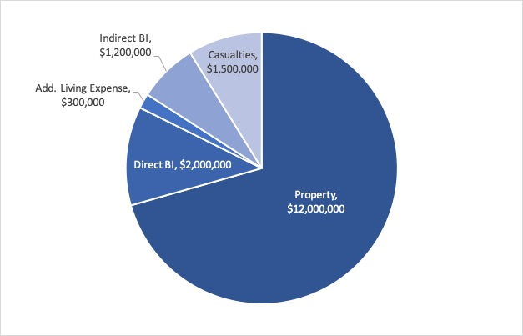
Elevate Rail in Coralville, Iowa
Estimated benefits from elevated rail and trails in Coralville, Iowa.

Slide 22
Relocate Iowa City, IA, Wastewater Treatment Plant out of Floodplain
EDA gave $46.5 million in 2010 USD to redirect wastewater from its north wastewater treatment plant in the FEMA special flood hazard area to its south wastewater treatment plant, and to expand the south plant to handle the greater demand.
The south plant also has some risk of flooding, but the expansion mitigated individual buildings and equipment by raising equipment within buildings, raising transformer pads, building berms, and other measures, to a level 1 ft. above the elevation of 500-year flooding.
The grant aims to maintain wastewater service during floods to the city’s population of 74,400 people.

Slide 23
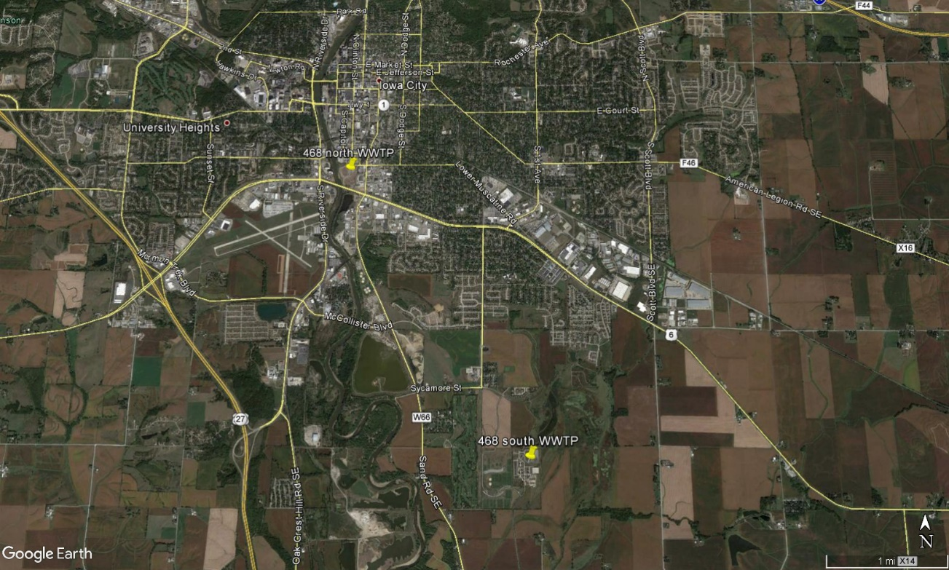
Relocate Iowa City, IA, Wastewater Treatment Plant out of Floodplain
Iowa City, IA wastewater treatment plants: the north plant (468 north WWTP) and the south plant (468 south WWTP). The north plant was decommissioned and its load taken up by an expanded south plant.

Slide 24
Relocate Iowa City, IA, Wastewater Treatment Plant out of Floodplain
Considering a 100-year project life, and a cost-of-borrowing discount rate of 2.17%, the project produces $195 million in benefit at a cost of $54 million, for an overall benefit-cost ratio of $3.60 saved per $1.00 invested, i.e., 3.6 to 1.
The BCR is relatively low compared with other water- and wastewater-related grants considered because of the assumption that Iowa City homes and businesses would not have to cease operations solely because of flooding of either wastewater treatment plant.
Not taken into account is untreated wastewater near businesses at the south end of Iowa City that might so impair air quality and public safety that some business would cease until cleanup were completed.
Most of the benefits are from property loss to the wastewater treatment plants.
Using higher discount rates of 3% and 7%, the benefit-cost ratios are lower: 2.3 and 1.04, respectively.

Slide 25
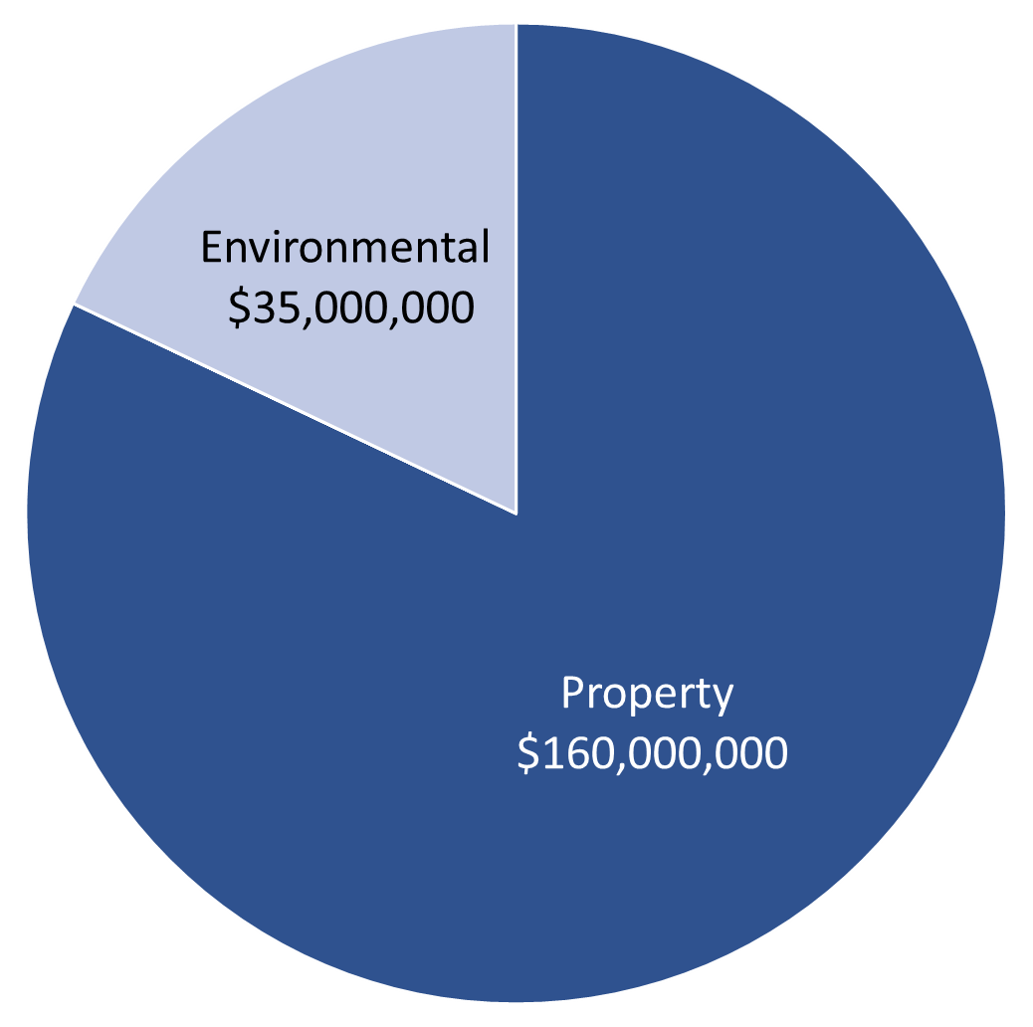
Relocate Iowa City, IA, Wastewater Treatment Plant out of Floodplain
Estimated benefits from decommissioning the Iowa City, IA, north wastewater treatment plant and elevating or otherwise protecting critical equipment at the south plant.

Slide 26
Relocate Reedsburg, WI Substation
A grant of $235,000 to build a telecommunications & electric switching station.
Replaced an older building about 40 feet away but 4 feet lower.
Based on a FEMA National Flood Hazard Layer FIRMette.

Slide 27
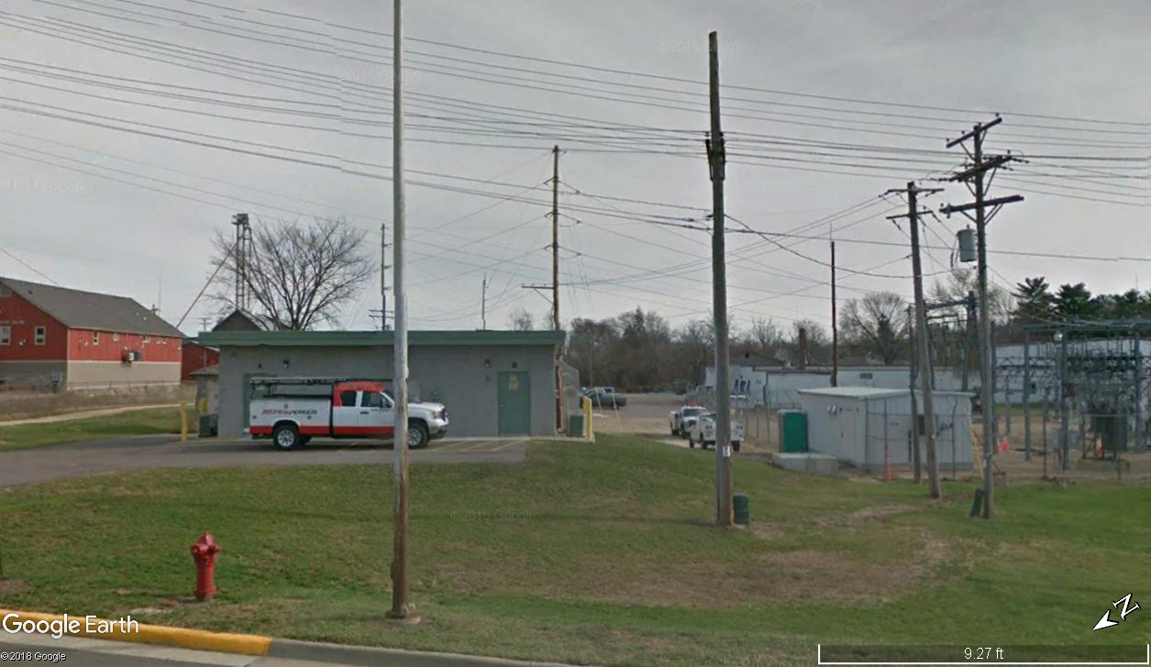
Relocate Reedsburg, WI Substation

Slide 28
Relocate Reedsburg, WI Substation
Considering a 75-year project life, and a cost-of-borrowing discount rate of 2.17%, the project produces $2.2 million in benefit at a cost of $235,000, for an overall benefit-cost ratio of $9.40 saved per $1.00 invested, i.e., 9.4 to 1.
Most of the benefits are from reduced business interruption to the community.
Using higher discount rates of 3% and 7%, the benefit-cost ratios are lower, 7.6 and 4.3, respectively, but still substantially above 1.0.

Slide 29
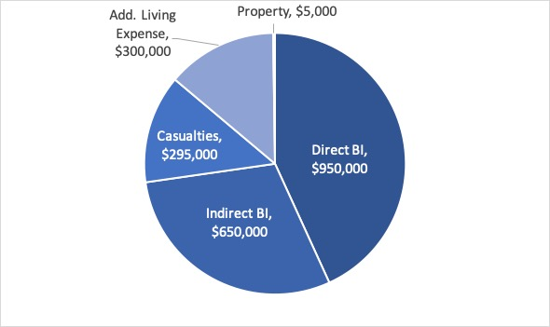
Relocate Reedsburg, WI Substation
Estimated benefits from new telephone and electrical switching building in Reedsburg, Wisconsin

Slide 30
Flood Protection for Greenville, NC, Water and Wastewater Treatment Plants
EDA gave $4.8 million in 2001 USD to construct a flood-protection berm and pumping station for Greenville's water treatment plant.
The grant also paid to raise a flood protection wall and a retaining wall at the Northside Wastewater Treatment Plant.
The grant aims to maintain water and wastewater service during floods to the city’s population of 91,500 people.

Slide 31
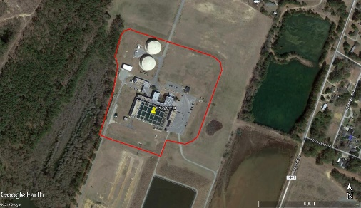
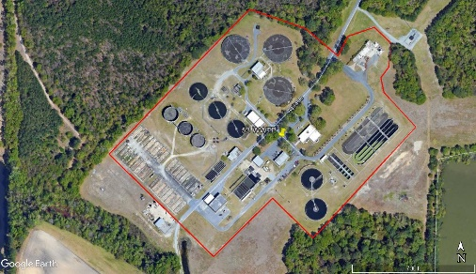
Flood Protection for Greenville, NC, Water and Wastewater Treatment Plants
Water treatment plant with the berm highlighted by the red-colored polygon
Wastewater treatment plant

Slide 32
Flood Protection for Greenville, NC, Water and Wastewater Treatment Plants
Considering a 100-year project life, and a cost-of-borrowing discount rate of 2.17%, the project produces $212 million in benefit at a cost of $6.8 million, for an overall benefit-cost ratio of $31.00 saved per $1.00 invested, i.e., 31 to 1.
The BCR is so high because it costs relatively little to build the flood-protection systems that protect a relatively large value.
Most of the benefits are from reduced business interruption to the community, but environmental benefits are also significant.
Using higher discount rates of 3% and 7%, the benefit-cost ratios are lower: 28 and 13, respectively.

Slide 33
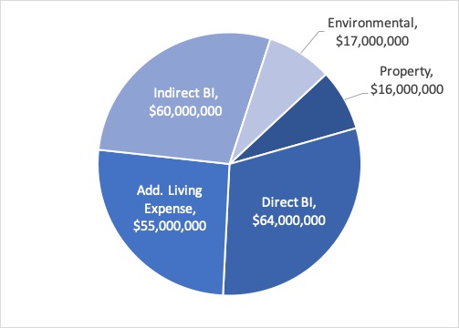
Flood Protection for Greenville, NC, Water and Wastewater Treatment Plants
Estimated benefits from adding flood protection to the water and wastewater treatment plants in Greenville, North Carolina

Slide 34

Thank You
Contact:
Ryan Colker (rcolker@nibs.org)
Philip Schneider (pschneider@nibs.org)
Natural Hazard Mitigation Saves:
Utilities and Transportation Infrastructure
October 30, 2018

