Slide 1
2012 Election: What We’ve Learned
Carroll J. Doherty
Associate Director
Pew Research Center for the People & the Press
Pew Center on the States – Voting in America 2012
December 10, 2012
cdoherty@pewresearch.org

Slide 2
The Electorate – The Most Diverse Ever
Changing Composition of the Electorate Helped Obama
Change from 2008 Was Modest – Nonwhites 28% of All Voters, Up From 26%
Demographics of Future Elections Will Look Much Different than Those of Today

Slide 3
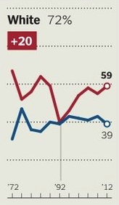
Obama Lost Whites by 20 Points – And Won
Based on exit poll data from National Election Pool

Slide 4
Changing Face of the American Voter
Dramatic Shifts among Young Voters - Now 42% Nonwhite
Voters 18-29
Voters 30+
Based on exit poll data from the National Election Pool

Slide 5
Age Gap in Voting Preferences
Based on exit poll data from the National Election Pool

Slide 6
By 2050, A Majority-Minority Nation
Population By Race And Ethnicity, Actual and Projected:
Pew Social and Demographic Trends

Slide 7
Profile of Nonvoters: Younger, More Hispanic
 | All adults | Likely voters | Non- voters
White, non-Hispanic | 68 | 74 | 59
Black non-Hispanic | 11 | 12 | 10
Hispanic | 12 | 7 | 21
18-29 | 21 | 13 | 36
30-49 | 33 | 31 | 35
50-64 | 29 | 33 | 20
65+ | 16 | 21 | 8
Pew Research Center for the People & the Press

Slide 8
Social Media and Politics
Facebook, Twitter Growing News Sources
They Help Drive Campaign Narrative …
A Mostly Negative Narrative
A “Fifth Estate” of Political Actors –
Partisan and Passionate

Slide 9
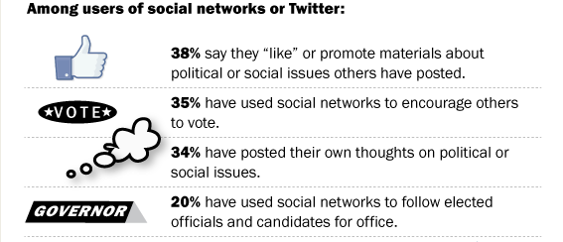
Online Participatory Politics
Pew Internet & American Life Project

Slide 10
Social Networkers: Beyond Red vs. Blue
Pew Internet & American Life Project

Slide 11
Campaign 2012: A Final Word
Compared with past elections, more or less discussion of issues?
Compared with past elections, more or less mudslinging?
Pew Research Center for the People & the Press

Slide 12
Few Complaints about Voting Process
How well was the voting process managed in the area where you live?
Did you have any problems voting this year (other than waiting in line)?
Do you know anyone who tried to vote but was not able to?
Pew Research Center for the People & the Press

Slide 13
2012 Election: What We’ve Learned
Carroll J. Doherty
Associate Director
Pew Research Center for the People & the Press
Pew Center on the States – Voting in America 2012
December 10, 2012
cdoherty@pewresearch.org

