Slide 1
2012 Survey of the Performance of American Elections*
Charles Stewart III
MIT
*A first look

Slide 2
Survey Background
Gauging the quality of the voting experience
Research design
  200 respondents contacted by Internet in every state + DC (YouGov/Polimetrix), or 10,200 total
  Survey in the field the week following Nov. 6
Previous administrations of survey
  Nov. ‘07
  Super Tuesday ‘08
  General Election ‘08
  Nov. ‘09

Slide 3
Overall, the experience of voters on Election Day was positive
86% said it was “very easy” to find their polling place
3% said they encountered a registration problem when they went to vote
13 min = avg. wait time to vote
  63% said most of this time was waiting to check in
2% said they encountered voting equipment problems
78% said their polling place was run “very well”
65% said the performance of polls workers was “excellent”
67% said they were “very confident” that their vote was counted as cast

Slide 4
Early voting experience was very similar to that of Election Day
83% said it was “very easy” to find their polling place
3% said they encountered a registration problem when they went to vote
20 min = avg. wait time to vote
  69% said most of this time was waiting to check in
2% said they encountered voting equipment problems
80% said their polling place was run “very well”
67% said the performance of polls workers was “excellent”
65% said they were “very confident” that their vote was counted as cast

Slide 5
Absentee voters also satisfied
2% said they encountered problems receiving their mail ballot
<1% said they encountered problems marking their mail ballot
83% said they found the instructions easy to follow in marking their ballot
56% said they were “very confident” that their vote was counted as cast
Of those who reported not voting, 18% reported requesting, but not receiving, an absentee ballot.

Slide 6
Voter identification
Lines
Partisan divisions

Slide 7
Voter identification
Attitudes about fraud
Effect on confidence
Effect on ID shown

Slide 8
69% of respondents favor requiring all voters to show photo ID when they vote.

Slide 9
Support for photo ID laws
53% of Democrats
58% of African Americans
Notes:
In contrast: 91% of Republicans, 71% of whites, and 90% of conservatives

Slide 10
Support for photo ID laws
53% of Democrats
58% of African Americans
(but only 43% of liberals)
Notes:
In contrast: 91% of Republicans, 71% of whites, and 90% of conservatives

Slide 11
It is very common in my city or county…
 | States w/ photo ID laws | All other states | Diff.
People pretending to be others | 11% | 11% | 0

Slide 12
How confident are you that … will be counted as you intended?
 | States w/ photo ID laws | All other states | Diff
…your vote… | 63% | 65% | -2
…votes in your county… | 52% | 52% | 0
…votes in your state… | 38% | 43% | -5%
…votes nationwide… | 27% | 24% | +3

Slide 13
Effect on IDs shown
 | Photo required/ preferred | ID (not photo) required | No ID required
Announced name | 1% | 3% | 55%
Voter reg. card | 9% | 30% | 11%
Driver’s license | 87% | 63% | 26%
Other | 3% | 4% | 8%

Slide 14
Effect on IDs shown
 | Photo required/ preferred | ID (not photo) required | No ID required
Announced name | 1% | 3% | 55%
Voter reg. card | 9% | 30% | 11%
Driver’s license | 87% | 63% | 26%*
Other | 3% | 4% | 8%
*45% state they were required to show license

Slide 15
Lines an issue in 2012 election

Slide 16
Lines an issue in 2012 election
36% did not wait at all in line (42% in 2008)
13% waited more than 30 min. (14% in 2008)

Slide 17
Lines an issue in 2012 election
36% did not wait at all in line (42% in 2008)
13% waited more than 30 min. (14% in 2008)
Lines longer for early voting than for Election Day voting
  Avg. 20 min. early voting
  Avg. 13 min. on Election Day

Slide 18
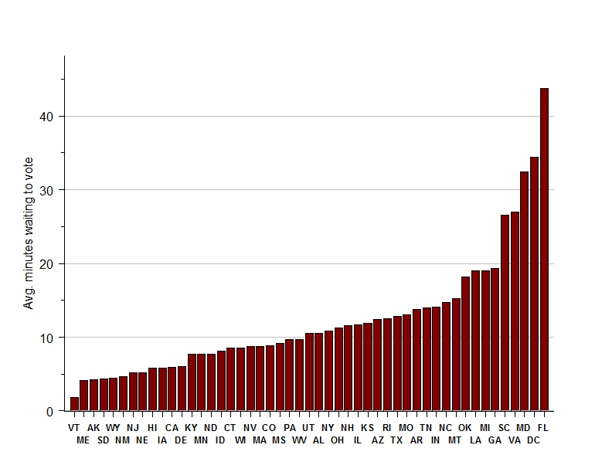

Slide 19
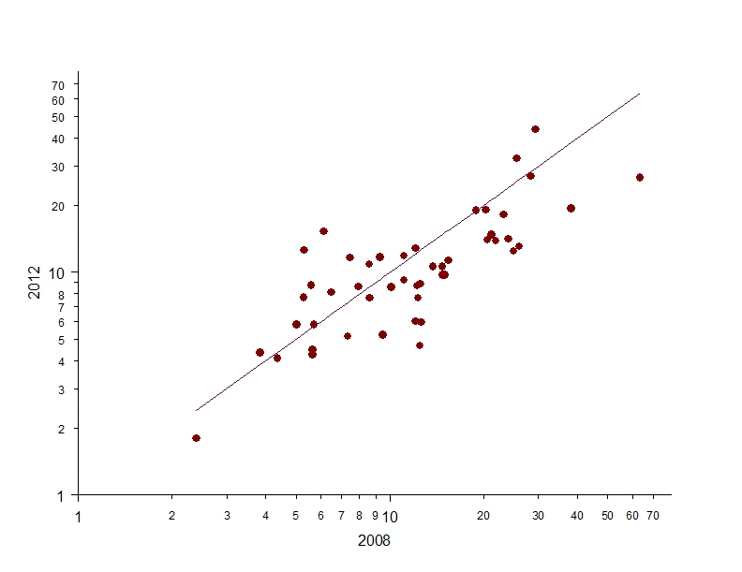

Slide 20
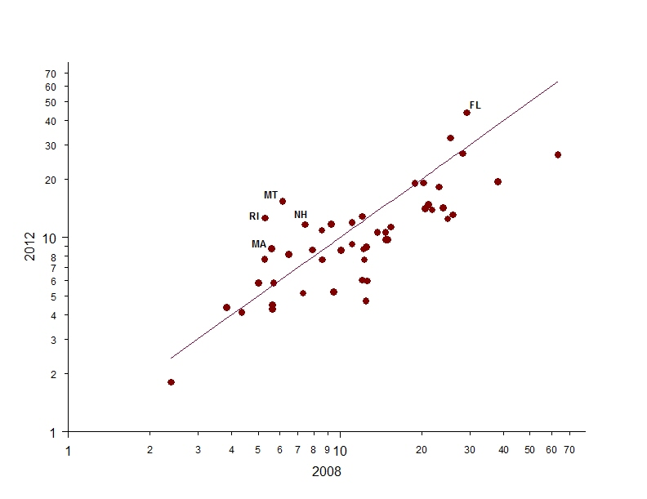

Slide 21
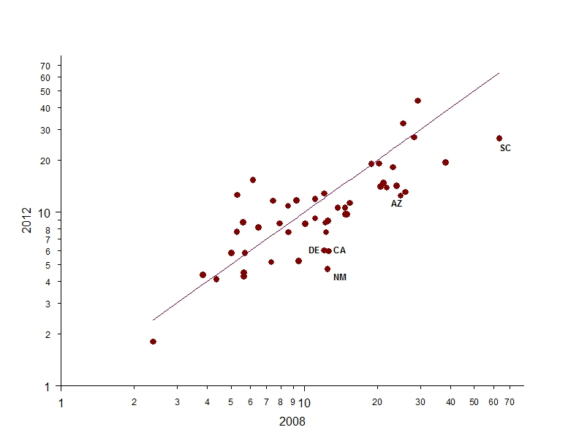

Slide 22
Average wait time by population density of county (min)
 | Election Day | Early Voting | Total
1st quartile (least dense) | 6 | 5 | 6
2nd quartile | 10 | 8 | 10
3rd quartile | 13 | 18 | 14
4th quartile (most dense) | 16 | 31 | 19
All | 13 | 20 | 14

Slide 23
Average wait time by race (minutes)
 | Election Day | Early Voting | Total
White | 11 | 16 | 12
Black | 19 | 26 | 22
Hispanic | 15 | 29 | 18
All | 13 | 20 | 14

Slide 24
Partisan Divisions on Election Admin.

Slide 25
Partisan Divisions on Election Admin.
Attitudes on confidence
Attitudes on fraud
Attitudes on reform

Slide 26
How confident are you that your vote will be counted as cast?
(Pct. saying “very confident”)
 | Dem. | Ind. | Rep. | Total
2008 | 76% | 68% | 69% | 71%

Slide 27
How confident are you that your vote will be counted as cast?
(Pct. saying “very confident”)
 | Dem. | Ind. | Rep. | Total
2008 | 76% | 68% | 69% | 71%
2012 | 78% | 57% | 53% | 65%

Slide 28
How confident are you that … in the General Election will be counted as intended?
 | Dem. | Ind. | Rep. | Total
…your vote… | 78% | 57% | 53% | 65%
…votes in your county… | 64% | 45% | 43% | 53%
…votes in your state… | 54% | 35% | 32% | 42%
…votes nationwide… | 37% | 18% | 13% | 25%

Slide 29
It is very common in my city or county…
 | Dem. | Ind. | Rep. | Total
Non-citizens voting | 9% | 25% | 35% | 21%
Absentee ballot fraud | 10% | 16% | 24% | 16%
People pretending to be others | 9% | 15% | 22% | 14%
People voting more than once | 7% | 14% | 22% | 14%
Officials tampering with vote totals | 9% | 12% | 16% | 12%
People tampering with ballots | 9% | 11% | 17% | 12%

Slide 30
Support for Reform
 | Dem. | Ind. | Rep. | Total
Require paper backup | 84% | 86% | 82% | 84%
Auto-register after moving | 87% | 75% | 62% | 77%
Require photo ID | 53% | 73% | 91% | 69%
Non-partisan election officials | 64% | 72% | 64% | 66%
Auto-register 18-year-olds | 77% | 55% | 38% | 60%
Election Day a holiday | 72% | 58% | 44% | 60%
Election Day on weekend | 63% | 54% | 40% | 54%
Election Day registration | 72% | 49% | 29% | 53%
Internet voting | 51% | 36% | 24% | 39%
All-mail voting | 31% | 20% | 13% | 23%
Cell phone voting | 25% | 16% | 8% | 18%

Slide 31
Support for Reform
 | Dem. | Ind. | Rep. | Total
Require paper backup | 84% | 86% | 82% | 84%
Auto-register after moving | 84% | 75% | 62% | 77%
Require photo ID | 72% | 73% | 91% | 69%
Non-partisan election officials | 64% | 72% | 64% | 66%
Auto-register 18-year-olds | 77% | 55% | 38% | 60%
Election Day a holiday | 72% | 58% | 44% | 60%
Election Day on weekend | 63% | 54% | 40% | 54%
Election Day registration | 72% | 49% | 29% | 53%
Internet voting | 51% | 36% | 24% | 39%
All-mail voting | 31% | 20% | 13% | 23%
Cell phone voting | 25% | 16% | 8% | 18%

Slide 32
Support for Reform
 | Dem. | Ind. | Rep. | Total
Require paper backup | 84% | 86% | 82% | 84%
Auto-register after moving | 84% | 75% | 62% | 77%
Require photo ID | 72% | 73% | 91% | 69%
Non-partisan election officials | 64% | 72% | 64% | 66%
Auto-register 18-year-olds | 77% | 55% | 38% | 60%
Election Day a holiday | 72% | 58% | 44% | 60%
Election Day on weekend | 63% | 54% | 40% | 54%
Election Day registration | 72% | 49% | 29% | 53%
Internet voting | 51% | 36% | 24% | 39%
All-mail voting | 31% | 20% | 13% | 23%
Cell phone voting | 25% | 16% | 8% | 18%

Slide 33
Conclusion
Substantive findings
  Positive voting experience for most voters
  Voter ID
  Lines
  Partisanship
More research is to be done
  Final report due February 1, 2013

