Slide 1

Lessons in online voter registration technologies to build on from 2012

Slide 2

About Rock the Vote
Founded in 1990 by artists and musicians in response to a wave of attacks on freedom of speech and artistic expression.
As a nonpartisan nonprofit organization, Rock the Vote doesn’t endorse candidates. Rather, it empowers young people to step up and claim their voices in the political process.
Rock the Vote is able to translate the success of its brand into real results by running innovative and successful voter outreach and registration efforts.
Rock the Vote was the first organization to introduce 1-800 # to register to vote and more recently an online voter registration tool used by more than 30,000 partners since 1996.

Slide 3
Online Vote Registration Tool
Top OVR Partners:
CA, WA, NV
MTV/Viacom, Comcast
Xbox
Barnes & Noble College
HeadCount, PIRG, VPC
Long Distance Voter
Total # of voter registration applications for 2011-2012:
1,058,994
Notes:
2012 results.

Slide 4
#1: New ‘partner’ tools to promote better OUTREACH
5 options:
  Link to rockthevote.com
  RTV ‘widget’
  White-label ‘widget’
  Build your own interface on the RTV API
  Set up unique instance on your own servers

Slide 5
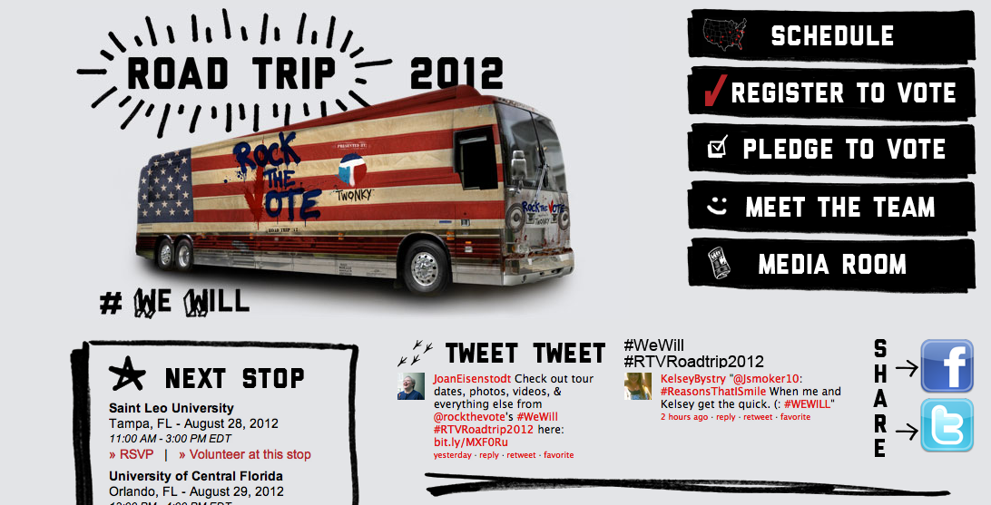
Bus Tours
LINK

Slide 6
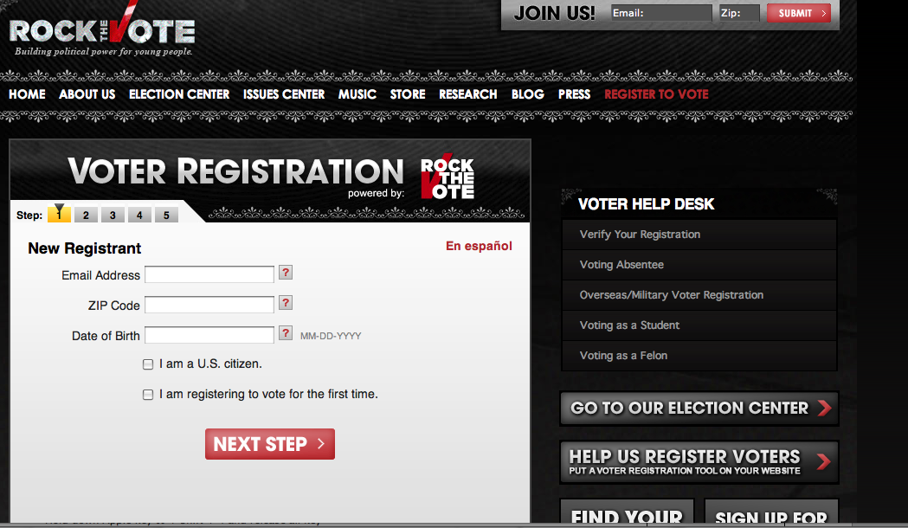

Slide 7
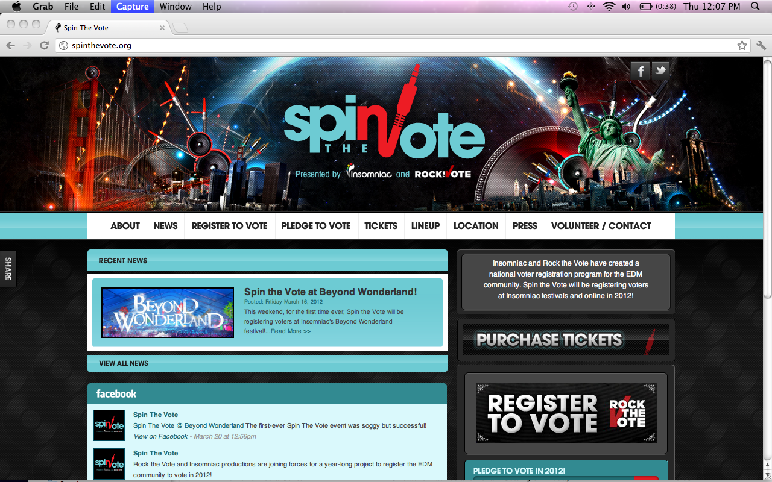
WIDGET
Notes:
RTV online voter registration tool’s code is embedded in this button.

Slide 8
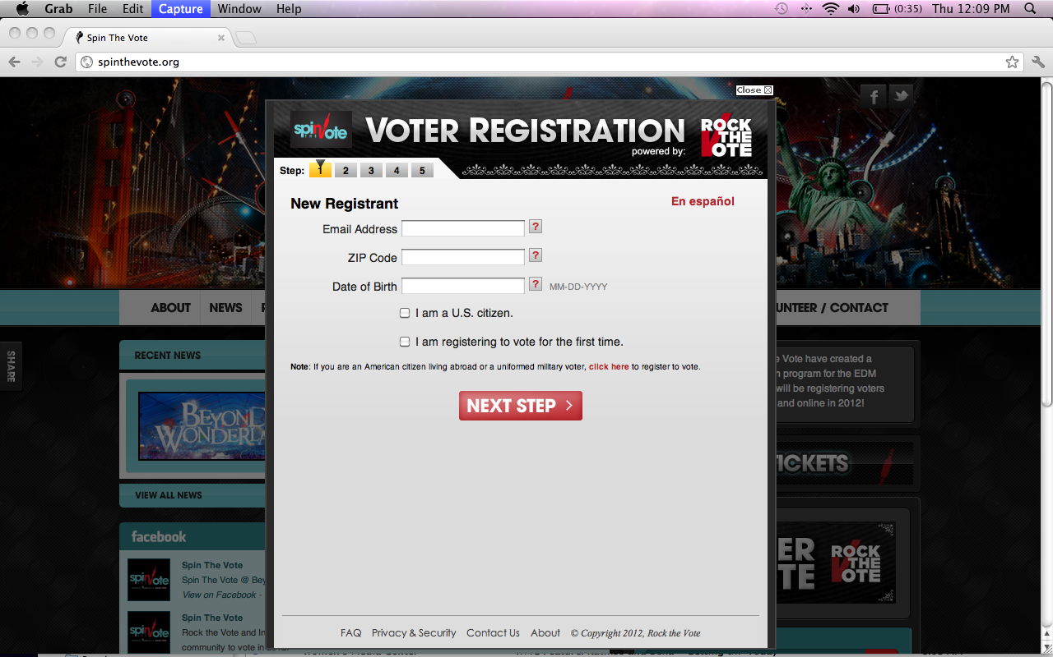
Notes:
When the button is clicked, the voter registration form appears as an overlay on the original website.

Slide 9
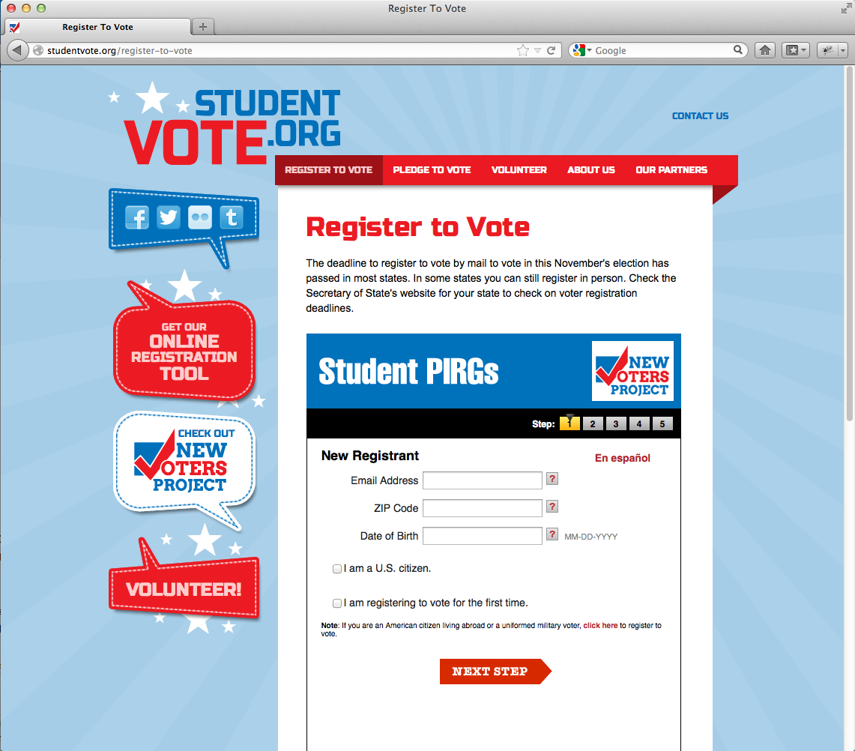
Notes:
WHITE LABEL TOOLS. Example #1.

Slide 10
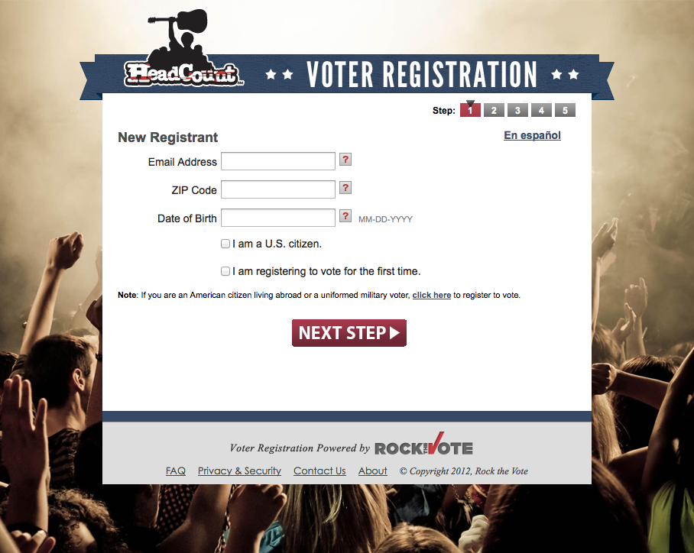
Notes:
WHITE LABEL TOOLS. Example #2.

Slide 11
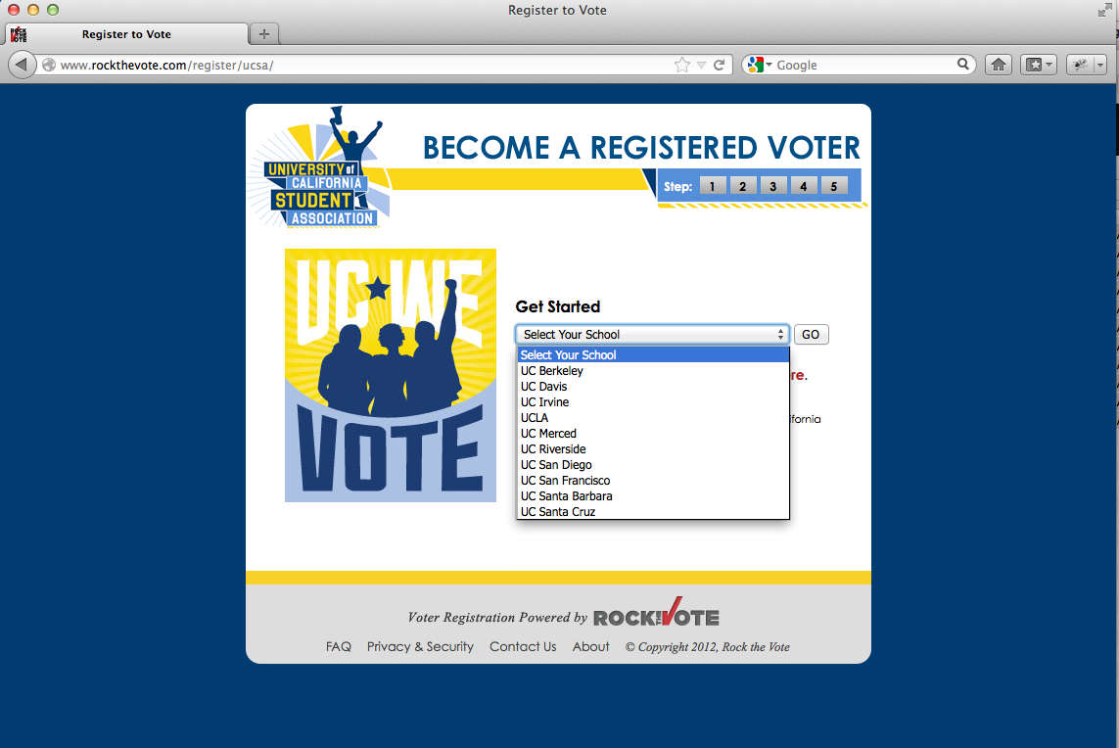
Notes:
WHITE LABEL TOOLS. Example #3 (UC School system).

Slide 12
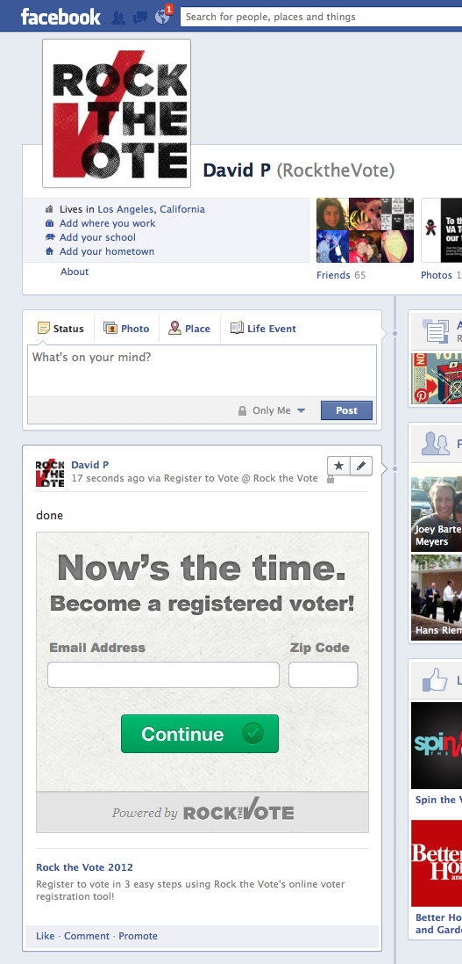
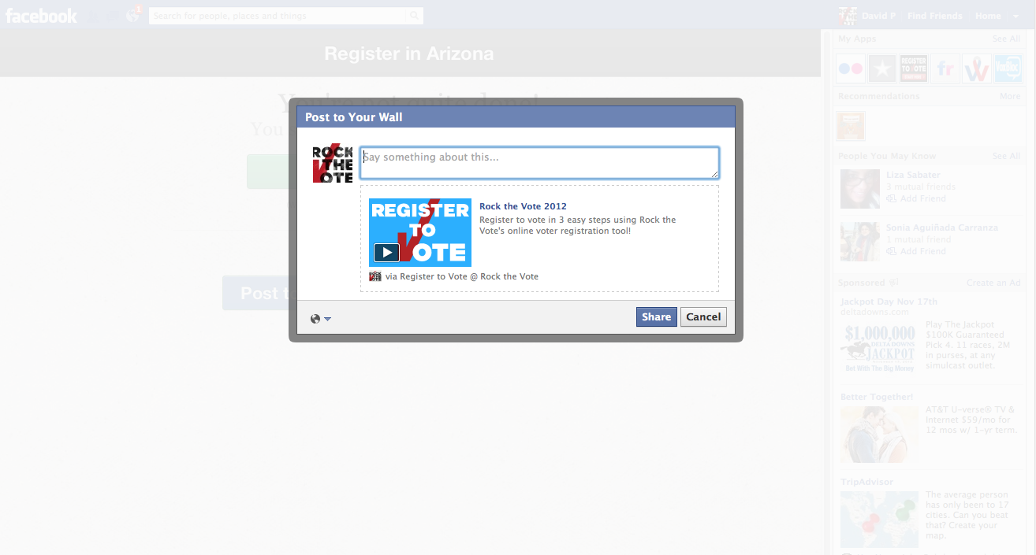
Facebook OVR on Timeline
Facebook Interfaces
Facebook OVR Tool: Share
Notes:
Interfaces built on the API. Example #1. Facebook,

Slide 13
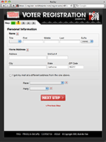
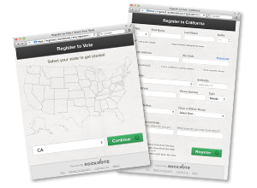
New Interface is Proven to Increase Completion Rates
5-step
2-step
Notes:
Interfaces built on the API. Example #2. User Interfaces that increase completion rates.

Slide 14
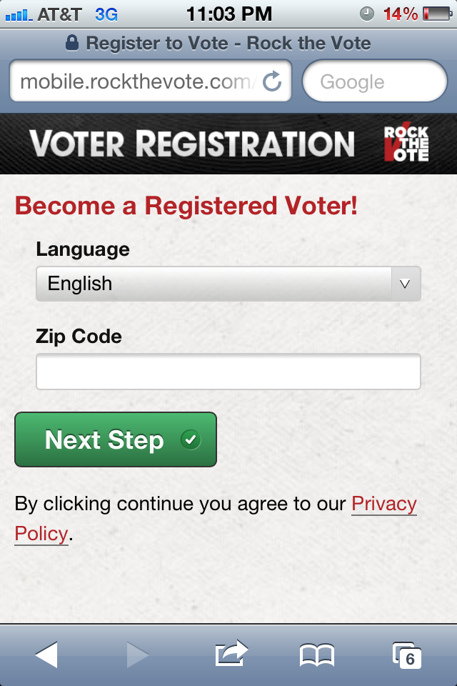
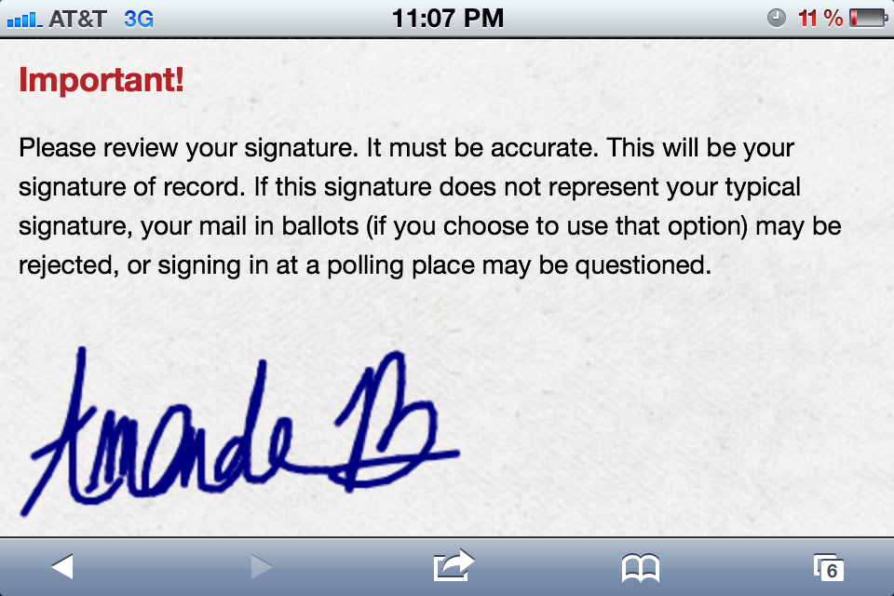
Mobile Interface
Mobile OVR with electronic signature
Notes:
Interfaces built on the API. Example #3. Mobile Interfaces.

Slide 15
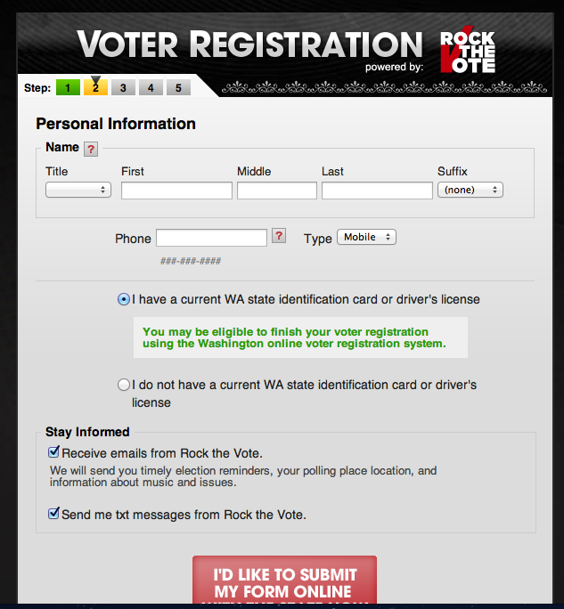
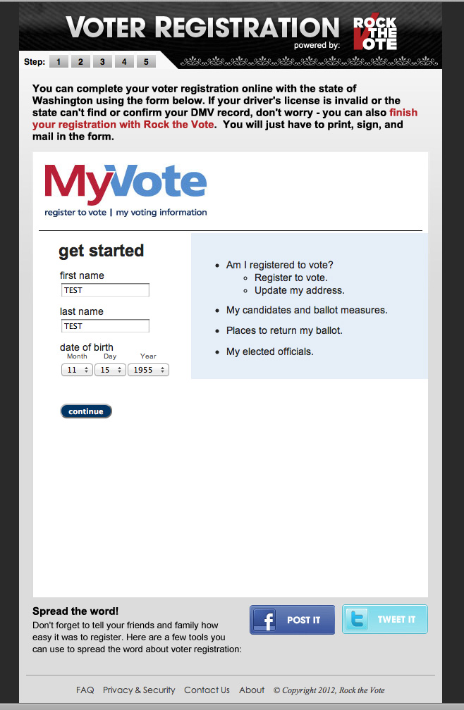
#2: State Integrations
Notes:
Directing voters from the Rock the Vote portal into a state’s online voter registration website.

Slide 16
Integration with STATE online voter registration systems
Washington:
  Piloted the integrated system for the primary VR deadline: 354 registrants complete the process within 24 hours, yielding a 96% completion rate
Nevada:
  Launched an integrated system in early September, transferring eligible NV users – and some basic info – over to the state tool
  Preliminary reporting confirm 90% were new voters
California:
  State integration allowed to transfer any voter registration applicant that submitted a CA zip code to the state’s system
  Groundbreaking collaboration with Universities, Community Groups, Elections Officials resulting in 179,293 applications

Slide 17
#3: Better Collaboration
With technology companies (ie. Online ads testing with Google and Facebook)
With elections officials (i.e. Surf the Vote)
All together: SOS →VIP→RTV SMS

Slide 18
Heather Smith
heather@rockthevote.com
Notes:
Contact us. We have decided to share our code - which has been proven over the years and handles nearly 4 million applications - for free to anyone to use… and could be a way to support a common voter registration technology across states.

