Slide 1

Cost of Elections:
Online Voter Registration & Provisional Ballots
Tammy Patrick
Federal Compliance Officer
Maricopa County, Arizona
Elections Department

Slide 2
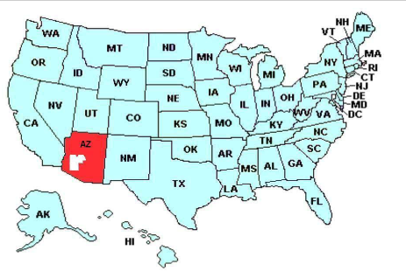
Maricopa County Profile
1,843,698 Active Voters (2,201,525 with Inactives)
  38% Republican
  34% Party Not Designated
  28% Democrat
  (Less than 1% Green & Libertarian)
Voting Rights Act Coverage:
  Section 203: Spanish & Tohono O’odham
  Section 4f4: Spanish
  Section 5 Preclearance
Conduct elections for all jurisdictions with exception of the City of Phoenix.
Blended system of optical scan & DREs
64% Voters on Permanent Early Voting

Slide 3

Online Voter Registration

Slide 4

History
Arizona’s Motor Vehicles Department has provided the public the opportunity to update their information on line since 1997.
Because the DMV is an established voter registration agency under the Federal National Voter Registration Act (NVRA—or Motor Voter), this online service was simply extended to voter registration in 2002.

Slide 5

2008-2012 Registration Sources: Online
In a Presidential Election Year, not having to process this volume of paper forms is critical
# Registrations

Slide 6
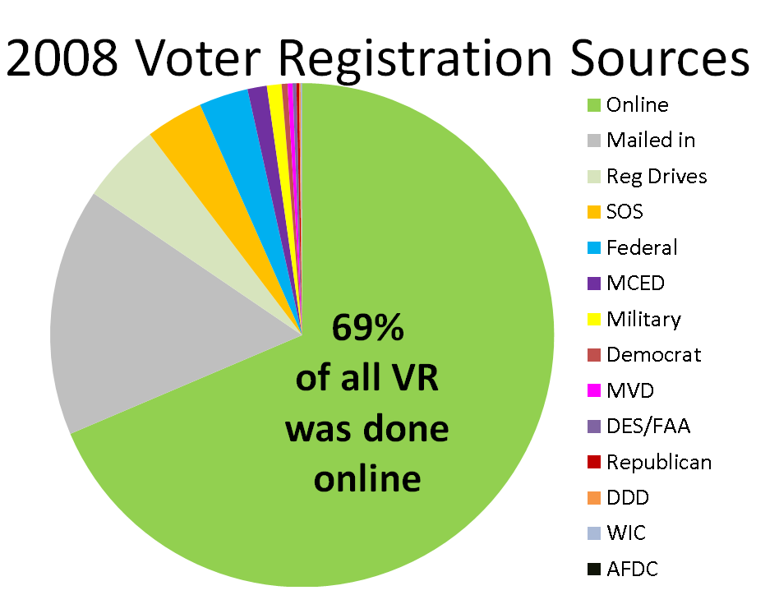
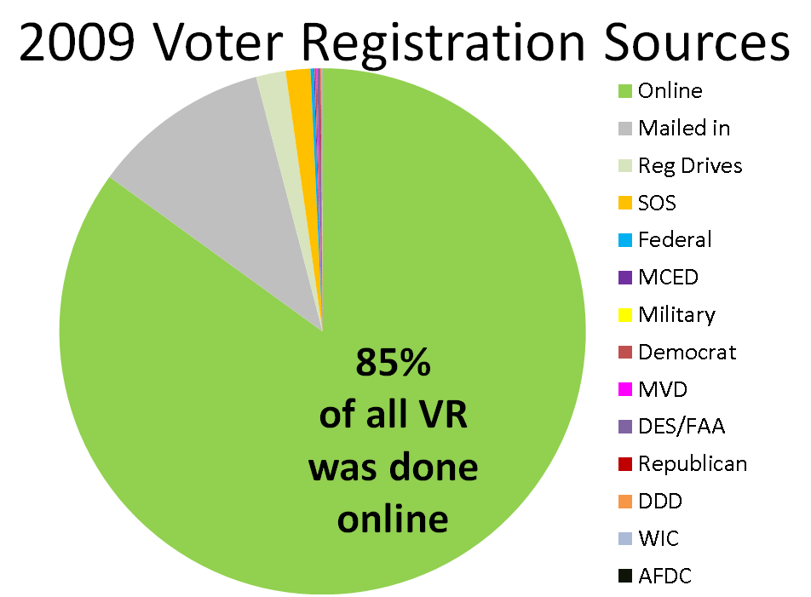
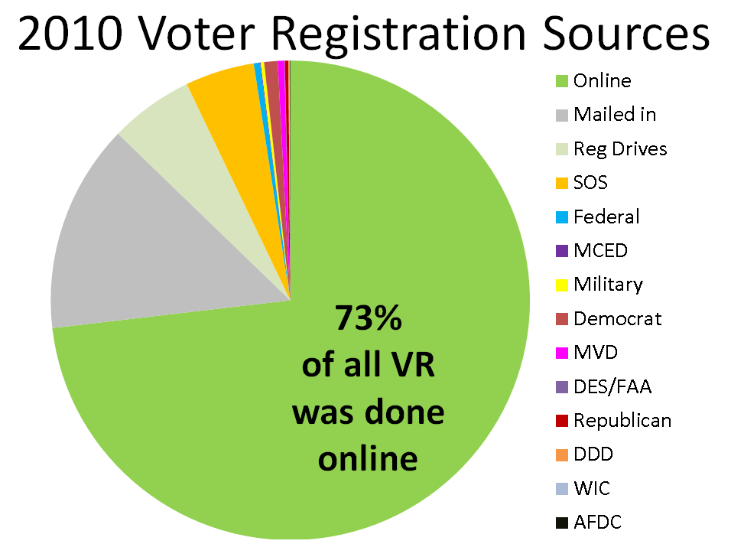
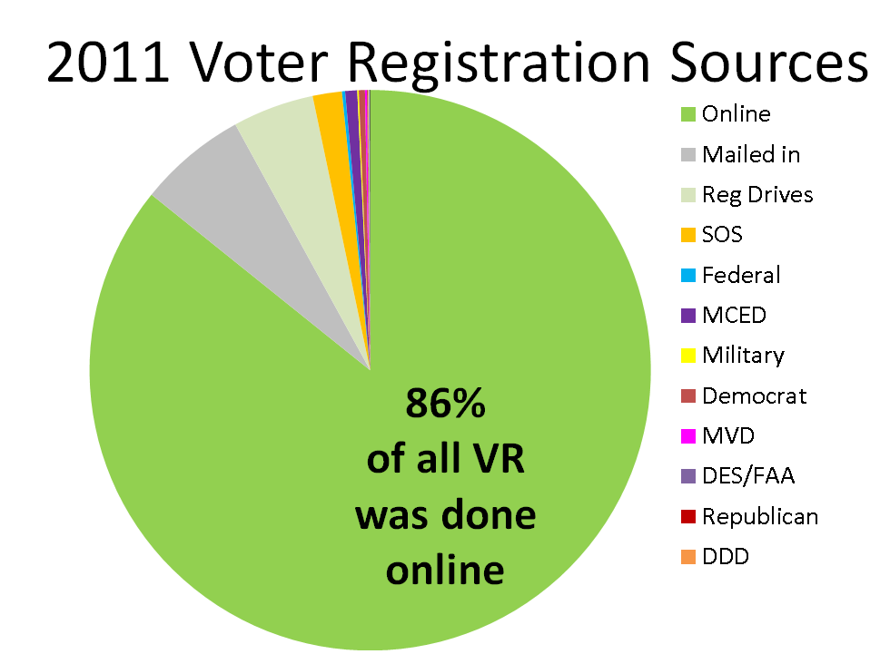

Slide 7

2012 YTD Voter Registration Sources
70%
of all VR was done online

Slide 8
MVD Voter Registration
In Arizona we have had online voter registration since September, 2002.
In 2007 we separated out the MVD counter forms from those coming via the online Service Arizona site so all totals from 2002-2006 contain both online AND counter forms.
# Registrations

Slide 9
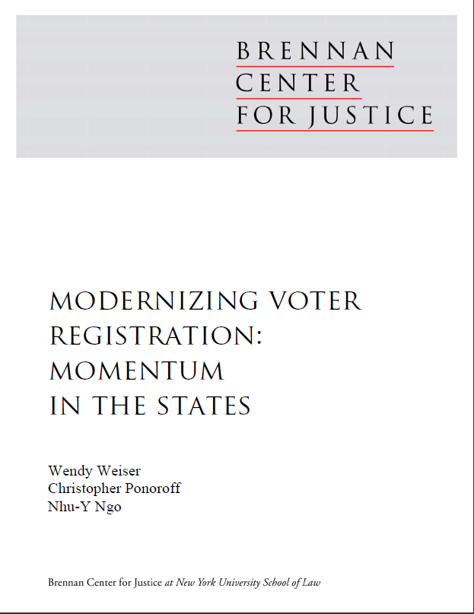
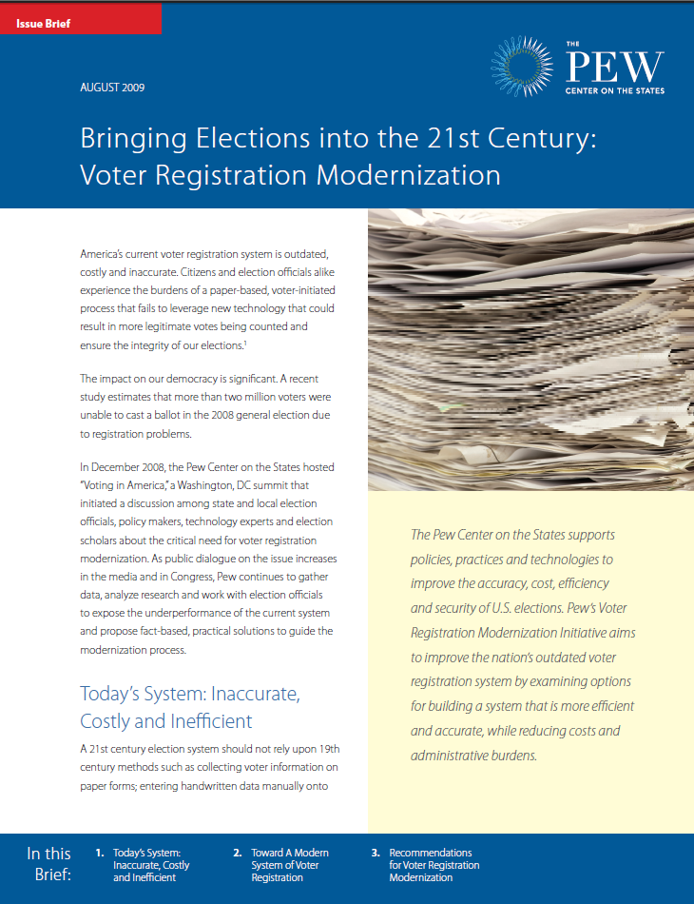
What are the numbers?
There has been a lot of research, academic studies, and attention to online voter registration & modernization; it’s convenience and efficiencies.

Slide 10

Costs
In 2002 less than $100,000 was invested in implementation:
  Purchases: Servers & Licenses
  Staffing & Labor
It costs approximately $125,000 a year to maintain:
  Developers for maintenance & enhancements
  Mainframe fees
  Licenses

Slide 11
Impact of Online Voter Registration
Some key points:
In the first year the number of registrations coming from MVD almost doubled from 47,234 in 2002 to 97,576 in 2003.
For the first Presidential Election after its implementation the number more than doubled again to 224,299 online registrations in 2004.
In 2008 we received 462,904 online registration forms which is almost 28 times the number of forms received from MVD in the year preceding the launch of online registration (16,831 in 2001).
The 2012 election we didn’t see the same volume: 388,633.

Slide 12

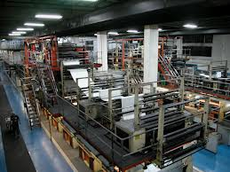
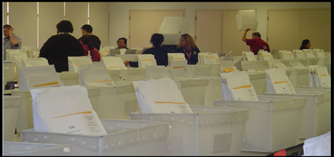
Savings
The savings realized by using online voter registration fall into 3 categories:
  Cost to process a registration form
  Printing and materials costs
  Tangential savings with shifts in staff & resources

Slide 13

Impact of Online Voter Registration
Online registration saves tax dollars as the voter is keying their own information, eliminating hours of overtime in large election cycles.
Standard VR = $.83 vs. Online VR = $.03
In the 4 year period of 2008-2012 YTD, MCED had 1,721,246 forms sent via the online system at a processing cost savings of almost $1.4 million.

Slide 14
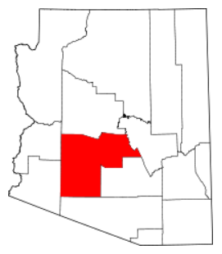
That million dollar+ savings is only in 1 county in the state (albeit the largest population):
Statewide we have seen 2,005,390 via internet and another 1,818,876 forms processed electronically at MVD since implementation

Slide 15
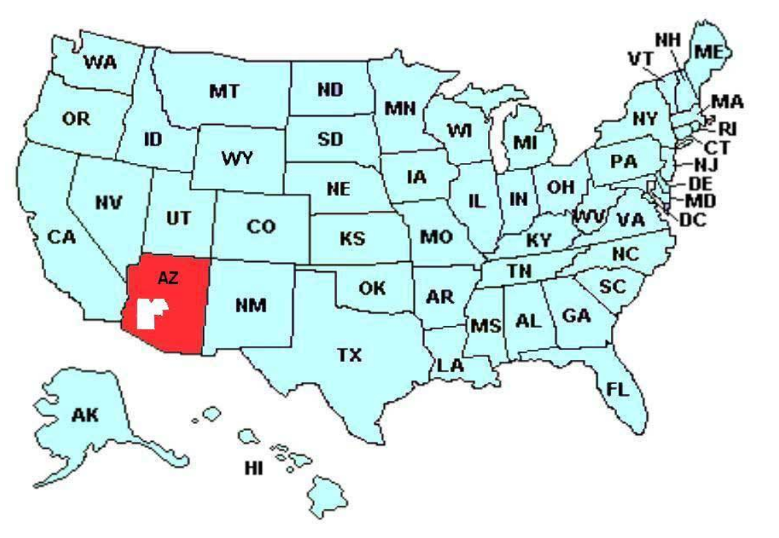
The savings nationally would be tremendous

Slide 16
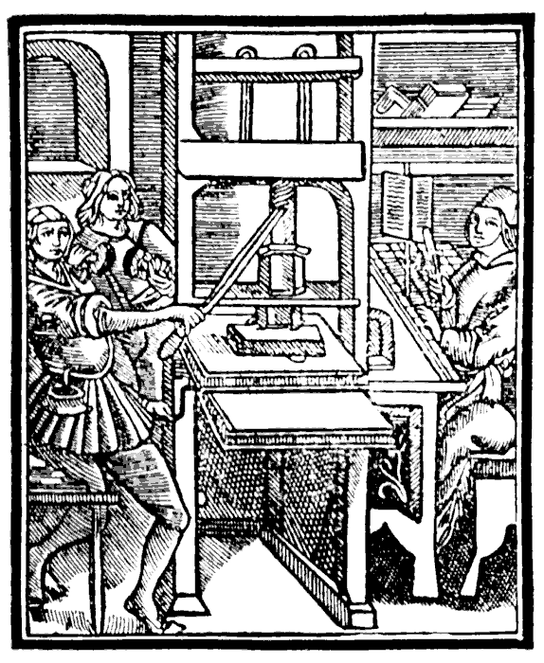
Impact of Online Voter Registration
From implementation through 2011, printing costs for voter registration forms were reduced by 83%--we went from ordering forms twice yearly pre-implementation at an average cost of $81,000 per year to ordering twice in the entire 8 year period post-implementation and the yearly average of only $14,226. (One as a result of citizenship documentation requirement passage so savings would have been even greater.)

Slide 17
Legislative Costs
These savings would have extended into 2011/2012, but the content and format of the registration forms changed twice in that time due to legislation, resulting in additional printing runs and their associated costs.
But we have found other ways for it to allow for good stewardship of the public’s resources…

Slide 18
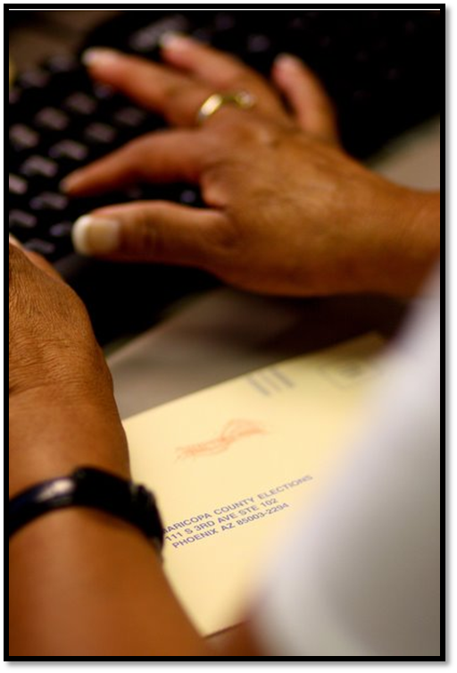
Impact of Online Voter Registration
Because our voter registration clerks have the dramatically smaller number of paper forms keyed in advance of Election Day, they are available to complete other operational functions.
This reduces the number of temporary staff hired as well as overtime hours.

Slide 19
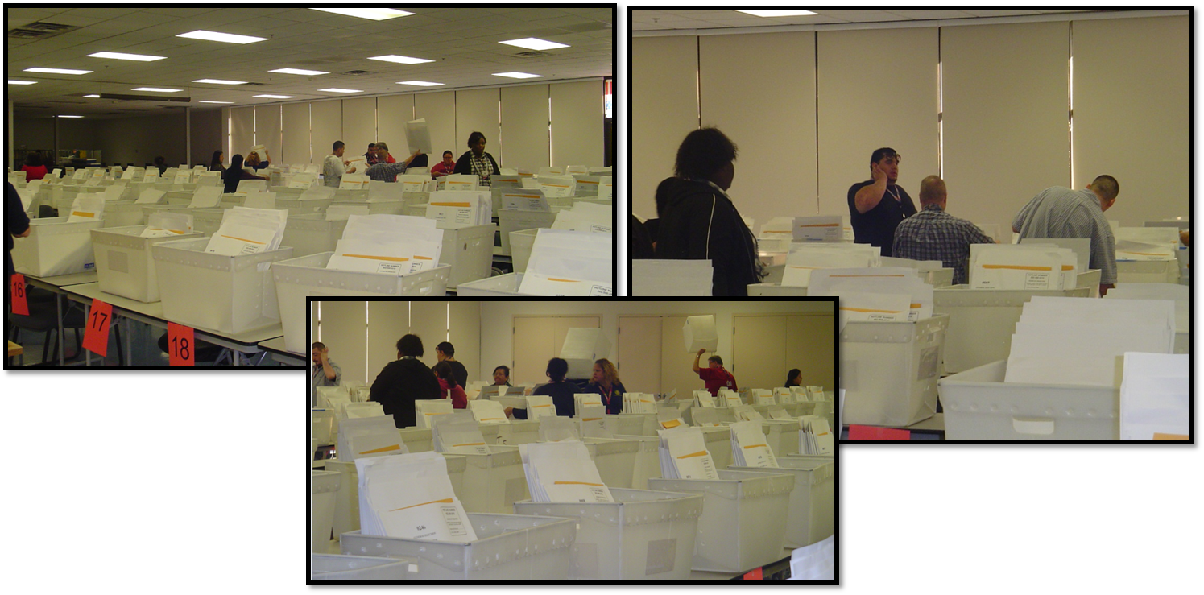
Here VR staff assist in preparing our Inspector Packets which are delivered to the boardworker in charge of the polling place on Election Day. This function was previously done by 10 temps in the week before the election.
Cost savings of $4,000 each election for this single function.

Slide 20
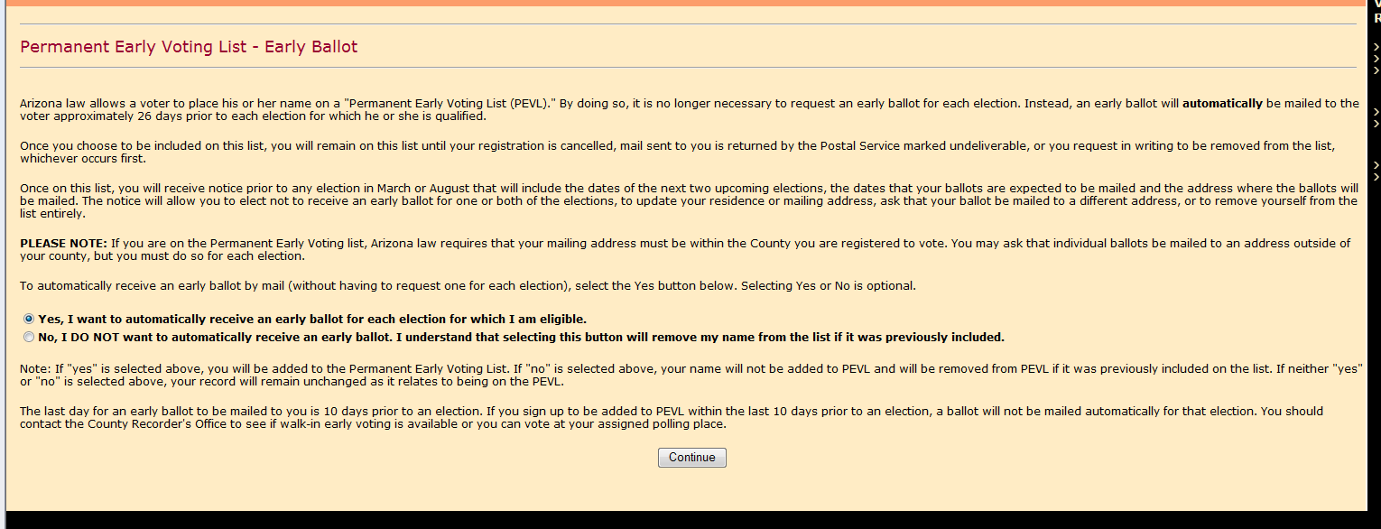
Impact of Online Voter Registration
Online registration eliminates keying errors by clerks unable to read illegible handwriting—it puts the voter in control of their own destiny.
Although the accuracy of voter-entered data is beneficial, does convenience come at a cost?
The online system expanded to include the ability to request to be on our Permanent Early Voting List (PEVL)

Slide 21
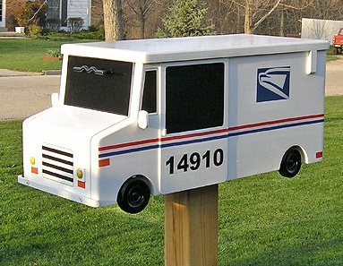
Initial Mailings on First Day of Early Voting
2000 G
2002 G
2004 G
2006 G
2008 G
2010 G
2012 G
155,999
171,495
239,189
198,174
637,288
593,682
1,004,052
2007 PEVL
2010 Online

Slide 22
Rate of EV Return 1992-2012
With that volume, we saw a decrease in the % return rate in the midterms, a slight recovery this year.
But an increase of 202,318 voters voting by mail:
763,887 in 2008 to
966,205 in 2012
%

Slide 23

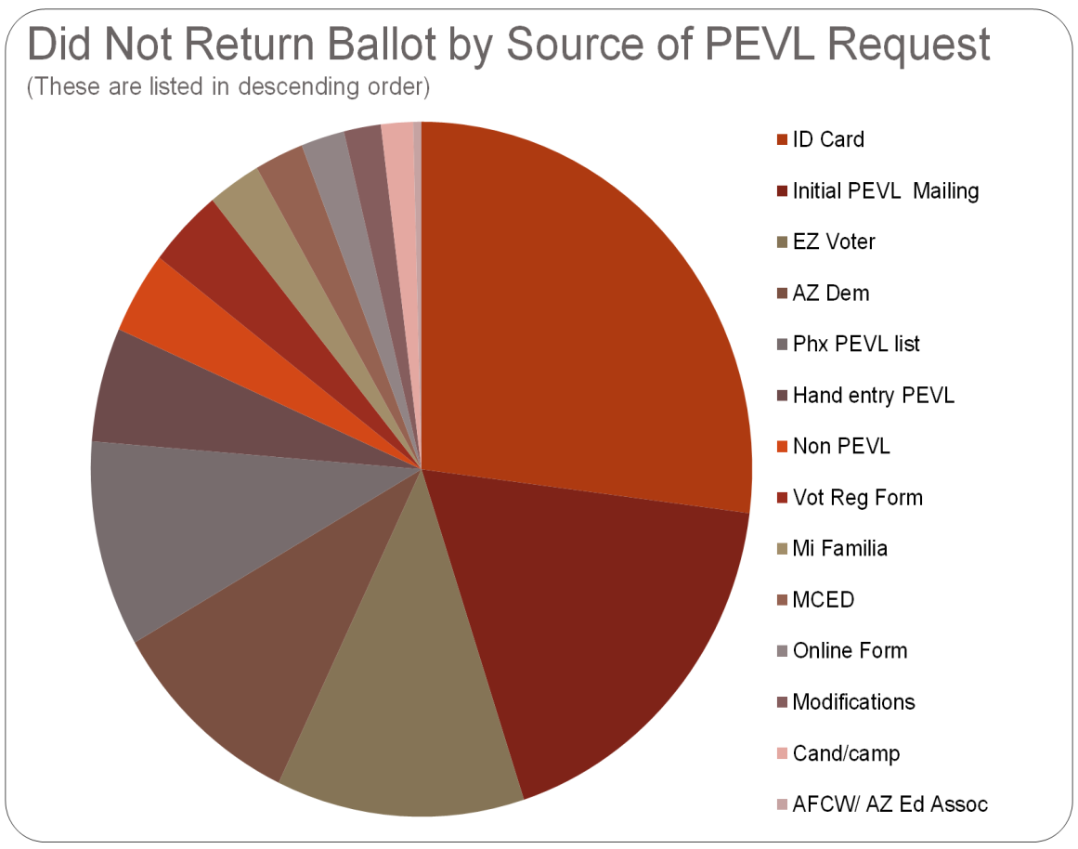
2010 Return Rate
When we first experienced a drop in the return rate we analyzed the source of those requests.
Online was the 3rd highest source.
This type of information is also extremely helpful in litigation as well as cost analysis.

Slide 24
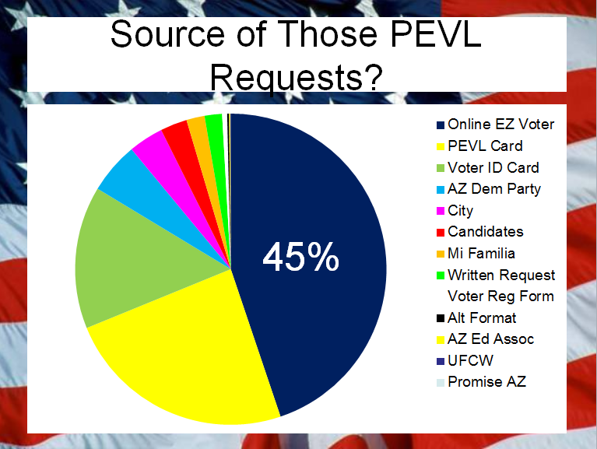
2012 General
The impact soared this election.
Our online request comprised 45% of voters who didn’t vote their early ballot and went to the polls and voted provisionally.

Slide 25
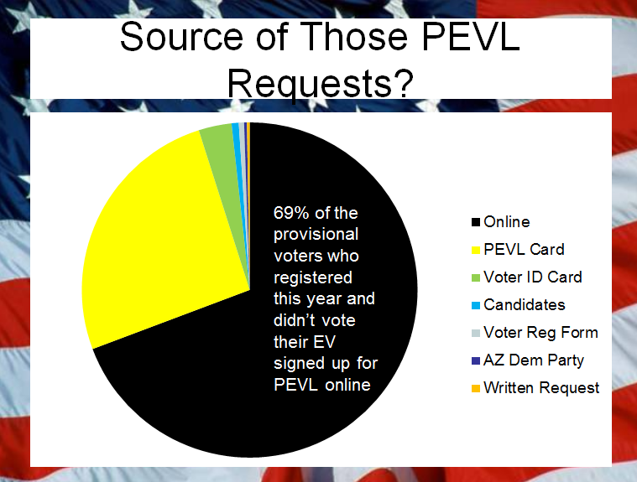
2012 General: Registered in 2012
Voters who registered to vote this year and ended up voting a provisional ballot were even more likely to have signed up for the PEVL online:

Slide 26
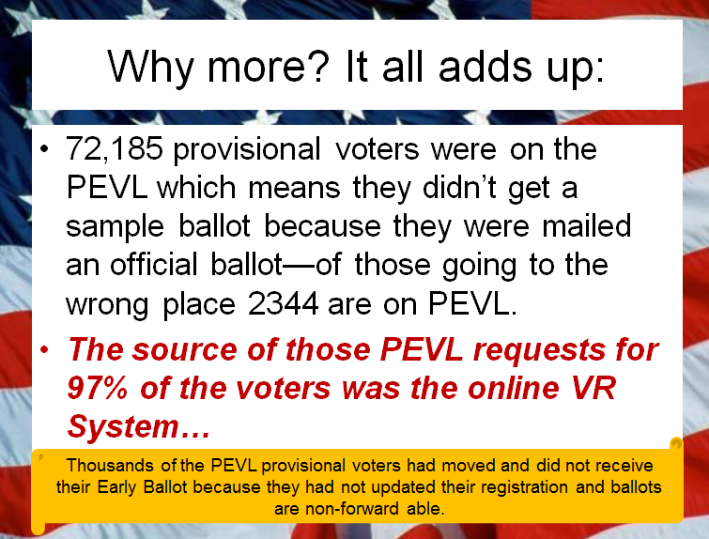
2012 General: Wrong PP
In Arizona voters have to go to the correct PP in order for their ballot to count.
We saw an increase in the percent that went to the wrong place, almost a third were on PEVL:

Slide 27
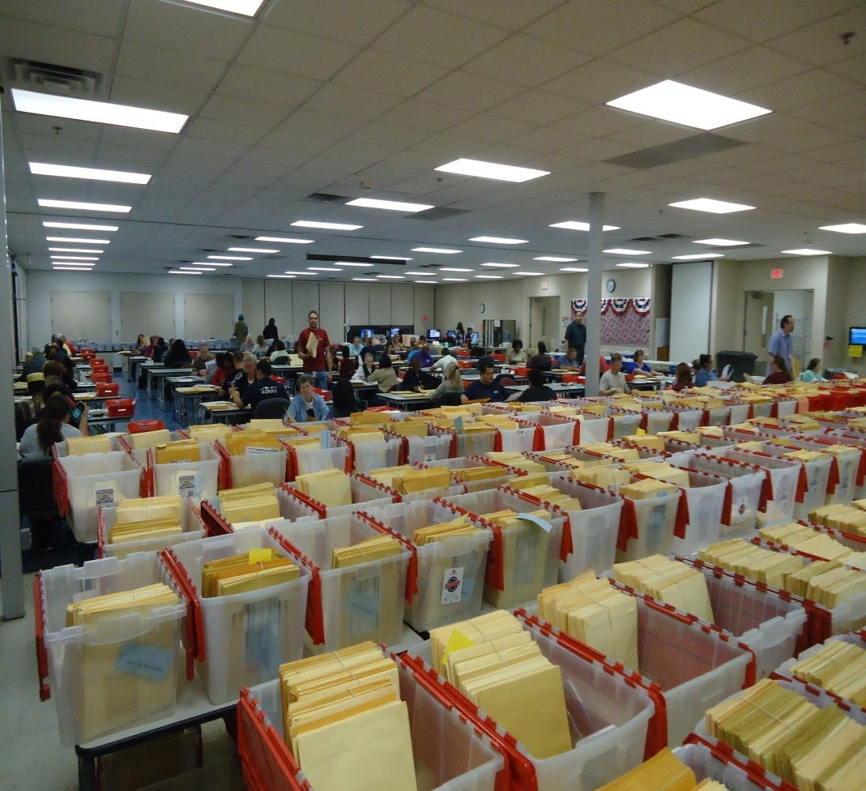
General 2012 Provisionals
More PEVL=more provisionals.
We had a 20% increase in provisionals in the recent General Election.
The growth was due to half being voters who were on the PEVL—59,622 to be exact…
Pre PEVL 1% of voters who requested an Early Ballot still went to the polls, post PEVL it increased to 3%.
This General Election that rose to 5%.

Slide 28
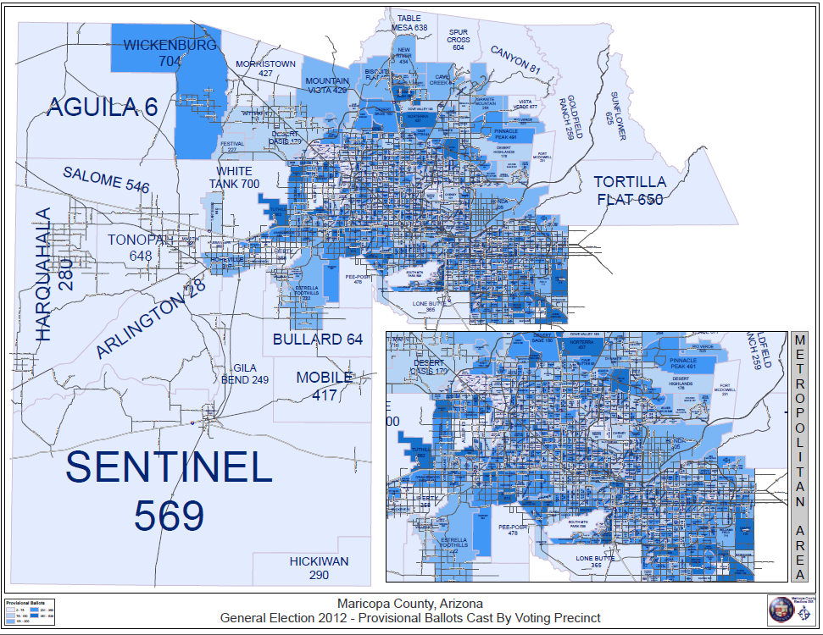
Our provisionals were everywhere.

Slide 29
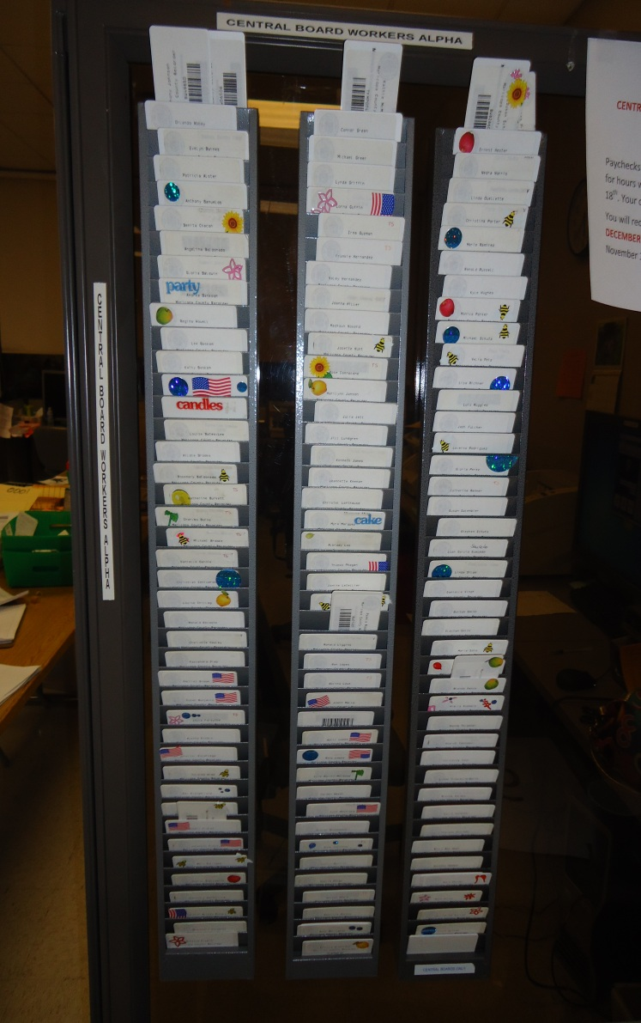
COST?
All this comes with a cost, including staffing.
We had almost 300 workers post election working on Early Ballots & Provisionals.
Payroll statistics are some of the easiest data to collect.

Slide 30
Cost of Provisionals
Provisional form $ .09
Envelope $ .05
Signature Verification $2.25 (research of the voter & signature verification)
Processing $1.50 (scanning, envelope & ballot processing, etc.)
TOTAL: $3.89
Gen 2008= $394,889.46
Gen 2010= $205,255.85
Gen 2012= $477,423.59
This doesn’t put a price on the longer lines due to provisionals nor the hits to voter confidence when covered poorly by the media.

Slide 31
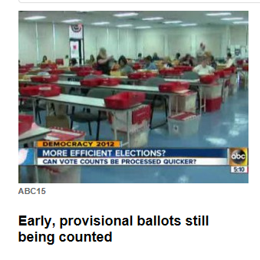
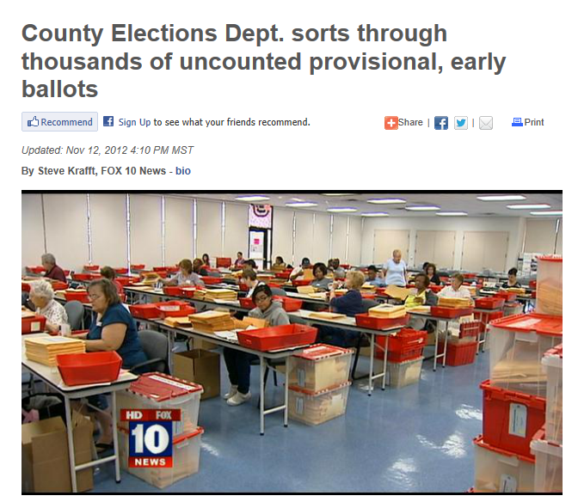
Local media told the public that provisional ballots get “thrown in the trash”—there is a cost to that as well.

Slide 32
IF NOT REGISTERED an additional:
VR form .13
Envelope .02
Postage .44
TOTAL .59 ($4.48 total)
Gen 2008: 8,818 voters costing $39,504.64 total
Gen 2010: 3,113 voters costing $13,946.24 total
Gen 2012: 7,220 voters costing $32,345.60 total

Slide 33
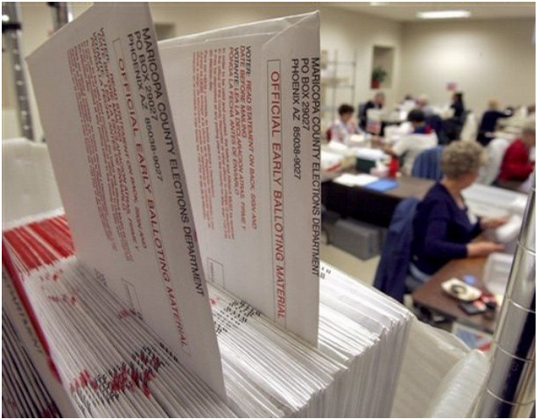
IF ON PEVL an additional:
EV ballot .30
Envelopes .14
Inserts .07
Postage .10
Processing 1.51
TOTAL $2.12 ($6.01 total)
Gen 2008: 25,176 voters costing $151,307.76 total
Gen 2010: 25,475 voters costing $153,104.75 total
Gen 2012: 59,607 voters costing $358,238.07 total
More than doubled!

Slide 34
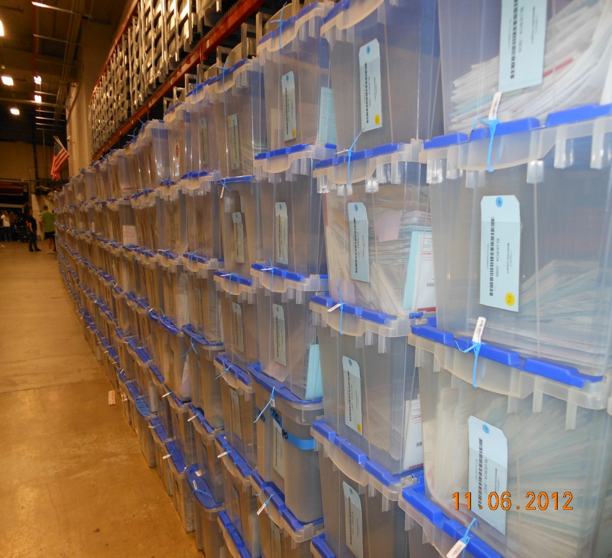
Permanent “Early” Voting List
In the recent General Election we had more than 171,000 voters drop their EVs at the polls.
This saved the County around $77,000 in postage.
This DID delay results however, as all the EVs have to be scanned prior to beginning work on the provisionals which further exacerbated the heightened environment.

Slide 35
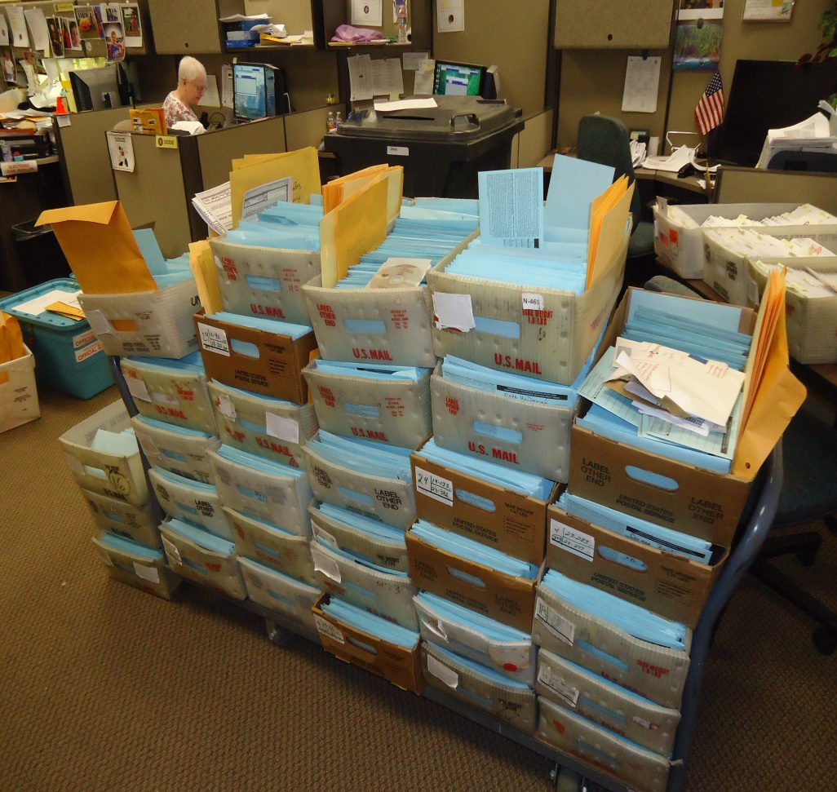
Replacement Envelope
More than 11,000 voters left their EV ballot envelope at home which causes them to use a replacement envelope which isn’t barcoded with their information and it has to be manually researched and entered.
Estimated Cost?
$20-25,000

Slide 36
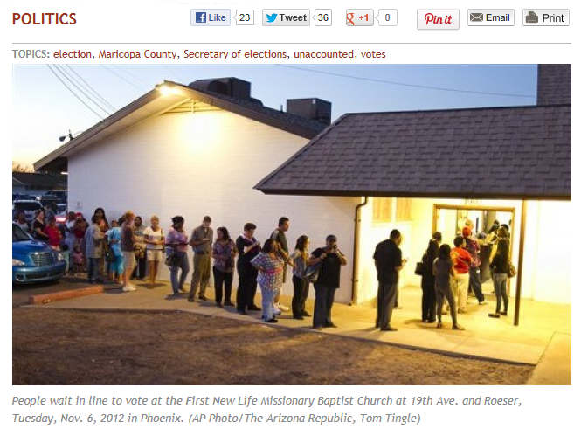
Almost one quarter of a million more voters voted by mail this election—if they had not gotten on PEVL (and gone to the polls instead) the story would have been about lines in Arizona.
This picture was taken just after the polls opened at dawn of voters who had lined up prior to 6:00 AM.

Slide 37
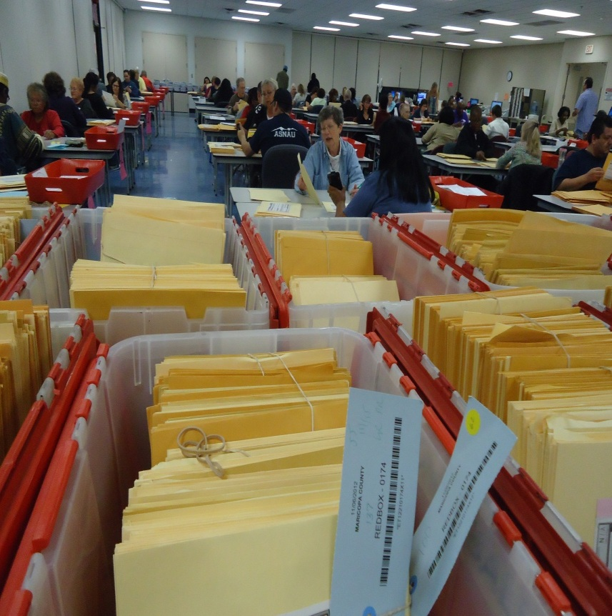
Solution?
It’s a balancing act:
Convenience vs. Security
Education vs. Misinformation
Mistrust vs. Confidence
Privacy vs. Transparency
Pros & Cons—
and all come at a cost.

